Slide 1
This template includes
Cover slide and divider slide options
Mix and match the cover slides with the divider slides.
You can use any combination of block composition backgrounds.
Content slides
Use these empty layouts to build your deck. A sample of the options
are shown. You can add or change layouts on the Home tab.
Examples of application
Refer to these slides for examples of how to use the layouts.

Slide 2
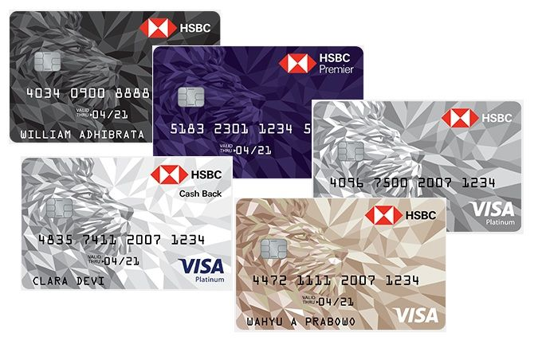
Risk detector credit card and analysis for bad risk customer
Analyst , Machine Learning, ETL Process

Slide 3
Introduction
In its efforts to overcome the risk of default from credit customers,HSBC Bank has taken the initiative to utilize data and technology. Our team was asked to assist in analysis and predictions regarding customers who have the potential to default.

Slide 4
Background
Problem Statement : To identify the distinct characteristics of each customer and reduce the percentage of credit card defaulters by 5% within 6 months.
Data Analyst: Tasked with knowing the characteristics of customers who are at risk of default so that banks are more careful in providing credit.
Data Scientist: Build models to predict customer repayment capabilities and group customers based on risk of default.
Data Engineer: Provides and organizes the data necessary for analysis and predictions to run smoothly.
With this teamwork, we strive to help HSBC minimize the risk of default.

Slide 5
Timeline
Comparison of SAW and TOPSIS
ETL Postgre and Clean Data
After we discuss which dataset we want to proceed. Data engineer make automation using airflow to make database , clean data, and push clean data to sql server to be proceed by data analyst and data scientist.
Machine Learning
Make classification and clustering machine learning to predict whether customer can pay credit or not with classification model and if customer can’t pay it we define characteristics each customer using clustering modeling.
Data Analyst
Monday
Model Deployment
Thursday
Data Engineer
Saturday - Sunday
Data Visualization
Do Exploratory Data Analyst regarding character customer and make insight from result. After that make data visualization in Tableau.
Data Scientist
Tuesday - Wednesday
Stream lit and Hugging Face
Make application using stream lit and deployed using hugging face based on machine learning model that has been made . After that we make presentation to show to stakeholder.
Timeline from brainstorming to release the project.

Slide 6
Data Engineer
Task : make automation ETL create database , clean data, and push clean data to sql to be proceed by data analyst and data scientist using airflow
Tools : PostgreSQL , Python, Airflow, Great Expectation
Process Flow
Make database : create database and table , insert value , save to csv
Cleaning_data : load data , replace data , change data type , save cleaned data
Push to sql server: push cleaned data to sql server
Do validation using great expectation

Slide 7
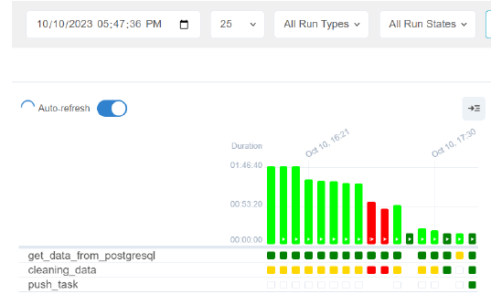
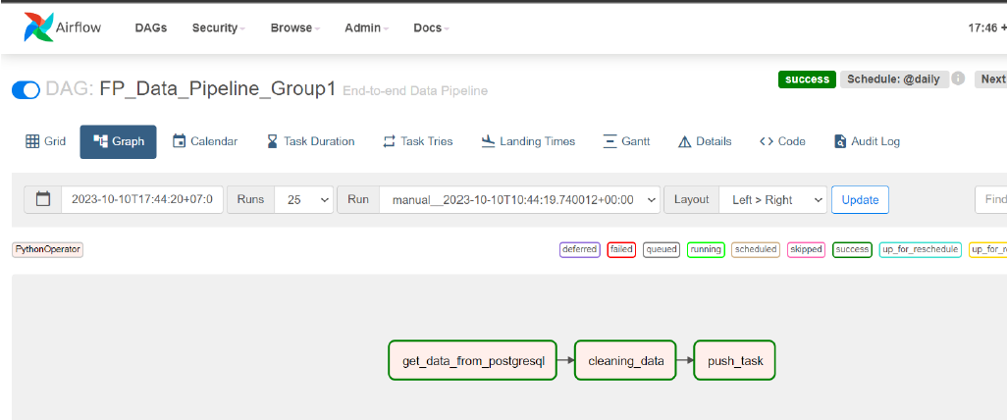
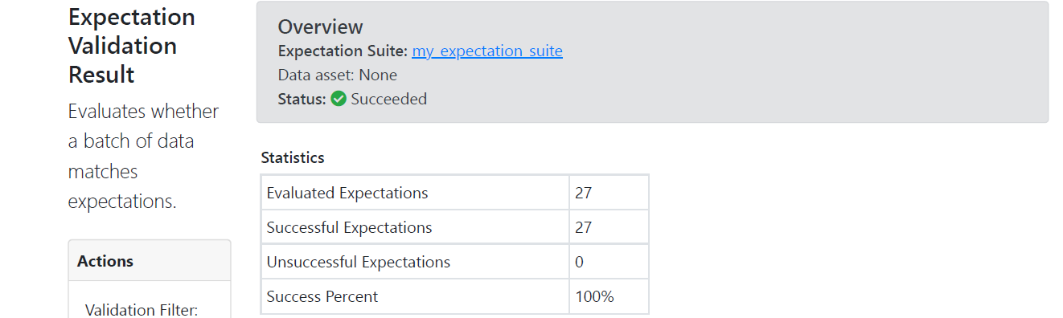
Data Engineer

Slide 8
Data Analyst
Task : Do Exploratory Data Analyst regarding character customer and make insight from result. After that make data visualization in Tableau.
Tools : Tableau
Process Flow
Make each sheet of Exploratory Data Analyst
Create Dashboard that contain all Exploratory Data Analyst
Deploy Tableau Dashboard

Slide 9
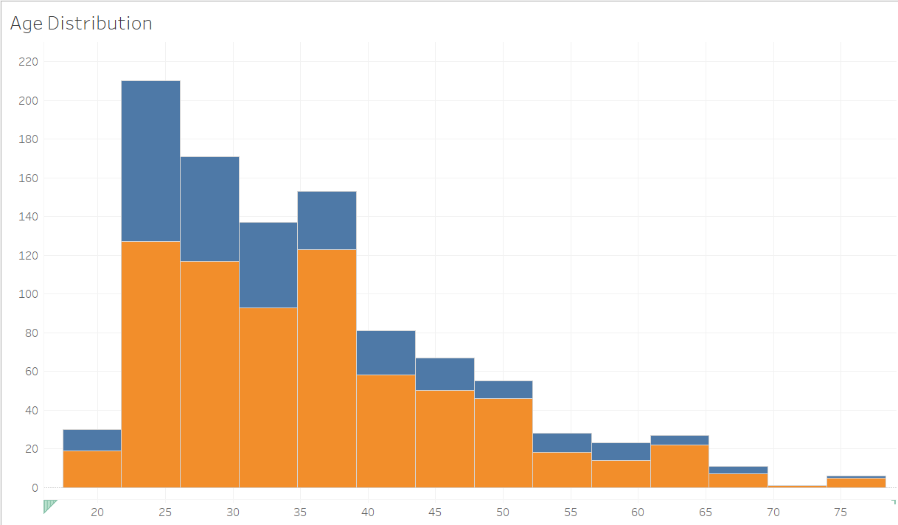
Data Analyst
Exploratory Data Analyst
Age Distribution
Result :
Percentage of customers who cannot pay compared to those who can pay at the age of 55-65, where at that age customers may no longer work and young people aged 18-25
Insight :
For customers who have this age range, we can ask the customer to re-update the data. For those who don't have a permanent income, they can ask for a beneficial owner where the customer gets income from a third party, either from their children/relatives. To reduce the percentage in that age range, they can't pay because they don't. have an income and are given an age threshold to apply for a credit card

Slide 10
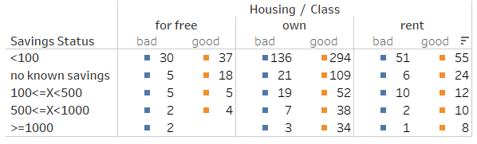
Data Analyst
Exploratory Data Analyst
Saving Status and House
Result:
Customers who have a savings balance of 0 and savings are unknown. Customers who don't own a home have a big potential for failure to pay
Insight:
Set a threshold for a minimum savings balance to apply for a credit card and can see the status of home ownership as a reference for whether a customer will give credit or not

Slide 11
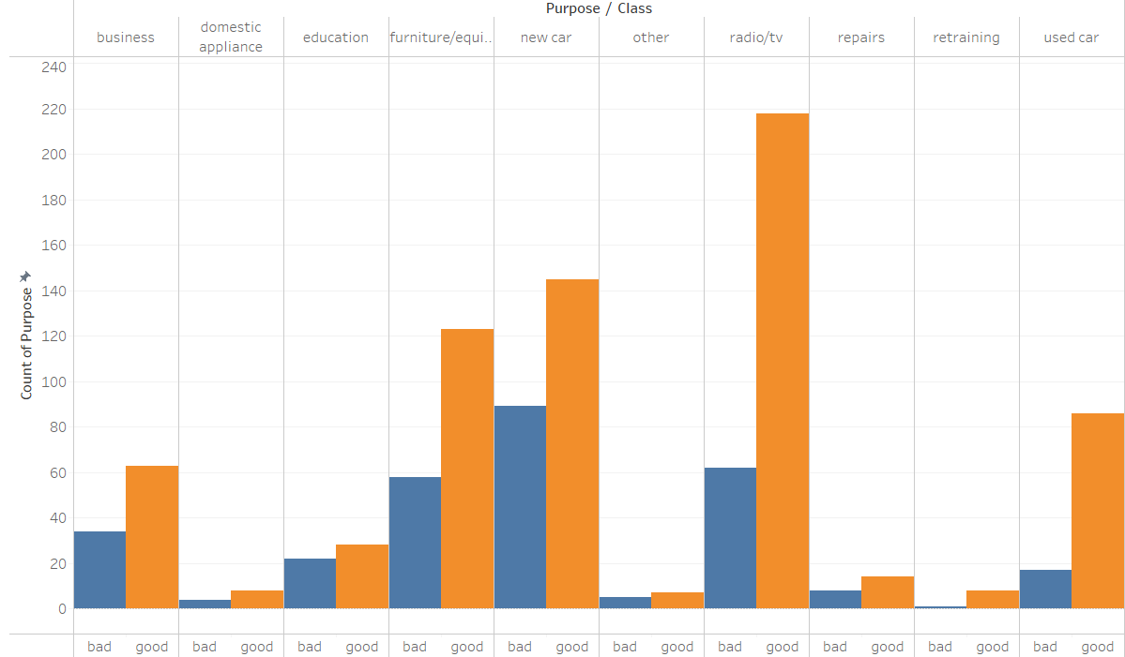
Data Analyst
Exploratory Data Analyst
Purpose
Result: The percentage of defaults is highest when purchasing new cars, businesses and furniture where these items are quite expensive
Insight:
If the customer's profile does not match the credit limit, don't give a high limit. If the customer wants to have a high limit, you can include a pay slip or proof of income.

Slide 12
Data Scientist
Task : Make classification and clustering machine learning to predict whether customer can pay credit or not with classification model and if customer can’t pay it we define characteristics each customer using clustering modeling.
Tools : Pandas , Numpy, Sklearn, Imblearn pipeline, seaborn, matplotlib, pickle,feature-engine,
Process Flow ( Classification Machine Learning)
Feature Selection : 'checking_status', 'credit_history', 'purpose', 'savings_status', 'employment', 'personal_status', 'other_parties', 'property_magnitude', 'other_payment_plans', 'housing', 'foreign_worker','age', 'duration', 'credit_amount'
Feature Engineering : Handling Outlier, Scaling , Encoder(Ordinal, One Hot Encoder)
Model Definition : LogisticRegression, DecisionTreeClassifier, RandomForestClassifier,KNeighborsClassifier, GaussianNB, GradientBoostingClassifier, SVC
Model Training : LogisticRegression, DecisionTreeClassifier, RandomForestClassifier,KNeighborsClassifier, GaussianNB, GradientBoostingClassifier, SVC
Cross Validation : GaussianNB
Hyperparameter Tuning : GridSearch ('priors': [0.8, 0.2], 'var_smoothing': 1e-05)
Model Evaluation : GaussianNB Hyperparameter Tuning

Slide 13
Data Scientist
Process Flow (Classification Machine Learning)
Feature Engineering : Scaling , Encoder(Ordinal, One Hot Encoder)
Model Definition : K-Means (Elbow Method, Silhouette)
Model Evaluation : 2 Clustering
EDA 2.0 :
Cluster 0: Comprises young customers who tend to use their credit cards for purchasing luxury or expensive items. The majority of them already own a house and typically choose shorter tenures for their credit card installment payments.
Cluster 1: Encompasses older customers living with their children. These customers tend to have high credit balances on their cards and opt for longer tenures when paying off their credit card installments.

Slide 14
Result
https://public.tableau.com/app/profile/kenneth.vincentius/viz/FinalProject_16968435099060/Dashboard2?publish=yes

Slide 15
Business Insight and Conclusions
Conclusions
On average, customers who default on their payments are aged between 18-25 and 55-65. They typically have a bank balance of zero or an unknown balance and do not own a house. These customers use their credit cards to purchase expensive items like new cars, furniture, and businesses.
Business Insight
Implement a threshold regarding the minimum balance and age for credit card users. Credit limits can be determined based on assets and appropriate employment to avoid incorrect credit allocations. For those who are unable to make payments, we can suggest extending the loan tenure and offering a reduced interest rate.

Slide 16




Thank You
Rizki Aditama
FTDS-HCK-007
Data Engineer
0812 801601939
rizki.aditama87@gmail.com
Kenneth Vincentius
FTDS-HCK-007
Data Analyst
0812 8920 5603
kennethvincentius@gmail.com
Harari Netanya Theon
FTDS-HCK-007
Data Scientist
0812 2972 0827
hararinetanya@gmail.com
Rais Yufli Xavier
FTDS-HCK-007
Data Scientist
0813 1314 6932
raisyufli@gmail.com
Hacktiv8id
Hacktiv8id
Hacktiv8
Hacktiv8 Indonesia

