Slide 1


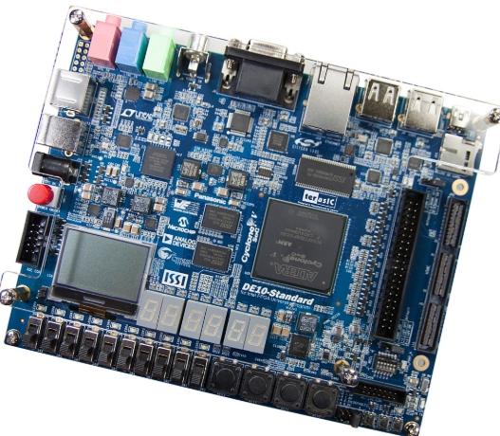
FPGA & SoC
Dr. Rizki Ardianto Priramadhi
Telkom University
Hands-out Session Guest Lecture
Coimbatore Institute of Technology
18 Sept 2026
DE10-Standard University Program

Slide 2
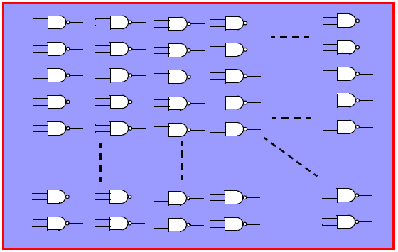
Historical Introduction
In the beginning, digital design was done with the ’74 series of chips.
Some people would design their own chips based on Gate Arrays, which were nothing else than an array of NAND gates:

Slide 3
Historical Introduction
The first programmable chips were PLAs (Programmable Logic Arrays): two level structures of AND and OR gates with user programmable connections.
Programmable Array Logic devices were an improvement in structure and cost over PLAs. Today such devices are generically called Programmable Logic Devices (PLDs).

Slide 4
Historical introduction
A complex PLD (CPLD) is nothing else than a collection of multiple PLDs and an interconnection structure.
Compared to a CPLD, a Field Programmable Gate Array (FPGA) contains a much larger number of smaller individual blocks + large interconnection structure that dominates the entire chip.

Slide 5
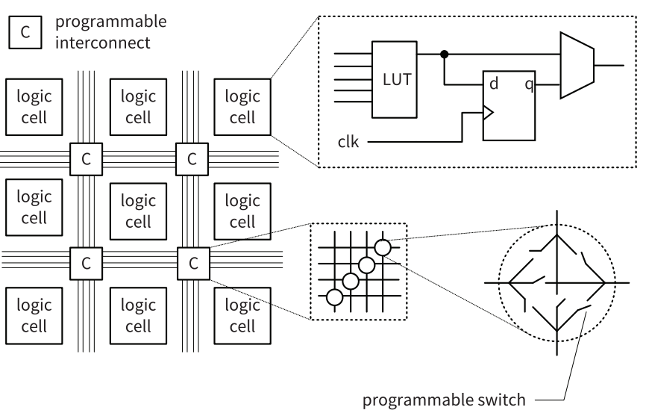
Conceptual structure of an FPGA device.

Slide 6
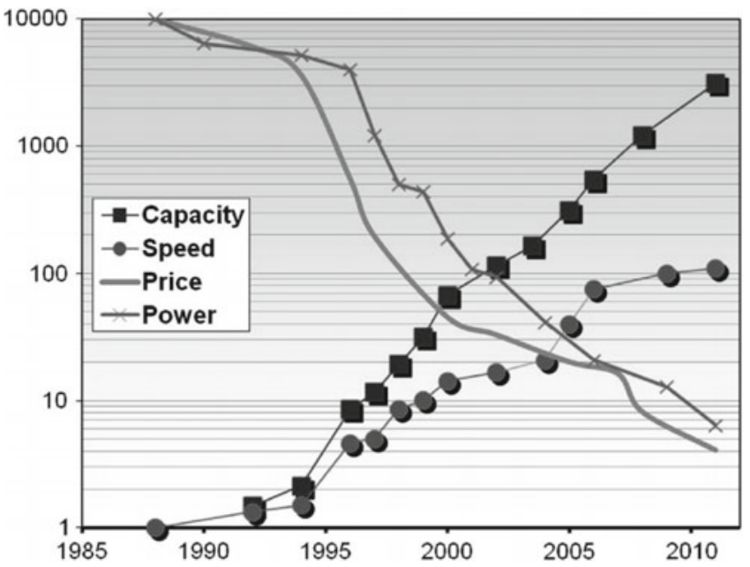
FPGA evolution since the 1980s

Slide 7
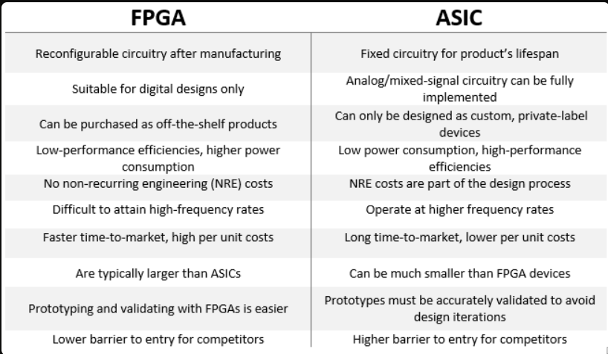
Programmable vs Fixed

Slide 8
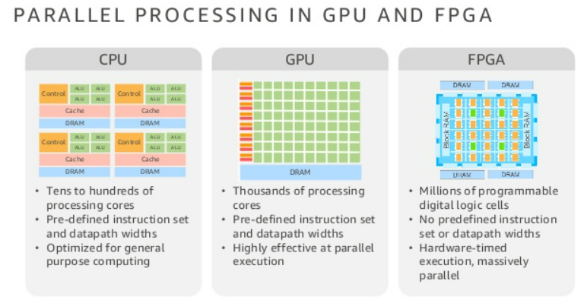
Computation Hardware

Slide 9
FPGA Application
ASIC prototyping
Wired communications: For system development, while the standards themselves are evolving.
Wireless communications: DSP in FPGAs is a major attraction for algorithmic computations.
Video systems and machine vision: Implement software algorithms at higher speed and lower power.
Industrial systems: Communication link between sensor nodes and robotic systems.
Medical systems: I/O interfaces including A-to-D and D-to-A conversion.
Automotive systems: Video processing (for driver assistance), fi eld upgradability.
Military and aerospace: Radio waveform processing and processing of huge amount of sensor data.
Data center: Interfaces to SSD (solid-state disks), machine learning related algorithms.

Slide 10
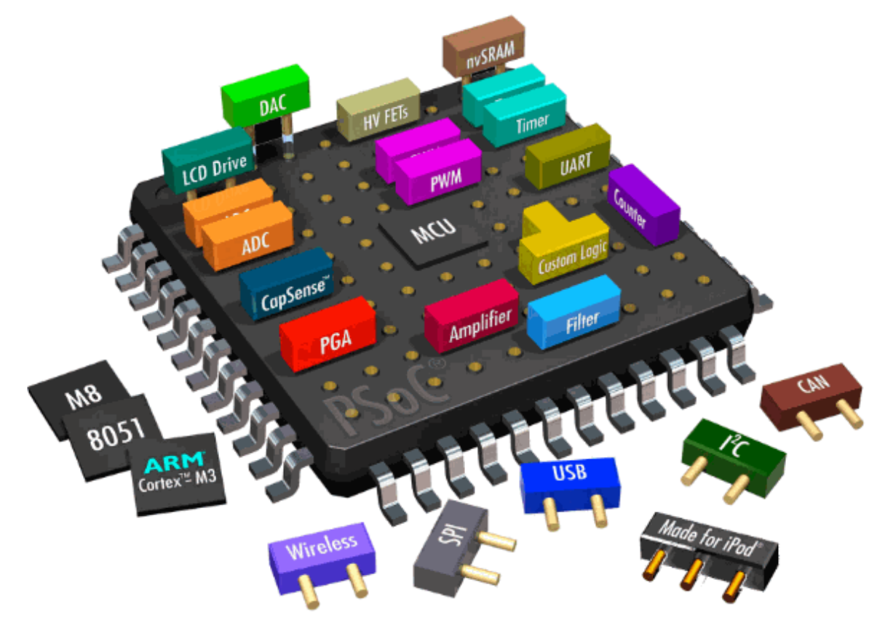
System on Chip (SoC)

Slide 11
SoC: System on a Chip
An IC that integrates multiple components of a system onto a single chip
The on-chip integration of variety of functional hardware blocks to suit a specific product application
In addition to IC, SoC consists of software and interconnection structure for integration
Can be as simple as a basic connectivity chip which combines some mixed-signal and digital circuitry
A more complex SoC may include the on-chip integration of an application processor unit (APU) and a graphics processor unit (GPU)
More functional SoCs further integrate various other hardware blocks (e.g. Image processor, audio/video decoder, and modem)

Slide 12
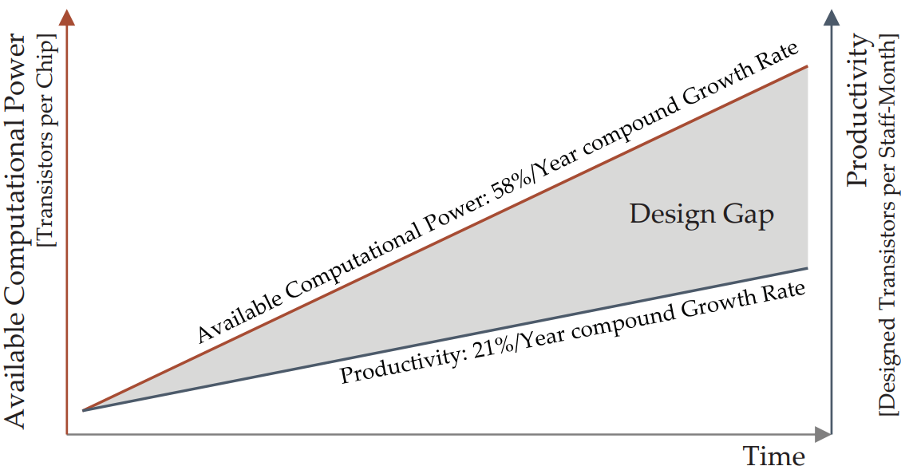
FPGA Productivity Gap
The Design Gap: Growth of available Computing Power outperforms the Productivity of System Designers [Belanovic 2003]

Slide 13
SoC Platforms
Types:
SoC FPGA
  Have FPGA part and HPS (Hard Processor System) part
  Flexibility in programming
  Example: Altera DE0 Nano-SoC, Xilinx Zynq 7000
Specific SoC Platforms
  Comersial and specific, already chip fprm
  Example: Apple A11 SoC, Samsung S11 CPU SoC, Siemens, etc

Slide 14
SoC Component
Programmable processore / CPU Cores
On-chip memory
On-chip interconnection (busses, network, etc.)
Analog Circuit
Accelerator or Hardware module for specific Application
ASICs logics
Software – OS, Application
Firmware

Slide 15
IP-Core
IP = Intellectual Property
An IP core is a block of logic or data that is used in making a field programmable gate array ( FPGA ) or application-specific integrated circuit ( ASIC ) for a product.
Utilizing the predesigned modules enables:
  to avoid reinventing the wheel for every new product,
  to accelerate the development of new products,
  to assemble various blocks of a large ASIC/SoC quite rapidly,
  to reduce the possibility of failure based on design and verification of a block for the first time.

Slide 16
IP Cores
Subblock
  A sub-component of a macro, core, or block.
Hard macro (or core or block)
  Delivered to the integrator as a GDSII file. Fully designed, placed, and routed
Soft macro (or core or block)
  Delivered to the integrator as RTL code

Slide 17
CPU Cores
A soft-core processor is a processor implemented using the FPGA fabric.
A hard-core processor is a processor that's actually physically implemented as a structure in the silicon.

Slide 18
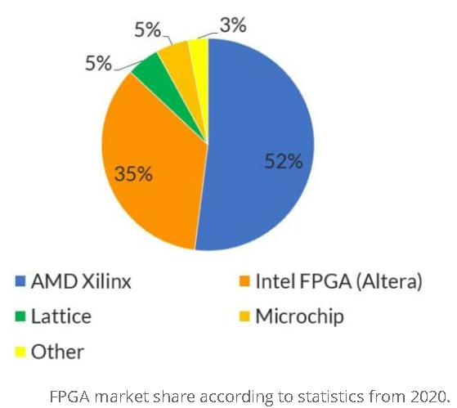
FPGA Producer

Slide 19
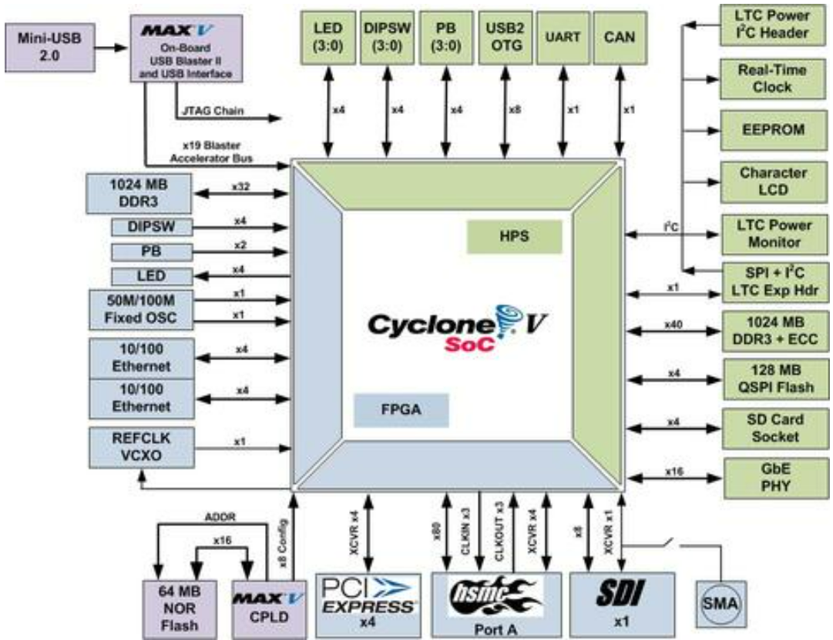
Altera Cyclone-V : FPGA + ARM

Slide 20
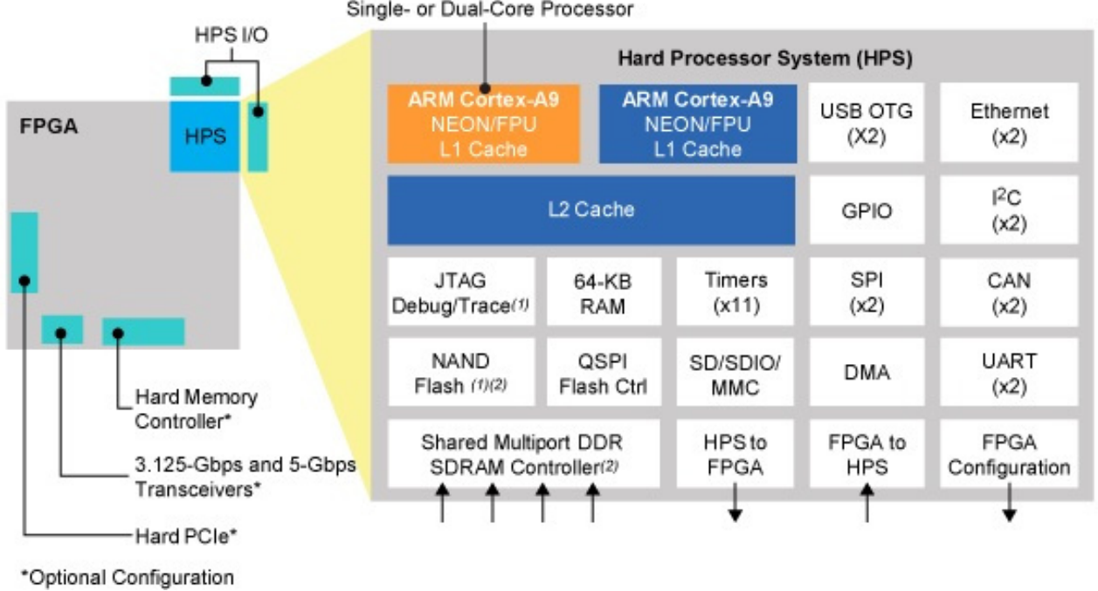
HPS in Cyclone-V

Slide 21
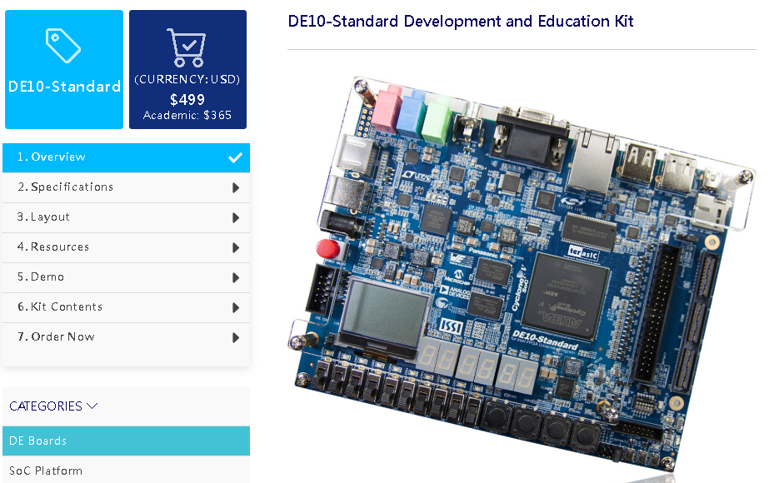
DE10-Standar from Terasic
https://www.terasic.com.tw/cgi-bin/page/archive.pl?Language=English&CategoryNo=165&No=1081&PartNo=1#contents

Slide 22
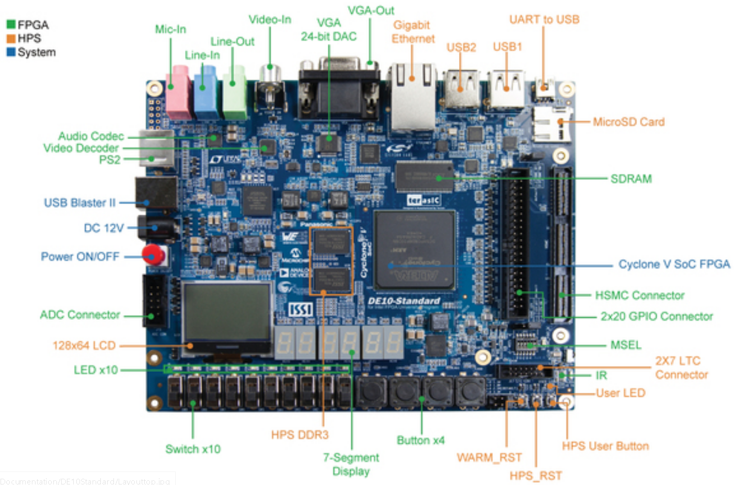
DE10-Standard

Slide 23
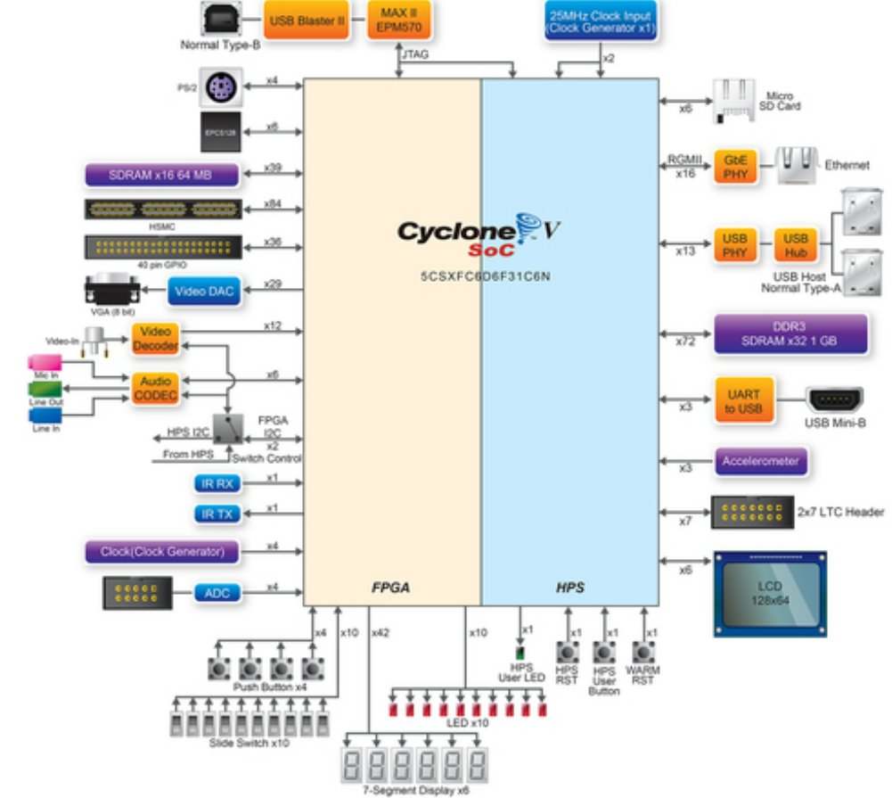

Slide 24
Resource :
Github.com/rizki-ap/vlsi/
Google
Claude AI

