Slide 2
Steps in Quartus FPGA Design
Creating Quartus Project
Creating Design Files (+edit)
Compiling Designs
Pin Assignments
Programming to Board

Slide 3
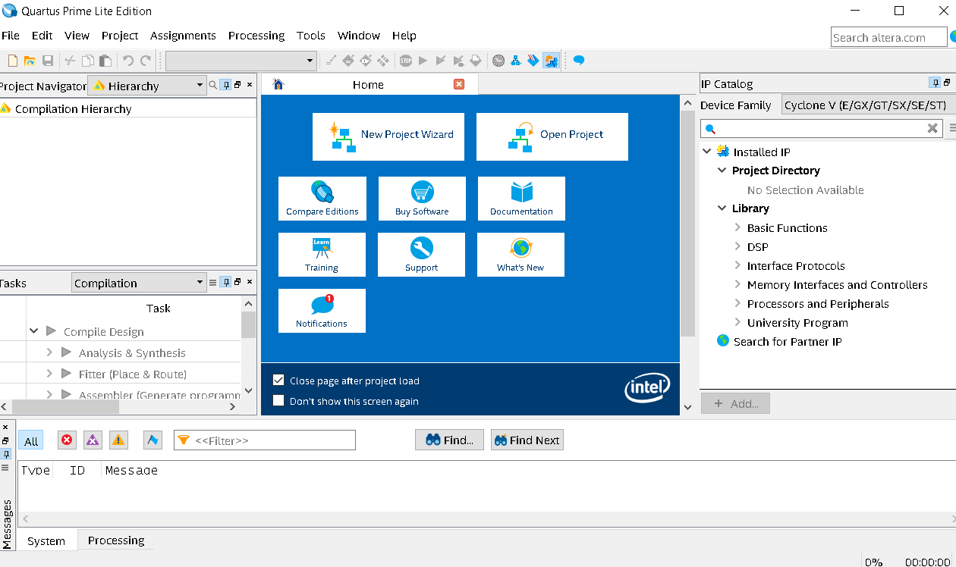

Creating Project (1)
Open Quartus 18.1

Slide 4
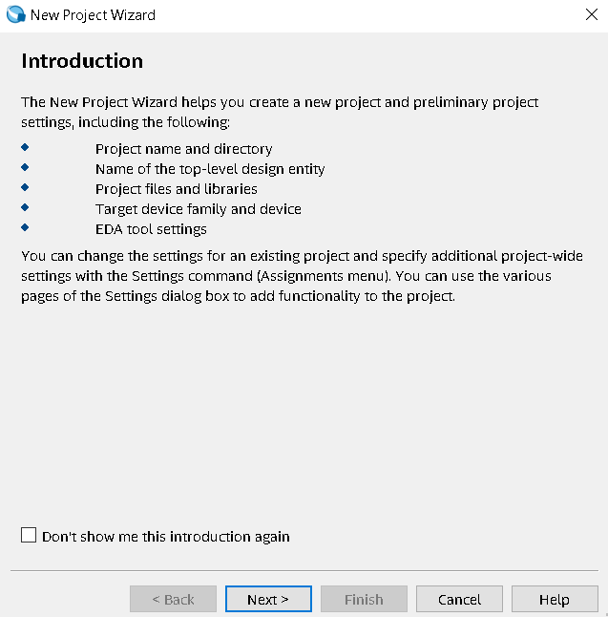
Creating Project (2)
File >> New Project Wizard...
next

Slide 5
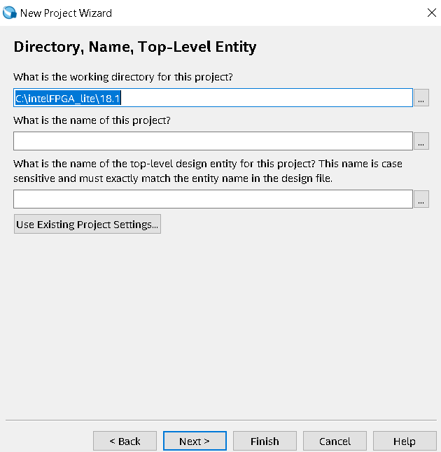
Creating Project (3)
Directory, Name, Top-Level…
Directory : C/altera/project1
Project-Name : project1
Top-level : project1
Note : Create the new directory if necessary

Slide 6
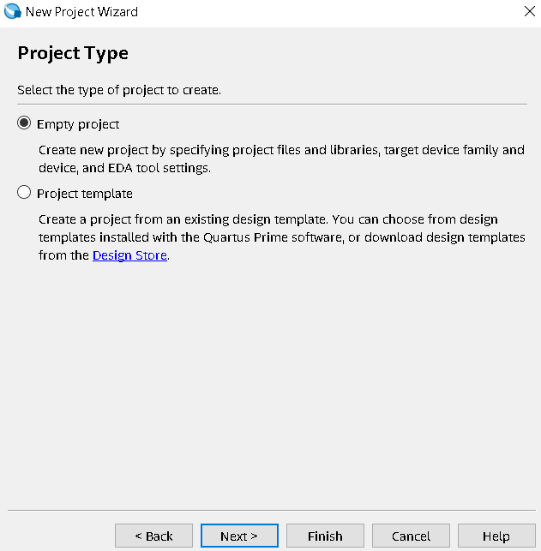
Creating Project (4)
Project Type : Empty Project
next

Slide 7
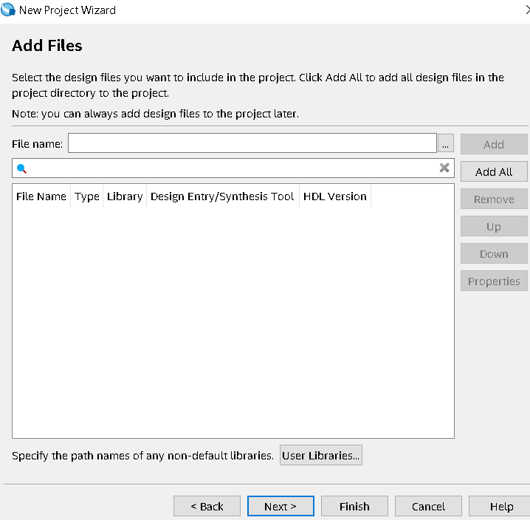
Creating Project (5)
Add files :
next

Slide 8
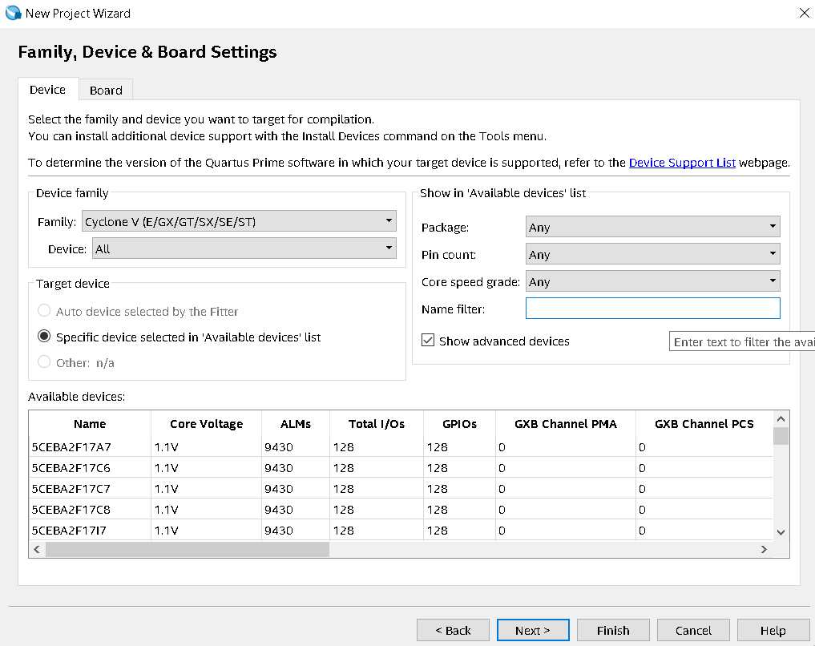
Creating Project (6)
Family, Device, Board Setting
Name Filter :
5CSXFC6D6F31C6
Next

Slide 9
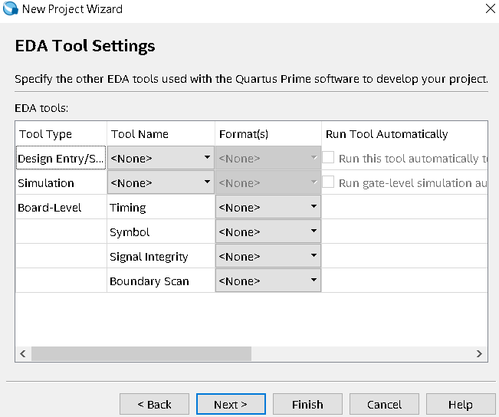
Creating Project (7)
EDA Tool Setting
Next

Slide 10
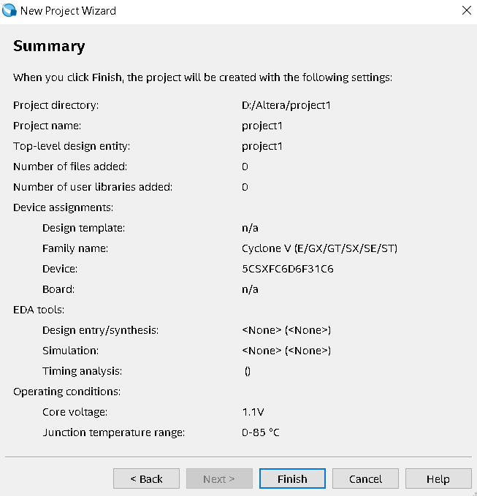
Creating Project (8)
Summary :
Make sure like this example
Finish

Slide 11
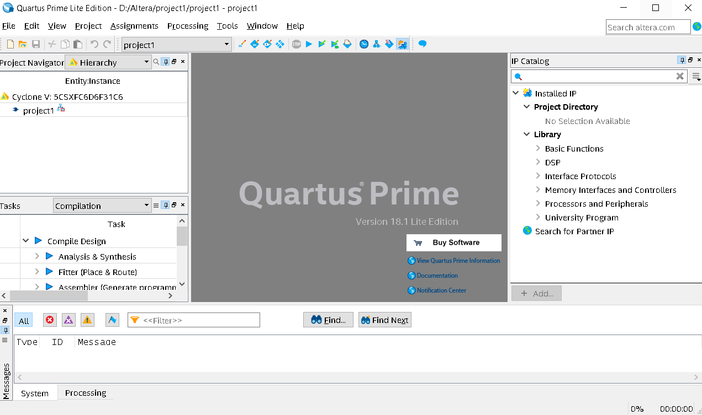
After Creating Project Step

Slide 12
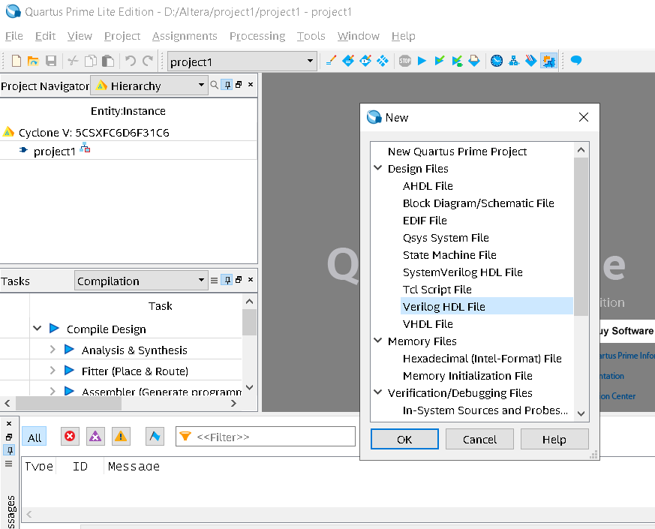
Creating Design Files: Verilog
File → New
Verilog HDL File
OK

Slide 13
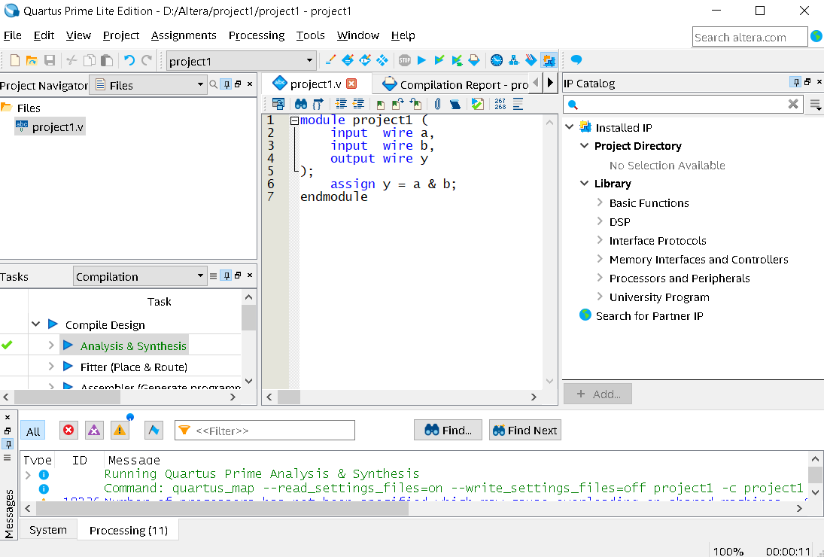
Creating Design Files: Verilog
In the Editor windows, add :
module project1 (
input wire a,
input wire b,
output wire y
);
assign y = a & b;
endmodule

Slide 14
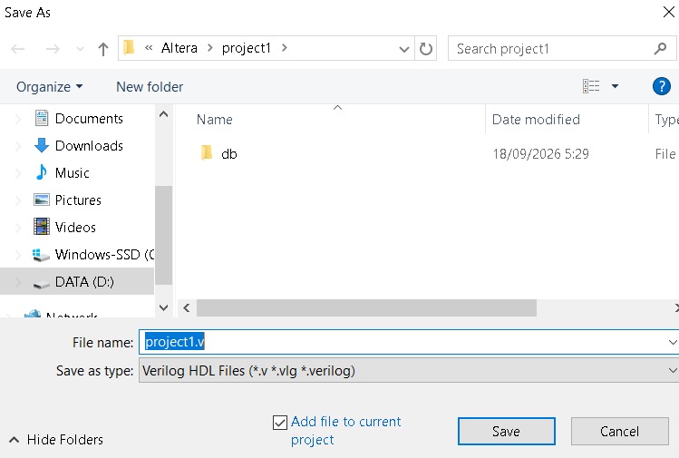
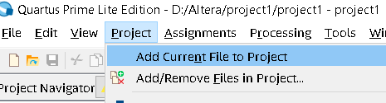
File → Save As
project1.v
Then :
Project → Add Current File to Project

Slide 15
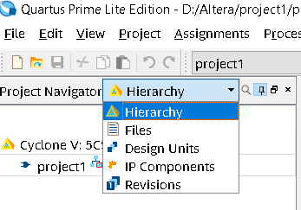
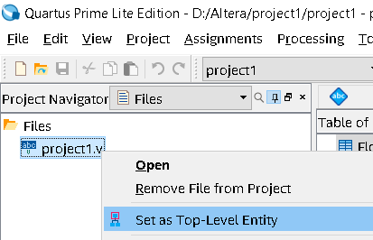
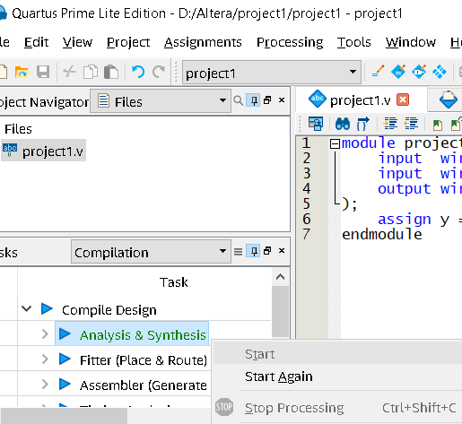
Analysis & Synthesis
Set Top Level :
Change Hierarchy to Files
In project1.v > right-click > Set as Top Level ….
Analysis & Synthesis :
below “Compile Design”
Right-Click at “Analysis & Synthesis” → Start

Slide 16
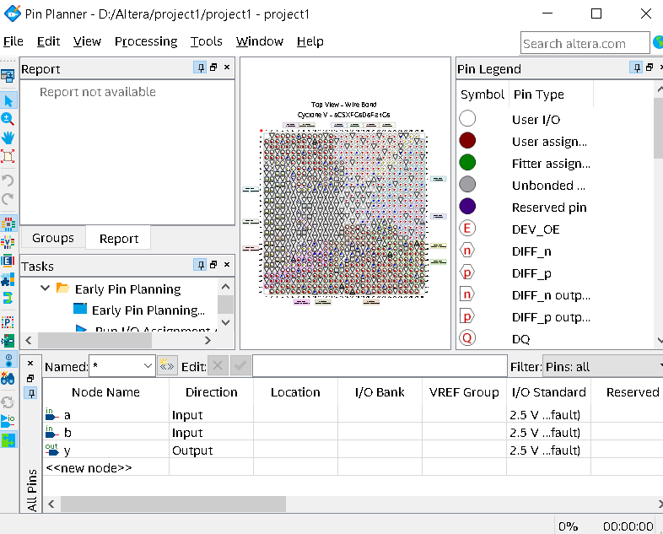
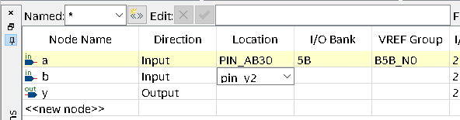
Pin Assignment
Assignments → Pin Planner
There are your input-output port
Fill in the “location”
a → pin_AB30
b → pin_Y27
y → pin_AA24
Press enter after each line
File → close (close the Pin Planner)

Slide 17
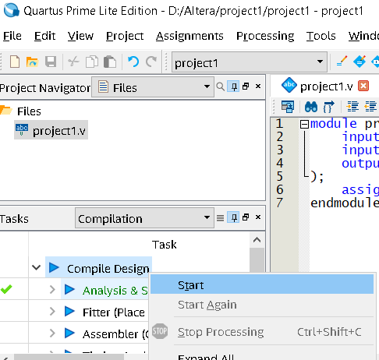
Compile Design
Processing → Start Compilation
Or
Right-Click in “Compile Design” > Start

Slide 18
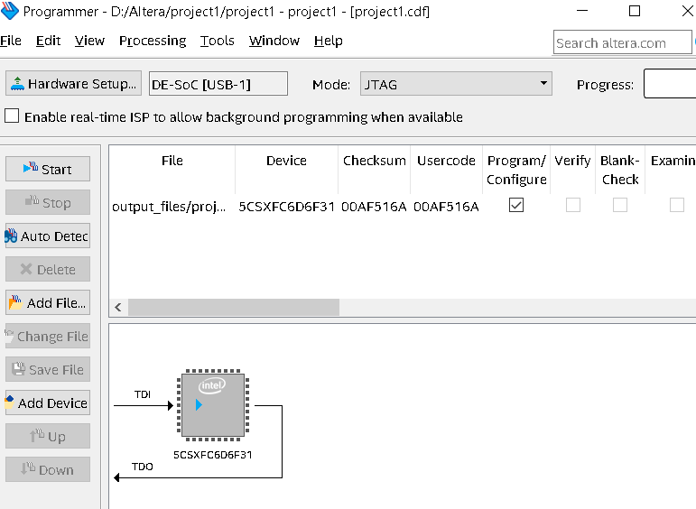
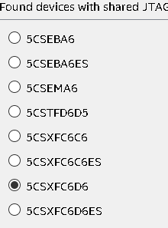
Programming the FPGA
Connect your Board to PC and power
Power up the board
Tools → Programmer
Auto Detect → choose “5CSXFC6D6”
OK
YES

Slide 19
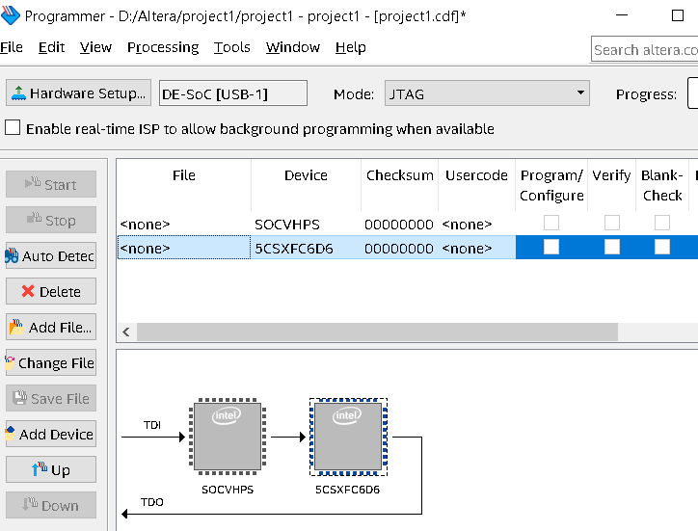
In File for 5csx… device → double click
Choose Output_files folder
Choose project1.sof
Open

Slide 20
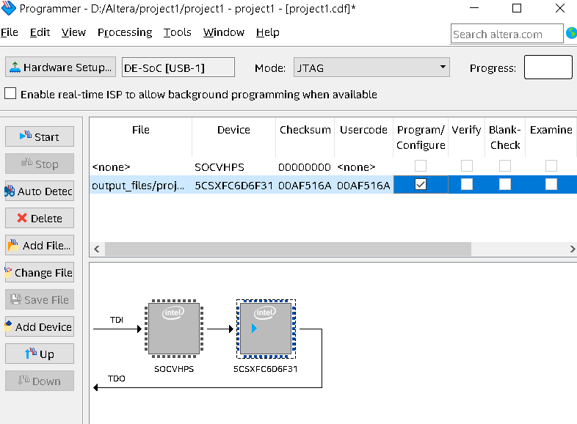
Check Program/Configure
Click Start
If success, progress bar will be green

Slide 21
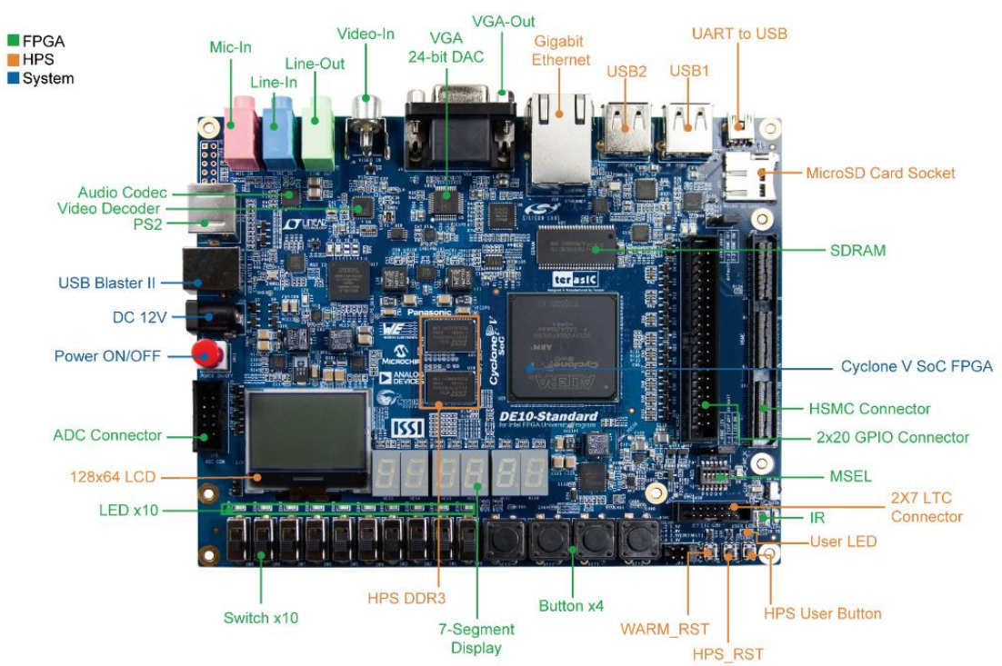
Try the Board
Change the SW0 & SW1
See what happen in the LED-RED-0

Slide 22
Blinking LED

Slide 23
New Project : Blinking 1 LED
Same project setting as before
Different Verilog
Different pin assignment → additional CLK pin
Test
Create your own creation

Slide 24
Verilog of Blinking
module blink (
input wire clk, // 50 MHz clock
output reg led = 0;
);
localparam integer HALF_PERIOD = 25_000_000; // 50,000,000 Hz / 2 = 25,000,000 cycles per half-period
reg [24:0] counter = 0; // 25 bits: max count needed is 24,999,999 (fits in 25 bits)
always @(posedge clk) begin
if (counter == HALF_PERIOD - 1) begin
counter <= 25'd0;
led <= ~led;
end else begin
counter <= counter + 1'b1;
end
end
endmodule

Slide 25
Pin Planner
Find clk and led port
Set the location to :
Clk → pin_AF14
Led → pin_AB23

Slide 26
Program the FPGA
Do just like previous project
See what happen to the board

Slide 27
Multi-LED blink

Slide 28
Multi-LED blink Verilog
module project1 (
input wire clk, // 50 MHz clock
input wire rst_n, // active-low reset
output wire [3:0] led
);
localparam integer HALF_PERIOD = 25_000_000; // 50,000,000 Hz / 2 = 25,000,000 cycles per half-period
reg [24:0] counter = 0; // 25 bits: max count needed is 24,999,999 (fits in 25 bits)
reg [3:0] count_out = 0;
always @(posedge clk or negedge rst_n) begin
if (!rst_n) begin
counter <= 25'd0;
count_out <= 4'd0;
end else if (counter == HALF_PERIOD - 1) begin
counter <= 25'd0;
count_out <= count_out + 1'b1;
end else begin
counter <= counter + 1'b1;
end
end
assign led = count_out;
endmodule

Slide 29
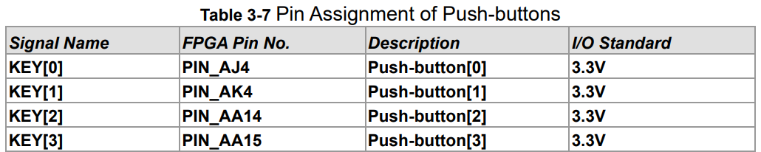
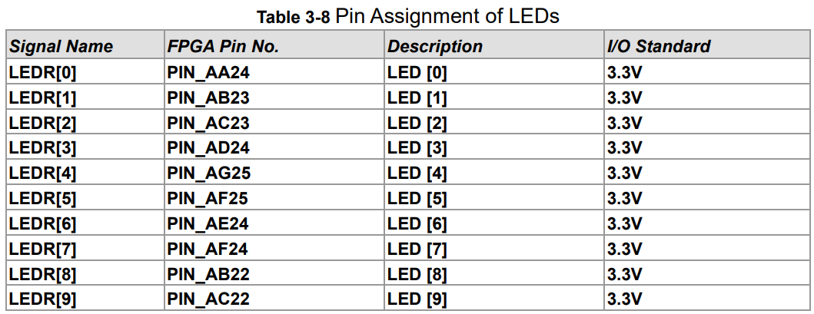
Board’s Pin Assignment
Now we have new reset button
DE10-Standard Manual → https://github.com/rizki-ap/VLSI/

Slide 30
Another Project
Input : 4 switch Button
Output : 7-segment led
Use AI to help

