Slide 1
INTRODUCTION
SOFTWARE DEVELOPER JOB, WEB PROGRAMMING, AND TOOLS INSTALLATION

Slide 2
INTRODUCTION

Slide 3
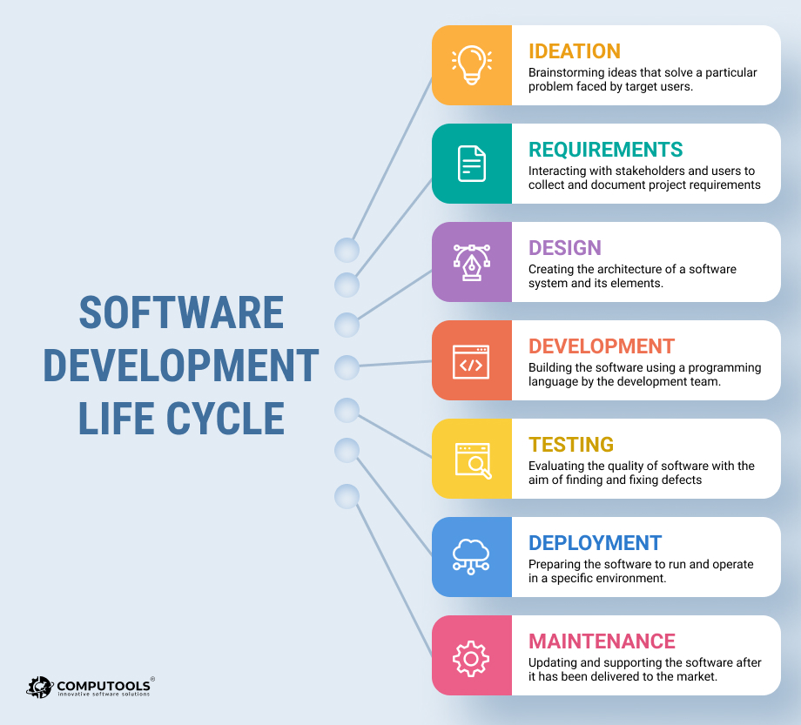
SOFTWARE DEVELOPMENT LIFE CYCLE

Slide 4
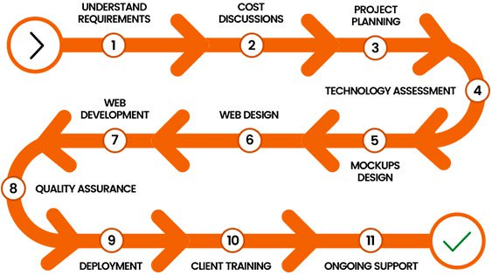
WEB DEVELOPMENT

Slide 5
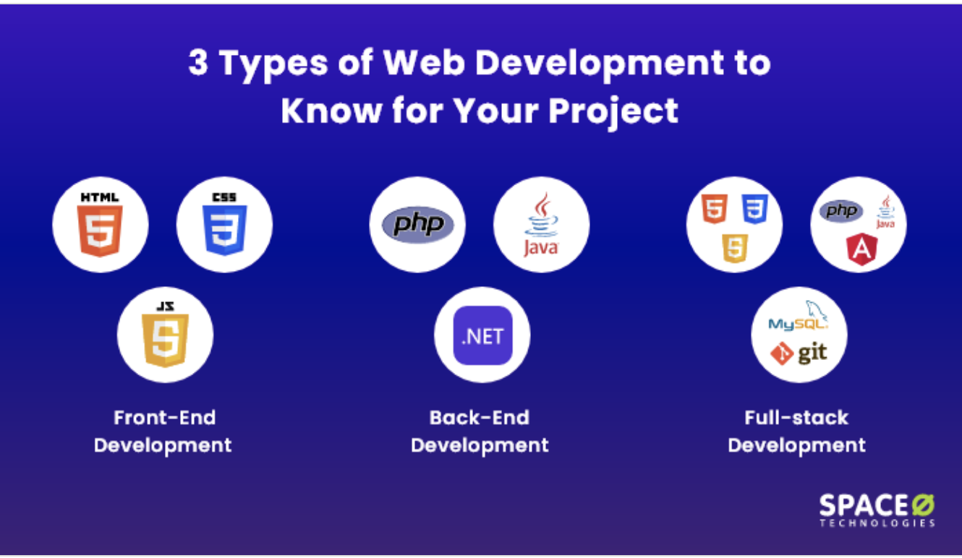
WEB DEVELOPER TYPE

Slide 6
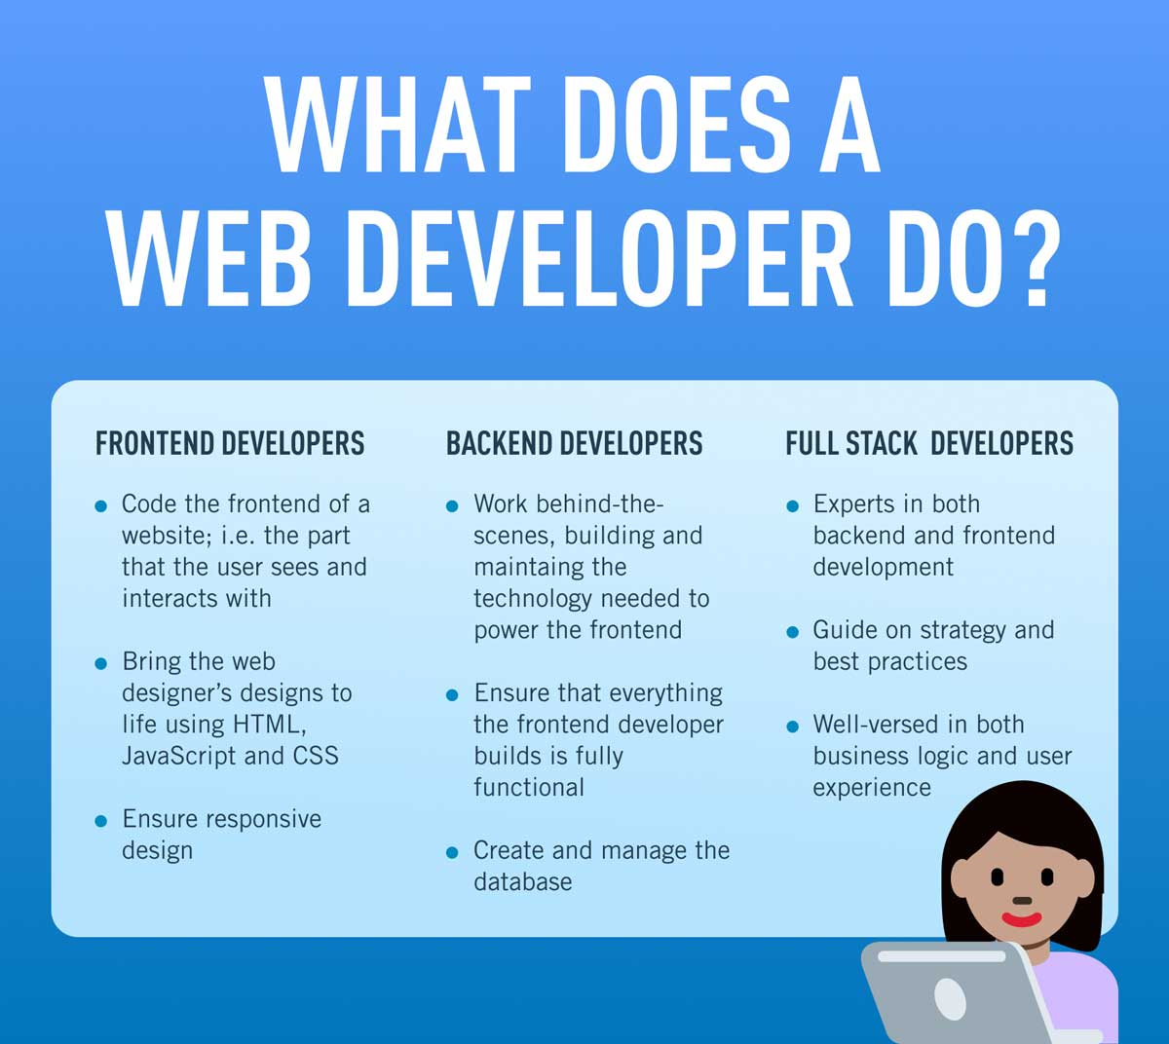
WEB DEVELOPER JOB DESCRIPTION

Slide 7
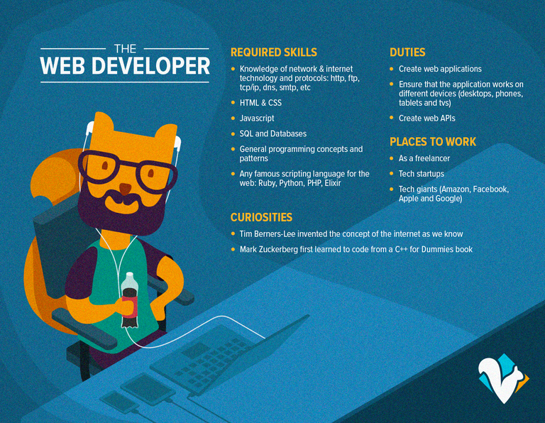
WEB DEVELOPER SKILL NEEDS

Slide 8

STEP TO BECOME WEB DEVELOPER

Slide 9
TEXT EDITOR

Slide 10


Slide 11
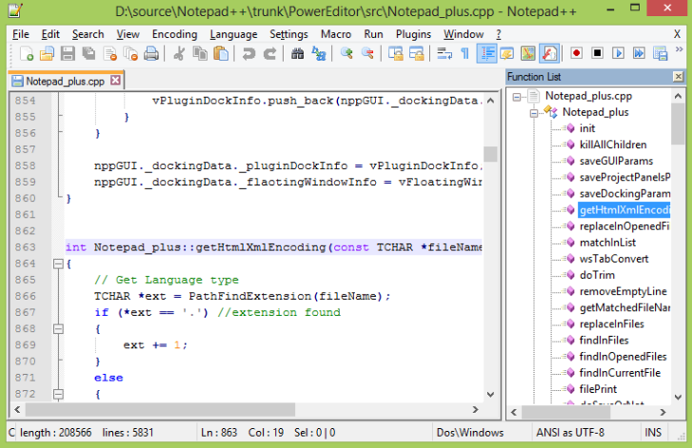

Slide 12
