Slide 1
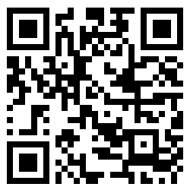

ALIF STONE PARK: AR
SCAN ME
THEN ME
bit.ly/2LXy10R

