Slide 1



MASSIVE MUSIC · TECHNICAL TEST
DSP Metadata Pipeline
Automated retrieval, cleaning & storage of song / video metadata
from Spotify and YouTube — built for analysts and data scientists.
Data Engineer · Rizky

Slide 2
01
The Brief
One pipeline, two questions the business needs answered
Videos / song
ISRCs / song
How many videos does each song have on YouTube?
How many ISRCs does each song have on Spotify?
OUTPUT mart_song_youtube_video_counts
OUTPUT mart_song_spotify_isrc_counts
Inputs: internal song catalog (Google Sheet) + Spotify Web API + YouTube Data API v3

Slide 3






02
Pipeline Architecture
Extract → Load → Transform → Serve, orchestrated by Airflow
EXTRACT
LOAD → RAW
TRANSFORM (dbt)
SERVE
Python jobs pull catalog, ISRCs (Spotify → MusicBrainz fallback) & YouTube videos. Retries, backoff, quota guard.
Immutable landing zone with ingest metadata + load-audit for lineage.
staging: clean, standardize, dedup, validate. marts: dim + facts + answers.
PostgreSQL warehouse → SQL, BI & data science.
Orchestration — Apache Airflow: daily DAG, each stage a DockerOperator task with retries & exponential backoff. Everything reproducible via Docker Compose.

Slide 4



03
Tech Stack & Why
Local-runnable today, cloud-portable tomorrow
Python: spotipy · MusicBrainz · YouTube
dbt
PostgreSQL (medallion)
Pluggable ISRC source (Spotify or free MusicBrainz); tenacity retries.
SQL-first, versioned, tested transforms. Lineage + docs for free.
raw / staging / marts schemas. ANSI-SQL = lift-and-shift to cloud.
Apache Airflow
dbt tests
Docker Compose
Scheduling, retries, observability; orchestration ≠ execution.
Uniqueness, not-null, relationships, format & range checks.
One command reproduces the full environment anywhere.

Slide 5
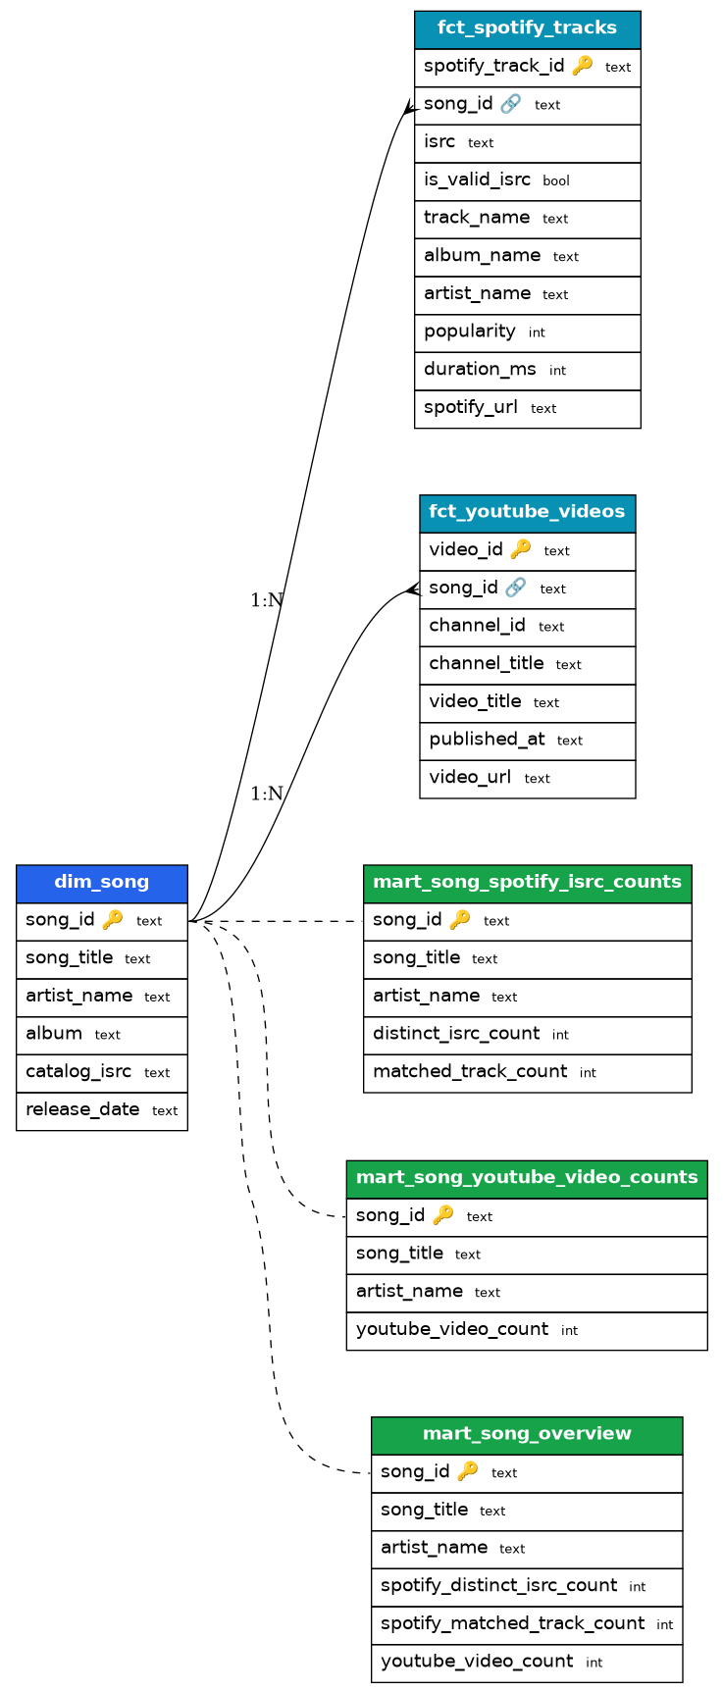
04
Data Model & ERD
Star schema in the marts layer — one conformed song dimension
dim_song — one row per internal song (PK song_id)
fct_spotify_tracks — track grain → distinct ISRCs roll up here
fct_youtube_videos — video grain → video count rolls up here
mart_song_*_counts — the two business answers, 1 row / song
mart_song_overview — both metrics joined for BI convenience
raw → staging (views) → marts (tables) · medallion architecture

Slide 6
05
Data Quality & Validation
Tests run on every build — fail-fast before bad data reaches analysts
Uniqueness & not-null
Referential integrity
On every primary key (song_id, track_id, video_id) — catches dupes & missing keys.
relationships tests ensure every fact row maps to a real dim_song.
Format validation
Deduplication
ISRC must match CC-XXX-YY-NNNNN; malformed-but-present values flagged as anomalies.
row_number() windows keep the latest row per natural key in staging.
Missing-data handling
Corruption / anomaly
LEFT JOINs keep zero-match songs (count = 0) instead of dropping them.
raw._load_audit tracks row-counts per load; sudden drops are alertable.

Slide 7

06
Storage & Scalability
PostgreSQL now → columnar cloud warehouse with no rewrite
Today — PostgreSQL
At scale — Cloud warehouse
Schemas as access tiers — analysts read marts only
Marts materialized as tables for fast BI; staging as cheap views
Runs anywhere via Docker; identical ANSI-SQL
Exposed on host:5433 for any SQL client
BigQuery / Snowflake / Redshift — change the dbt profile, not the models
fct_* become incremental models (append new ingest dates)
Partition by date, cluster / distkey on song_id
Separation of storage & compute, auto-suspend

Slide 8


07
Monitoring & Maintenance
Keeping the pipeline robust and the data trustworthy over time
Monitoring
Maintenance
Airflow UI: per-task status, duration, logs
Retries 3× with exponential backoff; on-failure alerts (email/Slack)
dbt tests gate publishing of marts
load-audit row-count trends per source
Idempotent refresh → incremental as volume grows
Schema drift absorbed in staging (flexible header mapping)
dbt docs = browsable catalog + lineage
Secrets via .env; rotate keys without code change

Slide 9
08
Demo Output
Real run on the provided catalog (698 songs; ISRC via Spotify)
Song | Artist | ISRC | YT videos
Bahasa Cinta | — | 10 | 50
Rindu Mama | — | 10 | 50
The Guiding Lights | — | 10 | 50
Panggil Aku Sayang | — | 10 | 50
Dusta | — | 9 | 50
Terbuai Asmara | — | 9 | 50
Kemana | Koes Plus | 8 | 50
Be Free | — | 5 | 50
marts.mart_song_overview
698 songs in catalog
30 processed / run (quota cap)
36 / 0 dbt tests pass / fail
ISRC via Spotify Web API (Development Mode caps search at 10 results — Feb 2026). YouTube count is capped at 50 (search max). Source is pluggable (Spotify / MusicBrainz) via one env var.

Slide 10


Run it & what's next
Three commands
Next steps
Incremental fct_* models + freshness SLAs
Relevance filtering on YouTube (Official Artist Channel, fuzzy match)
ISRC source pluggable: Spotify needs Extended Quota Mode (2026 dev-mode) → used free MusicBrainz
CI: run dbt tests on every PR
cp .env.example .env
docker compose build
docker compose run --rm pipeline run-all
Thank you · github repo + this deck submitted to adiyat.woro@massivemusic.co.id

