Slide 1
Dumways
Batch 34

Slide 2
Task
Creating card
Contact form Navbar & Layouting
Form Submission
Creating Blog Page
Count Post Blog Time

Slide 3
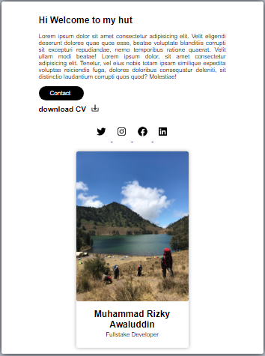
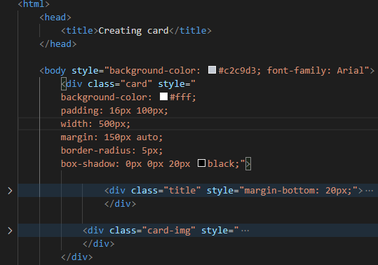
Day-1 Creating card
HTML
CSS

Slide 5
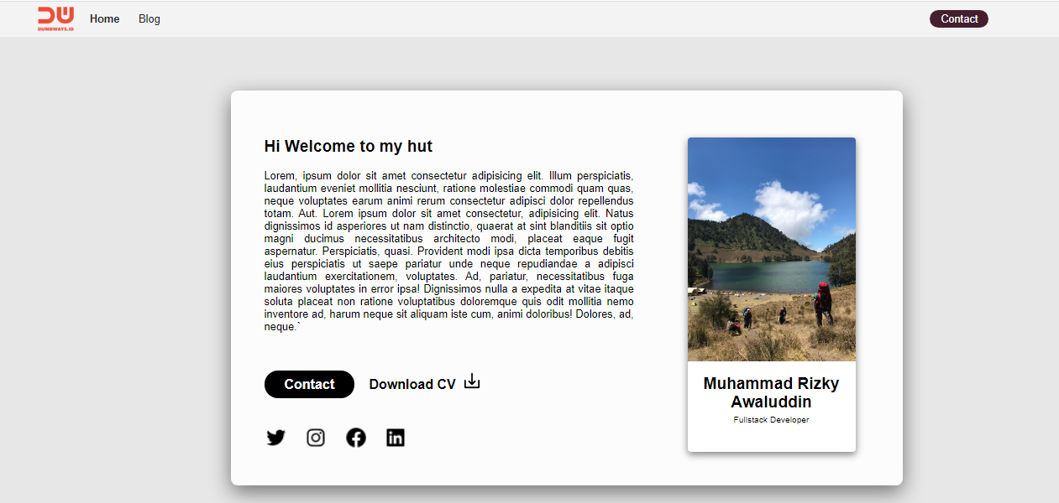
Day-2 Contact form Navbar & Layouting
HTML
CSS EXTERNAL

Slide 6
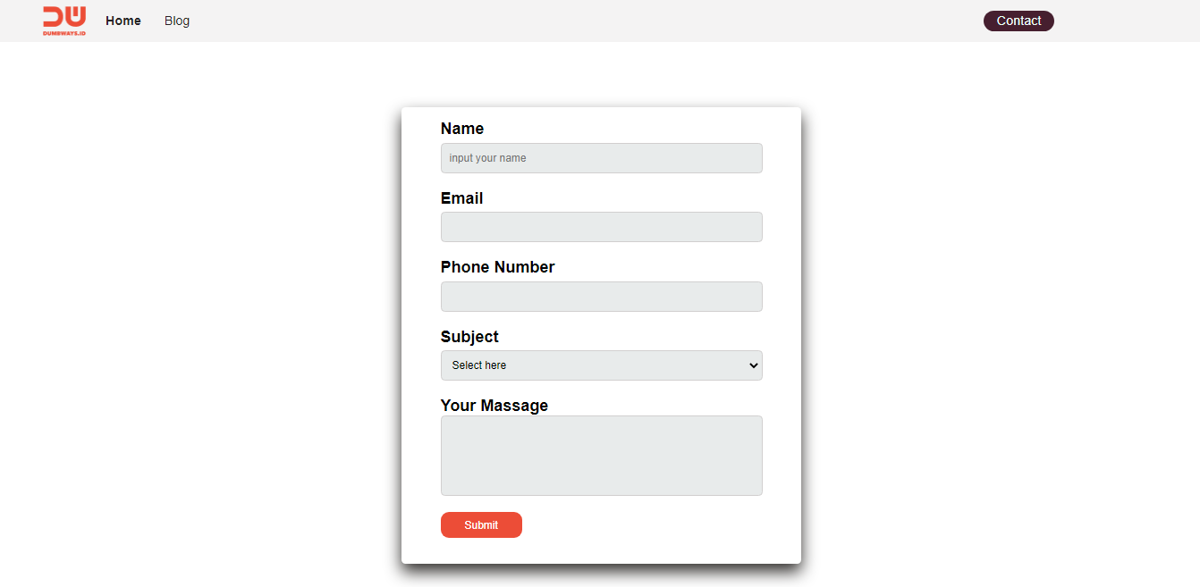
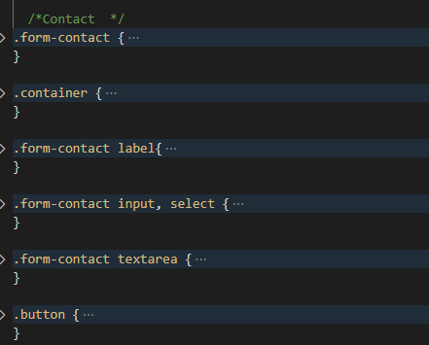
<label>
Text
Mail
Submit
button

Slide 7
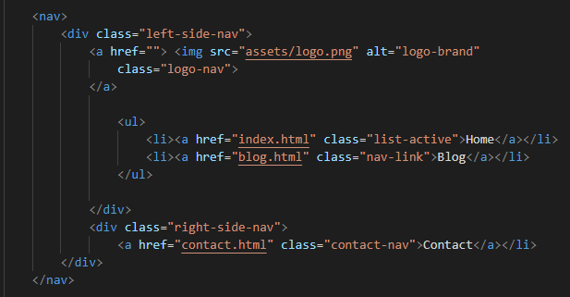
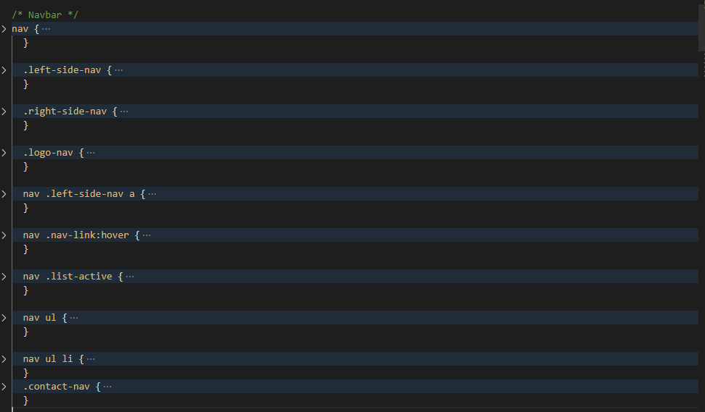
Navbar

Slide 8
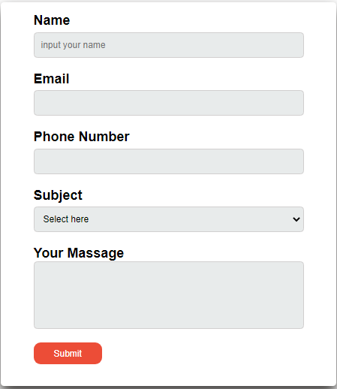
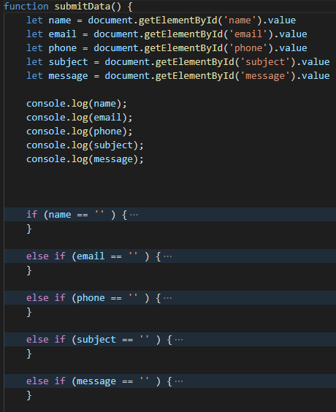
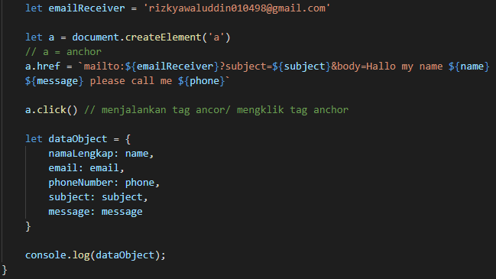
Day-3 Form Submission

Slide 9
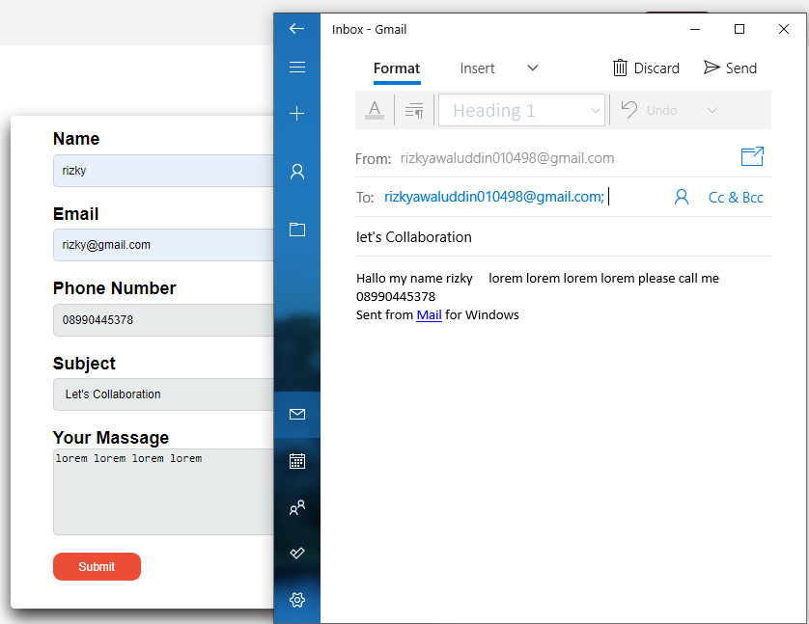

Slide 10
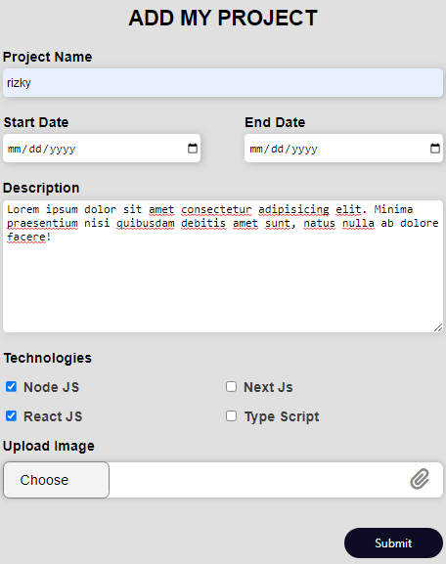
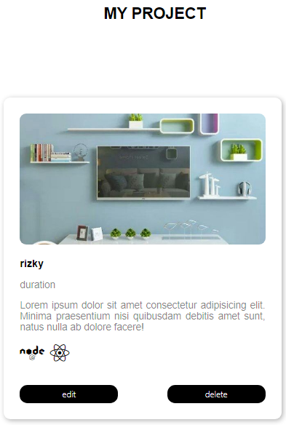
Day-4 Creating Blog Page
let blogs = {
name: name,
startDate: startDate,
endDate: endDate,
description: description,
image: image = URL.createObjectURL(image.files[0]),

Slide 11
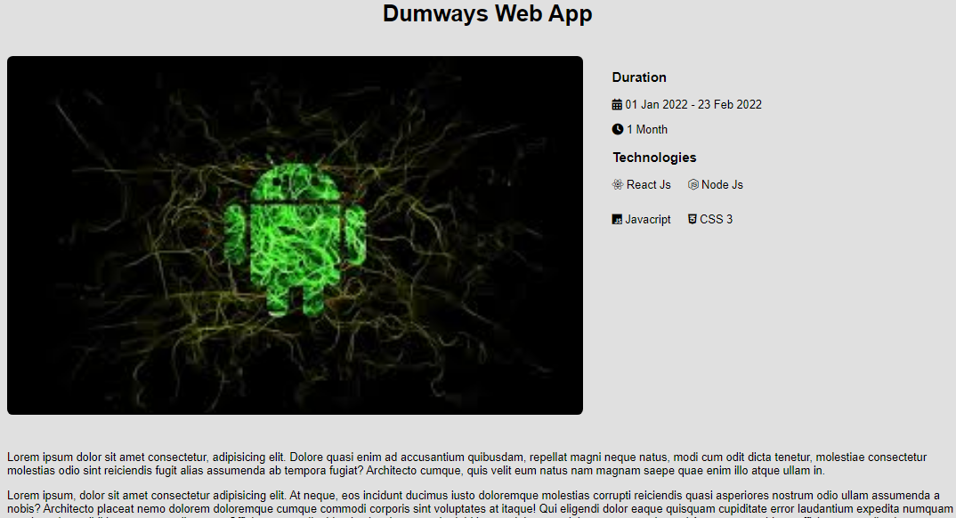
Halaman blog detail

