Slide 1
ØMQ
Tutorial

Slide 2
ØMQ
It's sockets on steroids.
It's like mailboxes with routing. It's fast!

Slide 3
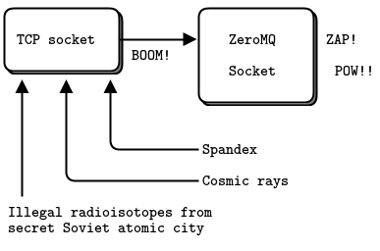
ZeroMQ

Slide 4
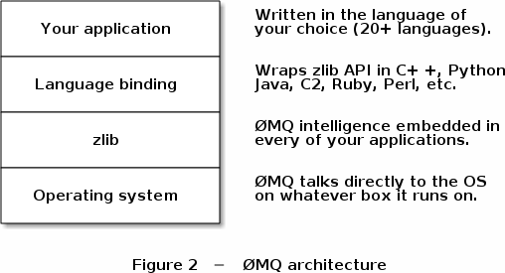
ZeroMQ Architecture

Slide 5
Panacea?
30+ Languages: C, C++, Python, Java…
Transport: inproc, IPC, TCP, multicast
Patterns: req-rep, pub-sub, push-pull, exclusive pair
Async by design: separate IO thread
Built for speed: originally for stock trading
OS-agnosticism: Linux, Windows, OS X

Slide 6
Transport Types
In-Process (INPROC): Local (in-process) communication transport.
Inter-Process (IPC): Local (inter-process) communication transport.
TCP: Unicast communication transport using TCP.
PGM: Multicast communication transport using PGM.

Slide 7
ZeroMQ socket
They go across an arbitrary transport (inproc, ipc, tcp, pgm, or epgm).
One socket may have many outgoing and many incoming connections, unlike TCP socket
The network connection itself happens in the background, and ZeroMQ will automatically reconnect if the network connection is broken (e.g., if the peer disappears and then comes back)

Slide 8
ZeroMQ Pattern
Request-reply, which connects a set of clients to a set of services. This is a remote procedure call and task distribution pattern.
Pub-sub, which connects a set of publishers to a set of subscribers. This is a data distribution pattern.
Pipeline, which connects nodes in a fan-out/fan-in pattern that can have multiple steps and loops. This is a parallel task distribution and collection pattern.
Exclusive pair, which connects two sockets exclusively. This is a pattern for connecting two threads in a process, not to be confused with "normal" pairs of sockets

Slide 9
ZeroMQ Pattern
Request/Reply Pattern: Used for sending a request and receiving subsequent replies for each one sent.
Publish/Subscribe Pattern: Used for distributing data from a single process (e.g. publisher) to multiple recipients (e.g. subscribers).
Pipeline Pattern: Used for distributing data to connected nodes.
Exclusive Pair Pattern: Used for connecting two peers together, forming a pair.

Slide 10
Request-Reply
the request/reply pattern probably forms the absolute classic
Use cases:
For simple communications between a server and client(s).
Checking information and requesting updates.
Sending checks and updates to the server.
Echo or ping/pong implementations.
Socket used:
REP
REQ

Slide 11
ZeroMQ Context
ZeroMQ applications always start by creating a context, and then using that for creating sockets
Technically, the context is the container for all sockets in a single process, and acts as the transport for inproc sockets, which are the fastest way to connect threads in one process.
Example: use as REP(ly)
context = zmq.Context()
socket = context.socket(zmq.REP)

Slide 12
Valid Combination
PUB and SUB
REQ and REP
DEALER and ROUTER
PUSH and PULL
PAIR and PAIR
Any other combination will produce undocumented and unreliable results

Slide 13
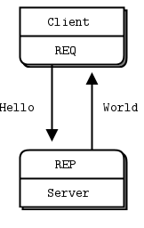
Request-Reply

Slide 14
Important Notes
The REQ-REP socket pair is in lockstep
The client issues send() and then recv()
Doing any other sequence (e.g., sending two messages in a row) will result in a return error code
Server issues recv() and then send() in that order

Slide 15

Note on ZeroMQ Server and Client
the node that does bind() is a "server", sitting on a well-known network address
Server is stable/fixed/well-known in network
the node which does connect() is a "client", with unknown or arbitrary network addresses.
Client is less stable, can come and go

Slide 16
Server
import time
import zmq
context = zmq.Context()
socket = context.socket(zmq.REP) socket.bind("tcp://*:5555")
while True:
message = socket.recv()
print("Received request: %s" % message) time.sleep(1)# do some “work”
socket.send(b"World")

Slide 17
Client
import zmq
context = zmq.Context() # Socket to talk to server print("Connecting to hello world server...")
socket = context.socket(zmq.REQ) socket.connect("tcp://localhost:5555")
for request in range(10):
print("Sending request %s ..." % request) socket.send(b"Hello") # Get the reply.
message = socket.recv()
print("Received reply %s [ %s ]" % (request, message))

Slide 18
Publish-Subscribe
Use cases:
used for evenly distributing messages across various consumers.
Automatic updates for scoreboards and news
Socket type:
PUB
SUB

Slide 19
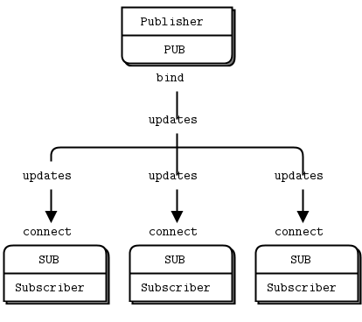
Publish-Subscribe

Slide 20
Pipeline (Push-Pull)
Use cases:
list of queued items need to be routed (i.e. pushed in line) for the one asking for it (i.e. those who pull).
distributing messages upon demand.
Socket:
PUSH
PULL

Slide 21
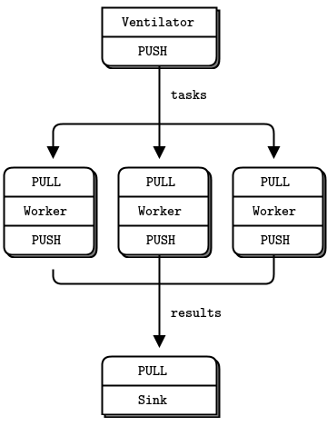
Push-Pull

Slide 22
Push-Pull
A ventilator that produces tasks that can be done in parallel (It generates 100 tasks, each a message telling the worker to work [sleep for some number of milliseconds])
A set of workers that process tasks
A sink that collects results back from the worker processes

Slide 23
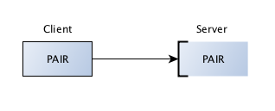
Exclusive Pair
The communication is bidirectional.
There is no specific state stored within the socket
There can only be one connected peer.
The server listens on a certain port and a client connects to it.

Slide 24
PairServer
import zmq
import random
import sys
import time
context = zmq.Context()
socket = context.socket(zmq.PAIR) socket.bind("tcp://*:5556")
while True:
socket.send("Server message to client".encode())
msg = socket.recv()
print (msg) time.sleep(1)

Slide 25
Pairclient
import zmq
import random
import sys
import time
context = zmq.Context()
socket = context.socket(zmq.PAIR) socket.connect("tcp://localhost:5556")
while True:
msg = socket.recv()
print (msg)
socket.send("client message 1 to server".encode()) socket.send("client message 2 to server".encode()) time.sleep(1)

Slide 26
Rob Gagnon's Story
"We use ZeroMQ to assist in aggregating thousands of events occurring every minute across our global network of telecommunications servers so that we can accurately report and monitor for situations that require our attention. ZeroMQ made the development of the system not only easier, but faster to develop and more robust and fault-tolerant than we had originally planned in our original design.
"We're able to easily add and remove clients from the network without the loss of any message. If we need to enhance the server portion of our system, we can stop and restart it as well without having to worry about stopping all of the clients first. The built-in buffering of ZeroMQ makes this all possible."

Slide 27
Vadim Shalts
"I am team leader in the company ActForex, which develops software for financial markets. Due to the nature of our domain, we need to process large volumes of prices quickly. In addition, it's extremely critical to minimize latency in processing orders and prices. Achieving a high throughput is not enough. Everything must be handled in a soft real time with a predictable ultra low latency per price. The system consists of multiple components exchanging messages. Each price can take a lot of processing stages, each of which increases total latency. As a consequence, low and predictable latency of messaging between components becomes a key factor of our architecture.
"We investigated different solutions to find something suitable for our needs. We tried different message brokers (RabbitMQ, ActiveMQ Apollo, Kafka), but failed to reach a low and predictable latency with any of them. In the end, we chose ZeroMQ used in conjunction with ZooKeeper for service discovery. Complex coordination with ZeroMQ requires a relatively large effort and a good understanding, as a result of the natural complexity of multithreading. We found that an external agent like ZooKeeper is better choice for service discovery and coordination while ZeroMQ can be used primarily for simple messaging. ZeroMQ fit perfectly into our architecture. It allowed us to achieve the desired latency using minimal efforts. It saved us from a bottleneck in the processing of messages and made processing time very stable and predictable.
"I can decidedly recommend ZeroMQ for solutions where low latency is important."

Slide 28
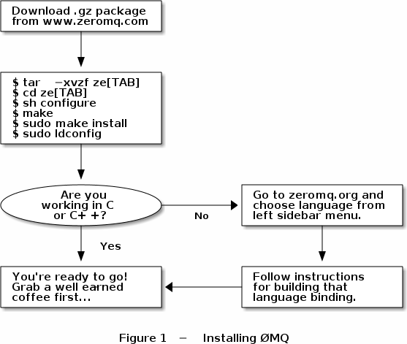
Installing on Linux

Slide 29
Thank You

