Slide 1
UJIAN AKHIR SEKOLAH
Merakit amplifier 150 watt
XII Teknik audio video
SMK ANGKASA 1 KALIJATI

Slide 2
Group 4
Dinda Rizki Utami
Lusi Aprianti
Rendy Roviadi
Rizky Widianto
Wawan Kurniawan

Slide 3
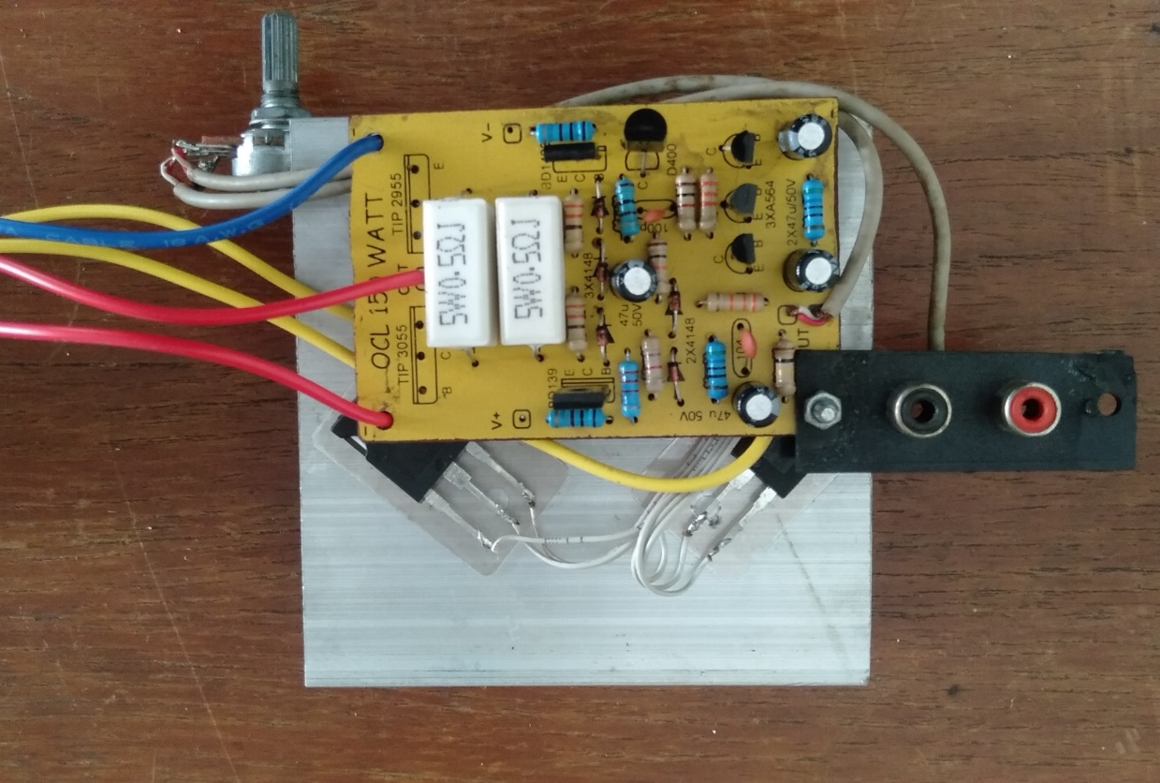
Amplifier 150 watt
What Is an Amplifier?
Amplifier is electronic device used to amplify audio signal.
(Amplifier adalah perangkat elektronik yang dipakai untuk menguatkan sinyal audio)

Slide 4
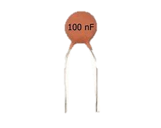

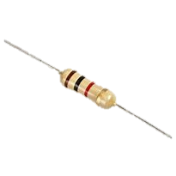
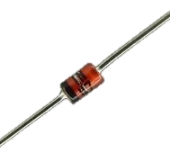
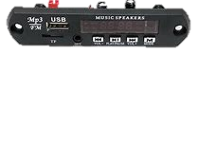
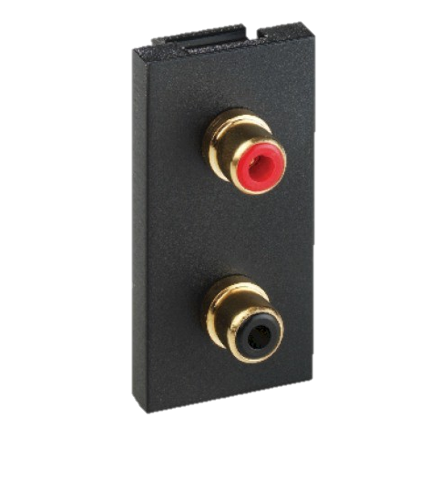
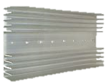
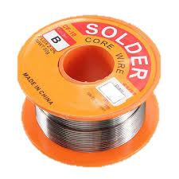
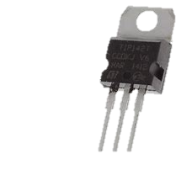
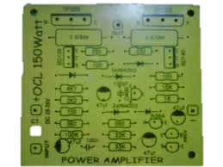
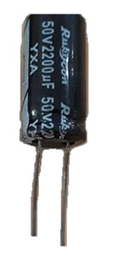
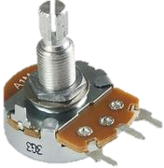

Materials and tools (Bahan dan alat)
Materials (Bahan)
PCB Heatsink
Resistor Cable
Transistor Isolator
Capacitor Solder Tin
Capacitor Elco
Diode
RCA Socket
MP3 Module
Potentio

Slide 5
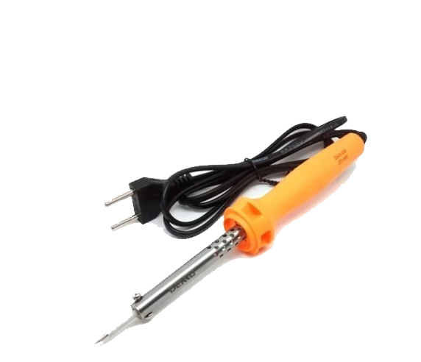
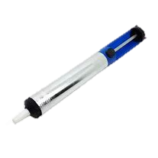
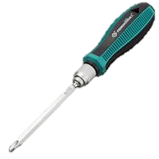
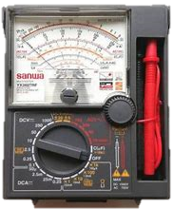

TOOLS (Alat)
Solder
AVO meter
Attractor
Cutting Pliers
Screwdriver

Slide 6
The steps to make an amplifier:
Prepare Tools and Materials.
(Siapkan Alat dan Bahan)
2. Check the components of resistors, diodes and transistors using the Avometer.
(Cek komponen resistor , diode dan transistor dengan menggunakan Avometer)
3. Check the PCB path, make sure there are no dirty or broken paths.
(Periksa jalur PCB, pastikan tidak ada jalur yang kotor atau terputus)
Prepare the soldering tool, then heat it.
(Siapkan alat solder, lalu panaskan.)
5. Install the components one by one starting from the resistors, capacitors and driver transistors to the PCB board according to the circuit.
(Pasang komponen satu persatu mulai dari resistor, kapasitor dan transistor driver ke papan PCB sesuai dengan rangkaian.)
6. Solder properly and neatly according to the circuit.
(Solder dengan benar dan rapih sesuai rangkaian.)

Slide 7
7. Cut the component legs using cutting pliers.
( Potong kaki komponen menggunakan tang pemotong)
8. Check the results of the soldering, make sure the component legs are perfectly attached and there are no short between paths.
( Periksa hasil solderan, pastikan kaki komponen menempel sempurna dan tidak ada short antar jalur)
9. Connect the audio input cable, positive wire to the input pin on the PCB, the negative wire to ground.
( Pasang kabel input audio, kabel positif ke pin input pada PCB, kabel negatif ke ground)
10. Plug the input cable into the RCA socket.
( Pasang kabel input ke soket RCA)
11. Install the pot. Pin 1 to input ground and RCA ground, pin 2 to the amplifier input, pin 3 to RCA input.
( Pasang potensio. Pin 1 ke ground input dan ground RCA, pin 2 ke input amplifier, pin 3 input RCA)
12. Plug in the cable for power supply, the positive wire is red, negative is blue, ground is yellow.
( Pasang kabel untuk catu daya, kabel positif warna merah, negative warna biru, ground warna kuning)

Slide 8
Testing pengujian
Prepare the power supply
(Persiapkan power supply)
Measure the amplifier output
(Ukur output amplifier)
Test with music
(Coba putar music)

Slide 9
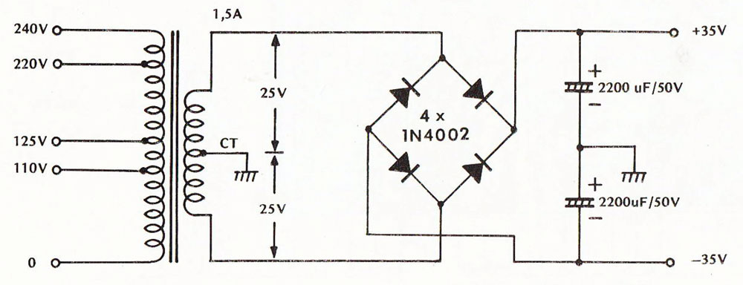
Prepare the power supply
Measure Output Power Supply
Type : Symmetrical Output
Materials :
Step down transformator
Diode
Elco

Slide 10

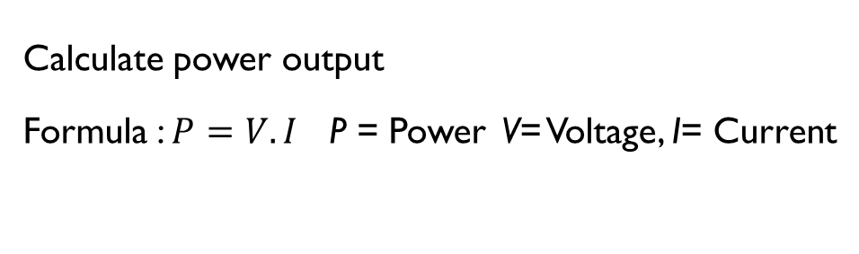



Prepare the power supply
Calculate power output
Formula : $P=V.I$ P = Power V= Voltage, I= Current
Type : Symmetrical Output
Materials :
Step down transformator
Diode
Elco
35 Volt
2 Ampre
$$P = 35 . 2$$
$$P = 70$$
70 Watt
30 Volt
5 Ampre
$$P =30 . 5$$
$$P =150$$
150Watt

Slide 11
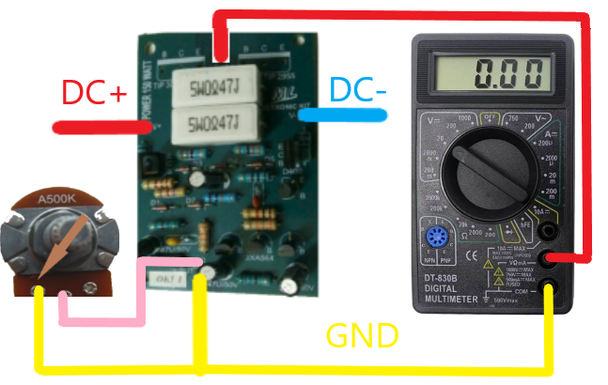
Measure the amplifier output mengukur output
Connect power cable to amplifier
Turn input potentio to minimum
Set AVO Meter to 10VDC
NO DC VOLTAGE ON AMPLIFIER OUTPUT

Slide 12
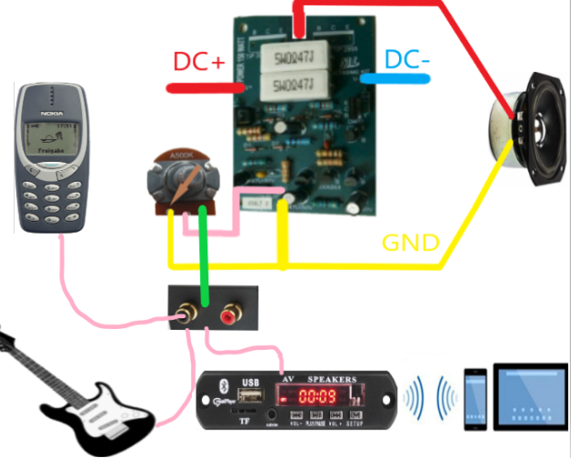
Test with music
Connect the loudspeaker
Connect the audio source
. Adjust volume potentio

Slide 13
Cost
Capacitor 100pF | 1 | Rp. 500.00 | Rp. 500.00
Capacitor 100nF | 1 | Rp. 500.00 | Rp. 500.00
Capacitor Elco 47uF | 4 | Rp. 1,000.00 | Rp. 4,000.00
PCB | 1 | Rp. 5000.00 | Rp. 5000.00
Transistor D400 | 1 | Rp. 2,000.00 | Rp. 2,000.00
Transistor BD139 | 1 | Rp. 2,500.00 | Rp. 2,500.00
Transistor BD140 | 1 | Rp. 2,500.00 | Rp. 2,500.00
Transistor TIP3055 | 1 | Rp. 10,000.00 | Rp. 10,000.00
Transistor TIP2955 | 1 | Rp. 10,000.00 | Rp. 10,000.00
Transistor BC547 | 3 | Rp. 2,000.00 | Rp. 6,000.00
Potensio | 1 | Rp. 5,000.00 | Rp. 5,000.00
Total : Rp.73.000,-
Name of goods | The amount of goods | Price Perunit | Total Price
Resistor 560 ohm | 2 | Rp. 500.00 | Rp. 1,000.00
Resistor 1K ohm | 1 | Rp. 500.00 | Rp. 500.00
Resistor 2K2 ohm | 1 | Rp. 500.00 | Rp. 500.00
Resistor 4K7 | 1 | Rp. 500.00 | Rp. 500.00
Resistor 33K | 2 | Rp. 500.00 | Rp. 1,000.00
Resistor 100K | 1 | Rp. 500.00 | Rp. 500.00
Resistor 100 ohm | 3 | Rp. 500.00 | Rp. 1,500.00
Resistor 330 ohm | 2 | Rp. 500.00 | Rp. 1,000.00
Resistor 10K ohm | 1 | Rp. 500.00 | Rp. 500.00
Resistor 0.5R | 2 | Rp. 1,000.00 | Rp. 2,000.00
Dioda | 5 | Rp. 500.00 | Rp. 2,500.00

Slide 14
Name of goods | The amount of goods | Price Perunit | Total Price
Isolator | 2 | Rp. 500.000 | Rp. 1.000.00
Mur & Baut | 2 | Rp. 1000.00 | Rp. 2,000.00
Heatsink | 1/2 | Rp. 28,000.00 | Rp. 14,000.00
Soket RCA | 1 | Rp. 2,500.00 | Rp. 2,500.00
Modul MP3 | 1 | Rp. 30,000.00 | Rp. 30,000.00
Kabel | 1 | Rp. 2,000.00 | Rp. 2,000.00
Kabel Input Audio | 1 | Rp. 3,000.00 | Rp. 3,000.00
Total : Rp. 54,000.00

Slide 15
THANK YOU

Slide 16
Cost
Name | amount | Price | Total Price
Resistor 560 ohm | 2 | Rp. 500.00 | Rp. 1,000.00
Resistor 1K ohm | 1 | Rp. 500.00 | Rp. 500.00
Resistor 2K2 ohm | 1 | Rp. 500.00 | Rp. 500.00
Resistor 4K7 | 1 | Rp. 500.00 | Rp. 500.00
Resistor 33K | 2 | Rp. 500.00 | Rp. 1,000.00
Resistor 100K | 1 | Rp. 500.00 | Rp. 500.00
Resistor 100 ohm | 3 | Rp. 500.00 | Rp. 1,500.00
Resistor 330 ohm | 2 | Rp. 500.00 | Rp. 1,000.00
Resistor 10K ohm | 1 | Rp. 500.00 | Rp. 500.00
Resistor 0.5R | 2 | Rp. 1,000.00 | Rp. 2,000.00
Dioda | 5 | Rp. 500.00 | Rp. 2,500.00
Capacitor 100pF | 1 | Rp. 500.00 | Rp. 500.00
Capacitor 100nF | 1 | Rp. 500.00 | Rp. 500.00
Elco 47uF | 4 | Rp. 1,000.00 | Rp. 4,000.00
Name | amount | Price | Total Price
PCB | 1 | Rp. 5000.00 | Rp. 5000.00
Transistor D400 | 1 | Rp. 2,000.00 | Rp. 2,000.00
Transistor BD139 | 1 | Rp. 2,500.00 | Rp. 2,500.00
Transistor BD140 | 1 | Rp. 2,500.00 | Rp. 2,500.00
Transistor TIP3055 | 1 | Rp. 10,000.00 | Rp. 10,000.00
Transistor TIP2955 | 1 | Rp. 10,000.00 | Rp. 10,000.00
Transistor BC547 | 3 | Rp. 2,000.00 | Rp. 6,000.00
Potensio | 1 | Rp. 5,000.00 | Rp. 5,000.00
Total : Rp.73.000,-

Slide 17
Name | amount | Price | Total Price
Isolator | 2 | Rp. 500.000 | Rp. 1.000.00
Nut & Bolt | 2 | Rp. 1000.00 | Rp. 2,000.00
Heatsink | 1/2 | Rp. 28,000.00 | Rp. 14,000.00
RCA socket | 1 | Rp. 2,500.00 | Rp. 2,500.00
MP3 module | 1 | Rp. 30,000.00 | Rp. 30,000.00
Cable | 1 | Rp. 2,000.00 | Rp. 2,000.00
Audio Cable | 1 | Rp. 3,000.00 | Rp. 3,000.00
Total : Rp. 54,000.00

Slide 18
The Step Of The Test Using The Power Supply :
Prepare a power supply with symmetrical voltage output.
(Siapkan catu daya dengan output tegangan simetris)
2. Measure the power supply voltage using the Avometer. Ground voltage to positive. and ground to negative must be balanced
(Ukur tegangan catu daya menggunakan Avometer. Tegangan ground ke positif dan ground ke negative harus seimbang)
Connect the power supply cable to the power amplifier.
(Pasang kabel catu daya dengan power amplifier)
4. Measure the amplifier output with a 10V DC scale Avometer, positive probe to the amplifier output, negative probe to ground.
(Ukur output amplifier dengan Avometer skala DC 10V, probe positif ke output amplifier, probe negative ke ground)
5. If there is no DC current that means the power amplifier is functioning normally.
(Jika tidak ada arus dc yang keluar berarti power amplifier berfungsi normal)
6. If there is a DC current, it means there was an error when installing the components.
(jika terdapat arus DC berarti ada kesalahan saat pemasangan komponen)

