Slide 1
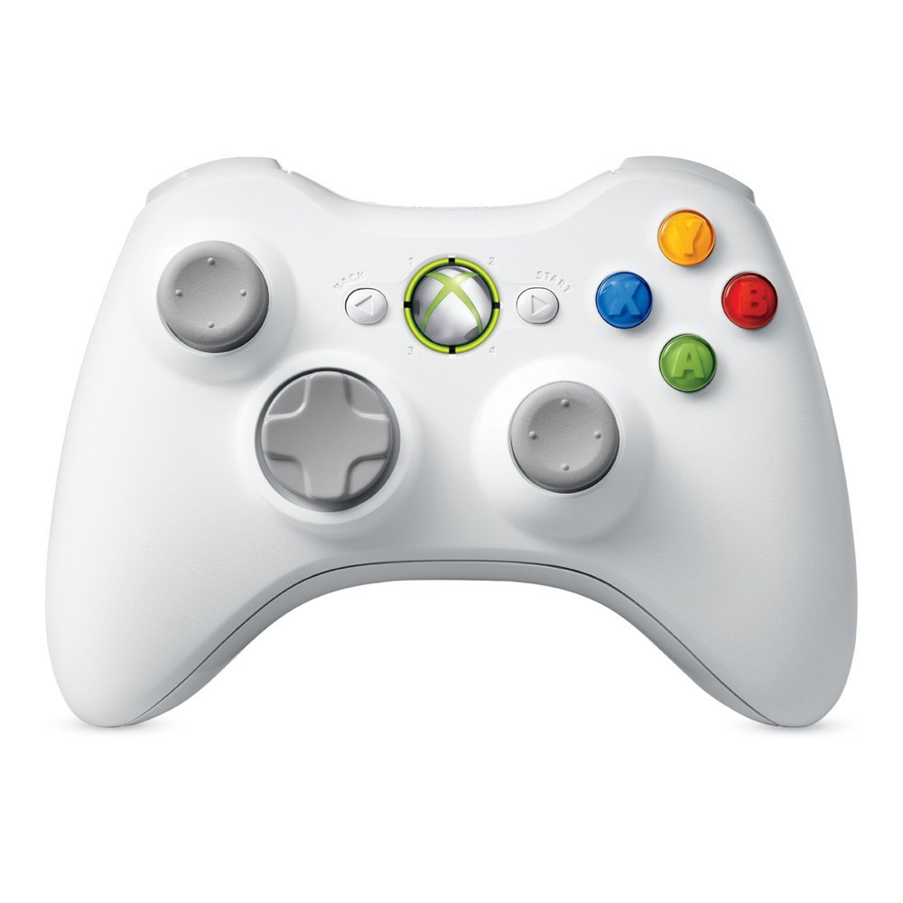
disarm
arm
alt_hold
translate forward/backward
translate left/right
stabilize
land
takeoff
tilt camera up
tilt camera down
translate up/down
rotate left/right
Notes:
Xbox 360 Wireless Controller

Slide 2
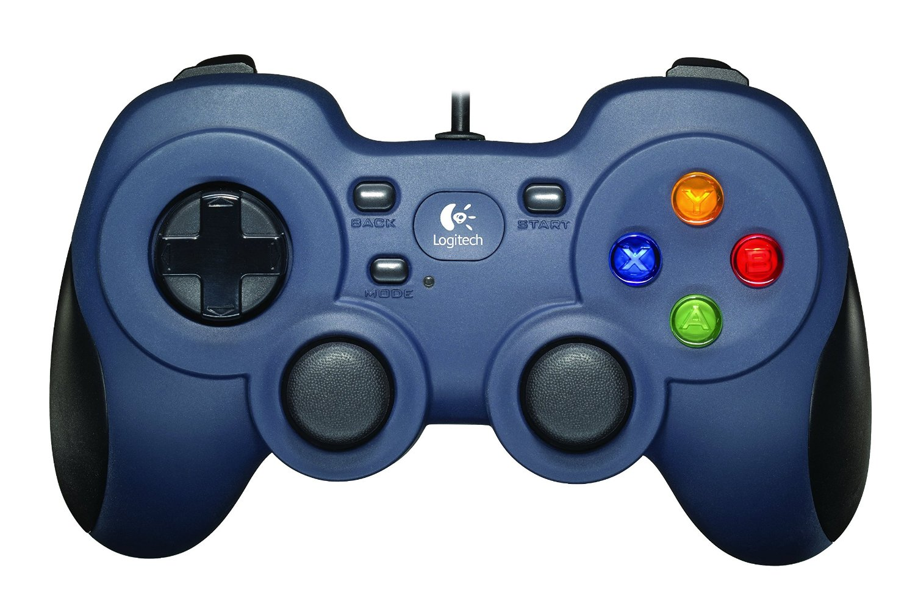
disarm
arm
alt_hold
stabilize
tilt camera up
land
tilt camera down
takeoff
translate forward/backward
translate left/right
translate up/down
rotate left/right
Notes:
Logitech F310 Wired USB Controller

