Slide 1
AI-Powered Multilingual Tourism Chatbot
(TF-IDF + Logistic Regression)
M V F Risla
CSC2405

Slide 2
Background and Motivation
Tourists need quick access to reliable information
Sri Lanka is a multilingual country, which creates communication challenges
Chatbots can provide real-time, interactive assistance
Goal: Build a practical multilingual tourism chatbot

Slide 3
Problem Statement
Build an accurate multilingual intent classifier
Handle a small, structured dataset
Compare traditional ML and deep learning models
Choose the most effective and efficient approach

Slide 4
Literature Review & Research Gaps
Lack of Focus on Low-Resource Languages in Tourism Chatbots
There is limited research on building and evaluating tourism chatbots for low-resource languages especially in a real Sri Lankan context.
Over-Reliance on Large Deep Learning Models Without Considering Small Datasets
There are few comparative studies that analyze how traditional ML methods perform against deep models when the dataset is small and domain-specific.

Slide 5
Literature Review & Research Gaps
Limited Evaluation of Practical, Deployable Tourism Chatbots
There is insufficient work on integrated, deployable tourism chatbot systems
Lack of Domain-Specific Multilingual Datasets for Tourism
There is a shortage of curated, domain-specific multilingual datasets for tourism, especially covering Sri Lanka-related queries.

Slide 6
Proposed Solution
Develop a multilingual tourism chatbot
Create and use a balanced tourism Q&A dataset
Implement and compare three models
Integrate the best model into the final system
Demonstrate the system using a simple UI

Slide 7
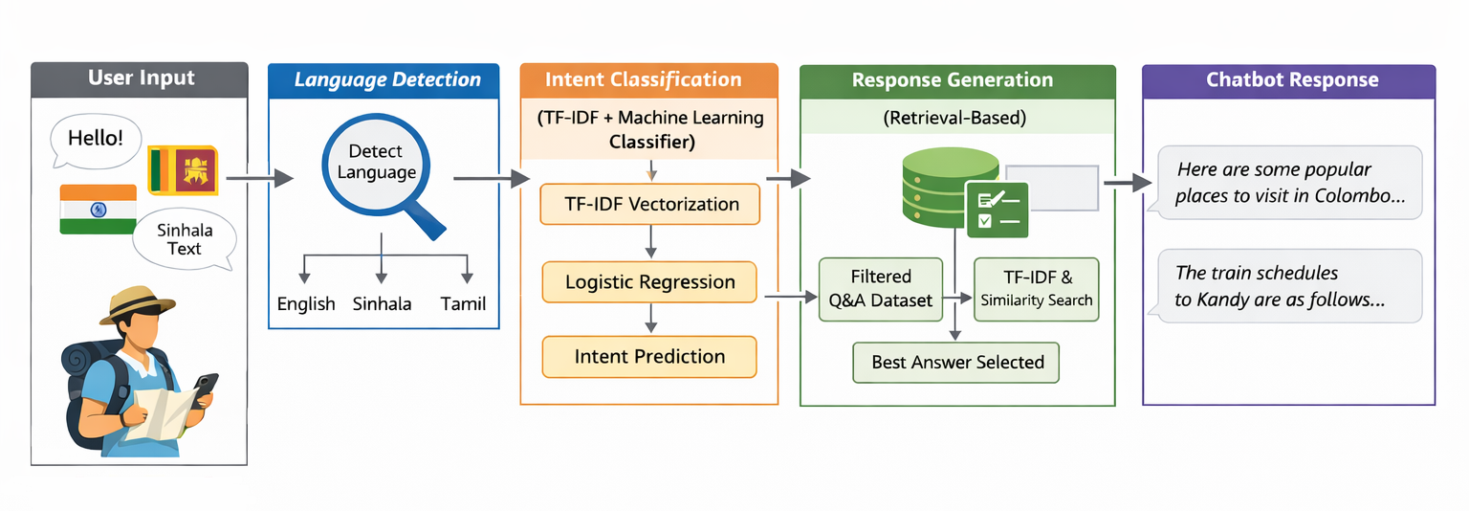
High-level Architecture Diagram

Slide 8
Models Implemented
Model 1: TF-IDF + Logistic Regression (final system)
Model 2: BiLSTM (deep learning)
Model 3: XLM-R (transformer-based multilingual model)
All models trained and evaluated using the same splits

Slide 9
User Interface
Developed using Gradio
Supports English, Sinhala, and Tamil queries
Displays answer, predicted category, and confidence score
Demonstrates end-to-end system functionality

Slide 10
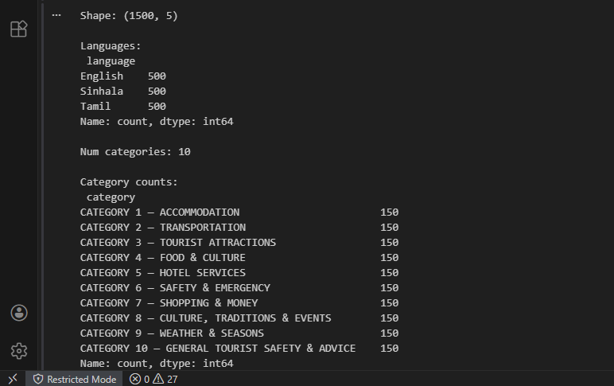
Dataset

Slide 11
Tools and Technologies Used
Tool/Technology | Purpose in the System
Python | Main language for system development
Google Colab | Used for development and experiments
PyTorch | Used to train BiLSTM and XLM-R models
Hugging Face Transformers | Used for fine-tuning and running XLM-R
Sckit-learn | Used for TF-IDF, Logistic Regression, and similarity matching
Gradio | Used to build the chatbot user interface

Slide 12
Evaluation Metrics
Accuracy: Overall correctness
Macro F1-score: Average performance across classes
Used for test set comparison

Slide 13
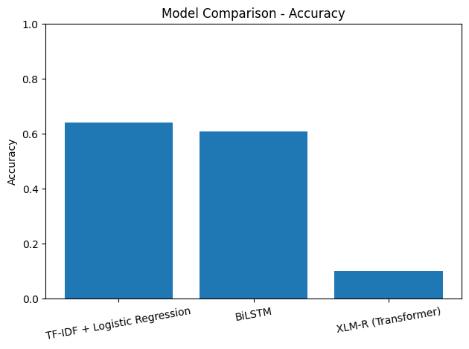
Model Comparison - Accuracy

Slide 14
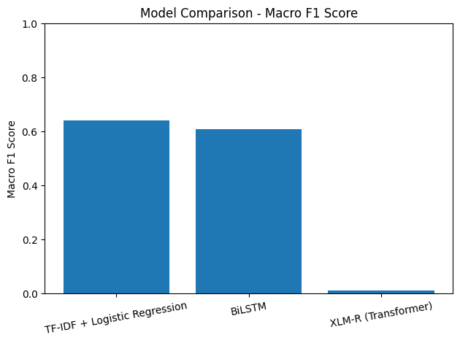
Model Comparison – Macro F1 Score

Slide 15
Conclusion
Compared three models for intent classification
TF-IDF + Logistic Regression achieved the best performance
BiLSTM needs more data to outperform traditional methods
XLM-R requires larger datasets and more fine-tuning
TF-IDF + Logistic Regression works well for limited, structured data
Simpler models can outperform complex models with small datasets

Slide 16
Lessons Learned
Simple models can work better with small datasets
Deep learning needs more data to perform well
Both data quality and data size matter
Proper evaluation helps avoid overfitting
AI systems need good design, not just accuracy

Slide 17
Future Work
Expand the dataset with more questions and categories
Experiment with SVM and Naive Bayes classifiers
Explore hybrid features (TF-IDF + embeddings)
Improve transformer fine-tuning with more computational resources
Enhance response generation and system deployment

Slide 18
Thank You

Slide 19
Link to the code and demo:
https://drive.google.com/drive/folders/1_zLKMbLOHpdaKCgRItEZdujNZZvNbd-O?usp=sharing

