Slide 1
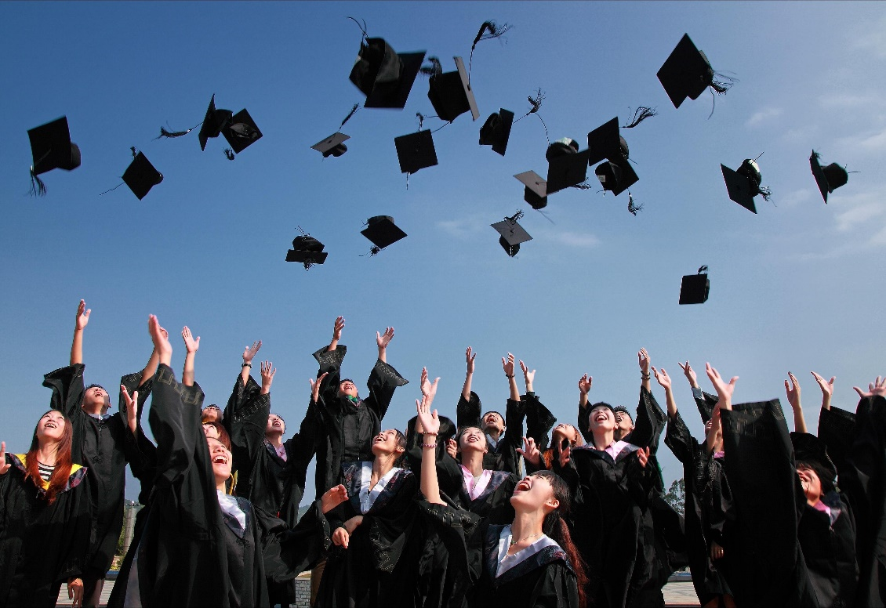
CLASS 2020
AN ADVENTURE BEGINS
Bon Voyage!
Dive into the real world with optimism and courage!

