Slide 1


Slide 2
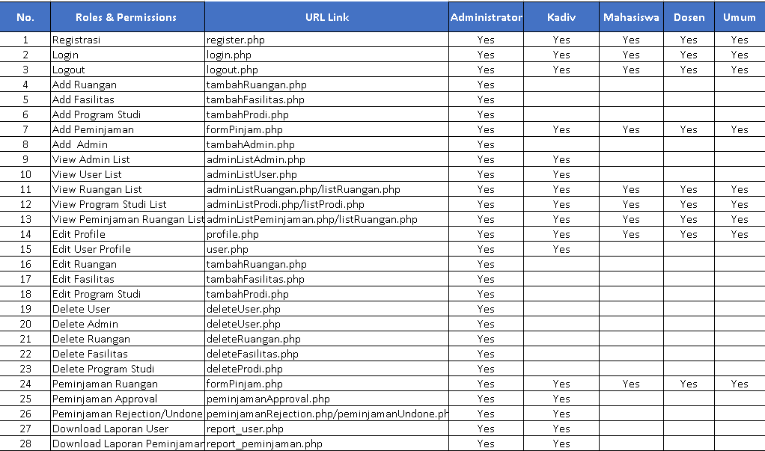

Slide 3
roombookingebs2020.000webhostapp.com

Slide 4
Admin Email : roombookingebs@gmail.com
Pass : esqbs165
Kadiv
Email : opowaex9@gmail.com
Pass : Kadiv.2020
User
Email : abdullah.a@students.esqbs.ac.id
Pass : esqbs165

