Slide 1



Alpha Tech Academy
Website The Jokowi Center
bukancebong.pythonanywhere.com

Slide 2
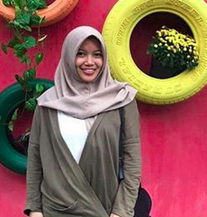
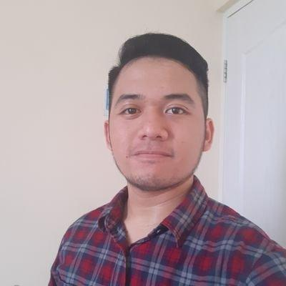
TEAM LIST
Agatha Rachmadika
Ahmad Rizqita

Slide 3
PROJECT PREPARATION - Analisa Project
Replicating footer and header from thejokowicenter.or.id
Simplifies some features
Remove unnecessary parts from the original website that did not work anymore
Add some working pages such as reworking on index.html , social media and input form.

Slide 4
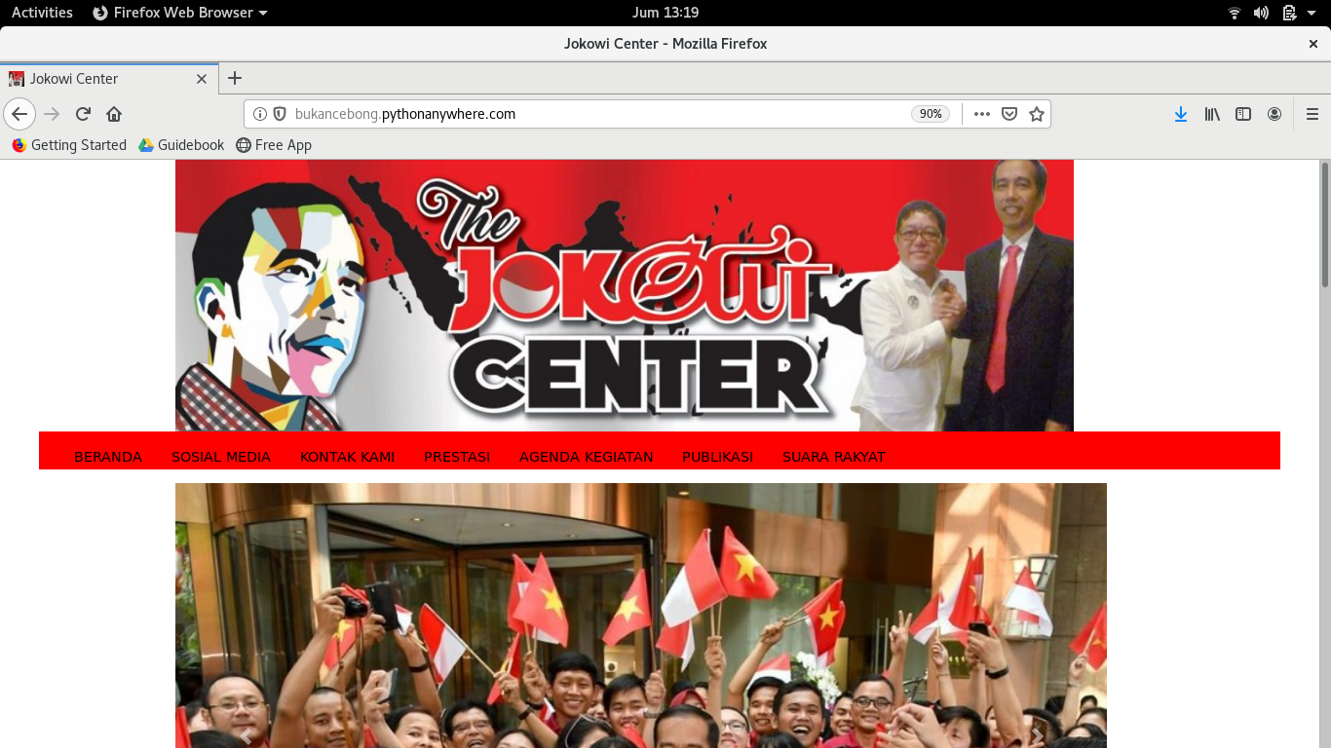
PROJECT PREPARATION - Analisa Project

Slide 5
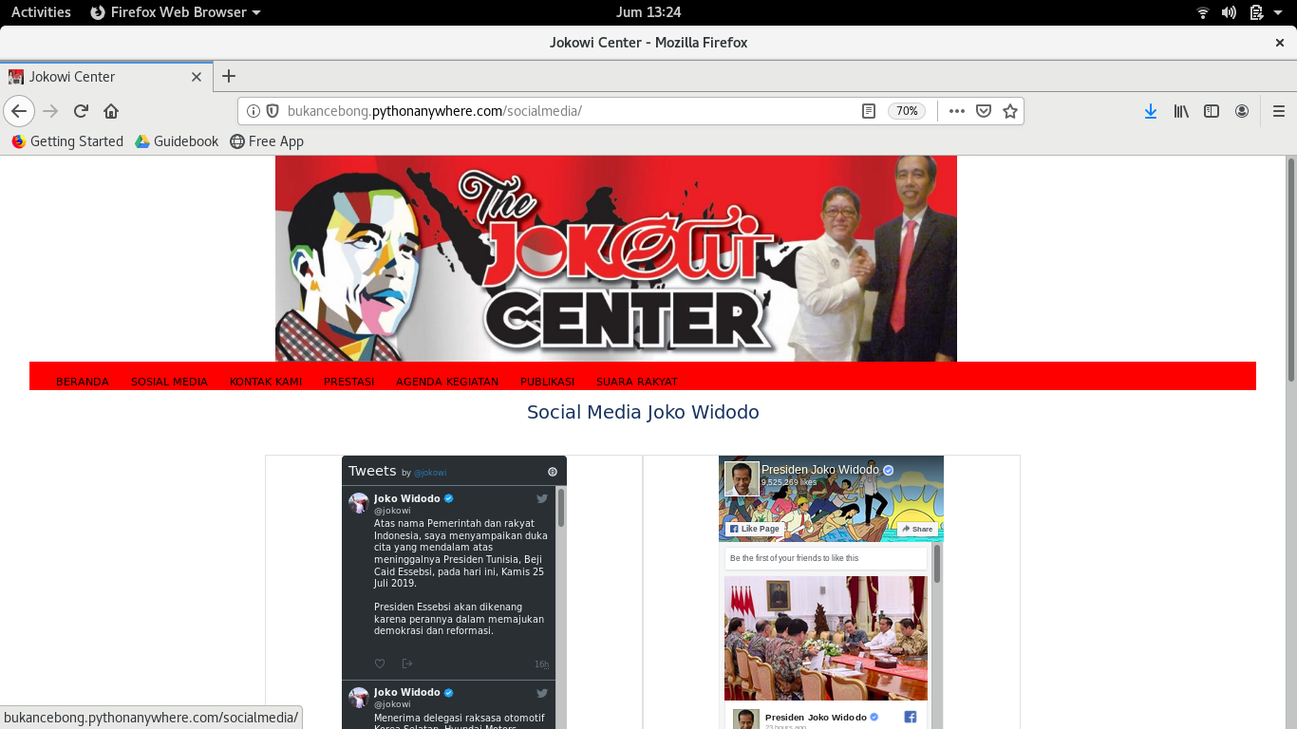
PROJECT PREPARATION - Analisa Project

Slide 6
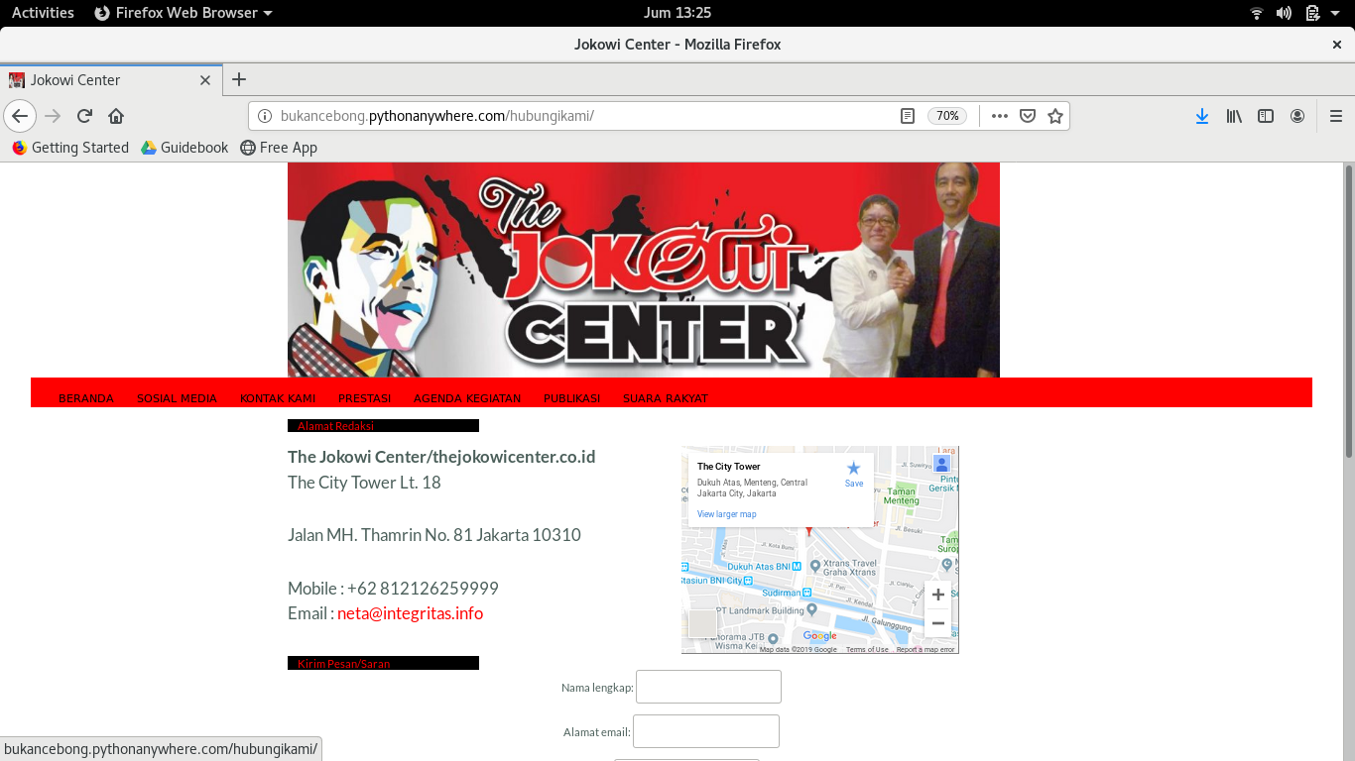
PROJECT PREPARATION - Analisa Project

Slide 7
PROJECT PREPARATION - Database Model
Class Masukan : Nama lengkap,Alamat email,Judul,Isi pesan
Class Blog :Judul,Gambar,Isi,Date

Slide 8
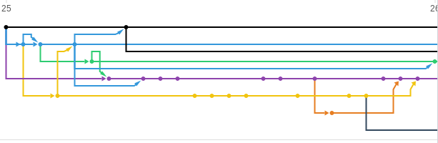
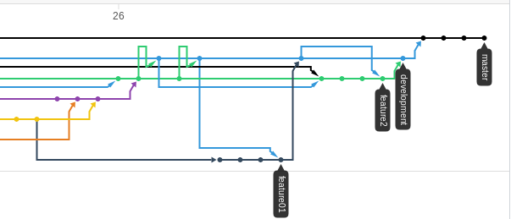
WORK FLOW

Slide 9
PROJECT PREPARATION - Views & URL
URLS.PY
‘Index.html’ or called main
‘Hubungikami’ functioned as feedback and comment for site administrator to be forwarded to Mr Jokowi
‘Socialmedia’ functioned as page to watch Mr. Jokowi’s social media moevement by embedding latest post from his social media handle such as instagram , twitter , facebook fan page and Sekertariat Negara instagram post
VIEWS
‘listmasukan’ : functioned as place to store input that submitted through ‘masukkan’ page
‘Masukkan_view’ : functioned as place to show all inputs that stored in ‘list_masukkan’ and render it in main page
‘Jkw_center_main’ : functioned to show all blog post that submitted by administrator
‘Jkw_social_media’: functioned to render socialmedia.html page

Slide 10
PROJECT PREPARATION - Extra Preparation
Obstacles :
Git and things (conflict on unnecessary binary files such as *.pyc and __pycache__)
CSS working especially put things as desired (text/object alignment)
Database error (need to delete/redownload db.sqlite several times)
Success Story :
Success using carousel to show several photos after several times trying (Thanks to Bootstrap!)

Slide 11
PROJECT DEMO

