Slide 1

Cultural Diversity Impact
Shayan Rizvi | Maria Estrada | Nicolas Martinez

Slide 2

OBJECTIVE
Our group set out to look at the top three largest US metropolitan areas and identify how culture diversity impacts the community's educational and healthcare infrastructure.

Slide 3
OUR QUESTIONS
Which is the most diverse metropolitan area?
What is community’s access to education?
What is the community’s access to healthcare?

Slide 4

How do we define diversity?
We established the benchmark for diversity by combining US Census Demographic Data for all metropolitan areas and getting a percentage against their total population.
If three or more ethnicities were above the benchmark, then we considered it a diverse county.

Slide 5
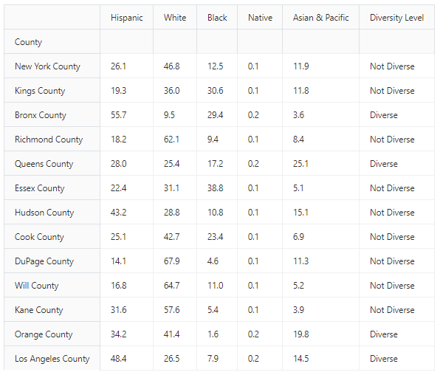



Which is the most diverse metro?
28% Diverse Counties
0% Diverse Counties
100% Diverse Counties

Slide 6
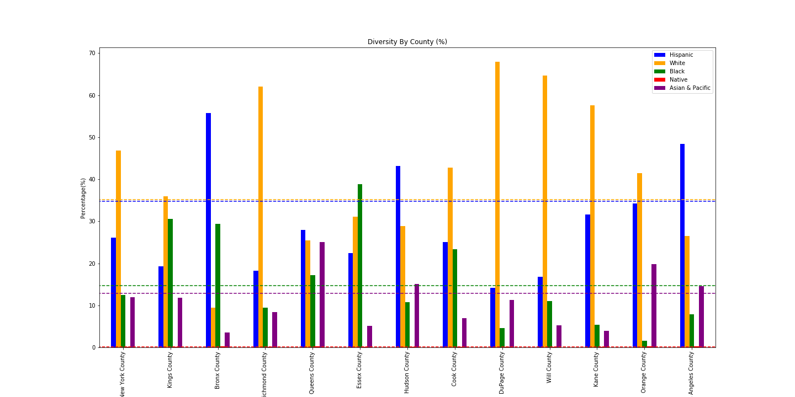
INSERT CHART HERE

Slide 7
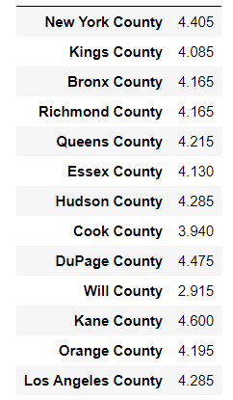

What is the community’s access to education?
Taking a dive into Google Places API, we were able to look at each county’s access to education and their corresponding rating.
By looking at the education average, we were able to see how our diverse counties fared compared to other counties.
We were also curious to find out if there was any correlation to access to education within a county and their poverty levels. By examining the US Census Demographic Data we were able to access and merge this information.

Slide 8
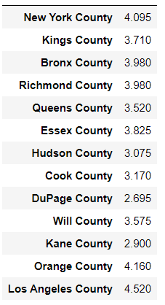

What is the community’s access to healthcare?
We looked at Google Places API to get the counties healthcare and ratings.
Interested to find if there was a correlation between healthcare, poverty levels and mortality rates, we looked at Kaggle data from Centers for Disease Control and Prevention to add to our research.

Slide 9

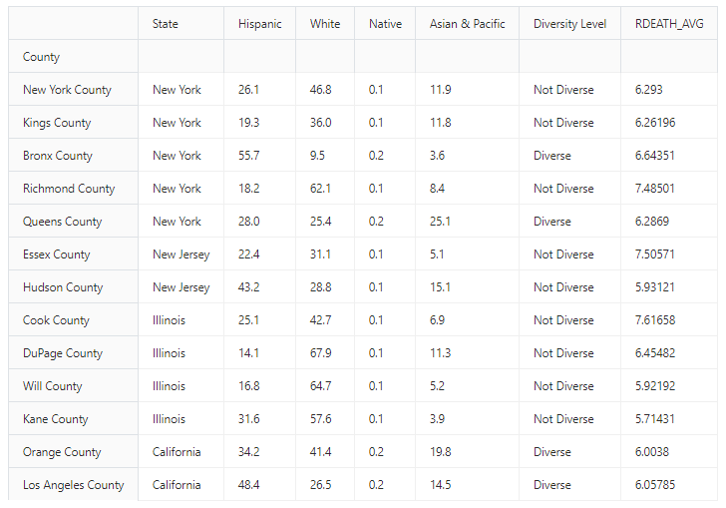
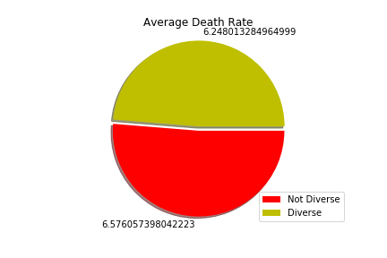
Diversity & Mortality Rates

Slide 10
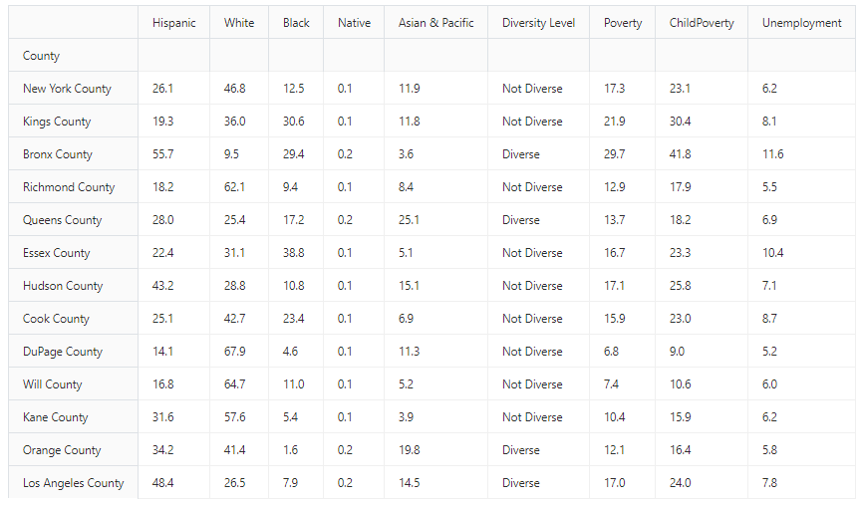
Diversity & Poverty Rates

Slide 11
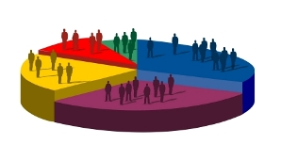


Limitations to our research
We looked at county diversity when claiming a metropolitan area as diverse. While this is a good starting point to get a glimpse, it does not show the full innerworkings of smaller sections like data from zip codes.
When analyzing our education data, we looked at a mix of educational institutions to get an average of the type of education available. Breaking it down into further detail, for example graduation rates, would allow us to explore further into any correlation between school rating and graduation rates.
Due to time constraints, we were not able to do a deep dive into the types of healthcare available. Our idea was to break it down by urgent care, clinics and hospitals available.

Slide 12
QUESTIONS
Shayan Rizvi | Maria Estrada | Nicolas Martinez

