Slide 1
Promoting Safety, Safety Training, and Mentoring
CONSTRUCTION SAFETY — CHAPTER 12
Keeping employees focused on working the safe way, every day
Mississippi State University | Building Construction Science

Slide 2
Learning Objectives
CHAPTER OVERVIEW
Describe the role of a company safety policy and safety rules
Explain why employee participation and training matter to promoting safety
Summarize suggestion programs, visual awareness, and safety committees
Explain how to gain personal commitment, and use incentives and competition well
Summarize the teamwork approach to promoting safety, and the role of mentoring
Explain how to build safety into construction contracts

Slide 3
Company Safety Policy & Safety Rules
THE FOUNDATION
Promoting safety begins with a published safety policy — the foundation every other promotional effort builds on. Short and simple is better.
Rules & Regulations
Legally, employers must: have rules, make sure employees know them, and enforce them objectively and consistently — enforcement is where most negligence charges arise.
“If you want employees to make a commitment, involve them from the start.” Employee participation — in writing the rules, and in the whole safety program — is one of the most effective strategies there is.
FIGURE 12–1
Baker Construction Company
Safety Policy
“It is the policy of this company and its top management to ensure a safe and healthy workplace for employees; safe and healthy buildings for customers; and a safe and healthy environment for the community.”
Figure 12–1. Sample company safety policy.

Slide 4
Safety Training
BUILDING KNOWLEDGE AND COMMITMENT
29 CFR 1926.21 requires employers to train employees in recognizing and avoiding hazardous conditions — training shows employees how to work safely, and shows management's commitment.
10-Hour Course
30-Hour Course
On-line Training
For entry-level workers with no prior safety training — recognizing, avoiding, and preventing common hazards.
For supervisors and workers with specific responsibilities — also covers worker rights and employer duties.
~40 self-paced OSHA courses with a certificate of completion, from orientation to scaffold safety.
Toolbox talks bring it to life (the classic watermelon-and-hard-hat demo). Blended learning, case studies, and computer-based training round out delivery. Immigrants approach 15% of the construction workforce, so multilingual training (often Spanish) matters too.

Slide 5
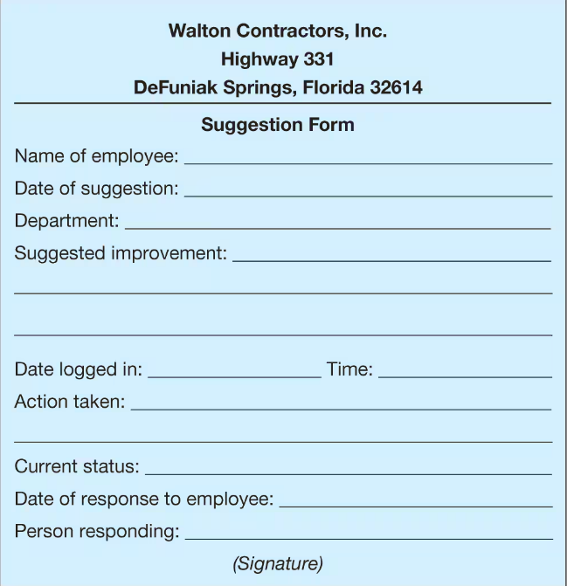
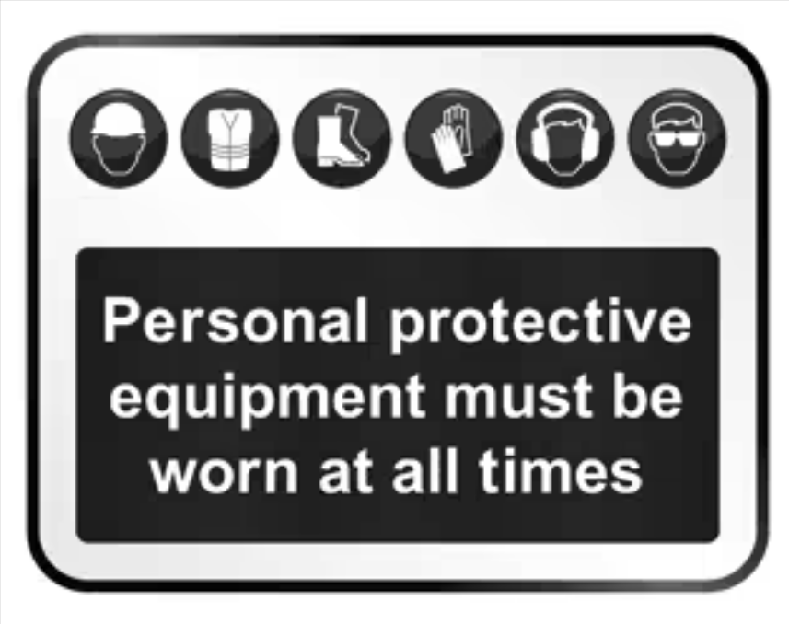
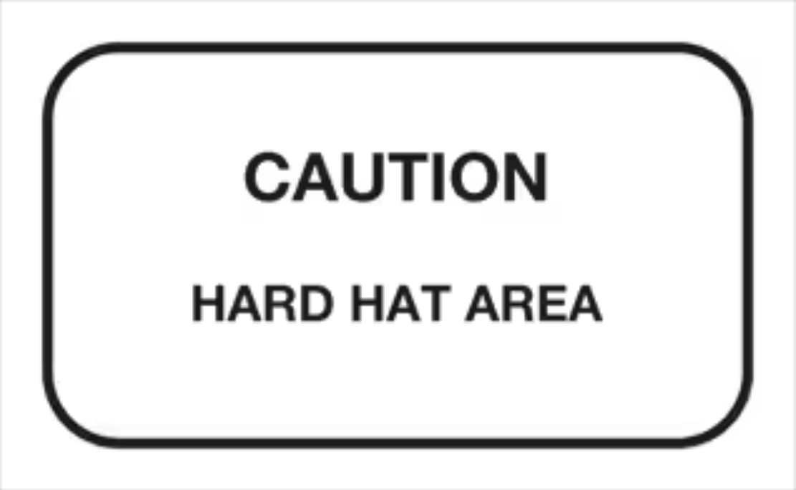
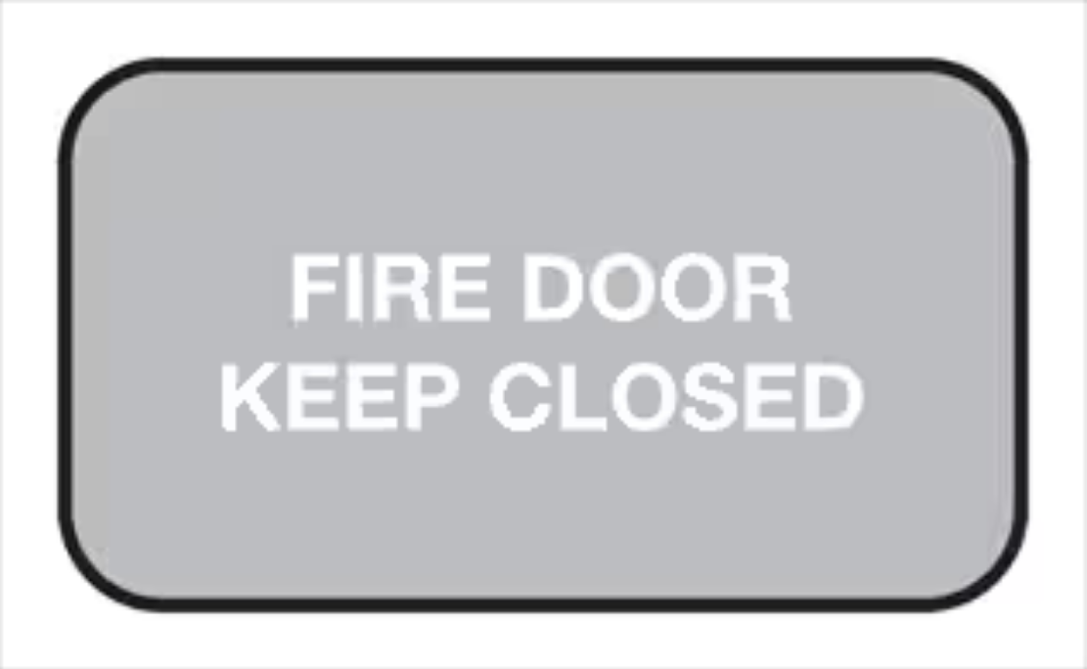
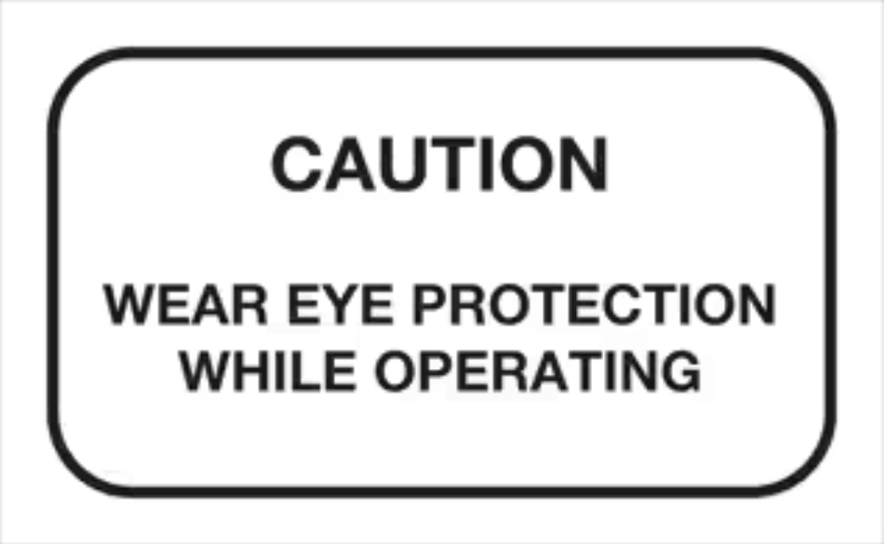
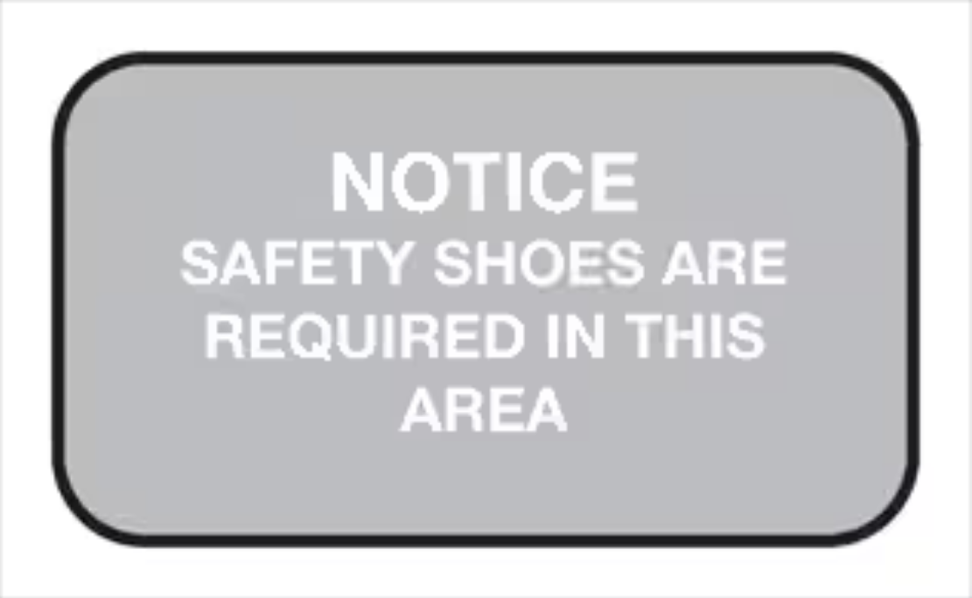
Suggestion Programs & Visual Awareness
GIVING THE MESSAGE A VOICE AND A FACE
Suggestion programs give employees ownership of safety — if every suggestion gets a formal, immediate response, costs/savings are reported, and good ideas are implemented.
Visual awareness uses signs and posters to keep safety top of mind — changed periodically, kept simple, sized and placed for maximum effect, and using color per OSHA standards.
Figure 12–3
Figures 12–3 through 12–8 — a sample suggestion form and five safety reminder signs.

Slide 6
Safety Committees
A FORMAL STRUCTURE FOR EMPLOYEE VOICE
The most effective committees have a broad cross section of workers representing all departments — giving every employee a representative voice. The safety director should advise and facilitate, never chair.
Meetings run on an agenda (call to order, minutes, old/new business, accidents and near misses, announcements, adjourn) because every member has another job waiting.
DO
Give the committee real authority, train members, reward participation, encourage trust and partnership.
DON'T
Let it act as “safety cops,” let one member dominate, rotate members too fast, or punish.

Slide 7
Commitment, Incentives & Competition
WINNING PERSONAL BUY-IN
Gaining a personal commitment — having employees sign a pledge — works because a signature is a written promise, and it gives coworkers permission to correct each other.
Incentives work when objectives and criteria are clear, rewards are meaningful, employees help plan them, and teams — not just individuals — are rewarded. OSHA is skeptical because poorly run incentives can cause underreporting.
Competition can motivate — but watch for teams hiding accidents to win. Make failing to report grounds for elimination.

Slide 8
The Cost of Not Keeping Records
Michigan School District
After a parent complained, the EPA investigated all 263 buildings in the district and found 256 had failed to properly monitor asbestos.
The EPA couldn't even tell whether the remaining schools had the same problem — because the district hadn't kept records.
Complaints from non-occupants of a building can result in fines just as large as those from employees.
$1.4M
EPA FINE

Slide 9
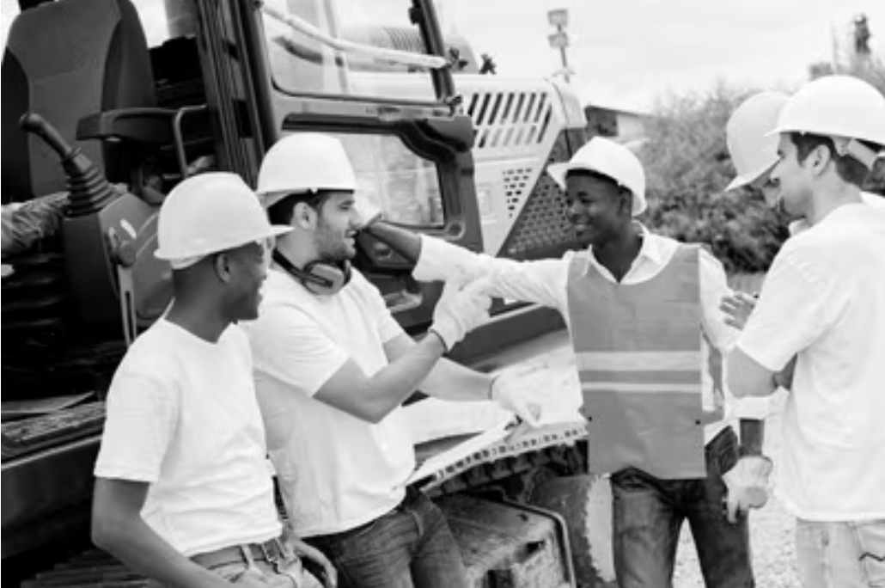
Teamwork
THE TEAMWORK APPROACH TO PROMOTING SAFETY
Effective teams share six characteristics: a supportive environment, team-player skills, role clarity, clear direction (a team charter), team-oriented rewards, and accountability.
Through teamwork, counterproductive internal competition gets replaced by collaboration — better rule understanding, visibility, awareness, and continual improvement.
One of the most common mistakes: building a teamwork culture on top of an individual-based reward system. Rewards have to be team-oriented too.
Figure 12–10
Teamwork promotes safety.

Slide 10
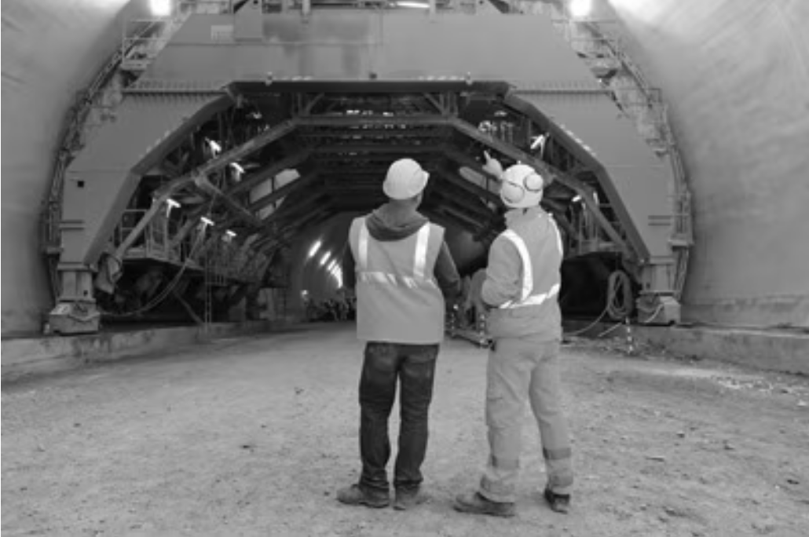
Mentoring for Safety
DEVELOPING PEOPLE, NOT JUST ENFORCING RULES
Mentoring is different from being a role model: it requires a face-to-face, one-on-one relationship with frequent contact — not just admirable qualities observed from afar.
Mentors communicate openly, listen, encourage, and help protégés set and reach realistic goals — while being a consistent safety-first role model themselves.
Parallel mentoring is mentoring between workers of equal rank — be a second pair of eyes and ears, work quietly to improve performance, and point out hazards in real time.
Figure 12–11
Effective mentoring can improve safety.

Slide 11
Safety in Construction Contracts
BUILDING SAFETY INTO THE PAPERWORK
Building safety requirements directly into contracts lets an owner or general contractor confirm it's working with contractors and subcontractors who give safety real priority.
Core requirements to build in: required safety meetings, monthly safety reports, required training, and mechanisms ensuring subcontractors meet safety requirements.
An approved safety plan should include: incident procedures, first aid, inspections, PPE, housekeeping, fire precautions, site access/security, waste disposal, material storage, lighting, and job-specific procedures.

Slide 12
Chapter Summary
A company's safety policy should convey company-wide commitment, the expectation of safe duty performance, and that the commitment includes customers and the community.
Employers must have safety rules, make all employees aware of them, and enforce them objectively and consistently.
“If you want employees to make a commitment, involve them from the start” — in rules, suggestions, committees, and teams alike.
Training, suggestion programs, and visual awareness each give employees a voice and keep safety visible.
Safety committees work best with a broad cross section of workers and real authority.
Incentives and competition can promote safety when objectives and criteria are clear and teams — not just individuals — are rewarded; both carry a real risk of accident underreporting.
Effective teams share a supportive environment, team-player skills, role clarity, clear direction, team-oriented rewards, and accountability.
Mentoring — including parallel mentoring among equals — builds the knowledge, skills, and attitudes employees need to work safely.
Building safety requirements directly into construction contracts signals to every stakeholder that safety is a priority on the project.

