Slide 1
Super-Convergence: Very Fast Training of Neural Networks Using Large Learning Rates
Leslie N. Smith, Nicholay Topin. arXiv:1708.07120v3, 2018

Slide 2
The paper's main question
Common concern: a large SGD step may make training unstable or cause it to diverge.
What authors observed: raising the learning rate and then lowering it can give good accuracy in far fewer iterations.
The authors call this unusually fast training super-convergence.

Slide 3
The usual learning rate schedule
Piecewise constant LR: the learning rate stays near 0.1 for a long time. When progress stalls, it is divided by ten.
Why it is slow: several long phases may be needed before the model reaches its final accuracy.
The paper tests whether a large LR used early can shorten training.

Slide 4
Cyclical learning rates
Phase | Learning rate | Length
First half | Linear rise from min to max | stepsize iterations
Second half | Linear fall from max to min | stepsize iterations
One CLR cycle has two equal length phases.
Min, max, and stepsize must be chosen before training.

Slide 5
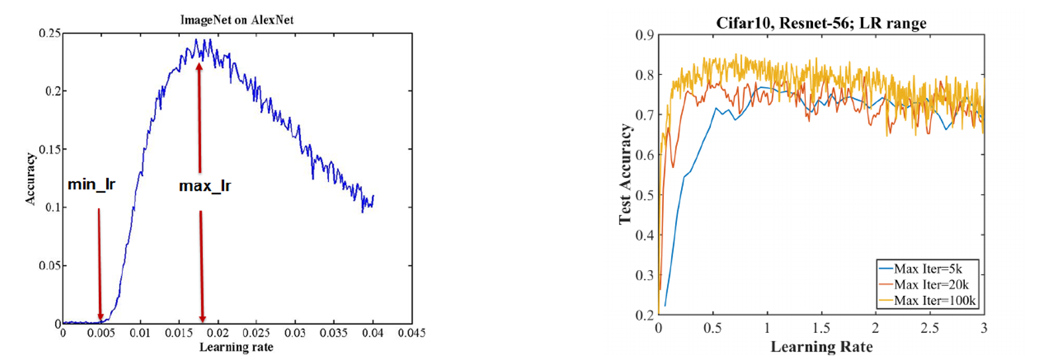
Choosing the learning rate bounds
Figure 2: a clear peak on the left; ResNet-56 remains accurate up to LR 3.0 on the right.
Set max near the peak and min roughly three to four times lower.

Slide 6
The 1cycle schedule
Phase | Learning rate | Purpose
1 | Rise from min to max | Fast progress and strong regularization
2 | Fall from max to min | Move toward a more precise solution
3 | Fall below the initial rate | Final stabilization
1cycle means one main cycle with a final low LR phase.

Slide 7
Momentum and other settings
Momentum: it usually falls as LR rises, then returns while LR falls.
MNIST example: LeNet, 12 epochs: LR 0.01-0.1, momentum 0.95-0.8, stepsize 5 epochs
LR, momentum, weight decay, and batch size affect each other..

Slide 8
Why a large LR may help
Authors explanation: large parameter updates may keep training away from narrow minima.
Practiccal consequence: increasing LR can require less weight decay or other regularization.
A larger LR is useful only while training remains stable.

Slide 9
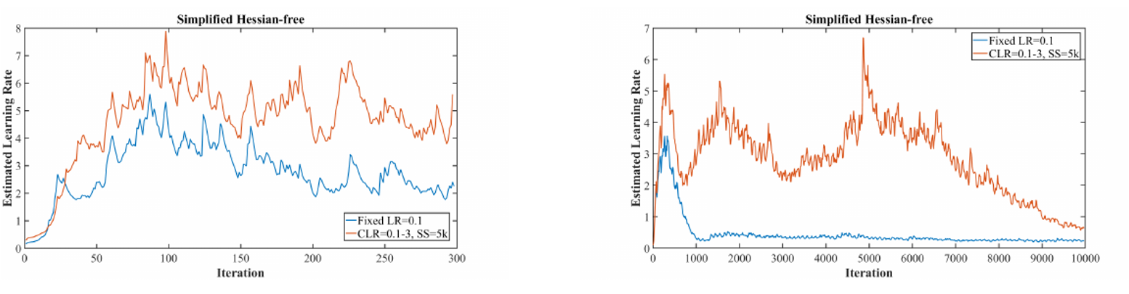
Estimating LR from curvature
Expression for one parameter
eps* = eps * (theta_(i+1) - theta_i) / (2 theta_(i+1) - theta_i - theta_(i+2))
Figure 3: the estimate reaches LR 2-6. This is an exploratory result.

Slide 10
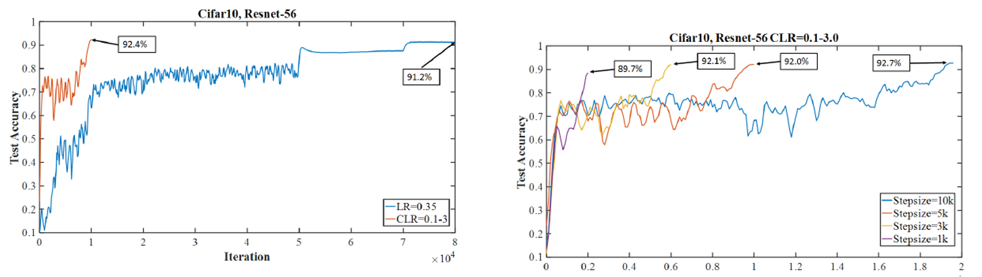
Main result: CIFAR-10 and ResNet-56
Figure 1: standard training reached 91.2% in 80,000 steps; CLR reached 92.4% in 10,000.
This comparison uses eight times fewer optimizer steps.

Slide 11
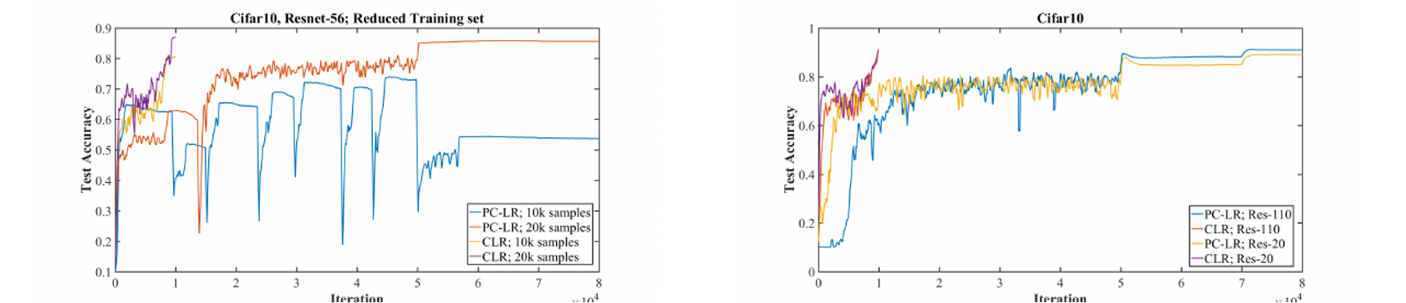
Results with less training data
Figure 4: the gap is especially clear with 10,000-20,000 images.
The next slide shows the exact values and a change in the BN setting.

Slide 12
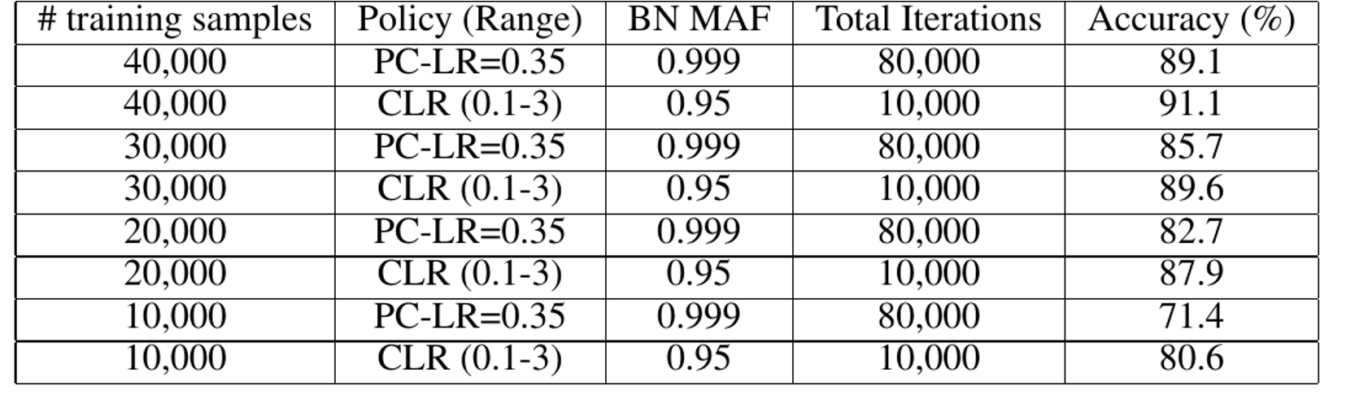
Table 1: limited training data
At 10,000 images: 71.4% versus 80.6%, a gap of 9.2 percentage points.
BN MAF also changes: 0.999 for PC-LR and 0.95 for CLR.

Slide 13
Other CIFAR-10 architectures
Architecture | Standard schedule | CLR / 1cycle
ResNet-20 | 88.6% | 90.4%
ResNet-110 | 91.0% | 92.1%
Wide ResNet | 90.3%, 800 epochs | 91.9%, 100 epochs
DenseNet | 92.7%, 400 epochs | 92.8%, 150 epochs
Several networks benefit, but the size of the gain varies.

Slide 14
CIFAR-100: accuracy by training length
Schedule | Epochs | Accuracy
Standard | 200 | 61.6%
1cycle | 25 | 65.4%
1cycle | 50 | 66.4%
1cycle | 100 | 69.0%
Even 25 epochs of 1cycle beat 200 epochs of standard training in this table.

Slide 15
MNIST and LeNet: Table 2
Schedule | Epochs | Accuracy
Inverse | 85 | 99.03%
Step | 85 | 99.00%
1cycle | 12 | 99.25%
1cycle | 25 | 99.28%
1cycle | 50 | 99.27%
1cycle, LR 0.02-0.2 | 85 | 99.35%
For 12 epochs: LR 0.01-0.1, momentum 0.95-0.8, stepsize 5 epochs.

Slide 16
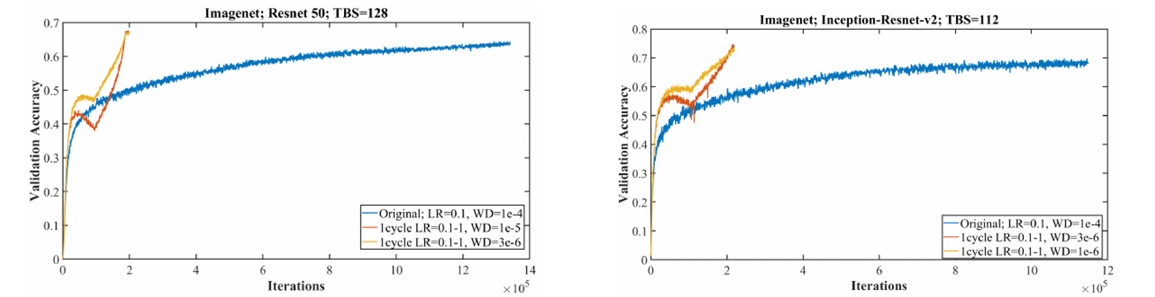
ImageNet: larger models
Figure 6: ResNet-50, 63.7% vs 67.6%; Inception-ResNet-v2, 67.6% vs 74.0%.
Weight decay also changed. The curves average two runs.

Slide 17
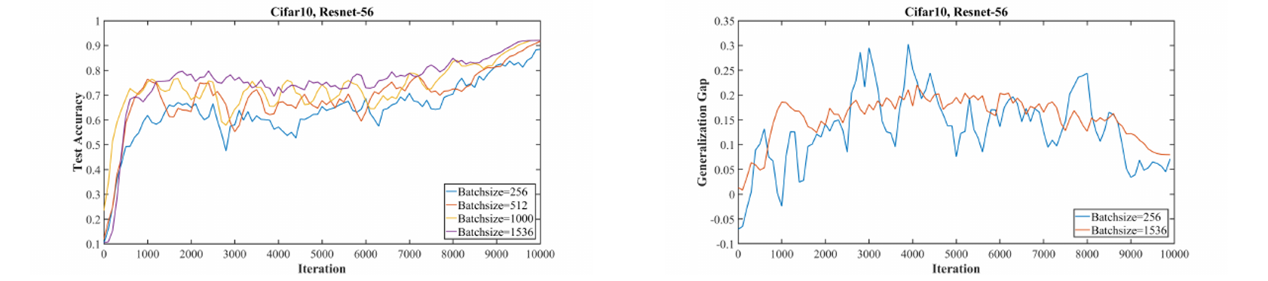
Batch size and batch normalization
Figure 5: larger batches worked better under these settings.
The authors also reduced BN moving_average_fraction from 0.999 to 0.95.

Slide 18
Takeaways from the paper
Run an LR range test and choose the bounds.
Use one rise-and-fall LR cycle.
Finish training and a very small LR.
Tune momentum, weight decay, and BN statistics.
Compare accuracy and training time with a baseline.
Main idea: a large LR can speed up training and act as a regularization.

