Slide 1
Chapter 14: Indexing

Slide 2
Outline
Basic Concepts
Ordered Indices
B⁺-Tree Index Files
B-Tree Index Files
Hashing
Write-optimized indices
Spatio-Temporal Indexing

Slide 3
Basic Concepts
Indexing mechanisms used to speed up access to desired data.
E.g., author catalog in library
Search Key - attribute to set of attributes used to look up records in a file.
An index file consists of records (called index entries) of the form
Index files are typically much smaller than the original file
Two basic kinds of indices:
Ordered indices: search keys are stored in sorted order
Hash indices: search keys are distributed uniformly across “buckets” using a “hash function”.
search-key
pointer

Slide 4
Index Evaluation Metrics
Access types supported efficiently. E.g.,
Records with a specified value in the attribute
Records with an attribute value falling in a specified range of values.
Access time
Insertion time
Deletion time
Space overhead
The whole idea states,
How and which types of data can be stored, should be stored and how to store so that performance related metrics can give better output.

Slide 5
Ordered Indices
In an ordered index, index entries are stored sorted on the search key value.
Clustering index (Dictator of Physical Order): in a sequentially ordered file, the index whose search key specifies the sequential order of the file. In simple terms, let us assume, we are storing a table(file) in DB. The attribute (indexed over this) over which the table is sorted and kept in DB, that indexed attribute is Clustering Index/Primary Index.
The search key of a primary index is usually but not necessarily the primary key. Primary Key can be different. In default setup, often primary key is primary index/clustering index.
Secondary index/ Nonclustering Index: an index whose search key specifies an order different from the sequential order of the file.
Index-sequential file: sequential file ordered on a search key, with a clustering index on the search key.

Slide 6
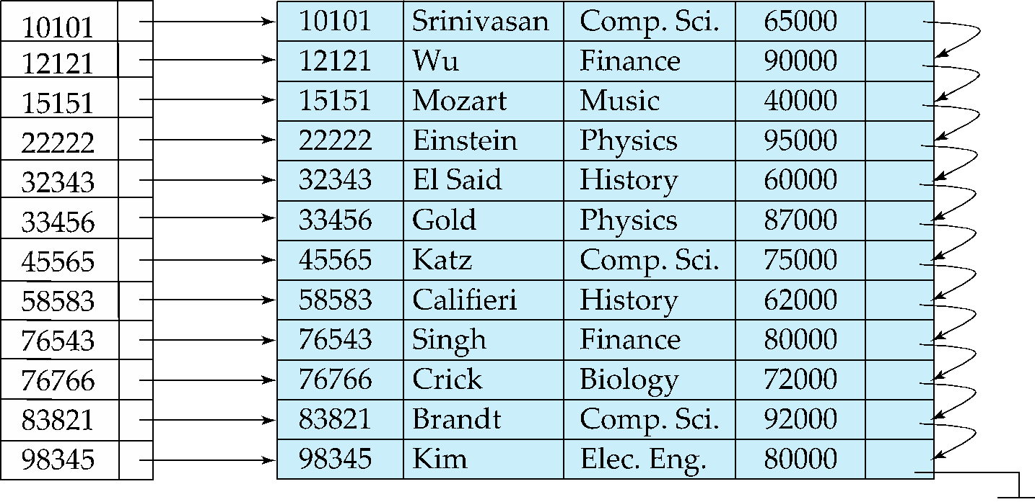
Dense Index Files
Dense index — Index record appears for every search-key value in the file.
E.g. index on ID attribute of instructor relation
Direct Location Mapping.

Slide 7
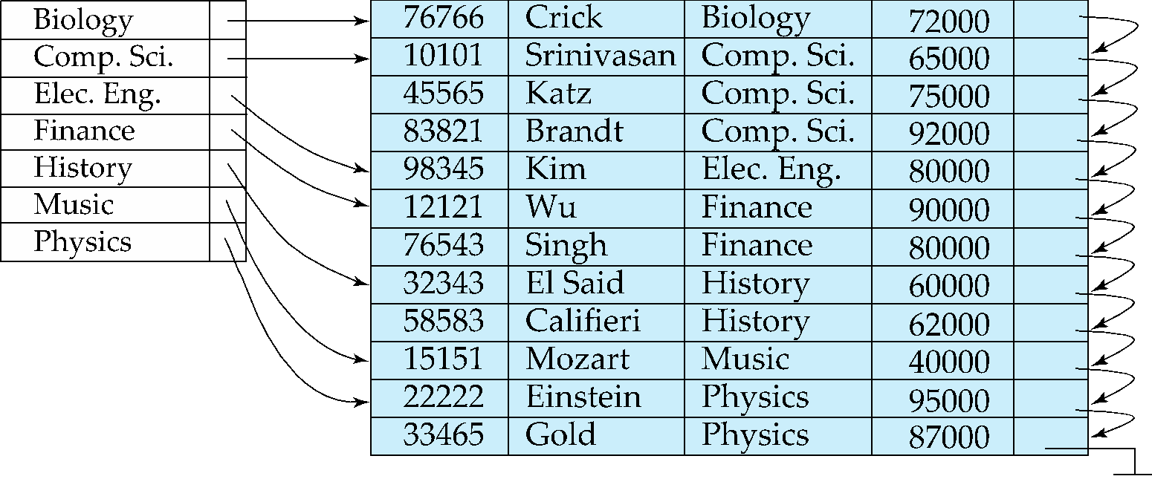
Dense Index Files (Cont.)
Dense index on dept_name, with instructor file sorted on dept_name
Similar values are grouped to make the searching efficient and faster

Slide 8
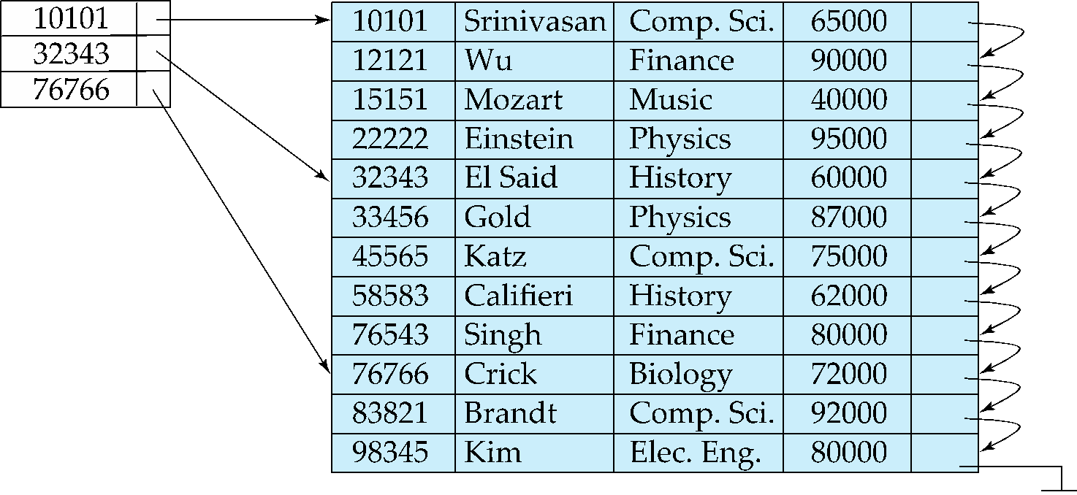
Sparse Index Files
Sparse Index: contains index records for only some search-key values.
Applicable when records are sequentially ordered on search-key
To locate a record with search-key value K we:
Find index record with largest search-key value < K [lower bound]
Search file sequentially starting at the record to which the index record points [sequential searching]

Slide 9
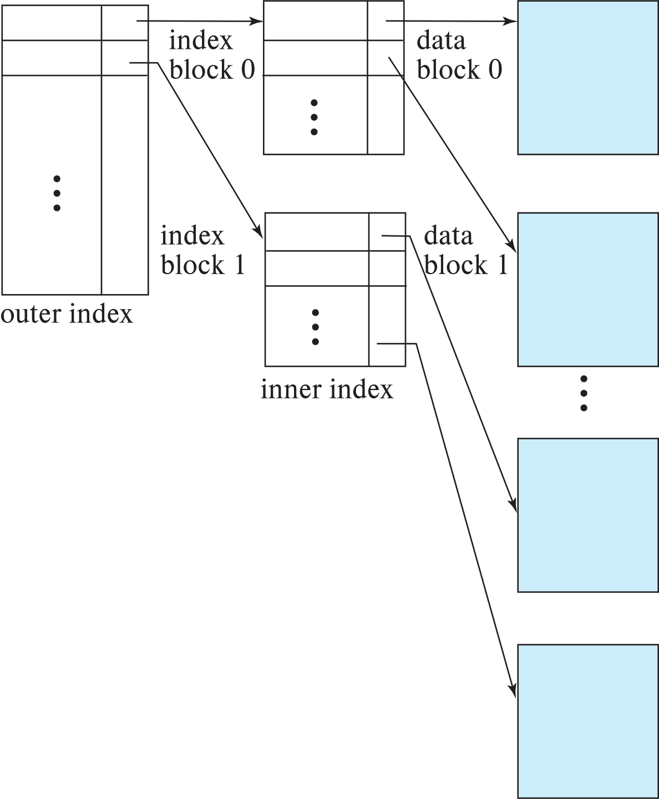
Sparse Index Files (Cont.)
Compared to dense indices:
Less space and less maintenance overhead for insertions and deletions.
Generally slower than dense index for locating records.
Good tradeoff:
for clustered index: sparse index with an index entry for every block in file, corresponding to least search-key value in the block.
For unclustered index: sparse index on top of dense index (multilevel index)
Get the group and then directly point.

Slide 10
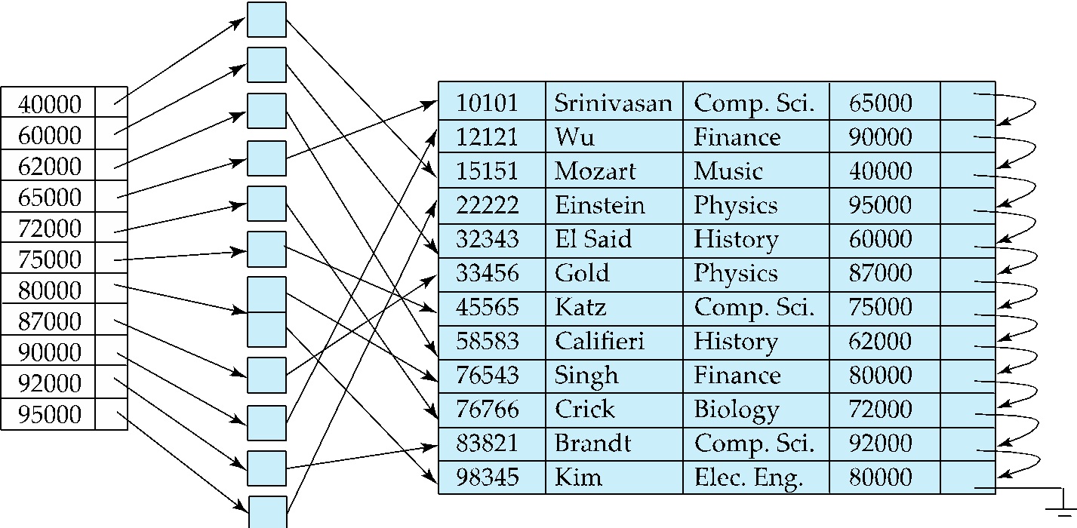
Secondary Indices Example
Secondary index on salary field of instructor
Index record points to a bucket that contains pointers to all the actual records with that particular search-key value.
Secondary indices have to be dense

Slide 11
Clustering vs Nonclustering Indices
Indices offer substantial benefits when searching for records.
BUT: indices imposes overhead on database modification
when a record is inserted or deleted, every index on the relation must be updated
When a record is updated, any index on an updated attribute must be updated
Sequential scan using clustering index is efficient, but a sequential scan using a secondary (nonclustering) index is expensive on magnetic disk
Each record access may fetch a new block from disk
Each block fetch on magnetic disk requires about 5 to 10 milliseconds

Slide 12
Multilevel Index
If index does not fit in memory, access becomes expensive.
Solution: treat index kept on disk as a sequential file (Dense) and construct a sparse index on it (sparse).
outer index – a sparse index of the basic index
inner index – the basic index file
If even outer index is too large to fit in main memory, yet another level of index can be created, and so on. (sparse -> sparse -> …. ->Dense)
Indices at all levels must be updated on insertion or deletion from the file.
WHENEVER YOU CAN NOT FIT, MAKE IT SPARSER AND INCREASE LEVEL FOR SEARCHING

Slide 13
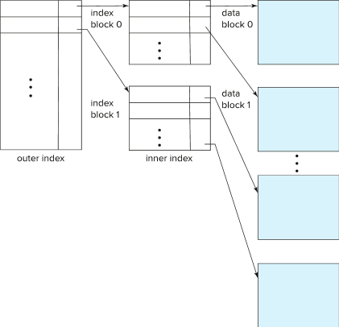
Multilevel Index (Cont.)

Slide 14
Index Update: Deletion
If deleted record was the only record in the file with its particular search-key value, the search-key is deleted from the index also.
Single-level index entry deletion:
Dense indices – deletion of search-key is similar to file record deletion. [ALMOST 1 vs 1 MAPPING]
Sparse indices –
Next Search Key Case: if an entry for the search key exists in the index, it is deleted by replacing the entry in the index with the next search-key value in the file (in search-key order).
Full Search Key Deletion Case: If the next search-key value already has an index entry, the entry is deleted instead of being replaced.

Slide 15
Index Update: Insertion
Single-level index insertion:
Perform a lookup using the search-key value of the record to be inserted.
Dense indices – if the search-key value does not appear in the index, insert it
Indices are maintained as sequential files
Need to create space for new entry, overflow blocks may be required
Sparse indices – if index stores an entry for each block of the file, no change needs to be made to the index unless a new block is created.
If a new block is created, the first search-key value appearing in the new block is inserted into the index.
Multilevel insertion and deletion: algorithms are simple extensions of the single-level algorithms

Slide 16
Indices on Multiple Keys
Composite search key
E.g., index on instructor relation on attributes (name, ID)
Values are sorted lexicographically
E.g. (John, 12121) < (John, 13514) and (John, 13514) < (Peter, 11223)
Can query on just name, or on (name, ID)

Slide 17
B⁺-Tree Index Files
Disadvantage of indexed-sequential files
Performance degrades as file grows, since many overflow blocks get created.
Periodic reorganization of entire file is required.
Advantage of B⁺-tree index files:
Automatically reorganizes itself with small, local, changes, in the face of insertions and deletions.
Reorganization of entire file is not required to maintain performance.
(Minor) disadvantage of B⁺-trees:
Extra insertion and deletion overhead, space overhead.
Advantages of B⁺-trees outweigh disadvantages
B⁺-trees are used extensively

Slide 18
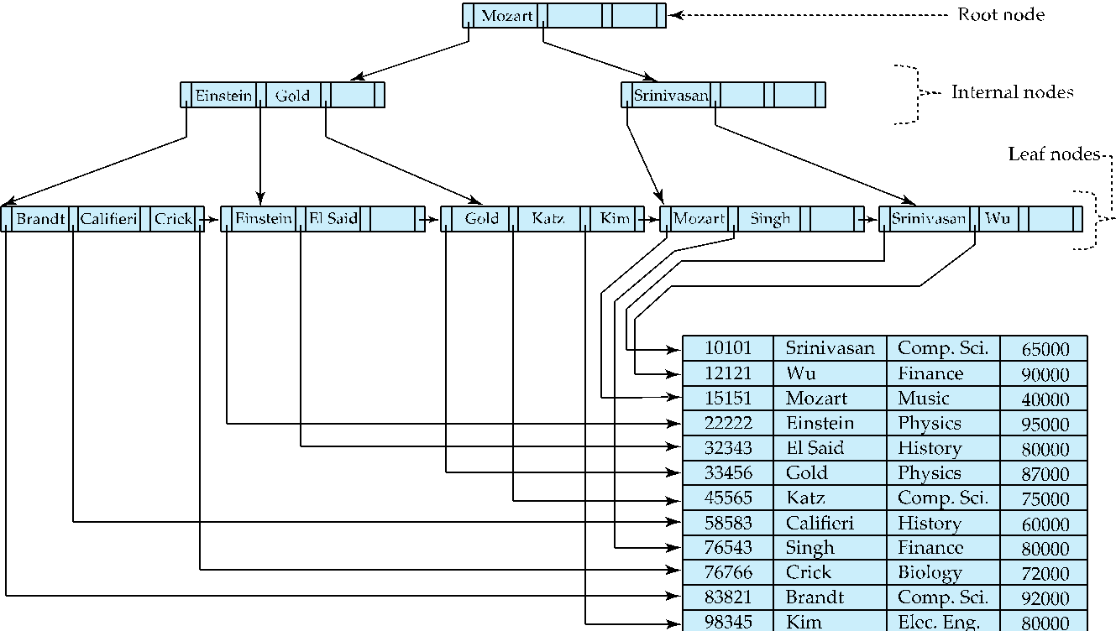
Example of B⁺-Tree

Slide 19
B⁺-Tree Index Files (Cont.)
A B⁺-tree is a rooted tree satisfying the following properties:
All paths from root to leaf are of the same length
Each node that is not a root or a leaf has between ⎡n/2⎤ and n children.
A leaf node has between ⎡(n–1)/2⎤ and n–1 values
Special cases:
If the root is not a leaf, it has at least 2 children.
If the root is a leaf (that is, there are no other nodes in the tree), it can have between 0 and (n–1) values.
At least half full

Slide 20
B⁺-Tree Node Structure
Typical node
K_{i} are the search-key values
P_{i} are pointers to children (for non-leaf nodes) or pointers to records or buckets of records (for leaf nodes).
The search-keys in a node are ordered
K₁ < K₂ < K₃ < . . . < K_{n–1}
(Initially assume no duplicate keys, address duplicates later)

Slide 21
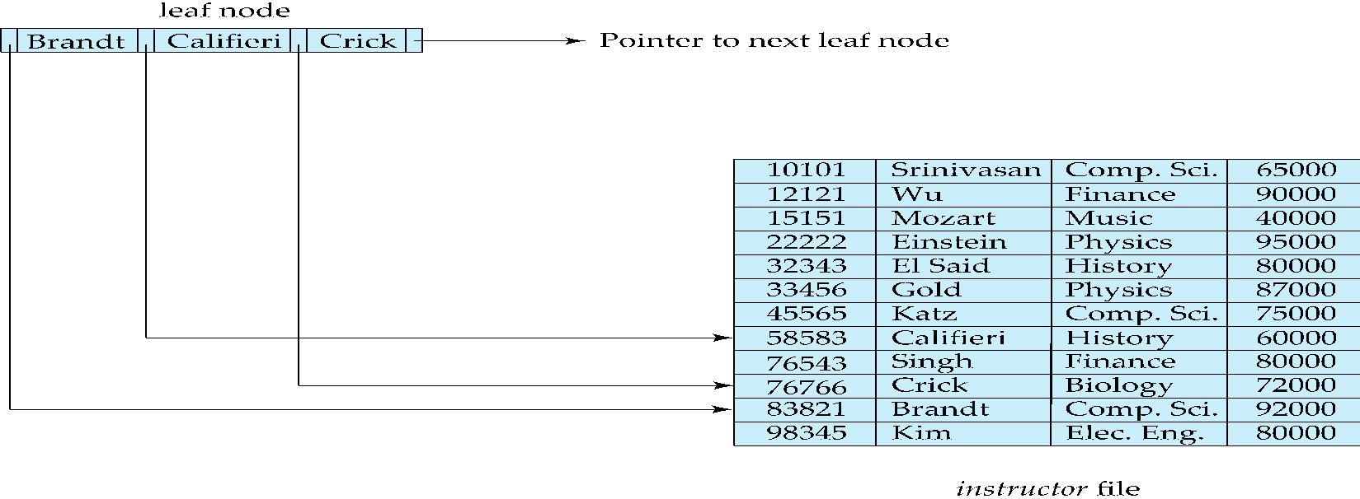
Leaf Nodes in B⁺-Trees
Properties of a leaf node:
For i = 1, 2, . . ., n–1, pointer P_{i} points to a file record with search-key value K_{i},
If L_{i}, L_{j} are leaf nodes and i < j, L_{i}’s search-key values are less than or equal to L_{j}’s search-key values
P_{n} points to next leaf node in search-key order
Pointer to next leaf node

Slide 22
Non-Leaf Nodes in B⁺-Trees
Non leaf nodes form a multi-level sparse index on the leaf nodes. For a non-leaf node with m pointers:
All the search-keys in the subtree to which P₁ points are less than K₁
For 2 ≤ i ≤ n – 1, all the search-keys in the subtree to which P_{i} points have values greater than or equal to K_{i–1} and less than K_{i}
All the search-keys in the subtree to which P_{n} points have values greater than or equal to K_{n–1}
General structure

Slide 23
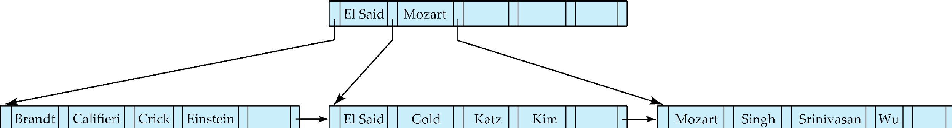
Example of B⁺-tree
B⁺-tree for instructor file (n = 6)
Leaf nodes must have between 3 and 5 values (⎡(n–1)/2⎤ and n –1, with n = 6).
Non-leaf nodes other than root must have between 3 and 6 children (⎡(n/2⎤ and n with n =6).
Root must have at least 2 children.

Slide 24
Observations about B⁺-trees
Since the inter-node connections are done by pointers, “logically” close blocks need not be “physically” close.
The non-leaf levels of the B⁺-tree form a hierarchy of sparse indices.
The B⁺-tree contains a relatively small number of levels
Level below root has at least 2* ⎡n/2⎤ values
Next level has at least 2* ⎡n/2⎤ * ⎡n/2⎤ values
.. etc.
If there are K search-key values in the file, the tree height is no more than ⎡ log_{⎡n/2⎤}(K)⎤
thus searches can be conducted efficiently.
Insertions and deletions to the main file can be handled efficiently, as the index can be restructured in logarithmic time (as we shall see).

Slide 25
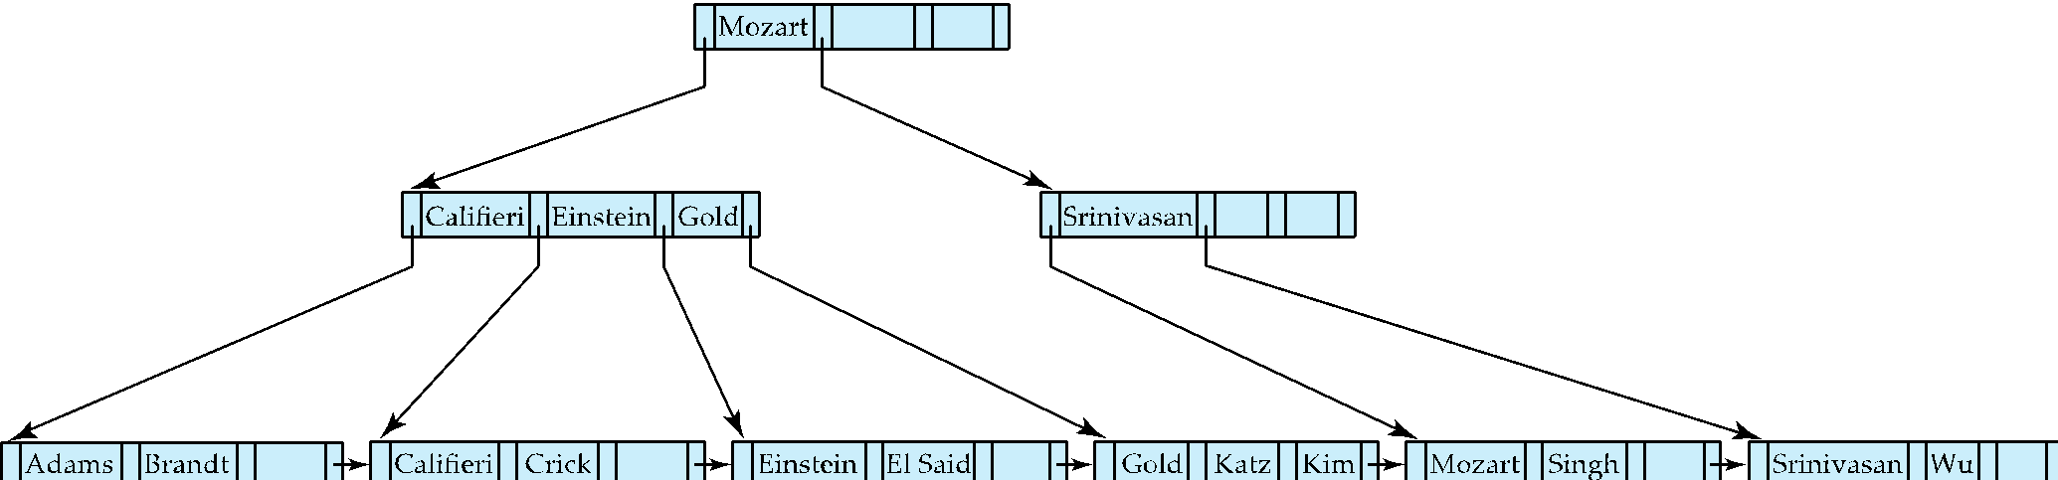
Queries on B⁺-Trees
function find(v)
1. C=root
2. while (C is not a leaf node)
Let i be least number s.t. V ≤ K_{i}.
if there is no such number i then
Set C = last non-null pointer in C
else if (v = C.K_{i} ) Set C = P_{i +1}
else set C = C.P_{i}
3. if for some i, K_{i} = V then return C.P_{i}
4. else return null /* no record with search-key value v exists. */

Slide 26
Queries on B⁺-Trees (Cont.)
Range queries find all records with search key values in a given range
See book for details of function findRange(lb, ub) which returns set of all such records
Real implementations usually provide an iterator interface to fetch matching records one at a time, using a next() function

Slide 27
Function Range Query
function range_query(v_low, v_high):
1. C = root
2. while (C is not a leaf node):
Let i be the least number such that v_low ≤ C.K_{i}
if no such i exists:
C = last non-null pointer in C
else if v_low == C.K_{i}:
C = C.P_{i+1}
else:
C = C.P_{i}
3. results = []
4. while (C is not null):
for i = 0 to len(C.K) - 1: // traversing all the search keys
if C.K_{i} > v_high:
return results
if C.K_{i} ≥ v_low:
results.append(C.Pi) // or C.values[i], data collection
C = C.next_leaf // link to move another leaf
5. return results

Slide 28
Queries on B⁺⁻Trees (Cont.)
If there are K search-key values in the file, the height of the tree is no more than ⎡log_{⎡n/2⎤}(K)⎤.
A node is generally the same size as a disk block, typically 4 kilobytes
and n is typically around 100 (40 bytes per index entry).
With 1 million search key values and n = 100
at most log₅₀(1,000,000) = 4 nodes are accessed in a lookup traversal from root to leaf.
Contrast this with a balanced binary tree with 1 million search key values — around 20 nodes are accessed in a lookup
above difference is significant since every node access may need a disk I/O, costing around 20 milliseconds

Slide 29
Non-Unique Keys
If a search key a_{i} is not unique, create instead an index on a composite key (a_{i} , A_{p}), which is unique
A_{p} could be a primary key, record ID, or any other attribute that guarantees uniqueness
Search for a_{i} = v can be implemented by a range search on composite key, with range (v, - ∞) to (v, + ∞)
But more I/O operations are needed to fetch the actual records
If the index is clustering, all accesses are sequential. It means that data is orderly stored by this index in the disk, so sequential access will provide all the data.
If the index is non-clustering, each record access may need an I/O operation. The data is stored by a different ordering scheme, to get the complete set of data, multiple disk based I/O might be required.

Slide 30
Updates on B⁺-Trees: Insertion
Assume record already added to the file. Let
pr be pointer to the record, and let
v be the search key value of the record
Find the leaf node in which the search-key value would appear
If there is room in the leaf node, insert (v, pr) pair in the leaf node
Otherwise, split the node (along with the new (v, pr) entry) as discussed in the next slide, and propagate updates to parent nodes.

Slide 31
Updates on B⁺-Trees: Insertion (Cont.)
Splitting a leaf node:
take the n (search-key value, pointer) pairs (including the one being inserted) in sorted order. Place the first ⎡n/2⎤ in the original node, and the rest in a new node.
let the new node be p, and let k be the least key value in p. Insert (k,p) in the parent of the node being split.
If the parent is full, split it and propagate the split further up.
Splitting of nodes proceeds upwards till a node that is not full is found.
In the worst case the root node may be split increasing the height of the tree by 1.
Result of splitting node containing Brandt, Califieri and Crick on inserting Adams
Next step: insert entry with (Califieri, pointer-to-new-node) into parent

Slide 32

B⁺-Tree Insertion
Affected nodes
B⁺-Tree before and after insertion of “Adams”

Slide 33
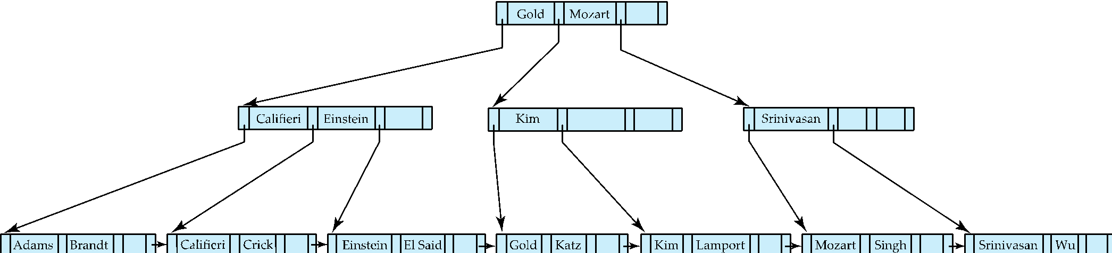
B⁺-Tree Insertion
B⁺-Tree before and after insertion of “Lamport”
Affected nodes
Affected nodes

Slide 34
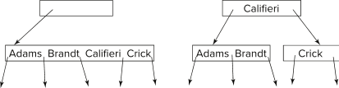
Insertion in B⁺-Trees (Cont.)
Splitting a non-leaf node: when inserting (k,p) into an already full internal node N
Copy N to an in-memory area M with space for n+1 pointers and n keys
Insert (k,p) into M
Copy P₁,K₁, …, K _{⎡n/2⎤-1},P _{⎡n/2⎤} from M back into node N
Copy P_{⎡n/2⎤+1},K _{⎡n/2⎤+1},…,K_{n},P_{n+1} from M into newly allocated node N'
Insert (K _{⎡n/2⎤},N') into parent N
Example
Read pseudocode in book!

Slide 35
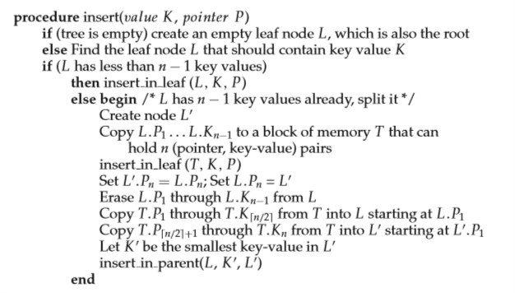
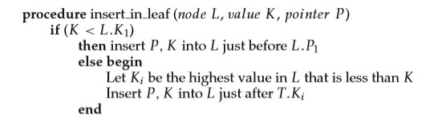
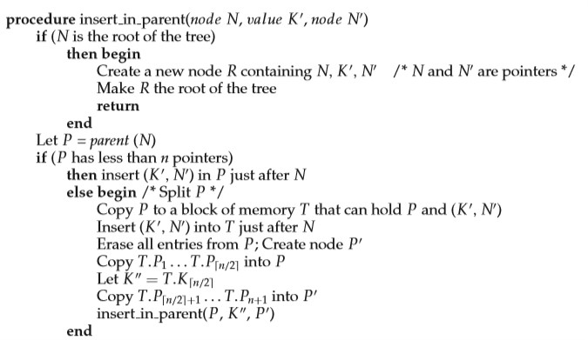

Slide 36
B+ Tree Deletion Steps
Step 1: Find and Delete the Key from the Leaf
Use standard search to locate the leaf node containing the key.
Remove the key from that leaf.
Step 2: Check for Underflow
Each node (except the root) must have at least ⌈n/2⌉ keys. If a node has fewer keys after deletion:
You have 2 options:
2A. Redistribute (Borrow from Sibling)
If a sibling (left or right) has more than the minimum number of keys, borrow a key:
Adjust the separating key in the parent node.
This is preferred as it's local and doesn’t shrink the tree height.
2B. Merge (Coalesce with Sibling)
If no sibling has extra keys, merge with one:
Combine the underflowing node and a sibling.
Remove the corresponding key in the parent.
This may recursively cause underflow in the parent.
Step 3: Propagate Upward (if merge affects parent)
If you removed a key from an internal node due to a merge, repeat Steps 2A/2B on the parent.
If the root becomes empty and has only one child → make that child the new root (tree shrinks in height).

Slide 37
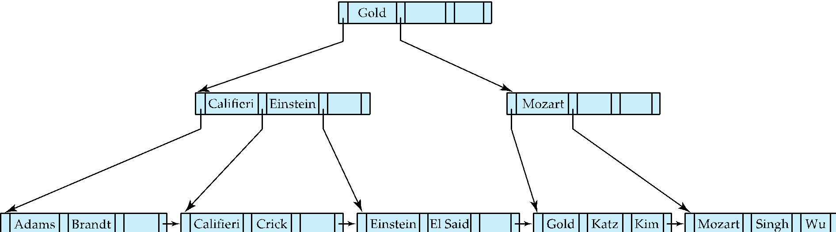
Examples of B⁺-Tree Deletion
Before and after deleting “Srinivasan”
Affected nodes
Deleting “Srinivasan” causes merging of under-full leaves

Slide 38
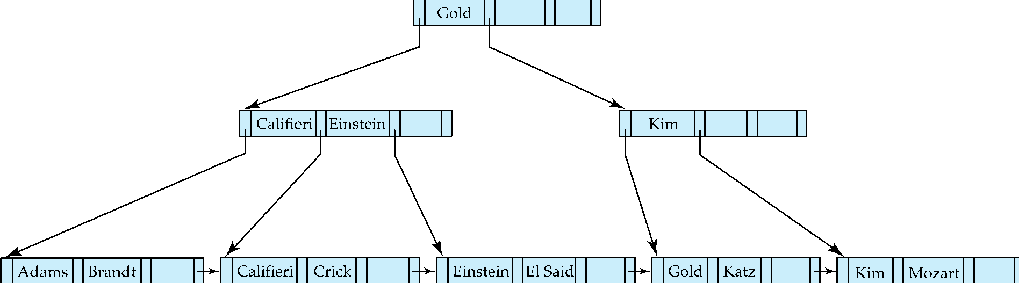
Examples of B⁺-Tree Deletion (Cont.)
Before and after deleting “Singh” and “Wu”
Affected nodes
Leaf containing Singh and Wu became underfull, and borrowed a value Kim from its left sibling
Search-key value in the parent changes as a result

Slide 39
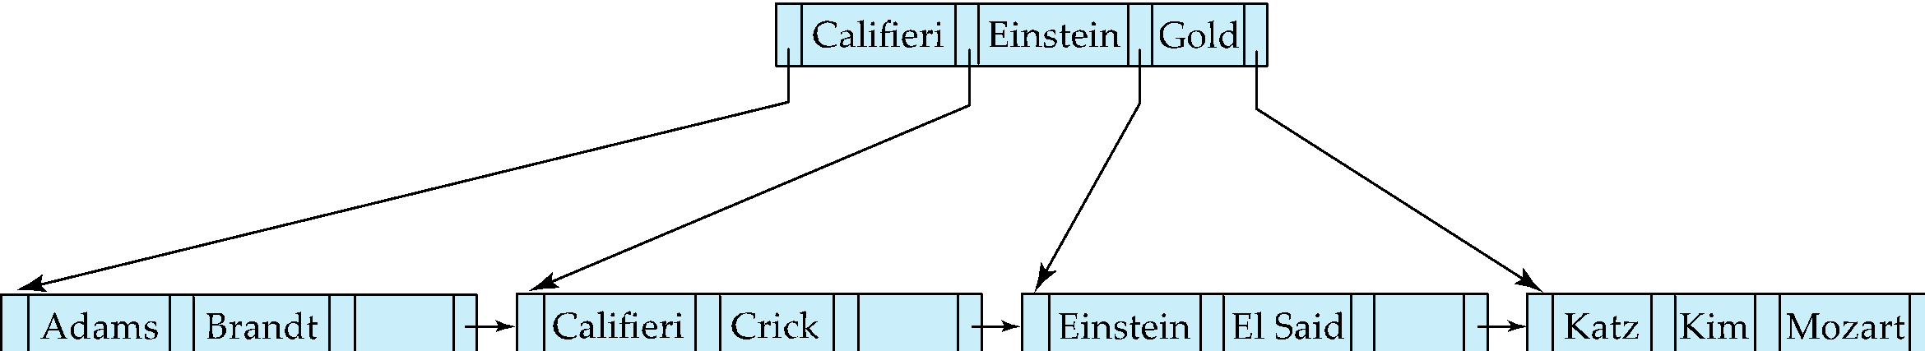
Example of B⁺-tree Deletion (Cont.)
Before and after deletion of “Gold”
Node with Gold and Katz became underfull, and was merged with its sibling
Parent node becomes underfull, and is merged with its sibling
Value separating two nodes (at the parent) is pulled down when merging
Root node then has only one child, and is deleted

Slide 40
Updates on B⁺-Trees: Deletion
Assume record already deleted from file. Let V be the search key value of the record, and Pr be the pointer to the record.
Remove (Pr, V) from the leaf node
If the node has too few entries due to the removal, and the entries in the node and a sibling fit into a single node, then merge siblings:
Insert all the search-key values in the two nodes into a single node (the one on the left), and delete the other node.
Delete the pair (K_{i–1}, P_{i}), where P_{i} is the pointer to the deleted node, from its parent, recursively using the above procedure.

Slide 41
Updates on B⁺-Trees: Deletion
Otherwise, if the node has too few entries due to the removal, but the entries in the node and a sibling do not fit into a single node, then redistribute pointers:
Redistribute the pointers between the node and a sibling such that both have more than the minimum number of entries.
Update the corresponding search-key value in the parent of the node.
The node deletions may cascade upwards till a node which has ⎡n/2⎤ or more pointers is found.
If the root node has only one pointer after deletion, it is deleted and the sole child becomes the root.

Slide 42
Examples
Example Links: https://github.com/rizveeredwan/course-contents/tree/main/CSE-3104/Slides/Ch-14%20Examples

Slide 43
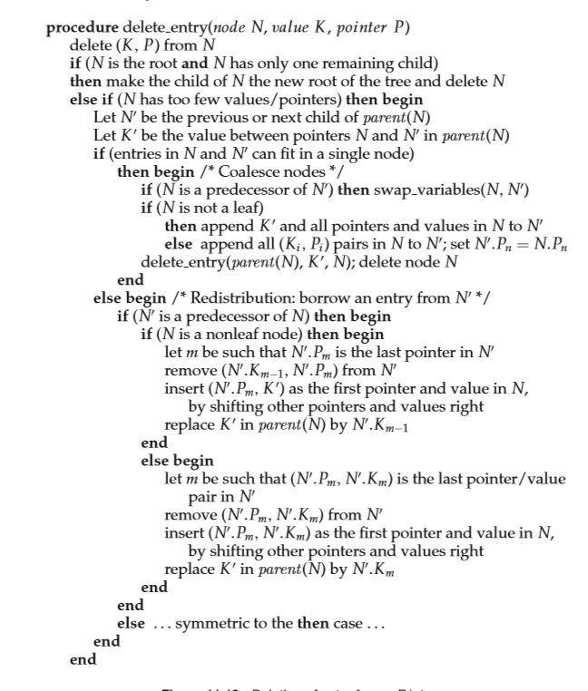

Deletion Pseudocode

Slide 44
Complexity of Updates
Cost (in terms of number of I/O operations) of insertion and deletion of a single entry proportional to height of the tree
With K entries and maximum fanout of n, worst case complexity of insert/delete of an entry is O(log_{⎡n/2⎤}(K))
In practice, number of I/O operations is less:
Internal nodes tend to be in buffer
Splits/merges are rare, most insert/delete operations only affect a leaf node
Average node occupancy depends on insertion order
2/3rds with random, ½ with insertion in sorted order

Slide 45
Non-Unique Search Keys
Alternatives to scheme described earlier
Buckets on separate block (bad idea)
List of tuple pointers with each key
Extra code to handle long lists
Deletion of a tuple can be expensive if there are many duplicates on search key (why?)
Worst case complexity may be linear!
Low space overhead, no extra cost for queries
Make search key unique by adding a record-identifier
Extra storage overhead for keys
Simpler code for insertion/deletion
Widely used
Notes:
‹#›

Slide 46
B⁺-Tree File Organization
B⁺-Tree File Organization:
Leaf nodes in a B⁺-tree file organization store records, instead of pointers
Helps keep data records clustered even when there are insertions/deletions/updates
Leaf nodes are still required to be half full
Since records are larger than pointers, the maximum number of records that can be stored in a leaf node is less than the number of pointers in a nonleaf node.
Insertion and deletion are handled in the same way as insertion and deletion of entries in a B⁺-tree index.

Slide 47
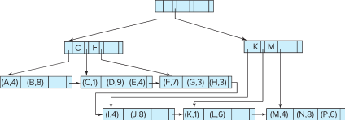
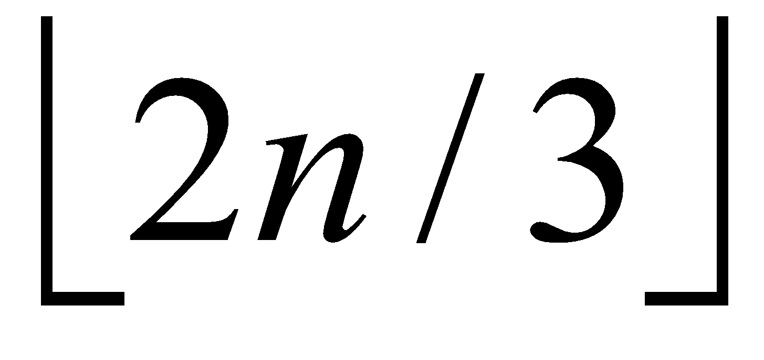
B⁺-Tree File Organization (Cont.)
Example of B+-tree File Organization
Good space utilization is important since records use more space than pointers.
To improve space utilization, involve more sibling nodes in redistribution during splits and merges
Involving 2 siblings in redistribution (to avoid split / merge where possible) results in each node having at least entries

Slide 48
Other Issues in Indexing
Record relocation and secondary indices
Cost Issue: If a record moves, all secondary indices that store record pointers have to be updated
Node splits in B⁺-tree file organizations become very expensive
Solution: use search key of B⁺-tree file organization instead of record pointer in secondary index. Secondary index will hold a search key. Through that search key, traverse the B+-Tree and get the actual file record.
Add record-id if B⁺-tree file organization search key is non-unique
Extra traversal of file organization to locate record
Higher cost for queries, but node splits are cheap (In the basic setting, adjusting the pointers everywhere become very expensive operation otherwise)
Notes:
‹#›

Slide 49
Indexing Strings
Variable length strings as keys
Variable fanout
Use space utilization as criterion for splitting, not number of pointers
Prefix compression
Key values at internal nodes can be prefixes of full key
Keep enough characters to distinguish entries in the subtrees separated by the key value
E.g., “Silas” and “Silberschatz” can be separated by “Silb”
Keys in leaf node can be compressed by sharing common prefixes

Slide 50
Bulk Loading and Bottom-Up Build
Inserting entries one-at-a-time into a B⁺-tree requires ≥ 1 I/O per entry
assuming leaf level does not fit in memory
can be very inefficient for loading a large number of entries at a time (bulk loading) as for each entry an I/O operation would be required.
Efficient alternative 1:
sort entries first (using efficient external-memory sort algorithms discussed later in Section 12.4)
insert in sorted order
Entries go left to right, hitting the same or adjacent leaf pages, which can be cached in memory.Fewer node splits since keys are in order. Greatly reduces random disk access.
insertion will go to existing page (or cause a split)
much improved I/O performance, but most leaf nodes half full
Efficient alternative 2: Bottom-up B⁺-tree construction
As before sort entries
And then create tree layer-by-layer, starting with leaf level
details as an exercise
Implemented as part of bulk-load utility by most database systems

Slide 51
Bulk Loading and Bottom-Up Build (Cont.)
Efficient alternative 2: Bottom-up B⁺-tree construction
Sort the entries by key (same as before).
Build the leaf level first by:
Filling pages completely (except possibly the last one).
Creating leaf nodes one after another from sorted data.
Then build the next level up:
Take the first key of each leaf node (which acts as a separator or pointer) and create the parent nodes.
Repeat this layer-by-layer, until you reach the root.
Benefits:
Very few disk I/Os, because there are no splits.
Leaf and internal nodes are fully packed, which is space efficient.
Performance is close to optimal — O(N) I/Os.

Slide 52
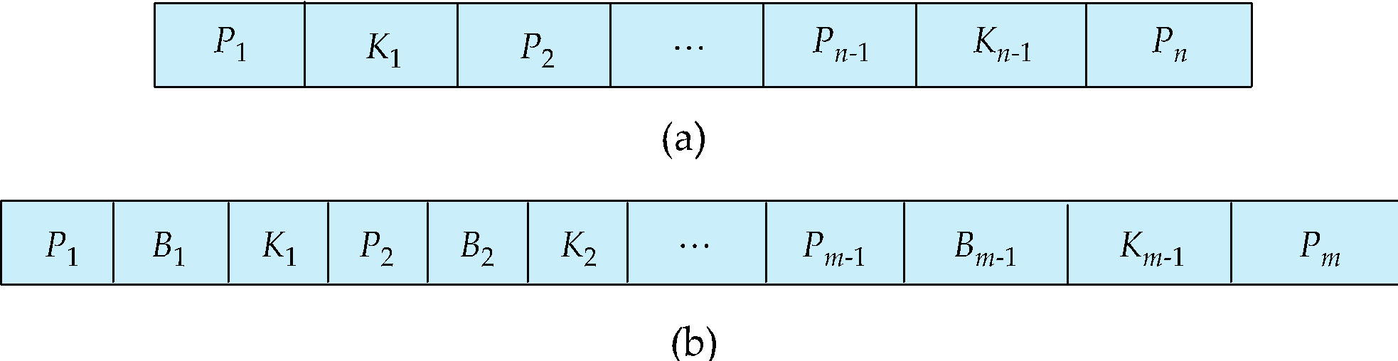
B-Tree Index Files
Similar to B+-tree, but B-tree allows search-key values to appear only once; eliminates redundant storage of search keys.
Search keys in nonleaf nodes appear nowhere else in the B-tree; an additional pointer field for each search key in a nonleaf node must be included.
Generalized B-tree leaf node
Nonleaf node – pointers Bi are the bucket or file record pointers.

Slide 53
B-Tree Index Files (Cont.)
Advantages of B-Tree indices:
May use less tree nodes than a corresponding B⁺-Tree.
Sometimes possible to find search-key value before reaching leaf node.
Disadvantages of B-Tree indices:
Only small fraction of all search-key values are found early
Non-leaf nodes are larger, so fan-out is reduced. Thus, B-Trees typically have greater depth than corresponding B⁺-Tree
Insertion and deletion more complicated than in B⁺-Trees
Implementation is harder than B⁺-Trees.
Typically, advantages of B-Trees do not out weigh disadvantages.

Slide 54
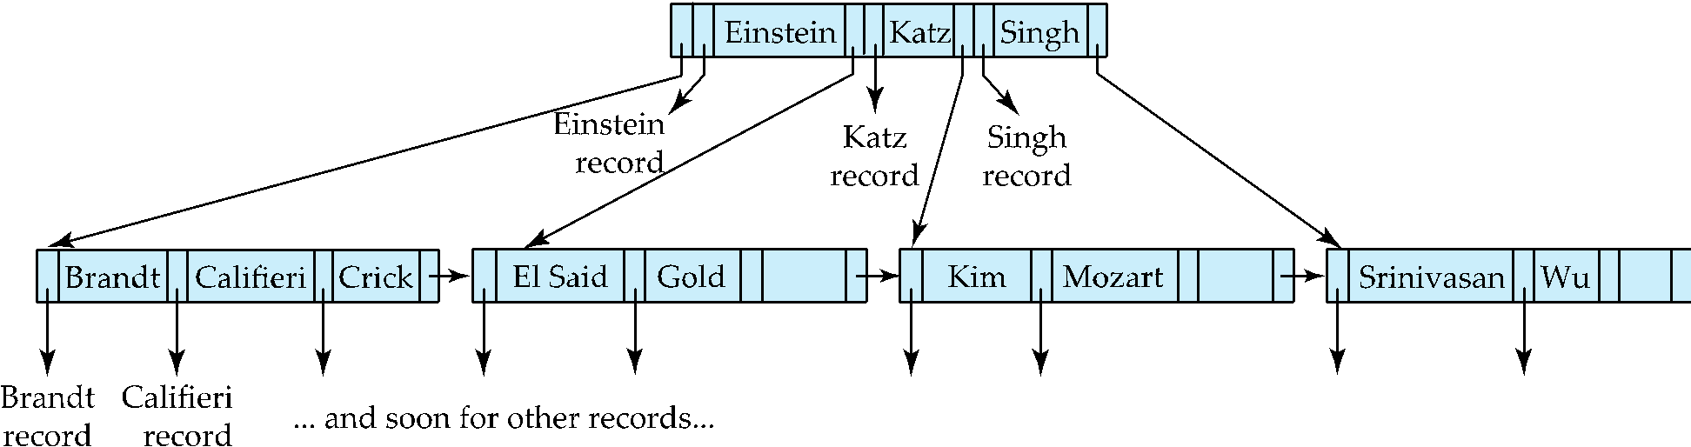
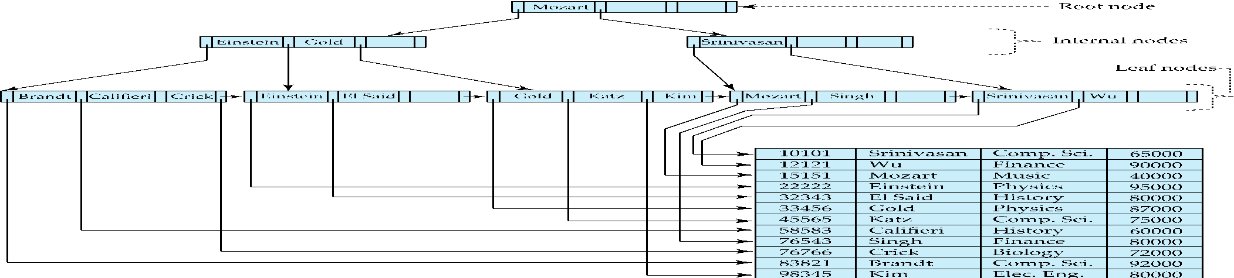
B-Tree Index File Example
B-tree (above) and B+-tree (below) on same data

Slide 55
Indexing on Flash
Random I/O cost much lower on flash
20 to 100 microseconds for read/write
Writes are not in-place, and (eventually) require a more expensive erase
Optimum page size therefore much smaller
Bulk-loading still useful since it minimizes page erases
Write-optimized tree structures (discussed later) have been adapted to minimize page writes for flash-optimized search trees

Slide 56
Indexing in Main Memory
Random access in memory
Much cheaper than on disk/flash
But still expensive compared to cache read
Data structures that make best use of cache preferable
Binary search for a key value within a large B⁺-tree node results in many cache misses
B⁺- trees with small nodes that fit in cache line are preferable to reduce cache misses
Key idea: use large node size to optimize disk access, but structure data within a node using a tree with small node size, instead of using an array.

Slide 57
Hashing

Slide 58
Static Hashing
A bucket is a unit of storage containing one or more entries (a bucket is typically a disk block).
we obtain the bucket of an entry from its search-key value using a hash function
Hash function h is a function from the set of all search-key values K to the set of all bucket addresses B.
Hash function is used to locate entries for access, insertion as well as deletion.
Entries with different search-key values may be mapped to the same bucket; thus entire bucket has to be searched sequentially to locate an entry.
In a hash index, buckets store entries with pointers to records
In a hash file-organization buckets store records

Slide 59
Handling of Bucket Overflows
Bucket overflow can occur because of
Insufficient buckets
Skew in distribution of records. This can occur due to two reasons:
multiple records have same search-key value
chosen hash function produces non-uniform distribution of key values
Although the probability of bucket overflow can be reduced, it cannot be eliminated; it is handled by using overflow buckets.

Slide 60
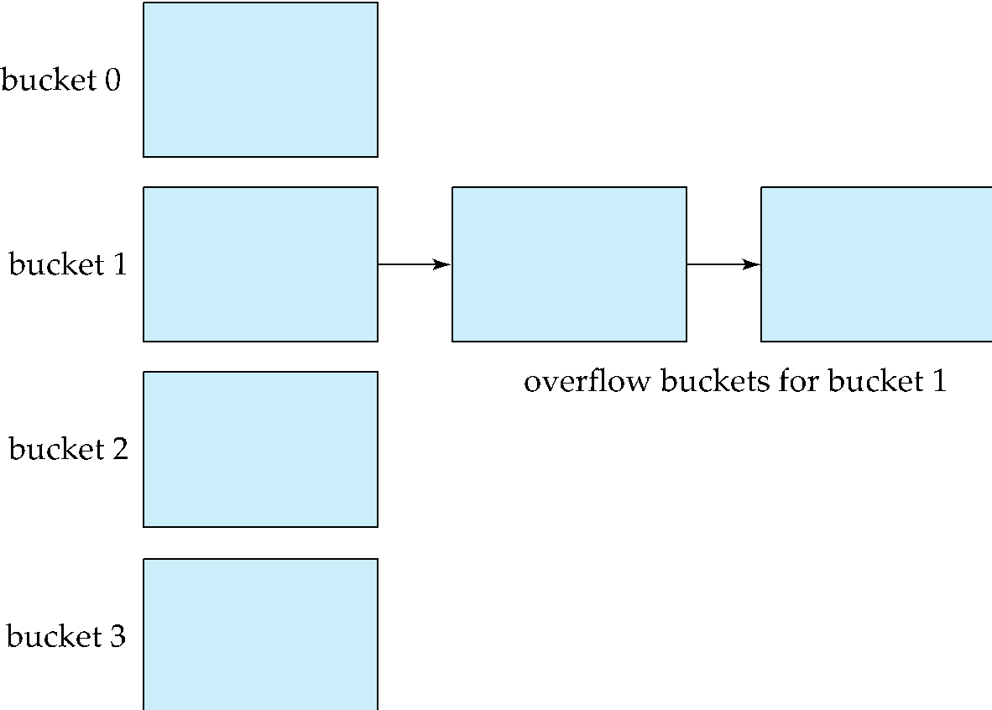
Handling of Bucket Overflows (Cont.)
Overflow chaining – the overflow buckets of a given bucket are chained together in a linked list.
Above scheme is called closed addressing (also called closed hashing or open hashing depending on the book you use)
An alternative, called open addressing (also called open hashing or closed hashing depending on the book you use) which does not use over- flow buckets, is not suitable for database applications.

Slide 61
Example of Hash File Organization
Hash file organization of instructor file, using dept_name as key (See figure in next slide.)
There are 10 buckets,
The binary representation of the I ^{th} character is assumed to be the integer i.
The hash function returns the sum of the binary representations of the characters modulo 10
E.g. h(Music) = 1 h(History) = 2 h(Physics) = 3 h(Elec. Eng.) = 3

Slide 62

Example of Hash File Organization
Hash file organization of instructor file, using dept_name as key.

Slide 63
Deficiencies of Static Hashing
In static hashing, function h maps search-key values to a fixed set of B of bucket addresses. Databases grow or shrink with time.
If initial number of buckets is too small, and file grows, performance will degrade due to too much overflows.
If space is allocated for anticipated growth, a significant amount of space will be wasted initially (and buckets will be underfull).
If database shrinks, again space will be wasted.
One solution: periodic re-organization of the file with a new hash function
Expensive, disrupts normal operations
Better solution: allow the number of buckets to be modified dynamically.

Slide 64
Dynamic Hashing
Periodic rehashing
If number of entries in a hash table becomes (say) 1.5 times size of hash table,
create new hash table of size (say) 2 times the size of the previous hash table
Rehash all entries to new table
Linear Hashing
Do rehashing in an incremental manner
Extendable Hashing
Tailored to disk based hashing, with buckets shared by multiple hash values
Doubling of # of entries in hash table, without doubling # of buckets

Slide 65
Comparison of Ordered Indexing and Hashing
Cost of periodic re-organization
Relative frequency of insertions and deletions
Is it desirable to optimize average access time at the expense of worst-case access time?
Expected type of queries:
Hashing is generally better at retrieving records having a specified value of the key.
If range queries are common, ordered indices are to be preferred
In practice:
PostgreSQL supports hash indices, but discourages use due to poor performance
Oracle supports static hash organization, but not hash indices
SQLServer supports only B⁺-trees

Slide 66
Multiple-Key Access
Use multiple indices for certain types of queries.
Example:
select ID
from instructor
where dept_name = “Finance” and salary = 80000
Possible strategies for processing query using indices on single attributes:
1. Use index on dept_name to find instructors with department name Finance; test salary = 80000
2. Use index on salary to find instructors with a salary of $80000; test dept_name = “Finance”.
3. Use dept_name index to find pointers to all records pertaining to the “Finance” department. Similarly use index on salary. Take intersection of both sets of pointers obtained.

Slide 67
Indices on Multiple Keys
Composite search keys are search keys containing more than one attribute
E.g., (dept_name, salary)
Lexicographic ordering: (a₁, a₂) < (b₁, b₂) if either
a₁ < b₁, or
a₁=b₁ and a₂ < b₂

Slide 68
Indices on Multiple Attributes
Suppose we have an index on combined search-key
(dept_name, salary).
With the where clause where dept_name = “Finance” and salary = 80000 the index on (dept_name, salary) can be used to fetch only records that satisfy both conditions.
Using separate indices in less efficient — we may fetch many records (or pointers) that satisfy only one of the conditions.
Can also efficiently handle where dept_name = “Finance” and salary < 80000
But cannot efficiently handle where dept_name < “Finance” and balance = 80000
May fetch many records that satisfy the first but not the second condition

Slide 69
Other Features
Covering indices
Add extra attributes to index so (some) queries can avoid fetching the actual records
Store extra attributes only at leaf
Why?
Particularly useful for secondary indices
Why?

Slide 70
Creation of Indices
Example create index takes_pk on takes (ID,course_ID, year, semester, section) drop index takes_pk
Most database systems allow specification of type of index, and clustering.
Indices on primary key created automatically by all databases
Why?
Some database also create indices on foreign key attributes
Why might such an index be useful for this query:
takes ⨝ σ_{name='Shankar'} (student)
Indices can greatly speed up lookups, but impose cost on updates
Index tuning assistants/wizards supported on several databases to help choose indices, based on query and update workload

Slide 71
Index Definition in SQL
Create an index
create index <index-name> on <relation-name> (<attribute-list>)
E.g.,: create index b-index on branch(branch_name)
Use create unique index to indirectly specify and enforce the condition that the search key is a candidate key is a candidate key.
Not really required if SQL unique integrity constraint is supported
To drop an index
drop index <index-name>
Most database systems allow specification of type of index, and clustering.

Slide 72
Write Optimized Indices
Performance of B⁺-trees can be poor for write-intensive workloads
One I/O per leaf, assuming all internal nodes are in memory
With magnetic disks, < 100 inserts per second per disk
With flash memory, one page overwrite per insert
Two approaches to reducing cost of writes
Log-structured merge tree
Buffer tree

Slide 73
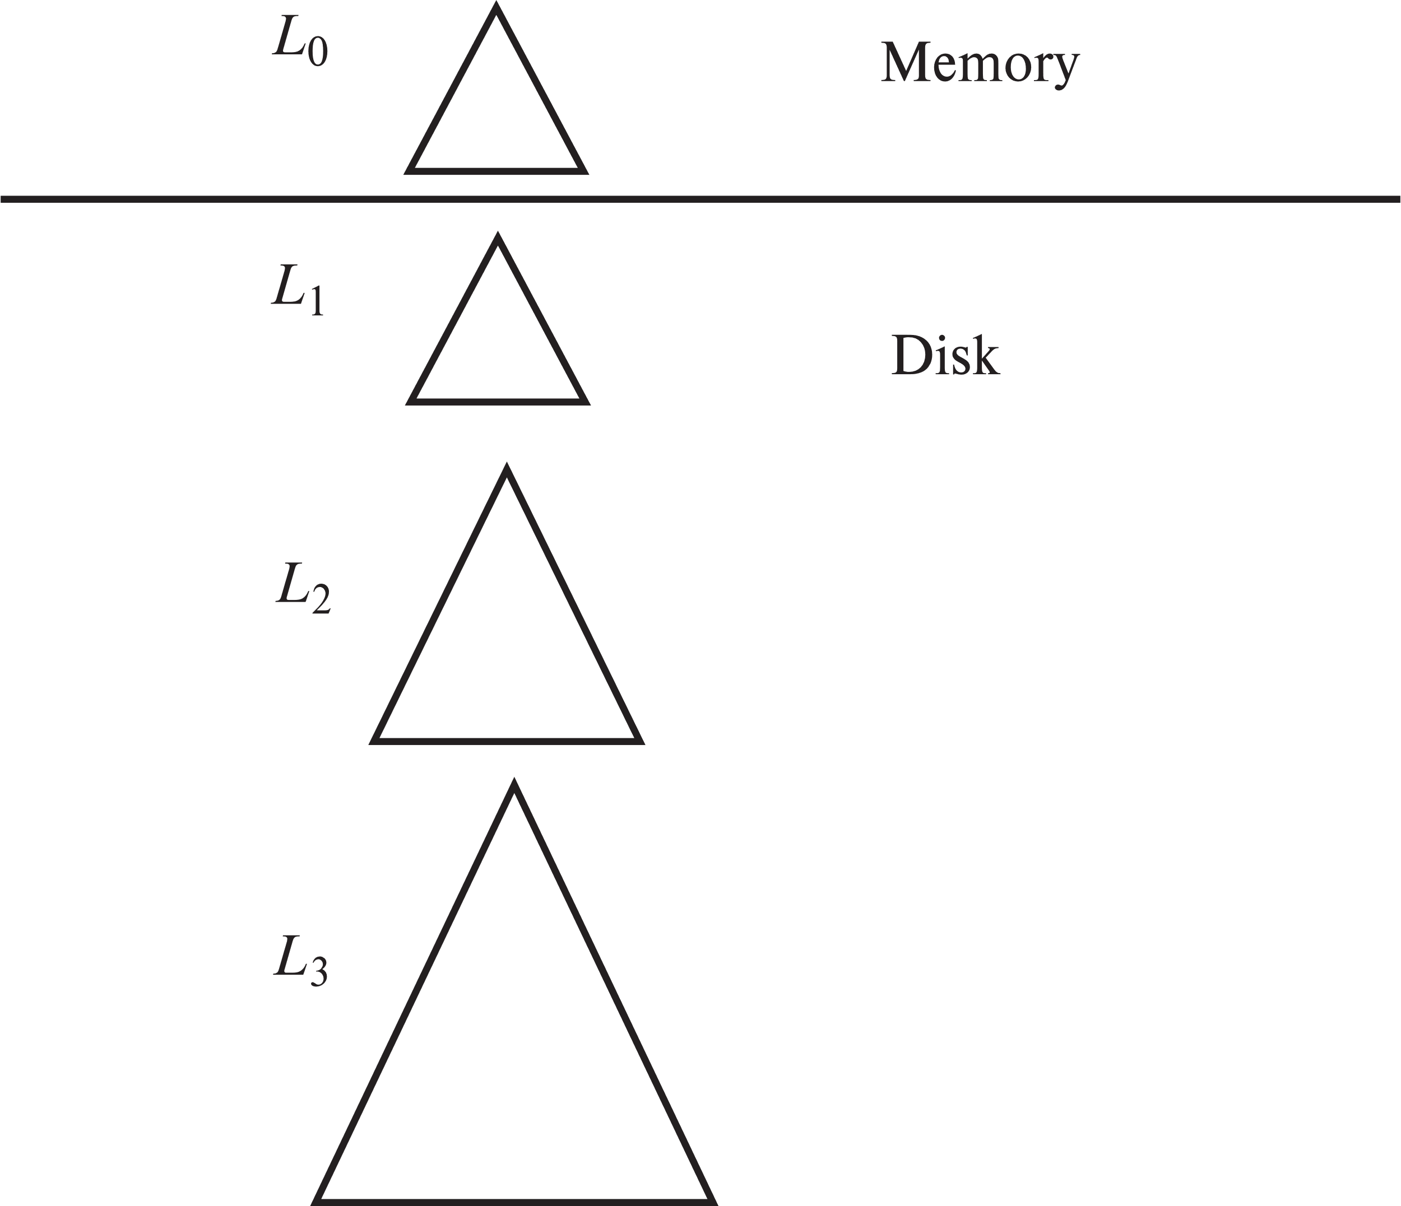
Log Structured Merge (LSM) Tree
Consider only inserts/queries for now
Records inserted first into in-memory tree (L₀ tree)
When in-memory tree is full, records moved to disk (L₁ tree)
B⁺-tree constructed using bottom-up build by merging existing L₁ tree with records from L₀ tree
When L₁ tree exceeds some threshold, merge into L₂ tree
And so on for more levels
Size threshold for L_{i+1} tree is k times size threshold for L_{i} tree

Slide 74
LSM Tree (Cont.)
Benefits of LSM approach
Inserts are done using only sequential I/O operations
Leaves are full, avoiding space wastage
Reduced number of I/O operations per record inserted as compared to normal B⁺-tree (up to some size)
Drawback of LSM approach
Queries have to search multiple trees
Entire content of each level copied multiple times
Stepped-merge index
Variant of LSM tree with multiple trees at each level
Reduces write cost compared to LSM tree
But queries are even more expensive
Bloom filters to avoid lookups in most trees
Details are covered in Chapter 24

Slide 75
LSM Trees (Cont.)
Deletion handled by adding special “delete” entries
Lookups will find both original entry and the delete entry, and must return only those entries that do not have matching delete entry
When trees are merged, if we find a delete entry matching an original entry, both are dropped.
Update handled using insert+delete
LSM trees were introduced for disk-based indices
But useful to minimize erases with flash-based indices
The stepped-merge variant of LSM trees is used in many BigData storage systems
Google BigTable, Apache Cassandra, MongoDB
And more recently in SQLite4, LevelDB, and MyRocks storage engine of MySQL

Slide 76
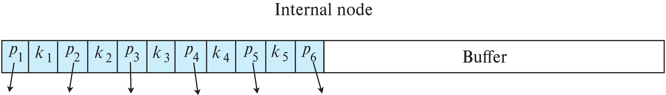
Buffer Tree
Alternative to LSM tree
Key idea: each internal node of B⁺-tree has a buffer to store inserts
Inserts are moved to lower levels when buffer is full
With a large buffer, many records are moved to lower level each time
Per record I/O decreases correspondingly
Benefits
Less overhead on queries
Can be used with any tree index structure
Used in PostgreSQL Generalized Search Tree (GiST) indices
Drawback: more random I/O than LSM tree

Slide 77
Bitmap Indices
Bitmap indices are a special type of index designed for efficient querying on multiple keys
Records in a relation are assumed to be numbered sequentially from, say, 0
Given a number n it must be easy to retrieve record n
Particularly easy if records are of fixed size
Applicable on attributes that take on a relatively small number of distinct values
E.g., gender, country, state, …
E.g., income-level (income broken up into a small number of levels such as 0-9999, 10000-19999, 20000-50000, 50000- infinity)
A bitmap is simply an array of bits

Slide 78
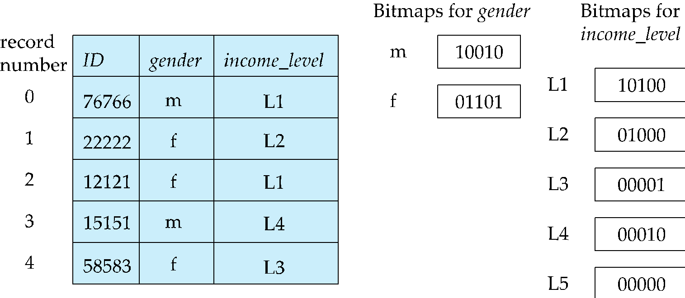
Bitmap Indices (Cont.)
In its simplest form a bitmap index on an attribute has a bitmap for each value of the attribute
Bitmap has as many bits as records
In a bitmap for value v, the bit for a record is 1 if the record has the value v for the attribute, and is 0 otherwise
Example

Slide 79
Bitmap Indices (Cont.)
Bitmap indices are useful for queries on multiple attributes
not particularly useful for single attribute queries
Queries are answered using bitmap operations
Intersection (and)
Union (or)
Each operation takes two bitmaps of the same size and applies the operation on corresponding bits to get the result bitmap
E.g., 100110 AND 110011 = 100010
100110 OR 110011 = 110111 NOT 100110 = 011001
Males with income level L1: 10010 AND 10100 = 10000
Can then retrieve required tuples.
Counting number of matching tuples is even faster

Slide 80
Bitmap Indices (Cont.)
Bitmap indices generally very small compared with relation size
E.g., if record is 100 bytes, space for a single bitmap is 1/800 of space used by relation.
If number of distinct attribute values is 8, bitmap is only 1% of relation size

Slide 81
Efficient Implementation of Bitmap Operations
Bitmaps are packed into words; a single word and (a basic CPU instruction) computes and of 32 or 64 bits at once
E.g., 1-million-bit maps can be and-ed with just 31,250 instruction
Counting number of 1s can be done fast by a trick:
Use each byte to index into a precomputed array of 256 elements each storing the count of 1s in the binary representation
Can use pairs of bytes to speed up further at a higher memory cost
Add up the retrieved counts
Bitmaps can be used instead of Tuple-ID lists at leaf levels of B⁺-trees, for values that have a large number of matching records
Worthwhile if > 1/64 of the records have that value, assuming a tuple-id is 64 bits
Above technique merges benefits of bitmap and B⁺-tree indices

Slide 82
Spatial and Temporal Indices

Slide 83
Spatial Data
Databases can store data types such as lines, polygons, in addition to raster images
allows relational databases to store and retrieve spatial information
Queries can use spatial conditions (e.g. contains or overlaps).
queries can mix spatial and nonspatial conditions
Nearest neighbor queries, given a point or an object, find the nearest object that satisfies given conditions.
Range queries deal with spatial regions. e.g., ask for objects that lie partially or fully inside a specified region.
Queries that compute intersections or unions of regions.
Spatial join of two spatial relations with the location playing the role of join attribute.

Slide 84
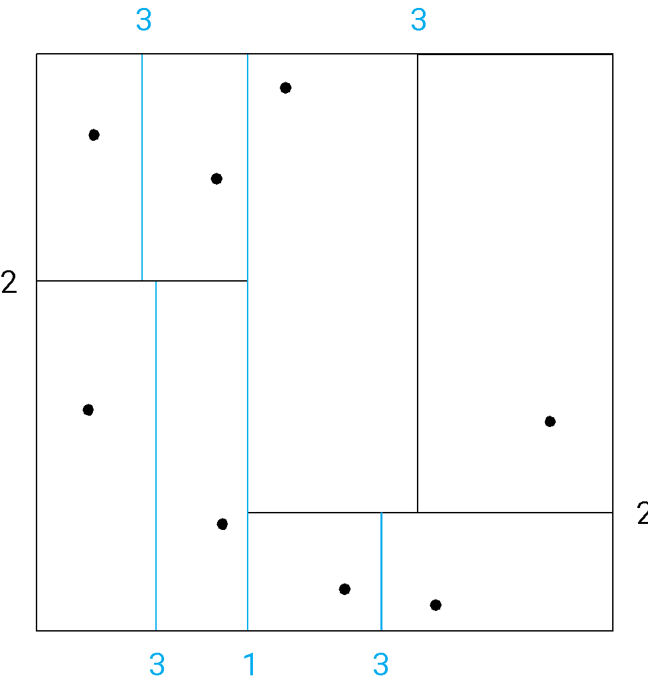
Indexing of Spatial Data
k-d tree - early structure used for indexing in multiple dimensions.
Each level of a k-d tree partitions the space into two.
Choose one dimension for partitioning at the root level of the tree.
Choose another dimensions for partitioning in nodes at the next level and so on, cycling through the dimensions.
In each node, approximately half of the points stored in the sub-tree fall on one side and half on the other.
Partitioning stops when a node has less than a given number of points.
The k-d-B tree extends the k-d tree to allow multiple child nodes for each internal node; well-suited for secondary storage.

Slide 85
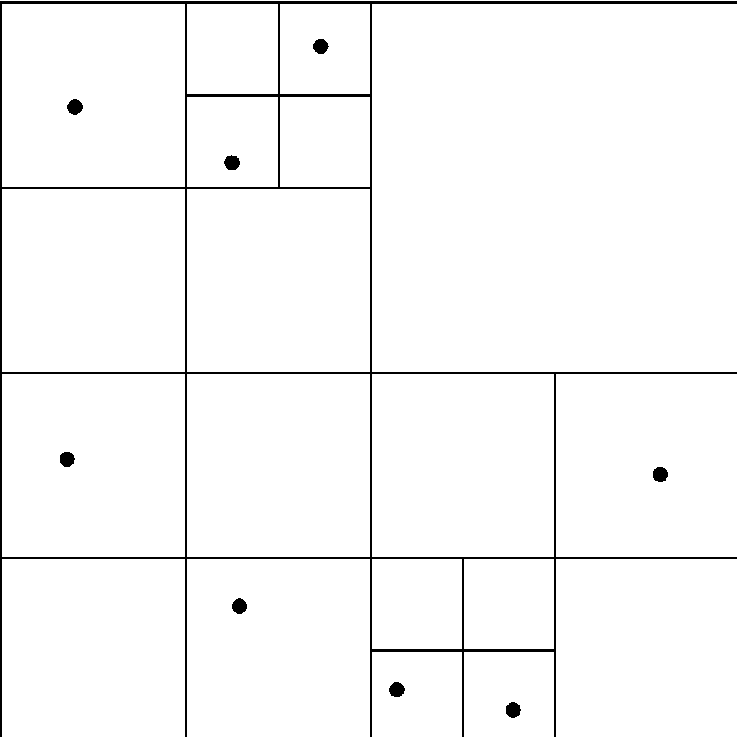
Division of Space by Quadtrees
Each node of a quadtree is associated with a rectangular region of space; the top node is associated with the entire target space.
Each non-leaf nodes divides its region into four equal sized quadrants
correspondingly each such node has four child nodes corresponding to the four quadrants and so on
Leaf nodes have between zero and some fixed maximum number of points (set to 1 in example).

Slide 86
R-Trees
R-trees are a N-dimensional extension of B⁺-trees, useful for indexing sets of rectangles and other polygons.
Supported in many modern database systems, along with variants like R⁺ -trees and R*-trees.
Basic idea: generalize the notion of a one-dimensional interval associated with each B+ -tree node to an N-dimensional interval, that is, an N-dimensional rectangle.
Will consider only the two-dimensional case (N = 2)
generalization for N > 2 is straightforward, although R-trees work well only for relatively small N
The bounding box of a node is a minimum sized rectangle that contains all the rectangles/polygons associated with the node
Bounding boxes of children of a node are allowed to overlap

Slide 87
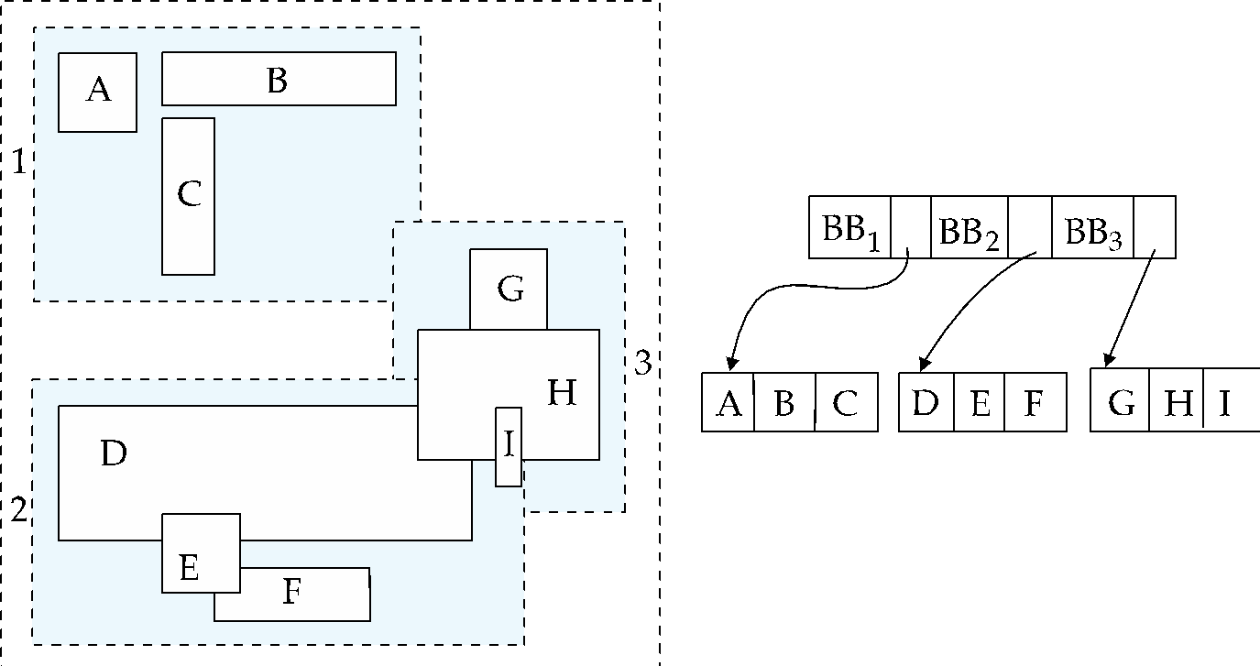
Example R-Tree
A set of rectangles (solid line) and the bounding boxes (dashed line) of the nodes of an R-tree for the rectangles.
The R-tree is shown on the right.

Slide 88
Search in R-Trees
To find data items intersecting a given query point/region, do the following, starting from the root node:
If the node is a leaf node, output the data items whose keys intersect the given query point/region.
Else, for each child of the current node whose bounding box intersects the query point/region, recursively search the child
Can be very inefficient in worst case since multiple paths may need to be searched, but works acceptably in practice.

Slide 89
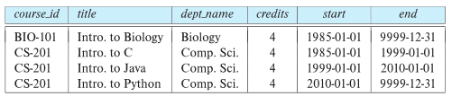
Indexing Temporal Data
Temporal data refers to data that has an associated time period (interval)
Example: a temporal version of the course relation
Time interval has a start and end time
End time set to infinity (or large date such as 9999-12-31) if a tuple is currently valid and its validity end time is not currently known
Query may ask for all tuples that are valid at a point in time or during a time interval
Index on valid time period speeds up this task

Slide 90
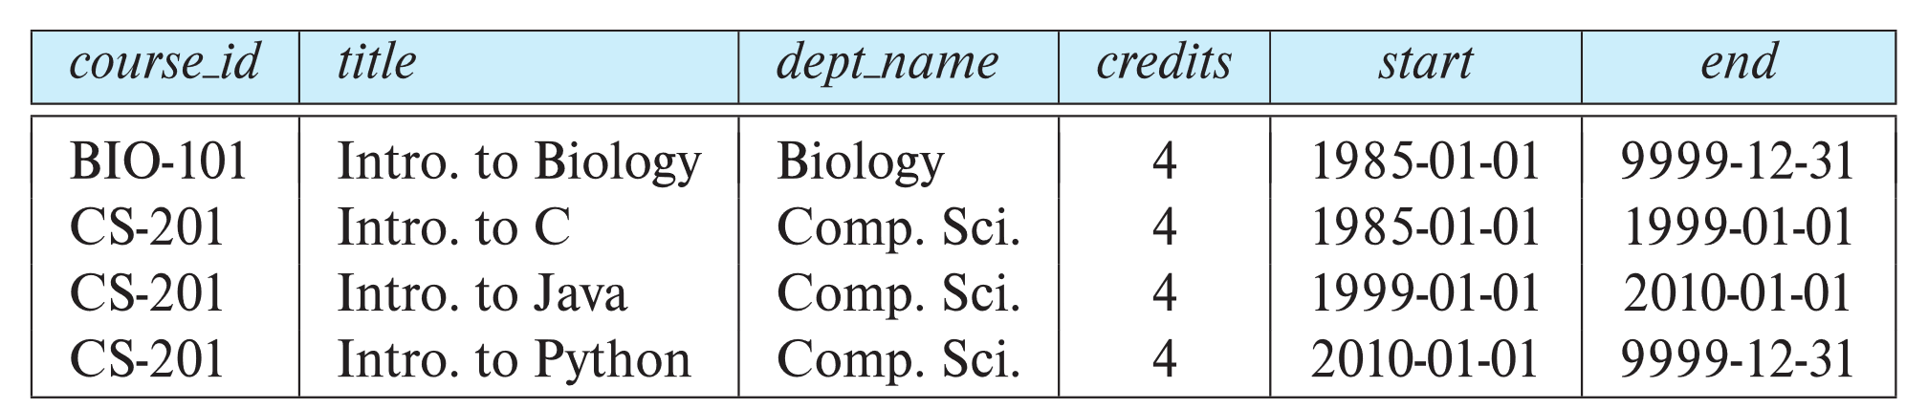
Indexing Temporal Data (Cont.)
To create a temporal index on attribute a:
Use spatial index, such as R-tree, with attribute a as one dimension, and time as another dimension
Valid time forms an interval in the time dimension
Tuples that are currently valid cause problems, since value is infinite or very large
Solution: store all current tuples (with end time as infinity) in a separate index, indexed on (a, start-time)
To find tuples valid at a point in time t in the current tuple index, search for tuples in the range (a, 0) to (a,t)
Temporal index on primary key can help enforce temporal primary key constraint

Slide 91
End of Chapter 14

Slide 92
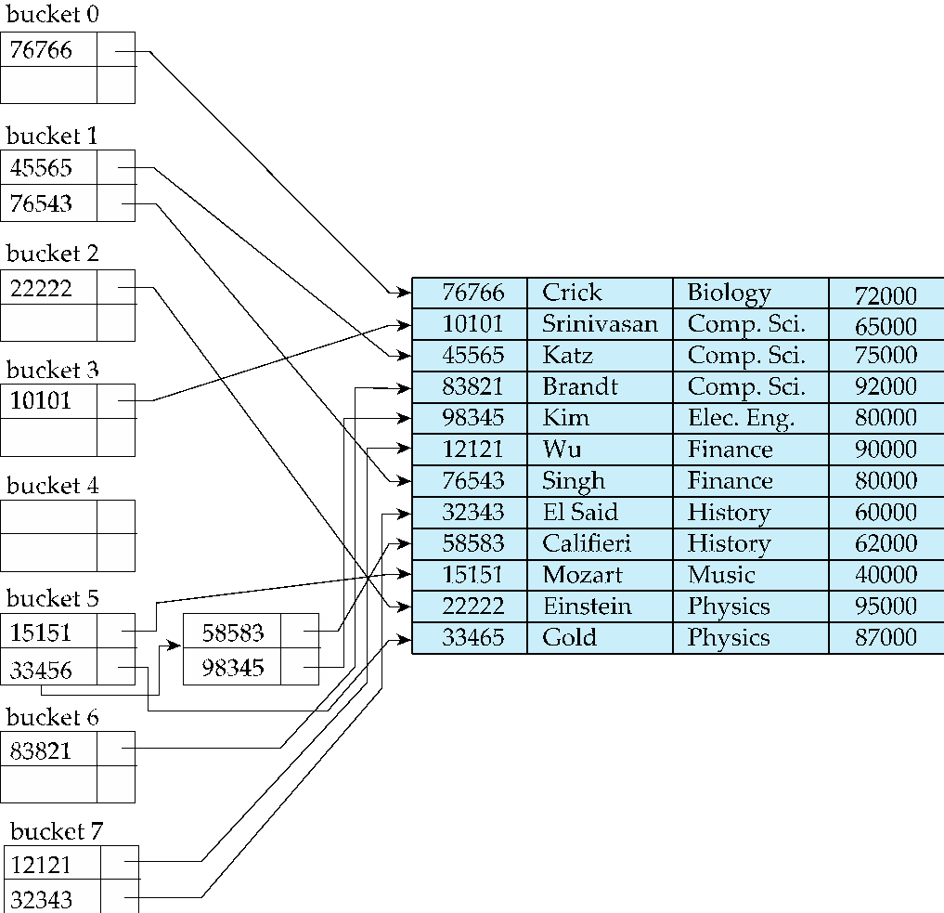
Example of Hash Index
hash index on instructor, on attribute ID

