Slide 1
Chapter 24: Advanced Indexing

Slide 2
Bloom Filters
A bloom filter is a probabilistic data structure used to check membership of a value in a set
May return true (with low probability) even if an element is not present
But never returns false if an element is present
Used to filter out irrelevant sets
Key data structure is a single bitmap
For a set with n elements, typical bitmap size is 10n
Uses multiple independent hash functions
With a single hash function h() with range=number of bits in bitmap:
For each element s in set S compute h(s) and set bit h(s)
To query an element v compute h(v), and check if bit h(v) is set
Problem with single hash function: significant chance of false positive due to hash collision
10% chance with 10n bits

Slide 3
Bloom Filters (Cont.)
Key idea of Bloom filter: reduce false positives by use multiple hash functions h_{i}() for i = 1..k
For each element s in set S for each i compute h_{i}(s) and set bit h_{i}(s)
To query an element v for each i compute h_{i}(v), and check if bit h_{i}(v) is set
If bit h_{i}(v) is set for every i then report v as present in set
Else report v as absent
With 10n bits, and k = 7, false positive rate reduces to 1% instead of 10% with k = 1

Slide 4
Write Optimized Indices
Performance of
B⁺-trees can be poor for write-intensive workloads
One I/O per leaf, assuming all internal nodes are in memory
With magnetic disks, < 100 inserts per second per disk
With flash memory, one page overwrite per insert
Two approaches to reducing cost of writes
Log-structured merge tree
Buffer tree

Slide 5
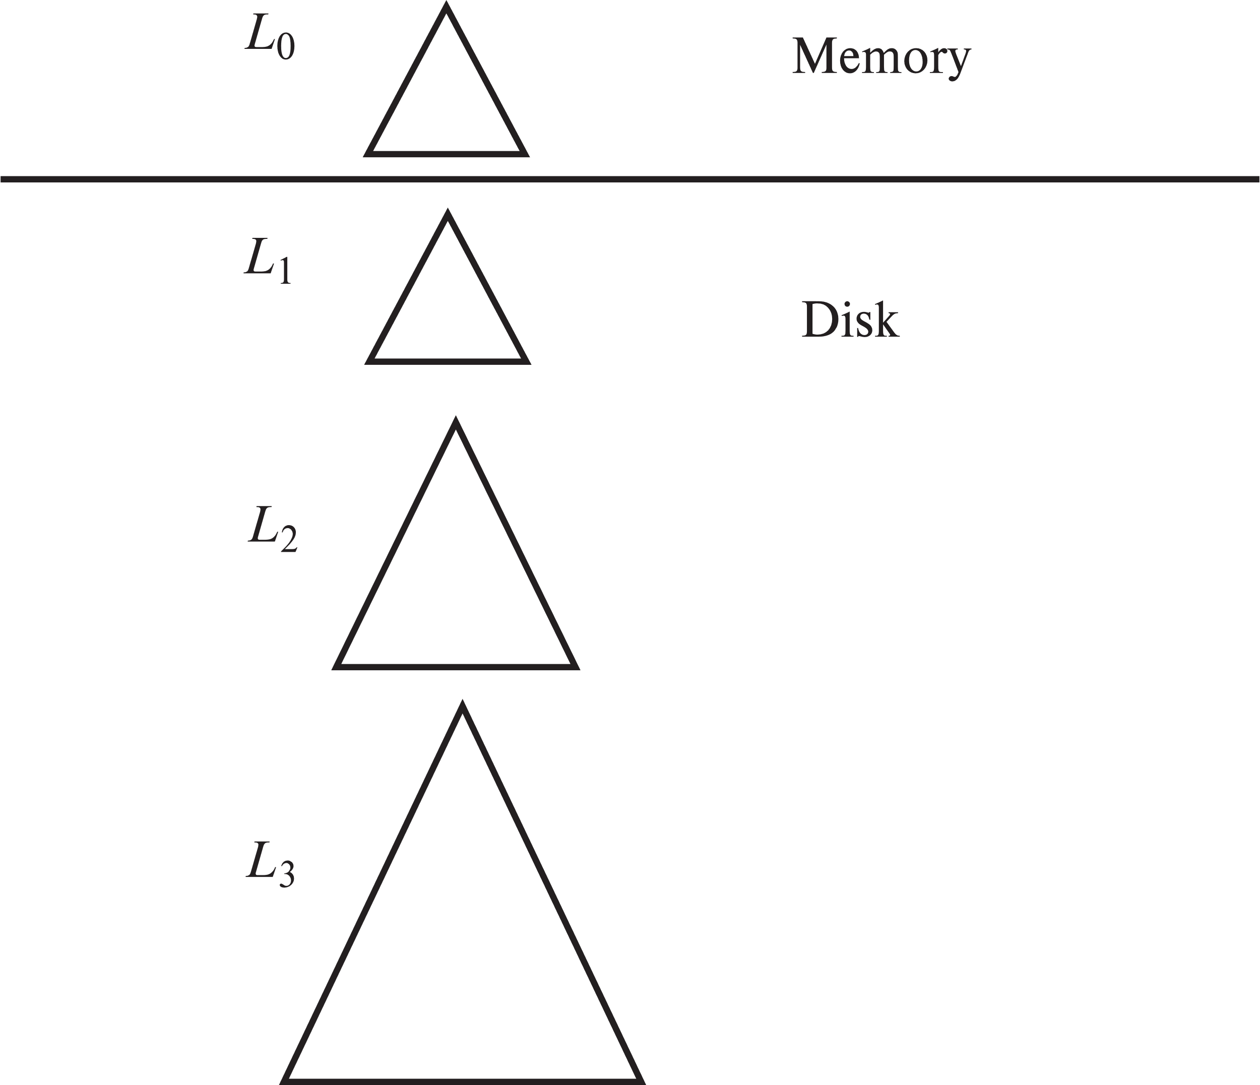
Log Structured Merge (LSM) Tree
Consider only inserts/queries for now
Records inserted first into in-memory tree (L₀ tree)
When in-memory tree is full, records moved to disk (L₁ tree)
B⁺-tree constructed using bottom-up build by merging existing L₁ tree with records from L₀ tree
When L₁ tree exceeds some threshold, merge into L₂ tree
And so on for more levels
Size threshold for L_{i+1} tree is k times size threshold for L_{i} tree
Merge creates a new B⁺-tree using bottom-up build

Slide 6
LSM Tree (Cont.)
Benefits of LSM approach
Inserts are done using only sequential I/O operations
Leaves are full, avoiding space wastage
Reduced number of I/O operations per record inserted as compared to normal B⁺-tree (up to some size)
If each leaf has m entries, m/k entries merged in using 1 IO
Total I/O operations: k/m log_{k}(I/M) where I = total number of entries, and M is the size of L₀ tree.
Drawback of LSM approach
Queries have to search multiple trees
Entire content of each level copied multiple times

Slide 7
Optimizations of LSM
Rolling merge
LSM/Stepped Merge often implemented on a partitioned relation
Each partition size set to some max, split if over-sized
Spread partitions over multiple machines

Slide 8
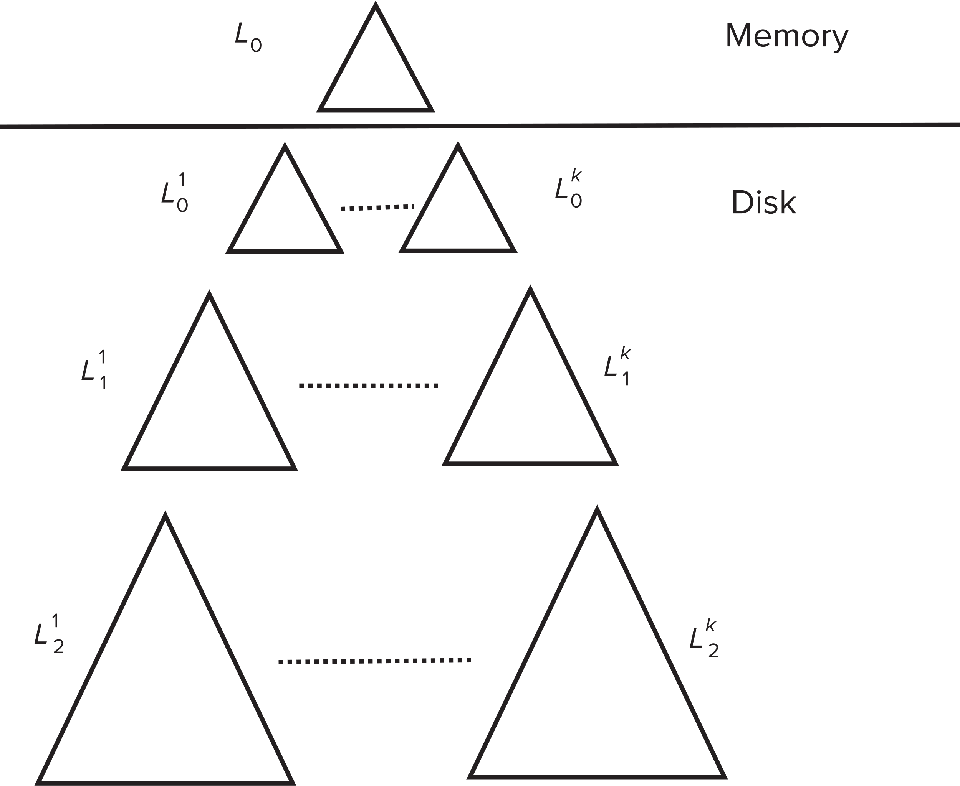
Stepped Merge Index
Stepped-merge index: variant of LSM tree with k trees at each level on disk
When all k indices exist at a level, merge them into one index of next level.
Reduces write cost compared to LSM tree
But queries are even more expensive since many trees need to be queries
Optimization for point lookups
Compute Bloom filter for each tree and store in-memory
Query a tree only if Bloom filter returns a positive result

Slide 9
LSM Trees (Cont.)
Deletion handled by adding special “delete” entries
Lookups will find both original entry and the delete entry, and must return only those entries that do not have matching delete entry
When trees are merged, if we find a delete entry matching an original entry, both are dropped.
Update handled using insert + delete
LSM trees were introduced for disk-based indices
But useful to minimize erases with flash-based indices
The stepped-merge variant of LSM trees is used in many BigData storage systems
Google BigTable, Apache Cassandra, MongoDB
And more recently in SQLite4, LevelDB, and MyRocks storage engine of MySQL

Slide 10
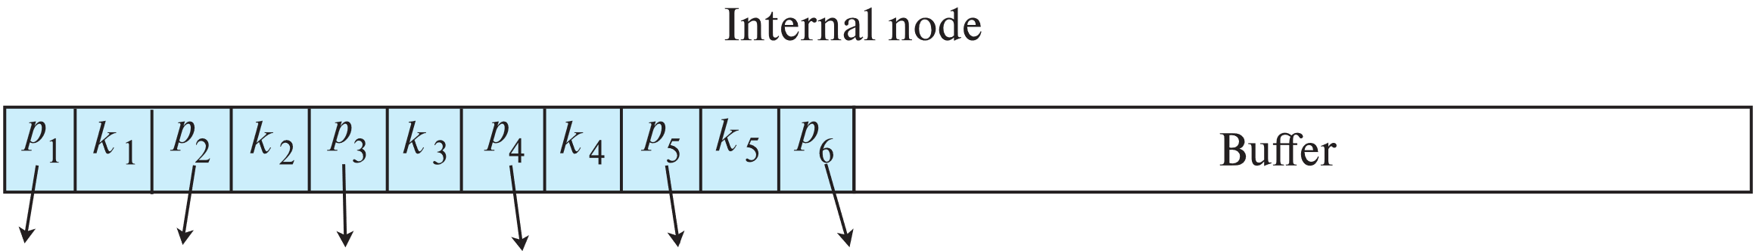
Buffer Tree
Alternative to LSM tree
Key idea: each internal node of B⁺-tree has a buffer to store inserts
Inserts are moved to lower levels when buffer is full
With a large buffer, many records are moved to lower level each time
Per record I/O decreases correspondingly
Benefits
Less overhead on queries
Can be used with any tree index structure
Used in PostgreSQL Generalized Search Tree (GiST) indices
Drawback: more random I/O than LSM tree

Slide 11
Bitmap Indices
Bitmap indices are a special type of index designed for efficient querying on multiple keys
Records in a relation are assumed to be numbered sequentially from, say, 0
Given a number n it must be easy to retrieve record n
Particularly easy if records are of fixed size
Applicable on attributes that take on a relatively small number of distinct values
E.g., gender, country, state, …
E.g., income-level (income broken up into a small number of levels such as 0-9999, 10000-19999, 20000-50000, 50000- infinity)
A bitmap is simply an array of bits

Slide 12
Bitmap Indices (Cont.)
In its simplest form a bitmap index on an attribute has a bitmap for each value of the attribute
Bitmap has as many bits as records
In a bitmap for value v, the bit for a record is 1 if the record has the value v for the attribute, and is 0 otherwise

Slide 13
Bitmap Indices (Cont.)
Bitmap indices are useful for queries on multiple attributes
not particularly useful for single attribute queries
Queries are answered using bitmap operations
Intersection (and)
Union (or)
Complementation (not)
Each operation takes two bitmaps of the same size and applies the operation on corresponding bits to get the result bitmap
E.g., 100110 AND 110011 = 100010
100110 OR 110011 = 110111 NOT 100110 = 011001
Males with income level L1: 10010 AND 10100 = 10000
Can then retrieve required tuples.
Counting number of matching tuples is even faster

Slide 14
Bitmap Indices (Cont.)
Bitmap indices generally very small compared with relation size
E.g., if record is 100 bytes, space for a single bitmap is 1/800 of space used by relation.
If number of distinct attribute values is 8, bitmap is only 1% of relation size
Deletion needs to be handled properly
Existence bitmap to note if there is a valid record at a record location
Needed for complementation
not(A=v): (NOT bitmap-A-v) AND ExistenceBitmap
Should keep bitmaps for all values, even null value
To correctly handle SQL null semantics for NOT(A=v):
intersect above result with (NOT bitmap-A-Null)

Slide 15
Efficient Implementation of Bitmap Operations
Bitmaps are packed into words; a single word and (a basic CPU instruction) computes and of 32 or 64 bits at once
E.g., 1-million-bit maps can be and-ed with just 31,250 instruction
Counting number of 1s can be done fast by a trick:
Use each byte to index into a precomputed array of 256 elements each storing the count of 1s in the binary representation
Can use pairs of bytes to speed up further at a higher memory cost
Add up the retrieved counts
Bitmaps can be used instead of Tuple-ID lists at leaf levels of B⁺-trees, for values that have a large number of matching records
Worthwhile if > 1/64 of the records have that value, assuming a tuple-id is 64 bits
Above technique merges benefits of bitmap and B⁺-tree indices

Slide 16
Spatial and Temporal Indices

Slide 17
Spatial Data
Databases can store data types such as lines, polygons, in addition to raster images
allows relational databases to store and retrieve spatial information
Queries can use spatial conditions (e.g. contains or overlaps).
queries can mix spatial and nonspatial conditions
Nearest neighbor queries, given a point or an object, find the nearest object that satisfies given conditions.
Range queries deal with spatial regions. e.g., ask for objects that lie partially or fully inside a specified region.
Queries that compute intersections or unions of regions.
Spatial join of two spatial relations with the location playing the role of join attribute.

Slide 18
Indexing of Spatial Data
k-d tree - early structure used for indexing in multiple dimensions.
Each level of a k-d tree partitions the space into two.
choose one dimension for partitioning at the root level of the tree.
choose another dimensions for partitioning in nodes at the next level and so on, cycling through the dimensions.
In each node, approximately half of the points stored in the sub-tree fall on one side and half on the other.
Partitioning stops when a node has less than a given number of points.
The k-d-B tree extends the k-d tree to allow multiple child nodes for each internal node; well-suited for secondary storage.

Slide 19
Division of Space by Quadtrees
Quadtrees
Each node of a quadtree is associated with a rectangular region of space; the top node is associated with the entire target space.
Each non-leaf nodes divides its region into four equal sized quadrants
correspondingly each such node has four child nodes corresponding to the four quadrants and so on
Leaf nodes have between zero and some fixed maximum number of points (set to 1 in example).

Slide 20
Quadtrees (Cont.)
PR quadtree: stores points; space is divided based on regions, rather than on the actual set of points stored.
Region quadtrees store array (raster) information.
A node is a leaf node is all the array values in the region that it covers are the same. Otherwise, it is subdivided further into four children of equal area, and is therefore an internal node.
Each node corresponds to a sub-array of values.
The sub-arrays corresponding to leaves either contain just a single array element, or have multiple array elements, all of which have the same value.
Extensions of k-d trees and PR quadtrees have been proposed to index line segments and polygons
Require splitting segments/polygons into pieces at partitioning boundaries
Same segment/polygon may be represented at several leaf nodes

Slide 21
R-Trees
R-trees are a N-dimensional extension of B⁺-trees, useful for indexing sets of rectangles and other polygons.
Supported in many modern database systems, along with variants like R⁺ -trees and R*-trees.
Basic idea: generalize the notion of a one-dimensional interval associated with each B+ -tree node to an N-dimensional interval, that is, an N-dimensional rectangle.
Will consider only the two-dimensional case (N = 2)
generalization for N > 2 is straightforward, although R-trees work well only for relatively small N
A polygon is stored only in one node, and the bounding box of the node must contain the polygon
The storage efficiency or R-trees is better than that of k-d trees or quadtrees since a polygon is stored only once

Slide 22
Example R-Tree
The bounding box of a node is a minimum sized rectangle that contains all the rectangles/polygons associated with the node
Bounding boxes of children of a node are allowed to overlap
Rectangles being Indexed R-Tree

Slide 23
Search in R-Trees
To find data items intersecting a given query point/region, do the following, starting from the root node:
If the node is a leaf node, output the data items whose keys intersect the given query point/region.
Else, for each child of the current node whose bounding box intersects the query point/region, recursively search the child

Slide 24
Search in R-Trees (Cont.)
Can be very inefficient in worst case since multiple paths may need to be searched
but works acceptably in practice.
Simple extensions of search procedure to handle predicates contained-in and contains

Slide 25
Insertion in R-Trees
To insert a data item:
Find a leaf to store it, and add it to the leaf
To find leaf, follow a child (if any) whose bounding box contains bounding box of data item, else child whose overlap with data item bounding box is maximum
Handle overflows by splits (as in B+ -trees)
Split procedure is different though (see below)
Adjust bounding boxes starting from the leaf upwards
Split procedure:
Goal: divide entries of an overfull node into two sets such that the bounding boxes have minimum total area
This is a heuristic. Alternatives like minimum overlap are possible
Finding the “best” split is expensive, use heuristics instead
See next slide

Slide 26
Splitting an R-Tree Node
Quadratic split divides the entries in a node into two new nodes as follows
1. Find pair of entries with “maximum separation”
that is, the pair such that the bounding box of the two would has the maximum wasted space (area of bounding box – sum of areas of two entries)
2. Place these entries in two new nodes
3. Repeatedly find the entry with “maximum preference” for one of the
two new nodes, and assign the entry to that node
Preference of an entry to a node is the increase in area of bounding box if the entry is added to the other node
4. Stop when half the entries have been added to one node
Then assign remaining entries to the other node
Cheaper linear split heuristic works in time linear in number of entries,
Cheaper but generates slightly worse splits.

Slide 27
Deleting in R-Trees
Deletion of an entry in an R-tree done much like a B⁺-tree deletion.
In case of underfull node, borrow entries from a sibling if possible, else merging sibling nodes
Alternative approach removes all entries from the underfull node, deletes the node, then reinserts all entries

Slide 28
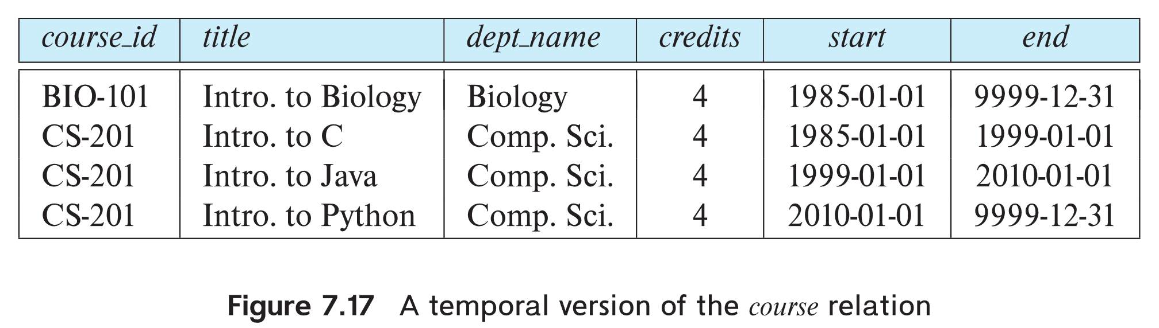
Indexing Temporal Data
Temporal data refers to data that has an associated time period (interval)
Time interval has a start and end time
End time set to infinity (or large date such as 9999-12-31) if a tuple is currently valid and its validity end time is not currently known
Query may ask for all tuples that are valid at a point in time or during a time interval
Index on valid time period speeds up this task

Slide 29
Indexing Temporal Data (Cont.)
To create a temporal index on attribute a:
Use spatial index, such as R-tree, with attribute a as one dimension, and time as another dimension
Valid time forms an interval in the time dimension
Tuples that are currently valid cause problems, since value is infinite or very large
Solution: store all current tuples (with end time as infinity) in a separate index, indexed on (a, start-time)
To find tuples valid at a point in time t in the current tuple index, search for tuples in the range (a, 0) to (a,t)
Temporal index on primary key can help enforce temporal primary key constraint

Slide 30
Hashing

Slide 31
Static Hashing
A bucket is a unit of storage containing one or more entries (a bucket is typically a disk block).
we obtain the bucket of an entry from its search-key value using a hash function
Hash function h is a function from the set of all search-key values K to the set of all bucket addresses B.
Hash function is used to locate entries for access, insertion as well as deletion.
Entries with different search-key values may be mapped to the same bucket; thus entire bucket has to be searched sequentially to locate an entry.
In a hash index, buckets store entries with pointers to records
In a hash file-organization buckets store records

Slide 32
Hash Functions
Worst hash function maps all search-key values to the same bucket; this makes access time proportional to the number of search-key values in the file.
An ideal hash function is uniform, i.e., each bucket is assigned the same number of search-key values from the set of all possible values.
Ideal hash function is random, so each bucket will have the same number of records assigned to it irrespective of the actual distribution of search-key values in the file.
Typical hash functions perform computation on the internal binary representation of the search-key.
For example, for a string search-key, the binary representations of all the characters in the string could be added and the sum modulo the number of buckets could be returned.

Slide 33
Example of Hash File Organization
Hash file organization of instructor file, using dept_name as key (See figure in next slide.)
There are 10 buckets,
The binary representation of the ith character is assumed to be the integer i.
The hash function returns the sum of the binary representations of the characters modulo 10
E.g., h(Music) = 1 h(History) = 2 h(Physics) = 3 h(Elec. Eng.) = 3

Slide 34
Example of Hash File Organization
Hash file organization of instructor file, using dept_name as key.

Slide 35
Handling of Bucket Overflows
Bucket overflow can occur because of
Insufficient buckets
Skew in distribution of records. This can occur due to two reasons:
multiple records have same search-key value
chosen hash function produces non-uniform distribution of key values
Although the probability of bucket overflow can be reduced, it cannot be eliminated; it is handled by using overflow buckets.

Slide 36
Handling of Bucket Overflows (Cont.)
Overflow chaining – the overflow buckets of a given bucket are chained together in a linked list.
Above scheme is called closed addressing (also called closed hashing or open hashing depending on the book you use)
An alternative, called open addressing (also called open hashing or closed hashing depending on the book you use) which does not use overflow buckets, is not suitable for database applications.

Slide 37
Example of Hash Index
hash index on instructor, on attribute ID

Slide 38
Deficiencies of Static Hashing
In static hashing, function h maps search-key values to a fixed set of B of bucket addresses. Databases grow or shrink with time.
If initial number of buckets is too small, and file grows, performance will degrade due to too much overflows.
If space is allocated for anticipated growth, a significant amount of space will be wasted initially (and buckets will be underfull).
If database shrinks, again space will be wasted.
One solution: periodic re-organization of the file with a new hash function
Expensive, disrupts normal operations
Better solution: allow the number of buckets to be modified dynamically.

Slide 39
Dynamic Hashing
Periodic rehashing
If number of entries in a hash table becomes (say) 1.5 times size of hash table,
create new hash table of size (say) 2 times the size of the previous hash table
Rehash all entries to new table
Linear Hashing
Do rehashing in an incremental manner
Extendable Hashing
Tailored to disk based hashing, with buckets shared by multiple hash values
Doubling of # of entries in hash table, without doubling # of buckets

Slide 40
Extendable Hashing
Extendable hashing – one form of dynamic hashing
Hash function generates values over a large range — typically b-bit integers, with b = 32.
At any time use only a prefix of the hash function to index into a table of bucket addresses.
Let the length of the prefix be i bits, 0 ≤ i ≤ 32.
Bucket address table size = 2^{i.} Initially i = 0
Value of i grows and shrinks as the size of the database grows and shrinks.
Multiple entries in the bucket address table may point to a bucket (why?)
Thus, actual number of buckets is < 2^{i}
The number of buckets also changes dynamically due to coalescing and splitting of buckets.

Slide 41
General Extendable Hash Structure
In this structure, i₂ = i₃ = i, whereas i₁ = i – 1 (see next slide for details)

Slide 42
Use of Extendable Hash Structure
Each bucket j stores a value i_{j}
All the entries that point to the same bucket have the same values on the first i_{j} bits.
To locate the bucket containing search-key K_{j}:
1. Compute h(K_{j}) = X
2. Use the first i high order bits of X as a displacement into bucket address table, and follow the pointer to appropriate bucket
To insert a record with search-key value K_{j}
follow same procedure as look-up and locate the bucket, say j.
If there is room in the bucket j insert record in the bucket.
Else the bucket must be split and insertion re-attempted (next slide.)
Overflow buckets used instead in some cases (will see shortly)

Slide 43
Insertion in Extendable Hash Structure (Cont.)
To split a bucket j when inserting record with search-key value K_{j}:
If i > i_{j} (more than one pointer to bucket j)
allocate a new bucket z, and set i_{j} = i_{z} = (i_{j} + 1)
Update the second half of the bucket address table entries originally pointing to j, to point to z
remove each record in bucket j and reinsert (in j or z)
recompute new bucket for K_{j} and insert record in the bucket (further splitting is required if the bucket is still full)
If i = i_{j} (only one pointer to bucket j)
If i reaches some limit b, or too many splits have happened in this insertion, create an overflow bucket
Else
increment i and double the size of the bucket address table.
replace each entry in the table by two entries that point to the same bucket.
recompute new bucket address table entry for K_{j} Now i > i_{j} so use the first case above.

Slide 44
Deletion in Extendable Hash Structure
To delete a key value,
locate it in its bucket and remove it.
The bucket itself can be removed if it becomes empty (with appropriate updates to the bucket address table).
Coalescing of buckets can be done (can coalesce only with a “buddy” bucket having same value of i_{j} and same i_{j} –1 prefix, if it is present)
Decreasing bucket address table size is also possible
Note: decreasing bucket address table size is an expensive operation and should be done only if number of buckets becomes much smaller than the size of the table

Slide 45
Use of Extendable Hash Structure: Example

Slide 46
Example (Cont.)
Initial hash structure; bucket size = 2

Slide 47
Example (Cont.)
Hash structure after insertion of “Mozart”, “Srinivasan”, and “Wu” records

Slide 48
Example (Cont.)
Hash structure after insertion of Einstein record

Slide 49
Example (Cont.)
Hash structure after insertion of Gold and El Said records

Slide 50
Example (Cont.)
Hash structure after insertion of Katz record

Slide 51
Example (Cont.)
And after insertion of
eleven records

Slide 52
Example (Cont.)
And after insertion of
Kim record in previous
hash structure

Slide 53
Extendable Hashing vs. Other Schemes
Benefits of extendable hashing:
Hash performance does not degrade with growth of file
Minimal space overhead
Disadvantages of extendable hashing
Extra level of indirection to find desired record
Bucket address table may itself become very big (larger than memory)
Cannot allocate very large contiguous areas on disk either
Solution: B⁺-tree structure to locate desired record in bucket address table
Changing size of bucket address table is an expensive operation
Linear hashing is an alternative mechanism
Allows incremental growth of its directory (equivalent to bucket address table)
At the cost of more bucket overflows

Slide 54
Comparison of Ordered Indexing and Hashing
Cost of periodic re-organization
Relative frequency of insertions and deletions
Is it desirable to optimize average access time at the expense of worst-case access time?
Expected type of queries:
Hashing is generally better at retrieving records having a specified value of the key.
If range queries are common, ordered indices are preferred
In practice:
Hash-indices are extensively used in-memory
But not used much on fisk
Oracle supports static hash organization, but not hash indices
SQL Server and PostgreSQL do not support hashing on disk

Slide 55
End of Chapter 24
Notes:
55

Slide 56
Partitioned Hashing
Hash values are split into segments that depend on each attribute of the search-key.
(A₁, A₂, . . . , A_{n}) for n attribute search-key
Example: n = 2, for customer, search-key being (customer-street, customer-city)
search-key value hash value (Main, Harrison) 101 111 (Main, Brooklyn) 101 001 (Park, Palo Alto) 010 010 (Spring, Brooklyn) 001 001 (Alma, Palo Alto) 110 010
To answer equality query on single attribute, need to look up multiple buckets. Similar in effect to grid files.

