Slide 1
Chapter 15: Query Processing

Slide 2
Chapter 15: Query Processing
Overview
Measures of Query Cost
Selection Operation
Sorting
Join Operation
Other Operations
Evaluation of Expressions

Slide 3
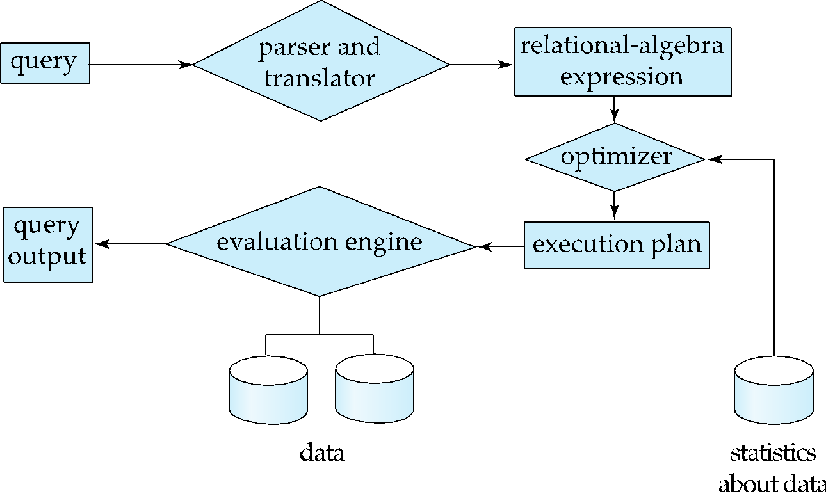
Basic Steps in Query Processing
1. Parsing and translation
2. Optimization
3. Evaluation

Slide 4
Basic Steps in Query Processing (Cont.)
Parsing and translation
translate the query into its internal form. This is then translated into relational algebra.
Parser checks syntax, verifies relations
Evaluation
The query-execution engine takes a query-evaluation plan, executes that plan, and returns the answers to the query.

Slide 5
Basic Steps in Query Processing: Optimization
A relational algebra expression may have many equivalent expressions
E.g., σ_{salary<75000}(∏_{salary}(instructor)) is equivalent to ∏_{salary}(σ_{salary<75000}(instructor))
Each relational algebra operation can be evaluated using one of several different algorithms
Correspondingly, a relational-algebra expression can be evaluated in many ways.
Annotated expression specifying detailed evaluation strategy is called an evaluation-plan. E.g.,:
Use an index on salary to find instructors with salary < 75000,
Or perform complete relation scan and discard instructors with salary ≥ 75000

Slide 6
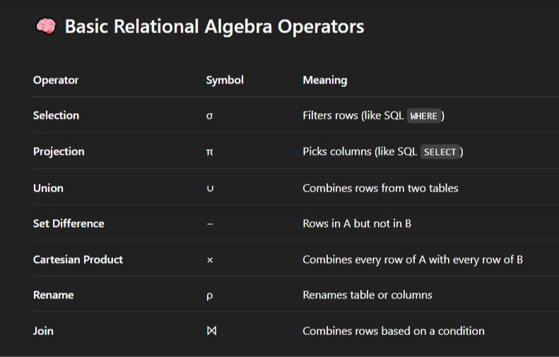
Basic Steps in Query Processing: Optimization

Slide 7
Basic Steps: Optimization (Cont.)
Query Optimization: Amongst all equivalent evaluation plans choose the one with lowest cost.
Cost is estimated using statistical information from the database catalog
e.g.. number of tuples in each relation, size of tuples, etc.
In this chapter we study
Metric: How to measure query costs
Algorithm: Algorithms for evaluating relational algebra operations
Modular: How to combine algorithms for individual operations in order to evaluate a complete expression
In Chapter 16
We study how to optimize queries, that is, how to find an evaluation plan with lowest estimated cost

Slide 8
Measures of Query Cost
Many factors contribute to time cost
disk access, CPU, and network communication
Cost can be measured based on
response time, i.e. total elapsed time for answering query, or
total resource consumption
We use total resource consumption as cost metric
Response time harder to estimate, and minimizing resource consumption is a good idea in a shared database
We ignore CPU costs for simplicity
Real systems do take CPU cost into account
Network costs must be considered for parallel systems
We describe how to estimate the cost of each operation
We do not include cost to writing output to disk

Slide 9
Measures of Query Cost
Disk cost can be estimated as:
Number of seeks *average-seek-cost
Number of blocks read *average-block-read-cost
Number of blocks written *average-block-write-cost
For simplicity we just use the number of block transfers from disk and the number of seeks as the cost measures
t_{T} – time to transfer one block
Assuming for simplicity that write cost is same as read cost
t_{S} – time for one seek
Cost for b block transfers plus S seeks b * t_{T} + S * t_{S}
t_{S} and t_{T} depend on where data is stored; with 4 KB blocks:
High end magnetic disk: t_{S} = 4 msec and t_{T} =0.1 msec
SSD: t_{S} = 20-90 microsec and t_{T} = 2-10 microsec for 4KB

Slide 10
Measures of Query Cost (Cont.)
Required data may be buffer resident already, avoiding disk I/O
But hard to take into account for cost estimation [frequent change of buffers]
Several algorithms can reduce disk I/O by using extra buffer space
Amount of real memory available to buffer depends on other concurrent queries and OS processes, known only during execution
Worst case calculation: Worst case estimates assume that no data is initially in buffer and only the minimum amount of memory needed for the operation is available
But more optimistic estimates are used in practice
Notes:
‹#›

Slide 11
Selection Operation
File scan
Algorithm A1 (linear search). Scan each file block and test all records to see whether they satisfy the selection condition.
Cost estimate = b_{r} block transfers + 1 seek (At least 1 seek to begin reading from the block)
b_{r} denotes number of blocks containing records from relation r
If selection is on a key attribute, can stop on finding record
cost = (b_{r} /2) block transfers + 1 seek
(b_{r}/2 denotes average cost, worst case still can be b_{r}/2)
Linear search can be applied regardless of
selection condition or [where clause]
ordering of records in the file, or [no ordering required]
availability of indices [no indexing required]
Note: binary search generally does not make sense since data is not stored consecutively
except when there is an index available,
and binary search requires more seeks than index search

Slide 12
Selections Using Indices
Index scan – search algorithms that use an index
selection condition must be on search-key of index.
A2 (clustering index, equality on key). Retrieve a single record that satisfies the corresponding equality condition
Cost = (h_{i} + 1) * (t_{T} + t_{S}) [h_{i} - height of the tree]
Explanation: Using B+ Tree, h_{i} levels are traversed with 1 move to reach the full record. As B+ Tree is disk-based, so each move requires a seek and transfer
A3 (clustering index, equality on nonkey) Retrieve multiple records.
Records will be on consecutive blocks
Let b = number of blocks containing matching records
Cost = h_{i} * (t_{T} + t_{S}) + t_{S} (seek cost in the disk to start reading) + t_{T} * b (transfer cost from leaf node)

Slide 13
Selections Using Indices
A4 (secondary index, equality on key/non-key).
Retrieve a single record if the search-key is a candidate key
Cost = (h_{i} + 1) * (t_{T} + t_{S})
Retrieve multiple records if search-key is not a candidate key
each of n matching records may be on a different block
Cost = (h_{i} + n) * (t_{T} + t_{S})
Can be very expensive!
Notes:
‹#›

Slide 14
Selections Involving Comparisons
Can implement selections of the form σ_{A≤V} (r) or σ_{A ≥ V}(r) by using
a linear file scan,
or by using indices in the following ways:
A5 (clustering index, comparison). (Relation is sorted on A)
For σ_{A ≥ V}(r) use index to find first tuple ≥ v and scan relation sequentially from there
For σ_{A≤V} (r) just scan relation sequentially till first tuple > v; do not use index
A6 (clustering index, comparison). [Secondary indexing]
For σ_{A ≥ V}(r) use index (B+ Tree) to find first index entry ≥ v and scan index sequentially from there, to find pointers to records. 1 I/O per operation.
For σ_{A≤V} (r) just scan leaf pages of index finding pointers to records, till first entry > v
In either case, retrieve records that are pointed to
requires an I/O per record; Linear file scan may be cheaper!

Slide 15
Implementation of Complex Selections
Conjunction: σ_{θ1}∧ _{θ2}∧. . . _{θn}(r)
A7 (conjunctive selection using one index).
Select a combination of θ_{i} and algorithms A1 through A7 that results in the least cost for σ_{θi} (r).
Test other conditions on tuple after fetching it into memory buffer.
A8 (conjunctive selection using composite index).
Use appropriate composite (multiple-key) index if available.
A9 (conjunctive selection by intersection of identifiers).
Requires indices with record pointers.
Use corresponding index for each condition, and take intersection of all the obtained sets of record pointers.
Then fetch records from file
If some conditions do not have appropriate indices, apply test in memory.

Slide 16
Algorithms for Complex Selections
Disjunction:σ_{θ1}∨ _{θ2} ∨. . . _{θn} (r).
A10 (disjunctive selection by union of identifiers).
Applicable if all conditions have available indices.
Otherwise use linear scan.
Use corresponding index for each condition, and take union of all the obtained sets of record pointers.
Then fetch records from file [Not Direct I/O But, I/O after extracting complete set]
Negation: σ_{¬θ}(r)
Use linear scan on file
If very few records satisfy ¬θ, and an index is applicable to θ
Find satisfying records using index and fetch from file

Slide 17
Bitmap Index Scan
The bitmap index scan algorithm of PostgreSQL
Bridges gap between secondary index scan and linear file scan when number of matching records is not known before execution
Bitmap with 1 bit per page in relation
Steps:
Index scan used to find record ids, and set bit of corresponding page in bitmap
Linear file scan fetching only pages with bit set to 1
Performance
Similar to index scan when only a few bits are set
Similar to linear file scan when most bits are set
Never behaves very badly compared to best alternative

Slide 18
Sorting
We may build an index on the relation, and then use the index to read the relation in sorted order. May lead to one disk block access for each tuple. [Data is in different locations of the disk, due to ordered on different index]
For relations that fit in memory, techniques like quicksort can be used.
For relations that don’t fit in memory, external sort-merge is a good choice.

Slide 19
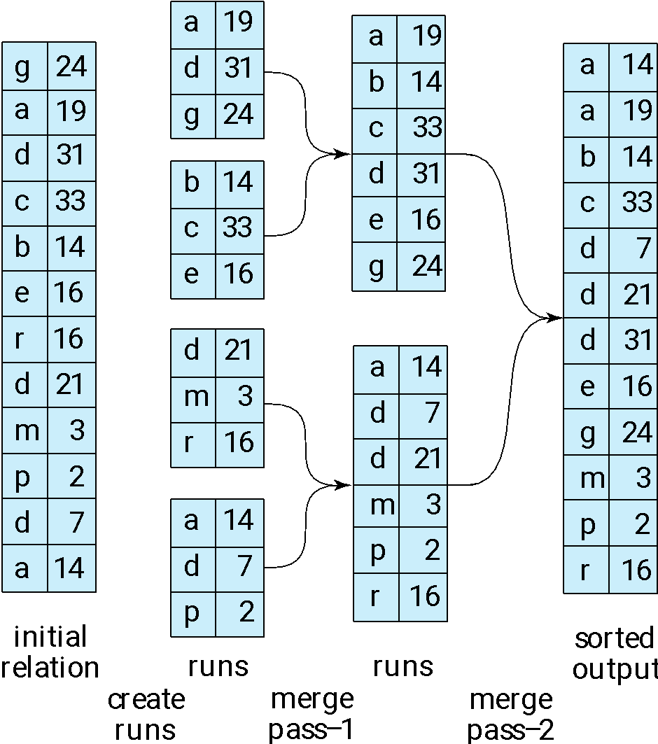
Example: External Sorting Using Sort-Merge

Slide 20
External Sort-Merge
Let M denote memory size (in pages).
1. Create sorted runs. Let i be 0 initially. Repeatedly do the following till the end of the relation: (a) Read M blocks of relation into memory (b) Sort the in-memory blocks (c) Write sorted data to run R_{i}; increment i.
Let the final value of i be N
2. Merge the runs (next slide)…..
Sorting small portions (M blocks of memory is not challenging that much in terms of memory)
Challenge is while merging.

Slide 21
External Sort-Merge (Cont.)
2. Merge the runs (N-way merge). We assume (for now) that N < M.
1. Use N blocks of memory to buffer input runs, and 1 block to buffer output. Read the first block of each run into its buffer page/buffer input
2. repeat
Select the first record (in sort order) among all buffer pages
Write the record to the output buffer. If the output buffer is full write it to disk.
Delete the record from its input buffer page. If the buffer page becomes empty then read the next block (if any) of the run into the buffer.
3. until all input buffer pages are empty:
N blocks of buffer input runs/pages
1 buffer output page

Slide 22
External Sort-Merge (Cont.) (N < M)
N Blocks of buffer input to hold the first record of the run
1 Output Buffer
N Blocks of input each corresponding a run

Slide 23
External Sort-Merge (Cont.) (N>M)
If N ≥ M, several merge passes are required. (Number of blocks, N > memory size, M)
First create N/(M-1) big runs (groups) and 1 output buffer, Each group has smaller (M-1) runs
Now we are going to work on each group
For each group, consider M-1 input buffers and 1 output buffer. In each input buffer, the smallest value of the corresponding run is stored.
Gradually pick the smallest ones and put them in the output buffer and continue
Eventually the group of runs will be sorted -> making them bigger length runs but with lesser number of runs.
In summary: In each pass, contiguous groups of M - 1 runs are merged. [1 is allocated for output buffer]
A pass reduces the number of runs by a factor of M -1 (by making groups), and creates runs (increases length) longer by the same factor.
E.g. If M=11, and there are 90 runs,
We create (M-1 = 10) groups, each group has 9 Runes
one pass reduces the number of runs to 9, each 10 times the size of the initial runs
Repeated passes are performed till all runs have been merged into one.

Slide 24
External Sort-Merge (Cont.) (N>M) Steps
1. Initial Setup
Suppose you have N sorted runs, each containing records that need to be merged. However, due to memory constraints, the available buffers are not enough to directly merge all N runs in one pass.
We allocate M-1 input buffers and 1 output buffer. This means that, in each pass, we can merge at most M-1 runs into one larger run using one output buffer.

Slide 25
External Sort-Merge (Cont.) (N>M) Steps
2. Creating Groups of Runs
In the first step, you create groups of runs from the N sorted runs.
The size of each group is M−1 runs (since you can merge M−1 runs at once). 1 is allocated for handling output buffer.
You divide the total number of runs N into groups of M−1 runs each.
After creating groups, you have N/(M-1) groups, where each group contains M−1 runs.
In cases where N is not perfectly divisible by M−1, the last group may contain fewer than M−1 runs.

Slide 26
External Sort-Merge (Cont.) (N>M) Steps
3. Merging Each Group
For each group of M−1 runs, the merging process proceeds as follows:
Buffer Allocation:
You allocate M-1 input buffers to store the smallest record from each of the M−1 in the group.
Additionally, allocate 1 output buffer to store the merged results.
2. Process:
Fill the Input Buffers:
For each run in the group, read the first record into one of the M−1 input buffers. Each input buffer holds the first record of a corresponding run.
Merge:
Identify the smallest record from the M−1 input buffers.
Write this smallest record into the output buffer.

Slide 27
External Sort-Merge (Cont.) (N>M) Steps
If the output buffer is full, write its contents to disk and empty the buffer to continue the merging.
Remove the Smallest Record:
After writing the smallest record, remove it from its respective input buffer.
If there are more records left in the corresponding run, read the next record into that input buffer.
If there are no more records in the run (i.e., the input buffer is empty), leave that buffer empty.

Slide 28
External Sort-Merge (Cont.) (N>M) Steps
3. Result of One Pass:
After completing the merging of the M−1 runs in the group, the output buffer will contain a single larger run, which is now sorted.
The number of runs in this group is reduced from M−1 to 1, but the length of each run has increased by a factor of M−1.
For example, if each initial run had k records, the resulting merged run will have (M−1)×k records.

Slide 29
External Sort-Merge (Cont.) (N>M) Steps
4. Repeating the Process
After merging all the groups, you will have N/(M-1)​ new runs, each (M-1) times longer than the original runs.
You now repeat the merging process for these new runs. Again, you divide the runs into new groups of M−1 runs, and the same process of merging the groups with M−1 input buffers and 1 output buffer is followed.
Each pass reduces the number of runs by a factor of M−1 while increasing the size of each run by the same factor.
Complexity:
N log₂N => N log _{(M-1)}N [APPROXIMATELY]

Slide 30
External Sort-Merge (Cont.) (N>M) Example
5. Example Walkthrough
Let’s take the example where M=11 and N=90:
First pass:
You can form 9 groups of 10 runs (since M−1=10).
Each group will be merged into a single sorted run, but each of these runs will be 10 times longer than the original runs.
After the first pass, you’ll have 9 runs, each containing 10 times the number of records as the initial runs.
Second pass:
Now, you have 9 runs to merge.
Form 1 group of 9 runs, and merge them into a single run. The merged run will be 10 times the size of the previous runs.
After the second pass, you’ll have 1 run, and it will contain all the records, but each record will be sorted across all the original runs.
Final Output:
The final output is a single merged run containing all the records, and this final run is sorted.

Slide 31
Cost Analysis: External Merge Sort (Cont.)
Cost analysis:
1 block per run leads to too many seeks during merge
Instead use b_{b} buffer blocks per run
🡺 read/write b_{b} blocks at a time
Can merge ⎣M/b_{b}⎦–1 runs in one pass
Total number of merge passes required: ⎡log _{⎣M/bb⎦–1}(b_{r}/M)⎤.
Block transfers for initial run creation as well as in each pass is 2b_{r}
for final pass, we don’t count write cost
we ignore final write cost for all operations since the output of an operation may be sent to the parent operation without being written to disk
Thus total number of block transfers for external sorting: b_{r} ( 2 ⎡log _{⎣M/bb⎦–1} (b_{r} / M)⎤ + 1) ⎡
Seeks: next slide

Slide 32
Cost Analysis (breakdown)
Problem Setup
b_{r} = number of blocks needed to store the entire relation (data).
M = number of blocks available in memory (RAM).
b_{b} = number of blocks allocated per run for buffering during merge (input buffers).
Instead of just 1 block per run (which leads to too many seeks and poor performance), we allocate b_{b} > 1 blocks per run.
Output buffer also uses b_{b} blocks.

Slide 33
Cost Analysis (breakdown)
Question: Why multiple blocks (b_{b}) per run?
If you only allocate 1 block per run, each time a block is consumed you need to immediately fetch the next block from disk for that run. This causes:
High seek overhead (disk heads moving a lot).
Small and frequent reads (inefficient).
Thus:
By allocating bb blocks per run, we read or write bb blocks at a time, reducing the number of I/O operations and amortizing seek costs.
This improves sequential access and minimizes random I/O.

Slide 34
Cost Analysis (breakdown)
2. How many runs can we merge in one pass?
Given that:
Each run needs b_{b} blocks for input buffer. (Look ahead values)
The output also needs b_{b} blocks.
Thus, the number of runs we can merge simultaneously is:
Number of runs we can merge=⌊M/b_{b}⌋−1
Floor because we need an integer number of runs.
-1 because one group of b_{b} blocks must be reserved for the output buffer.

Slide 35
Cost Analysis (breakdown)
3. 3. How many passes are needed?
Initially, there are b_{r}/M sorted runs (each of size M blocks) after the run creation phase.
In each pass:
You merge about ⌊M/b_{b}⌋−1 runs into one.
Thus, the total number of passes needed is:
⌈log_{⁡(⌊M/bb⌋−1)}(b_{r}/M)⌉
where:
b_{r}= total blocks,
M = available memory blocks,
⌊M/b_{b}⌋−1= number of runs merged per pass.
(log base is the number of runs merged per pass.)

Slide 36
Cost Analysis (Breakdown)
4. Block Transfer Cost
Each pass over the data involves:
Reading all b_{r} blocks. (the whole collection of data)
Writing all b_{r} blocks back to disk (as merged runs).
Thus, per pass, block transfer cost,
2×b_{r} (read + write).
However:
For the final pass, often only reading is counted, because the final output may directly be streamed into the next operation (e.g., join, aggregation) without explicitly writing to disk.
Thus:
We don't count the final write cost.
Therefore, total block transfers =b_{r}×(2×number of passes+1), where "+1" accounts for initial read. Actually the calculation considers two factors a) No write required in the final pass (-br) + b) 2 br transfer in the initial pass, combining the final equation
Inserting the number of passes, the total block transfer cost is:
b_{r}×(2×⌈log_{⁡(⌊M/bb⌋−1)}(b_{r}/M)⌉+1) [Mind the subscripts]

Slide 37
External Merge Sort (Cont.)
Cost of seeks
During run generation: one seek to read each run and one seek to write each run
2 ⎡b_{r} / M⎤
During the merge phase
Need 2 ⎡b_{r} / b_{b}⎤ seeks for each merge pass
except the final one which does not require a write
Total number of seeks: 2 ⎡b_{r} / M⎤ + ⎡b_{r} / b_{b}⎤ (2 ⎡log_{⎣M/bb⎦–1}(b_{r} / M)⎤ -1)
It is also a merged equation, as the lastpass does not require any seek to write, main equation was like this
2 ⎡b_{r} / M⎤ + 2⎡b_{r} / b_{b}⎤ ( ⎡log_{⎣M/bb⎦–1}(b_{r} / M)⎤) - ⎡b_{r} / b_{b}⎤

Slide 38
Join Operation
Several different algorithms to implement joins
Nested-loop join
Block nested-loop join
Indexed nested-loop join
Merge-join
Hash-join
Choice based on cost estimate
Examples use the following information
Number of records of student: 5,000 takes: 10,000
Number of blocks of student: 100 takes: 400

Slide 39
Nested-Loop Join
To compute the theta join r ⨝ _{θ} s for each tuple t_{r} in r do begin for each tuple t_{s} in s do begin test pair (t_{r},t_{s}) to see if they satisfy the join condition θ if they do, add t_{r} • t_{s} to the result. end end
r is called the outer relation and s the inner relation of the join.
Requires no indices and can be used with any kind of join condition.
Expensive since it examines every pair of tuples in the two relations.

Slide 40
Nested-Loop Join (Cont.)
In the worst case, if there is enough memory only to hold one block of each relation, the estimated cost is n_{r} * b_{s} + b_{r} block transfers, plus n_{r} + b_{r} seeks
outer relation has b_{r} blocks, each time seeking one block
outer relation has n_{r} records
per seek gives you a pointer of the relation in disk
If the smaller relation fits entirely in memory, use that as the inner relation.
Reduces cost to b_{r} + b_{s} block transfers and 2 seeks [considering sequential access and prefetching paradigm]
Assuming worst case memory availability cost estimate is
with student as outer relation:
5000 * 400 + 100 = 2,000,100 block transfers,
5000 + 100 = 5100 seeks
with takes as the outer relation
10000 * 100 + 400 = 1,000,400 block transfers and 10,400 seeks
If smaller relation (student) fits entirely in memory, the cost estimate will be 500 block transfers.

Slide 41
Block Nested-Loop Join
Variant of nested-loop join in which every block of inner relation is paired with every block of outer relation.
for each block B_{r} of r do begin for each block B_{s} of s do begin for each tuple t_{r} in B_{r} do begin for each tuple t_{s} in B_{s} do begin Check if (t_{r},t_{s}) satisfy the join condition if they do, add t_{r} • t_{s} to the result. end end end end

Slide 42
Block Nested-Loop Join (Cont.)
Worst case estimate: b_{r} * b_{s} + b_{r} block transfers + 2 * b_{r} seeks
Each block in the inner relation s is read once for each block in the outer relation
Best case: b_{r} + b_{s} block transfers + 2 seeks.
Improvements to nested loop and block nested loop algorithms:
In block nested-loop, use M — 2 disk blocks as blocking unit for outer relations, where M = memory size in blocks; use remaining two blocks to buffer inner relation and output
Cost = ⎡b_{r} / (M-2)⎤ * b_{s} + b_{r} block transfers + 2 ⎡b_{r} / (M-2)⎤ seeks
If equi-join attribute forms a key or inner relation, stop inner loop on first match
Scan inner loop forward and backward alternately, to make use of the blocks remaining in buffer (with LRU replacement)
Use index on inner relation if available (next slide)

Slide 43
Indexed Nested-Loop Join
Index lookups can replace file scans if
join is an equi-join (e.g., r.A = s.b) or natural join (same name column) and
an index is available on the inner relation’s join attribute
Can construct an index just to compute a join.
For each tuple t_{r} in the outer relation r, use the index to look up tuples in s that satisfy the join condition with tuple t_{r}.
Worst case: buffer has space for only one page/block of r, and, for each tuple in r, we perform an index lookup on s.
Cost of the worst case join: b_{r} (t_{T} + t_{S}) + n_{r} * c
Where c is the cost of traversing index and fetching all matching s tuples for one tuple or r
c can be estimated as cost of a single selection on s using the join condition.
Optimization trick: If indices are available on join attributes of both r and s, use the relation with fewer tuples as the outer relation (reduction of n_{r} a,d c is almost always logarithmic because of B+ Tree).

Slide 44
Example of Nested-Loop Join Costs
Compute student ⨝ takes, with student as the outer relation.
Let takes have a primary B⁺-tree index on the attribute ID, which contains 20 entries in each index node.
Since takes has 10,000 tuples, the height of the tree is 4, and one more access is needed to find the actual data
student has 5000 tuples
Cost of block nested loops join
400*100 + 100 = 40,100 block transfers + 2 * 100 = 200 seeks
assuming worst case memory
may be significantly less with more memory
Cost of indexed nested loops join
100 + 5000 * 5 = 25,100 block transfers and seeks.
CPU cost likely to be less than that for block nested loops join

Slide 45
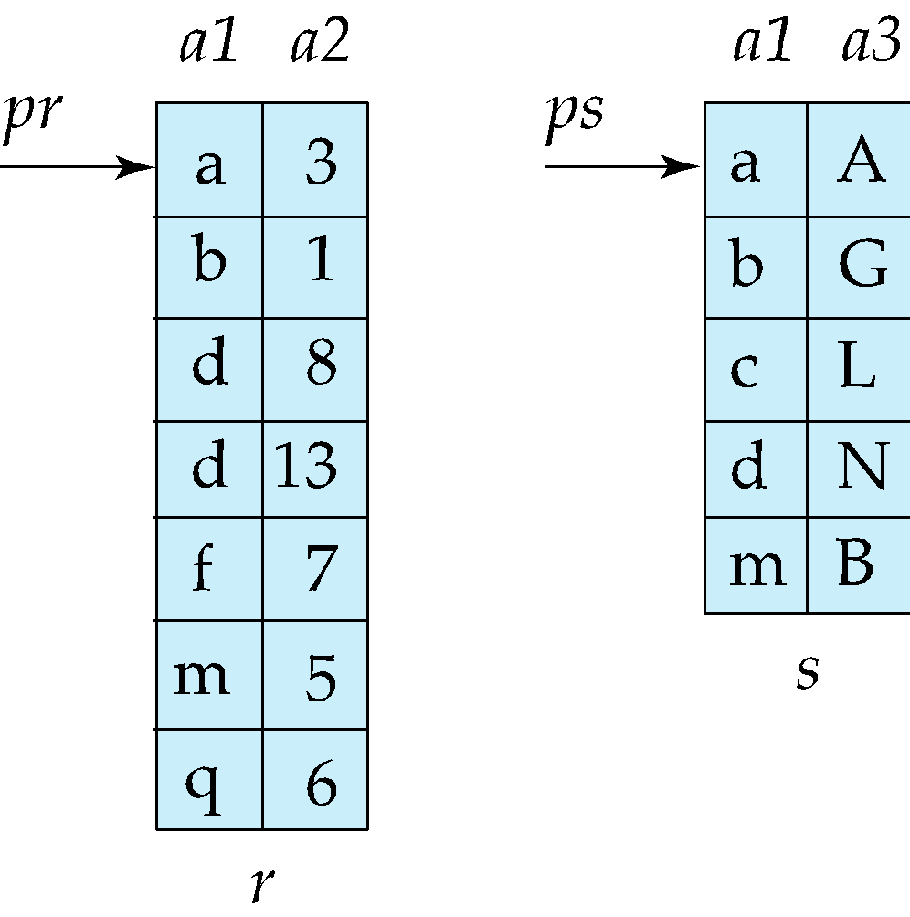
Merge-Join
1. Sort both relations on their join attribute (if not already sorted on the join
attributes).
2. Merge the sorted relations to join them
1. Join step is similar to the merge stage of the sort-merge algorithm.
2. Main difference is handling of duplicate values in join attribute —
every pair with same value on join attribute must be matched
3. Detailed algorithm in book
Hint: Move the pointers if key matches then put it in the output buffer.

Slide 46
Merge-Join (Cont.)
Dominating Factors:
Can I access all the data sequentially through 1 seek: O(b_{r})
How many blocks can be stored in memory for processing: O(b_{r} / b_{b})
Can be used only for equi-joins and natural joins
Each block needs to be read only once (assuming all tuples for any given value of the join attributes fit in memory)
Thus the cost of merge join is: b_{r} + b_{s} block transfers (*all can be hold in memory) + ⎡b_{r} / b_{b}⎤ + ⎡b_{s} / b_{b}⎤ seeks (*not contiguous worst case seeks)
+ the cost of sorting if relations are unsorted.

Slide 47
hybrid merge-join
hybrid merge-join: If one relation is sorted, and the other has a secondary B⁺-tree index on the join attribute
S1: Scan the sorted relation. S2: For each join attribute value, probe the B+-tree of the second relation. S3: Collect all matching leaf entries (these contain record addresses).
S4: Sort those addresses to minimize random access cost. S5: Perform a sequential scan of the second relation in the order of addresses.
The Improvements:
Random access (like following pointers) is costly.
But by sorting the pointers first, you convert many random accesses into sequential disk reads, which are much faster.
Cost:
Reading sorted relation: br
Reading matching entries from B+-tree (cheap due to index structure).
Sorting addresses: depends on number of matches. [Disk based vs memory based]
Reading actual tuples sequentially: fast because of sorted addresses.

Slide 48
Hash-Join
Applicable for equi-joins and natural joins.
A hash function h is used to partition tuples of both relations
h maps JoinAttrs values to {0, 1, ..., n}, where JoinAttrs denotes the common attributes of r and s used in the natural join.
r₀, r₁, . . ., r_{n} denote partitions of r tuples
Each tuple t_{r} ∈ r is put in partition r_{i} where i = h(t_{r} [JoinAttrs]).
r₀,, r₁. . ., r_{n} denotes partitions of s tuples
Each tuple t_{s} ∈s is put in partition s_{i}, where i = h(t_{s} [JoinAttrs]).
Note: In book, Figure 12.10 r_{i} is denoted as H_{ri,} s_{i} is denoted as H_{si} and n is denoted as n_{h.}

Slide 49
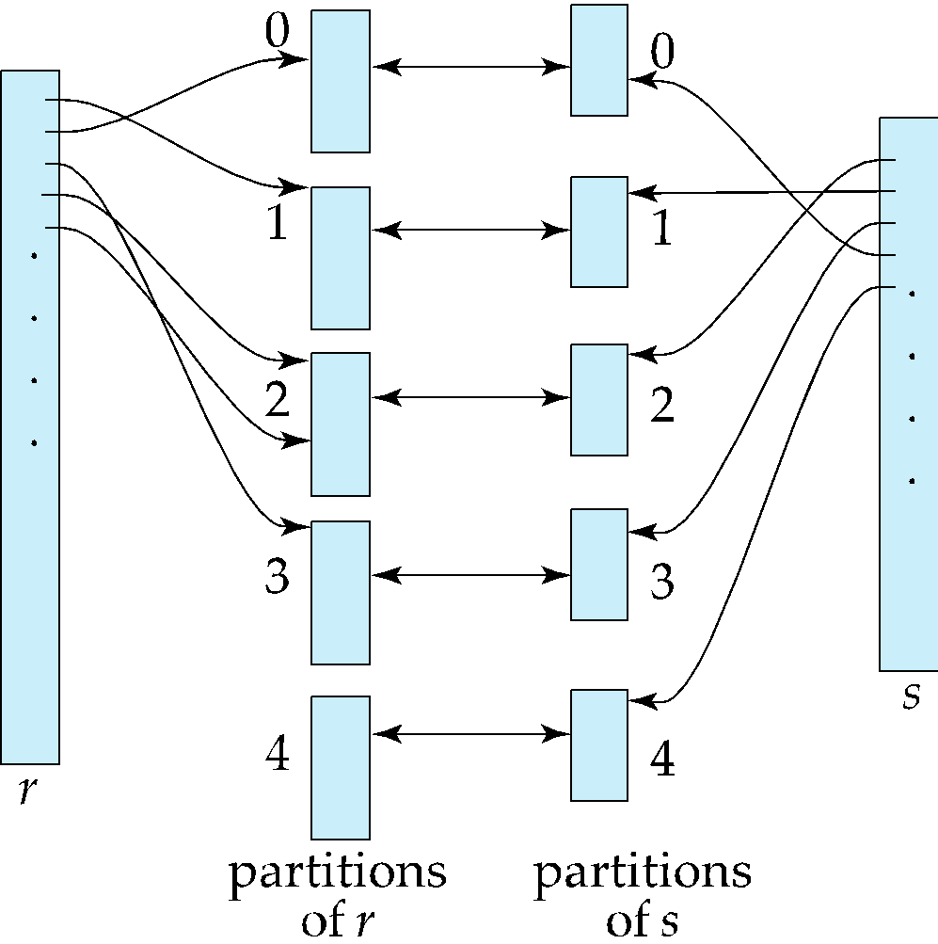
Hash-Join (Cont.)

Slide 50
Hash-Join (Cont.)
r tuples in r_{i} need only to be compared with s tuples in s_{i} Need not be compared with s tuples in any other partition, since:
an r tuple and an s tuple that satisfy the join condition will have the same value for the join attributes.
If that value is hashed to some value i, the r tuple has to be in r_{i} and the s tuple in s_{i}.

Slide 51
Hash-Join Algorithm
The hash-join of r and s is computed as follows.
1. Partition the relation s using hashing function h. When partitioning a relation, one block of memory is reserved as the output buffer for each partition.
2. Partition r similarly.
3. For each i:
(a) Load s_{i} into memory and build an in-memory hash index on it using the join attribute. This hash index uses a different hash function than the earlier one h.
(b) Read the tuples in r_{i} from the disk one by one. For each tuple t_{r} locate each matching tuple t_{s} in s_{i} using the in-memory hash index. Output the concatenation of their attributes.
Relation s is called the build input and r is called the probe input.

Slide 52
Hash-Join algorithm (Cont.)
The value n and the hash function h is chosen such that each s_{i} should fit in memory.
Typically n is chosen as ⎡b_{s}/M⎤ * f where f is a “fudge factor” (safety factor for overhead), typically around 1.2 [ b_{s} = number of blocks for s relation]
The probe relation partitions r_{i} need not fit in memory
Recursive partitioning required if number of partitions n is greater than number of pages M of memory. [Multi level partition tree => so that each partition can hold in main memory]
instead of partitioning n ways, use M – 1 partitions for s (1 block is allocated for handling input)
Further partition the M – 1 partitions using a different hash function (Each level would require different hash functions)
Use same partitioning method on r [apply same level hash functions for r, in each partition]
Rarely required: e.g., with block size of 4 KB, recursive partitioning not needed for relations of < 1GB with memory size of 2MB, or relations of < 36 GB with memory of 12 MB

Slide 53
Handling of Overflows
Partitioning is said to be skewed if some partitions have significantly more tuples than some others
Hash-table overflow occurs in partition s_{i} if s_{i} does not fit in memory. Reasons could be
Many tuples in s with same value for join attributes
Bad hash function
Overflow resolution can be done in build phase (Reactive strategy : things after occurrence).
Partition s_{i} is further partitioned using different hash function. So that partitions can be properly maintained
Partition r_{i} must be similarly partitioned.
Overflow avoidance performs partitioning carefully to avoid overflows during build phase
E.g., partition build relation into many partitions, then combine them (N > M), then merge.
Both approaches fail with large numbers of duplicates
Fallback option: use block nested loops join on overflowed partitions (linking from one block to another, something like closed or open addressing)

Slide 54
Cost of Hash-Join
If recursive partitioning is not required: cost of hash join is 3(b_{r} + b_{s}) +4 * n_{h} block transfers + 2( ⎡b_{r} / b_{b}⎤ + ⎡b_{s} / b_{b}⎤) seeks
If recursive partitioning required:
number of passes required for partitioning build relation s to less than M blocks per partition is ⎡log_{⎣M/bb⎦–1}(b_{s}/M)⎤
best to choose the smaller relation as the build relation.
Total cost estimate is: 2(b_{r} + b_{s}) ⎡log_{⎣M/bb⎦–1}(b_{s}/M)⎤ + b_{r} + b_{s} block transfers + 2(⎡b_{r} / b_{b}⎤ + ⎡b_{s} / b_{b}⎤) ⎡log_{⎣M/bb⎦–1}(b_{s}/M) ⎤ seeks
If the entire build input can be kept in main memory no partitioning is required
Cost estimate goes down to b_{r} + b_{s}.

Slide 55
Cost: No Recursive Partitioning
Phases:
Partition Phase:
Read both r and s once and hash-partition them using a hash function.
Cost: b_{r} + b_{s} block reads and writes.
Probe Phase:
For each partition pair (r_{i}, s_{i}), load s_{i} into memory, scan r_{i}, and perform the join.
Cost: b_{r} + b_{s} block reads.
Overhead for managing n_{h} partitions, each involving setup and cleanup. Per partition for s and r, read and write.
Block Transfers=3(b_{r}+b_{s})+4⋅n_{h}
Seeks=2(⌈b_{r}/b_{b}​⌉+⌈b_{s}/b_{b}​⌉)
1 seek per block read and 1 per block write for each of r and s.

Slide 56
Cost: Recursive Partitioning
Number of Passes Needed:
Passes=⌈log _{⌊M/bb⌋-1} (b_{s}/M)]
This represents how many times we must partition s to get partition sizes < M.
The base ⎣M/bb⎦ - 1 arises because you can only use M – 1 output buffers, each of size bb, for writing out partitions in memory.
Block Transfers=2(b_{r}+b_{s})⋅Passes+b_{r}+b_{s}
2(b_{r} + b_{s}) per pass (read and write for both r and s)
Final b_{r} + b_{s} for the probe phase after partitioning is done.
2(⌈b_{r}/b_{b}​⌉+⌈b_{s}/b_{b}​⌉). Passes
Each block read or write causes a seek during each pass.
This happens when the number of partitions (n) needed exceeds memory limits (i.e., n_{h} > M), or a partition still doesn’t fit in memory even after first-level partitioning.
Multiple passes are needed to recursively partition large partitions.
Each pass reads and writes all of s and r again and again [repeated block transfers]
You repeat this until all partitions of s are ≤ M in size.

Slide 57
Example of Cost of Hash-Join
instructor ⨝ teaches
Assume that memory size is 20 blocks
b_{instructor}= 100 and b_{teaches} = 400.
instructor is to be used as build input. Partition it into five partitions, each of size 20 blocks. This partitioning can be done in one pass.
Similarly, partition teaches into five partitions,each of size 80. This is also done in one pass.
Therefore total cost, ignoring cost of writing partially filled blocks:
3(100 + 400) = 1500 block transfers + 2( ⎡100/3⎤ + ⎡400/3⎤) = 336 seeks

Slide 58
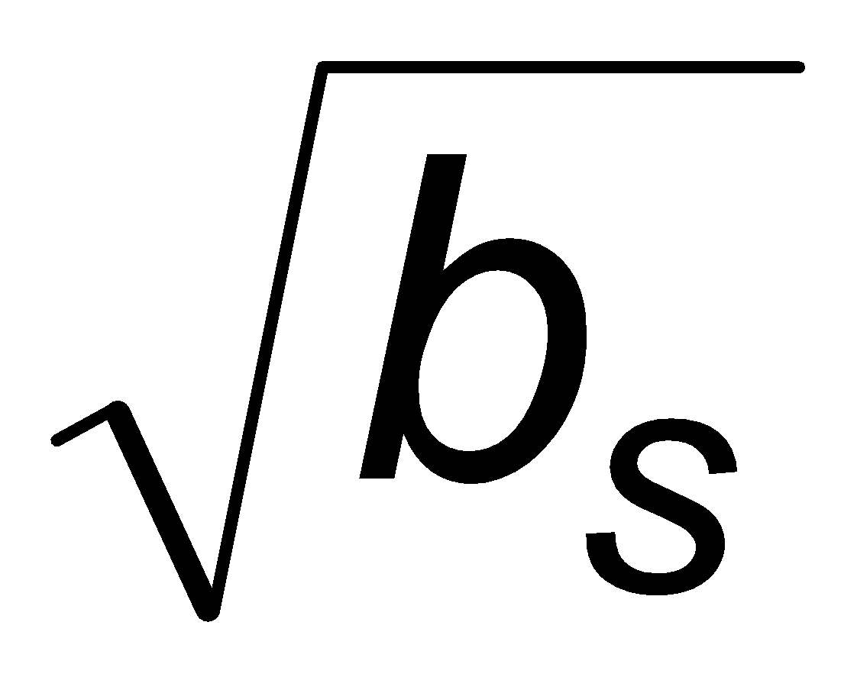
Hybrid Hash–Join
Useful when memory sized are relatively large, and the build input is bigger than memory. [Premise]
Main feature of hybrid hash join:
Keep the first partition of the build relation in memory.
E.g. With memory size of 25 blocks, instructor can be partitioned into five partitions, each of size 20 blocks (let’s say instructor has a total of 100 blocks).
Division of memory:
The first partition occupies 20 blocks of memory
1 block is used for input, and 1 block each for buffering the other 4 partitions.
teaches is similarly partitioned into five partitions each of size 80 (from 400 blocks)
the first is used right away for probing, instead of being written out
Cost of 3(4 * 20 + 4 * 80) + 20 +80 = 1300 block transfers for hybrid hash join, instead of 1500 with plain hash-join. { 3 because for partitioning, we need to read, write and read, 1st block stays in memory}
Hybrid hash-join most useful if M >>

Slide 59
Complex Joins
Join with a conjunctive condition:
r ⨝ _{θ1∧ θ 2∧... ∧ θ n} s
Either use nested loops/block nested loops, or
Compute the result of one of the simpler joins r ⨝ _{θi} s
final result comprises those tuples in the intermediate result that satisfy the remaining conditions
θ₁ ∧ . . . ∧ θ_{i –1} ∧ θ_{i +1} ∧ . . . ∧ θ_{n}
Join with a disjunctive condition
r ⨝ _{θ1 ∨ θ2 ∨... ∨ θn} s
Either use nested loops/block nested loops, or
Compute as the union of the records in individual joins r ⨝ _{θi} s:
(r ⨝ _{θ1} s) ∪ (r ⨝ _{θ2} s) ∪ . . . ∪ (r ⨝ _{θn} s)

Slide 60
Joins over Spatial Data
No simple sort order for spatial joins
Indexed nested loops join with spatial indices
R-trees, quad-trees, k-d-B-trees

Slide 61
Other Operations
Duplicate elimination can be implemented via hashing or sorting.
On sorting duplicates will come adjacent to each other, and all but one set of duplicates can be deleted.
Optimization: duplicates can be deleted during run generation as well as at intermediate merge steps in external sort-merge.
Hashing is similar – duplicates will come into the same bucket.
Projection:
perform projection on each tuple
followed by duplicate elimination.

Slide 62
Other Operations : Aggregation
Aggregation can be implemented in a manner similar to duplicate elimination.
Sorting or hashing can be used to bring tuples in the same group together, and then the aggregate functions can be applied on each group.
Optimization: partial aggregation
combine tuples in the same group during run generation and intermediate merges, by computing partial aggregate values
For count, min, max, sum: keep aggregate values on tuples found so far in the group.
When combining partial aggregate for count, add up the partial aggregates
For avg, keep sum and count, and divide sum by count at the end

Slide 63
Other Operations : Set Operations
Set operations (∪, ∩ and ⎯): can either use variant of merge-join after sorting, or variant of hash-join.
E.g., Set operations using hashing:
1. Partition both relations using the same hash function
2. Process each partition i as follows.
Using a different hashing function, build an in-memory hash index on r_{i}.
Process s_{i} as follows
r ∪ s:
Add tuples in s_{i} to the hash index if they are not already in it.
At end of s_{i} add the tuples in the hash index to the result.

Slide 64
Other Operations : Set Operations
E.g., Set operations using hashing:
1. as before partition r and s,
2. as before, process each partition i as follows
build a hash index on r_{i}
Process s_{i} as follows
r ∩ s:
output tuples in s_{i} to the result if they are already there in the hash index
r – s:
for each tuple in s_{i}, if it is there in the hash index, delete it from the index.
At end of s_{i} add remaining tuples in the hash index to the result.
Notes:
‹#›

Slide 65
Answering Keyword Queries
Indices mapping keywords to documents
For each keyword, store sorted list of document IDs that contain the keyword
Commonly referred to as a inverted index
E.g.,: database: d1, d4, d11, d45, d77, d123 distributed: d4, d8, d11, d56, d77, d121, d333
To answer a query with several keywords, compute intersection of lists corresponding to those keywords
To support ranking, inverted lists store extra information
“Term frequency” of the keyword in the document
“Inverse document frequency” of the keyword
Page rank of the document/web page

Slide 66

Other Operations : Outer Join
Outer join can be computed either as
A join followed by addition of null-padded non-participating tuples.
by modifying the join algorithms.
Modifying merge join to compute r ⟕ s
In r ⟕ s, non participating tuples are those in r – Π_{R}(r ⨝ s)
Modify merge-join to compute r ⟕ s:
During merging, for every tuple t_{r} from r that do not match any tuple in s, output t_{r} padded with nulls.
Right outer-join and full outer-join can be computed similarly.

Slide 67
Other Operations : Outer Join
Modifying hash join to compute r ⟕ s
If r is probe relation, output non-matching r tuples padded with nulls
If r is build relation, when probing keep track of which r tuples matched s tuples. At end of s_{i} output non-matched r tuples padded with nulls
Notes:
‹#›

Slide 68
Evaluation of Expressions
So far: we have seen algorithms for individual operations
Alternatives for evaluating an entire expression tree
Materialization: generate results of an expression whose inputs are relations or are already computed, materialize (store) it on disk. Repeat.
Pipelining: pass on tuples to parent operations even as an operation is being executed
We study above alternatives in more detail

Slide 69
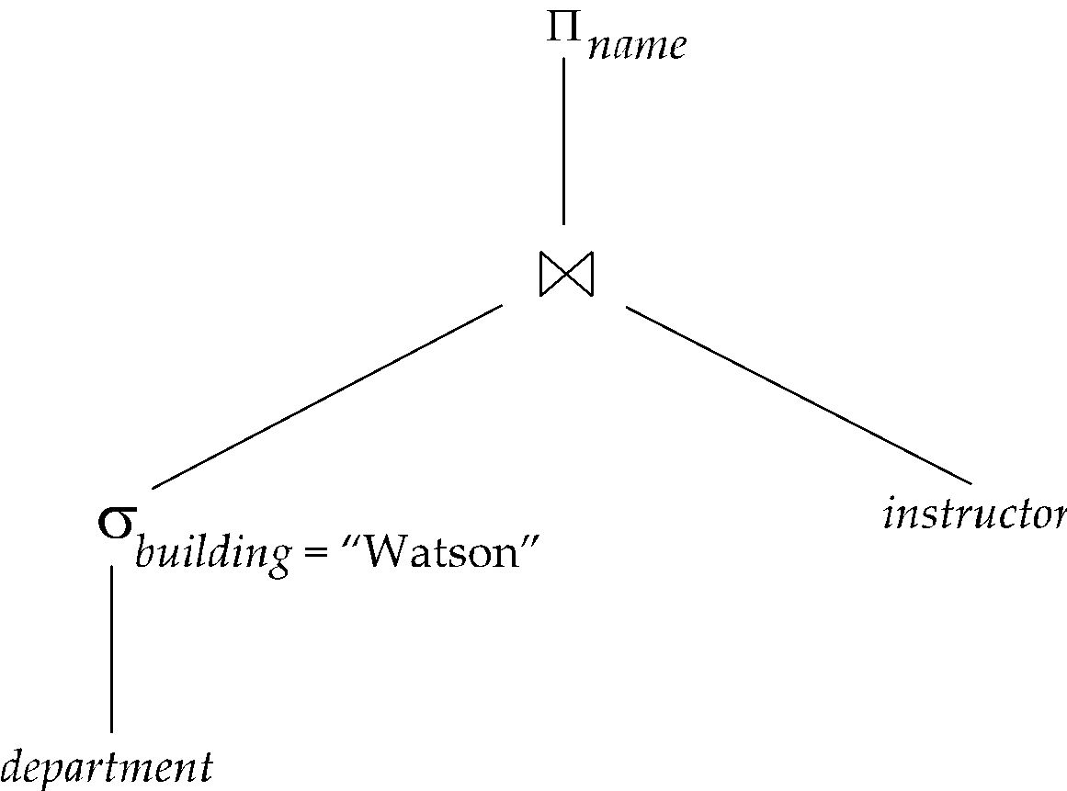
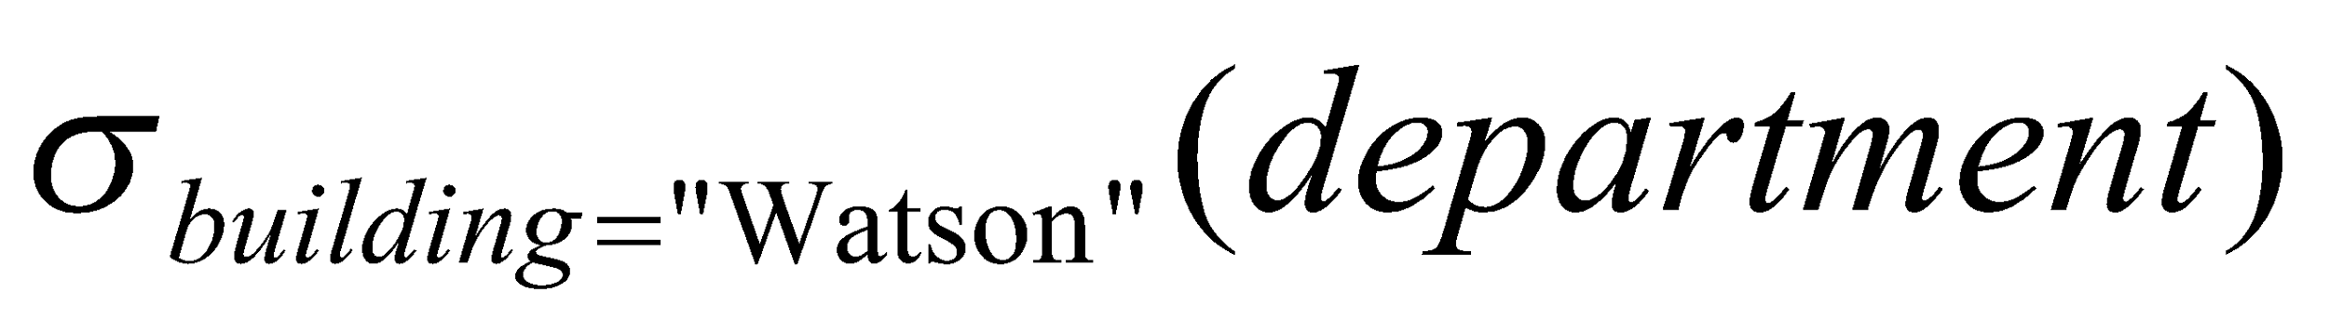
Materialization
Materialized evaluation: evaluate one operation at a time, starting at the lowest-level. Use intermediate results materialized into temporary relations to evaluate next-level operations.
E.g., in figure below, compute and store then compute the store its join with instructor, and finally compute the projection on name.

Slide 70
Materialization (Cont.)
Materialized evaluation is always applicable
Cost of writing results to disk and reading them back can be quite high
Our cost formulas for operations ignore cost of writing results to disk, so
Overall cost = Sum of costs of individual operations + cost of writing intermediate results to disk
Double buffering: use two output buffers for each operation, when one is full write it to disk while the other is getting filled
Allows overlap of disk writes with computation and reduces execution time

Slide 71
Pipelining [Not wait for full processing, process simultaneously]
Pipelined evaluation: evaluate several operations simultaneously, passing the results of one operation on to the next.
E.g., in previous expression tree, don’t store result of
instead, pass tuples directly to the join.. Similarly, don’t store result of join, pass tuples directly to projection. [Produce 1 tuple -> send it to parent, produce 2nd tuple send it to parent, etc. => multiple operations are being performed simultaneously]
Much cheaper (in cost) than materialization: no need to store a temporary relation to disk.
Pipelining may not always be possible – e.g., sort, hash-join. [Full result computation is required]
For pipelining to be effective, use evaluation algorithms that generate output tuples even as tuples are received for inputs to the operation.
Pipelines can be executed in two ways: demand driven and producer driven

Slide 72
Pipelining (Cont.)
In demand driven or lazy evaluation
system repeatedly requests next tuple from top level operation
Each operation requests next tuple from children operations as required, in order to output its next tuple
In between calls, operation has to maintain “state” so it knows what to return next
In producer-driven or eager pipelining
Operators produce tuples eagerly and pass them up to their parents
Buffer maintained between operators, child puts tuples in buffer, parent removes tuples from buffer
if buffer is full, child waits till there is space in the buffer, and then generates more tuples
System schedules operations that have space in output buffer and can process more input tuples
Alternative name: pull and push models of pipelining

Slide 73
Demand-Driven / Lazy Evaluation / Pull Model
How It Works:
The top-level operation (e.g., SELECT) requests the next tuple from its child (e.g., a join).
That child, in turn, asks its own child (e.g., a scan or filter) for a tuple.
This chain continues until a base operator (like a table scan) returns a tuple.
The tuple then "bubbles up" the tree.
Key Idea:
Each operator pulls data from its child only when it needs to output the next tuple.
State Maintenance:
Since operators are called repeatedly (e.g., getNext()), they must maintain internal state between calls.
Example: a join operator must remember which tuple pairs it has already tried, so it can resume where it left off.
✅ Pros:
Simple control flow: only compute what is requested.
Memory efficient: doesn't buffer large numbers of tuples.
❌ Cons:
May result in inefficient use of CPU if child operators are called frequently but return few or no results.

Slide 74
Pipelining (Cont.)
Implementation of demand-driven pipelining
Each operation is implemented as an iterator implementing the following operations
open()
E.g., file scan: initialize file scan
state: pointer to beginning of file
E.g., merge join: sort relations;
state: pointers to beginning of sorted relations
next()
E.g., for file scan: Output next tuple, and advance and store file pointer
E.g., for merge join: continue with merge from earlier state till next output tuple is found. Save pointers as iterator state.
close()

Slide 75
Producer-Driven / Eager Evaluation / Push Model
🔧 How It Works:
The base operators (e.g., scans) start producing tuples eagerly.
They push their output tuples into a buffer connected to their parent operator.
Parent operators pull from the buffer when they're ready to process more tuples.
🧠 Key Idea:
Data flows from the bottom up, and operators push tuples into the system as they are generated.
🔄 Buffering:
A buffer is used between each pair of operators.
If the buffer is full, the child must wait (i.e., the pipeline is backpressured).
The system’s scheduler determines which operators can run, based on buffer availability.
✅ Pros:
Potentially better CPU utilization by parallelizing operators. (DFS-alike holding vs parallel computation
Good for streaming results and pipelining over data-intensive tasks.
❌ Cons:
More complex to manage (buffering, scheduling).
May use more memory.

Slide 76
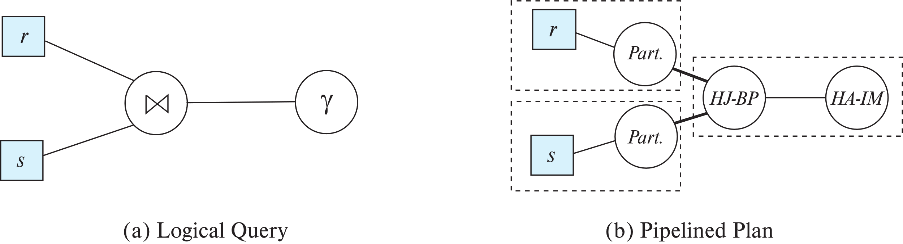
Blocking Operations
Blocking operations: cannot generate any output until all input is consumed
E.g., sorting, aggregation, …
But can often consume inputs from a pipeline, or produce outputs to a pipeline
Key idea: blocking operations often have two suboperations (build & Produce)
E.g., for sort: run generation and merge
For hash join: partitioning and build-probe
Treat them as separate operations (Build vs Produce)

Slide 77
Blocking Operations (Example)
1. Sorting Operation
a. Run Generation Phase (Blocking)
Input tuples are read (possibly pipelined from a child operator).
Tuples are sorted in-memory until memory fills up.
When memory is full, sorted "runs" are written to disk.
Repeat until all input is consumed.
b. Merge Phase (Output)
Merge the sorted runs (using external merge sort).
As tuples are merged, they are output one-by-one, enabling them to be pipelined to the next operator.
✅ So, while sorting blocks initially, it can resume pipelining in the second phase.
2. Hash Join Operation (Classic)
Suppose we’re joining R ⋈ S on attribute A.
a. Partitioning / Build Phase (Blocking)
All tuples of the build relation (say, S) are read.
A hash table is built on attribute A.
b. Probe Phase (Output)
Tuples from the probe relation (R) are read.
Each R tuple probes the hash table.
If a match is found, the joined tuple is output immediately (now pipelining is possible again).
✅ Again, the blocking is confined to the build step; pipelining resumes in the probe step.

Slide 78
Pipeline Stages (Concurrent Processing)
Pipeline stages:
All operations in a stage run concurrently
A stage can start only after preceding stages have completed execution

Slide 79
Evaluation Algorithms for Pipelining
Some algorithms are not able to output results even as they get input tuples
E.g., merge join, or hash join
intermediate results written to disk and then read back
Algorithm variants to generate (at least some) results on the fly, as input tuples are read in
E.g., hybrid hash join generates output tuples even as probe relation tuples in the in-memory partition (partition 0) are read in
Double-pipelined join technique: Hybrid hash join, modified to buffer partition 0 tuples of both relations in-memory, reading them as they become available, and output results of any matches between partition 0 tuples
When a new r₀ tuple is found, match it with existing s₀ tuples, output matches, and save it in r₀
Symmetrically for s₀ tuples

Slide 80
Pipelining for Continuous-Stream Data
Data streams
Data entering database in a continuous manner
E.g., Sensor networks, user clicks, …
Continuous queries
Results get updated as streaming data enters the database
Aggregation on windows is often used
E.g., tumbling windows divide time into units, e.g., hours, minutes
Need to use pipelined processing algorithms
Punctuations (special markers) used to infer when all data for a window has been received

Slide 81
Query Processing in Memory
Query compilation to machine code
Overheads of interpretation
E.g., repeatedly finding attribute location within tuple, from metadata
Overhead of expression evaluation
Compilation can avoid many such overheads and speed up query processing
Often via generation of Java byte code / LLVM, with just-in-time (JIT) compilation
Column-oriented storage
Allows vector operations (in conjunction with compilation)
Cache conscious algorithms

Slide 82
Query Processing In Memory: Why Optimize Query Execution?
Traditional DBMSes often interpret query plans ( resolving the queries) — which is flexible, but slow due to:
Interpretation overhead: Every row or operation is evaluated with lots of metadata lookups and function calls.
Cache misses: Poor memory locality in traditional row-wise storage.
Repeated logic: Same operations are re-evaluated for each tuple.
To address this, modern systems use query compilation, column-oriented storage, and cache-conscious designs.

Slide 83
Query Compilation to Machine Code
“SELECT salary * 1.1 FROM Employee WHERE age > 30;”
Compilation Approach:
Instead, the system generates optimized machine code (conversion to a code) that:
Accesses attributes directly (no metadata lookup).
Inlines expressions (salary * 1.1 becomes a native machine multiply).
Avoids general-purpose interpreter overhead.
🔧 Implementation:
LLVM: Used to generate highly optimized native code (C-like performance).
Java bytecode: Some systems (like Apache Flink) generate JVM bytecode and use the JIT compiler.
A traditional system would:
Use metadata to locate salary and age in each tuple.
Evaluate the filter (age > 30) and expression (salary * 1.1) through function pointers or interpreted logic.
Do this repeatedly for every tuple.
Benefits: Massive speedups

Slide 84
column oriented storage
Traditional
[ id | name | age | salary ]
[ 1 | Joe | 28 | 50000 ]
(Bad for analytical queries that only need a few columns (e.g., salary, age). Find attribute location -> filtering -> processing)
vs
id: [1, 2, 3, 4, ...]
name: [Joe, Mary, ...]
age: [28, 35, 42, ...]
salary: [50000, 70000, ...]
Benefits:
Excellent for queries that:
Read a few columns
Apply filters or aggregation
Enables vectorized processing — operating on entire arrays of data.

Slide 85
Vectorized Execution
Instead of processing one row at a time, modern systems:
Load an entire vector/batch (e.g., 1024 values).
Apply operations (filter, add, multiply) in bulk, often using SIMD (Single Instruction, Multiple Data).
Further boosts CPU throughput and cache utilization.
“ SELECT AVG(salary) FROM Employee WHERE age > 30, ”
Optimized solution:
→ Scan the age column (vector of 1024), compute a bitmap of rows where age > 30, then apply it to salary.

Slide 86
Cache Conscious Algorithms
Modern CPUs are very fast, but memory access is very slow unless the data is in cache (L1, L2, L3).
Problem:
Row-based scans or poor memory layout → lots of cache misses → slow performance.
Solution:
Design algorithms to:
Access data sequentially (e.g., column vectors).
Minimize pointer chasing.
Use compact data structures that fit in cache.
Examples:
Cache-conscious B-trees: Nodes sized to fit cache lines.
Hash joins: With bucket buffers in cache.
Tiling: Break large computations into cache-sized blocks

Slide 87
Cache Conscious Algorithms
Goal: minimize cache misses, make best use of data fetched into the cache as part of a cache line
For sorting:
Use runs that are as large as L3 cache (a few megabytes) to avoid cache misses during sorting of a run
Then merge runs as usual in merge-sort
For hash-join
First create partitions such that build+probe partitions fit in memory
Then subpartition further s.t. build subpartition+index fits in L3 cache
Speeds up probe phase significantly by avoiding cache misses
Lay out attributes of tuples to maximize cache usage
Attributes that are often accessed together should be stored adjacent to each other
Use multiple threads for parallel query processing
Cache misses leads to stall of one thread, but others can proceed

Slide 88
End of Chapter 15

