Slide 1
Chapter 20: Database System Architectures

Slide 2
Outline
Centralized Database Systems
Server System Architectures
Parallel Systems
Distributed Systems
Network Types

Slide 3
Centralized Database Systems
centralized database system is that all data is stored, managed, and processed on a single centralized server or system
Run on a single computer system
Single-user system
Multi-user systems also known as server systems.
Service requests received from client systems
Multi-core systems with coarse-grained parallelism
Typically, a few to tens of processor cores
In contrast, fine-grained parallelism uses very large number of computers or nodes [Not belong to centralized database systems, rather distributed database systems]
coarse-grained parallelism | Few big tasks across few (4–64) CPU cores
fine-grained parallelism | Many tiny tasks across many machines or processors
Horizontal scaling (Scale out) : increasing the number of machines/nodes in the cluster
Vertical scaling (Scale Up): increasing the number of CPUs, RAM, Storage

Slide 4
Server System Architecture
Server systems can be broadly categorized into two kinds:
Transaction servers
Widely used in relational database systems, and
Ensure ACID Properties: Consistency, Atomicity, Isolation, and Durability.
Data servers
Parallel data servers used to implement high-performance transaction processing systems

Slide 5
Transaction Servers
Also called query server systems or SQL server systems
Clients send requests to the server
Transactions are executed at the server
Results are shipped back to the client.
Requests are specified in SQL and communicated to the server through a remote procedure call (RPC) mechanism.
SQL: SELECT * FROM Orders WHERE CustomerID = 5;
RPC: Call executeSQL("SELECT * FROM Orders WHERE CustomerID = 5")
Transactional RPC allows many RPC calls to form a transaction. So any of the failing or RPC call will revert back all the previous calls.
1. StartTransaction(), 2. RPC: Insert new order, 3. RPC: Update customer balance 4. RPC: Deduct inventory, 5.CommitTransaction()
Applications typically use ODBC/JDBC APIs to communicate with transaction servers
Connection conn = DriverManager.getConnection(url, user, pass);
conn.setAutoCommit(false);
Statement stmt = conn.createStatement();
stmt.executeUpdate("UPDATE accounts SET balance = balance - 100 WHERE id = 1");
stmt.executeUpdate("UPDATE accounts SET balance = balance + 100 WHERE id = 2");
conn.commit();
Example with JDBC

Slide 6
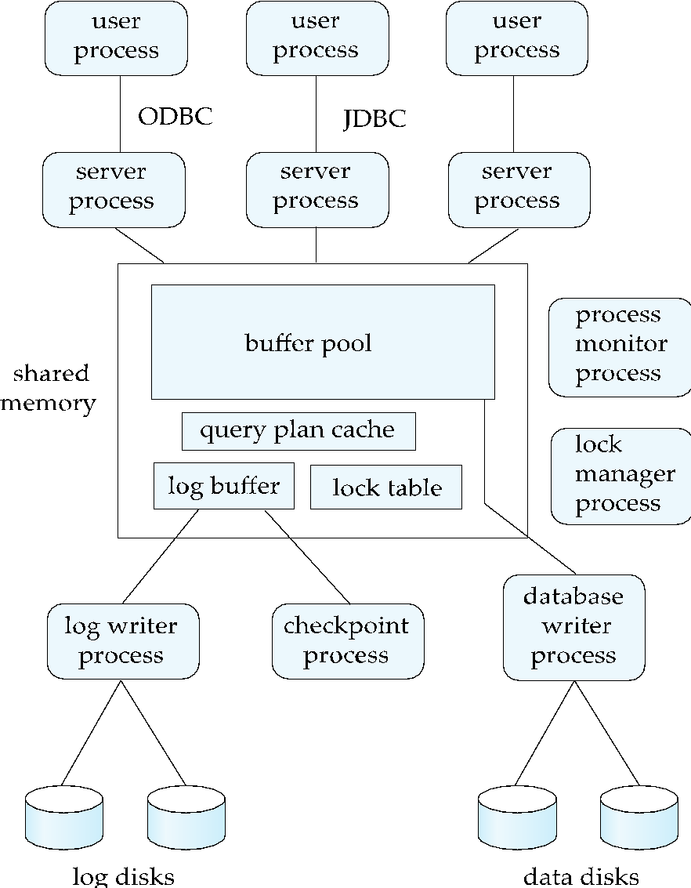
Transaction System Processes (Cont.)

Slide 7
Transaction Server Process Structure
A typical transaction server consists of multiple processes accessing data in shared memory
Shared memory contains shared data
Buffer pool [For buffering]
Lock table [Lock Mechanism]
Log buffer [Activity Logging]
Cached query plans (reused if same query submitted again)
All database processes can access shared memory
Server processes
These receive user queries (transactions), execute them and send results back
Processes may be multithreaded, allowing a single process to execute several user queries concurrently
Typically, multiple multithreaded server processes

Slide 8
Transaction Server Processes (Cont.)
Database writer process
Output modified buffer blocks to disks continually
Log writer process
Server processes simply add log records to log record buffer
Log writer process outputs log records to stable storage.
Checkpoint process
Performs periodic checkpoints
Process monitor process
Monitors other processes, and takes recovery actions if any of the other processes fail
E.g. aborting any transactions being executed by a server process and restarting it

Slide 9
Transaction System Processes (Cont.)
Lock manager process
To avoid overhead of interprocess communication for lock request/grant, each database process operates directly on the lock table
Instead of sending requests to lock manager process
Lock manager process still used for deadlock detection
To ensure that no two processes are accessing the same data structure at the same time, databases systems implement mutual exclusion using either
Atomic instructions
Test-And-Set
Compare-And-Swap (CAS)
Operating system semaphores
Higher overhead than atomic instructions
Important for process synchronization and mutual exclusion
a semaphore is a synchronization primitive used to control access to shared resources in a concurrent system like multitasking processes or threads.
wait() (also called P() or down())
signal() (also called V() or up())

Slide 10
Atomic Instructions
Test-And-Set(M)
Memory location M, initially 0
Test-and-set(M) sets M to 1, and returns old value of M
Return value 0 indicates process has acquired the mutex
Return value 1 indicates someone is already holding the mutex
Must try again later
Release of mutex done by setting M = 0
// Lock variable
int M = 0;
// Process trying to acquire the lock
while (TestAndSet(M) == 1) {
// Busy-wait (spinlock)
}
// Critical section
// ...
// Release the lock
M = 0;

Slide 11
Atomic Instructions
Compare-and-swap(M, V1, V2)
Atomically do following
If M = V1, set M = V2 and return success
Else return failure
With M = 0 initially, CAS(M, 0, 1) equivalent to test-and-set(M)
Can use CAS(M, 0, id) where id = thread-id or process-id to record who has the mutex

Slide 12
Data Servers/Data Storage Systems
Data items are shipped to clients where processing is performed. Instead of doing heavy computation or query processing on the server, the raw data is sent to the client, which does the necessary processing (e.g., filtering, aggregating).This system is known as client-centric system. E.g., Edge Computing.
Updated data items written back to server. [Persistency]
Earlier generation data servers operated on disk pages, each potentially containing multiple data items, or occasionally at the level of individual items. In contrast, current-generation data storage systems operate exclusively at the level of individual data items.
Current generation commonly includes:
Commonly used data item formats include JSON, XML, or just uninterpreted binary strings

Slide 13
Data Servers/Storage Systems (Cont.)
Prefetching
Prefetch items that may be used soon
Data caching
Cache coherence
Lock caching
Locks can be cached by client across transactions
Locks can be called back by the server
Adaptive lock granularity
Lock granularity escalation
switch from finer granularity (e.g. tuple) lock to coarser
Lock granularity de-escalation
Start with coarse granularity to reduce overheads, switch to finer granularity in case of more concurrency conflict at server
Details in book

Slide 14
Data Servers (Cont.)
Data Caching
Data can be cached at client even in between transactions
But check that data is up-to-date before it is used (cache coherency)
Check can be done when requesting lock on data item
Lock Caching (not immediate release of the lock after transaction execution)
Locks can be retained by client system even in between transactions
Transactions can acquire cached locks locally, without contacting server
Server calls back locks from clients when it receives conflicting lock request. If another client requests a lock that conflicts (e.g., wants to write to the same data), the server sends a callback to the caching client: return the lock
If any local transaction is using it, it can not return, otherwise it returns
Client returns lock once no local transaction is using it.
This idea is similar to lock callback on prefetch, but across transactions, keeping lock though the transaction has already ended.

Slide 15
Parallel Systems
Parallel database systems consist of multiple processors and multiple disks connected by a fast interconnection network.
Motivation: handle workloads beyond what a single computer system can handle
High performance transaction processing
E.g. handling user requests at web-scale
Decision support on very large amounts of data
E.g. data gathered by large web sites/apps

Slide 16
Parallel Systems (Cont.)
A coarse-grain parallel machine consists of a small number of powerful processors
A massively parallel or fine grain parallel machine utilizes thousands of smaller processors.
Typically hosted in a data center
Two main performance measures:
Throughput --- the number of tasks that can be completed in a given time interval
Response time --- the amount of time it takes to complete a single task from the time it is submitted

Slide 17
Speed-Up and Scale-Up
Speedup: a fixed-sized problem executing on a small system is given to a system which is N-times larger.
Measured by:
speedup = small system elapsed time
large system elapsed time
Speedup is linear if equation equals N.
Scaleup: increase the size of both the problem and the system
N-times larger system used to perform N-times larger job
Measured by:
scaleup = small system small problem elapsed time
big system big problem elapsed time
Scale up is linear if equation equals 1.

Slide 18
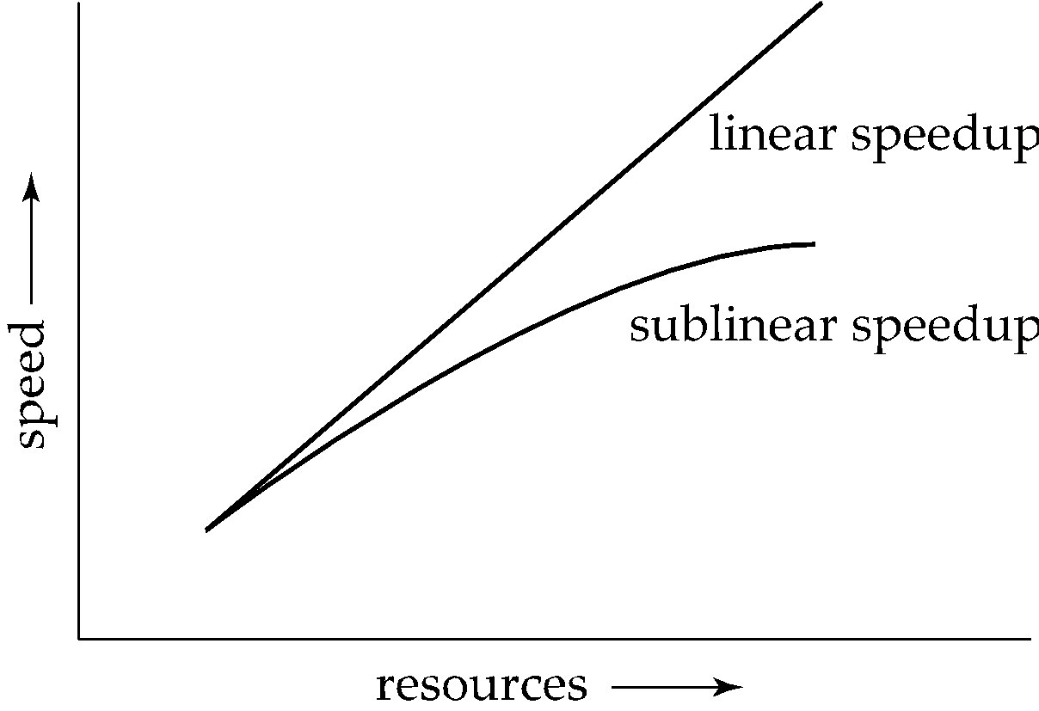
Speedup

Slide 19
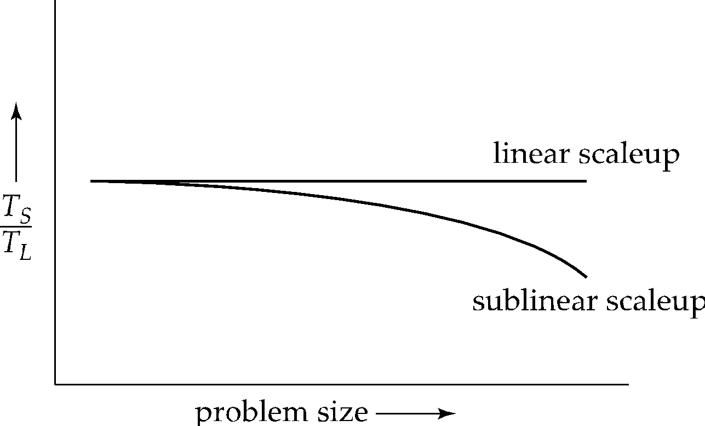
Scaleup

Slide 20
Batch and Transaction Scaleup
Batch scaleup:
A single large job; typical of most decision support queries and scientific simulation.
Use an N-times larger computer on N-times larger problem.
Transaction scaleup:
Numerous small queries submitted by independent users to a shared database; typical transaction processing and timesharing systems.
N-times as many users submitting requests (hence, N-times as many requests) to an N-times larger database, on an N-times larger computer.
Well-suited to parallel execution.

Slide 21
Factors Limiting Speedup and Scaleup
Speedup and scaleup are often sublinear due to:
Startup/sequential costs: Cost of starting up multiple processes, and sequential computation before/after parallel computation
May dominate computation time, if the degree of parallelism is high
Suppose p fraction of computation is sequential
Amdahl’s law: speedup limited to: 1 / [(1-p)+(p/n)]
Gustafson’s law: scaleup limited to: 1 / [n(1-p)+p]
Interference: Processes accessing shared resources (e.g.,system bus, disks, or locks) compete with each other, thus spending time waiting on other processes, rather than performing useful work.
Skew: Increasing the degree of parallelism increases the variance in service times of parallely executing tasks. Overall execution time determined by slowest of parallely executing tasks.

Slide 22
Interconnection Network Architectures
Bus. System components send data on and receive data from a single communication bus;
Does not scale well with increasing parallelism.
Mesh. Components are arranged as nodes in a grid, and each component is connected to all adjacent components
Communication links grow with growing number of components, and so scales better.
But may require 2√n hops to send message to a node (or √n with wraparound connections at edge of grid).
Hypercube. Components are numbered in binary; components are connected to one another if their binary representations differ in exactly one bit.
n components are connected to log(n) other components and can reach each other via at most log(n) links; reduces communication delays.
Tree-like Topology. Widely used in data centers today

Slide 23
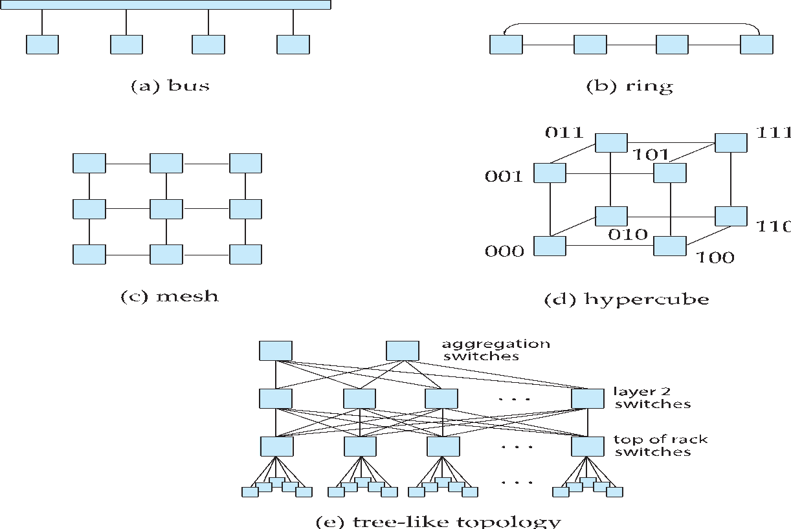
Interconnection Architectures

Slide 24
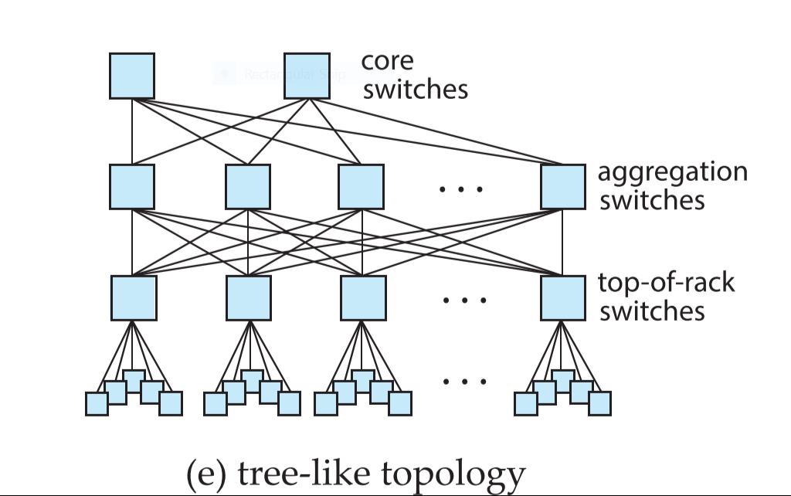
Interconnection Network Architectures
Tree-like or Fat-Tree Topology: widely used in data centers today
Top of rack switch for approx 40 machines in rack
Each top of rack switch connected to multiple aggregation switches.
Aggregation switches connect to multiple core switches.
Data center fabric

Slide 25
Network Technologies
Ethernet
1 Gbps and 10 Gbps common, 40 Gbps and 100 Gbps are available at higher cost
Fiber Channel
32-138 Gbps available
Infiniband
A very-low-latency networking technology
0.5 to 0.7 microseconds, compared to a few microseconds for optimized ethernet

Slide 26
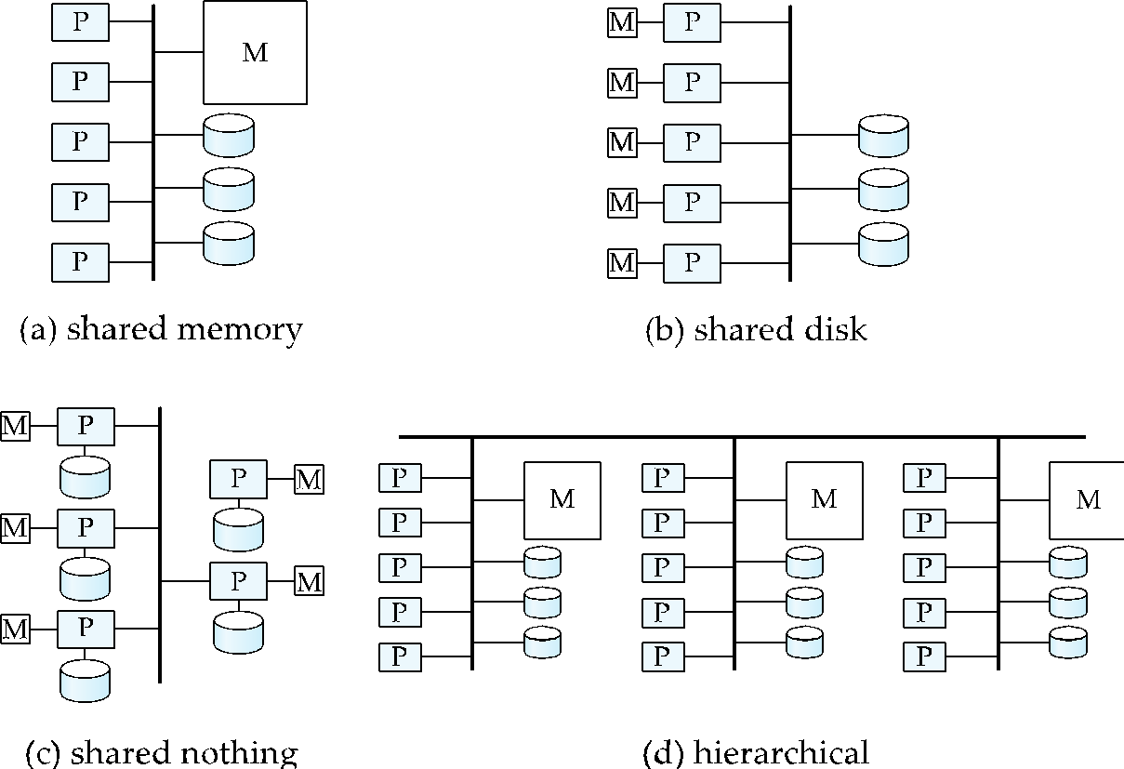
Parallel Database Architectures

Slide 27
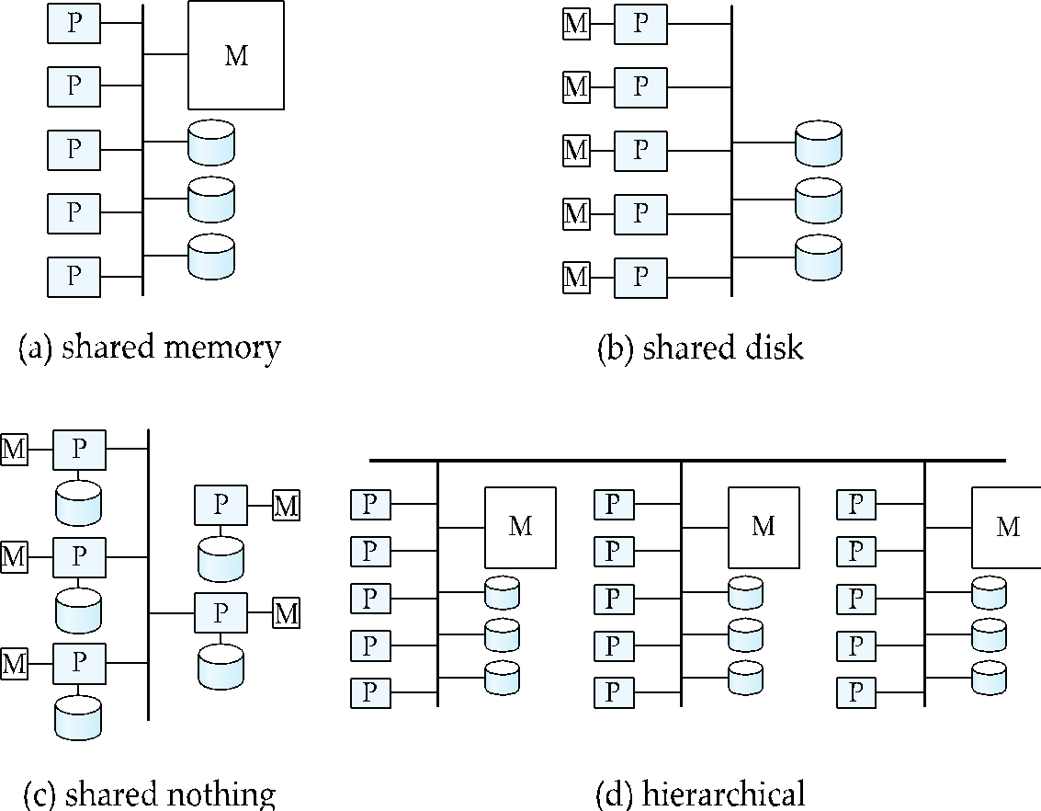
Shared Memory
Processors (or processor cores) and disks have access to a common memory
Via a bus in earlier days, through an interconnection network today
Extremely efficient communication between processors
Downside: shared-memory architecture is not scalable beyond 64 to 128 processor cores
Memory interconnection network becomes a bottleneck

Slide 28
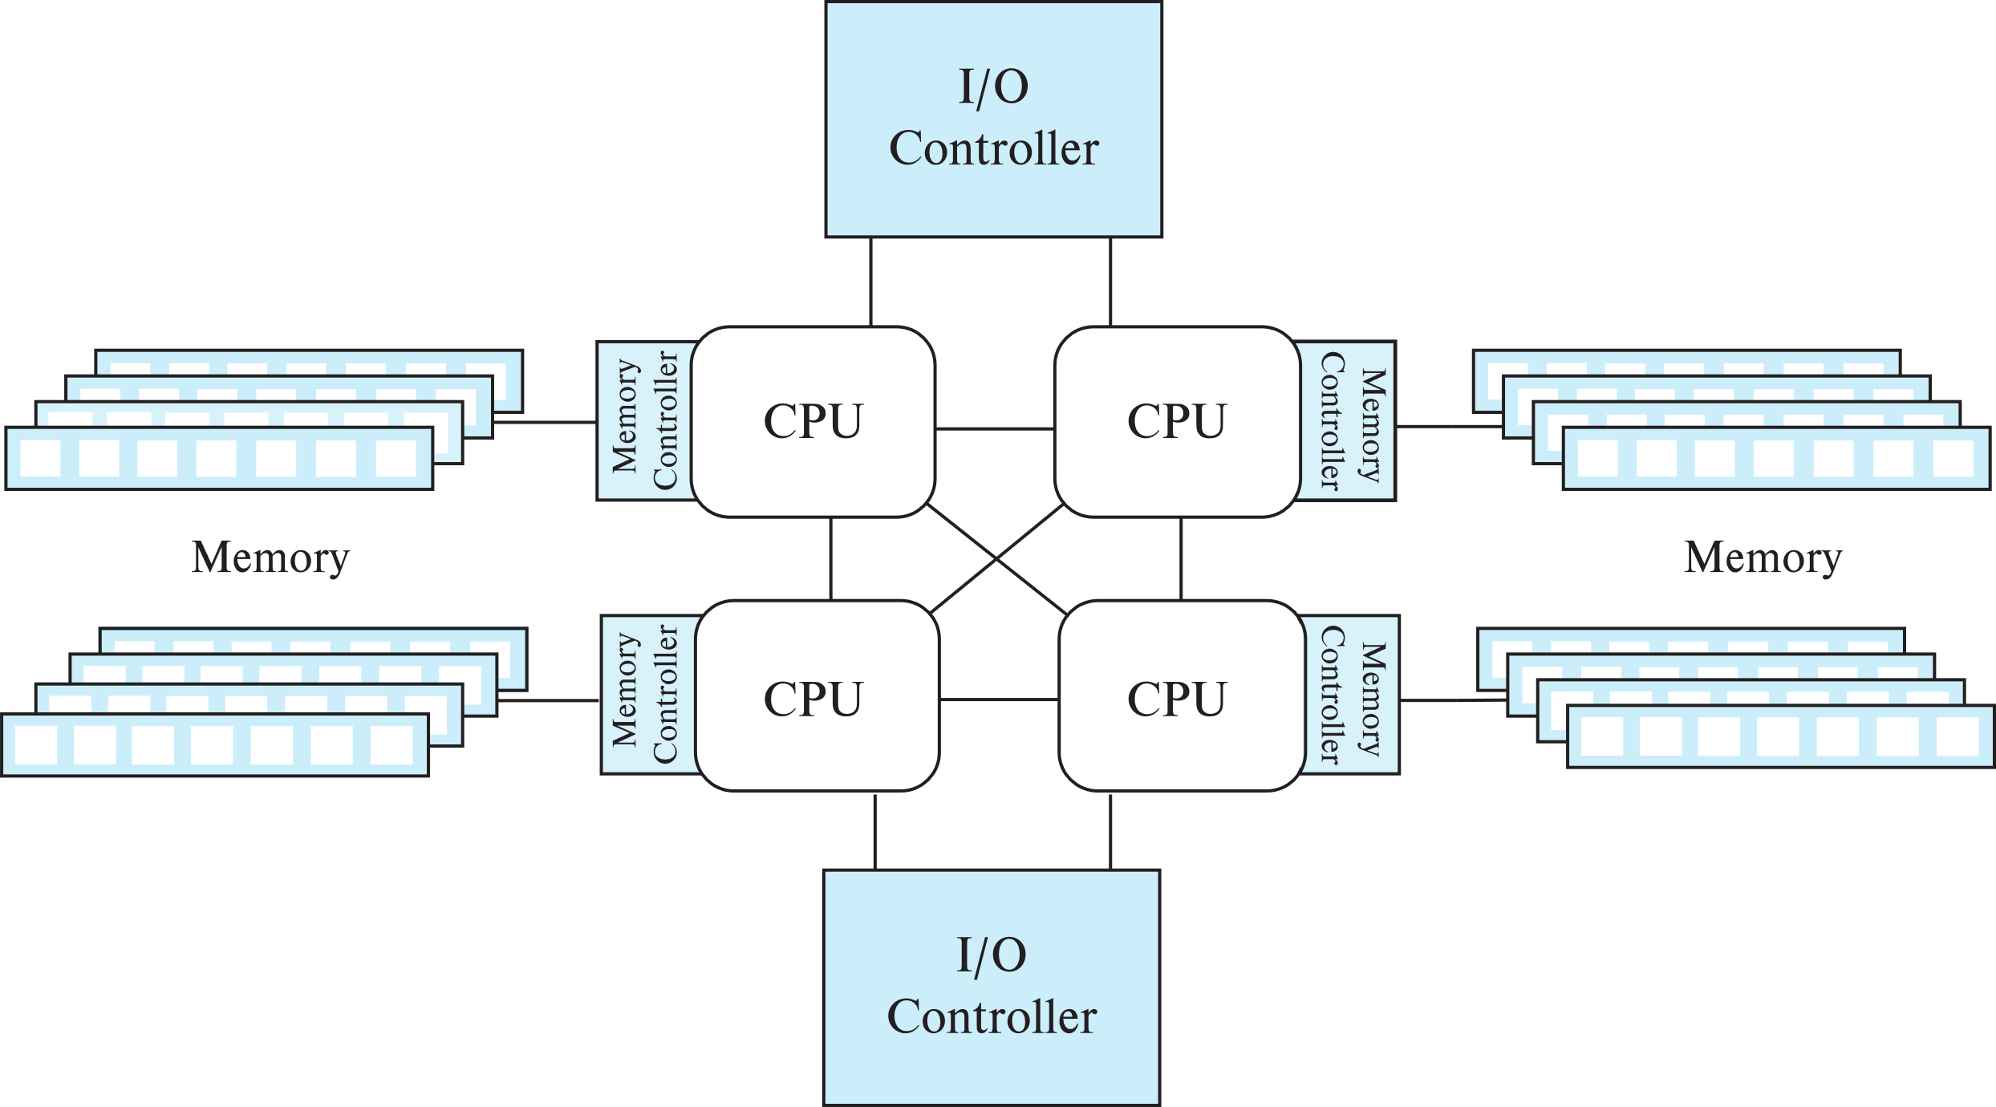
Modern Shared Memory Architecture

Slide 29
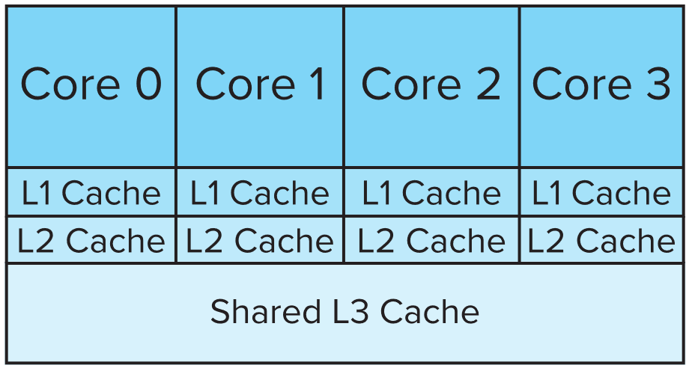
Cache Levels
Cache line: typically 64 bytes in today’s processors
Cache levels within a single multi-core processor
Shared memory system can have multiple processors, each with its own cache levels

Slide 30
Cache Coherency
Cache coherency:
Local cache may have out of date value
Strong vs weak consistency models
With weak consistency, need special instructions to ensure cache is up to date
Memory barrier instructions
Store barrier (sfence)
Instruction returns after forcing cached data to be written to memory and invalidations sent to all caches
Load barrier (lfence)
Returns after ensuring all pending cache invalidations are processed
mfence instruction does both of above
Locking code usually takes care of barrier instructions
Lfence done after lock acquisition and sfence done before lock release

Slide 31
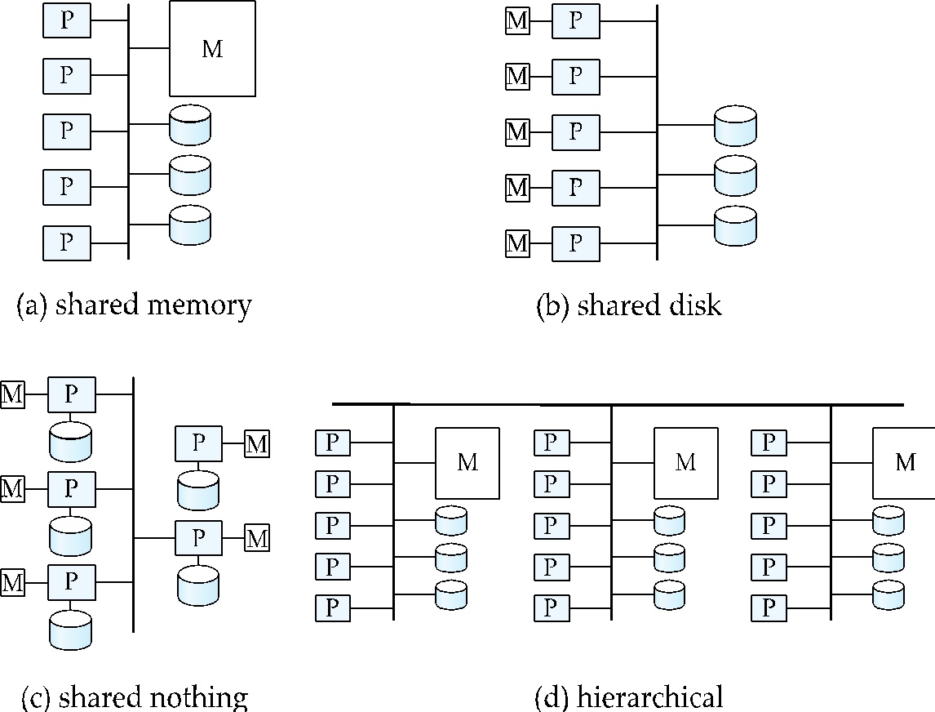
Shared Disk
All processors can directly access all disks via an interconnection network, but the processors have private memories.
Architecture provides a degree of fault-tolerance — if a processor fails, the other processors can take over its tasks
the data of the failed processor is resident on disks that are accessible from all processors.
Downside: bottleneck now occurs at interconnection to the disk subsystem.

Slide 32
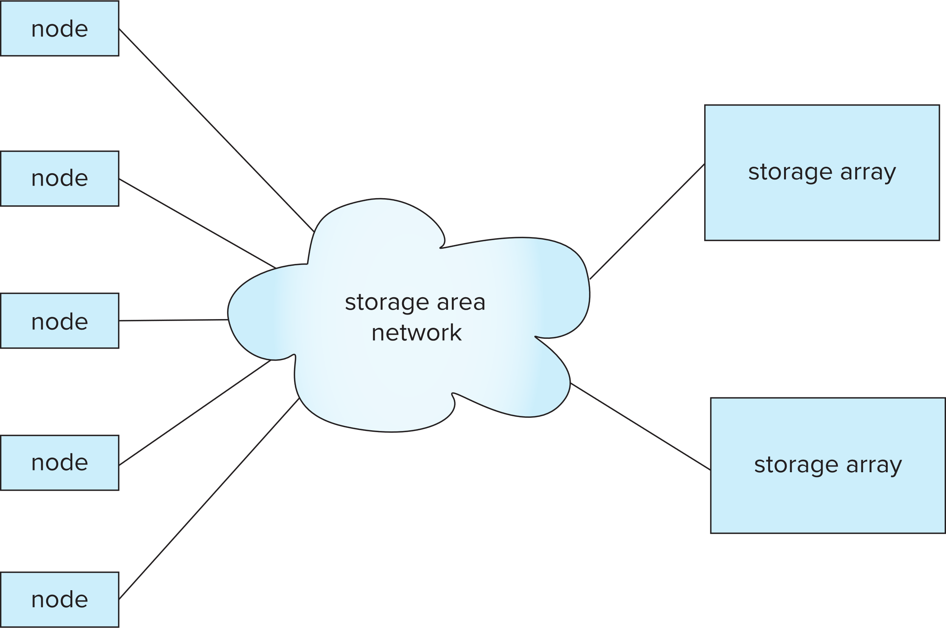
Storage Area Network (SAN)

Slide 33
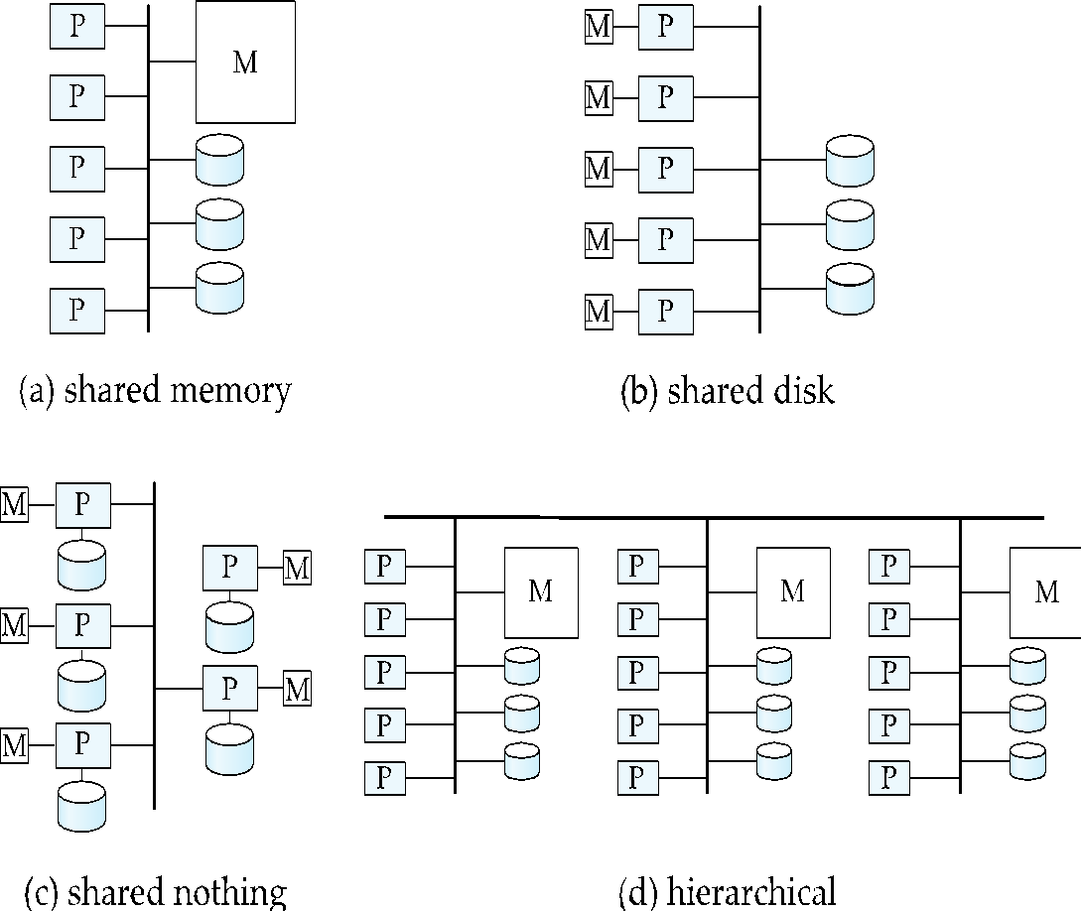
Shared Nothing
Node consists of a processor, memory, and one or more disks
All communication via interconnection network
Can be scaled up to thousands of processors without interference.
Main drawback: cost of communication and non-local disk access; sending data involves software interaction at both ends.

Slide 34
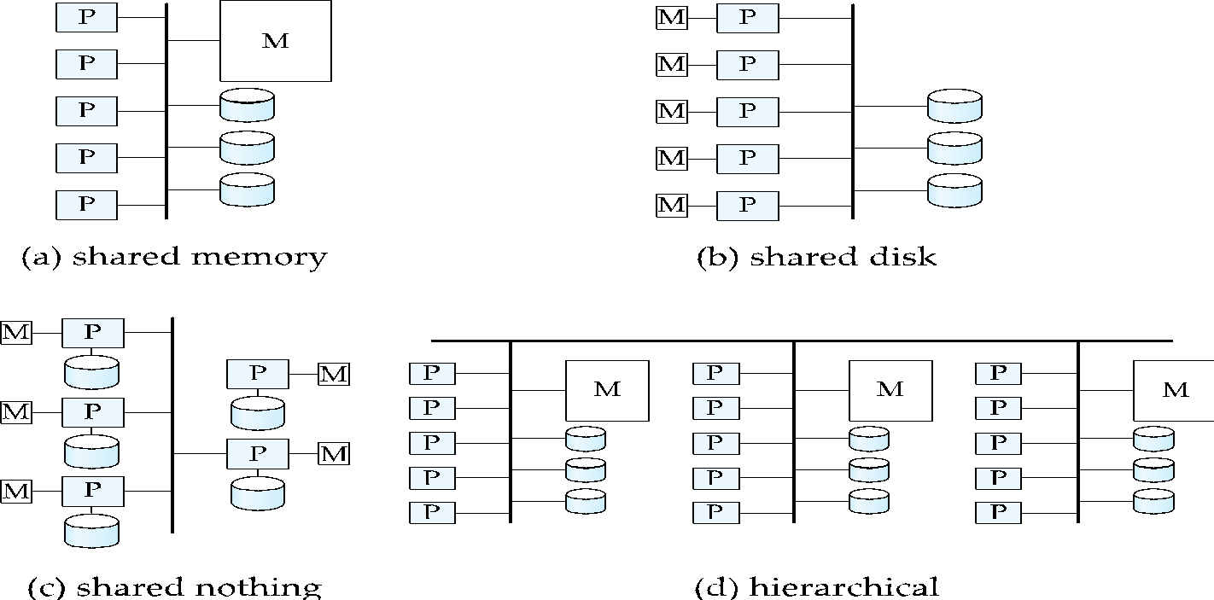
Hierarchical
Combines characteristics of shared-memory, shared-disk, and shared-nothing architectures.
Top level is a shared-nothing architecture
With each node of the system being a shared-memory system
Alternatively, top level could be a shared-disk system
With each node of the system being a shared-memory system

Slide 35
Shared-Memory Vs Shared-Nothing
Shared-memory internally looks like shared-nothing!
Each processor has direct access to its own memory, and indirect (hardware level) access to rest of memory
Also called non-uniform memory architecture (NUMA)
Shared-nothing can be made to look like shared memory
Reduce the complexity of programming such systems by distributed virtual-memory abstraction
Remote Direct Memory Access (RDMA) provides very low-latency shared memory abstraction on shared-nothing systems
Often implemented on top of infiniband due it its very-low-latency
But careless programming can lead to performance issues

Slide 36
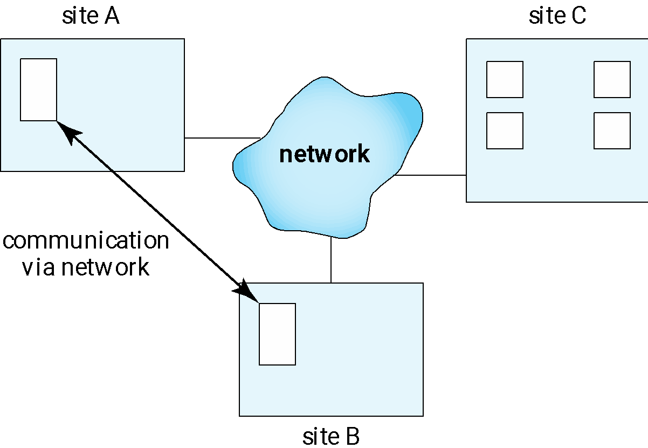
Distributed Systems
Data spread over multiple machines (also referred to as sites or nodes).
Local-area networks (LANs)
Wide-area networks (WANs)
Higher latency

Slide 37
Distributed Databases
Homogeneous distributed databases
Same software/schema on all sites, data may be partitioned among sites
Goal: provide a view of a single database, hiding details of distribution
Heterogeneous distributed databases
Different software/schema on different sites
Goal: integrate existing databases to provide useful functionality
Differentiate between local transactions and global transactions
A local transaction accesses data in the single site at which the transaction was initiated.
A global transaction either accesses data in a site different from the one at which the transaction was initiated or accesses data in several different sites.

Slide 38
Data Integration and Distributed Databases
Data integration between multiple distributed databases
Benefits:
Sharing data – users at one site able to access the data residing at some other sites.
Autonomy – each site is able to retain a degree of control over data stored locally.

Slide 39
Availability
Network partitioning
Availability of system
If all nodes are required for system to function, failure of even one node stops system functioning.
Higher system availability through redundancy
data can be replicated at remote sites, and system can function even if a site fails.

Slide 40
Implementation Issues for Distributed Databases
Atomicity needed even for transactions that update data at multiple sites
The two-phase commit protocol (2PC) is used to ensure atomicity
Basic idea: each site executes transaction until just before commit, and the leaves final decision to a coordinator
Each site must follow decision of coordinator, even if there is a failure while waiting for coordinators decision
2PC is not always appropriate: other transaction models based on persistent messaging, and workflows, are also used
Distributed concurrency control (and deadlock detection) required
Data items may be replicated to improve data availability
Details of all above in Chapter 24

Slide 41
Cloud Based Services
Cloud computing widely adopted today
On-demand provisioning and elasticity
ability to scale up at short notice and to release of unused resources for use by others
Infrastructure as a service
Virtual machines/real machines
Platform as a service
Storage, databases, application server
Software as a service
Enterprise applications, emails, shared documents, etc,
Potential drawbacks
Security
Network bandwidth

Slide 42
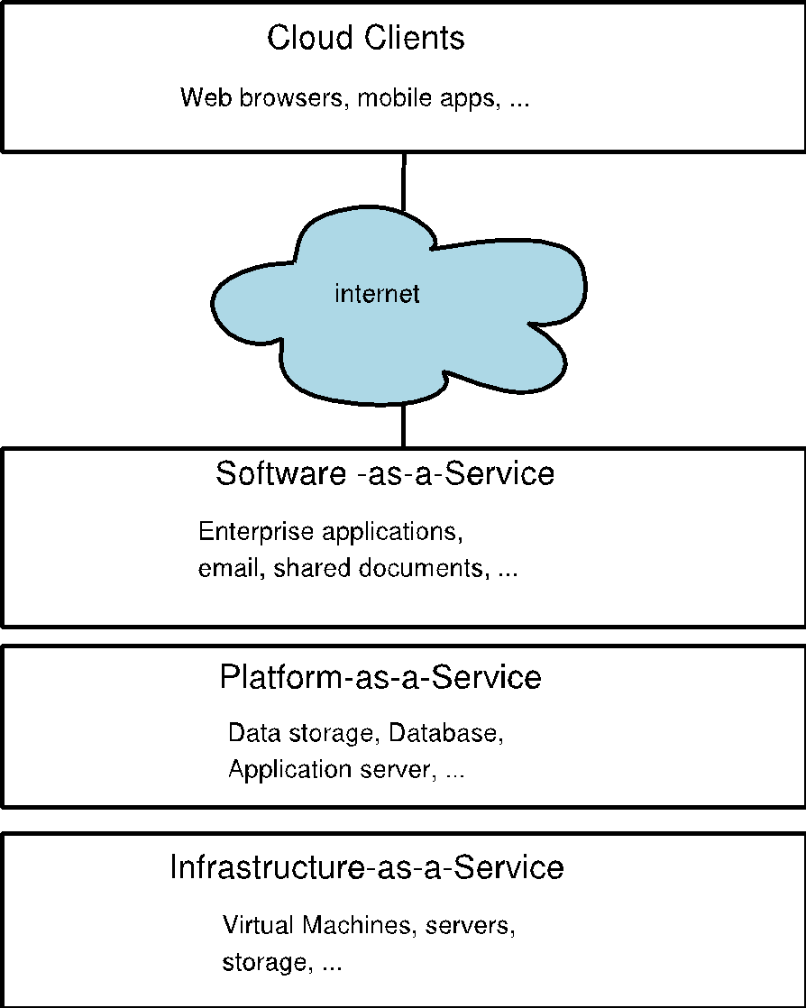
Cloud Service Models

Slide 43
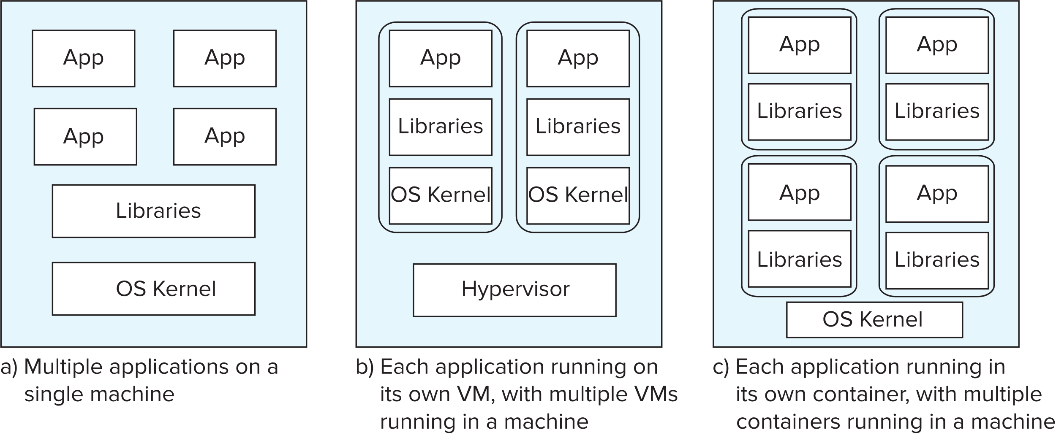
Application Deployment Alternatives
Individual Machines Virtual Machines Containers (e.g. VMWare, KVM, ..) (e.g. Docker)

Slide 44
Application Deployment Architectures
Services
Microservice Architecture
Application uses a variety of services
Service can add or remove instances as required
Kubernetes supports containers, and microservices

Slide 45
End of Chapter 20

