Slide 1
Design and Analysis of Algorithms
String Matching
Knuth-Morris-Pratt (KMP) algorithm

Slide 2
String Matching (Chap. 32)
Given a pattern P[1..m] and a text T[1..n], find all occurrences of P in T. Both P and T belong to ∑*.
P occurs with shift s (beginning at s+1): P[1]=T[s+1], P[2]=T[s+2],…,P[m]=T[s+m].
If so, call s is a valid shift, otherwise, an invalid shift.
Note: one occurrence begins within another one: P=abab, T=abcabababbc, P occurs at s=3 and s=5.

Slide 3
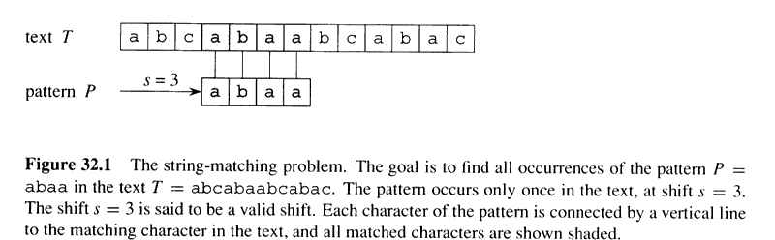
An example of string matching

Slide 4
Notation and terminology
w is a prefix of x, if x=wy for some y∈∑*. Denoted as w⇒x.
w is a suffix of x, if x=yw for some y∈∑*. Denoted as w⇐x.
Lemma 32.1 (Overlapping shift lemma):
Suppose x,y,z and x⇐z and y⇐z, then if |x|≤|y|, then x⇐y; if |x| ≥ |y|, then y⇐x; if |x| = |y|, then x=y.

Slide 5
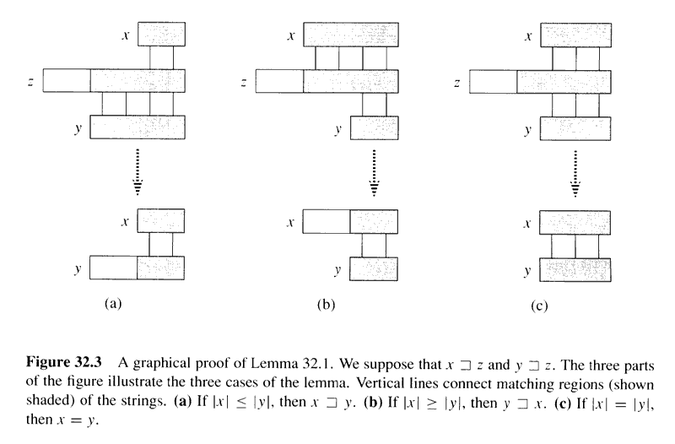
Graphical Proof of Lemma 32.1

Slide 6
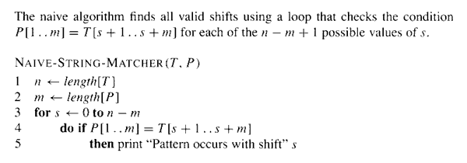
Naïve string matching
Running time: O((n-m+1)m).

Slide 7
Problem with naïve algorithm
Problem with Naïve algorithm:
Suppose p=ababc, T=cabababcd.
T: c a b a b a b c d
P: a …
P: a b a b c
P: a…
P: a b a b c
Whenever a character mismatch occurs after matching of several characters, the comparison begins by going back in T from the character which follows the last beginning character.
Can we do better: not go back in T?

Slide 8
Knuth-Morris-Pratt (KMP) algorithm
Idea: after some character (such as q) matches of P with T and then a mismatch, the matched q characters allows us to determine immediately that certain shifts are invalid. So directly go to the shift which is potentially valid.
The matched characters in T are in fact a prefix of P, so just from P, it is OK to determine whether a shift is invalid or not.
Define a prefix function π, which encapsulates the knowledge about how the pattern P matches against shifts of itself.
π :{1,2,…,m}→{0,1,…,m-1}
π[q]=max{k: k<q and P_{k} ⇐ P_{q}}, that is π[q] is the length of the longest prefix of P that is a proper suffix of P_{q}.

Slide 9
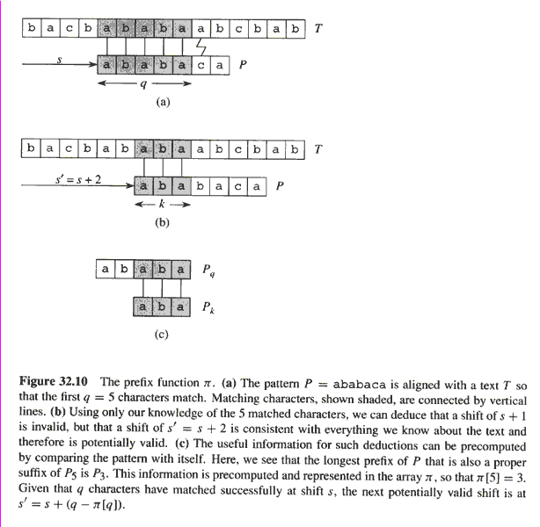
Prefix function
If we pre compute prefix function of
P (against itself), then whenever
a mismatch occurs, the prefix function
can determine which shift(s) are invalid
and directly ruled out.
So move directly
to the shift which is potentially valid.
However, there is no need to compare
these characters again since they are
equal.

Slide 10
Prefix Function
 |  | ci | c(i+1) | c(i+2) | c(i+3) | c(i+4) | c(i+5) | c(i+6) | c(i+7) | c(i+8) | c(i+9)
C1 | C2 | C3 | C4 | C1 | C2 | C3 | Cx
0 | 1 | 2 | 3 | 4 | 5 | 6 | 7
𝞹(6) = 3
When failed
we will start from c(i+7) with already matched three characters from prefix

Slide 11
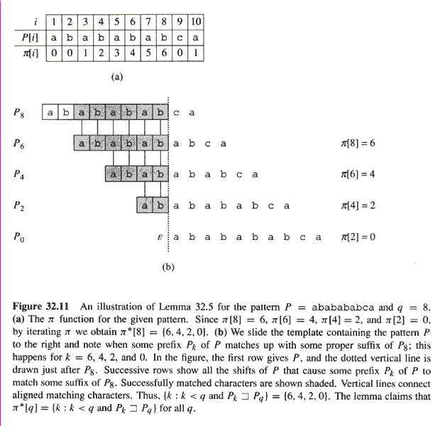
Copyright © The McGraw-Hill Companies, Inc. Permission required for reproduction or display.

Slide 12
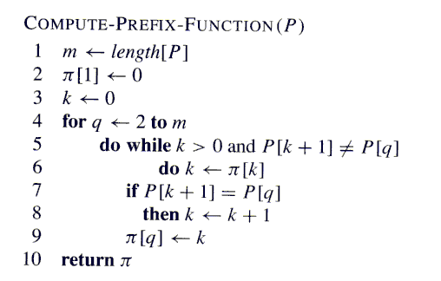
Copyright © The McGraw-Hill Companies, Inc. Permission required for reproduction or display.
Already have matched first k characters
Trying to match with first (k+1) characters with last (k+1) characters including k
Failed to match, trying with less characters from prefix to match

Slide 13
Computing Prefix-Function, 𝞹
We will be using 1 based indexing here for easier understanding,
Let P = “ABABABABCA”
and the final 𝞹 table will be following,
This table mainly interprets, for a particular length string, the maximum length suffix suf that can be found in the prefix pre. e.g, for “ABABABA”, suf=”ABABA”[3:7] and pre=”ABABA”[1:5], max length = 5, 𝞹[7] = 5
𝞹[1] | 𝞹[2] | 𝞹[3] | 𝞹[4] | 𝞹[5] | 𝞹[6] | 𝞹[7] | 𝞹[8] | 𝞹[9] | 𝞹[10]
A | B | A | B | A | B | A | B | C | A
0 | 0 | 1 | 2 | 3 | 4 | 5 | 6 | 0 | 1

Slide 14
Computing Prefix-Function, 𝞹
m = 10, 𝞹[0] = 0, 𝞹[1] = 0, k=0
q = 1
P = “ABABABABCA”
1 | 2 | 3 | 4 | 5 | 6 | 7 | 8 | 9 | 10
A | B | A | B | A | B | A | B | C | A

Slide 15
Computing Prefix-Function, 𝞹
m = 10, k=0, q = 2
P = “ABABABABCA”
1 | 2 | 3 | 4 | 5 | 6 | 7 | 8 | 9 | 10
A | B | A | B | A | B | A | B | C | A
0 | 0
P[k+1] !=P[q], update k = 𝞹[k] = 0, k>0 condition violates
Eventually, 𝞹[q] = 𝞹[2] = 0
k=0
q = 3

Slide 16
Computing Prefix-Function, 𝞹
m = 10,
k=0, q = 3
P = “ABABABABCA”
A | B | A | B | A | B | A | B | C | A
0 | 0 | 1
P[k+1] ==P[q], no while loop continuation
If condition satisfies, k=k+1 = 1, pre == suf length increases
Eventually, 𝞹[3] = 1
k=1
q = 4

Slide 17
Computing Prefix-Function, 𝞹
m = 10, k = 1, q = 4
P = “ABABABABCA”
1 | 2 | 3 | 4 | 5 | 6 | 7 | 8 | 9 | 10
A | B | A | B | A | B | A | B | C | A
0 | 0 | 1 | 2
P[k+1] ==P[q], no while loop continuation
If condition satisfies, k=k+1 = 2, pre == suf length increases
Eventually, 𝞹[4] = 2
k=2
q = 5

Slide 18
Computing Prefix-Function, 𝞹
m = 10, k=2, q = 5
P = “ABABABABCA”
1 | 2 | 3 | 4 | 5 | 6 | 7 | 8 | 9 | 10
A | B | A | B | A | B | A | B | C | A
0 | 0 | 1 | 2 | 3
P[k+1] ==P[q], no while loop continuation
If condition satisfies, k=k+1 = 3, pre == suf length increases
Eventually, 𝞹[5] = 3
k=3
q = 6

Slide 19
Computing Prefix-Function, 𝞹
m = 10, k =3, q = 6
P = “ABABABABCA”
1 | 2 | 3 | 4 | 5 | 6 | 7 | 8 | 9 | 10
A | B | A | B | A | B | A | B | C | A
0 | 0 | 1 | 2 | 3 | 4
P[k+1] ==P[q], no while loop continuation
If condition satisfies, k=k+1 = 4, pre == suf length increases
Eventually, 𝞹[6] = 4
k=4
q = 7

Slide 20
Computing Prefix-Function, 𝞹
m = 10, k = 4, q = 7
P = “ABABABABCA”
1 | 2 | 3 | 4 | 5 | 6 | 7 | 8 | 9 | 10
A | B | A | B | A | B | A | B | C | A
0 | 0 | 1 | 2 | 3 | 4 | 5
P[k+1] ==P[q], no while loop continuation
If condition satisfies, k=k+1 = 5, pre == suf length increases
Eventually, 𝞹[7] = 5
k=5
q = 8

Slide 21
Computing Prefix-Function, 𝞹
m = 10, k = 5, q = 8
P = “ABABABABCA”
1 | 2 | 3 | 4 | 5 | 6 | 7 | 8 | 9 | 10
A | B | A | B | A | B | A | B | C | A
0 | 0 | 1 | 2 | 3 | 4 | 5 | 6
P[k+1] ==P[q], no while loop continuation
If condition satisfies, k=k+1 = 6, pre == suf length increases
Eventually, 𝞹[8] = 6
k=6
q = 9

Slide 22
Computing Prefix-Function, 𝞹
m = 10, k = 6, q = 9
P = “ABABABABCA”
1 | 2 | 3 | 4 | 5 | 6 | 7 | 8 | 9 | 10
A | B | A | B | A | B | A | B | C | A
0 | 0 | 1 | 2 | 3 | 4 | 5 | 6 | 0
P[k+1] !=P[q] [can not increase suf and pre match]
k=𝞹[k] = 𝞹[6] = 4 [can not match P[5] and P[9], can’t increase matching, tried first 7 characters with last 7 characters]
k=𝞹[k] = 𝞹[4] = 2[can not match P[3] and P[9], can’t increase matching, tried first 5 characters with last 5 characters]
k=𝞹[k] = 𝞹[2] = 0, [ k > 0 condition violates, gets out from the while loop ]
Eventually, 𝞹[9] = 0
k = 0
q = 10

Slide 23
Computing Prefix-Function, 𝞹
m = 10, k = 0, q = 10
P = “ABABABABCA”
1 | 2 | 3 | 4 | 5 | 6 | 7 | 8 | 9 | 10
A | B | A | B | A | B | A | B | C | A
0 | 0 | 1 | 2 | 3 | 4 | 5 | 6 | 0 | 1
P[k+1] ==P[q] [can increase suf and pre match]
If condition satisfies, k=k+1 = 1, pre == suf length increases
Eventually, 𝞹[10] = 1
k = 1
q = 11

Slide 24
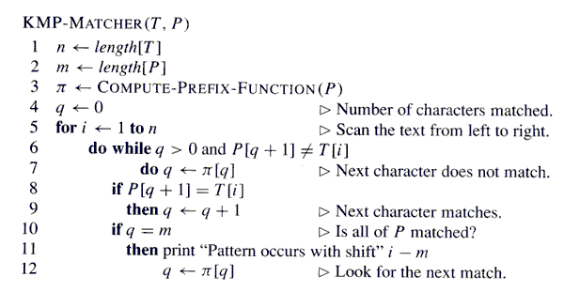
Copyright © The McGraw-Hill Companies, Inc. Permission required for reproduction or display.

Slide 25
KMP-Matcher(T,P)
Let T = “ABABABABABABABABCA”
P = “ABABABABCA”
n = 18
m = 10
𝞹 Table
q = 0, i = 1 [ We will be using 1 based indexing ]
1 | 2 | 3 | 4 | 5 | 6 | 7 | 8 | 9 | 10
A | B | A | B | A | B | A | B | C | A
0 | 0 | 1 | 2 | 3 | 4 | 5 | 6 | 0 | 1

Slide 26
KMP-Matcher(T,P)
i = 1, q = 0
1 | 2 | 3 | 4 | 5 | 6 | 7 | 8 | 9 | 10 | 11 | 12 | 13 | 14 | 15 | 16 | 17 | 18
A | B | A | B | A | B | A | B | A | B | A | B | A | B | A | B | C | A
A | B | A | B | A | B | A | B | C | A
1 | 2 | 3 | 4 | 5 | 6 | 7 | 8 | 9 | 10
P[q+1] == T[i], matching string length increases
i = 2, q = 1

Slide 27
KMP-Matcher(T,P)
i = 2, q = 1
1 | 2 | 3 | 4 | 5 | 6 | 7 | 8 | 9 | 10 | 11 | 12 | 13 | 14 | 15 | 16 | 17 | 18
A | B | A | B | A | B | A | B | A | B | A | B | A | B | A | B | C | A
A | B | A | B | A | B | A | B | C | A
1 | 2 | 3 | 4 | 5 | 6 | 7 | 8 | 9 | 10
P[q+1] == T[i], matching string length increases
i = 3, q = 2

Slide 28
KMP-Matcher(T,P)
i = 2, q = 2
1 | 2 | 3 | 4 | 5 | 6 | 7 | 8 | 9 | 10 | 11 | 12 | 13 | 14 | 15 | 16 | 17 | 18
A | B | A | B | A | B | A | B | A | B | A | B | A | B | A | B | C | A
A | B | A | B | A | B | A | B | C | A
1 | 2 | 3 | 4 | 5 | 6 | 7 | 8 | 9 | 10
P[q+1] == T[i], matching string length increases
i = 4, q = 3

Slide 29
KMP-Matcher(T,P)
i = 4, q = 3
1 | 2 | 3 | 4 | 5 | 6 | 7 | 8 | 9 | 10 | 11 | 12 | 13 | 14 | 15 | 16 | 17 | 18
A | B | A | B | A | B | A | B | A | B | A | B | A | B | A | B | C | A
A | B | A | B | A | B | A | B | C | A
1 | 2 | 3 | 4 | 5 | 6 | 7 | 8 | 9 | 10
P[q+1] == T[i], matching string length increases
i = 5, q = 4

Slide 30
KMP-Matcher(T,P)
i = 5, q = 4
1 | 2 | 3 | 4 | 5 | 6 | 7 | 8 | 9 | 10 | 11 | 12 | 13 | 14 | 15 | 16 | 17 | 18
A | B | A | B | A | B | A | B | A | B | A | B | A | B | A | B | C | A
A | B | A | B | A | B | A | B | C | A
1 | 2 | 3 | 4 | 5 | 6 | 7 | 8 | 9 | 10
P[q+1] == T[i], matching string length increases
i = 6, q = 5

Slide 31
KMP-Matcher(T,P)
i = 6, q = 5
1 | 2 | 3 | 4 | 5 | 6 | 7 | 8 | 9 | 10 | 11 | 12 | 13 | 14 | 15 | 16 | 17 | 18
A | B | A | B | A | B | A | B | A | B | A | B | A | B | A | B | C | A
A | B | A | B | A | B | A | B | C | A
1 | 2 | 3 | 4 | 5 | 6 | 7 | 8 | 9 | 10
P[q+1] == T[i], matching string length increases
i = 7, q = 6

Slide 32
KMP-Matcher(T,P)
i = 7, q = 6
1 | 2 | 3 | 4 | 5 | 6 | 7 | 8 | 9 | 10 | 11 | 12 | 13 | 14 | 15 | 16 | 17 | 18
A | B | A | B | A | B | A | B | A | B | A | B | A | B | A | B | C | A
A | B | A | B | A | B | A | B | C | A
1 | 2 | 3 | 4 | 5 | 6 | 7 | 8 | 9 | 10
P[q+1] == T[i], matching string length increases
i = 8, q = 7

Slide 33
KMP-Matcher(T,P)
i = 8, q = 7
1 | 2 | 3 | 4 | 5 | 6 | 7 | 8 | 9 | 10 | 11 | 12 | 13 | 14 | 15 | 16 | 17 | 18
A | B | A | B | A | B | A | B | A | B | A | B | A | B | A | B | C | A
A | B | A | B | A | B | A | B | C | A
1 | 2 | 3 | 4 | 5 | 6 | 7 | 8 | 9 | 10
P[q+1] == T[i], matching string length increases
i = 9, q = 8

Slide 34
KMP-Matcher(T,P)
1 | 2 | 3 | 4 | 5 | 6 | 7 | 8 | 9 | 10
A | B | A | B | A | B | A | B | C | A
0 | 0 | 1 | 2 | 3 | 4 | 5 | 6 | 0 | 1
i = 9, q = 8
1 | 2 | 3 | 4 | 5 | 6 | 7 | 8 | 9 | 10 | 11 | 12 | 13 | 14 | 15 | 16 | 17 | 18
A | B | A | B | A | B | A | B | A | B | A | B | A | B | A | B | C | A
A | B | A | B | A | B | A | B | C | A
P[q+1] != T[i], matching string length does not increase
Going to use 𝝿 table to reuse already matching prefixes
q=𝝿[8] = 6, P[6+1] == T[9], first 7 characters could be matched
1 | 2 | 3 | 4 | 5 | 6 | 7 | 8 | 9 | 10
A | B | A | B | A | B | A | B | A | B | A | B | A | B | A | B | C | A
A | B | A | B | A | B | A | B | C | A
i = 10, q = 7

Slide 35
KMP-Matcher(T,P)
1 | 2 | 3 | 4 | 5 | 6 | 7 | 8 | 9 | 10
A | B | A | B | A | B | A | B | C | A
0 | 0 | 1 | 2 | 3 | 4 | 5 | 6 | 0 | 1
i = 10, q = 7
1 | 2 | 3 | 4 | 5 | 6 | 7 | 8 | 9 | 10 | 11 | 12 | 13 | 14 | 15 | 16 | 17 | 18
A | B | A | B | A | B | A | B | A | B | A | B | A | B | A | B | C | A
A | B | A | B | A | B | A | B | C | A
1 | 2 | 3 | 4 | 5 | 6 | 7 | 8 | 9 | 10
P[q+1] == T[i], matching string length increases
i = 11, q = 8

Slide 36
KMP-Matcher(T,P)
1 | 2 | 3 | 4 | 5 | 6 | 7 | 8 | 9 | 10
A | B | A | B | A | B | A | B | C | A
0 | 0 | 1 | 2 | 3 | 4 | 5 | 6 | 0 | 1
i = 11, q = 8
1 | 2 | 3 | 4 | 5 | 6 | 7 | 8 | 9 | 10 | 11 | 12 | 13 | 14 | 15 | 16 | 17 | 18
A | B | A | B | A | B | A | B | A | B | A | B | A | B | A | B | C | A
A | B | A | B | A | B | A | B | C | A
P[q+1] != T[i], matching string length does not increase
q=𝝿[8] = 6, P[6+1] == T[11], first 7 characters could be matched, reuse
1 | 2 | 3 | 4 | 5 | 6 | 7 | 8 | 9 | 10
A | B | A | B | A | B | A | B | A | B | A | B | A | B | A | B | C | A
A | B | A | B | A | B | A | B | C | A
i = 12, q = 7

Slide 37
KMP-Matcher(T,P)
1 | 2 | 3 | 4 | 5 | 6 | 7 | 8 | 9 | 10
A | B | A | B | A | B | A | B | C | A
0 | 0 | 1 | 2 | 3 | 4 | 5 | 6 | 0 | 1
i = 12, q = 7
1 | 2 | 3 | 4 | 5 | 6 | 7 | 8 | 9 | 10 | 11 | 12 | 13 | 14 | 15 | 16 | 17 | 18
A | B | A | B | A | B | A | B | A | B | A | B | A | B | A | B | C | A
A | B | A | B | A | B | A | B | C | A
1 | 2 | 3 | 4 | 5 | 6 | 7 | 8 | 9 | 10
P[q+1] == T[i], matching string length increases
i = 13, q = 8

Slide 38
KMP-Matcher(T,P)
1 | 2 | 3 | 4 | 5 | 6 | 7 | 8 | 9 | 10
A | B | A | B | A | B | A | B | C | A
0 | 0 | 1 | 2 | 3 | 4 | 5 | 6 | 0 | 1
i = 13, q = 8
1 | 2 | 3 | 4 | 5 | 6 | 7 | 8 | 9 | 10 | 11 | 12 | 13 | 14 | 15 | 16 | 17 | 18
A | B | A | B | A | B | A | B | A | B | A | B | A | B | A | B | C | A
A | B | A | B | A | B | A | B | C | A
1. Due to mismatch we shift
2. q = 𝝿[8]=6 , we try with 𝝿[6+1] and T[13], it matches
3. First 7 characters can be directly matched
1 | 2 | 3 | 4 | 5 | 6 | 7 | 8 | 9 | 10
A | B | A | B | A | B | A | B | A | B | A | B | A | B | A | B | C | A
A | B | A | B | A | B | A | B | C | A
i = 14, q = 7

Slide 39
KMP-Matcher(T,P)
1 | 2 | 3 | 4 | 5 | 6 | 7 | 8 | 9 | 10
A | B | A | B | A | B | A | B | C | A
0 | 0 | 1 | 2 | 3 | 4 | 5 | 6 | 0 | 1
i = 14, q = 7
1 | 2 | 3 | 4 | 5 | 6 | 7 | 8 | 9 | 10 | 11 | 12 | 13 | 14 | 15 | 16 | 17 | 18
A | B | A | B | A | B | A | B | A | B | A | B | A | B | A | B | C | A
A | B | A | B | A | B | A | B | C | A
1 | 2 | 3 | 4 | 5 | 6 | 7 | 8 | 9 | 10
P[q+1] == T[i], matching string length increases
i = 15, q = 8

Slide 40
KMP-Matcher(T,P)
1 | 2 | 3 | 4 | 5 | 6 | 7 | 8 | 9 | 10
A | B | A | B | A | B | A | B | C | A
0 | 0 | 1 | 2 | 3 | 4 | 5 | 6 | 0 | 1
i = 15, q = 8
1 | 2 | 3 | 4 | 5 | 6 | 7 | 8 | 9 | 10 | 11 | 12 | 13 | 14 | 15 | 16 | 17 | 18
A | B | A | B | A | B | A | B | A | B | A | B | A | B | A | B | C | A
Due to mismatch we shift
q = 𝝿[8]=6 , we try with 𝝿[6+1] and T[15], it matches
First 7 characters can be directly matched
A | B | A | B | A | B | A | B | C | A
1 | 2 | 3 | 4 | 5 | 6 | 7 | 8 | 9 | 10
A | B | A | B | A | B | A | B | A | B | A | B | A | B | A | B | C | A
A | B | A | B | A | B | A | B | C | A
i = 16, q = 7

Slide 41
KMP-Matcher(T,P)
1 | 2 | 3 | 4 | 5 | 6 | 7 | 8 | 9 | 10
A | B | A | B | A | B | A | B | C | A
0 | 0 | 1 | 2 | 3 | 4 | 5 | 6 | 0 | 1
i = 16, q = 7
1 | 2 | 3 | 4 | 5 | 6 | 7 | 8 | 9 | 10 | 11 | 12 | 13 | 14 | 15 | 16 | 17 | 18
A | B | A | B | A | B | A | B | A | B | A | B | A | B | A | B | C | A
A | B | A | B | A | B | A | B | C | A
1 | 2 | 3 | 4 | 5 | 6 | 7 | 8 | 9 | 10
P[q+1] == T[i], matching string length increases
i = 17, q = 8

Slide 42
KMP-Matcher(T,P)
1 | 2 | 3 | 4 | 5 | 6 | 7 | 8 | 9 | 10
A | B | A | B | A | B | A | B | C | A
0 | 0 | 1 | 2 | 3 | 4 | 5 | 6 | 0 | 1
i = 17, q = 8
1 | 2 | 3 | 4 | 5 | 6 | 7 | 8 | 9 | 10 | 11 | 12 | 13 | 14 | 15 | 16 | 17 | 18
A | B | A | B | A | B | A | B | A | B | A | B | A | B | A | B | C | A
A | B | A | B | A | B | A | B | C | A
1 | 2 | 3 | 4 | 5 | 6 | 7 | 8 | 9 | 10
P[q+1] == T[i], matching string length increases
i = 18, q = 9

Slide 43
KMP-Matcher(T,P)
1 | 2 | 3 | 4 | 5 | 6 | 7 | 8 | 9 | 10
A | B | A | B | A | B | A | B | C | A
0 | 0 | 1 | 2 | 3 | 4 | 5 | 6 | 0 | 1
i = 17, q = 9
1 | 2 | 3 | 4 | 5 | 6 | 7 | 8 | 9 | 10 | 11 | 12 | 13 | 14 | 15 | 16 | 17 | 18
A | B | A | B | A | B | A | B | A | B | A | B | A | B | A | B | C | A
A | B | A | B | A | B | A | B | C | A
1 | 2 | 3 | 4 | 5 | 6 | 7 | 8 | 9 | 10
P[q+1] == T[i], matching string length increases
i = 19, q = 10
q == m=, a complete matching has been found

Slide 44
Runtime Analysis of KMP algorithm
Θ = big theta/avg bound
The running time of COMPUTE-PREFIX-FUNCTION is Θ(m) and KMP-MATCHER Θ(n).
Using amortized analysis (potential method) (for COMPUTE-PREFIX-FUNCTION):
Associate a potential of k with the current state k of the algorithm:
Consider codes in Line 5 to 9.
Initial potential is 0, line 6 decreases k since π[k]<k, k never becomes negative.
Line 8 increases k at most 1.
Amortized cost = actual-cost + potential-increase
=(repeat-times-of-Line-5+O(1))+(potential-decrease-at-least the repeat-times-of-Line-5+O(1) in line 8)=O(1).

Slide 45
Copyright © The McGraw-Hill Companies, Inc. Permission required for reproduction or display.
putting it all together, Θ(m)
always k < q and 𝝿(q) < q
K is always > 0 and reduced here only so bounded by (m-1), while loop iterates at most (m-1) times
K by increasing maximum can be (m-1)

