Slide 1
Design & Analysis of Algorithm
Single Source Shortest Path
(Dijkstra’s Algorithm)

Slide 2
Shortest Path Problems
What is shortest path ?
shortest length between two vertices for an unweighted graph:
smallest cost between two vertices for a weighted graph:
B
B
210
A
A
450
60
190
C
unweighted graph
C
weighted graph
200
130
D
D
E
E

Slide 3
Shortest Path Problems
How can we find the shortest route between two points on a map?
Model the problem as a graph problem:
Road map is a weighted graph:
vertices = cities
edges = road segments between cities
edge weights = road distances
Goal: find a shortest path between two vertices (cities)
‹#›

Slide 4
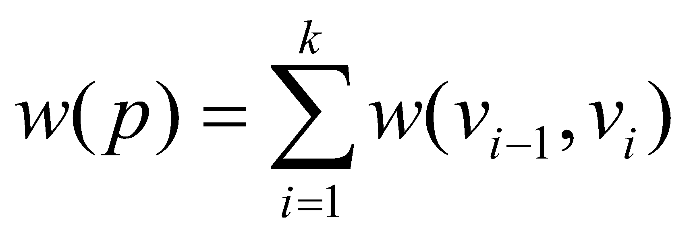
Shortest Path Problems
Input:
Directed graph G = (V, E)
Weight function w : E → R
Weight of path p = 〈v₀, v₁, . . . , v_{k}〉
Shortest-path weight from u to v:
δ(u, v) = min w(p) : u v if there exists a path from u to v
∞ otherwise
Shortest path u to v is any path p such that w(p) = δ(u, v)
t
x
3
6
9
3
4
s
0
2
1
2
7
5
3
5
11
6
y
z
p
‹#›

Slide 5
Variants of Shortest Paths
Single-source shortest path
G = (V, E) ⇒ find a shortest path from a given source vertex s to each vertex v ∈ V
Single-destination shortest path
Find a shortest path to a given destination vertex t from each vertex v
Reverse the direction of each edge ⇒ single-source
Single-pair shortest path
Find a shortest path from u to v for given vertices u and v
Solve the single-source problem
All-pairs shortest-paths
Find a shortest path from u to v for every pair of vertices u and v
‹#›

Slide 6
Optimal Substructure of Shortest Paths
Given:
A weighted, directed graph G = (V, E)
A weight function w: E → R,
A shortest path p = 〈v₁, v₂, . . . , v_{k}〉 from v₁ to v_{k}
A subpath of p: p_{ij} = 〈v_{i}, v_{i+1}, . . . , v_{j}〉, with 1 ≤ i ≤ j ≤ k
Then: p_{ij} is a shortest path from v_{i} to v_{j}
Proof: p = v₁ v_{i} v_{j} v_{k}
w(p) = w(p_{1i}) + w(p_{ij}) + w(p_{jk})
Assume ∃ p_{ij}’ from v_{i} to v_{j} with w(p_{ij}’) < w(p_{ij})
⇒ w(p’) = w(p_{1i}) + w(p_{ij}’) + w(p_{jk}) < w(p) contradiction!
v_{j}
p_{ij}
p_{jk}
v₁
p_{1i}
p_{ij}’
v_{k}
v_{i}
p_{1i}
p_{ij}
p_{jk}
‹#›

Slide 7
Shortest-Path Representation
For each vertex v ∈ V:
d[v] = δ(s, v): a shortest-path estimate
Initially, d[v]=∞
Reduces as algorithms progress
π[v] = predecessor of v on a shortest path from s
If no predecessor, π[v] = NIL
π induces a tree—shortest-path tree
Shortest paths & shortest path trees are not unique
t
x
3
6
9
3
4
s
0
2
1
2
7
5
3
5
11
6
y
z
‹#›

Slide 8
Initialization
Alg.: INITIALIZE-SINGLE-SOURCE(V, s)
for each v ∈ V
do d[v] ← ∞
π[v] ← NIL
d[s] ← 0
All the shortest-paths algorithms start with INITIALIZE-SINGLE-SOURCE
‹#›

Slide 9
Relaxation
Relaxing an edge (u, v) = testing whether we can improve the shortest path to v found so far by going through u
If d[v] > d[u] + w(u, v)
we can improve the shortest path to v
⇒ update d[v] and π[v]
s
s
u
v
u
v
After relaxation:
d[v] ≤ d[u] + w(u, v)
5
2
9
5
2
6
RELAX(u, v, w)
RELAX(u, v, w)
u
v
u
v
5
2
7
5
2
6
‹#›

Slide 10
RELAX(u, v, w)
if d[v] > d[u] + w(u, v)
then d[v] ← d[u] + w(u, v)
π[v] ← u
All the single-source shortest-paths algorithms
start by calling INIT-SINGLE-SOURCE
then relax edges
The algorithms differ in the order and how many times they relax each edge
‹#›

Slide 11
Dijkstra’s Algorithm
Single-source shortest path problem:
No negative-weight edges: w(u, v) > 0 ∀ (u, v) ∈ E
Maintains two sets of vertices:
S = vertices whose final shortest-path weights have already been determined
Q = vertices in V – S: min-priority queue
Keys in Q are estimates of shortest-path weights (d[v])
Repeatedly select a vertex u ∈ V – S, with the minimum shortest-path estimate d[v]
‹#›

Slide 12
Dijkstra (G, w, s)
t
1
x
INITIALIZE-SINGLE-SOURCE(V, s)
S ← ∅
Q ← V[G]
while Q ≠ ∅
do u ← EXTRACT-MIN(Q)
S ← S ∪ {u}
for each vertex v ∈ Adj[u]
do RELAX(u, v, w)
∞
∞
10
9
s
0
2
3
4
6
5
7
∞
∞
2
y
z
t
1
x
∞
∞
10
10
9
s
0
2
3
4
6
5
7
∞
∞
5
2
y
z
‹#›

Slide 13
Example
black edge means: it has been relaxed through another path
t
1
x
t
1
x
10
∞
8
14
8
14
13
10
9
10
9
s
0
2
3
4
6
s
0
2
3
4
6
5
7
5
7
5
∞
5
7
7
2
2
y
z
y
z
t
x
t
1
x
1
8
9
8
13
9
10
9
10
9
2
3
4
6
s
0
2
3
4
6
s
0
5
7
5
7
5
7
5
7
2
2
y
z
y
z
‹#›

Slide 14
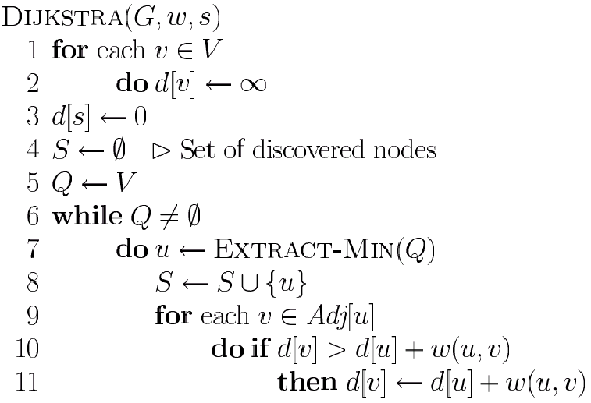
Dijkstra’s Pseudo Code
Graph G, weight function w, root s
if updated insert v into MIN(Q)
relaxing edges

Slide 15
Dijkstra (G, w, s)
INITIALIZE-SINGLE-SOURCE(V, s)
S ← ∅
Q ← V[G]
while Q ≠ ∅
do u ← EXTRACT-MIN(Q)
S ← S ∪ {u}
for each vertex v ∈ Adj[u]
do RELAX(u, v, w)
Running time: O(VlgV + ElgV) = O(ElgV)
Θ(V)
O(V) build min-heap
Executed O(V) times
O(lgV)
Decrease key/relax
O(E) times; O(lgV)
‹#›

Slide 16
Dijkstra (G, w, s)
Why VlogV
O(log(1) + log(2) + log(3) + ….. + log(V))
= O(V * log V)
For each edge, we are relaxing a node and inserting it in MIN Q. So E times log V operation. O( E * log V)

Slide 17
Dijkstra’s Running Time
O(VlogV + E log V)
~ O( E log V)
if E ~ V², E log V domination
if E ~ V, E log V = V log V
Extract-Min executed |V| time
Decrease-Key executed |E| time
Time = |V| T_{Extract-Min} + |E| T_{Decrease-Key}
T depends on different Q implementations
Q | T(Extract-Min) | T(Decrease-Key) | Total Time in big Ο
array | Ο(V) | Ο(1) | Ο(V ²)
binary heap | Ο(lg V) | Ο(lg V) | Ο(E lg V)
Fibonacci heap | Ο(lg V) | Ο(1) (amort.) | Ο(V lgV + E)

Slide 18
Question
Prove that, if there exists negative edge, dijkstra’s shortest path algorithm may fail to find the shortest path
if cycle exists within the connected component
Print the shortest path for dijkstra’s algorithm
Using prev[ ] or parent [ ] array
How many shortest paths are there from source to destination?
If d[v] = d[u] + w(u,v) its another valid shortest path
use prev[node][number of path] : 2 dimensional info
‹#›

Slide 19
Question
Suppose you are given a graph where each edge represents the path cost and each vertex has also a cost which represents that, if you select a path using this node, the cost will be added with the path cost. How can it be solved using Dijkstra’s algorithm?
d[v] > d[u] + Cost(u) + w(u,v): Relax

Slide 20
Practice Problem
How to solve ACM534 – Frogger?
https://onlinejudge.org/external/5/534.pdf
Hint: Rocks are nodes, Construct Edges Between rocks.
‹#›

