Slide 1
Design and Analysis of Algorithm
Minimum Spanning Tree

Slide 2
Last Class’s Topic
Articulation Point
How can we ensure that the root of the DFS tree is an articulation point?
What does LOW[v] mean?
What’s the way to calculate the LOW[v] for any vertex? How can it be done by post order traversal?
What is the criteria for a vertex to be an articulation point (except root)?
‹#›

Slide 3
Problem: Laying Telephone Wire
Central office
‹#›

Slide 4
Wiring: Naïve Approach
Central office
Expensive!
‹#›

Slide 5
Wiring: Better Approach
Central office
Minimize the total length of wire connecting the customers
‹#›

Slide 6
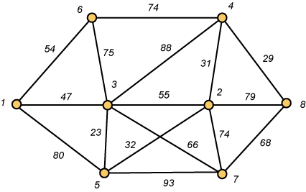
A Networking Problem
Problem: The vertices represent 8 regional data centers which need to be connected with high-speed data lines. Feasibility studies show that the links illustrated above are possible, and the cost in millions of dollars is shown next to the link. Which links should be constructed to enable full communication (with relays allowed) and keep the total cost minimal.
‹#›

Slide 7
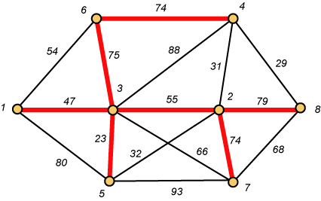
Links Will Form a Spanning Tree
Cost (T) = 47 + 23 + 75 + 74 + 55 + 74 + 79
= 427
‹#›

Slide 8
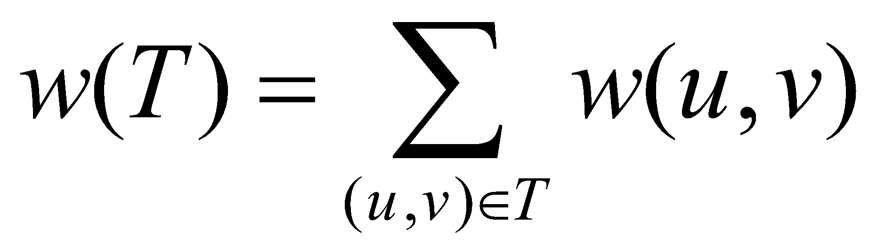
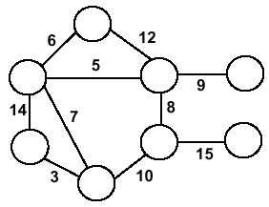
Minimum Spanning Trees
Undirected, connected graph G = (V,E)
Weight function W: E → R (assigning cost or length or other values to edges)
Spanning tree: tree that connects all the vertices (above?)
Minimum spanning tree: tree that connects all the vertices and minimizes
‹#›

Slide 9
Minimum Spanning Tree (MST)
A minimum spanning tree is a subgraph of an undirected weighted graph G, such that
it is a tree (i.e., it is acyclic)
it covers all the vertices V
contains |V| - 1 edges
the total cost associated with tree edges is the minimum among all possible spanning trees
not necessarily unique
‹#›

Slide 10
How Can We Generate a MST?
9
b
9
b
a
2
6
a
2
6
d
d
4
5
4
5
5
4
5
4
5
e
5
e
c
c
‹#›

Slide 11
Greedy Choice
We will show two ways to build a minimum spanning tree.
A MST can be grown from the current spanning tree by adding the nearest vertex and the edge connecting the nearest vertex to the MST. (Prim's algorithm)
A MST can be grown from a forest of spanning trees by adding the smallest edge connecting two spanning trees. (Kruskal's algorithm)
‹#›
Notes:
‹#›

Slide 12
Notation
Tree-vertices: in the tree constructed so far
Non-tree vertices: rest of vertices
Prim’s Selection rule
Select the minimum weight edge between a tree-node and a non-tree node and add to the tree
‹#›
Notes:
‹#›

Slide 13
The Prim’s algorithm Main Idea
Select a vertex to be a tree-node
while (there are non-tree vertices) {
if there is no edge connecting a tree node with a non-tree node
return “no spanning tree”
select an edge of minimum weight between a tree node and a non-tree node
add the selected edge and its new vertex to the tree
}
return tree
6
a
4
b
5
u
14
2
10
c
v
3
8
15
d
f
‹#›
Notes:
‹#›

Slide 14
Prim’s Algorithm
Vertex based algorithm
Grows one tree T, one vertex at a time
‹#›

Slide 15
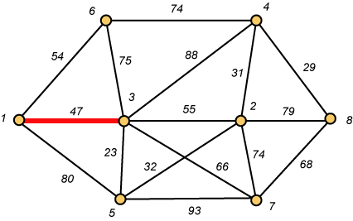
Prim – Step 1
‹#›

Slide 16
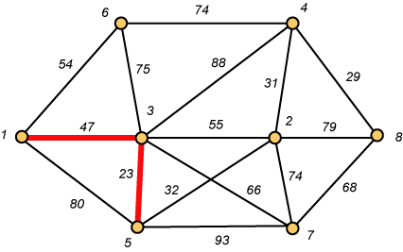
Prim – Step 2
‹#›

Slide 17
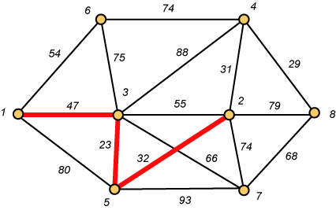
Prim – Step 3
‹#›

Slide 18
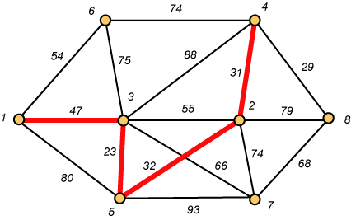
Prim – Step 4
‹#›

Slide 19
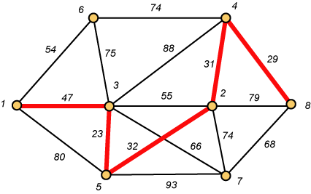
Prim – Step 5
‹#›

Slide 20
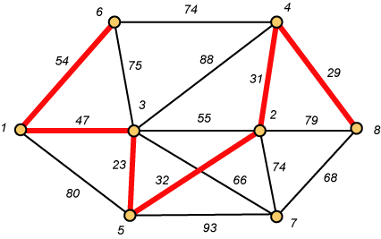
Prim – Step 6
‹#›

Slide 21
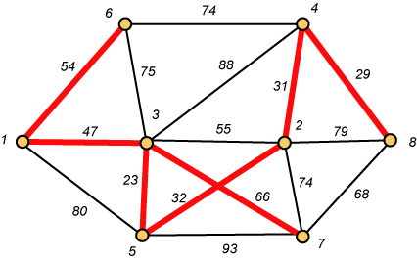
Prim – Step 7 Done!!
Weight (T) = 23 + 29 + 31 + 32 + 47 + 54 + 66 = 282
‹#›

Slide 22
Prim Algorithm (2)
MST-Prim(G,w,r)
01 Q ← V[G] // Q – vertices out of T
02 for each u ∈ Q
03 key[u] ← ∞
04 key[r] ← 0 // r is the first tree node, let r=1
05 π[r] ← NIL
06 while Q ≠ ∅ do
07 u ← ExtractMin(Q) // making u part of T
08 for each v ∈ Adj[u] do
09 if v ∈ Q and w(u,v) < key[v] then
10 π[v] ← u
11 key[v] ← w(u,v)
12
‹#›

Slide 23
Prim Algorithm:Variables
r:
Grow the minimum spanning tree from the root vertex “r”.
Q:
is a priority queue, holding all vertices that are not in the tree now.
key[v]:
is the minimum weight of any edge connecting v to a vertex in the tree.
π [v]:
names the parent of v in the tree.
T[v] –
Vertex v is already included in MST if T[v]==1, otherwise, it is not included yet.
‹#›

Slide 24
The execution of Prim's algorithm(moderate part)
8
7
the root vertex
b
c
d
9
4
2
a
11
i
14
e
4
7
6
8
10
h
g
f
1
2
V | a | b | c | d | e | f | g | h | i
T | 1 | 0 | 0 | 0 | 0 | 0 | 0 | 0 | 0
Key | 0 | - | - | - | - | - | - | - | -
π | -1 | - | - | - | - | - | - | - | -
‹#›

Slide 25
The execution of Prim's algorithm(moderate part)
8
7
the root vertex
b
c
d
9
4
2
a
11
i
14
e
4
7
6
8
10
h
g
f
1
2
V | a | b | c | d | e | f | g | h | i
T | 1 | 0 | 0 | 0 | 0 | 0 | 0 | 0 | 0
Key | 0 | 4 | - | - | - | - | - | 8 | -
π | -1 | a | - | - | - | - | - | a | -
‹#›

Slide 26
The execution of Prim's algorithm(moderate part)
8
7
the root vertex
b
c
d
9
4
2
a
11
i
14
e
4
7
6
8
10
h
g
f
1
2
Important: Update Key[v] only if T[v]==0
V | a | b | c | d | e | f | g | h | i
T | 1 | 1 | 0 | 0 | 0 | 0 | 0 | 0 | 0
Key | 0 | 4 | 8 | - | - | - | - | 8 | -
π | -1 | a | b | - | - | - | - | a | -
‹#›

Slide 27
The execution of Prim's algorithm(moderate part)
8
7
the root vertex
b
c
d
9
4
2
a
11
i
14
e
4
7
6
8
10
h
g
f
1
2
V | a | b | c | d | e | f | g | h | i
T | 1 | 1 | 1 | 0 | 0 | 0 | 0 | 0 | 0
Key | 0 | 4 | 8 | 7 | - | 4 | - | 8 | 2
π | -1 | a | b | c | - | c | - | a | c
‹#›

Slide 28
The execution of Prim's algorithm(moderate part)
8
7
the root vertex
b
c
d
9
4
2
a
11
i
14
e
4
7
6
8
10
h
g
f
1
2
V | a | b | c | d | e | f | g | h | i
T | 1 | 1 | 1 | 0 | 0 | 0 | 0 | 0 | 1
Key | 0 | 4 | 8 | 7 | - | 4 | 6 | 7 | 2
π | -1 | a | b | c | - | c | i | i | c
‹#›

Slide 29
The execution of Prim's algorithm(moderate part)
8
7
the root vertex
b
c
d
9
4
2
a
11
i
14
e
4
7
6
8
10
h
g
f
1
2
V | a | b | c | d | e | f | g | h | i
T | 1 | 1 | 1 | 0 | 0 | 1 | 0 | 0 | 1
Key | 0 | 4 | 8 | 7 | 10 | 4 | 2 | 7 | 2
π | -1 | a | b | c | f | c | f | i | c
‹#›

Slide 30
The execution of Prim's algorithm(moderate part)
8
7
the root vertex
b
c
d
9
4
2
a
11
i
14
e
4
7
6
8
10
h
g
f
1
2
V | a | b | c | d | e | f | g | h | i
T | 1 | 1 | 1 | 0 | 0 | 1 | 1 | 0 | 1
Key | 0 | 4 | 8 | 7 | 10 | 4 | 2 | 1 | 2
π | -1 | a | b | c | f | c | f | g | c
‹#›

Slide 31
The execution of Prim's algorithm(moderate part)
8
7
the root vertex
b
c
d
9
4
2
a
11
i
14
e
4
7
6
8
10
h
g
f
1
2
V | a | b | c | d | e | f | g | h | i
T | 1 | 1 | 1 | 0 | 0 | 1 | 1 | 1 | 1
Key | 0 | 4 | 8 | 7 | 10 | 4 | 2 | 1 | 2
π | -1 | a | b | c | f | c | f | g | c
‹#›

Slide 32
The execution of Prim's algorithm(moderate part)
8
7
the root vertex
b
c
d
9
4
2
a
11
i
14
e
4
7
6
8
10
h
g
f
1
2
V | a | b | c | d | e | f | g | h | i
T | 1 | 1 | 1 | 1 | 0 | 1 | 1 | 1 | 1
Key | 0 | 4 | 8 | 7 | 9 | 4 | 2 | 1 | 2
π | -1 | a | b | c | d | c | f | g | c
‹#›

Slide 33
The execution of Prim's algorithm(moderate part)
8
7
the root vertex
b
c
d
9
4
2
a
11
i
14
e
4
7
6
8
10
h
g
f
1
2
V | a | b | c | d | e | f | g | h | i
T | 1 | 1 | 1 | 1 | 1 | 1 | 1 | 1 | 1
Key | 0 | 4 | 8 | 7 | 9 | 4 | 2 | 1 | 2
π | -1 | a | b | c | d | c | f | g | c
‹#›

Slide 34
Complexity: Prim Algorithm
MST-Prim(G,w,r)
01 Q ← V[G] // Q – vertices out of T
02 for each u ∈ Q
03 key[u] ← ∞
04 key[r] ← 0
05 π[r] ← NIL
06 while Q ≠ ∅ do
07 u ← ExtractMin(Q) // making u part of T
08 for each v ∈ Adj[u] do
09 if v ∈ Q and w(u,v) < key[v] then
10 π[v] ← u
11 key[v] ← w(u,v)
O(V)
O(V)
Heap: O(lgV)
Overall: O(E)
Decrease Key: O(lgV)
Overall complexity: O(V)+O(V lg V+E lg V) = O(E lg V)
‹#›

Slide 35
Overall Complexity Analysis
O(V²)
When we don’t use heap
To find the minimum element, we traverse the “KEY” array from beginning to end
We use adjacency matrix to update KEY.
O(ElogV)
When min-heap is used to find the minimum element from “KEY”.
O(E+VlogV)
When fibonacci heap is used to find the minimum element from “KEY”.
‹#›

