Slide 1
CSE-304 Design & Analysis of Algorithm
Asymptotic Notation II
and Recurrence Relation

Slide 2
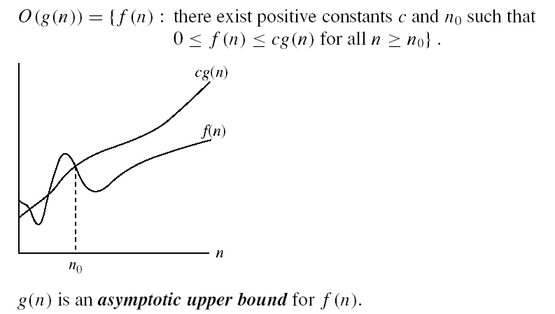
Asymptotic notations
O-notation
Intuitively: O(g(n)) = the set of functions with a smaller or same order of growth as g(n)

Slide 3
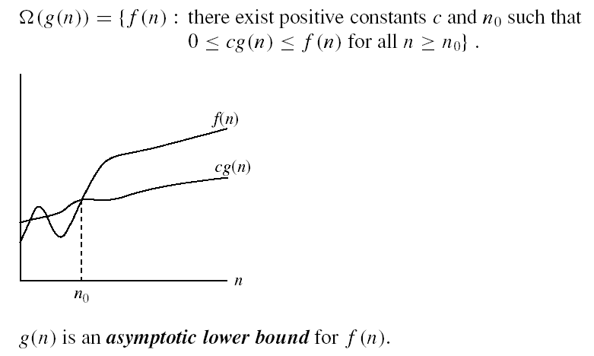
Asymptotic notations (cont.)
Ω - notation
Intuitively: Ω(g(n)) = the set of functions with a larger or same order of growth as g(n)

Slide 4

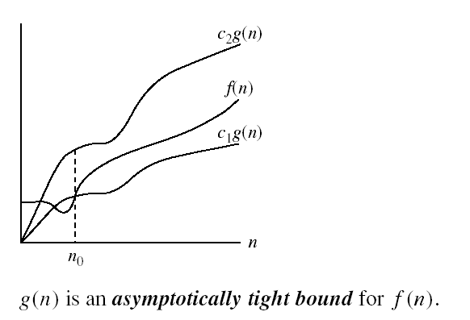
Asymptotic notations (cont.)
Θ-notation
Intuitively Θ(g(n)) = the set of functions with the same order of growth as g(n)

Slide 5
Exercise on O-notation
Show that 3n²+2n+5 = O(n²)
10 n² = 3n² + 2n² + 5n²
≥ 3n² + 2n + 5 for n ≥ 1
c = 10, n₀ = 1

Slide 6
Exercise on O-notation
O(n²)
O(n log n)
O(n²)
O(n log n)
f1(n) = 10 n + 25 n²
f2(n) = 20 n log n + 5 n
f3(n) = 12 n log n + 0.05 n²
f4(n) = n^{1/2} + 3 n log n
Notes:
For each function, find the simplest and g(n) such that f_i(n) = O(g(n))

Slide 7
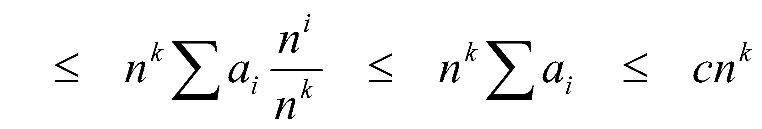
Big O Fact
A polynomial of degree k is O(n^{k})
Proof:
Suppose f(n) = b_{k}n^{k} + b_{k-1}n^{k-1} + … + b₁n + b₀
Let a_{i} = | b_{i} |
f(n) ≤ a_{k}n^{k} + a_{k-1}n^{k-1} + … + a₁n + a₀

Slide 8
Comparisons of Functions
Transitivity:
f(n) = Θ(g(n)) and g(n) = Θ(h(n)) ⇒ f(n) = Θ(h(n))
Same for O and Ω
Reflexivity:
f(n) = Θ(f(n))
Same for O and Ω
Symmetry:
f(n) = Θ(g(n)) if and only if g(n) = Θ(f(n))
Transpose symmetry:
f(n) = O(g(n)) if and only if g(n) = Ω(f(n))

Slide 9
Simplifying Assumptions
1. If f(n) = O(g(n)) and g(n) = O(h(n)), then f(n) = O(h(n))
2. If f(n) = O(kg(n)) for any k > 0, then f(n) = O(g(n))
3. If f₁(n) = O(g₁(n)) and f₂(n) = O(g₂(n)),
then f₁(n) + f₂(n) = O(max (g₁(n), g₂(n)))
4. If f₁(n) = O(g₁(n)) and f₂(n) = O(g₂(n)),
then f₁(n) * f₂(n) = O(g₁(n) * g₂(n))
‹#›
Notes:
‹#›

Slide 10
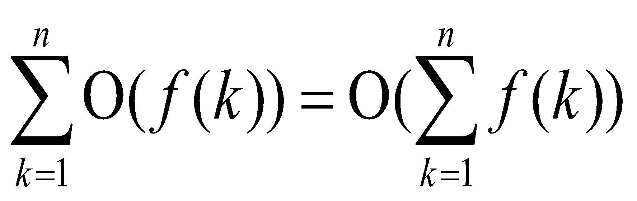
Manipulating Asymptotic Notation
cO(f(n)) = O(f(n))
O(O(f(n))) = O(f(n))
O(f(n))O(g(n)) = O(f(n)g(n))
O(f(n)g(n)) = f(n)O(g(n))
O(f(n)+g(n)) = ( max ( f(n),g(n))

Slide 11
More Examples
(a) 0.5n² - 5n + 2 = Ω( n²).
Let c = 0.25 and n₀ = 25.
0.5 n² - 5n + 2 = 0.25( n²) for all n = 25
(b) 0.5 n² - 5n + 2 = O( n²).
Let c = 0.5 and n₀ = 1.
0.5( n²) = 0.5 n² - 5n + 2 for all n = 1
(c) 0.5 n² - 5n + 2 = Θ( n²)
from (a) and (b) above.
Use n₀ = 25, c₁ = 0.25, c₂ = 0.5 in the definition.

Slide 12
GENERAL RULES FOR ANALYSIS(1/5)
1. Consecutive statements
Maximum statement is the one counted
e.g. a fragment with single for-loop followed by double for- loop is O(n²).
Block #1
t₁
t₁+t₂ = max(t₁,t₂)
Block #2
t₂

Slide 13
GENERAL RULES FOR ANALYSIS(2/5)
If/Else
if cond then S1
else
S2
if S1
else
Block # 1
t1
Block # 2
t2
Max(t₁,t₂)

Slide 14
GENERAL RULES FOR ANALYSIS(3/5)
3. For Loops
Running time of a for-loop is at most the running time of the statements inside the for-loop times number of iterations
for (i = sum = 0; i < n; i++)
sum += a[i];
for loop iterates n times, executes 2 assignment statements each iteration ==> asymptotic complexity of O(n)

Slide 15
GENERAL RULES FOR ANALYSIS(4/5)
4. Nested For-Loops
Analyze inside-out. Total running time is running time of the statement multiplied by product of the sizes of all the for-loops
e.g. for (i =0; i < n; i++)
for (j = 0, sum = a[0]; j <= i ; j++)
sum += a[j];
printf("sum for subarray - through %d is %d\n", i, sum);

Slide 16
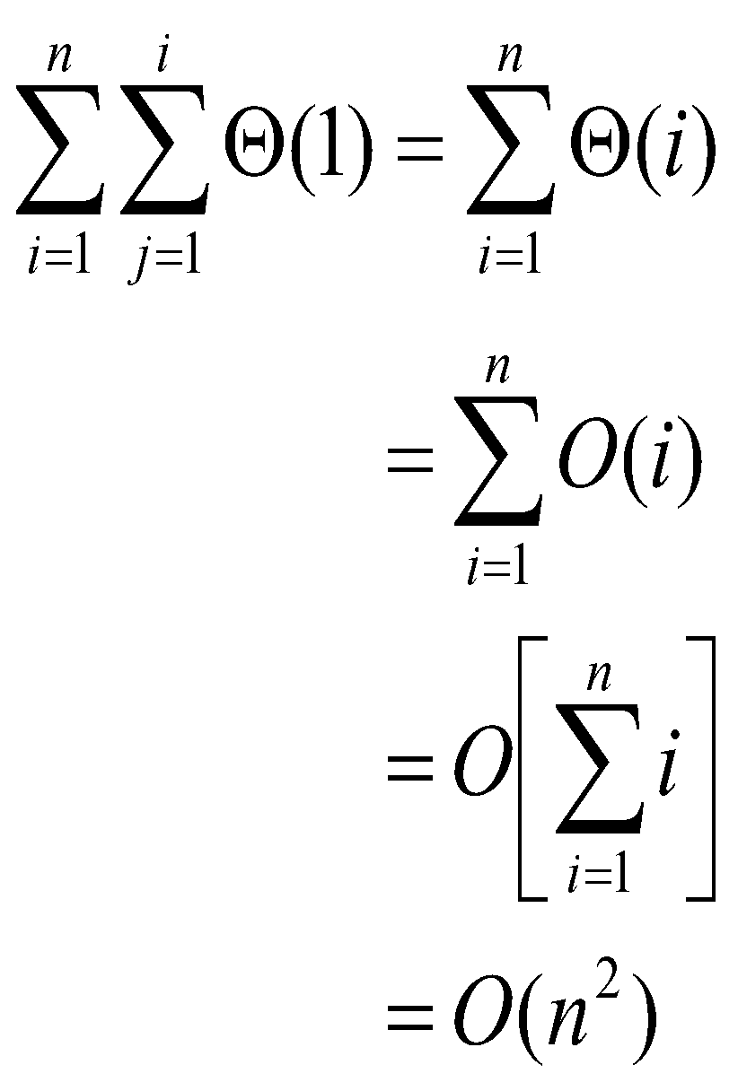
GENERAL RULES FOR ANALYSIS(5/5)

Slide 17
Recurrence Relations (1/2)
A recurrence relation is an equation which is defined in terms of itself.
Why are recurrences good things?
Many natural functions are easily expressed as recurrences:
a_{n} = a _{n-1} + 1, a₁ = 1−−> a_{n} = n (polynomial)
a_{n} = 2a _{n-1} ,a₁ = 1−−> a_{n} = 2^{n} (exponential)
a_{n} = na _{n-1} ,a₁ = 1−−> a_{n} = n! (weird function)
It is often easy to find a recurrence as the solution of a counting problem

Slide 18
Recurrence Relations (2/2)
In both, we have general and boundary conditions, with the general condition breaking the problem into smaller and smaller pieces.
The initial or boundary condition terminate the recursion (base case).

Slide 19
Recurrence Equations
A recurrence equation defines a function, say T(n). The function is defined recursively, that is, the function T(.) appear in its definition. (recall recursive function call). The recurrence equation should has a base case.
For example:
T(n) = T(n-1)+T(n-2), if n>1
1, if n=1 or n=0.
base case
for convenient, we sometime write the recurrence equation as:
T(n) = T(n-1)+T(n-2)
T(0) = T(1) = 1.

Slide 20
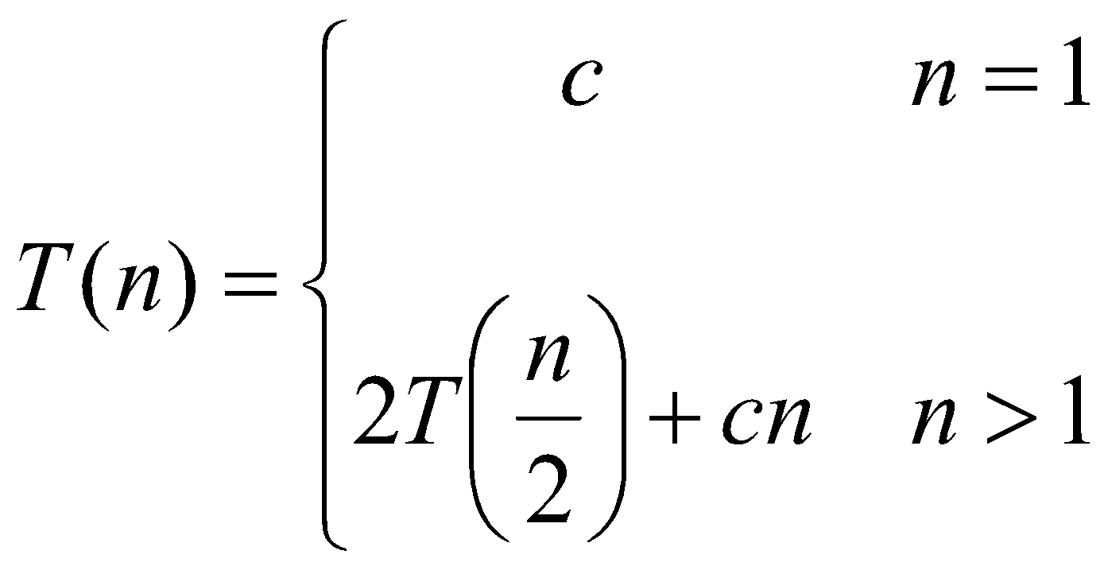
Recurrences
The expression:
is a recurrence.
Recurrence: an equation that describes a function in terms of its value on smaller functions

Slide 21
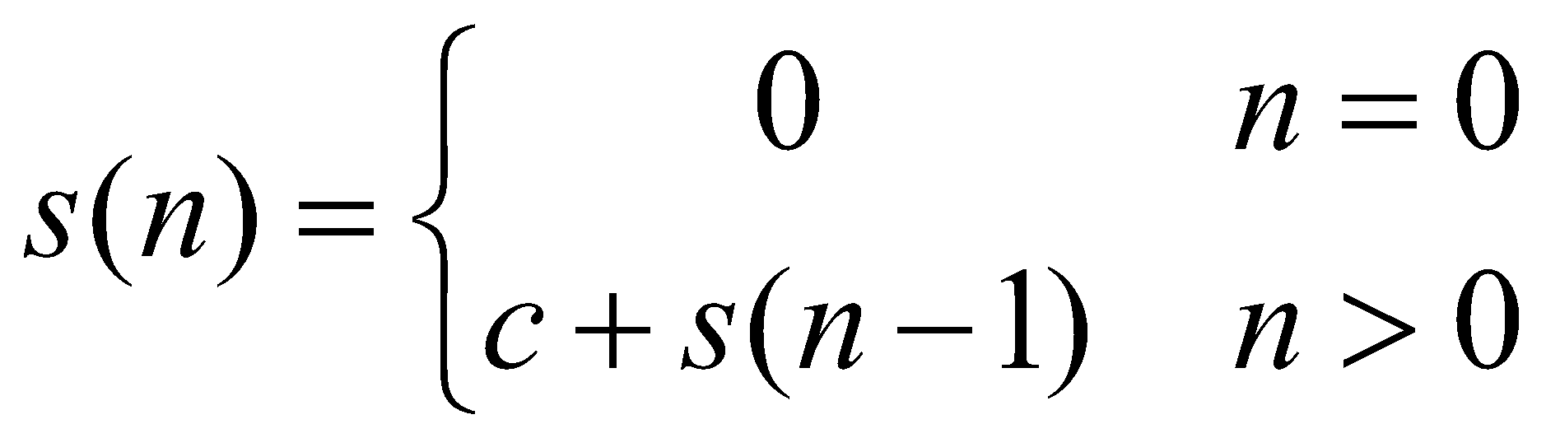
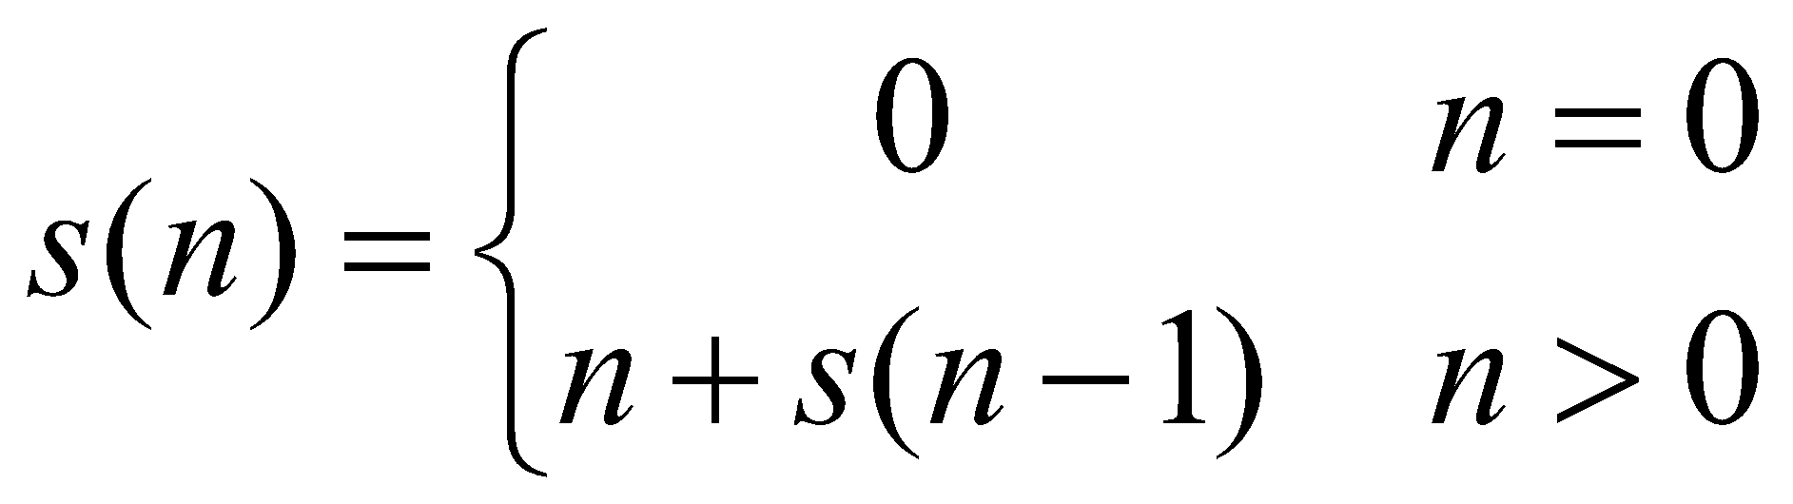
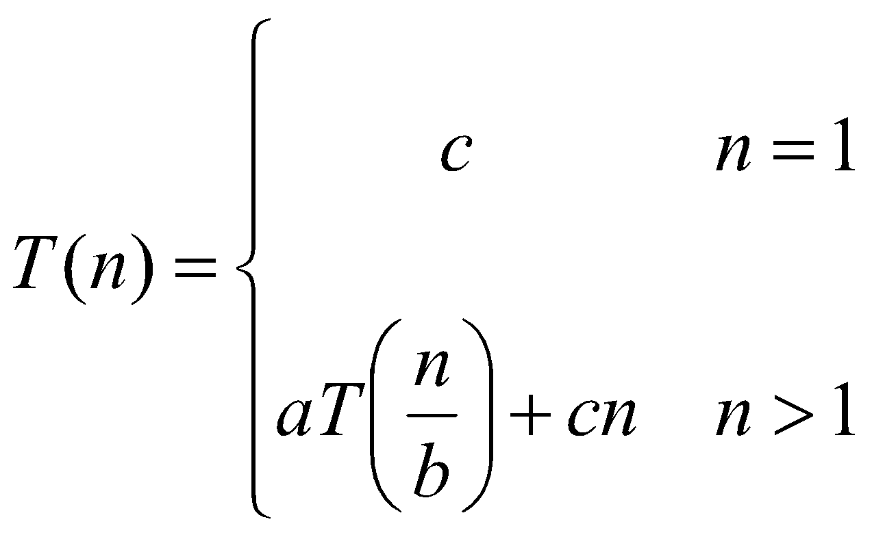
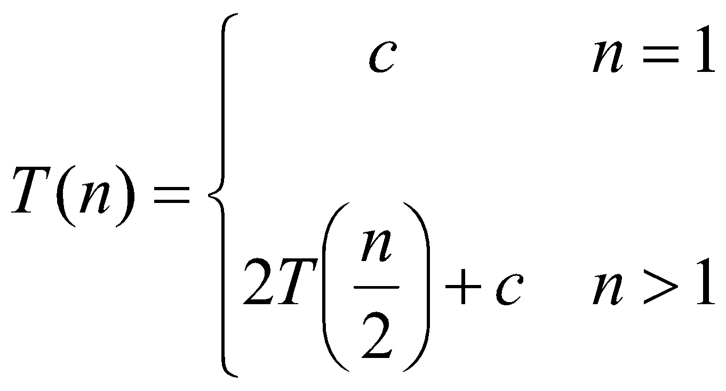
Recurrence Examples

Slide 22
More Recurrence equations:
T(n) = 2 * T(n/2) + 1,
T(1) = 1.
Base case;
initial condition.
T(n) = T(n-1) + n,
T(1) = 1.
Selection Sort
T(n) = 2* T(n/2) + n,
T(1) = 1.
Merge Sort
Quick Sort
T(n) = 2*T(n/2) + log n,
T(1) = 1.
Heap Construction
T(n) = T(n/2) + 1,
T(1) = 0.
Binary search

Slide 23
Methods for Solving Recurrences
Iteration method
Substitution method
Recursion tree method
Master method
‹#›

Slide 24
Simplications:
There are two simplifications we apply that won't affect asymptotic analysis
ignore floors and ceilings (justification in text)
assume base cases are constant, i.e., T(n) = Θ(1) for n small enough

Slide 25
Solving Recurrences: Iteration (convert to summation)
Expand the recurrence
Work some algebra to express as a summation
Evaluate the summation

Slide 26
The Iteration Method
T(n) = c + T(n/2)
T(n) = c + T(n/2)
= c + c + T(n/4)
= c + c + c + T(n/8)
Assume n = 2^{k}
T(n) = c + c + … + c + T(1)
= clgn + T(1)
= Θ(lgn)
T(n/2) = c + T(n/4)
T(n/4) = c + T(n/8)
k times
‹#›

Slide 27
s(n) =
c + s(n-1)
c + c + s(n-2)
2c + s(n-2)
2c + c + s(n-3)
3c + s(n-3)
…
kc + s(n-k) = ck + s(n-k)

Slide 28
So far for n >= k we have
s(n) = ck + s(n-k)
What if k = n?
s(n) = cn + s(0) = cn

Slide 29
So far for n >= k we have
s(n) = ck + s(n-k)
What if k = n?
s(n) = cn + s(0) = cn
So
Thus in general
s(n) = cn

Slide 30
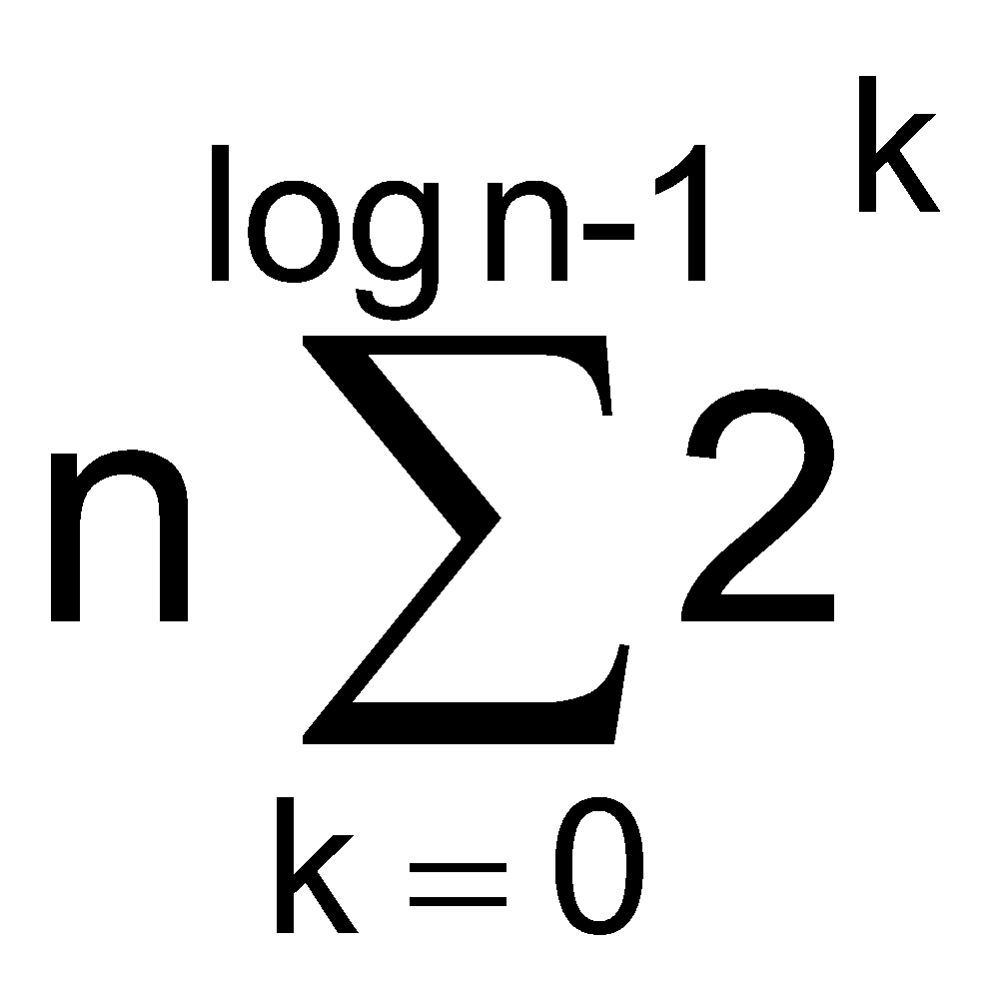
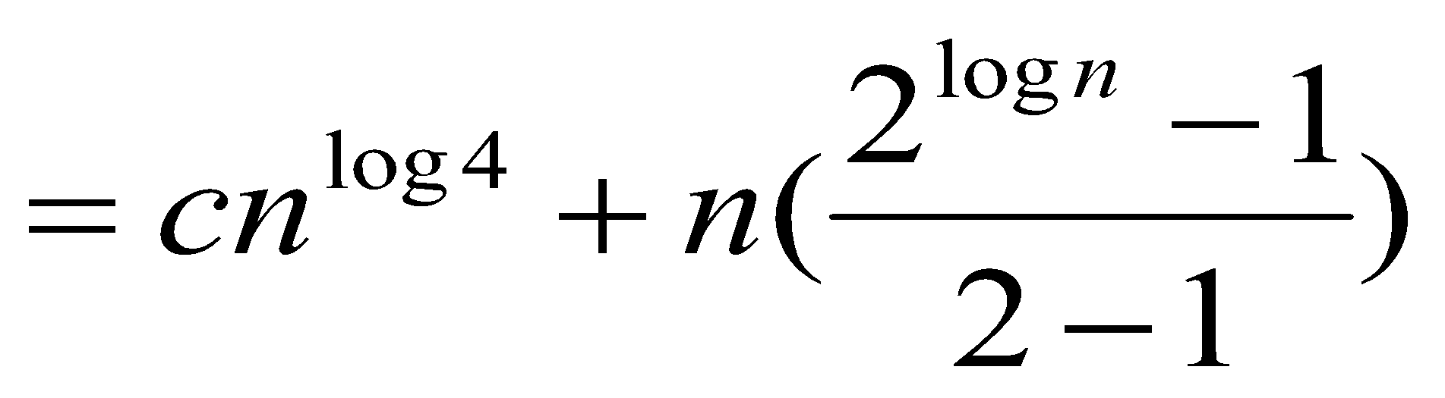
Solving Recurrences: Iteration (convert to summation)
Example: T(n) = 4T(n/2) + n
T(n) = 4T(n/2) + n /**expand**/
= 4(n/2 + 4T(n/4)) + n /**simplify**/
= 16T(n/4) + 2n + n /**expand**/
= 16(n/4 + 4T(n/8)) + 2n + n = 4³ T(n/2³) + 4n + 2n + 1
= 4^{log n} T(1)+ … + 4n + 2n + n /** #levels = log n **/
= c4^{log n} + /** convert to summation**/
/** a^{log b} = b^{log a} **/

Slide 31
Solving Recurrences: Iteration (convert to summation) (cont.)
= cn²+n(n^{log 2} -1) /** 2^{log n} = n^{log 2} **/
= cn² +n(n - 1)
= cn² +n² - n
= Θ(n²)
Proof:
a^{log b} = b^{log a}
Let a^{log b} = K
log(a^{log b}) = k
-> log b * log a = log (K)
Let b^{log a} = K1
-> log a * log b = log (K1)
it has to be log (K) = log(k1)
k = k1 = b ^{log a}

Slide 32
The substitution method
Guess a solution
Use induction to prove that the solution works
‹#›

Slide 33
Substitution method
Guess a solution
T(n) = O(g(n))
Induction goal: apply the definition of the asymptotic notation
T(n) ≤ d g(n), for some d > 0 and n ≥ n₀
Induction hypothesis: T(k) ≤ d g(k) for all k < n
Prove the induction goal
Use the induction hypothesis to find some values of the constants d and n₀ for which the induction goal holds
‹#›

Slide 34
Example: Binary Search
T(n) = c + T(n/2)
Guess: T(n) = O(lgn)
Induction goal: T(n) ≤ d lgn, for some d and n ≥ n₀
Induction hypothesis: T(n/2) ≤ d lg(n/2)
Proof of induction goal:
T(n) = T(n/2) + c ≤ d lg(n/2) + c
= d lgn – d + c ≤ d lgn
if: – d + c ≤ 0, d ≥ c
‹#›

Slide 35
Example 2
T(n) = T(n-1) + n
Guess: T(n) = O(n²)
Induction goal: T(n) ≤ c n², for some c and n ≥ n₀
Induction hypothesis: T(k-1) ≤ c(k-1)² for all k < n
Proof of induction goal:
T(n) = T(n-1) + n ≤ c (n-1)² + n
= cn² – (2cn – c - n) ≤ cn²
if: 2cn – c – n ≥ 0 ⇔ c ≥ n/(2n-1) ⇔ c ≥ 1/(2 – 1/n)
For n ≥ 1 ⇒ 2 – 1/n ≥ 1 ⇒ any c ≥ 1 will work
‹#›

Slide 36
Example 3
T(n) = 2T(n/2) + n
Guess: T(n) = O(nlgn)
Induction goal: T(n) ≤ cn lgn, for some c and n ≥ n₀
Induction hypothesis: T(n/2) ≤ cn/2 lg(n/2)
Proof of induction goal:
T(n) = 2T(n/2) + n ≤ 2c (n/2)lg(n/2) + n
= cn lgn – cn + n ≤ cn lgn
if: - cn + n ≤ 0 ⇒ c ≥ 1
‹#›

Slide 37
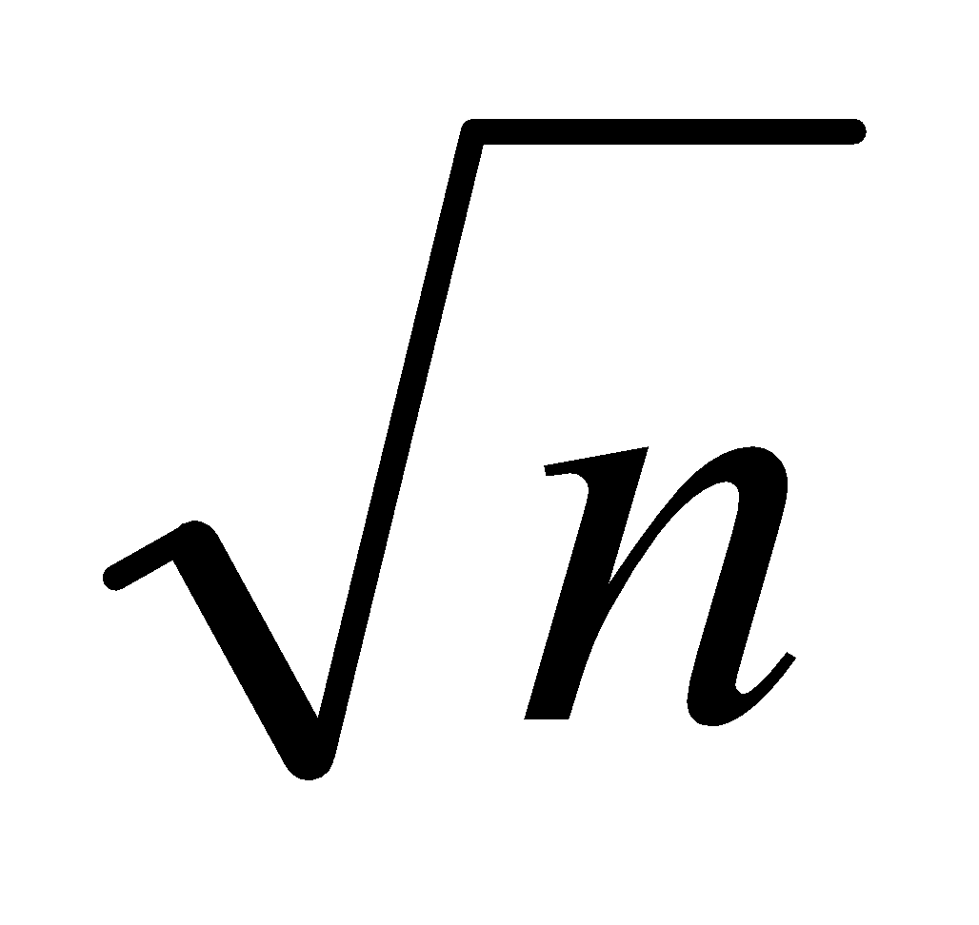
Changing variables
T(n) = 2T( ) + lgn
Rename: m = lgn ⇒ n = 2^{m}
T (2^{m}) = 2T(2^{m/2}) + m
Rename: S(m) = T(2^{m})
S(m) = 2S(m/2) + m ⇒ S(m) = O(mlgm) (demonstrated before)
T(n) = T(2^{m}) = S(m) = O(mlgm)=O(lgnlglgn)
Idea: transform the recurrence to one that you have seen before
‹#›

Slide 38
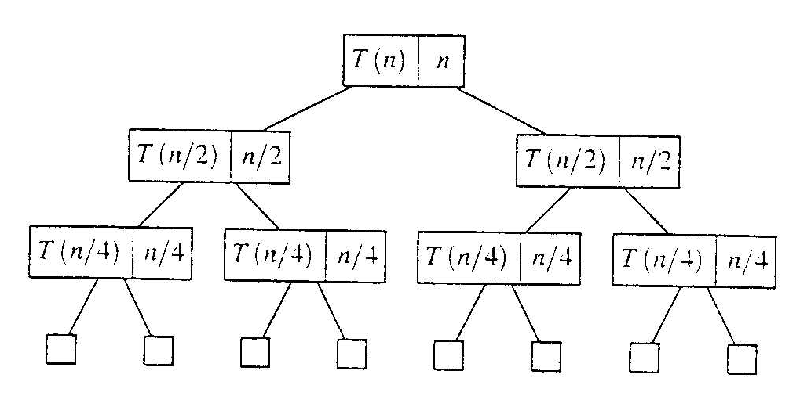
Evaluate recursive equation using Recursion Tree
Evaluate: T(n) = T(n/2) + T(n/2) + n
Work copy: T(k) = T(k/2) + T(k/2) + k
For k=n/2, T(n/2) = T(n/4) + T(n/4) + (n/2)
[size|cost]

Slide 39
Recursion-tree method
A recursion tree models the costs (time) of a recursive execution of an algorithm.
The recursion tree method is good for generating guesses for the substitution method.
The recursion-tree method can be unreliable.
The recursion-tree method promotes intuition, however.

Slide 40
Recursion Tree e.g.
To evaluate the total cost of the recursion tree
sum all the non-recursive costs of all nodes
= Sum (rowSum(cost of all nodes at the same depth))
Determine the maximum depth of the recursion tree:
For our example, at tree depth d the size parameter is n/(2^{d})
the size parameter converging to base case, i.e. case 1
such that, n/(2^{d}) = 1,
d = lg(n)
The rowSum for each row is n
Therefore, the total cost, T(n) = n lg(n)

Slide 41
Example of recursion tree
Solve T(n) = T(n/4) + T(n/2) + n²:

Slide 42
Example of recursion tree
Solve T(n) = T(n/4) + T(n/2) + n²:
T(n)

Slide 43
Example of recursion tree
Solve T(n) = T(n/4) + T(n/2) + n²:
n²
T(n/4)
T(n/2)

Slide 44
Example of recursion tree
Solve T(n) = T(n/4) + T(n/2) + n²:
n²
(n/4)²
(n/2)²
T(n/16)
T(n/8)
T(n/8)
T(n/4)

Slide 45
Example of recursion tree
Solve T(n) = T(n/4) + T(n/2) + n²:
n²
(n/4)²
(n/2)²
(n/16)²
(n/8)²
(n/8)²
(n/4)²
…
Θ(1)

Slide 46
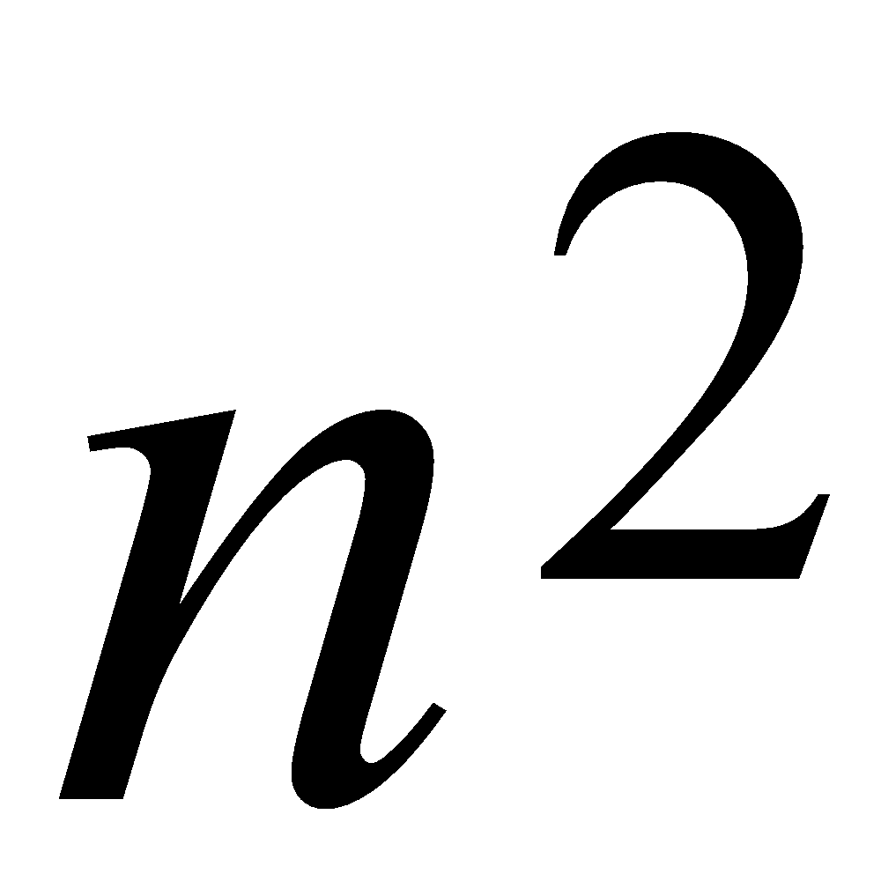
Example of recursion tree
Solve T(n) = T(n/4) + T(n/2) + n²:
n²
(n/4)²
(n/2)²
(n/16)²
(n/8)²
(n/8)²
(n/4)²
…
Θ(1)

Slide 47
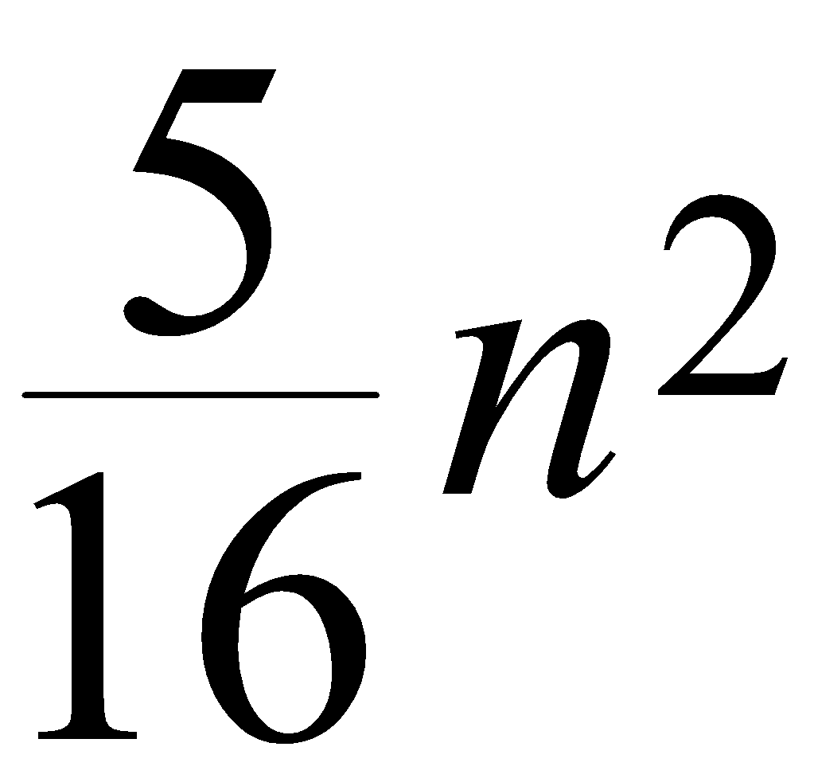
Example of recursion tree
Solve T(n) = T(n/4) + T(n/2) + n²:
n²
(n/4)²
(n/2)²
(n/16)²
(n/8)²
(n/8)²
(n/4)²
…
Θ(1)

Slide 48
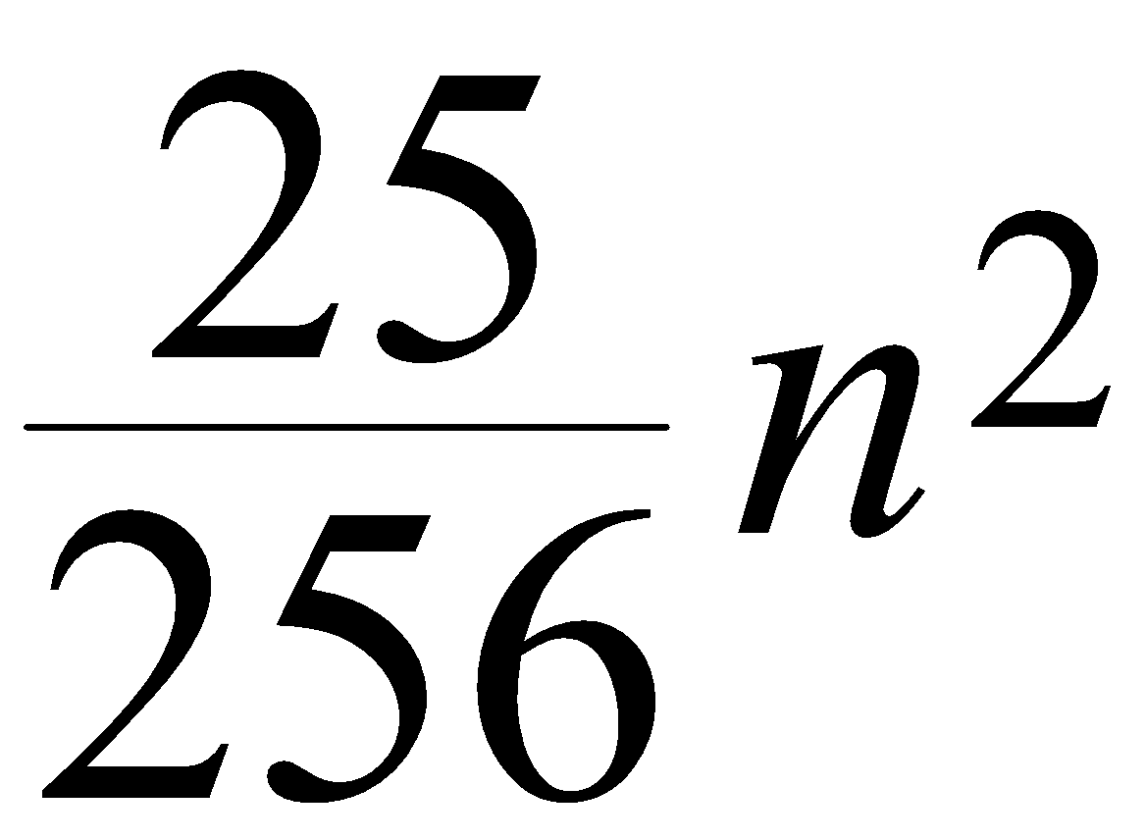
Example of recursion tree
Solve T(n) = T(n/4) + T(n/2) + n²:
n²
(n/4)²
(n/2)²
(n/16)²
(n/8)²
(n/8)²
(n/4)²
…
…
Θ(1)

Slide 49
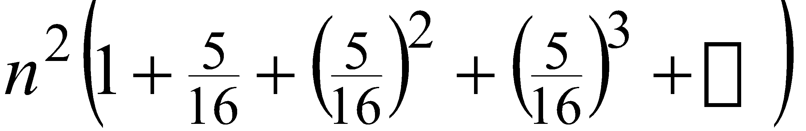
Example of recursion tree
Solve T(n) = T(n/4) + T(n/2) + n²:
n²
(n/4)²
(n/2)²
(n/16)²
(n/8)²
(n/8)²
(n/4)²
…
…
Θ(1)
Total =
= Θ(n²)
geometric series

Slide 50
The Master Method
Based on the Master theorem.
“Cookbook” approach for solving recurrences of the form
T(n) = aT(n/b) + f(n)
a ≥ 1, b > 1 are constants.
f(n) is asymptotically positive.
n/b may not be an integer, but we ignore floors and ceilings.
Requires memorization of three cases.

Slide 51
The Master Theorem
Theorem 4.1
Let a ≥ 1 and b > 1 be constants, let f(n) be a function, and Let T(n) be defined on nonnegative integers by the recurrence T(n) = aT(n/b) + f(n), where we can replace n/b by ⎣n/b⎦ or ⎡n/b⎤. T(n) can be bounded asymptotically in three cases:
If f(n) = O(n^{(logba)–ε}) for some constant ε > 0, then T(n) = Θ(n^{logba}).
If f(n) = Θ(n^{logba}), then T(n) = Θ(n^{logba}lg n).
If f(n) = Ω(n^{logba+ε}) for some constant ε > 0, and if, for some constant c < 1 and all sufficiently large n, we have a·f(n/b) ≤ c f(n), then T(n) = Θ(f(n)).

Slide 52
Master Method – Examples
T(n) = 16T(n/4)+n
a = 16, b = 4, n^{logba} = n^{log416} = n².
f(n) = n = O(n^{logba-ε}) = O(n^{2-ε} ), where ε = 1 ⇒ Case 1.
Hence, T(n) = Θ(n^{logba} ) = Θ(n²).
T(n) = T(3n/7) + 1
a = 1, b=7/3, and n^{logba} = n^{log 7/3 1} = n⁰ = 1
f(n) = 1 = Θ(n^{logba}) ⇒ Case 2.
Therefore, T(n) = Θ(n^{logba} lg n) = Θ(lg n)

Slide 53
Master Method – Examples
T(n) = 3T(n/4) + n lg n
a = 3, b=4, thus n^{logba} = n^{log43} = O(n^{0.793})
f(n) = n lg n = Ω(n^{log43 + ε} ) where ε ≈ 0.2 ⇒ Case 3.
Therefore, T(n) = Θ(f(n)) = Θ(n lg n).
T(n) = 2T(n/2) + n lg n
a = 2, b=2, f(n) = n lg n, and n^{logba} = n^{log22} = n
f(n) is asymptotically larger than n^{logba}, but not polynomially larger. The ratio lg n is asymptotically less than n^{ε} for any positive ε. Thus, the Master Theorem doesn’t apply here.
nlogn ≠ O(n^{1-ε}), T(n) is not Θ(n¹)
nlogn ≠ Θ(n¹), T(n) is not Θ(n¹log n)
nlogn ≠ 𝞨(n^{1+ε}), T(n) is not Θ(f(n))

Slide 54
Summary
Summary of master method
O(n^{(logba)–ε}) | Θ(n^{logba}) | Ω(n^{logba+ε})
Θ(n^{logba}) | Θ(n^{logba}lg n) | Θ(f(n))
 |  | Condition a·f(n/b) ≤ c f(n) where c < 1

