Slide 1
Analysis of Algorithms
NP Completeness
Notes:
‹#›

Slide 2
NP-Completeness
Polynomial-time algorithms
on inputs of size n, worst-case running time is O(n^{k}), for a constant k
Not all problems can be solved in polynomial time
Some problems cannot be solved by any computer no matter how much time is provided (Turing’s Halting problem) – such problems are called undecidable
Some problems can be solved but not in O(n^{k})
‹#›
Notes:
‹#›

Slide 3
Turing’s Halting Problem
The halting problem
Given a program and inputs for it, decide whether it will run forever or will eventually stop.
This is not the same thing as actually running a given program and seeing what happens. The halting problem asks whether there is any general prescription for deciding how long to run an arbitrary program so that its halting or non-halting will be revealed.
In this abstract framework, there are no resource limitations of memory or time on the program's execution; it can take arbitrarily long, and use arbitrarily much storage space, before halting.
Example
while(1) {x = x+1;}
The reason the halting problem is famous is because it is undecidable, which means there is no computable function that correctly determines which programs halt and which ones do not.
Turing proved no algorithm exists that always correctly decides whether, for a given arbitrary program and input, the program halts when run with that input.
‹#›

Slide 4
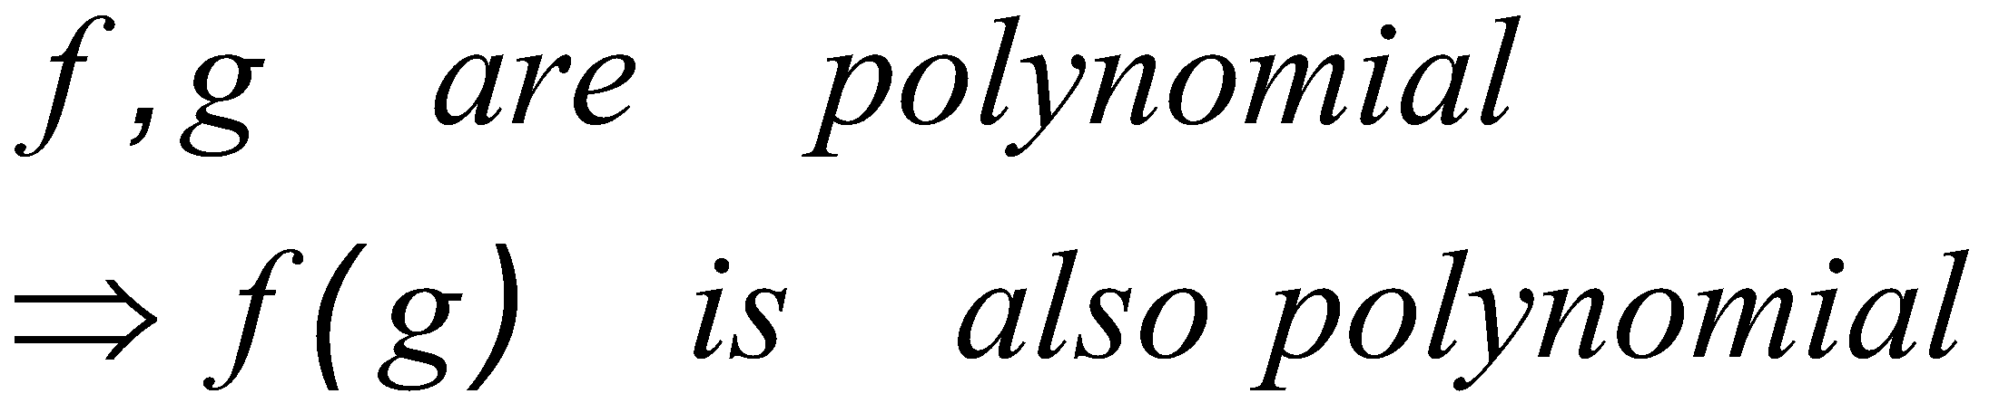
34.1 Polynomial Time
Polynomial time solvable problem are regarded as tractable.
Even if the current best algorithm for a problem has a running time of Θ(n¹⁰⁰), it is likely that an algorithm with a much better running time will soon be discovered.
Problems for many reasonable models of computation, that can be solved in one model can be solved in polynomial in another.
Polynomial-time solvable problems has a nice closure property.
‹#›

Slide 5
Class of “P” Problems
Class P consists of (decision) problems that are solvable in polynomial time:
there exists an algorithm that can solve the problem in O(n^{k}), k constant
Problems in P are also called tractable
Problems not in P are also called intractable
Can be solved in reasonable time only for small inputs
‹#›
Notes:
‹#›

Slide 6
Decision problems
A class of problems where for each input algorithm
have to produce one of two possible answers - “yes” or
“no”, i.e. computable functions of the type
f: N → {0,1}
‹#›

Slide 7
Optimization & Decision Problems
Decision problems
Given an input and a question regarding a problem, determine if the answer is yes or no
Optimization problems
Find a solution with the “best” value
Optimization problems can be cast as decision problems that are easier to study
E.g.: Shortest path: G = unweighted directed graph
Find a path between u and v that uses the fewest edges
Does a path exist from u to v consisting of at most k edges?
‹#›
Notes:
‹#›

Slide 8
Nondeterministic Algorithms
Nondeterministic algorithm = two stage procedure:
Nondeterministic (“guessing”) stage:
generate an arbitrary string that can be thought of as a candidate solution (“certificate”)
Deterministic (“verification”) stage:
take the certificate and the instance to the problem and returns YES if the certificate represents a solution
Nondeterministic polynomial (NP) = verification stage is polynomial
‹#›
Notes:
‹#›

Slide 9
Class of “NP” Problems
Class NP consists of problems that are verifiable in polynomial time (i.e., could be solved by nondeterministic polynomial algorithms)
If we were given a “certificate” of a solution, we could verify that the certificate is correct in time polynomial to the size of the input
‹#›
Notes:
‹#›

Slide 10
E.g.: Hamiltonian Cycle
Given: a directed graph G = (V, E), determine a simple cycle that contains each vertex in V
Each vertex can only be visited once
Certificate:
Sequence: 〈v₁, v₂, v₃, …, v_{|V|}〉
Verification:
1) (v_{i}, v_{i+1}) ∈ E for i = 1, …, |V|
2) (v_{|V|}, v₁) ∈ E
hamiltonian
not
hamiltonian
‹#›
Notes:
‹#›

Slide 11
Polynomial Reduction Algorithm
Polynomial time algorithm to decide A
yes
A
f
B
Polynomial time
algorithm to decide B
yes
no
no
To solve a decision problem A in polynomial time
Use a polynomial time reduction algorithm to transform A into B
Run a known polynomial time algorithm for B
Use the answer for B as the answer for A
‹#›
Notes:
‹#›

Slide 12
Reductions
Given two problems A, B, we say that A is reducible to B (A ≤_{p} B) if:
There exists a function f that converts the input of A to inputs of B in polynomial time
A(i) = YES ⇔ B(f(i)) = YES
‹#›
Notes:
‹#›

Slide 13
NP-Completeness
A problem B is NP-complete if:
1) B ∈ NP
2) A ≤_{p} B for all A ∈ NP
If B satisfies only property 2) we say that B is NP-hard
No polynomial time algorithm has been discovered for an NP-Complete problem
No one has ever proven that no polynomial time algorithm can exist for any NP-Complete problem
‹#›
Notes:
‹#›

Slide 14
NP-Completeness (why NPC?)
A problem p ∈NP, and any other problem p′ can be translated as p in poly time.
So if p can be solved in poly time, then all problems in NP can be solved in poly time.
‹#›

Slide 15
Proving NP-Completeness
Theorem: If A is NP-Complete and A ≤_{p} B
⇒ B is NP-Hard
In addition, if B ∈ NP
⇒ B is NP-Complete
Proof: Assume that B ∈ P
Since A ≤_{p} B ⇒ A ∈ P contradiction!
⇒ B is NP-Hard
‹#›
Notes:
‹#›

Slide 16
Reduction and NP-Completeness
yes
A
f
B
Problem B
yes
no
no
Problem A
Suppose we know:
No polynomial time algorithm exists for problem B
We have a polynomial reduction f from A to B
No polynomial time algorithm exists for A
‹#›
Notes:
‹#›

Slide 17
Proving NP-Completeness
Prove that the problem B is in NP
A randomly generated string can be checked in polynomial time to determine if it represents a solution
Show that one known NP-Complete problem can be transformed to B in polynomial time
No need to check that all NP-Complete problems are reducible to B
‹#›
Notes:
‹#›

Slide 18
Is P = NP?
Any problem in P is also in NP:
P ⊆ NP
We can solve problems in P, even without having a certificate
The big (and open question) is whether P = NP
Theorem: If any NP-Complete problem can be solved in polynomial time ⇒ then P = NP.
P
NP-complete
NP
‹#›
Notes:
‹#›

Slide 19
Relation among P, NP, NPC
P ⊆ NP (Sure)
NPC ⊆ NP (sure)
P = NP (or P ⊂ NP, or P ≠ NP) ???
NPC = NP (or NPC ⊂ NP, or NPC ≠ NP) ???
P ≠ NP: one of the deepest, most perplexing open research problems in (theoretical) computer science since 1971.
‹#›

Slide 20
Arguments about P, NP, NPC
No poly algorithm found for any NPC problem (even so many NPC problems)
No proof that a poly algorithm cannot exist for any of NPC problems, (even having tried so long so hard).
Most theoretical computer scientists believe that NPC is intractable (i.e., hard, and P ≠ NP).
‹#›

Slide 21
View of Theoretical Computer Scientists on P, NP, NPC
NP
NPC
P
P ⊂ NP, NPC ⊂ NP, P ∩ NPC = ∅
‹#›

Slide 22
P Vs NP vs NPC vs NP Hard
NP Hard
Difficulty Level
NP
NPC
P

Slide 23
Why discussion on NPC
If a problem is proved to be NPC, a good evidence for its intractability (hardness).
Not waste time on trying to find efficient algorithm for it
Instead, focus on design approximate algorithm or a solution for a special case of the problem
Some problems looks very easy on the surface, but in fact, is hard (NPC).
‹#›

Slide 24
P & NP-Complete Problems
Shortest simple path
Given a graph G = (V, E) find a shortest path from a source to all other vertices
Polynomial solution: O(VE)
Longest simple path
Given a graph G = (V, E) find a longest path from a source to all other vertices
NP-complete
‹#›
Notes:
‹#›

Slide 25
P & NP-Complete Problems
Euler tour
G = (V, E) a connected, directed graph find a cycle that traverses each edge of G exactly once (may visit a vertex multiple times)
Polynomial solution O(E)
Hamiltonian cycle
G = (V, E) a connected, directed graph find a cycle that visits each vertex of G exactly once
NP-complete
‹#›
Notes:
‹#›

Slide 26
A First NP-complete problem
Because the technique of reduction relies on having a problem already known to be NP-complete in order to prove a different problem NP-complete,
we need a “first” NPC problem.
Circuit-satisfiability problem
‹#›

Slide 27
First NP-complete problem—Circuit Satisfiability (problem definition)
Boolean combinational circuit
Boolean combinational elements, wired together
Each element, inputs and outputs (binary)
Limit the number of outputs to 1.
Called logic gates: NOT gate, AND gate, OR gate.
true table: giving the outputs for each setting of inputs
true assignment: a set of boolean inputs.
satisfying assignment: a true assignment causing the output to be 1
A circuit is satisfiable if it has a satisfying assignment.
‹#›

Slide 28
Circuit Satisfiability Problem: definition
Circuit satisfying problem:
given a boolean combinational circuit composed of AND, OR, and NOT, is it stisfiable?
CIRCUIT-SAT={<C>: C is a satisfiable boolean circuit}
Implication:
in the area of computer-aided hardware optimization, if a subcircuit always produces 0, then the subcircuit can be replaced by a simpler subcircuit that omits all gates and just output a 0.
‹#›

Slide 29
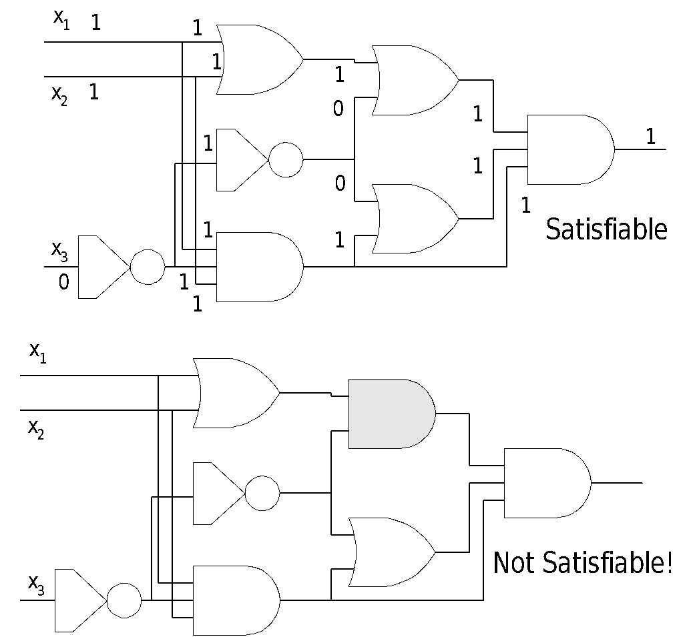
Circuit Satisfiability Problem
‹#›

Slide 30
Solving circuit-satisfiability problem
Intuitive solution:
for each possible assignment, check whether it generates 1.
suppose the number of inputs is k, then the total possible assignments are 2^{k}. So the running time is Ω(2^{k}). When the size of the problem is Θ(k), then the running time is not poly.
‹#›

Slide 31
Circuit Satisfiability: Theorem
Lemma 34.5.
The circuit-satisfiability problem belongs to the class NP.
Lemma 34.6.
The circuit-satisfiability problem is NP-hard.
Theorem 34.7.
The circuit-satisfiability problem is NP-Complete.
‹#›

Slide 32
Circuit-satisfiability problem is NP-complete
Lemma 34.5: CIRCUIT-SAT belongs to NP.
Proof:
CIRCUIT-SAT is poly-time verifiable.
Given (an encoding of) a CIRCUIT-SAT problem C and a certificate, which is an assignment of boolean values to (all) wires in C.
The algorithm is constructed as follows: just checks each gates and then the output wire of C:
If for every gate, the computed output value matches the value of the output wire given in the certificate and the output of the whole circuit is 1, then the algorithm outputs 1, otherwise 0.
The algorithm is executed in poly time (even linear time).
‹#›

Slide 33
Circuit-satisfiability problem is NP-complete (cont.)
Lemma 34.6: (page 991)
CIRCUIT-SAT is NP-hard.
Proof:
Difficult to proof
If you are interested, read from the book
‹#›

Slide 34
NPC proof –Formula Satisfiability (SAT)
SAT definition
n boolean variables: x₁, x₂,…, x_{n}.
M boolean connectives: any boolean function with one or two inputs and one output, such as ∧,∨,¬,→,↔,… and
Parentheses.
A SAT φ is satisfiable
if there exists a true assignment which causes φ to evaluate to 1.
E.g.: Φ = (x₁ ∨ x₂) ∧ (x₁ ∨ ¬ x₂) ∧ (¬ x₁ ∨ ¬ x₂)
Certificate: x₁ = 1, x₂ = 0 ⇒ Φ = 1 ∧ 1 ∧ 1 = 1
SAT={< φ>: φ is a satifiable boolean formula}.
The historical honor of the first NP-complete problem ever shown.
‹#›

Slide 35
SAT is NP-complete
Theorem 34.9: (page 997)
SAT is NP-complete.
Proof:
SAT belongs to NP.
Given a satisfying assignment, the verifying algorithm replaces each variable with its value and evaluates the formula, in poly time.
SAT is NP-hard (show CIRCUIT-SAT≤_{p} SAT).
‹#›

Slide 36
SAT is NP-complete (cont.)
CIRCUIT-SAT≤_{p} SAT, i.e., any instance of circuit satisfiability can be reduced in poly time to an instance of formula satisfiability.
Intuitive induction:
Look at the gate that produces the circuit output.
Inductively express each of gate’s inputs as formulas.
Formula for the circuit is then obtained by writing an expression that applies the gate’s function to its input formulas.
Unfortunately, this is not a poly reduction
Shared formula (the gate whose output is fed to 2 or more inputs of
other gates) cause the size of generated formula to grow exponentially.
‹#›

Slide 37
SAT is NP-complete (cont.)
Correct reduction:
For every wire x_{i} of C, give a variable x_{i} in the formula.
Every gate can be expressed as x_{o}↔(x_{i1}θ x_{i2}θ… θ x_{il})
The final formula φ is the AND of the circuit output variable and conjunction of all clauses describing the operation of each gate. (example Figure 34.10)
Correctness of the reduction
Clearly the reduction can be done in poly time.
C is satisfiable if and only if φ is satisfiable.
If C is satisfiable, then there is a satisfying assignment. This means that each wire of C has a well-defined value and the output of C is 1. Thus the assignment of wire values to variables in φ makes each clause in φ evaluate to 1. So φ is 1.
The reverse proof can be done in the same way.
‹#›

Slide 38
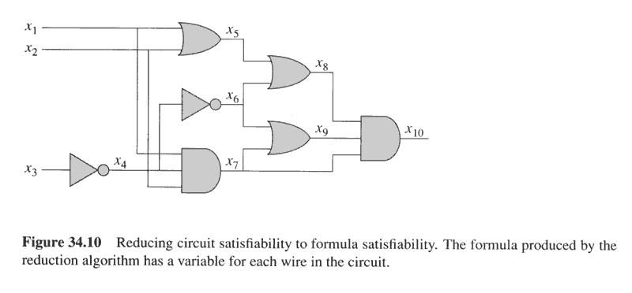
Example of reduction of CIRCUIT-SAT to SAT
φ= x₁₀∧(x₁₀↔(x₇∧ x₈∧ x₉))
∧(x₉↔(x₆ ∨ x₇))
∧(x₈↔(x₅ ∨ x₆))
∧(x₇↔(x₁∧ x₂∧ x₄))
∧(x₆↔ ¬x₄))
∧(x₅↔(x₁ ∨ x₂))
∧(x₄↔¬x₃)
INCORRECT REDUCTION: φ= x₁₀= x₇∧ x₈∧ x₉=(x₁∧ x₂∧ x₄) ∧ (x₅ ∨ x₆)∧ (x₆ ∨ x₇)
=(x₁∧ x₂∧ x₄) ∧ ((x₁ ∨ x₂) ∨ ¬x₄)∧ (¬x₄ ∨ (x₁∧ x₂∧ x₄))=….
‹#›

Slide 39
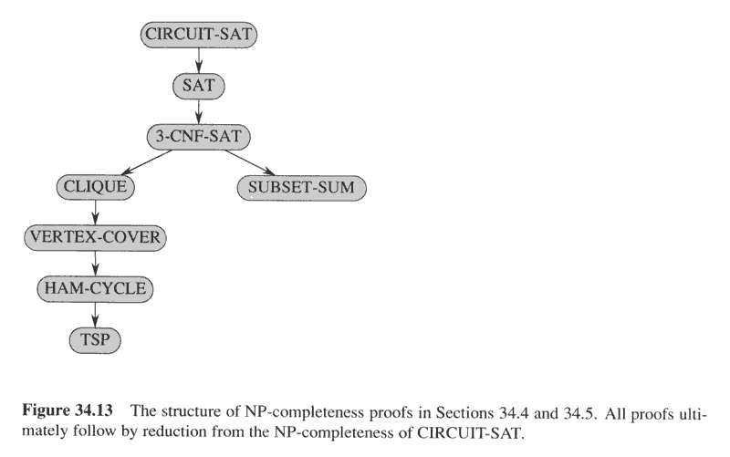
NP-completeness proof structure
‹#›

Slide 40
3-CNF Satisfiability
3-CNF Satisfiability Problem:
n boolean variables: x₁, x₂, …, x_{n}
Literal: x_{i} or ¬ x_{i} (a variable or its negation)
Clause: c_{j} = an OR of three literals (m clauses)
Formula: Φ = c₁ ∧ c₂ ∧ … ∧ c_{m}
E.g.:
Φ = (x₁ ∨ ¬x₁ ∨ ¬x₂) ∧
(x₃ ∨ x₂ ∨ x₄) ∧
(¬x₁ ∨ ¬x₃ ∨ ¬ x₄)
3-CNF is NP-Complete
‹#›
Notes:
‹#›

Slide 41
3-CNF-SAT is NP-complete
Proof: 3-CNF-SAT ∈NP. Easy.
3-CNF-SAT is NP-hard. (show SAT ≤_{p}3-CNF-SAT)
Suppose φ is any boolean formula, Construct a binary ‘parse’ tree, with literals as leaves and connectives as internal nodes.
Introduce a variable y_{i} for the output of each internal nodes.
Rewrite the formula to φ' as the AND of the root variable and a conjunction of clauses describing the operation of each node.
The result is that in φ', each clause has at most three literals.
Change each clause into conjunctive normal form as follows:
Construct a true table, (small, at most 8 by 4)
Write the disjunctive normal form for all true-table items evaluating to 0
Using DeMorgan law to change to CNF.
The resulting φ'' is in CNF but each clause has 3 or less literals.
Change 1 or 2-literal clause into 3-literal clause as follows:
If a clause has one literal l, change it to (l∨p∨q)∧(l∨p∨¬q)∧ (l∨¬p∨q)∧ (l∨¬p∨¬q).
If a clause has two literals (l₁∨ l₂), change it to (l₁∨ l₂ ∨p) ∧ (l₁∨ l₂ ∨¬p).
‹#›

Slide 42
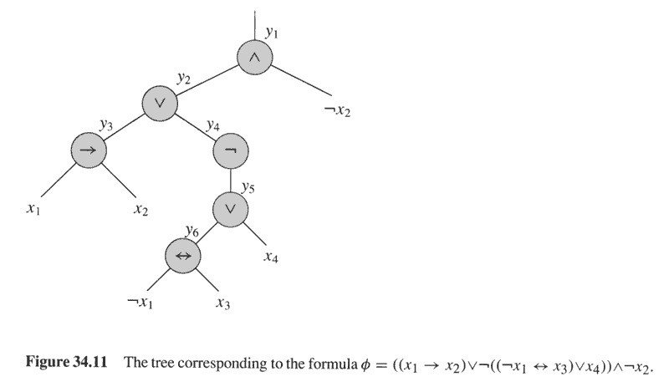
Binary parse tree for φ=((x₁→ x₂) ∨¬((¬x₁↔ x₃) ∨ x₄))∧¬x₂
φ'= y₁∧(y₁ ↔ (y₂∧¬x₂))
∧(y₂ ↔ (y₃ ∨ y₄))
∧(y₄ ↔ ¬y₅)
∧(y₃ ↔ (x₁ → x₂))
∧(y₅ ↔ (y₆ ∨ x₄))
∧(y₆ ↔ (¬x₁ ↔ x₃))
‹#›

Slide 43
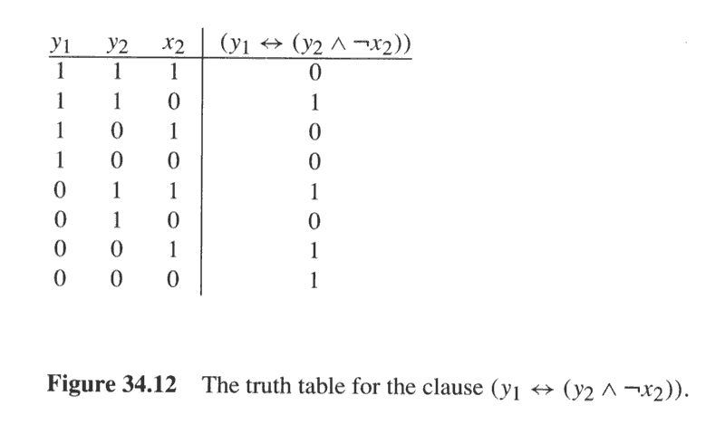
Example of Converting a 3-literal clause to CNF format
Disjunctive Normal Form:
φ_{i}'=(y₁∧y₂∧x₂)∨(y₁∧¬y₂∧x₂)
∨(y₁∧¬y₂∧¬x₂) ∨(¬y₁∧y₂∧¬x₂)
Conjunctive Normal Form:
φ_{i}''=(¬y₁∨¬y₂∨¬x₂)∧(¬y₁∨y₂∨¬x₂)
∧(¬y₁∨y₂∨x₂)∧(y₁∨¬y₂∨x₂)
‹#›

Slide 44
3-CNF is NP-complete
φ and reduced 3-CNF are equivalent:
From φ to φ' , keep equivalence.
From φ' to φ'' , keep equivalence.
From φ'' to final 3-CNF, keep equivalence.
Reduction is in poly time,
From φ to φ' , introduce at most 1 variable and 1 clause per connective in φ.
From φ' to φ'' , introduce at most 8 clauses for each clause in φ'.
From φ'' to final 3-CNF, introduce at most 4 clauses for each clause in φ''.
‹#›

Slide 45
Clique
Clique Problem:
Undirected graph G = (V, E)
Clique: a subset of vertices in V all connected to each other by edges in E (i.e., forming a complete graph)
Size of a clique: number of vertices it contains
Optimization problem:
Find a clique of maximum size
Decision problem:
Does G have a clique of size k?
Clique(G, 2) = YES
Clique(G, 3) = NO
Clique(G, 3) = YES
Clique(G, 4) = NO
‹#›
Notes:
‹#›

Slide 46
Clique Verifier
Given: an undirected graph G = (V, E)
Problem: Does G have a clique of size k?
Certificate:
A set of k nodes
Verifier:
Verify that for all pairs of vertices in this set there exists an edge in E
‹#›
Notes:
‹#›

Slide 47
CLIQUE is NP-complete
Theorem 34.11: (page 1003)
CLIQUE problem is NP-complete.
Proof:
CLIQUE ∈NP:
given G=(V,E) and a set V'⊆V as a certificate for G. The verifying algorithm checks for each pair of u,v∈V', whether <u,v> ∈E. time: O(|V'|²|E|).
CLIQUE is NP-hard:
show 3-CNF-SAT ≤_{p}CLIQUE.
The result is surprising, since from boolean formula to graph.
‹#›

Slide 48
3-CNF ≤_{p} Clique
Start with an instance of 3-CNF:
Φ = C₁ ∧ C₂ ∧ … ∧ C_{k} (k clauses)
Each clause C_{r} has three literals: C_{r} = l₁^{r} ∨ l₂^{r} ∨ l₃^{r}
Idea:
Construct a graph G such that Φ is satisfiable only if G has a clique of size k
‹#›
Notes:
‹#›

Slide 49
3-CNF ≤_{p} Clique
Φ = C₁ ∧ C₂ ∧ C₃
C₁ = x₁ ∨ ¬x₂ ∨ ¬x₃
x₁
¬x₂
¬x₃
C₂ = ¬x₁ ∨ x₂ ∨ x₃
C₃ = x₁ ∨ x₂ ∨ x₃
¬x₁
x₁
x₂
x₂
x₃
x₃
For each clause C_{r} = l₁^{r} ∨ l₂^{r} ∨ l₃^{r} place a triple of vertices v₁^{r}, v₂^{r}, v₃^{r} in V
Put an edge between two vertices v_{i}^{r} and v_{j}^{s} if:
v_{i}^{r} and v_{j}^{s} are in different triples
l_{i}^{r} is not the negation of l_{j}^{s} (consistent correspondent literals)
‹#›
Notes:
‹#›

Slide 50
3-CNF ≤_{p} Clique
Φ = C₁ ∧ C₂ ∧ C₃
Suppose Φ has a satisfying assignment
Each clause C_{r} has a literal assigned to 1 – this corresponds to a vertex v_{i}^{r}
Picking one such literal from each C_{r} ⇒ a set V’ of k vertices
C₁ = x₁ ∨ ¬x₂ ∨ ¬x₃
x₁
¬x₂
¬x₃
¬x₁
x₁
x₂
x₂
x₃
x₃
C₂ = ¬x₁ ∨ x₂ ∨ x₃
C₃ = x₁ ∨ x₂ ∨ x₃
Claim: V’ is a clique
∀ v_{i}^{r}, v_{j}^{s} ∈ V’ the corresponding literals are 1 ⇒ cannot be complements
by the design of G the edge (v_{i}^{r}, v_{j}^{s}) ∈ E
‹#›
Notes:
‹#›

Slide 51
3-CNF ≤_{p} Clique
Φ = C₁ ∧ C₂ ∧ C₃
C₁ = x₁ ∨ ¬x₂ ∨ ¬x₃
Suppose G has a clique
of size k
No edges between nodes
in the same clause
Clique contains only one
vertex from each clause
Assign 1 to vertices in
the clique
The literals of these vertices cannot belong to complementary literals
Each clause is satisfied ⇒ Φ is satisfied
x₁
¬x₂
¬x₃
¬x₁
x₁
x₂
x₂
x₃
x₃
C₂ = ¬x₁ ∨ x₂ ∨ x₃
C₃ = x₁ ∨ x₂ ∨ x₃
‹#›
Notes:
‹#›

Slide 52
NP-completeness proof structure
‹#›

Slide 53
Vertex Cover
G = (V, E), undirected graph
Vertex cover = a subset V’ ⊆ V
such that covers all the edges
if (u, v) ∈ E then u ∈ V’ or v ∈ V’ or both.
Size of a vertex cover = number of vertices in it
Problem:
Find a vertex cover of minimum size
Does graph G have a vertex cover of size k?
u
v
z
z
w
w
y
x
‹#›
Notes:
‹#›

Slide 54
Clique ≤_{p} Vertex Cover
G
G^{C}
G
G^{C}
Clique = 2
VxCv = 2
Clique = 2
VxCv = 3
Size[Clique](G) + Size[VxCv](G^{C}) = n
G has a clique of size k ⇔ G^{C} has a vertex cover of size n – k
S is a clique in G ⇔ V – S is a vertex cover in G^{C}
‹#›
Notes:
‹#›

Slide 55
Clique ≤_{p} Vertex Cover
G
u
v
G^{C}
u
v
z
w
z
w
y
x
y
x
G = (V, E) ⇒ G^{C} = (V, E^{C})
E^{C} = {(u, v):, u, v ∈V, and (u, v) ∉E}
Idea:
〈G, k〉 (clique) → 〈G^{C}, |V|-k〉 (vertex cover)
‹#›
Notes:
‹#›

Slide 56
Clique ≤_{p} Vertex Cover
G
u
v
G^{C}
u
v
z
w
z
w
y
x
y
x
G has a clique V’⊆ V, |V’| = k ⇒ V-V’ is a V-C in G^{C}
Let (u, v) ∈ E^{C}
⇒ (u, v) ∉ E
⇒ u and v were not connected in E
⇒ at least one of u or v does not belong in the clique V’
⇒ at least one of u or v belongs in V - V’
⇒ edge (u, v) is covered by V – V’
⇒ edge (u, v) was arbitrary ⇒ every edge of E^{C} is covered
‹#›
Notes:
‹#›

Slide 57
Clique ≤_{p} Vertex Cover
G
u
v
G^{C}
u
v
z
w
z
w
y
x
y
x
G^{C} has a vertex cover V’⊆ V, |V’| = |V| - k
For all u, v ∈ V, if (u, v) ∈ E^{C}
⇒ u ∈ V’ or v ∈ V’ or both ∈ V’
For all u, v ∈ V, if u ∉ V’ and v ∉ V’:
no edge between u, v in E^{G}
⇒ (u, v) ∈ E
⇒ V – V’ is a clique, of size |V| - |V’| = k
‹#›
Notes:
‹#›

Slide 58
The Traveling Salesman Problem
G = (V, E), |V| = n, vertices represent cities
Cost: c(i, j) = cost of travel from city i to city j
Problem: salesman should make a tour (hamiltonian cycle):
Visit each city only once
Finish at the city he started from
Total cost is minimum
TSP = tour with cost at most k
u
v
1
3
2
1
x
w
5
〈u, w, v, x, u〉
‹#›
Notes:
‹#›

Slide 59
Traveling-salesman problem is NPC
TSP={<G,c,k>:
G=(V,E) is a complete graph,
c is a function from V×V→Z,
k∈Z, and G has a traveling salesman
tour with cost at most k.}
Theorem 34.14: (page 1012)
TSP is NP-complete.
‹#›

Slide 60
TSP ∈ NP
Certificate:
Sequence of n vertices, cost
E.g.: 〈u, w, v, x, u〉, 7
Verification:
Each vertex occurs only once
Sum of costs is at most k
u
v
1
3
2
1
x
w
5
‹#›
Notes:
‹#›

Slide 61
HAM-CYCLE ≤_{p} TSP
Start with an instance of Hamiltonian cycle G = (V, E)
Form the complete graph G’ = (V, E’)
E’ = {(i, j): i, j ∈ V and i ≠ j}
0 if (i, j) ∈ E
1 if (i, j) ∉ E
TSP: 〈G’, c, 0〉
G has a hamiltonian cycle ⇔ G’ has a tour of cost at most 0
u
v
1
3
2
1
c(i, j) =
x
w
5
u
1
v
0
0
0
0
x
w
0
‹#›
Notes:
‹#›

Slide 62
HAM-CYCLE ≤_{p} TSP
u
v
u
1
v
1
0
3
2
0
0
1
0
x
w
x
w
5
0
G has a hamiltonian cycle h
Each edge in h ∈ E ⇒ has cost 0 in G’
h is a tour in G’ with cost 0
G’ has a tour h’ of cost at most 0
Each edge on tour must have cost 0
h’ contains only edges in E
‹#›
Notes:
‹#›

Slide 63
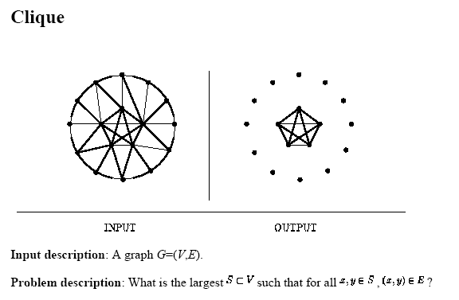
Some popular NP-complete problems
‹#›

Slide 64
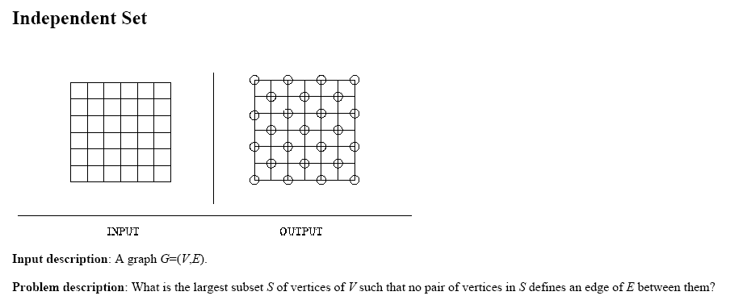
Some popular NP-complete problems
‹#›

Slide 65
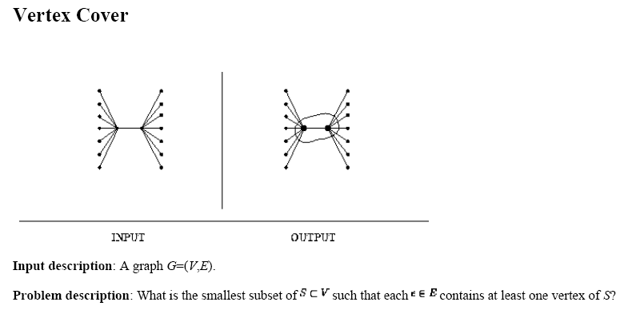
Some popular NP-complete problems
‹#›

Slide 66
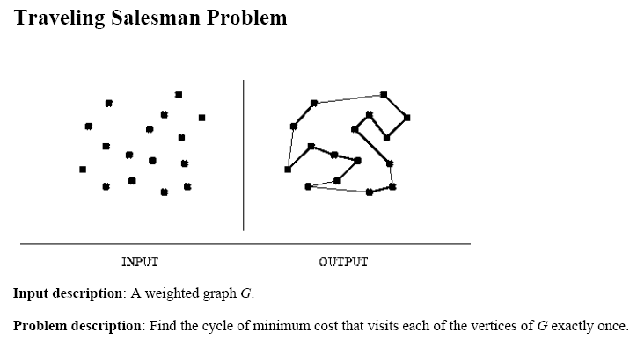
Some popular NP-complete problems
‹#›

Slide 67
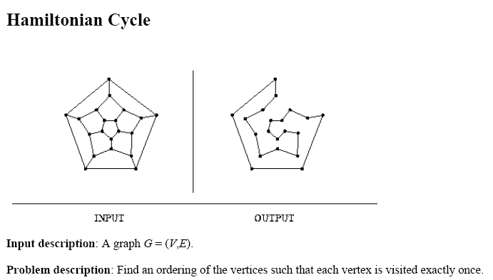
Some popular NP-complete problems
‹#›

Slide 68
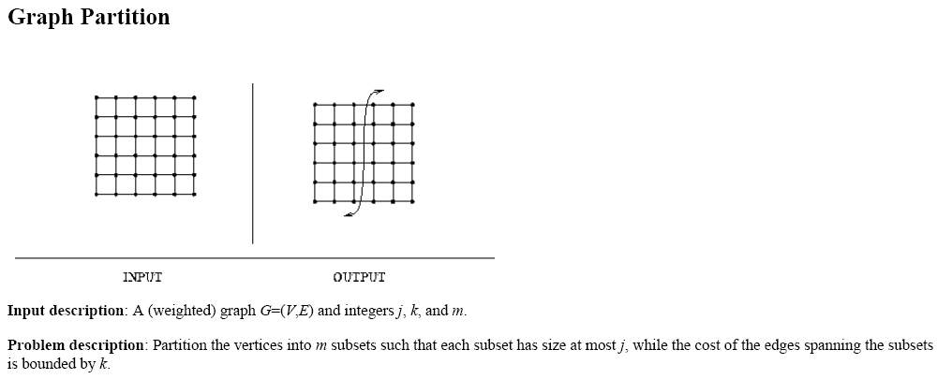
Some popular NP-complete problems
‹#›

Slide 69
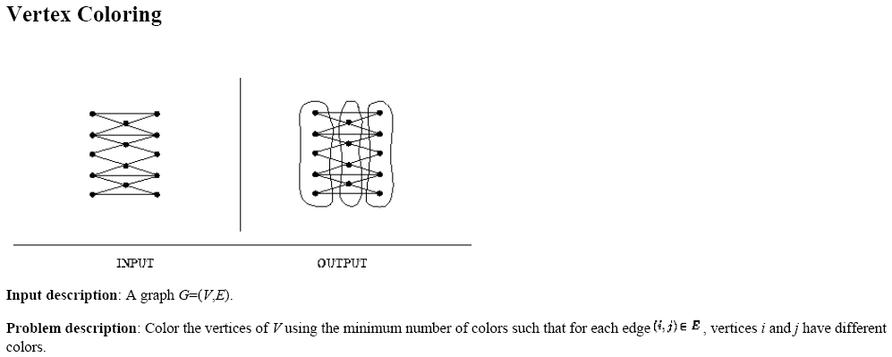
Some popular NP-complete problems
‹#›

Slide 70
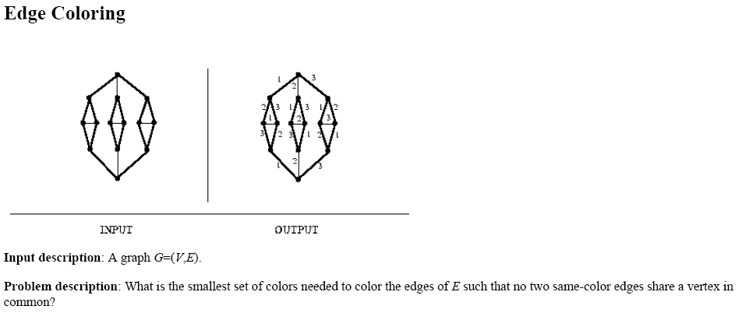
Some popular NP-complete problems
‹#›

Slide 71
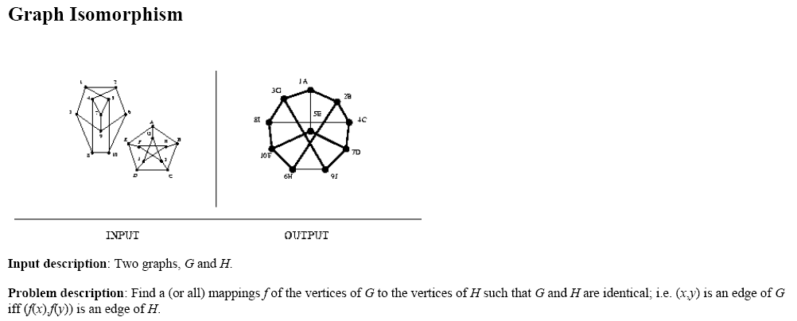
Some popular NP-complete problems
‹#›

Slide 72
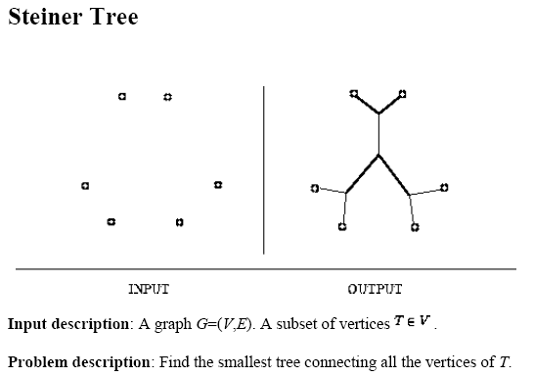
Some popular NP-complete problems
‹#›

Slide 73
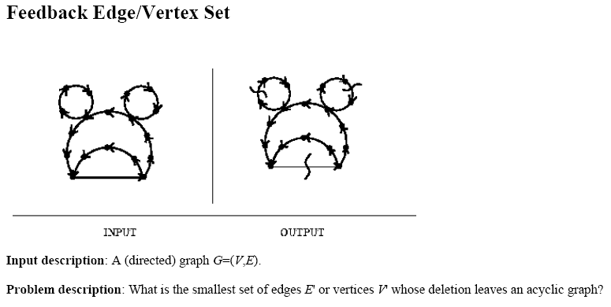
Some popular NP-complete problems
‹#›

Slide 74
Readings
Chapter 34
‹#›
Notes:
‹#›

