Slide 1
Graph & BFS
Lecture 1
Notes:
‹#›

Slide 2
Graphs
Extremely useful tool in modeling problems
Consist of:
Vertices
Edges
Vertices can be considered “sites” or locations.
Edges represent
connections.
D
E
C
A
F
B
Vertex
Edge
Notes:
‹#›

Slide 3
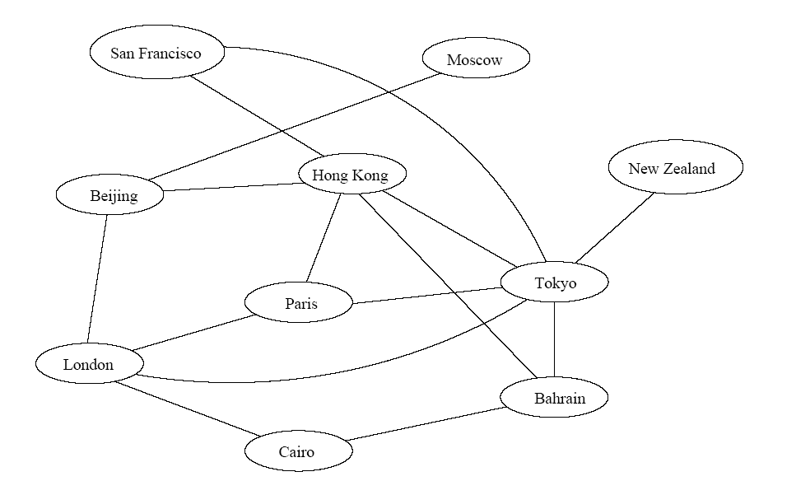
Application
Air flight system
Each vertex represents a city
Each edge represents a direct flight between two cities
A query on direct flights = a query on whether an edge exists
A query on how to get to a location = does a path exist from A to B
We can even associate costs to edges (weighted graphs), then ask “what is the cheapest path from A to B”
Notes:
‹#›

Slide 4
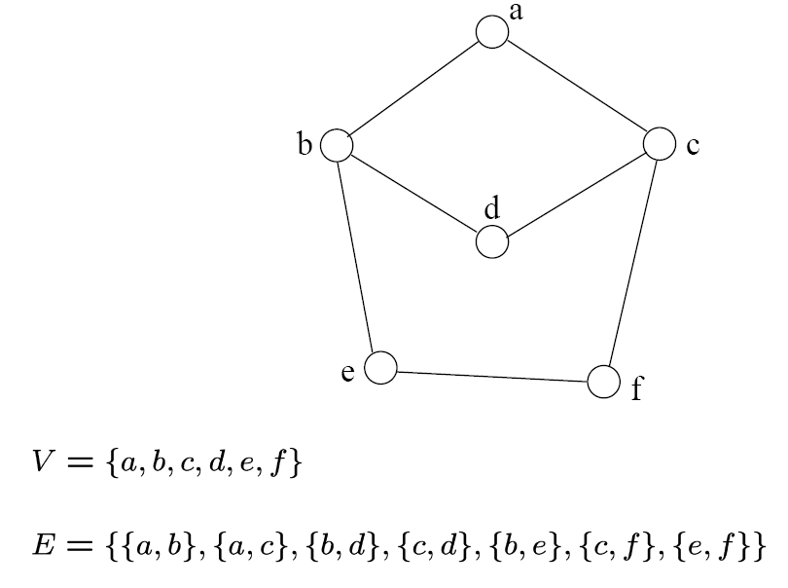
Definition
A graph G=(V, E) consists a set of vertices, V, and a set of edges, E.
Each edge is a pair of (v, w), where v, w belongs to V
If the pair is unordered, the graph is undirected; otherwise it is directed
{a,b}
{a,c}
{b,d}
{c,d}
{b,e}
{c,f}
{e,f}
An undirected graph
Notes:
‹#›

Slide 5
Definition
Complete Graph
How many edges are there in an N-vertex complete graph?
Bipartite Graph
What is its property? How can we detect it?
Path
Tour
Degree of a vertices
Indegree
Outdegree
Indegree+outdegree = Even (why??)

Slide 6
Definition
^{N}C₂=N(N-1)/2
Complete Graph (undirected)
How many edges are there in an N-vertex complete graph?
Bipartite Graph
What is its property? How can we detect it?
Path
Tour [no repeated edge]
Degree of a vertices
Indegree
Outdegree
Indegree+outdegree = Even (why??)
Graph’s nodes can be divided into two groups and can make edges between these two groups.
An edge goes outward from a node and inward in another node

Slide 7
Walk->Trail->Path->Tour
Walk - A walk is a finite or infinite sequence of edges which joins a sequence of vertices
Trail - is a walk with no repeated edges
Path - is a trail with no repeated vertices
Tour - is a trail and ends where it started

Slide 8
Graph Variations
Variations:
A connected graph has a path from every vertex to every other
In an undirected graph:
Edge (u,v) = edge (v,u)
No self-loops
In a directed graph:
Edge (u,v) goes from vertex u to vertex v, notated u→v

Slide 9
Graph Variations
More variations:
A weighted graph associates weights with either the edges or the vertices
E.g., a road map: edges might be weighted w/ distance
A multigraph allows multiple edges between the same vertices
E.g., the call graph in a program (a function can get called from multiple points in another function)

Slide 10
Graphs
We will typically express running times in terms of |E| and |V| (often dropping the |’s)
If |E| ≈ |V|² the graph is dense
If |E| ≈ |V| the graph is sparse
If you know you are dealing with dense or sparse graphs, different data structures may make sense

Slide 11
Graph Representation
Two popular computer representations of a graph. Both represent the vertex set and the edge set, but in different ways.
Adjacency Matrix
Use a 2D matrix to represent the graph
Adjacency List
Use a 1D array of linked lists
Notes:
‹#›

Slide 12
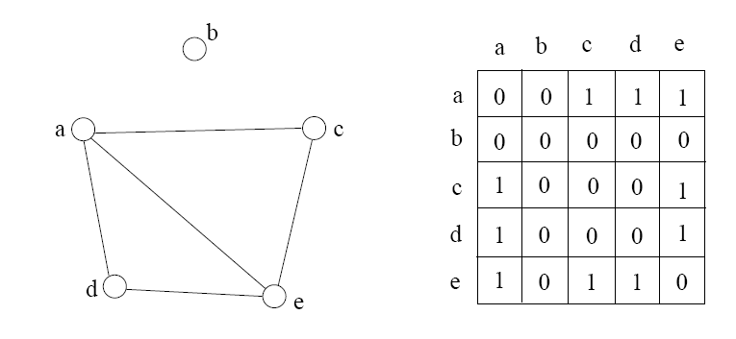
Adjacency Matrix
2D array A[0..n-1, 0..n-1], where n is the number of vertices in the graph
Each row and column is indexed by the vertex id
e,g a=0, b=1, c=2, d=3, e=4
A[i][j]=1 if there is an edge connecting vertices i and j; otherwise, A[i][j]=0
The storage requirement is Θ(n²). It is not efficient if the graph has few edges. An adjacency matrix is an appropriate representation if the graph is dense: |E|=Θ(|V|²)
We can detect in O(1) time whether two vertices are connected.
Notes:
‹#›

Slide 13
Simple Questions on Adjacency Matrix
Is there a direct link between A and B?
What is the indegree and outdegree for a vertex A?
How many nodes are directly connected to vertex A?
Is it an undirected graph or directed graph?
Suppose ADJ is an NxN matrix. What will be the result if we create another matrix ADJ2 where ADJ2=ADJxADJ?

Slide 14
ADJ2 = ADJ * ADJ
ADJ2[i][j] = ∑_{K} ADJ[i][k] * ADJ[k][j]
So, an edge between [i][j] is created if there’s edge between [i][k] and [j][k].

Slide 15
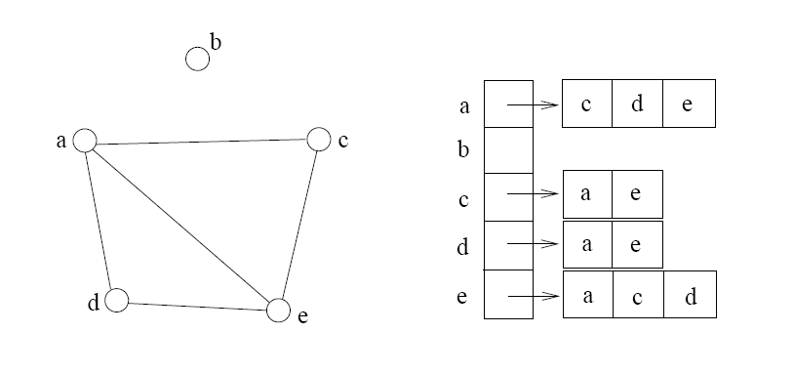
Adjacency List
If the graph is not dense, in other words, sparse, a better solution is an adjacency list
The adjacency list is an array A[0..n-1] of lists, where n is the number of vertices in the graph.
Each array entry is indexed by the vertex id
Each list A[i] stores the ids of the vertices adjacent to vertex i
Notes:
‹#›

Slide 16
Adjacency Matrix Example
0
 | 0 | 1 | 2 | 3 | 4 | 5 | 6 | 7 | 8 | 9
0 | 0 | 0 | 0 | 0 | 0 | 0 | 0 | 0 | 1 | 0
1 | 0 | 0 | 1 | 1 | 0 | 0 | 0 | 1 | 0 | 1
2 | 0 | 1 | 0 | 0 | 1 | 0 | 0 | 0 | 1 | 0
3 | 0 | 1 | 0 | 0 | 1 | 1 | 0 | 0 | 0 | 0
4 | 0 | 0 | 1 | 1 | 0 | 0 | 0 | 0 | 0 | 0
5 | 0 | 0 | 0 | 1 | 0 | 0 | 1 | 0 | 0 | 0
6 | 0 | 0 | 0 | 0 | 0 | 1 | 0 | 1 | 0 | 0
7 | 0 | 1 | 0 | 0 | 0 | 0 | 1 | 0 | 0 | 0
8 | 1 | 0 | 1 | 0 | 0 | 0 | 0 | 0 | 0 | 1
9 | 0 | 1 | 0 | 0 | 0 | 0 | 0 | 0 | 1 | 0
8
2
9
1
3
7
6
4
5
Notes:
‹#›

Slide 17
Adjacency List Example
8
0
0
1
2
3
4
5
6
7
8
9
2 | 3 | 7 | 9
8
1 | 4 | 8
2
9
1 | 4 | 5
1
2 | 3
7
3 | 6
3
6
5 | 7
4
5
1 | 6
0 | 2 | 9
1 | 8
Notes:
‹#›

Slide 18
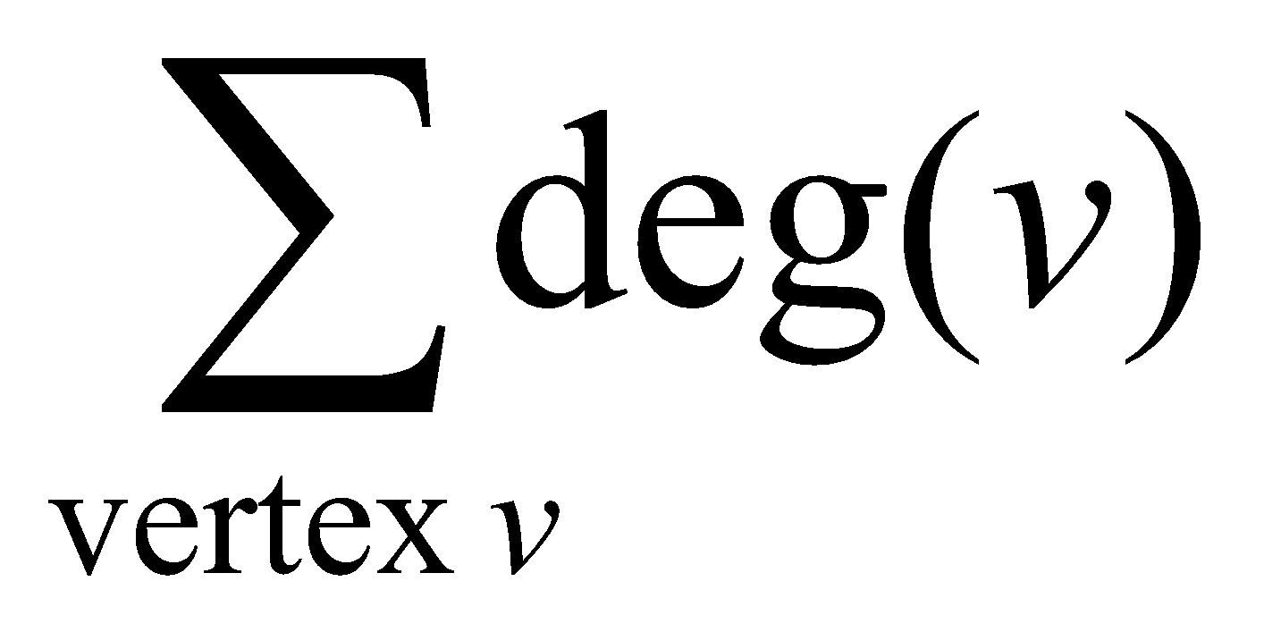
Storage of Adjacency List
The array takes up Θ(n) space
Define degree of v, deg(v), to be the number of edges incident to v. Then, the total space to store the graph is proportional to:
An edge e={u,v} of the graph contributes a count of 1 to deg(u) and contributes a count 1 to deg(v)
Therefore, Σ_{vertex v}deg(v) = 2m, where m is the total number of edges
In all, the adjacency list takes up Θ(n+m) space
If m = O(n²) (i.e. dense graphs), both adjacent matrix and adjacent lists use Θ(n²) space.
If m = O(n), adjacent list outperform adjacent matrix
However, one cannot tell in O(1) time whether two vertices are connected
Notes:
‹#›

Slide 19
Adjacency List vs. Matrix
Adjacency List
More compact than adjacency matrices if graph has few edges
Requires more time to find if an edge exists
Adjacency Matrix
Always require n² space
This can waste a lot of space if the number of edges are sparse
Can quickly find if an edge exists
Notes:
‹#›

Slide 20
Path between Vertices
A path is a sequence of vertices (v₀, v₁, v₂,… v_{k}) such that:
For 0 ≤ i < k, {v_{i}, v_{i+1}} is an edge
Note: a path is allowed to go through the same vertex or the same edge any number of times!
The length of a path is the number of edges on the path
Notes:
‹#›

Slide 21

Types of paths
A path is simple if and only if it does not contain a vertex more than once.
A path is a cycle if and only if v₀= v_{k}
The beginning and end are the same vertex!
A path contains a cycle as its sub-path if some vertex appears twice or more
Notes:
‹#›

Slide 22
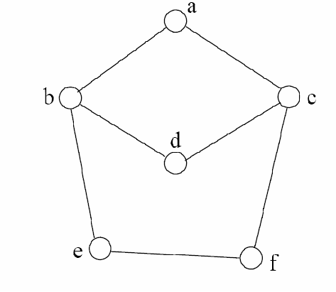
Path Examples
Are these paths?
Any cycles?
What is the path’s length?
{a,c,f,e}
{a,b,d,c,f,e}
{a, c, d, b, d, c, f, e}
{a,c,d,b,a}
{a,c,f,e,b,d,c,a}
Notes:
‹#›

Slide 23
Graph Traversal
Application example
Given a graph representation and a vertex s in the graph
Find paths from s to other vertices
Two common graph traversal algorithms
Breadth-First Search (BFS)
Find the shortest paths in an unweighted graph
Depth-First Search (DFS)
Topological sort
Find strongly connected components
Notes:
‹#›

Slide 24
BFS and Shortest Path Problem
Given any source vertex s, BFS visits the other vertices at increasing distances away from s. In doing so, BFS discovers paths from s to other vertices
What do we mean by “distance”? The number of edges on a path from s
Example
0
Consider s=vertex 1
8
2
Nodes at distance 1?
2, 3, 7, 9
1
2
s
9
1
1
Nodes at distance 2?
8, 6, 5, 4
7
1
3
6
2
4
1
5
Nodes at distance 3?
0
2
2
Notes:
‹#›

Slide 25
Graph Searching
Given: a graph G = (V, E), directed or undirected
Goal: methodically explore every vertex and every edge
Ultimately: build a tree on the graph
Pick a vertex as the root
Choose certain edges to produce a tree
Note: might also build a forest if graph is not connected

Slide 26
Breadth-First Search
“Explore” a graph, turning it into a tree
One vertex at a time
Expand frontier of explored vertices across the breadth of the frontier
Builds a tree over the graph
Pick a source vertex to be the root
Find (“discover”) its children, then their children, etc.

Slide 27
Breadth-First Search
Every vertex of a graph contains a color at every moment:
White vertices have not been discovered
All vertices start with white initially
Grey vertices are discovered but not fully explored
They may be adjacent to white vertices
Black vertices are discovered and fully explored
They are adjacent only to black and gray vertices
Explore vertices by scanning adjacency list of grey vertices

Slide 28
Breadth-First Search: The Code
Data: color[V], prev[V],d[V]
BFS(G) // starts from here
{
for each vertex u ∈ V-{s}
{
color[u]=WHITE;
prev[u]=NIL;
d[u]=inf;
}
color[s]=GRAY;
d[s]=0; prev[s]=NIL;
Q=empty;
ENQUEUE(Q,s);
While(Q not empty)
{
u = DEQUEUE(Q);
for each v ∈ adj[u]{
if (color[v] == WHITE){
color[v] = GREY;
d[v] = d[u] + 1;
prev[v] = u;
Enqueue(Q, v);
}
}
color[u] = BLACK;
}
}
‹#›

Slide 29
Breadth-First Search: Example
r
s
t
u
∞
∞
∞
∞
∞
∞
∞
∞
v
w
x
y
Vertex | r | s | t | u | v | w | x | y
color | W | W | W | W | W | W | W | W
d | ∞ | ∞ | ∞ | ∞ | ∞ | ∞ | ∞ | ∞
prev | nil | nil | nil | nil | nil | nil | nil | nil

Slide 30
Breadth-First Search: Example
r
s
t
u
∞
0
∞
∞
∞
∞
∞
∞
v
w
x
y
Q:
s
vertex | r | s | t | u | v | w | x | y
Color | W | G | W | W | W | W | W | W
d | ∞ | 0 | ∞ | ∞ | ∞ | ∞ | ∞ | ∞
prev | nil | nil | nil | nil | nil | nil | nil | nil

Slide 31
Breadth-First Search: Example
r
s
t
u
1
0
∞
∞
∞
1
∞
∞
v
w
x
y
Q:
s
w
r
vertex | r | s | t | u | v | w | x | y
Color | G | B | W | W | W | G | W | W
d | 1 | 0 | ∞ | ∞ | ∞ | 1 | ∞ | ∞
prev | s | nil | nil | nil | nil | s | nil | nil

Slide 32
Breadth-First Search: Example
r
s
t
u
1
0
2
∞
∞
1
2
∞
v
w
x
y
Q:
s
w
r
t
x
vertex | r | s | t | u | V | w | X | y
Color | G | B | G | W | W | B | G | W
d | 1 | 0 | 2 | ∞ | ∞ | 1 | 2 | ∞
prev | s | nil | w | nil | nil | s | w | nil

Slide 33
Breadth-First Search: Example
r
s
t
u
1
0
2
∞
2
1
2
∞
v
w
x
y
Q:
s
w
r
t
x
v
vertex | r | s | t | u | v | w | x | y
Color | B | B | G | W | G | B | G | W
d | 1 | 0 | 2 | ∞ | 2 | 1 | 2 | ∞
prev | s | nil | w | nil | r | s | w | nil

Slide 34
Breadth-First Search: Example
r
s
t
u
1
0
2
3
2
1
2
∞
v
w
x
y
Q:
s
w
r
t
x
v
u
vertex | r | s | t | u | v | w | x | y
Color | B | B | B | G | G | B | G | W
d | 1 | 0 | 2 | 3 | 2 | 1 | 2 | ∞
prev | s | nil | w | t | r | s | w | nil

Slide 35
Breadth-First Search: Example
r
s
t
u
1
0
2
3
2
1
2
3
v
w
x
y
Q:
s
w
r
t
x
v
u
y
vertex | r | s | t | u | v | w | x | y
Color | B | B | B | G | G | B | B | G
d | 1 | 0 | 2 | 3 | 2 | 1 | 2 | 3
prev | s | nil | w | t | r | s | w | x

Slide 36
Breadth-First Search: Example
r
s
t
u
1
0
2
3
2
1
2
3
v
w
x
y
Q:
s
w
r
t
x
v
u
y
vertex | r | s | t | u | v | w | x | y
Color | B | B | B | G | B | B | B | G
d | 1 | 0 | 2 | 3 | 2 | 1 | 2 | 3
prev | s | nil | w | t | r | s | w | x

Slide 37
Breadth-First Search: Example
r
s
t
u
1
0
2
3
2
1
2
3
v
w
x
y
Q:
s
w
r
t
x
v
u
y
vertex | r | s | t | u | v | w | x | y
Color | B | B | B | B | B | B | B | G
d | 1 | 0 | 2 | 3 | 2 | 1 | 2 | 3
prev | s | nil | w | t | r | s | w | x

Slide 38
Breadth-First Search: Example
r
s
t
u
1
0
2
3
2
1
2
3
v
w
x
y
Q:
s
w
r
t
x
v
u
y
vertex | r | s | t | u | v | w | x | y
Color | B | B | B | G | B | B | B | B
d | 1 | 0 | 2 | 3 | 2 | 1 | 2 | 3
prev | s | nil | w | t | r | s | w | x

Slide 39
BFS: The Code (again)
Data: color[V], prev[V],d[V]
BFS(G) // starts from here
{
for each vertex u ∈ V-{s}
{
color[u]=WHITE;
prev[u]=NIL;
d[u]=inf;
}
color[s]=GRAY;
d[s]=0; prev[s]=NIL;
Q=empty;
ENQUEUE(Q,s);
While(Q not empty)
{
u = DEQUEUE(Q);
for each v ∈ adj[u]{
if (color[v] == WHITE){
color[v] = GREY;
d[v] = d[u] + 1;
prev[v] = u;
Enqueue(Q, v);
}
}
color[u] = BLACK;
}
}
‹#›

Slide 40
Breadth-First Search: Print Path
Data: color[V], prev[V],d[V]
Print-Path(G, s, v)
{
if(v==s)
print(s)
else if(prev[v]==NIL)
print(No path);
else{
Print-Path(G,s,prev[v]);
print(v);
}
}
‹#›

Slide 41
Amortized Analysis
Stack with 3 operations:
Push, Pop, Multi-pop
What will be the complexity if “n” operations are performed?

Slide 42
BFS: Complexity
Data: color[V], prev[V],d[V]
BFS(G) // starts from here
{
for each vertex u ∈ V-{s}
{
color[u]=WHITE;
prev[u]=NIL;
d[u]=inf;
}
color[s]=GRAY;
d[s]=0; prev[s]=NIL;
Q=empty;
ENQUEUE(Q,s);
While(Q not empty)
{
u = DEQUEUE(Q);
for each v ∈ adj[u]{
if(color[v] == WHITE){
color[v] = GREY;
d[v] = d[u] + 1;
prev[v] = u;
Enqueue(Q, v);
}
}
color[u] = BLACK;
}
}
u = every vertex, but only once (Why?)
O(E)
O(V)
What will be the running time?
‹#›
Total running time: O(V+E)

Slide 43
Breadth-First Search: Properties
BFS calculates the shortest-path distance from the source node
Shortest-path distance δ(s,v) = minimum number of edges from s to v, or ∞ if v not reachable from s
Proof given in the book (p. 472-5)
BFS builds breadth-first tree, in which paths to root represent shortest paths in G
Thus can use BFS to calculate shortest path from one vertex to another in O(V+E) time

Slide 44
Application of BFS
Find the shortest path in an undirected/directed unweighted graph.
Find the bipartiteness of a graph.
Find cycle in a graph.
Find the connectedness of a graph.

Slide 45
Books
Cormen – Chapter 22 – elementary Graph Algorithms
Exercise you have to solve:
22.1-5 (Square)
22.1-6 (Universal Sink)
22.2-6 (Wrestler)
22.2-7 (Diameter)
22.2-8 (Traverse)

