Slide 1
NETWORK FLOW

Slide 2
Network Flow
Instance:
A Network is a directed graph G
Edges represent pipes that carry flow
Each edge <u,v> has a maximum capacity c_{<u,v>}
A source node s in which flow arrives
A sink node t out which flow leaves

Slide 3
The Problem
Use a graph to model material that flows through conduits.
Each edge represents one conduit, and has a capacity, which is an upper bound on the flow rate = units/time.
Can think of edges as pipes of different sizes.
Want to compute max rate that we can ship material from a designated source to a designated sink.

Slide 4
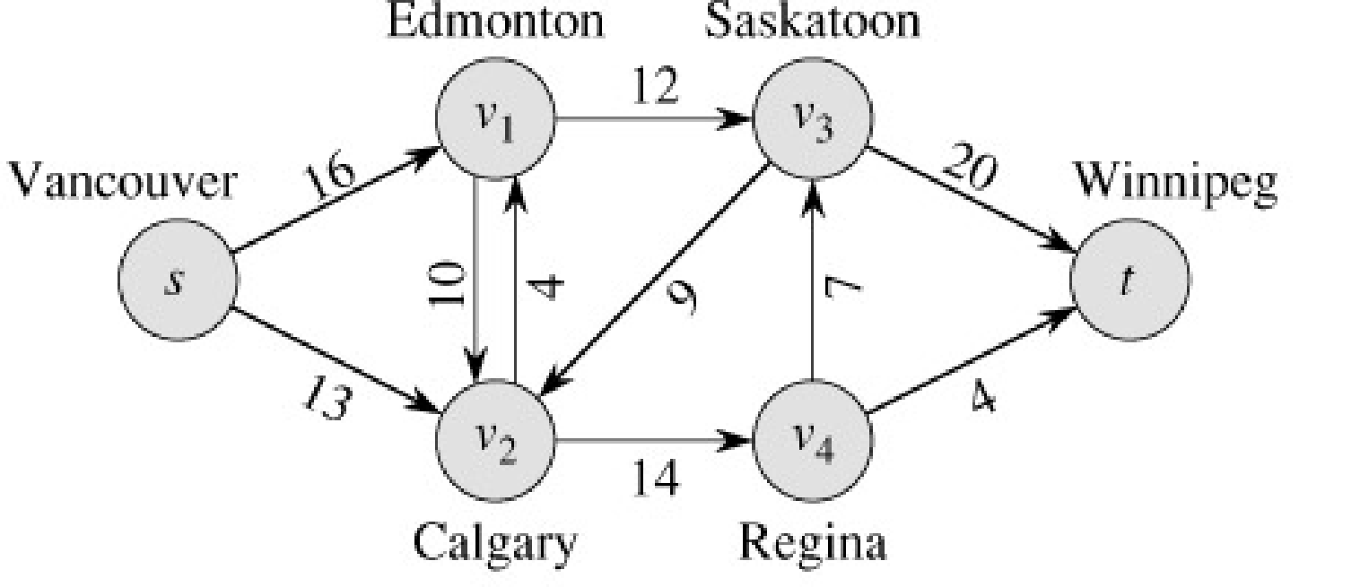
What is Network Flow?
Each edge (u,v) has a nonnegative capacity c(u,v).
If (u,v) is not in E, assume c(u,v)=0.
We have a source s, and a sink t.
Assume that every vertex v in V is on some path from s to t.
c(s,v₁)=16; c(v₁,s)=0; c(v₂,v₃)=0

Slide 5
Flow in a Flow Network
A flow in the network is an integer-valued function f defined on the edges of G satisfying 0 ≤ f(i,j) ≤ c(i,j) for every edge (i,j) in E.
100
1
100
s
t
1
100
100
Flow of these two paths are same.
Flow gets dominated by the minimum edge capacity of a path

Slide 6
What is a Flow in a Network?
For each edge (u,v), the flow f(u,v) is a real-valued function that must satisfy 3 conditions:
Note that skew symmetry condition implies that f(u,u)=0.

Slide 7
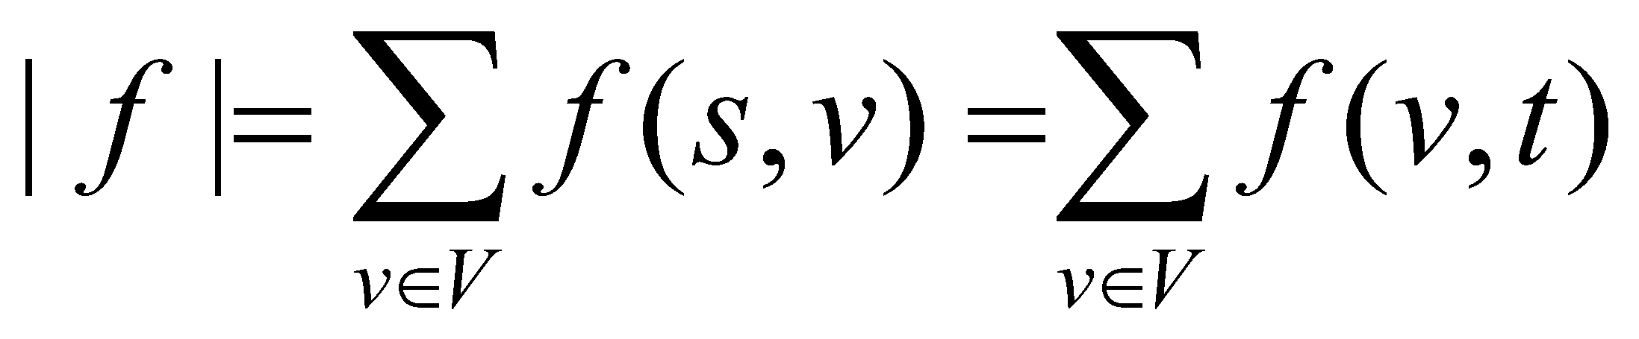
The Value of a flow
The value of a flow is given by
This is the total flow leaving s = the total flow arriving in t.

Slide 8
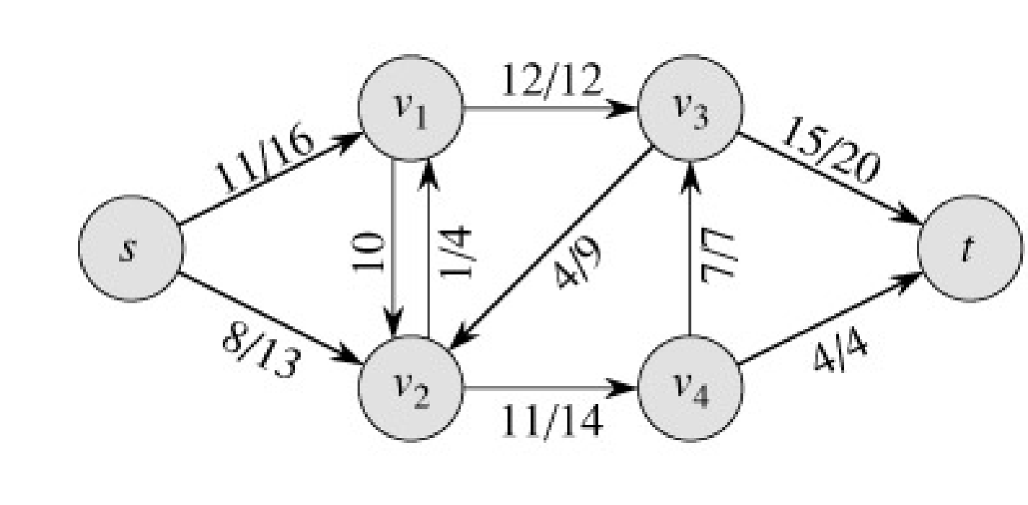
Example:
|f| = f(s, v₁) + f(s, v₂) + f(s, v₃) + f(s, v₄) + f(s, t) =
11 + 8 + 0 + 0 + 0 = 19
|f|= f(s, t) + f(v₁, t) + f(v₂, t) + f(v₃, t) + f(v₄, t) =
0 + 0 + 0 + 15 + 4 = 19

Slide 9
Example of a Flow
flow
capacity
0
0
f(v₂, v₁) = 1, c(v₂, v₁) = 4.
f(v₁, v₂) = -1, c(v₁, v₂) = 10.
f(v3, s) + f(v3, v1) + f(v3, v2) + f(v3, v4) + f(v3, t) =
0 + (-12) + 4 + (-7) + 15 = 0

Slide 10

A flow in a network
We assume that there is only flow in one direction at a time.
Sending 7 trucks from Edmonton to Calgary and 3 trucks from Calgary to Edmonton has the same net effect as sending 4 trucks from Edmonton to Calgary.
- From a node, matters is how much flow is going (it can occur in multiple ways, e.g, (x1->x2) going 10, (x2->x1) returning 3 == (x1->x2) going 7)

Slide 11
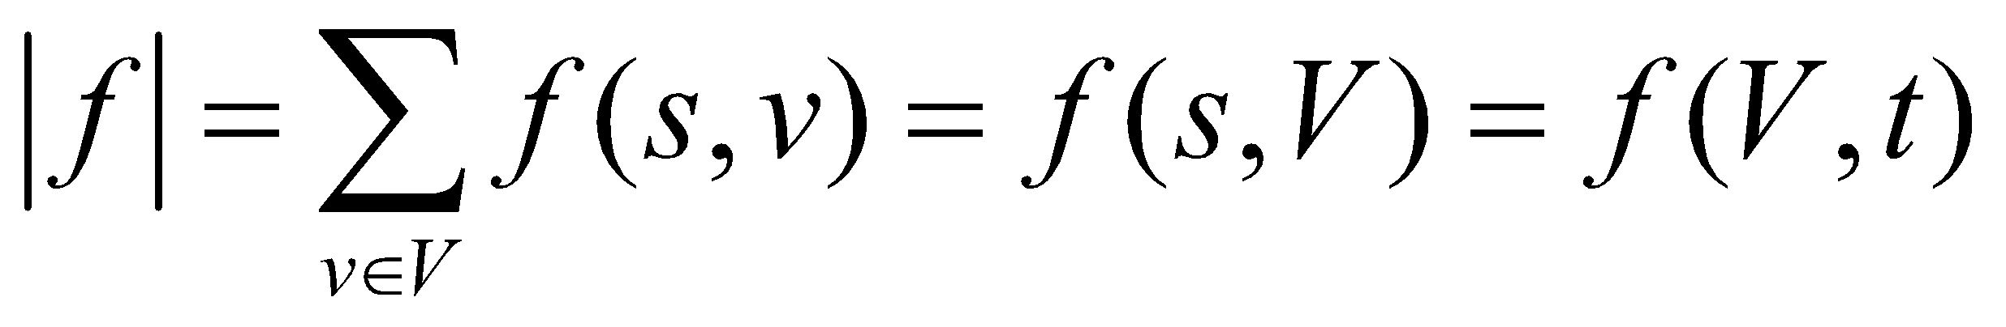
Maximum flow
What do we want to maximize?
Value of the flow f:
a
13
b
15
8
19
10
10
13
t
s
4
2
9
5
6
5
3
14
c
11
d
3
8

Slide 12
Some Lemmas:
Prove that, f(s,V)=f(V,t) [pg-649]
[Lemma26.2] Prove that, |f+f′|=|f|+|f′|
Lemma: 26.3
Lemma 26.4 |f′| = |f| + |f_{p}| ≥|f|
Lemma: 26.5 |f| = f(S,T)
Lemma: 26.6 |f| ≤ c(S,T)

Slide 13
Cuts
A cut is a partition of V into S and T = V – S, such that s ∈ S and t ∈ T
The net flow (f(S,T)) through the cut is the sum of flows f(s,t), where s ∈ S and t ∈ T
Includes negative flows back from T to S
The capacity (c(S,T)) of the cut is the sum of capacities c(s,t), where s ∈ S and t ∈ T
The sum of positive capacities
Minimum cut – a cut with the smallest capacity of all cuts.
|f|= f(S,T) i.e. the value of a max flow is equal to the capacity of a min cut.
a
8/13
b
10/15
13/19
s
10
9
5/5
t
2/4
6/14
c
8/11
d
3/3
Cut capacity = 24
Min Cut capacity = 21
Notes:
‹#›

Slide 14

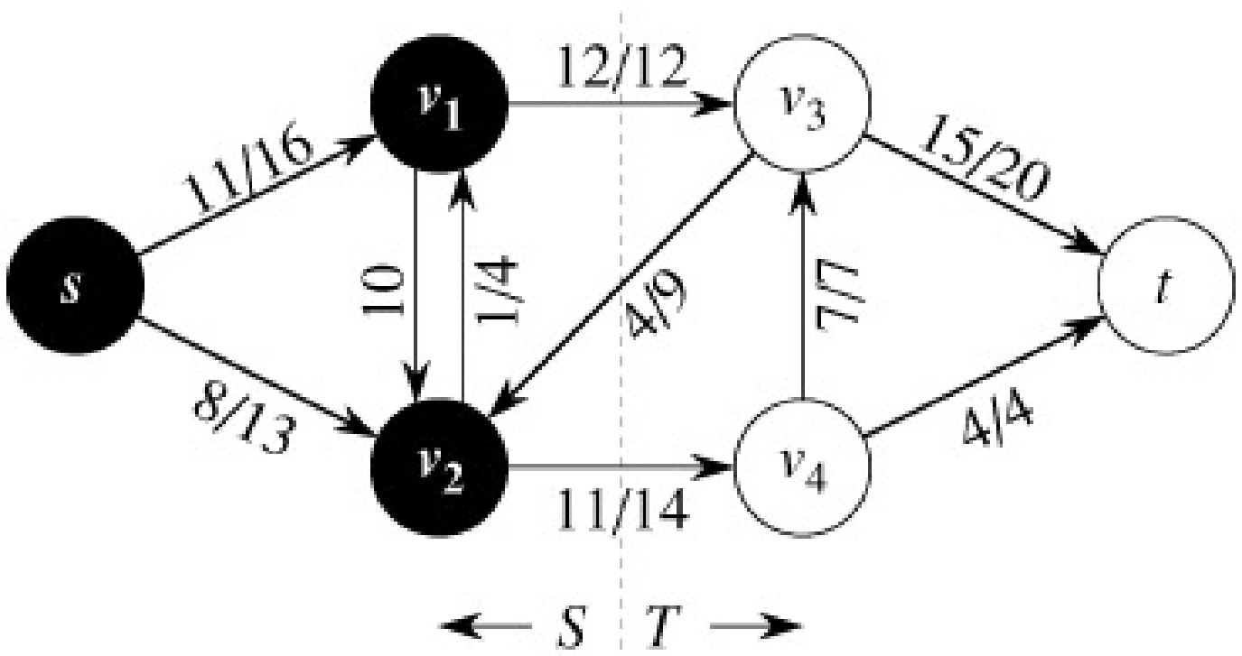
The Net Flow Through a Cut(S,T)
The value of any flow f in a flow network G is bounded from above by the capacity of any cut of G.
S
T
f(S,T) = 12 – 4 + 11 = 19

Slide 15
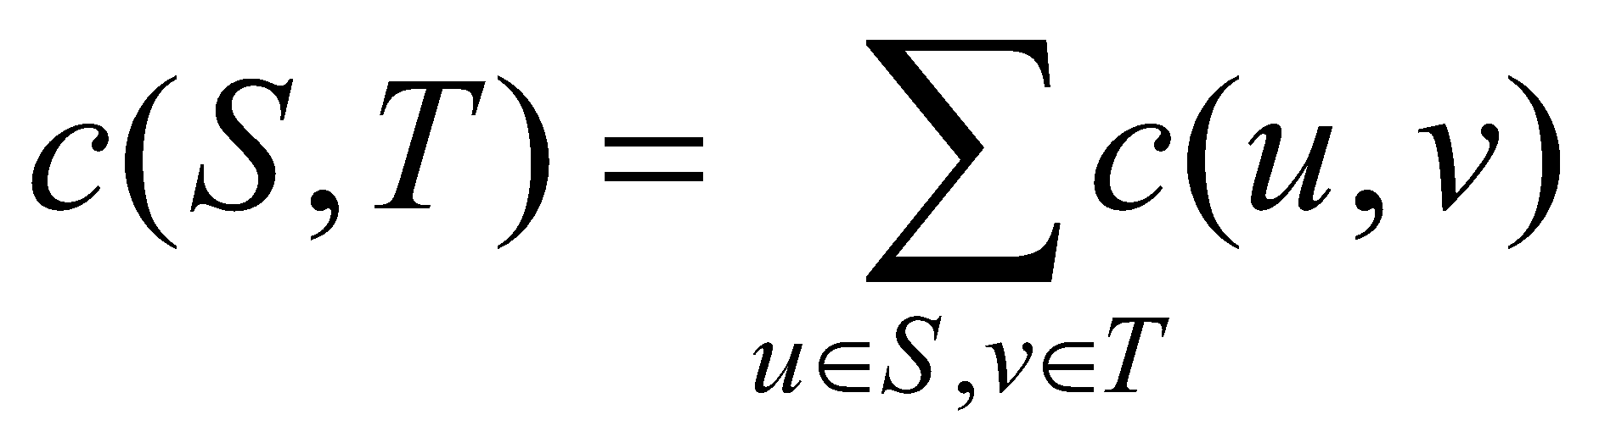
The Capacity of Cut(S,T)
c(S,T)= 12+ 14 = 26

Slide 16
Maxflow-Mincut Theorem
Max-flow min-cut theorem:
If f is the flow in G, the following conditions are equivalent:
1. f is a maximum flow in G
2. The residual network G_{f} contains no augmenting paths
3. |f| = c(S,T) for some cut (S,T) of G

Slide 17
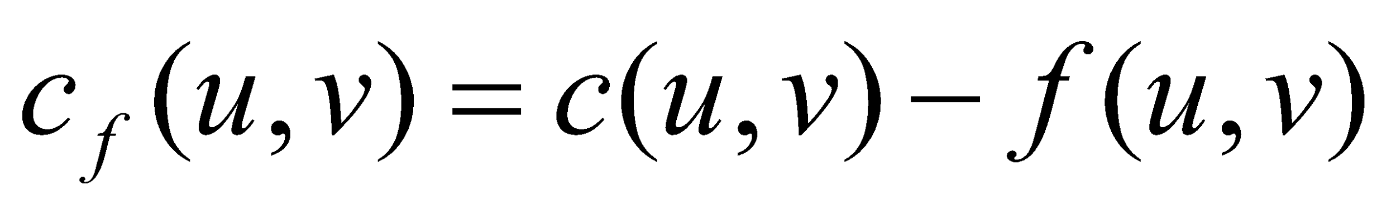
The Ford-Fulkerson Method
Try to improve the flow, until we reach the maximum.
The residual capacity of the network with a flow f is given by:
Always nonnegative (why?)

Slide 18
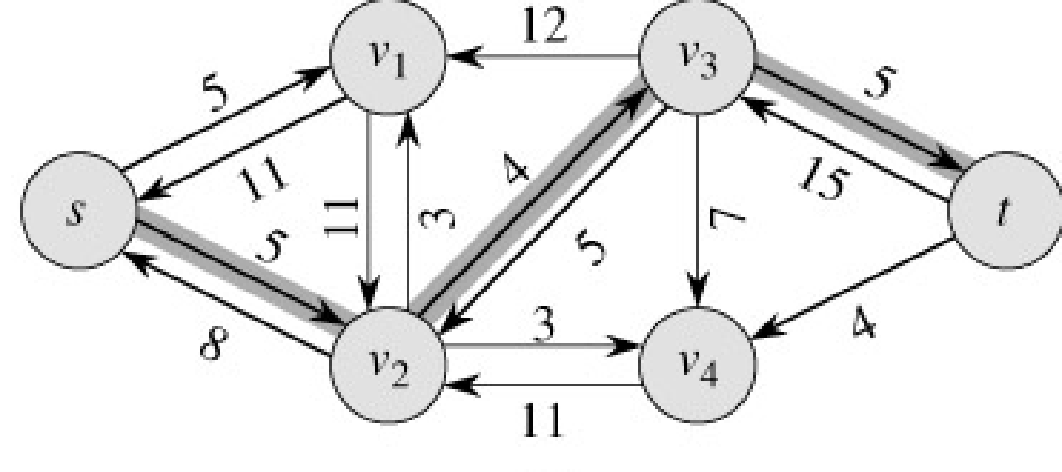
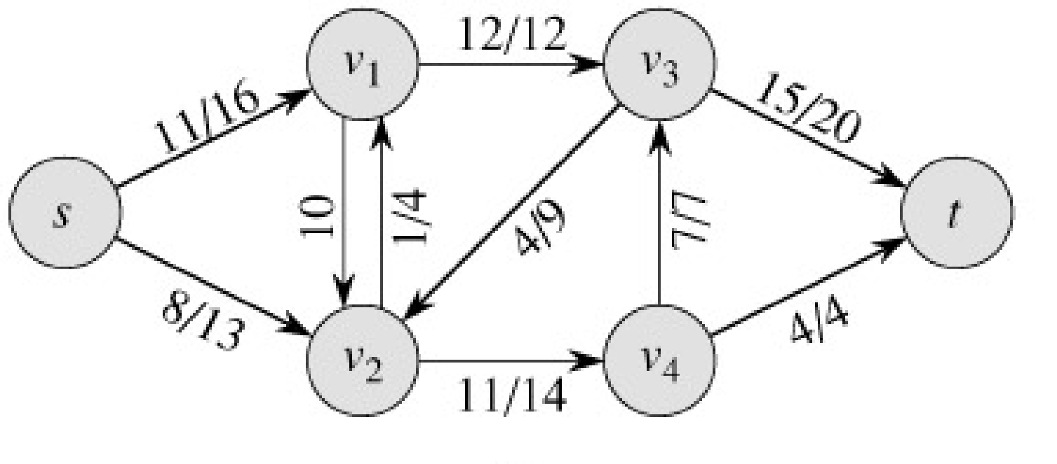
Example of residual capacities
Network:
Residual Network:
Augmenting path

Slide 19
The residual network
The edges of the residual network are the edges on which the residual capacity is positive.

Slide 20
Why do we need residual networks?
Residual networks allow us to reverse flows if necessary.
If we have taken a bad path then residual networks allow one to detect the condition and reverse the flow.
A bad path is one which overlaps with too many other paths.

Slide 21
Example
a
Source
1
1
Destination
1
1
1
b
Paths source, a, destinations and source, b destination gives a flow of 2 units.
Path source, a, b, destination overlaps with both the optimal paths.
If we initially choose source, a, b, destination as our path, then no greedy strategy will be able to augment the network flow any further (unless we use residual edges which allows recovery)
Verify how we recover in spite of the initial bad choice, if we use the residual network to augment flows.

Slide 22
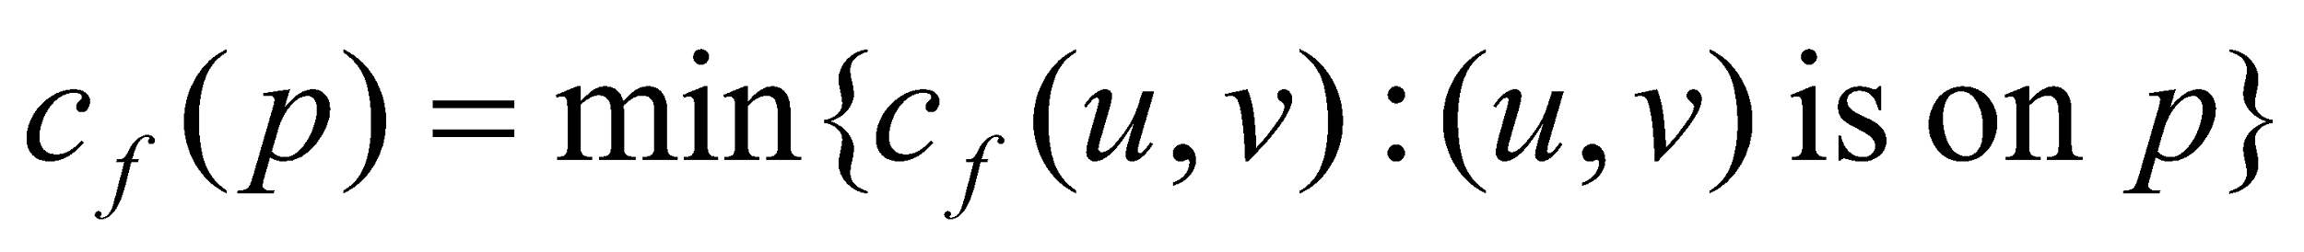
Augmenting Paths
An augmenting path p is a simple path from s to t on the residual network.
We can put more flow from s to t through p.
We call the maximum capacity by which we can increase the flow on p the residual capacity of p.

Slide 23
Augmenting Paths - example
The residual capacity of p = 4.
Can improve the flow along p by 4.

Slide 24
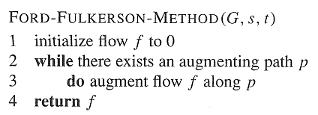
Ford-Fulkerson Method

Slide 25
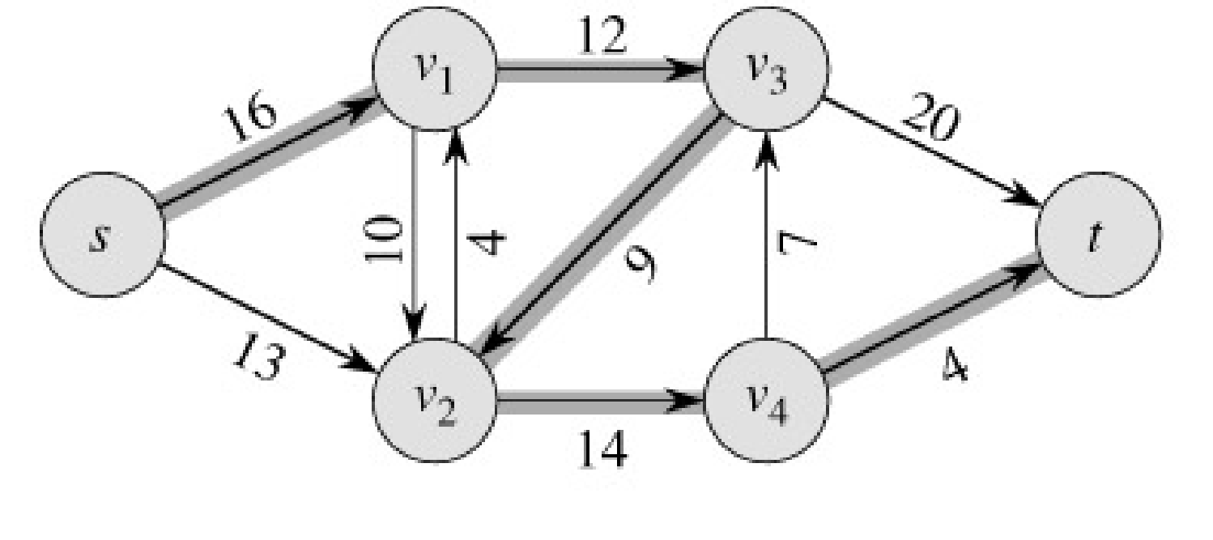
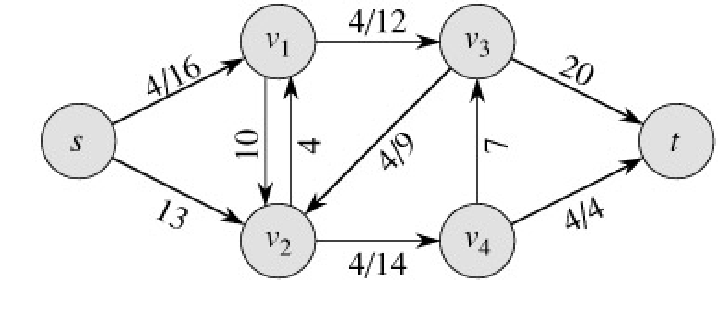
Example
We will work on residual network, original network is just shown to understand the status in the initial graph
augmenting path
Original Network
Resulting Flow =4

Slide 26
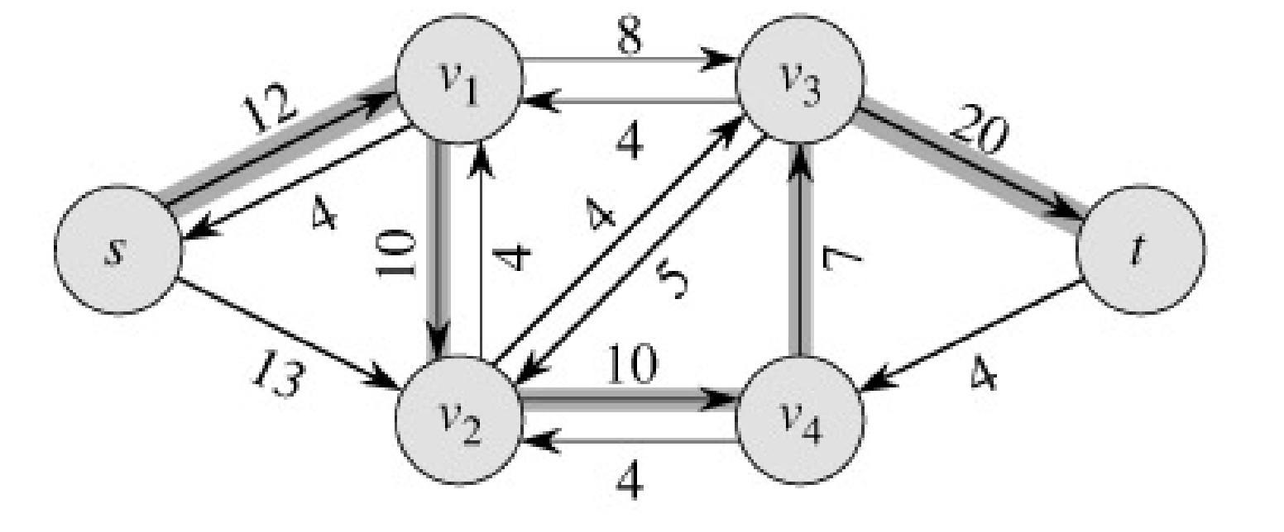
Example
Resulting
Flow = 4
augmenting path
Residual Network

Slide 27
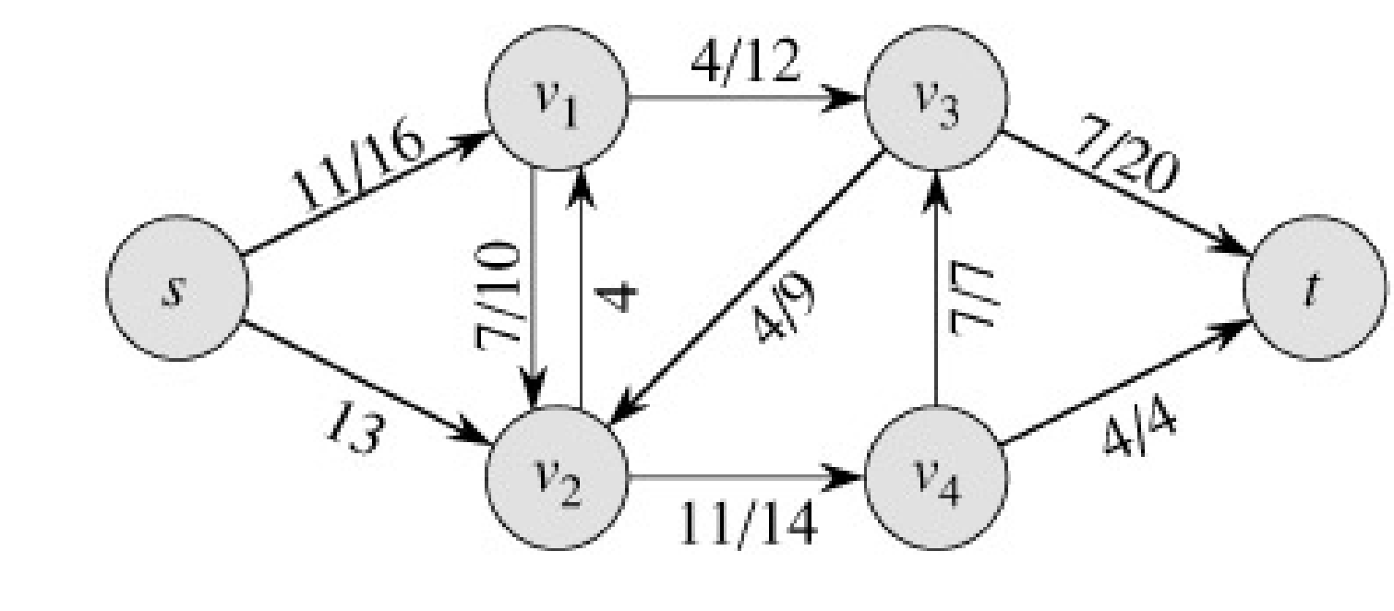
Example
Residual Network
Resulting Flow =11

Slide 28
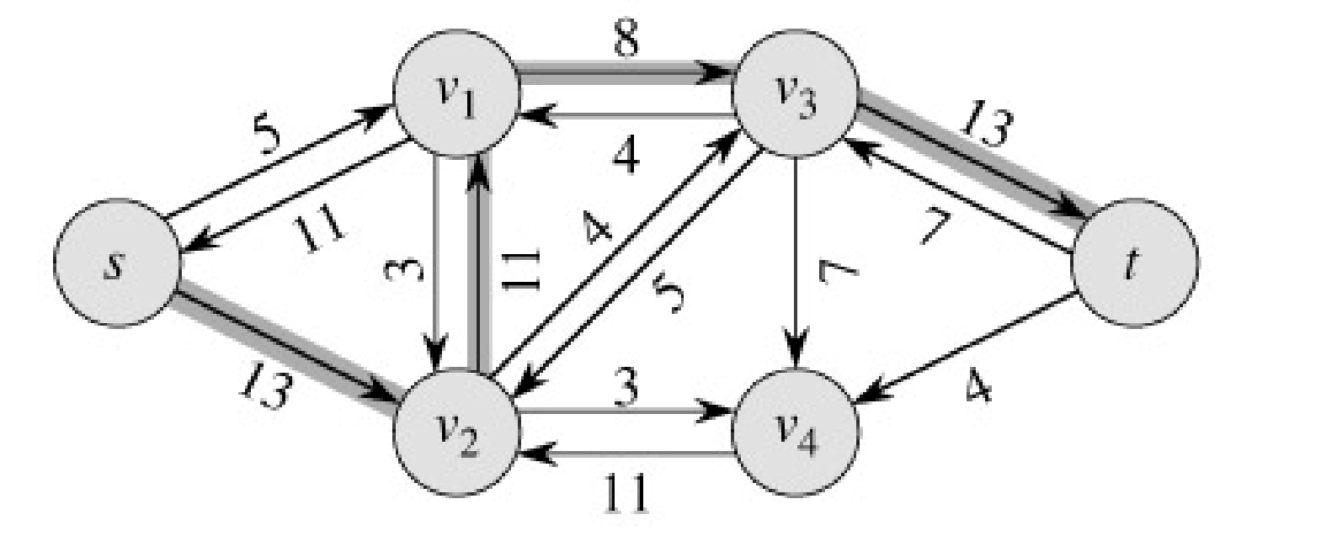
Example
Resulting
Flow =11
augmenting path
Residual Network

Slide 29
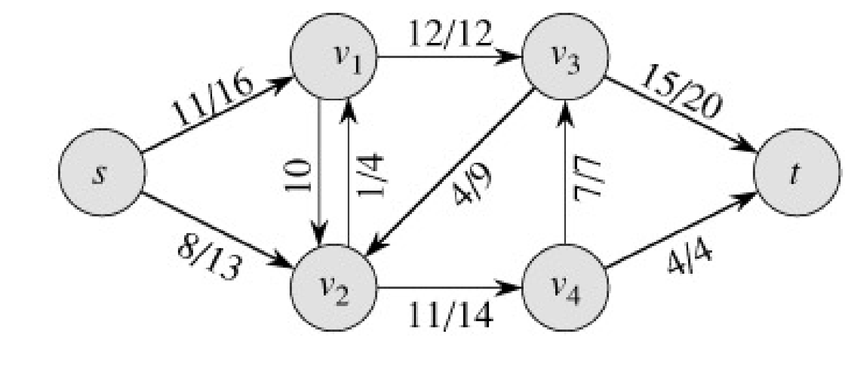
Example
Residual Network
Resulting
Flow =19
V2, incoming 12
outgoing 12

Slide 30
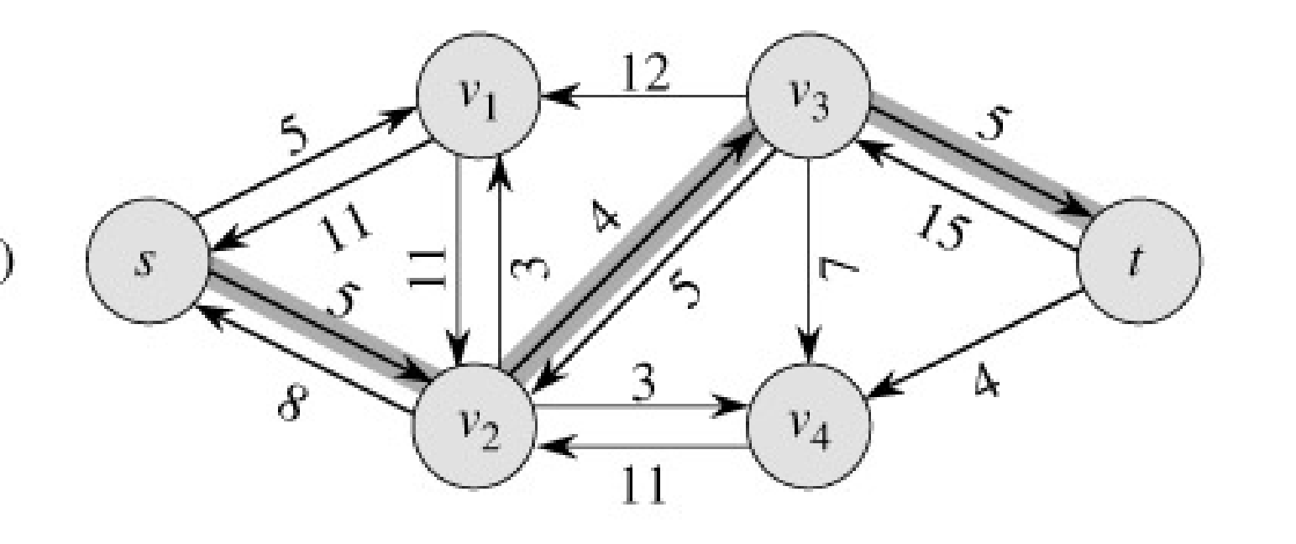
Example
Resulting
Flow = 19
augmenting path
Residual Network

Slide 31
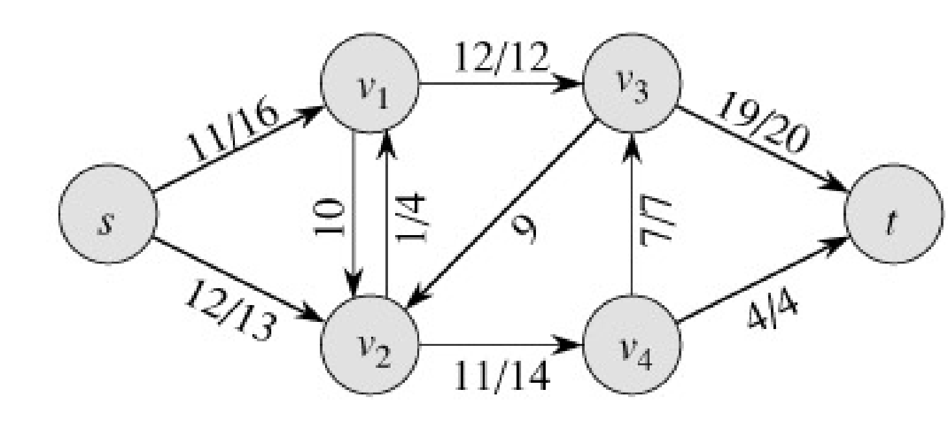
Example
Residual Network
Resulting
Flow = 23

Slide 32
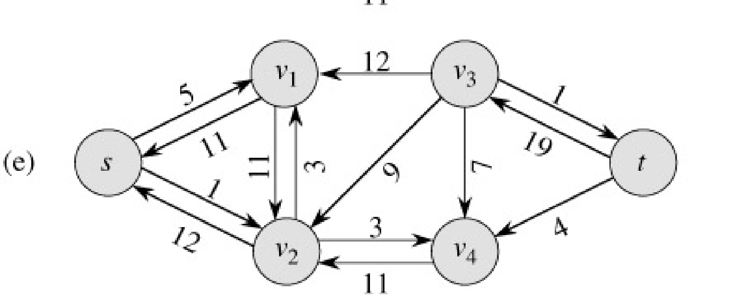
Example
Resulting
Flow = 23
No augmenting path:
Maxflow=23
Residual Network
The residual network Gf contains no
augmented paths. So f is a maximum
flow in G.

Slide 33
Ford-Fulkerson method, with details
Ford-Fulkerson(G,s,t)
1 for each edge (u,v)∈G.E do
2 f(u,v) = f(v,u) = 0
3 while ∃ path p from s to t in residual network G_{f} do
4 c_{f} = min{c_{f}(u,v): (u,v)∈p}
5 for each edge (u,v) in p do
6 f(u,v) = f(u,v) + c_{f}
7 f(v,u) = -f(u,v)
8 return f
The algorithms based on this method differ in how they choose p in step 3.

Slide 34
Time Analysis I
A complete analysis establishing which specific method is best is a complex task, however, because their running times depend on
The number of augmenting paths needed to find a maxflow
The time needed to find each augmenting path

Slide 35
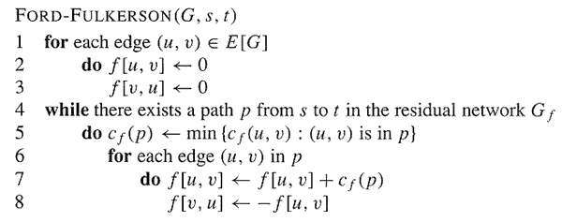
Analysis
O(E)
O(E)

Slide 36
Analysis
If capacities are all integer, then each augmenting path raises |f| by ≥ 1.
If max flow is f*, then need ≤ |f*| iterations
So time is O(E|f*|).
Note that this running time is not polynomial in input size. It depends on |f*|, which is not a function of |V| or |E|.
If capacities are rational, can scale them to integers.
If irrational, FORD-FULKERSON might never terminate!

Slide 37
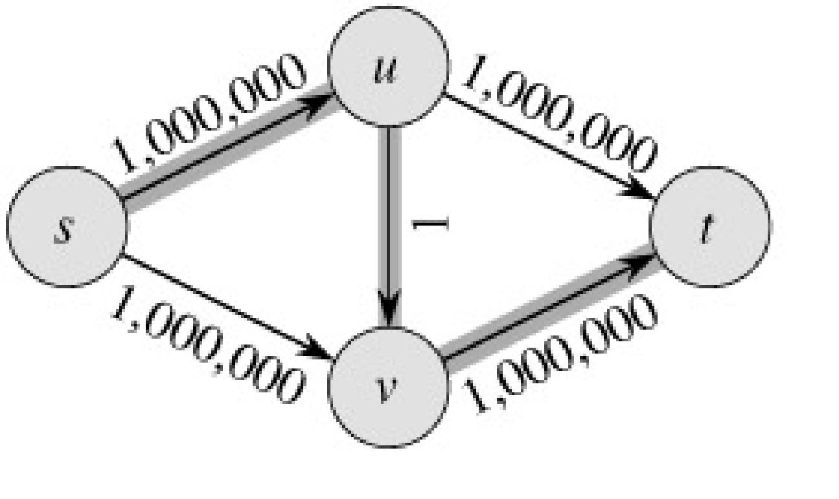
The basic Ford-Fulkerson Algorithm
With time O ( E |f*|), the algorithm is not polynomial.
This problem is real: Ford-Fulkerson may perform very badly if we are unlucky:
|f*|=2,000,000
repeated usage and correction in residual of (u,v)

Slide 38
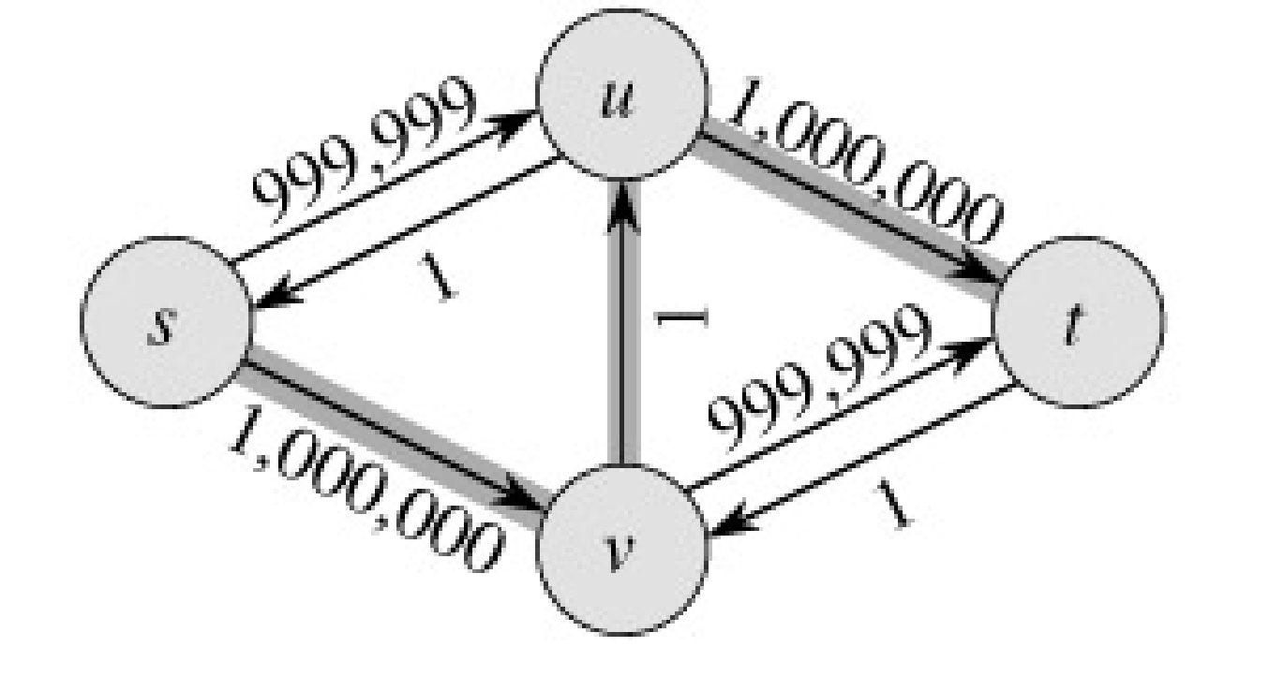
Run Ford-Fulkerson on this example
Augmenting Path
Residual Network

Slide 39
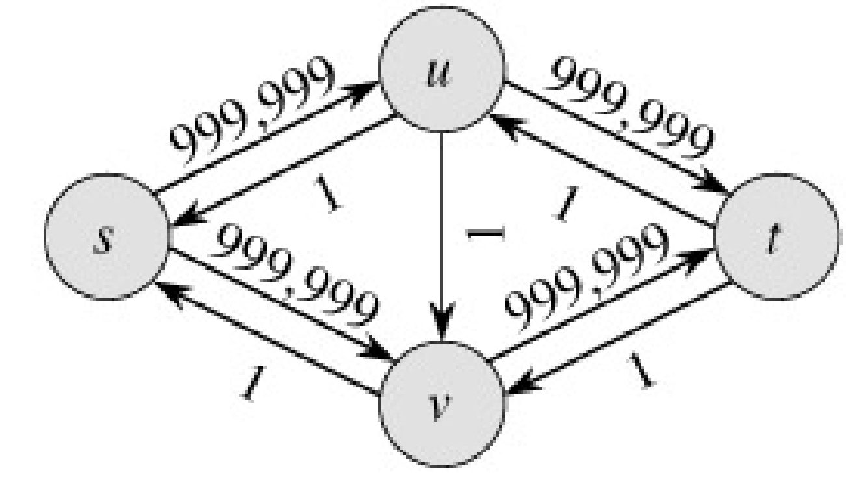
Run Ford-Fulkerson on this example
Augmenting Path
Residual Network

Slide 40
Run Ford-Fulkerson on this example
Repeat 999,999 more times…

Slide 41
The Edmonds-Karp Algorithm
A small fix to the Ford-Fulkerson algorithm makes it work in polynomial time.
Specify how to compute the path in line 4.

Slide 42
The Edmonds-Karp Algorithm
Compute the path in line 4 using breadth-first search on residual network.
The augmenting path p is the shortest path from s to t in the residual network (treating all edge weights as 1).
Runs in time O(V E²).

Slide 43
The Edmonds-Karp Algorithm - example
Edmonds-Karp’s algorithm runs only 2 iterations on this graph.

Slide 44
Time Complexity
Let, total number of flow augmentations performed by Edmonds-Karp algorithm is O(VE)
BFS to find the augmented path – O(E)
So, Total running time is O(VE²)

Slide 45
Thm: Total number of flow augmentations is O(VE)
Proof: (Theorem 26.8)

Slide 46
Conditions
If f is a flow in a flow network G=(V,E), with source s and sink t, then the following conditions are equivalent:
f is a maximum flow in G.
The residual network G_{f} contains no augmented paths.
|f| = c(S,T) for some cut (S,T) (a min-cut).
It is a flow since there is no augmented paths It is maximum since the sink is not reachable from the source

Slide 47
How to identify cut edges
1. The edges of the main graph which now has capacity 0 in the residual network are the desired edges that cross(es) between cuts.
2. From these edges (u→v), we can identify some nodes where u belongs to set S and v belongs to set T.
3. Now conduct DFS from the source S. While traversing the nodes do not use the nodes that belong to T, they will not be crossed or visited. Record the nodes that are visited now. These make the full set S.
4. The other remaining unvisited nodes comprise the set T.

