Slide 1
NETWORK FLOW

Slide 2
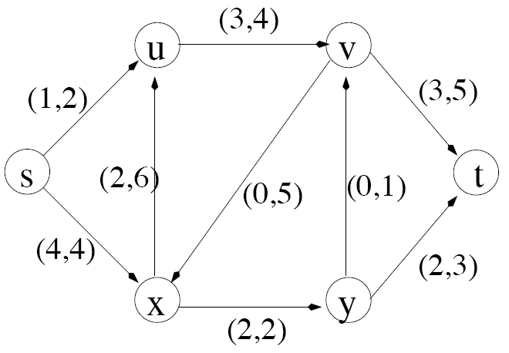
Example Graph
-
Sink node
Source node
Actual flow through this edge
Max. capacity of edge

Slide 3
Simplified Model
The network is modeled simply as
a directed graph G = (V,E) with
non-negative capacity on each edge,
a single source node, s, and
a single sink node, t

Slide 4
Some assumptions…
We will simplify our discussion by assuming the following:
No edge enters s, the source
No edge leaves t, the sink
At least one edge is incident to each node
All capacities are integers

Slide 5
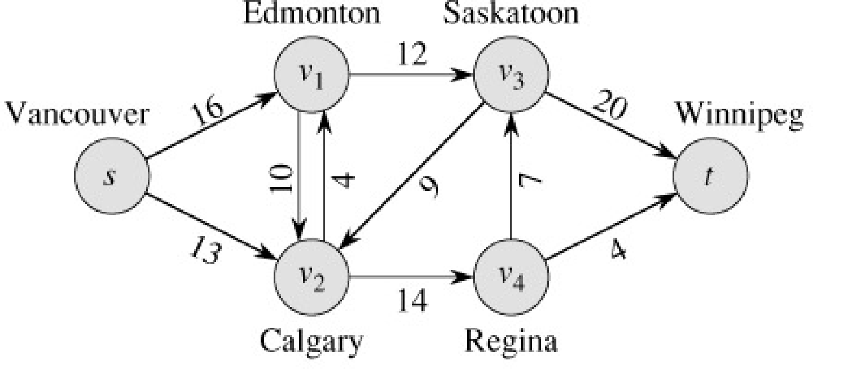
What is Network Flow?
Each edge (u,v) has a nonnegative capacity c(u,v).
If (u,v) is not in E, assume c(u,v)=0.
We have a source s, and a sink t.
Assume that every vertex v in V is on some path from s to t.
c(s,v₁)=16; c(v₁,s)=0; c(v₂,v₃)=0

Slide 6
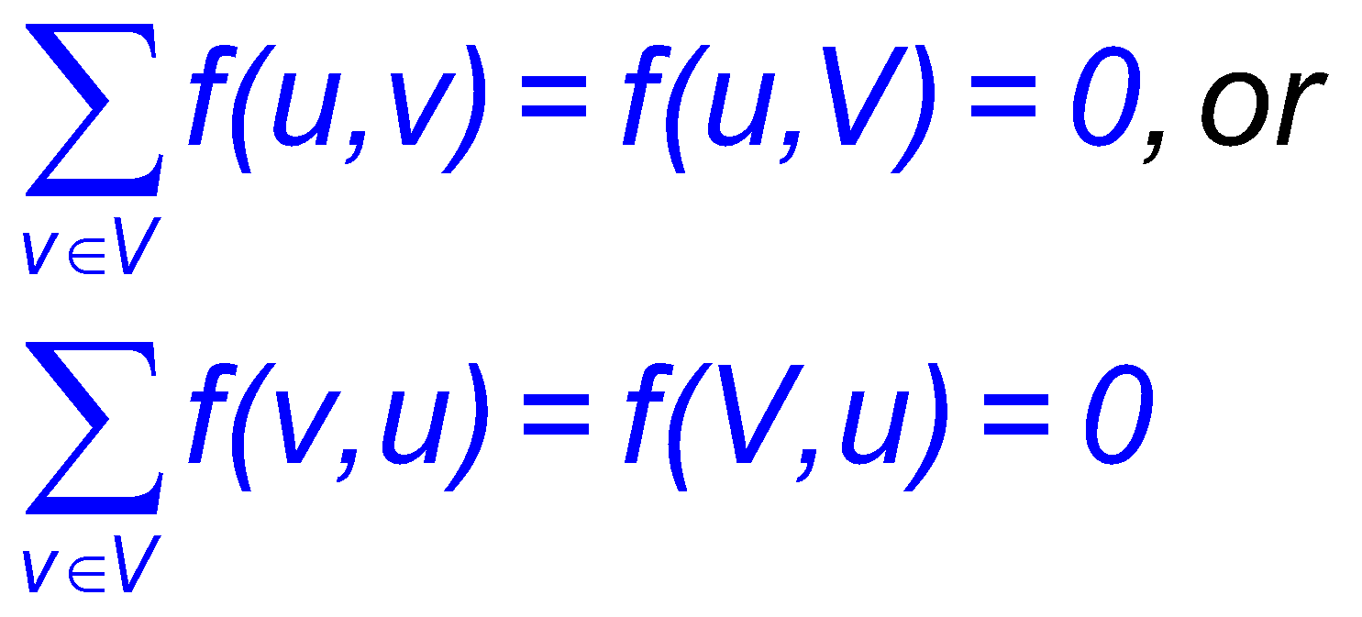
Formalization
Flow network – G=(V,E)
Directed, each edge has capacity c(u,v) ≥ 0
Two special vertices: source s, and sink t
For any other vertex v, there is a path s→…→v→…→t
Flow – f : V × V → R
Capacity constraint: ∀u,v ∈ V: f(u,v) ≤ c(u,v)
Skew symmetry: ∀u,v ∈ V: f(u,v) = –f(v,u)
Flow conservation: ∀u ∈ V – {s, t}:
Except of s and t, for all other nodes, the amount of flow comes and goes out from a node is equal.

Slide 7
Flow in a Flow Network
A flow in the network is an integer-valued function f defined on the edges of G satisfying 0 ≤ f(i,j) ≤ c(i,j) for every edge (i,j) in E.
100
1
100
s
t
1
100
100
Flow of these two paths are same.
Flow gets dominated by the minimum edge capacity of a path

Slide 8
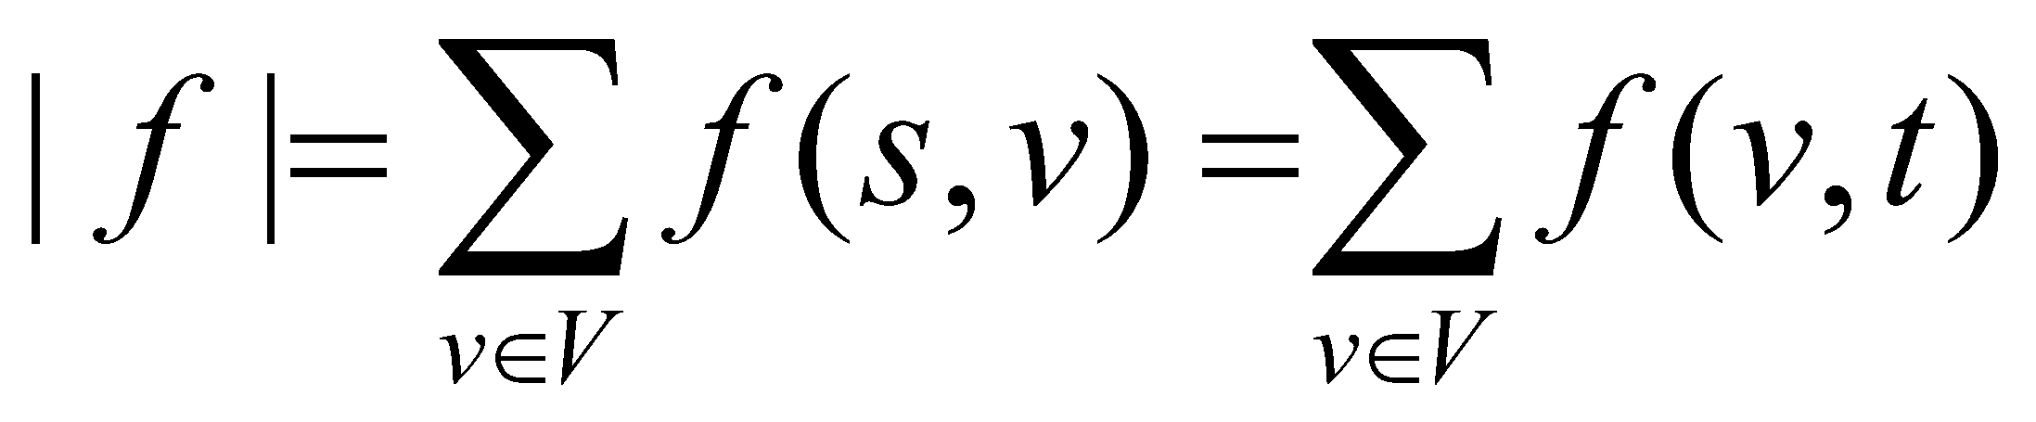
The Value of a Flow
The value of a flow is given by
This it the total flow leaving s = the total flow arriving in t

Slide 9
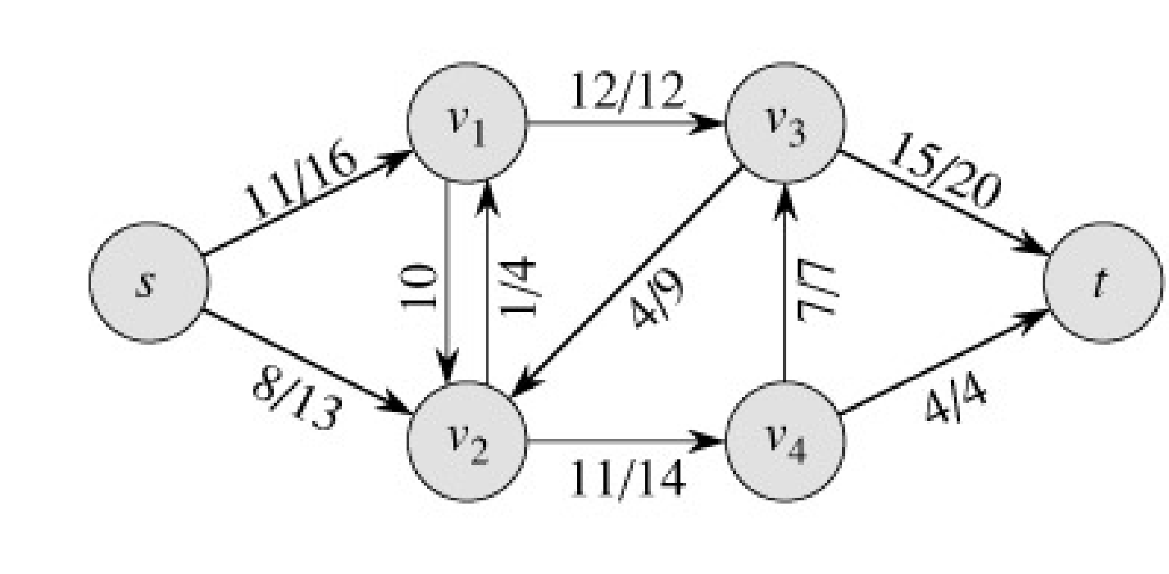
Example:
|f| = f(s, v₁) + f(s, v₂) + f(s, v₃) + f(s, v₄) + f(s, t) =
11 + 8 + 0 + 0 + 0 = 19
|f|= f(s, t) + f(v₁, t) + f(v₂, t) + f(v₃, t) + f(v₄, t) =
0 + 0 + 0 + 15 + 4 = 19

Slide 10
Example of a Flow
flow
capacity
0
f(v₂, v₁) = 1, c(v₂, v₁) = 4.
f(v₁, v₂) = -1, c(v₁, v₂) = 10.
f(v3, s) + f(v3, v1) + f(v3, v2) + f(v3, v4) + f(v3, t) =
0 + (-12) + 4 + (-7) + 15 = 0

Slide 11
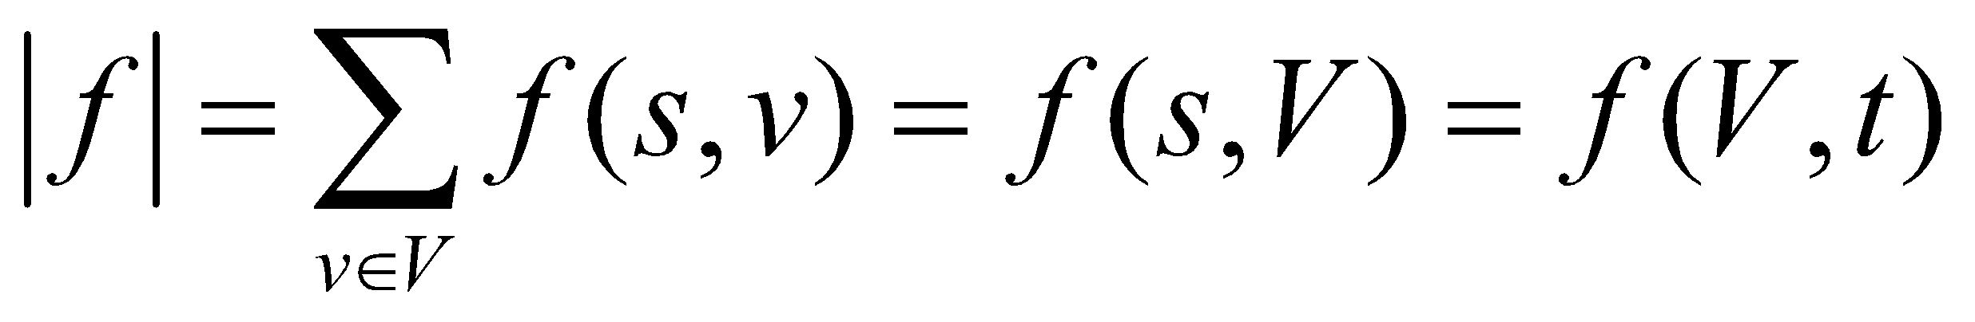
Maximum flow
Choosing a best path that will maximize the flow.
What do we want to maximize?
Value of the flow f:

