Slide 1

Maximum Flow (Part 3)

Slide 2
Reduction to Maximum Flow

Slide 3
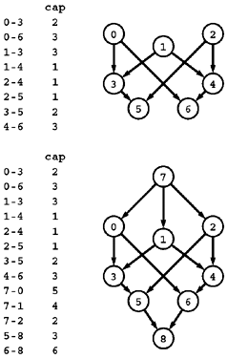
R1: Multiple sources and sinks
Problem:
What if you have a problem with more than one source and more than one sink?
The network at the top has three sources (0, 1, and 2) and two sinks (5 and 6).
Reduction: Create a network which
is a copy of the original network
with the addition of a new source 7 and
a new sink 8.
There is an edge from 7 to each original-network source with capacity equal to the sum of the capacities of that source's outgoing edges,
an edge from each original-network sink to 8 with capacity equal to the sum of the capacities of that sink's incoming edges.

Slide 4
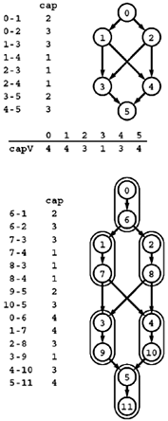
R2: Removing vertex capacities
Problem:
Given a flow network, find a maxflow satisfying additional constraints specifying that the flow through each vertex must not exceed some fixed capacity.
Reduction: Create a new network
Associate a new vertex u* (where u* denotes u+V) with each vertex u,
add an edge u->u* whose capacity is the capacity of u,
include an edge u*->v for each edge u->v.

Slide 5
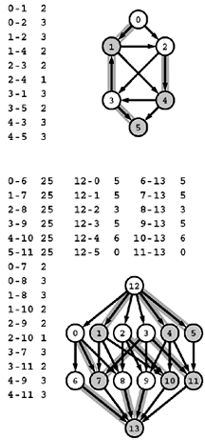
R3: Reduction to acyclic network
Problem:
Find a maxflow in an acyclic network.
Reduction: Create a new network where
Each vertex u in the top network corresponds to two vertices u and u* (where u* denotes u+V) in the bottom network,
each edge u-v in the top network corresponds to an edge u-v* in the bottom network.
Additionally, the bottom network has uncapacitated edges u-u*
a source s with an edge to each unstarred vertex,
a sink t with an edge from each starred vertex.

Slide 6
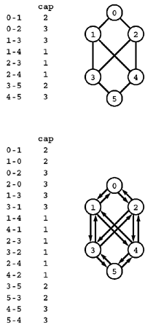
R4: Reduction from undirected networks
Problem:
Given an undirected weighted graph find the maximum flow
Reduction: Create a network s.t.
we can consider it to be a directed network with edges in each direction.

Slide 7
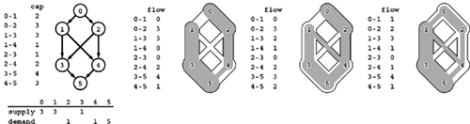
R5: Feasible flow
Problem:
Suppose that a weight is assigned to each vertex in a flow network and is to be interpreted as supply (if positive) or demand (if negative), with the sum of the vertex weights equal to zero. Define a flow to be feasible if the difference between each vertex's outflow and inflow is equal to that vertex's weight (supply if positive and demand if negative). Given such a network, determine whether or not a feasible flow exists.

Slide 8
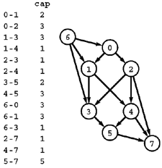
R5: Reduction from feasible solution
Reduction: Create a network
by adding edges from a new source vertex to the supply vertices (each with capacity equal to the amount of the supply) and
edges to a new sink vertex from the demand vertices (each with capacity equal to the amount of the demand).
The network has a feasible flow if and only if this network has a flow (a maxflow) that fills all the edges from the sink and all the edges to the source.

Slide 9
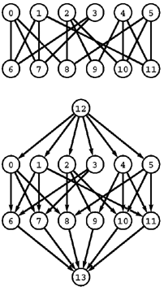
R6: Bipartite matching
Problem:
Given a bipartite graph, find a set of edges of maximum cardinality such that each vertex is connected to at most one other vertex.
Reduction: Construct an st-network
by directing all the edges from the top row to the bottom row,
adding a new source with edges to each vertex on the top row,
adding a new sink with edges to each vertex on the bottom row, and
assigning capacity 1 to all edges.
In any flow, at most one outgoing edge from each vertex on the top row can be filled and at most one incoming edge to each vertex on the bottom row can be filled, so a solution to the maxflow problem on this network gives a maximum matching for the bipartite graph.

Slide 10
Model for Matching Problem
Group1 on leftmost set, Group2 on rightmost set, edges if they are compatible
A
A
X
A
X
X
B
B
B
Y
Y
Y
C
C
C
Z
Z
D
Z
D
D
G1
G2
A matching
Optimal matching
Notes:
‹#›

Slide 11
Solution Using Max Flow
Add a supersource, supersink, make each undirected edge directed with a flow of 1
A
A
X
X
B
B
t
Y
s
Y
C
C
Z
Z
D
D
Since the input is 1, flow conservation prevents multiple matchings
Notes:
‹#›

Slide 12
Edge Connectivity
What is the minimum number of edges that need to be removed to separate a given undirected graph into two pieces?
Find a set of edges of minimal cardinality that does this separation.
Solution idea
For all pair (s=source,t=destination) calculate flow (V²*VE²), the min flow will provide the answer of removing minimum number edges to separate s and t to two different groups.
per edge cost = 1
flow denotes number of paths between s and t

Slide 13
Vertex Connectivity
What is the minimum number of vertices that need to be removed to separate a given undirected graph into two pieces?
First split nodes ( u-v) to (u1,u2) and (v1,v2)
create directed edges (u2->v1) and (v2->u1), (u1->u2) and (v1->v2)
All edges cost are 1.
Now for all pair (s,t) calculate flow. Min flow will denote the min number of vertices to be removed to make the graph disconnected.

Slide 14
Vertex Connectivity
u
v
s
t
w
x
u1
u2
v1
v2
s
t
w1
w2
x1
x2

