Slide 1
Design and Analysis of Algorithm
Minimum Spanning Tree
(Kruskal’s Algorithm)

Slide 2
Last Class’s Topic
Minimum Spanning Tree (Prim’s Algorithm)
What is spanning tree & Minimum spanning tree?
What will happen if we add an edge in a minimum spanning tree?
Read the following topics from “Cormen-pg563”
Cut
Cross
Light edge
‹#›

Slide 3
Some Definition
Cut:
Partition of V. Ex: (S, V-S)
Cross:
Edge (u,v) crosses the cut (S, V-S) if one of its endpoints is in S and the other is in V-S.
Light edge:
An edge crossing a cut if its weight is the minimum of any edge crossing the cut.
‹#›

Slide 4
Kruskal's Algorithm
Edge based algorithm
Add the edges one at a time, in increasing weight order
The algorithm maintains A – a forest of trees. An edge is accepted it if connects vertices of distinct trees
We need a data structure that maintains a partition, i.e.,a collection of disjoint sets
MakeSet(S,x)
Union(S_{i},S_{j})
FindSet(S, x)
‹#›

Slide 5
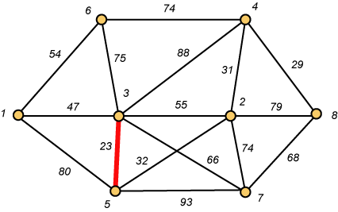
Kruskal – Step 1
Almost like merging 2 MSTs to become 1 MST
‹#›

Slide 6
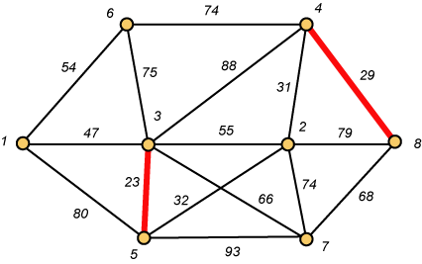
Kruskal – Step 2
Almost like merging 2 MSTs to become 1 MST
‹#›

Slide 7
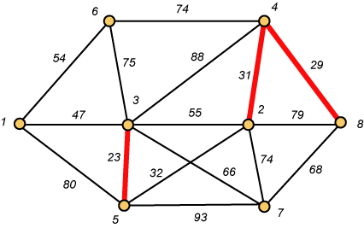
Kruskal – Step 3
Almost like merging 2 MSTs to become 1 MST
‹#›

Slide 8
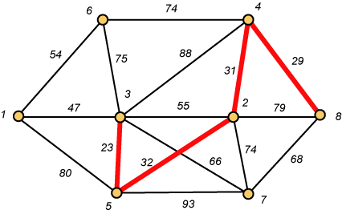
Kruskal – Step 4
Almost like merging 2 MSTs to become 1 MST
‹#›

Slide 9
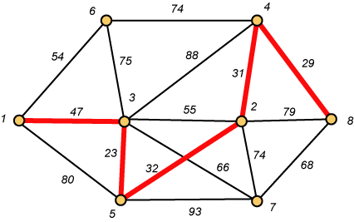
Kruskal – Step 5
Almost like merging 2 MSTs to become 1 MST
‹#›

Slide 10
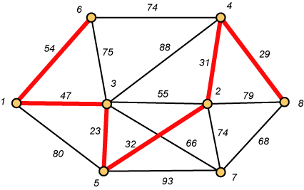
Kruskal – Step 6
Almost like merging 2 MSTs to become 1 MST
‹#›

Slide 11
Why Avoiding Cycles Matters
Up to this point, we have simply taken the edges in order of their weight. But now we will have to reject an edge since it forms a cycle when added to those already chosen.
‹#›

Slide 12
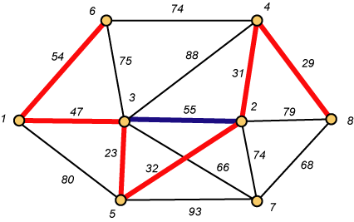
Forms a Cycle
These 2 nodes already belong to same MST
So we cannot take the blue edge having weight 55.
‹#›

Slide 13
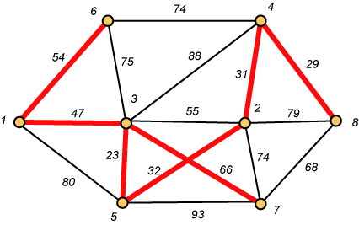
Kruskal – Step 7 DONE!!
Weight (T) = 23 + 29 + 31 + 32 + 47 + 54 + 66 = 282
‹#›

Slide 14
Disjoint-Set
Keep a collection of sets S₁, S₂, .., S_{k},
Each S_{i} is a set, e,g, S₁={v₁, v₂, v₈}.
Three operations
Make-Set(x)-creates a new set whose only member is x.
Union(x, y) –unites the sets that contain x and y, say, S_{x} and S_{y}, into a new set that is the union of the two sets. Update the representative.
Find-Set(x)-returns a pointer to the representative of the set containing x.
Each set or subgraph will have a representative.
‹#›

Slide 15
Kruskal's Algorithm
The algorithm adds the cheapest edge that connects two trees of the forest
MST-Kruskal(G,w)
01 A ← ∅
02 for each vertex v ∈ V[G] do
03 Make-Set(v)
04 sort the edges of E by non-decreasing weight w
05 for each edge (u,v) ∈ E, in order by non-decreasing weight do
06 if Find-Set(u) ≠ Find-Set(v) then
07 A ← A ∪ {(u,v)}
08 Union(u,v)
09 return A
O(V)
O(ElogE)
O(E)
O(V)
Overall Complexity: O(VE)
‹#›

Slide 16
Disjoint Set Union using path compression
Can use path compression technique while finding representative Find-Set(u)
Let Par[ ] array holds the representative information for each node u.
Initially each node’s representative is itself, Par[u] = u [as it lies individually]
We gradually update Par[ ] while merging trees

Slide 17
Disjoint Set Union using path compression
a
a
b
Par[a] = a
b
Par[a] = a
Par[b] = b
Par[b] = a

Slide 18
Disjoint Set Union using path compression
Par[a] = a
a
a
Par[a] = a
Par[b] = a
b
b
Par[c] = c
Par[b] = a
c
c
Par[c] = Par[b] = a

Slide 19
Disjoint Set Union using path compression
def Find-Set(u):
if Par[u] == u
return u
Par[u] = Find-Set(Par[u])
return Par[u]
Par[a] = a
a
Par[b] = a
b
def Union(a,b):
u = Find-Set(a)
v = Find-Set(b)
if u != v:
Par[u]=v(or Par[v]=u)
else:
print(“in same subtree”)
Par[c] = Par[b] = a
c

Slide 20
Disjoint Set Union using path compression
Par[a] = a
a
Par[b] = a
b
After union(c,d)
Par[c] = a
d
Par[d] = par[c]=a
c
Par[e] = d
e
f
Par[f] = e

Slide 21
Disjoint Set Union using path compression
Par[a] = a
An example how after find(f) function call Par [e] and Par[f] get updated
a
Par[b] = a
After find(f)
b
a
When Par [ ] gets updated, path gets compressed
Par[c] = a
c
d
We are making false parent connections to find representative of a tree
Par[d] = a
Par[e] = d
a
e
Par[e] = a
f
Par[f] = e
a
Par[f] = a

Slide 22
Main MST and Path Compressed
a
a
e
Par[b] = a
f
b
b
c
d
Par[c] = a
c
d
Par[d] = a
Par[e] = d
e
Par[e] = a
After find(f)
f
Par[f] = e
Par[f] = a

Slide 23
Question
Exercise
23.2.7 – Add new vertices & edges in a graph
23-1: Second best minimum spanning tree
Put restriction over a select edge chosen from the algorithm: That this edge can not be considered for the MST
Again run the algorithm to compute MST
Repeat this process for every selected edges by the initial MST algorithm, the minimum valued MST will represent the second best MST
‹#›

