Slide 1
Algorithms Analysis Quicksort

Slide 2
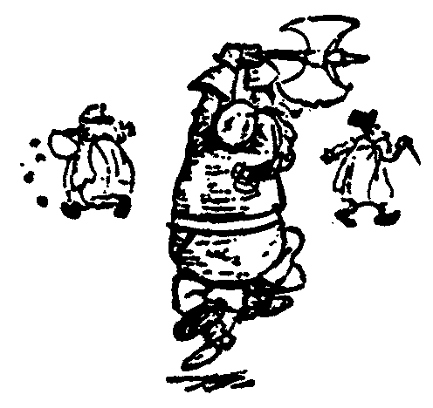
Quick Sort
88
52
14
31
98
25
30
62
23
79
Divide and Conquer

Slide 3
Quick Sort
Partition set into two using randomly chosen pivot
88
52
14
31
98
25
30
62
23
79
14
88
98
31
30
≤ 52 ≤
62
25
23
79

Slide 4
Quick Sort
14
88
98
31
30
≤ 52 ≤
62
25
23
79
sort the first half.
sort the second half.
62,79,98,88
14,23,25,30,31

Slide 5
Quick Sort
14,23,25,30,31
52
62,79,88,98
Glue pieces together.
14,23,25,30,31,52,62,79,88,98

Slide 6
Quicksort
Quicksort pros [advantage]:
Sorts in place
Sorts O(n lg n) in the average case
Very efficient in practice , it’s quick
Quicksort cons [disadvantage]:
Sorts O(n²) in the worst case
And the worst case doesn’t happen often … sorted

Slide 7
Quicksort
Another divide-and-conquer algorithm:
Divide: A[p…r] is partitioned (rearranged) into two nonempty subarrays A[p…q-1] and A[q+1…r] s.t. each element of A[p…q-1] is less than or equal to each element of A[q+1…r]. Index q is computed here, called pivot.
Conquer: two subarrays are sorted by recursive calls to quicksort.
Combine: unlike merge sort, no work needed since the subarrays are sorted in place already.

Slide 8
Quicksort
The basic algorithm to sort an array A consists of the following four easy steps:
If the number of elements in A is 0 or 1, then return
Pick any element v in A. This is called the pivot
Partition A-{v} (the remaining elements in A) into two disjoint groups:
A₁ = {x ∈ A-{v} | x ≤ v}, and
A₂ = {x ∈ A-{v} | x ≥ v}
return
{ quicksort(A₁) followed by v followed by quicksort(A₂)}

Slide 9
Quicksort
Small instance has n ≤ 1
Every small instance is a sorted instance
To sort a large instance:
select a pivot element from out of the n elements
Partition the n elements into 3 groups left, middle and right
The middle group contains only the pivot element
All elements in the left group are ≤ pivot
All elements in the right group are ≥ pivot
Sort left and right groups recursively
Answer is sorted left group, followed by middle group followed by sorted right group

Slide 10
Quicksort Code
P: first element
r: last element
Quicksort(A, p, r)
{
if (p < r)
{
q = Partition(A, p, r)
Quicksort(A, p , q-1)
Quicksort(A, q+1 , r)
}
}
Initial call is Quicksort(A, 1, n), where n in the length of A

Slide 11
Partition
Clearly, all the action takes place in the partition() function
Rearranges the subarray in place
End result:
Two subarrays
All values in first subarray ≤ all values in second
Returns the index of the “pivot” element separating the two subarrays

Slide 12
Partition Code
Partition(A, p, r)
{
x = A[r] // x is pivot
i = p - 1
for j = p to r – 1
{
do if A[j] <= x
then
{
i = i + 1
exchange A[i] ↔ A[j]
}
}
exchange A[i+1] ↔ A[r]
return i+1
}
partition() runs in O(n) time

Slide 13
i is the pointer of left side where I will keep the value/ where last small value ended
j is my movement pointer during iteration
Partition Example,
A = {2 , 8, 7, 1, 3, 5, 6, 4 }
i
p j
r
p i
j
r
2 8 7 1 3 5 6 4
2
2 8 7 1 3 5 6 4
p i
j
r
p i
j
r
2
2 8 7 1 3 5 6 4
2
8
7
1
3
5
6
4
p
i
j
r
p
i
j
r
2
2
1
3
5
6
4
2
2
1
1
3
7
8
3
8
7
5
6
4
p
i
j
r
p
i
r
2
1
6
4
2
1
3
3
8
7
5
2
2
1
1
3
4
3
8
7
5
6
p
i
r
r is my pivoting index
2
2
1
1
3
3
4
7
5
6
8

Slide 14
Partition Example Explanation
Red shaded elements are in the first partition with values ≤ x (pivot)
Gray shaded elements are in the second partition with values ≥ x (pivot)
The unshaded elements have not yet been put in one of the first two partitions
The final white element is the pivot

Slide 15
Choice Of Pivot
Three ways to choose the pivot:
Pivot is rightmost element in list that is to be sorted
When sorting A[6:20], use A[20] as the pivot
Textbook implementation does this
Randomly select one of the elements to be sorted as the pivot
When sorting A[6:20], generate a random number r in the range [6, 20]
Use A[r] as the pivot

Slide 16
Choice Of Pivot
Median-of-Three rule - from the leftmost, middle, and rightmost elements of the list to be sorted, select the one with median key as the pivot
When sorting A[6:20], examine A[6], A[13] ((6+20)/2), and A[20]
Select the element with median (i.e., middle) key
If A[6].key = 30, A[13].key = 2, and A[20].key = 10, A[20] becomes the pivot
If A[6].key = 3, A[13].key = 2, and A[20].key = 10, A[6] becomes the pivot

Slide 17
Worst Case Partitioning
The running time of quicksort depends on whether the partitioning is balanced or not.
Θ(n) time to partition an array of n elements
Let T(n) be the time needed to sort n elements
T(0) = T(1) = c, where c is a constant
When n > 1,
T(n) = T(|left|) + T(|right|) + Θ(n)
T(n) is maximum (worst-case) when either |left| = 0 or |right| = 0 following each partitioning

Slide 18
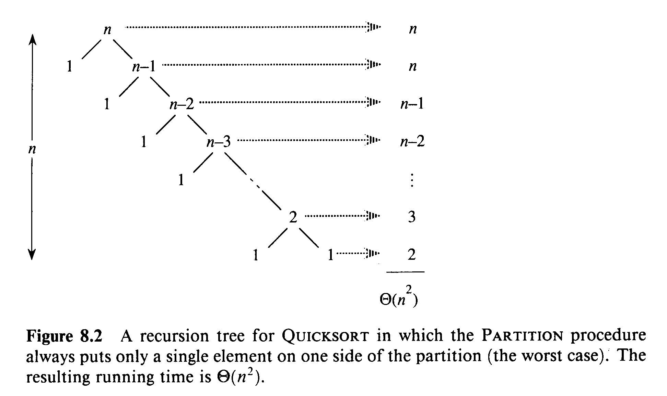
Worst Case Partitioning

Slide 19
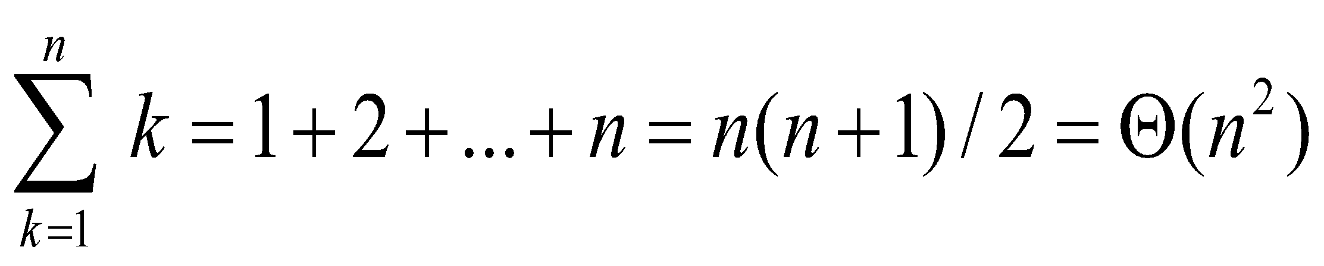
Worst Case Partitioning
Worst-Case Performance (unbalanced):
T(n) = T(1) + T(n-1) + Θ(n)
partitioning takes Θ(n)
= [2 + 3 + 4 + …+ n-1 + n ]+ n =
= [∑_{k = 2 to n} k ]+ n = Θ(n²)
This occurs when
the input is completely sorted
or when
the pivot is always the smallest (largest) element

Slide 20
Best Case Partition
When the partitioning procedure produces two regions of size n/2, we get the a balanced partition with best case performance:
T(n) = 2T(n/2) + Θ(n) = Θ(n lg n)
Average complexity is also Θ(n lg n)

Slide 21
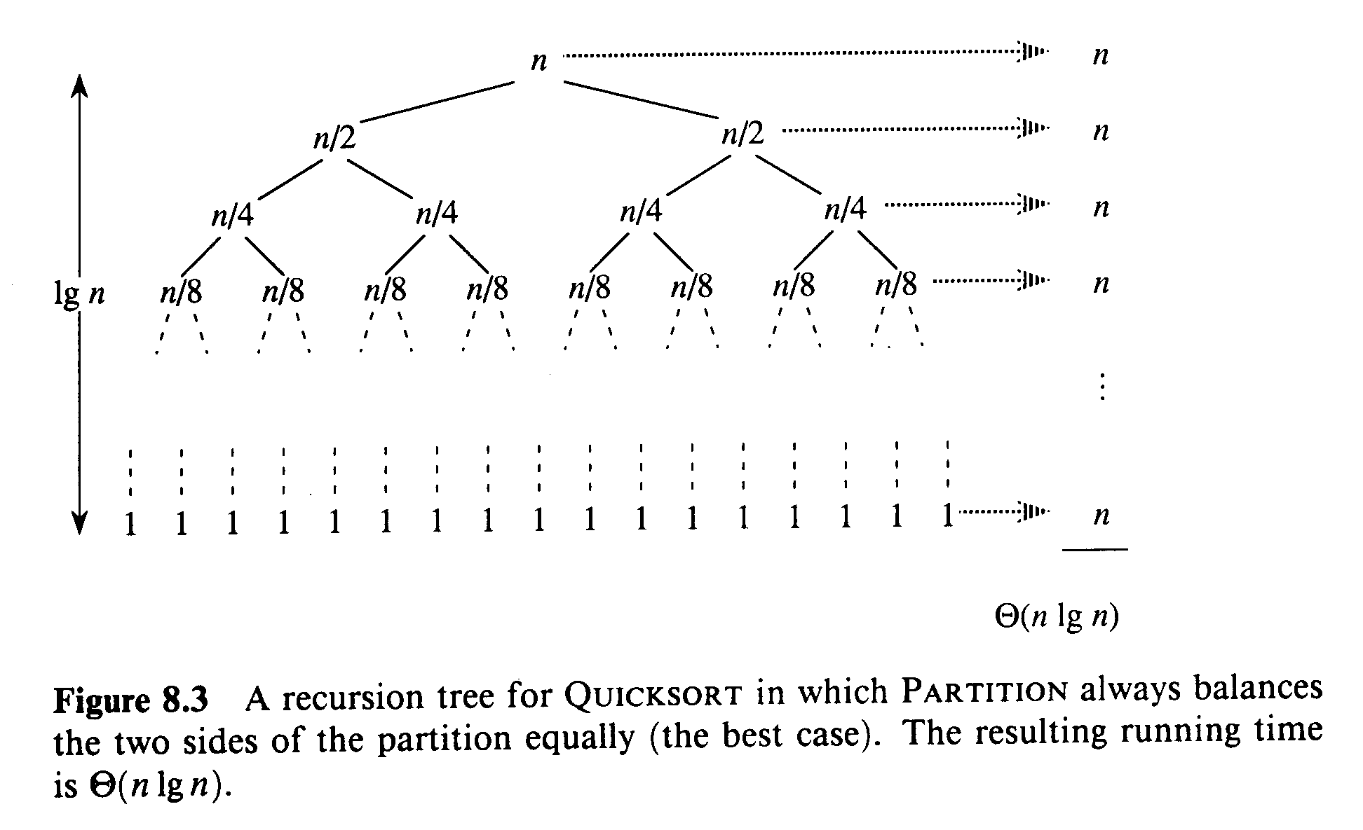
Best Case Partitioning

Slide 22
Average Case
Assuming random input, average-case running time is much closer to Θ(n lg n) than Θ(n²)
First, a more intuitive explanation/example:
Suppose that partition() always produces a 9-to-1 proportional split. This looks quite unbalanced!
The recurrence is thus:
T(n) = T(9n/10) + T(n/10) + Θ(n) = Θ(n lg n)?
[Using recursion tree method to solve]

Slide 23
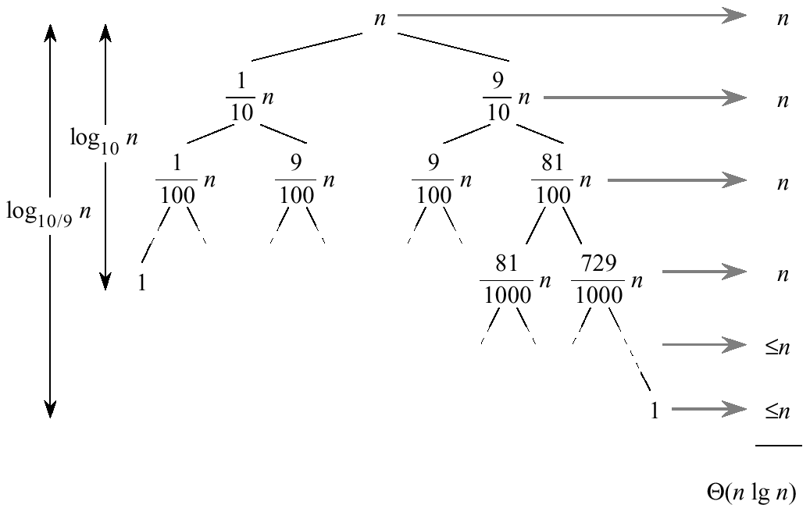
Average Case
(10/9)^{K} = n , (10)^{k} = n
log₂n = log₁₀n/log₁₀2

Slide 24
Average Case
Every level of the tree has cost cn, until a boundary condition is reached at depth log₁₀ n = Θ( lgn), and then the levels have cost at most cn.
The recursion terminates at depth log_{10/9} n= Θ(lg n).
The total cost of quicksort is therefore O(n lg n).

Slide 25
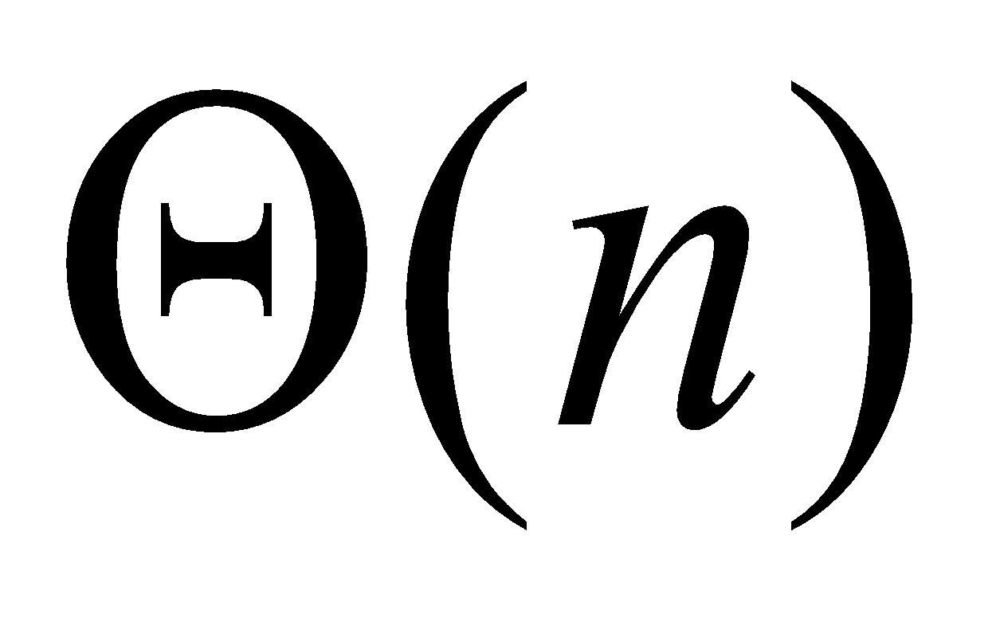
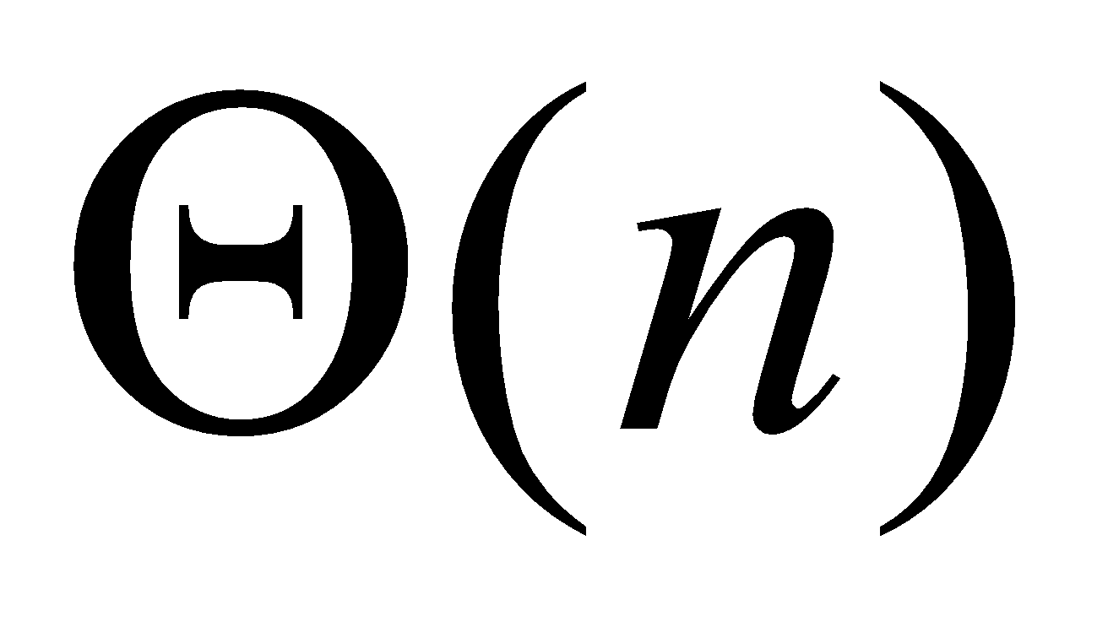
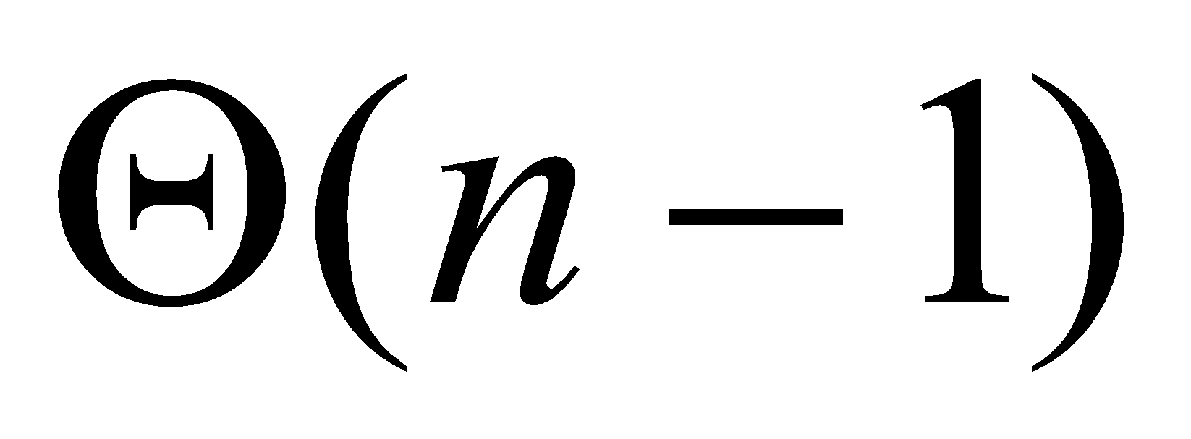
Average Case
What happens if we bad-split root node, then good-split the resulting size (n-1) node?
We end up with three subarrays, size
1, (n-1)/2, (n-1)/2
Combined cost of splits = n + n-1 = 2n -1 = Θ(n)
n
n
1
n-1
(n-1)/2
(n-1)/2
(n-1)/2
(n-1)/2

Slide 26
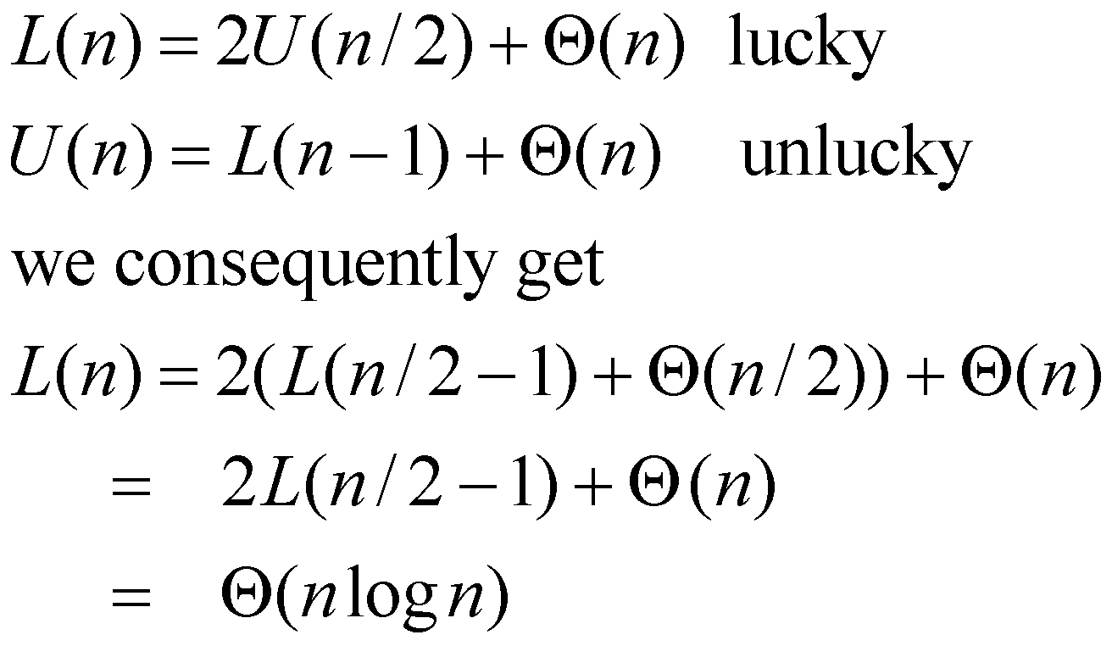
Intuition for the Average Case
Suppose, we alternate lucky and unlucky cases to get an average behavior
The combination of good and bad splits would result in
T(n) = O (n lg n), but with slightly larger constant hidden by the O-notation.
Notes:
‹#›
larger constant in the O notation

Slide 27
Randomized Quicksort
An algorithm is randomized if its behavior is determined not only by the input but also by values produced by a random-number generator.
Exchange A[r] with an element chosen at random from A[p…r] in Partition.
This ensures that the pivot element is equally likely to be any of input elements.
We can sometimes add randomization to an algorithm in order to obtain good average-case performance over all inputs.

Slide 28
Randomized Quicksort
Randomized-Partition(A, p, r)
1. i ← Random(p, r)
2. exchange A[r] ↔ A[i]
3. return Partition(A, p, r)
Randomized-Quicksort(A, p, r)
1. if p < r
2. then q ← Randomized-Partition(A, p, r)
3. Randomized-Quicksort(A, p , q-1)
4. Randomized-Quicksort(A, q+1, r)
swap
pivot

Slide 29
Review: Analyzing Quicksort
What will be the worst case for the algorithm?
Partition is always unbalanced
What will be the best case for the algorithm?
Partition is balanced

Slide 30
Summary: Quicksort
In worst-case, efficiency is Θ(n²)
But easy to avoid the worst-case
On average, efficiency is Θ(n lg n)
Better space-complexity than mergesort.
In practice, runs fast and widely used

