Slide 1
Automobile Sales Analysis
Key insights from the Power BI sales dashboard: where sales come from, what sells, and who buys
Notes:
Introduce the dashboard: it covers sales by country, deal size, product line, quantity and top buyers.

Slide 2
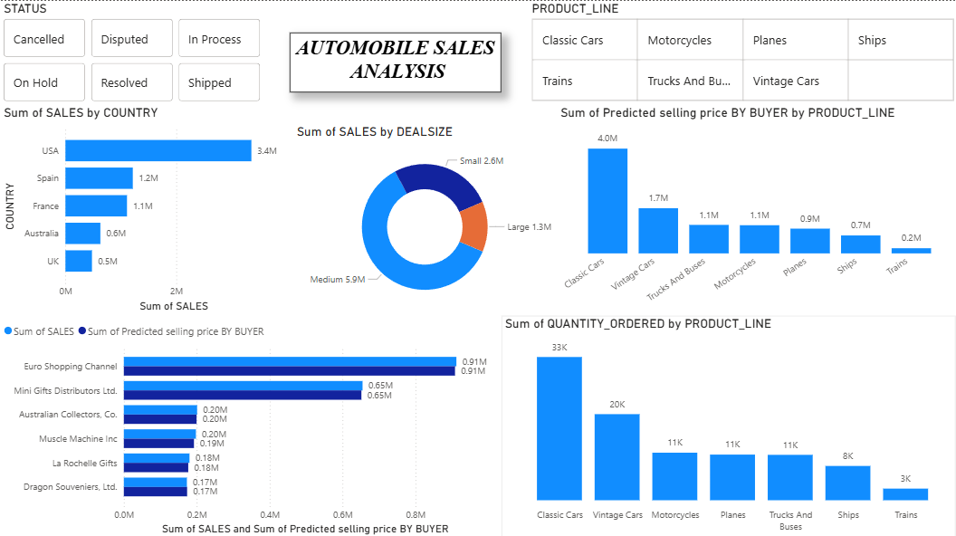
One dashboard, four business questions
≈9.8M
Total sales (sum of deal sizes)
97K
Units ordered across 7 product lines
5
Top countries shown, 69% of sales
Source: Automobile Sales Analysis dashboard (Power BI). Totals calculated from the chart labels.
Notes:
Walk through the dashboard layout. Slicers for Status and Product Line let viewers filter every chart.

Slide 3
The USA alone brings in about 35% of sales
KEY TAKEAWAY
USA sells almost 3x more than Spain, the next best market. The top 5 countries make up 69% of sales.
SO WHAT
Protect the US business, and test growth campaigns in Spain and France.
Sales by country, top 5 countries. USA share = 3.4M of ≈9.8M total.
Notes:
Single highlighted bar draws the eye to the USA. Other bars are muted on purpose.

Slide 4
Medium-sized deals drive 60% of sales
KEY TAKEAWAY
Medium deals bring 5.9M, more than small (2.6M) and large (1.3M) combined.
SO WHAT
Upsell small deals into medium bundles, and grow the large-deal pipeline.
Sales by deal size: Medium 5.9M, Small 2.6M, Large 1.3M.
Notes:
A donut works here because there are only three parts of one whole.

Slide 5
Classic Cars lead on both value and volume
KEY TAKEAWAY
Classic Cars are ~41% of predicted sales value and 33K of 97K units ordered. Trains are only ~2% of value.
SO WHAT
Keep Classic and Vintage Cars well stocked, and review whether to bundle or trim Trains.
Predicted selling price by product line. Units: Classic 33K, Vintage 20K, Motorcycles/Planes/Trucks 11K each, Ships 8K, Trains 3K.
Notes:
Quantity ordered chart shows the same ranking as value, so the story is consistent.

Slide 6
Two buyers make up ~16% of sales
KEY TAKEAWAY
Euro Shopping Channel (0.91M) and Mini Gifts (0.65M) lead. Predicted price almost matches actual sales for every buyer.
SO WHAT
Look after these key accounts, and trust the pricing model for planning.
Top 6 buyers. Two largest buyers = 1.56M of ≈9.8M total sales.
Notes:
Both series are nearly equal, which shows the price prediction is accurate at buyer level.

Slide 7
Summary: what to do next
GEOGRAPHY
USA = 35% of sales
Protect the US, grow Spain and France
DEAL SIZE
Medium deals = 60%
Upsell small deals, build large ones
PRODUCTS
Classic Cars = ~41% of value
Prioritise stock, review Trains
BUYERS
Top 2 buyers = ~16%
Retain key accounts, grow mid-tier
Notes:
Close with the four actions. Each one links back to a chart in this deck.

