Slide 1
BUSINESS WALLET
Solution Architecture
& Process Flows
Derived from the Functional Scope Document v1.0 — Corporate & Franchise Digital Wallet Platform, PayFast EMI
27
8
7
12
diagrams
architecture views
onboarding flows
transaction flows
Advisory design pack · for review and confirmation before build
Notes:
This pack turns the Business Wallet FSD v1.0 into an architecture and a set of executable process flows.
It is a design proposal, not a restatement of the FSD. Where the FSD is silent — failure handling, idempotency, reconciliation mechanics, state transitions, approval routing — this pack proposes an answer and flags it for confirmation. Those points are collected on the 'Decisions to confirm' slides.
Every diagram cites the FSD sections it derives from. All 27 are supplied as an editable multi-page draw.io file alongside this deck.

Slide 2
How this pack is organised
Three sections. Architecture answers 'what are we building'; the flow sections answer 'how does it behave'.
SECTION A · 8 VIEWS
SECTION F · 7 FLOWS
SECTION T · 12 FLOWS
Solution Architecture
Onboarding Flows
Transaction Flows
Context, logical layers, component decomposition, integration map, deployment and security zoning, data and record model, control overlay, and the wallet hierarchy.
Audience: technology, security, and the regulator's technical reviewer.
A1 · A2 · A3 · A4 · A5 · A6 · A7 · A8
The master onboarding flow, then a detailed swimlane for each entity type, the wallet lifecycle state machine, and the franchise invitation, activation and suspension journeys.
Audience: operations, compliance, product.
F1 · F2 · F3 · F4 · F5 · F6 · F7
Maker-checker payments, approval routing, transfers across all three rails, bulk, bill and telco, QR, cards, commission, both settlement models, reconciliation and the end-to-end journey.
Audience: product, finance, operations, build.
T1 … T12

Slide 3
Reading conventions
The same visual grammar is used on every diagram, so a reader learns it once.
Blue
A customer or applicant action, or a customer-facing channel.
Green
Automated platform behaviour — validation, calculation, posting, a service.
Amber
PayFast Operations or Compliance action, or a restricted / pending state.
Purple
A decision point, or a governance and control element.
Red
Rejection, failure, suspension, or a rule the design must not break.
Teal cylinder
A data store owned by the component it sits under.
Dashed line
An asynchronous, advisory or out-of-band interaction.
§ reference
The FSD section each diagram derives from, shown in every subtitle.
Every diagram in this deck is also supplied as an editable page in the accompanying .drawio file, at the same coordinates and in the same colours.
Notes:
Worth 30 seconds at the start of a walkthrough. Once the colour grammar is established, the diagrams read much faster.

Slide 4
Product scope — the six modules the design must deliver
FSD §3. Thirty-five numbered requirements, BW-001 to BW-035, distributed across these six modules.
MODULE 1
MODULE 2
MODULE 3
Onboarding & Compliance
Wallet & User Management
Child Wallet & Franchise
Business onboarding · entity classification · KYB · KYC · AML · documentation · risk assessment · account activation
BW-001 – BW-007
Master Wallet · partner access · authorised users · user roles · transaction services · corporate portal · mobile application
BW-008 – BW-010, BW-029
Child Wallet creation · franchise invitation · onboarding · franchise KYB/KYC · activation · monitoring · suspension
BW-011 – BW-015
MODULE 4
MODULE 5
MODULE 6
Payments, Commission & Settlement
Corporate Cards & Maker-Checker
Reporting, Recon, Risk & Governance
Wallet & bank transfers · RAAST · IBFT · bill & telco · bulk · QR · commission calculation · push and pull settlement
BW-016 – BW-026
Card issuance · partner cards · user-level cards · card controls · maker-checker · approval hierarchy · transaction limits
BW-027, BW-028, BW-035
Statements · transaction, commission and settlement reports · reconciliation · audit trail · risk controls · compliance monitoring
BW-030 – BW-034

Slide 5
SECTION A
Solution Architecture
Eight views, from the boundary of the system down to its deployment zones and its financial record model.
A1 Solution context
A2 Logical layers
A3 Components
A4 Integration map
A5 Deployment & zoning
A6 Data & record model
A7 Control overlay
A8 Hierarchy model

Slide 6
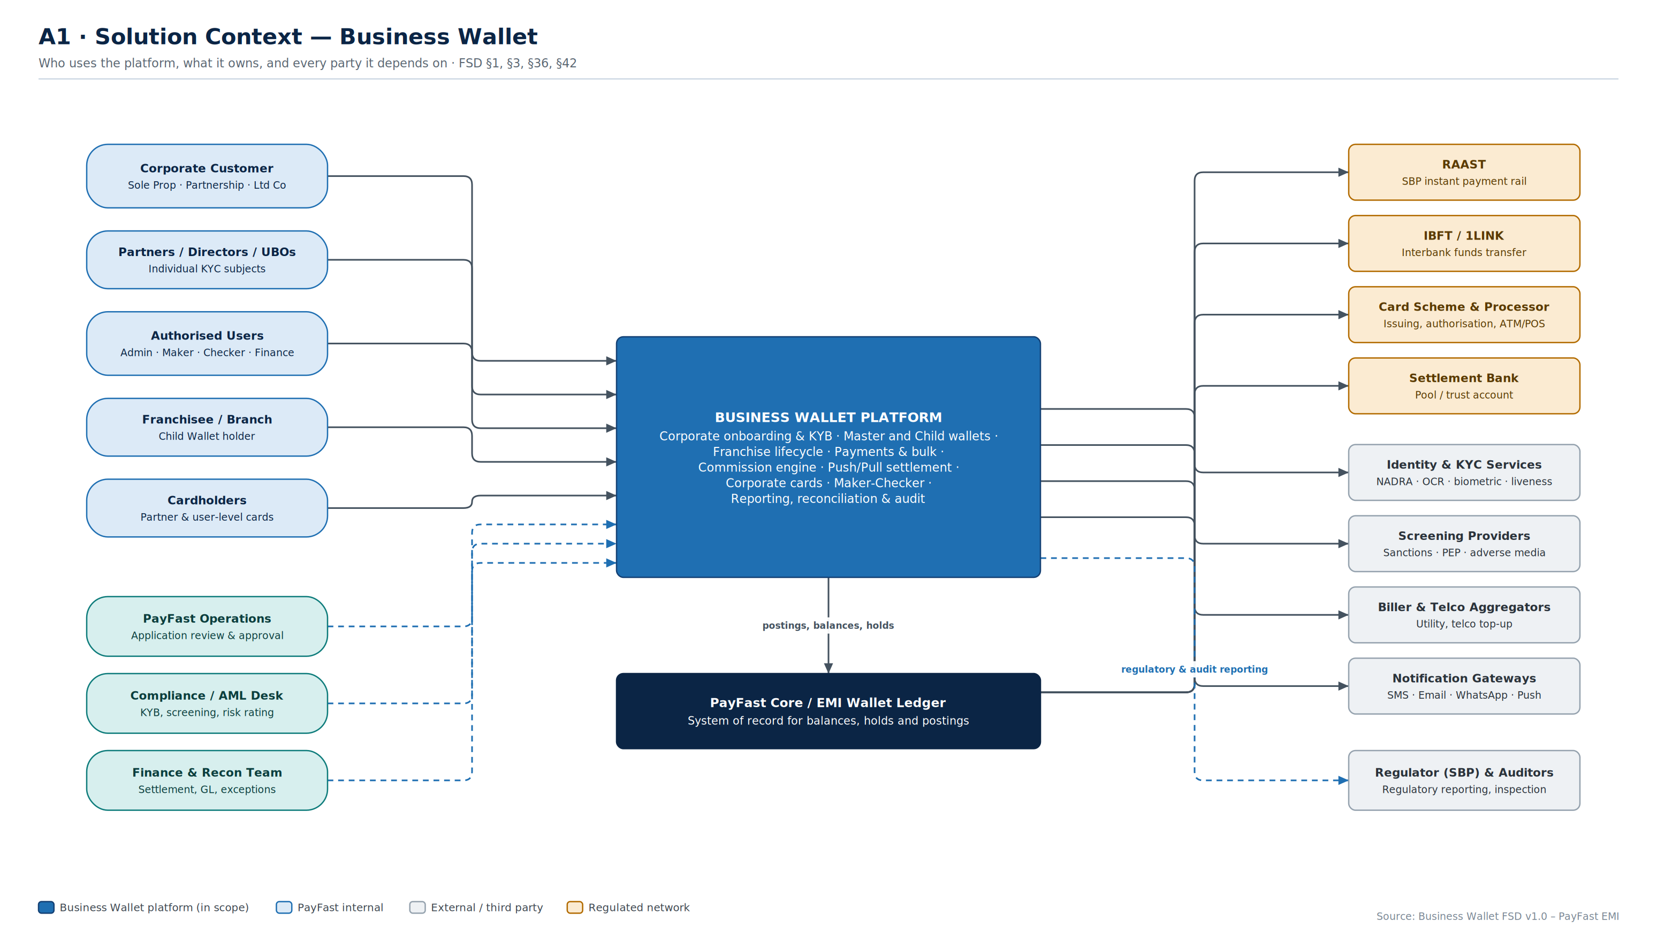
A1
Solution Context
Five customer-facing actor groups, three internal PayFast functions, and eleven external dependencies around one platform.
Business Wallet · Solution Architecture & Flows
A1
Notes:
Purpose: agree the boundary before agreeing the internals. Everything inside the blue box is in scope for build; everything outside is an integration with its own contract, SLA and failure mode.
Key points to raise:
• The PayFast EMI core ledger is the system of record. The Business Wallet does not hold its own truth about balances — it orchestrates, the core posts. This decision drives A6.
• Ops, Compliance and Finance are shown as actors, not as a back-office afterthought. Their queues, SLAs and approval authority are functional requirements, not operational detail.
• Eleven external dependencies is the real project risk. Each one needs a named owner, a test environment and a contracted response time before build starts.
Confirm: which of the external parties are already contracted, and which are assumptions.

Slide 7
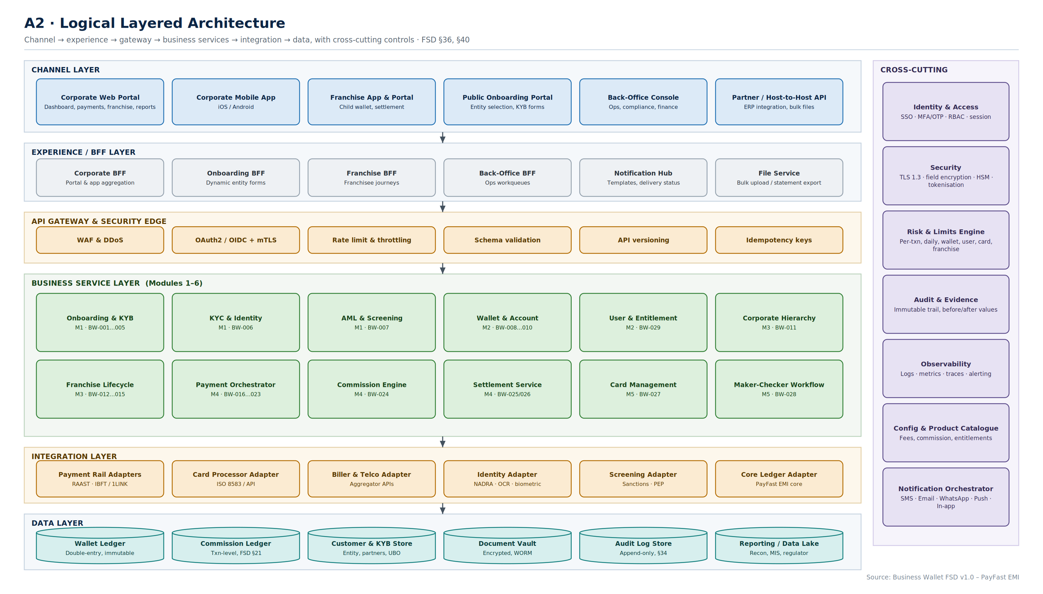
A2
Logical Layered Architecture
Six layers, twelve business services mapped one-to-one onto the FSD's six modules, seven cross-cutting concerns.
Business Wallet · Solution Architecture & Flows
A2
Notes:
Purpose: show that every FSD requirement has a home, and that nothing is left as 'the platform will handle it'.
Key points:
• The BFF layer exists because the corporate portal, the mobile app, the franchise app and the back-office console need very different aggregations of the same services. Without it, business services get polluted with channel-specific logic.
• The twelve business services map directly to modules 1–6 and carry their BW requirement ranges, so the build backlog can be cut straight from this diagram.
• The cross-cutting column is deliberately separate. Risk and limits, audit, and the notification orchestrator are used by every service — building them per-service is the most common way this kind of platform becomes unmaintainable.
• The data layer separates the wallet ledger from the commission ledger. They are different records with different lifecycles (see A6, T7).
Confirm: whether the risk and limits engine is built here or reused from an existing PayFast component.

Slide 8
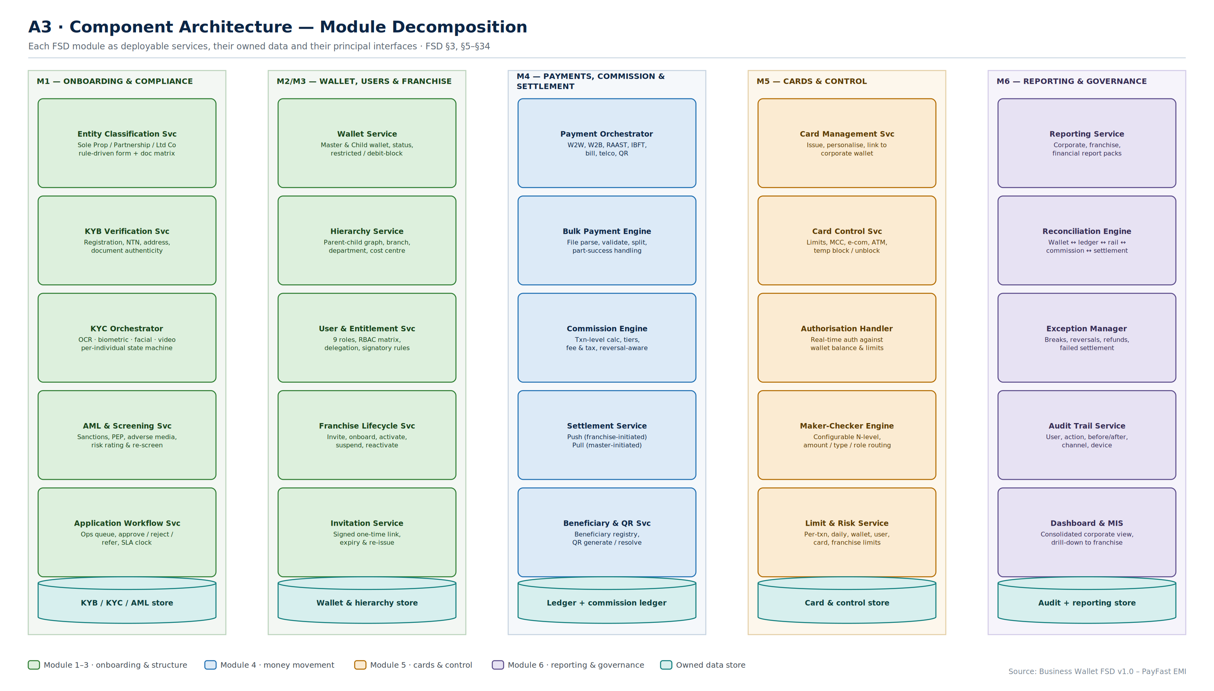
A3
Component Architecture
Twenty-five services grouped by module, each with its own data store — the deployable unit view.
Business Wallet · Solution Architecture & Flows
A3
Notes:
Purpose: this is the build breakdown. Each card is a service with an owner, an API contract and a test suite.
Key points:
• Onboarding is split into five services rather than one, because entity classification, KYB, KYC, screening and workflow have genuinely different change rates. Entity rules change with product; screening changes with regulation.
• The invitation service is separated from franchise lifecycle deliberately — signed, expiring, single-use links are a security concern with its own threat model.
• The commission engine is separate from the settlement service. Commission accrues continuously; settlement happens in batches. Merging them is what makes reversal handling (T11) impossible to get right.
• Each column owns its data. Cross-module reads go through APIs, not through shared tables.
Confirm: team topology — this decomposition assumes roughly five squads, one per column.

Slide 9
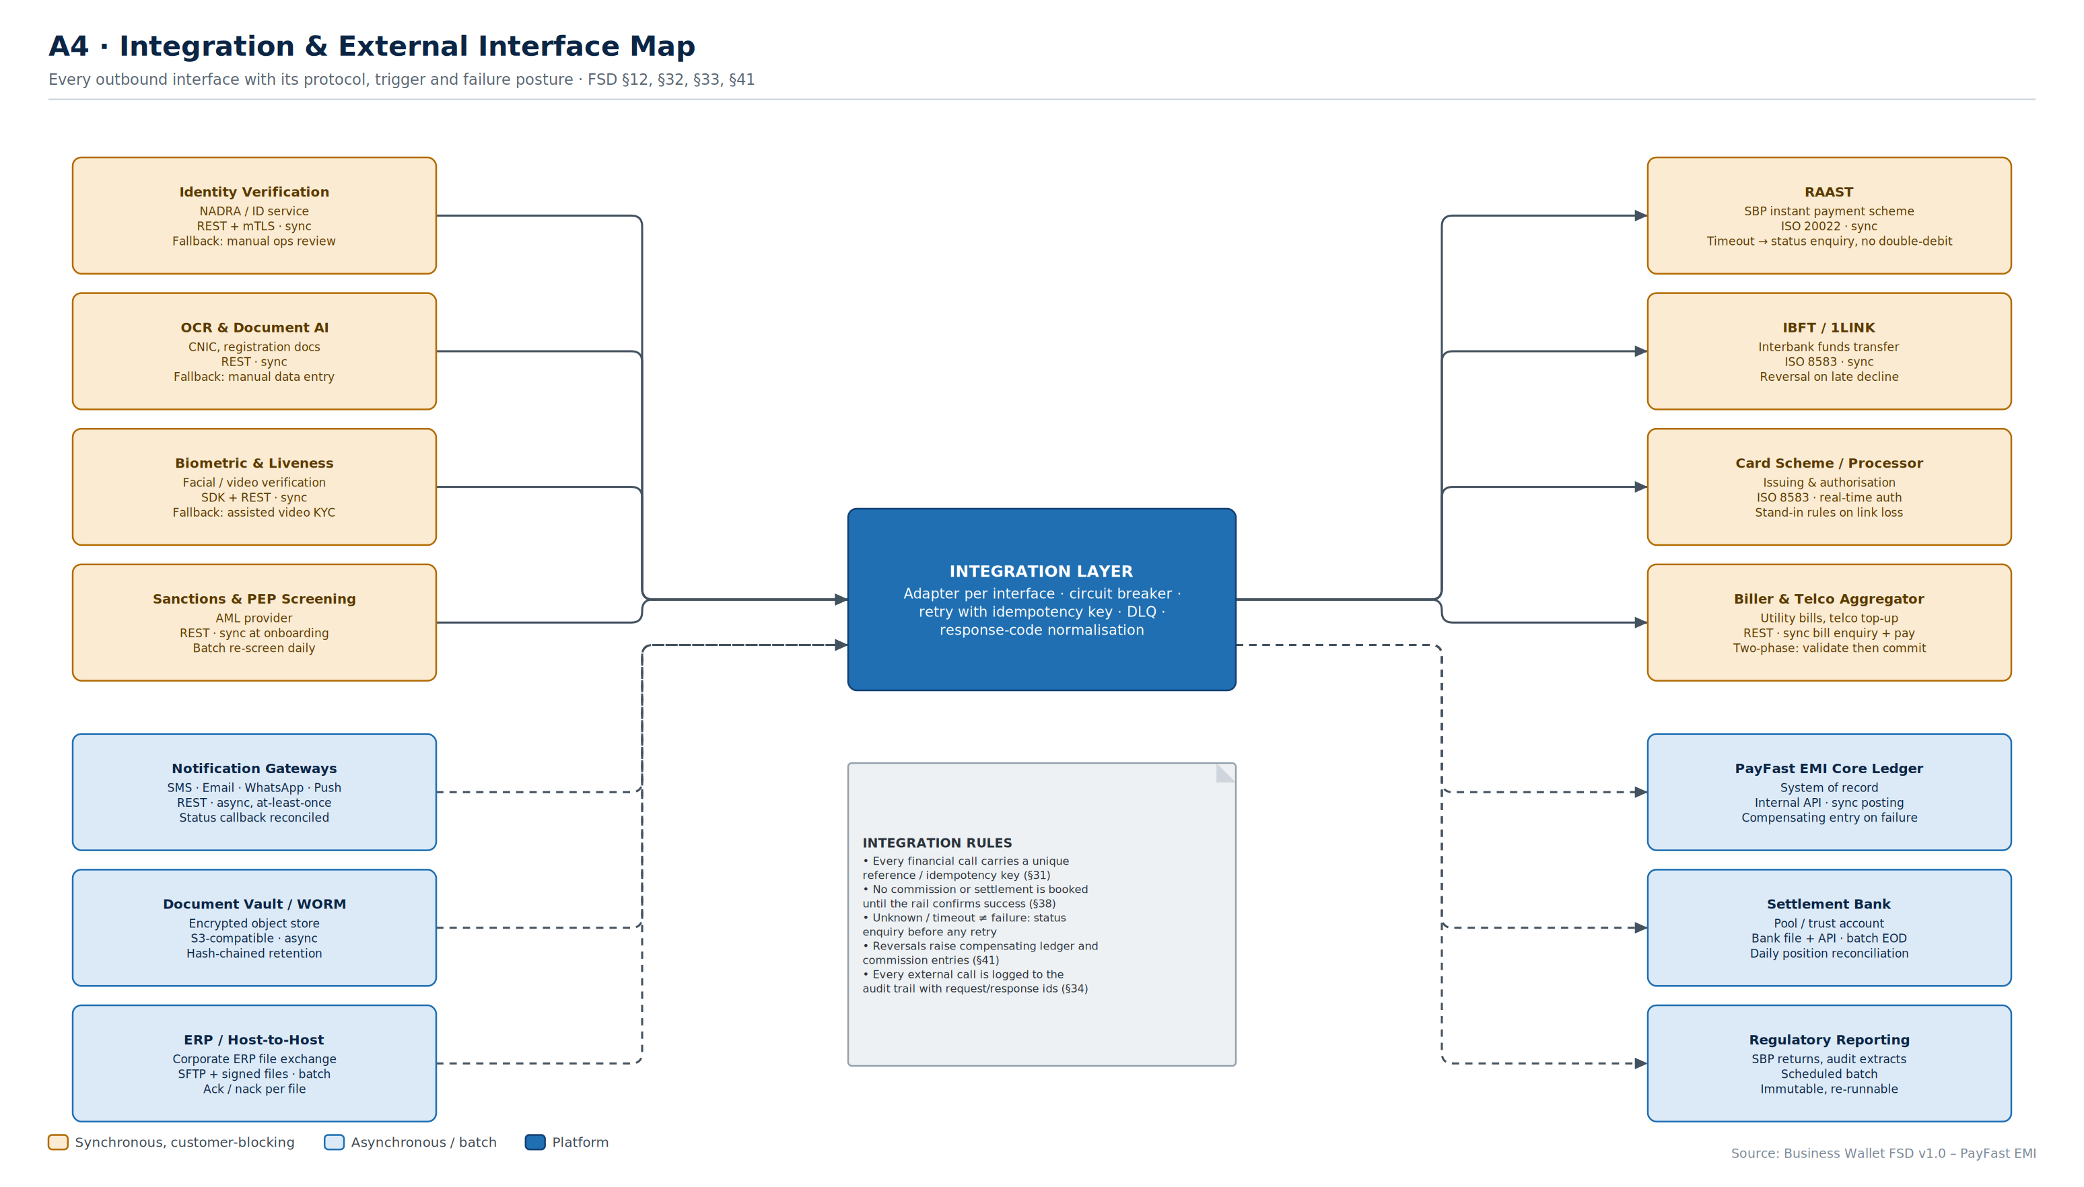
A4
Integration & Interface Map
Fourteen external interfaces, each with its protocol, its trigger and — most importantly — its failure posture.
Business Wallet · Solution Architecture & Flows
A4
Notes:
Purpose: integrations are where this programme will actually slip. This page makes each one explicit and states what happens when it fails.
Key points:
• The right-hand note is the important part of the page. Idempotency keys, status enquiry before retry, and no-commission-until-confirmed are the three rules that prevent the classic failure modes: double debits, phantom commission and unreconcilable positions.
• 'Unknown is not failure' deserves emphasis. A timeout on RAAST or IBFT must trigger a status enquiry against the original reference, never a blind resend.
• Synchronous customer-blocking calls (left top, right top) need aggressive timeouts and a defined fallback. Asynchronous ones need a dead-letter queue and a replay path.
Confirm: sandbox availability and test data for RAAST, IBFT, the card processor and the biller aggregator — these usually have the longest lead time.

Slide 10
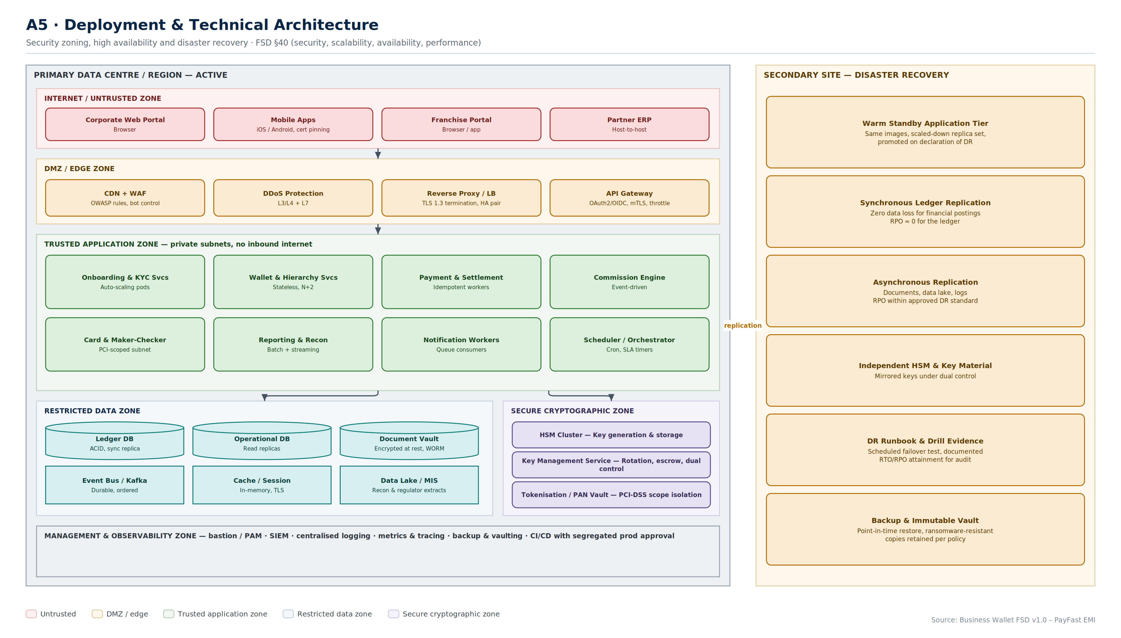
A5
Deployment & Technical Architecture
Five security zones in the primary site, a warm-standby DR site, and synchronous replication for the ledger only.
Business Wallet · Solution Architecture & Flows
A5
Notes:
Purpose: satisfy the non-functional requirements in FSD §40 — security, scalability, availability, performance — and give the regulator a zoning story.
Key points:
• Nothing in the trusted application zone accepts inbound internet traffic. All ingress is through the DMZ.
• The cryptographic zone is separate from the data zone. HSM, key management and the PAN vault sit inside the PCI-DSS scope boundary, and card services are the only components that reach into it.
• DR is deliberately asymmetric: the ledger replicates synchronously (RPO near zero for financial postings), everything else asynchronously. Synchronous replication of the data lake would buy nothing and cost latency.
• DR drill evidence is listed as a component because the regulator will ask for it, and an untested DR site is not a DR site.
Confirm: the approved RTO and RPO targets, and whether the secondary site is in-country.

Slide 11
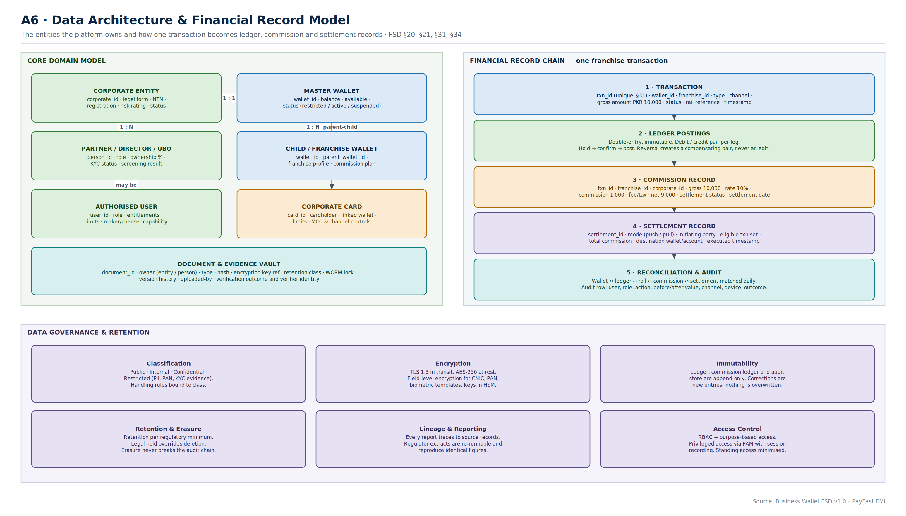
A6
Data Architecture & Record Model
The domain model on the left, and the five-record chain that one franchise transaction produces on the right.
Business Wallet · Solution Architecture & Flows
A6
Notes:
Purpose: this is the page the build team will argue over, and the page the auditor will ask for.
Key points:
• The financial record chain is the heart of it. One transaction produces a ledger posting pair, a commission record, a settlement record and a reconciliation position. They are separate records, linked by the transaction reference.
• Immutability is a design constraint, not a policy statement. Ledger, commission ledger and audit store are append-only. A correction is a new compensating entry. This is what makes T11 work.
• The commission record captures the rate, not a reference to the rate. A plan change next quarter must not silently rewrite last quarter's commission.
• Every financial movement carries a unique reference (FSD §31). Reconciliation matches on that reference, never on amount-and-date heuristics.
Confirm: retention periods per record class, and whether erasure requests can ever reach financial records.

Slide 12
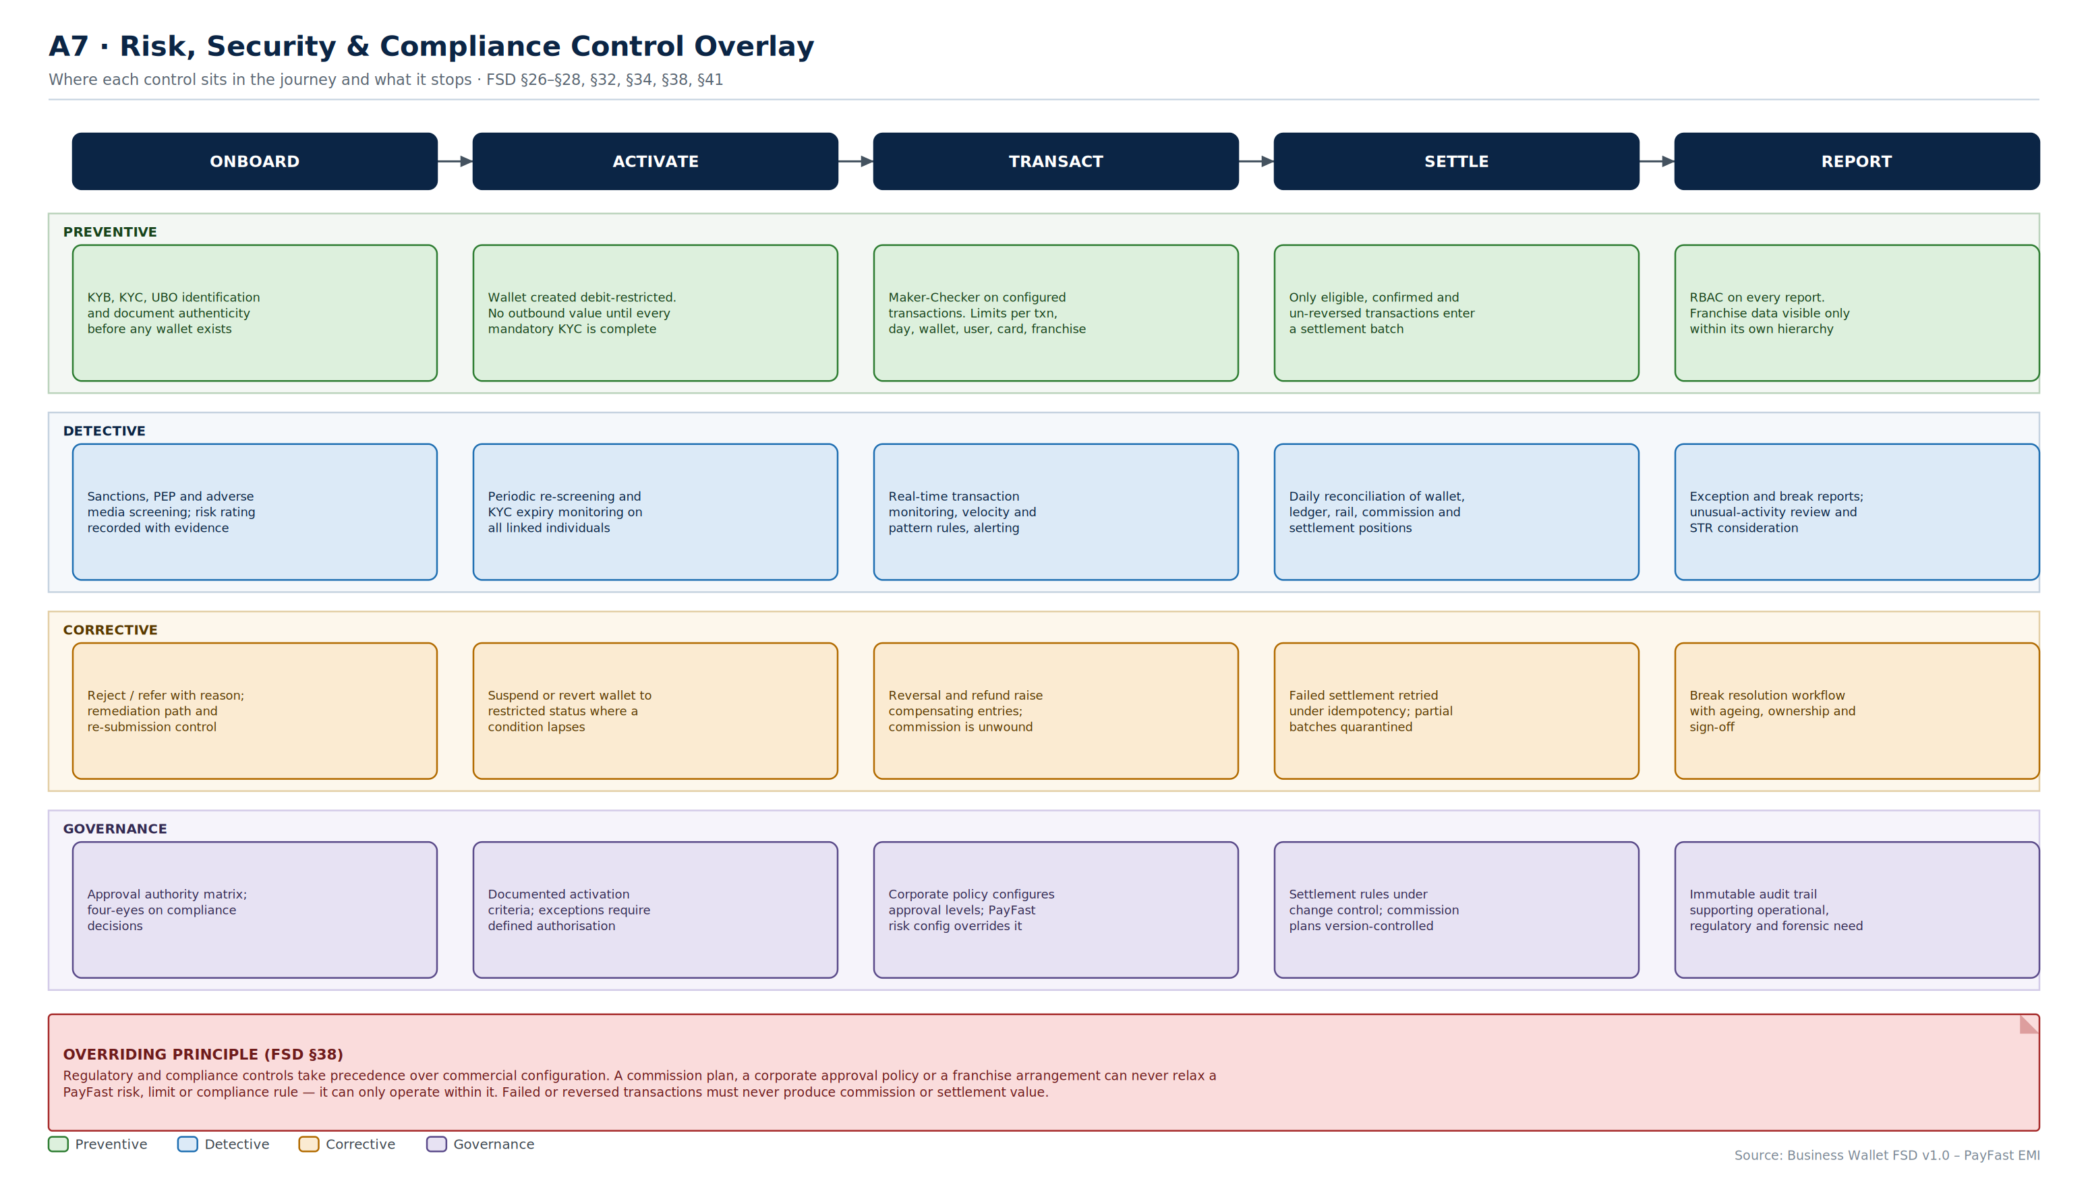
A7
Risk, Security & Compliance Overlay
Twenty controls across five journey stages, classified preventive, detective, corrective and governance.
Business Wallet · Solution Architecture & Flows
A7
Notes:
Purpose: show Compliance and Risk where their controls sit, in the language they use, mapped to the same journey the build team is working to.
Key points:
• Reading down a column shows every control at one stage. Reading across a row shows one control type through the whole journey. Both views are needed — Compliance reads rows, the build team reads columns.
• The red banner is the single most important sentence in the pack: regulatory and compliance controls take precedence over commercial configuration. A generous commission plan or a permissive corporate approval policy can never relax a PayFast risk rule.
• The corrective row is the one usually missing from FSDs. Every preventive control needs a defined remediation path, or operations invents one under pressure.
Confirm: control ownership — who signs off each control as designed, implemented and tested.

Slide 13
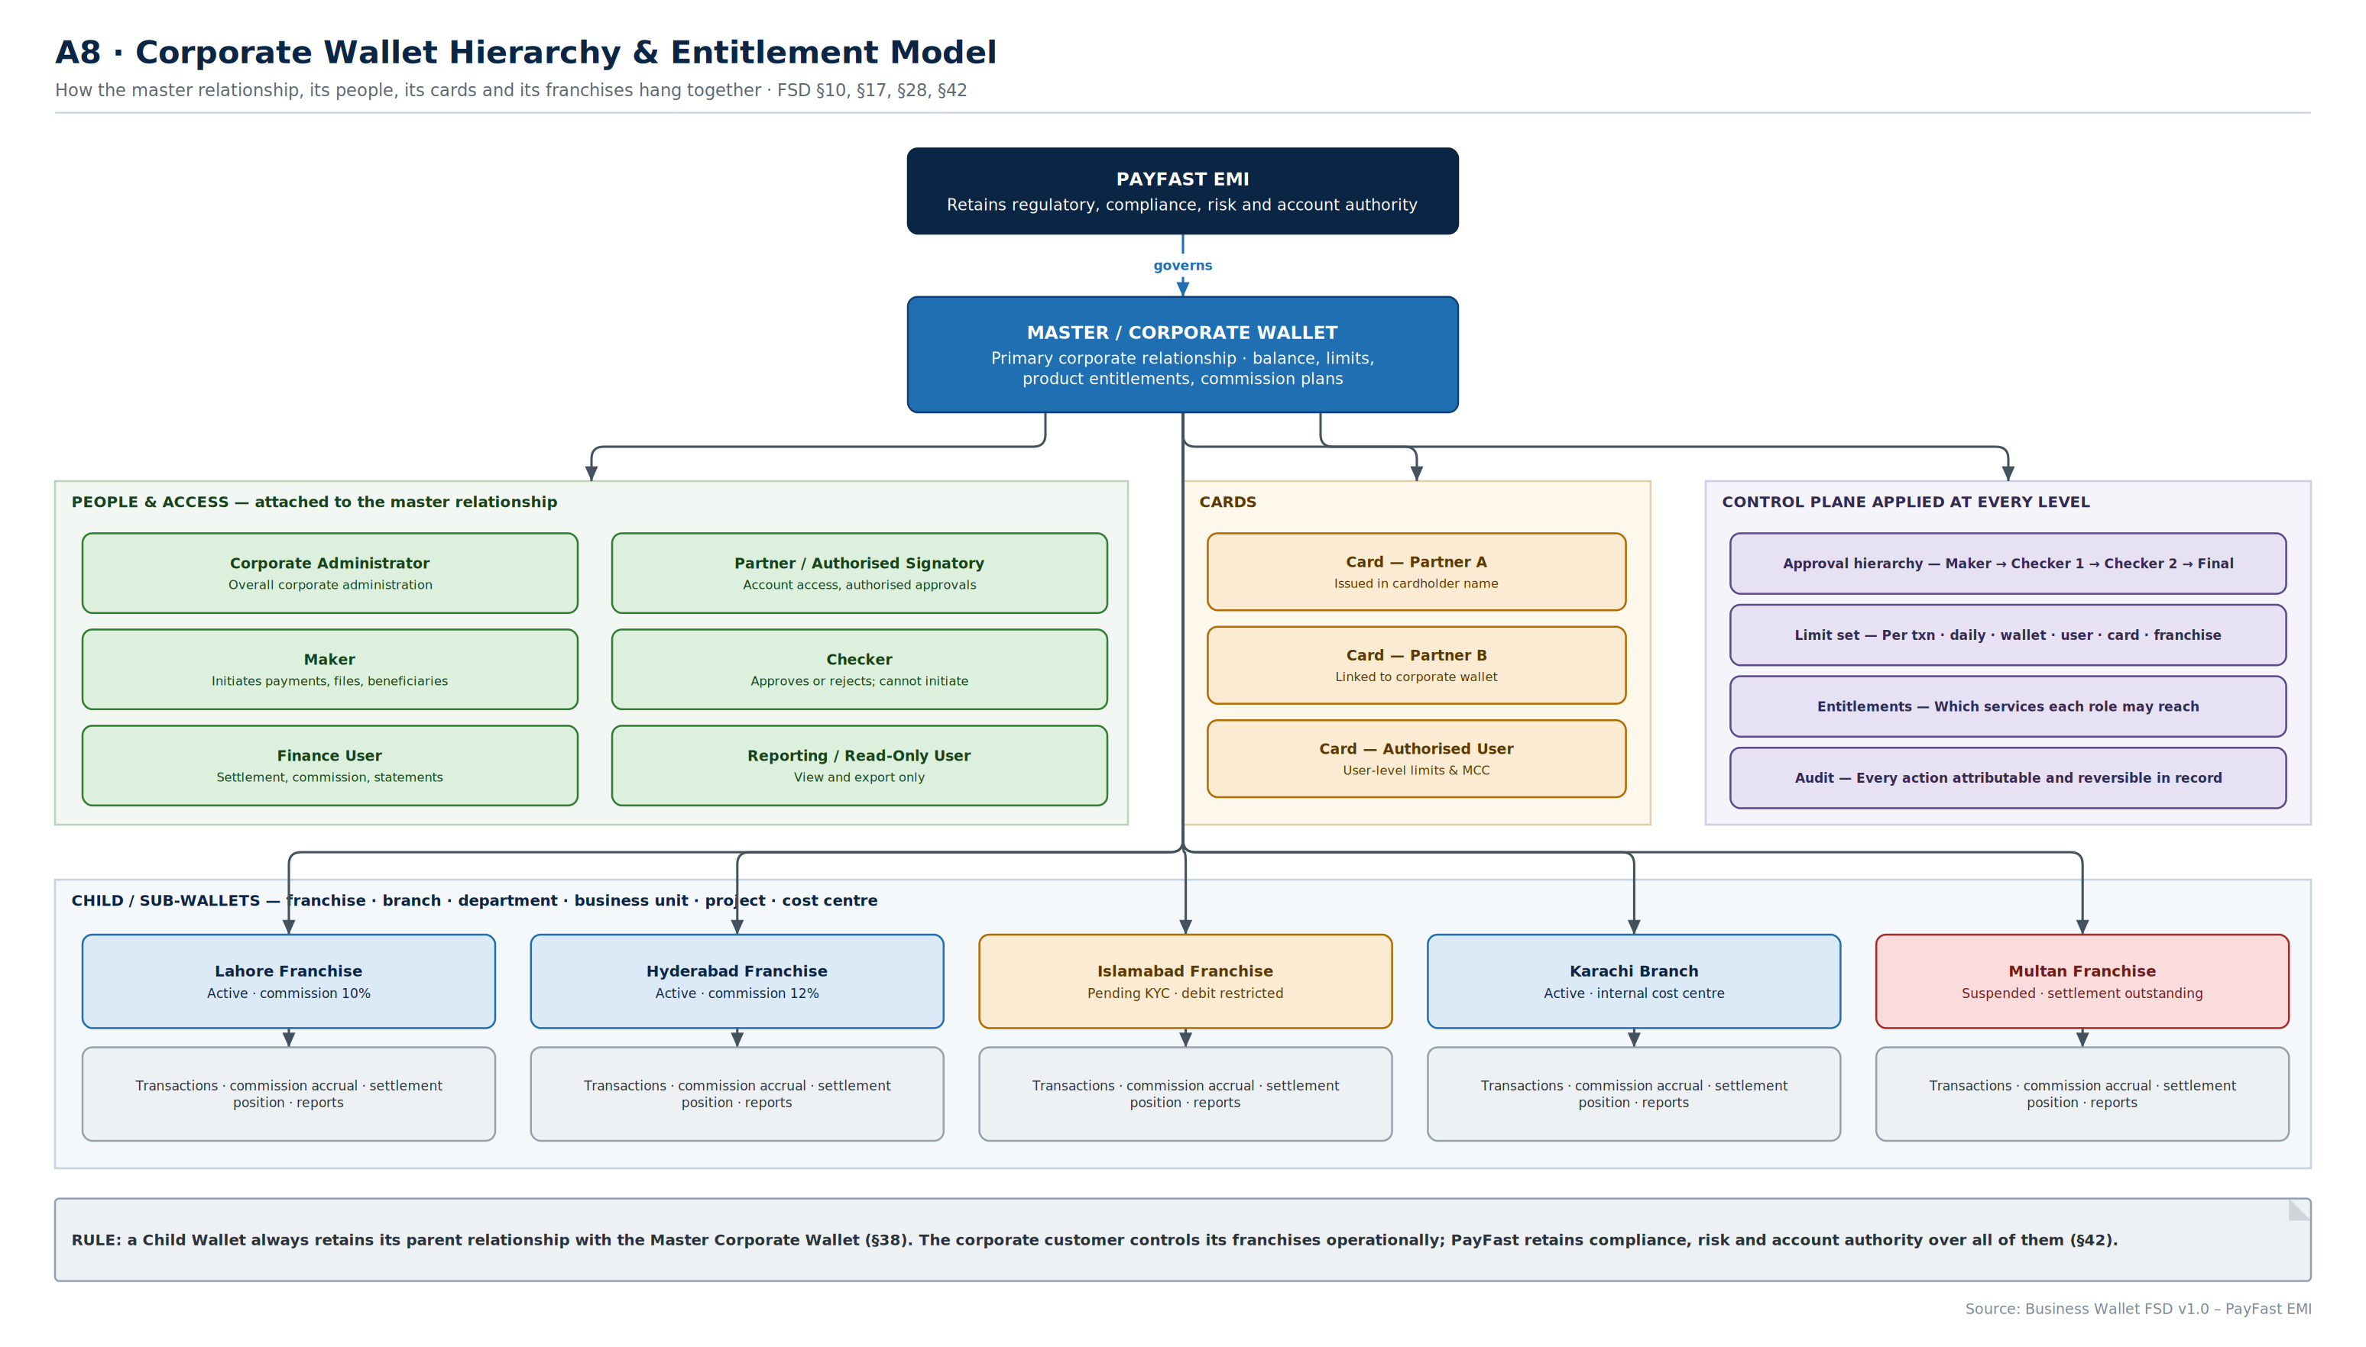
A8
Hierarchy & Entitlement Model
PayFast governs the master; the master governs people, cards and franchises; the control plane applies at every level.
Business Wallet · Solution Architecture & Flows
A8
Notes:
Purpose: resolve the governance question that FSD §42 raises — where corporate authority ends and PayFast authority begins.
Key points:
• The corporate customer has operational control over its franchises: invite, configure commission, monitor, suspend. It does not have compliance authority. It cannot approve a franchise, and it cannot lift a PayFast suspension.
• All nine roles from FSD §28 are shown against the master relationship. Entitlements are configurable but role separation — particularly maker and checker — is not.
• Child wallets can represent franchises, branches, departments, business units, projects or cost centres. The mechanics are identical; only the commercial arrangement differs.
• The example franchise row deliberately shows a suspended franchise with outstanding settlement, because that is the state the design most often mishandles (see F7).
Confirm: maximum hierarchy depth. This design assumes two levels — master and child. Franchises of franchises would need a separate decision.

Slide 14
Architecture decisions embedded in Section A
Positions this pack takes where the FSD is silent. Each needs confirmation before build.
DECISION 1
DECISION 2
DECISION 3
The core ledger is the system of record
Commission ledger separate from wallet ledger
Append-only financial and audit stores
The Business Wallet orchestrates; the PayFast EMI core posts and holds truth about balances. The platform keeps its own commission ledger, but never a competing balance.
Alternative: a Business Wallet ledger reconciled to core — more autonomy, materially more reconciliation risk.
Commission accrues continuously and settles in batches; postings happen per transaction. Different lifecycles, so different records linked by transaction reference.
Merging them makes reversal handling (T11) effectively impossible.
Ledger, commission ledger and audit trail are immutable. Corrections are new compensating entries, never edits.
This is what makes FSD §34 and §41 satisfiable, and what an auditor will look for first.
DECISION 4
DECISION 5
DECISION 6
Two-level hierarchy only
Idempotency on every financial call
PCI scope isolated to a cryptographic zone
Master and child. Child wallets may represent franchises, branches, departments, business units, projects or cost centres — but not further children.
Franchises of franchises would need an explicit decision and changes to A8, T7 and T8.
Unique reference plus idempotency key on every outbound financial interaction; unknown responses resolved by status enquiry, never blind retry.
This is the control that prevents double debits and phantom commission.
HSM, key management and the PAN vault sit in their own zone. Only card services reach into it.
Keeps the PCI-DSS assessment boundary small, which materially reduces cost and audit effort.

Slide 15
SECTION F
Onboarding Flows
From first click to an activated wallet — for three entity types, and for the franchises that hang beneath them.
F1 Master flow
F2 Sole proprietor
F3 Partnership
F4 Limited company
F5 Wallet lifecycle
F6 Franchise onboarding
F7 Suspension & exit

Slide 16
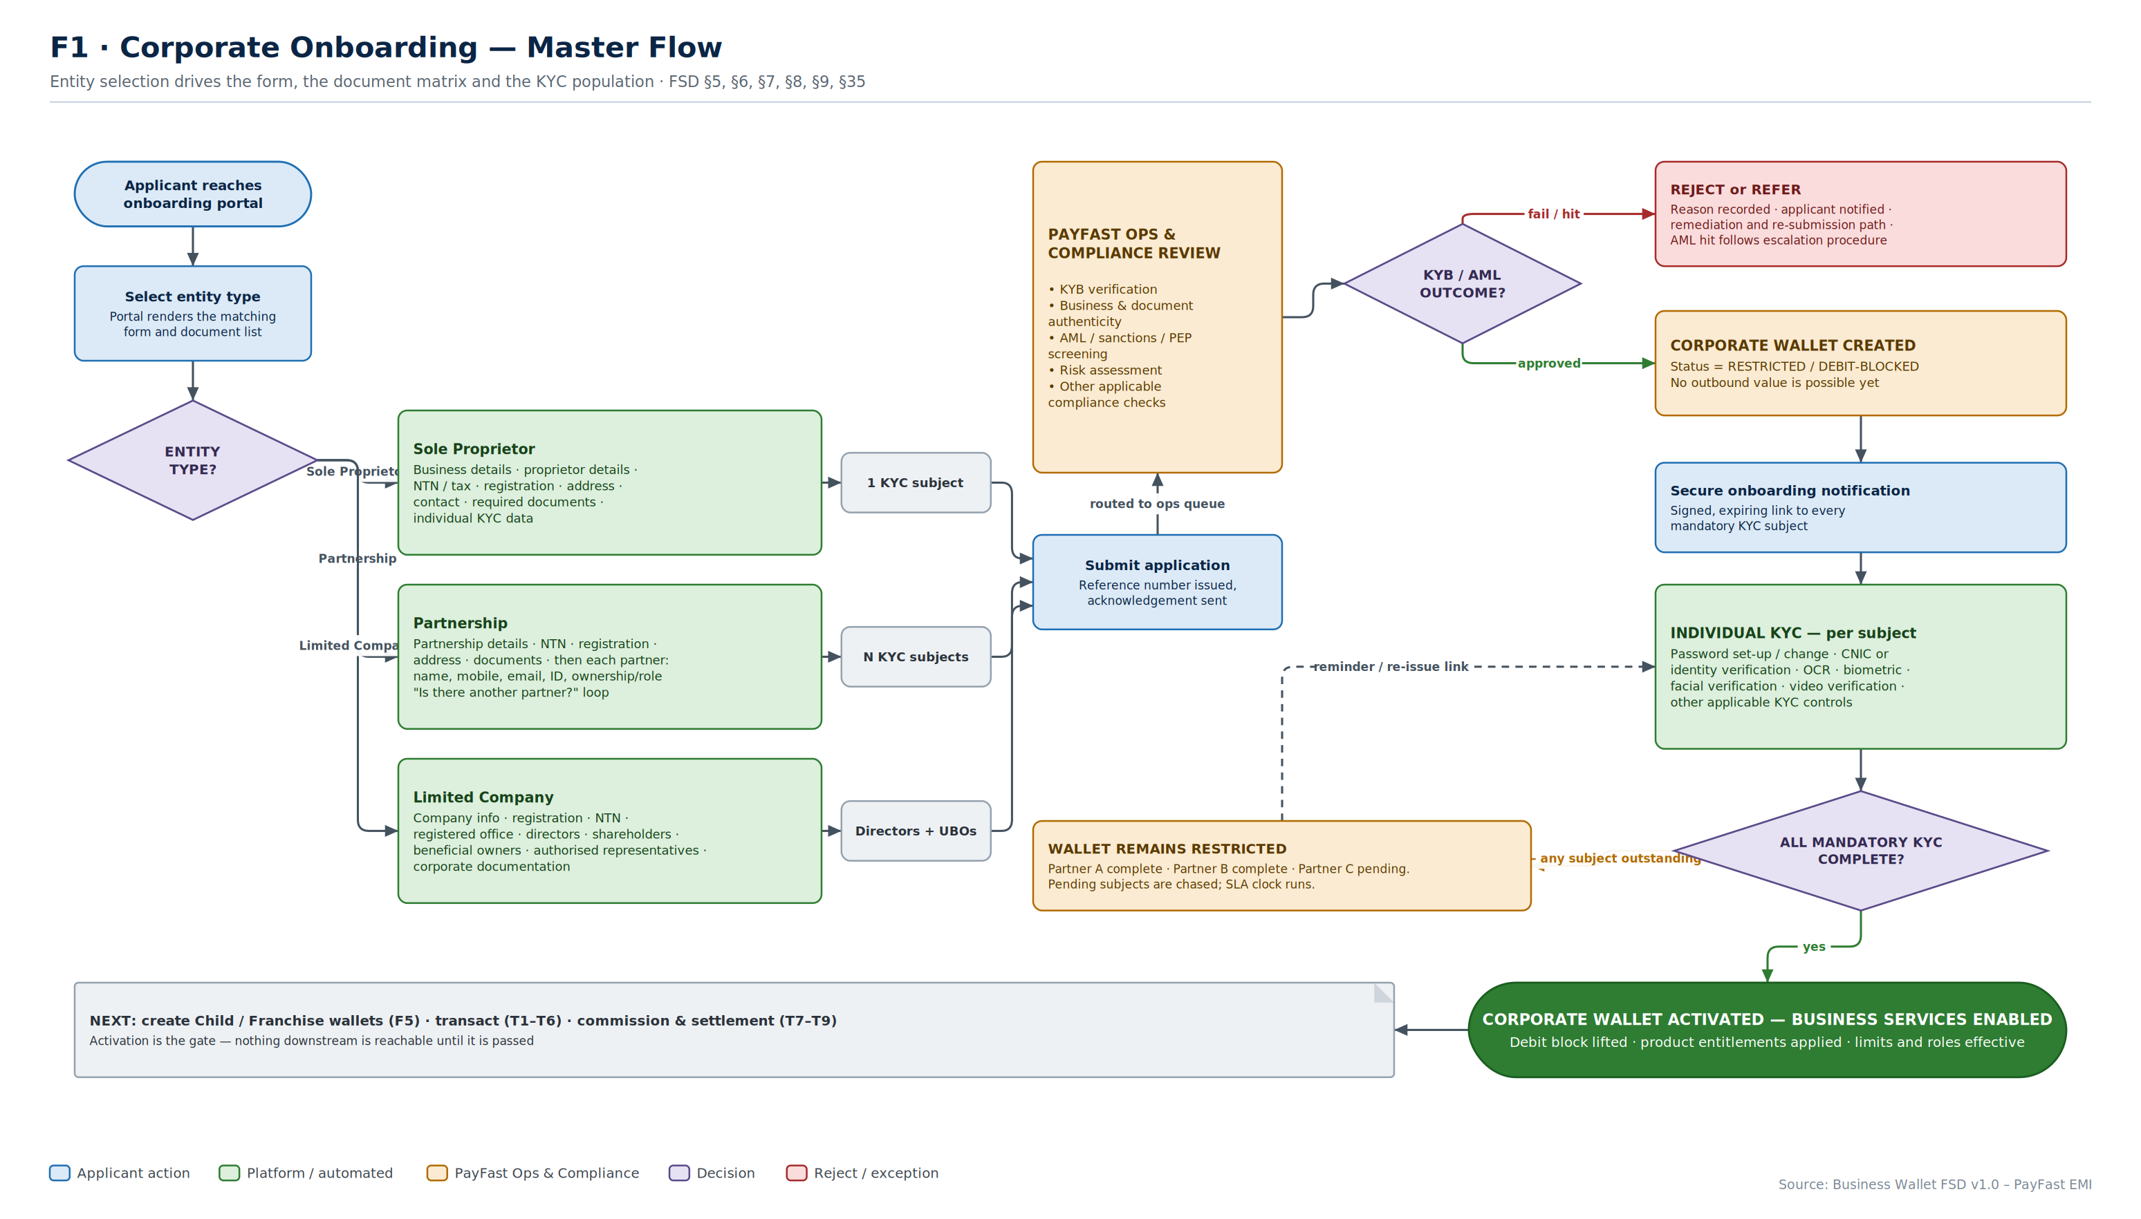
F1
Onboarding — Master Flow
One entry point, three entity paths, one approval gate, then per-subject KYC before activation.
Business Wallet · Solution Architecture & Flows
F1
Notes:
Purpose: the master view of FSD §5–§9 and §35. Every other onboarding diagram is a detail of this one.
Key points:
• Entity selection happens first and drives everything downstream — which form renders, which documents are demanded, and how many people must complete KYC.
• The two-stage model (FSD §9) is the important design decision: entity approval and individual KYC are separated. The wallet is created restricted after KYB, then activated after KYC. This lets operations progress the corporate case while individuals complete verification at their own pace.
• 'Wallet remains restricted' is a loop, not a dead end. The SLA clock and the reminder path are functional requirements.
• Activation is the gate for everything downstream — franchises, transactions, commission, settlement.
Confirm: SLA targets for ops review, and the re-attempt limit on failed KYC before referral.

Slide 17
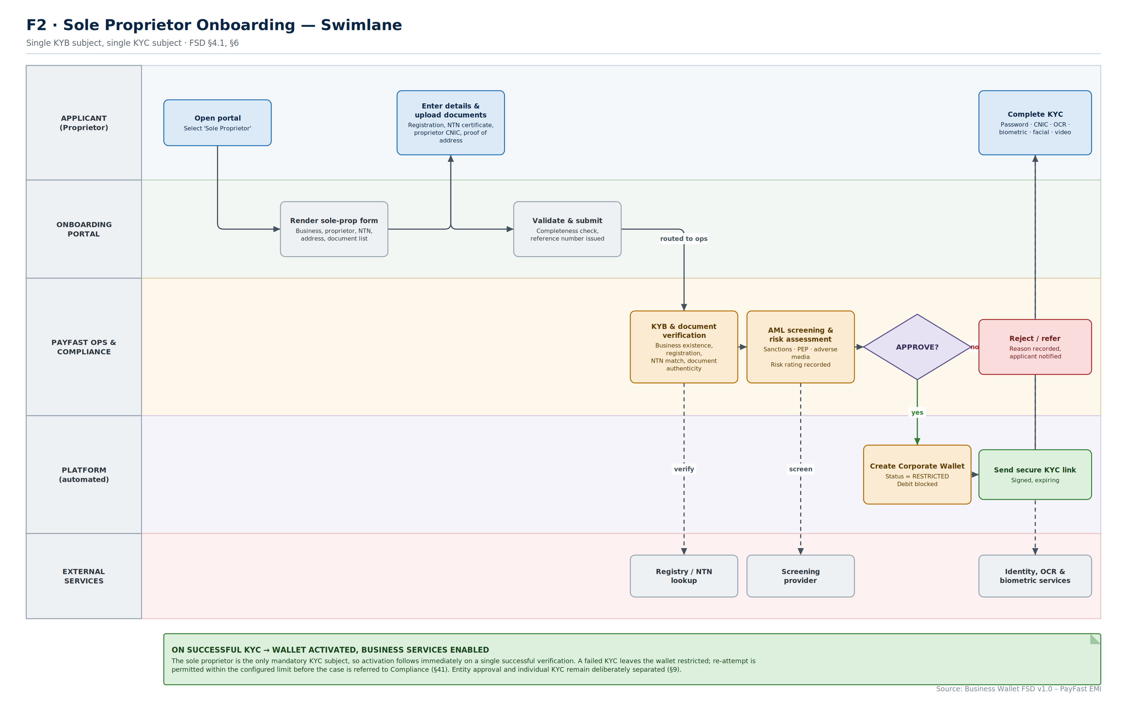
F2
Sole Proprietor Onboarding
The simplest path — one KYB subject, one KYC subject, so activation follows a single successful verification.
Business Wallet · Solution Architecture & Flows
F2
Notes:
Purpose: the reference implementation. Get this path right and the other two are variations on it.
Key points:
• Five swimlanes make the handoffs explicit. The two that matter are portal-to-ops (where the SLA clock starts) and platform-to-applicant (the secure KYC link).
• External services appear as their own lane because they are the failure points. Registry lookup, screening and biometric verification each need a defined fallback — manual ops review, manual data entry, assisted video KYC.
• Even here the wallet is created restricted first. Consistency of the state machine matters more than shaving a step off the simplest case.
Confirm: whether ops review is mandatory for every sole proprietor, or whether low-risk cases can be auto-approved on clean screening.

Slide 18
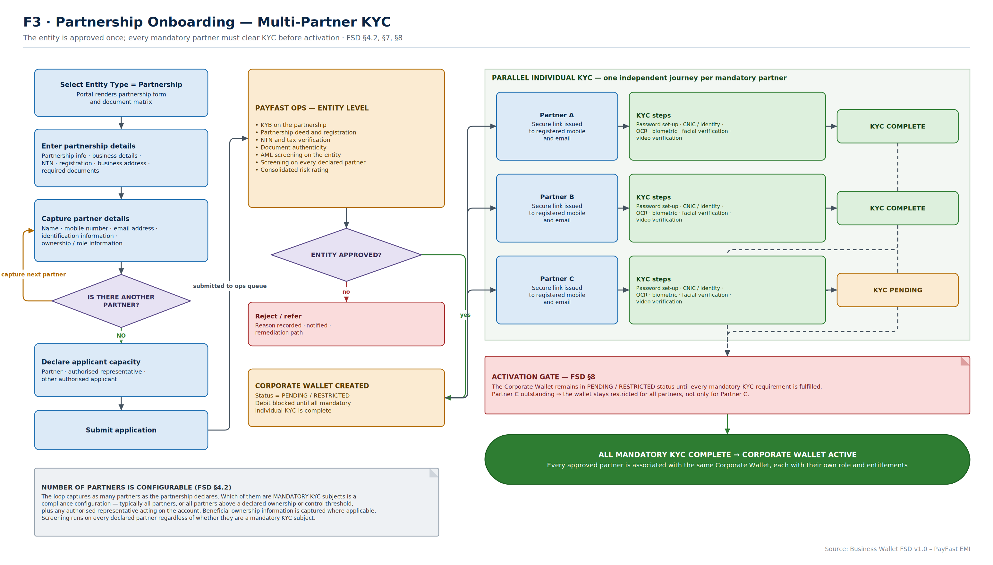
F3
Partnership Onboarding
The entity is approved once; every mandatory partner must clear KYC independently before the wallet activates.
Business Wallet · Solution Architecture & Flows
F3
Notes:
Purpose: the multi-subject case, and the one most likely to cause customer friction.
Key points:
• The 'Is there another partner?' loop from FSD §7 is the capture mechanism, and the number of partners is configurable.
• The right-hand panel is the design point: KYC journeys run in parallel and independently. Each partner gets their own signed link to their own registered mobile and email.
• The activation gate is relationship-wide. Partner C outstanding means the wallet stays restricted for Partner A and Partner B too. This is correct per FSD §8, and it is the single thing to explain to the business before launch — it is a common source of complaints.
• Screening runs on every declared partner, whether or not they are a mandatory KYC subject.
Confirm: which partners are mandatory KYC subjects — all of them, or those above an ownership or control threshold.

Slide 19
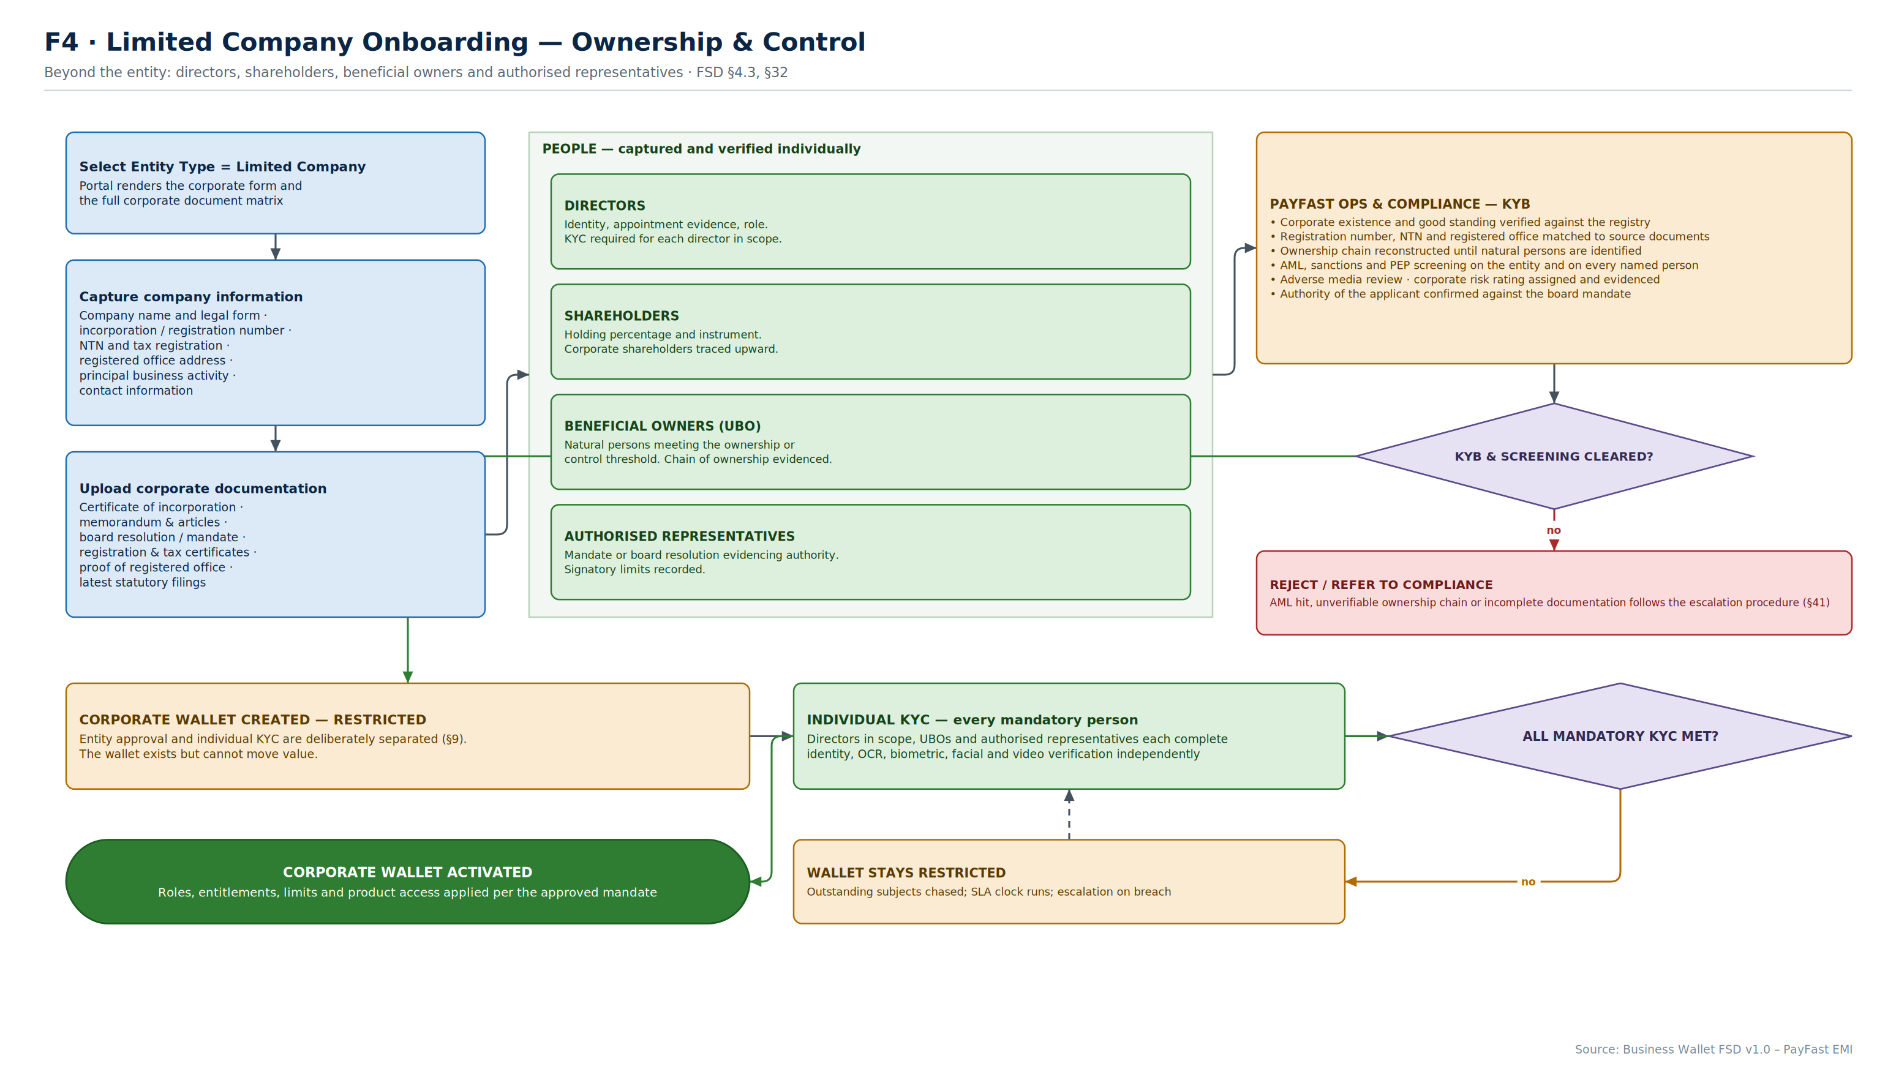
F4
Limited Company Onboarding
The entity, plus directors, shareholders, beneficial owners and authorised representatives — each verified individually.
Business Wallet · Solution Architecture & Flows
F4
Notes:
Purpose: the highest-effort path, and the one with the most regulatory exposure.
Key points:
• The people panel is where the work is. Ownership chains must be traced until natural persons are identified, and corporate shareholders traced upward.
• The applicant's own authority must be verified against a board resolution or mandate. An application submitted by someone without authority is a control failure regardless of how good the rest of the KYB is.
• Signatory limits are captured at onboarding because they feed the approval hierarchy in T2.
• The same two-stage model applies — entity approval, then individual KYC, then activation.
Confirm: the UBO threshold to apply, and whether directors who are not signatories require full KYC.

Slide 20
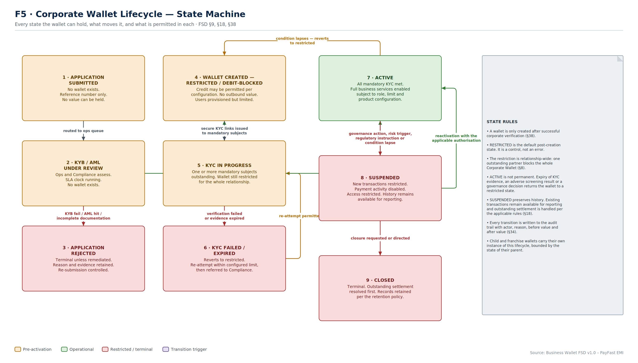
F5
Wallet Lifecycle State Machine
Nine states, eleven transitions — and ACTIVE is not permanent.
Business Wallet · Solution Architecture & Flows
F5
Notes:
Purpose: define exactly what the wallet can be, so status handling is consistent across every service and every screen.
Key points:
• RESTRICTED is a control state, not an error state. The UI must present it as 'verification in progress', not as a failure.
• The transition back from ACTIVE to RESTRICTED is the one usually missing. Expired KYC evidence, an adverse screening result or a governance decision must be able to pull an active wallet back. If the state machine cannot do that, compliance ends up suspending accounts instead, which is a heavier action with worse customer impact.
• SUSPENDED preserves history and outstanding settlement. It is not a soft delete.
• Every transition writes actor, reason, before value and after value to the audit trail.
• Child and franchise wallets carry their own instance of this lifecycle, bounded by the parent's state.
Confirm: whether a suspended master automatically suspends its children, or whether that is an explicit action.

Slide 21
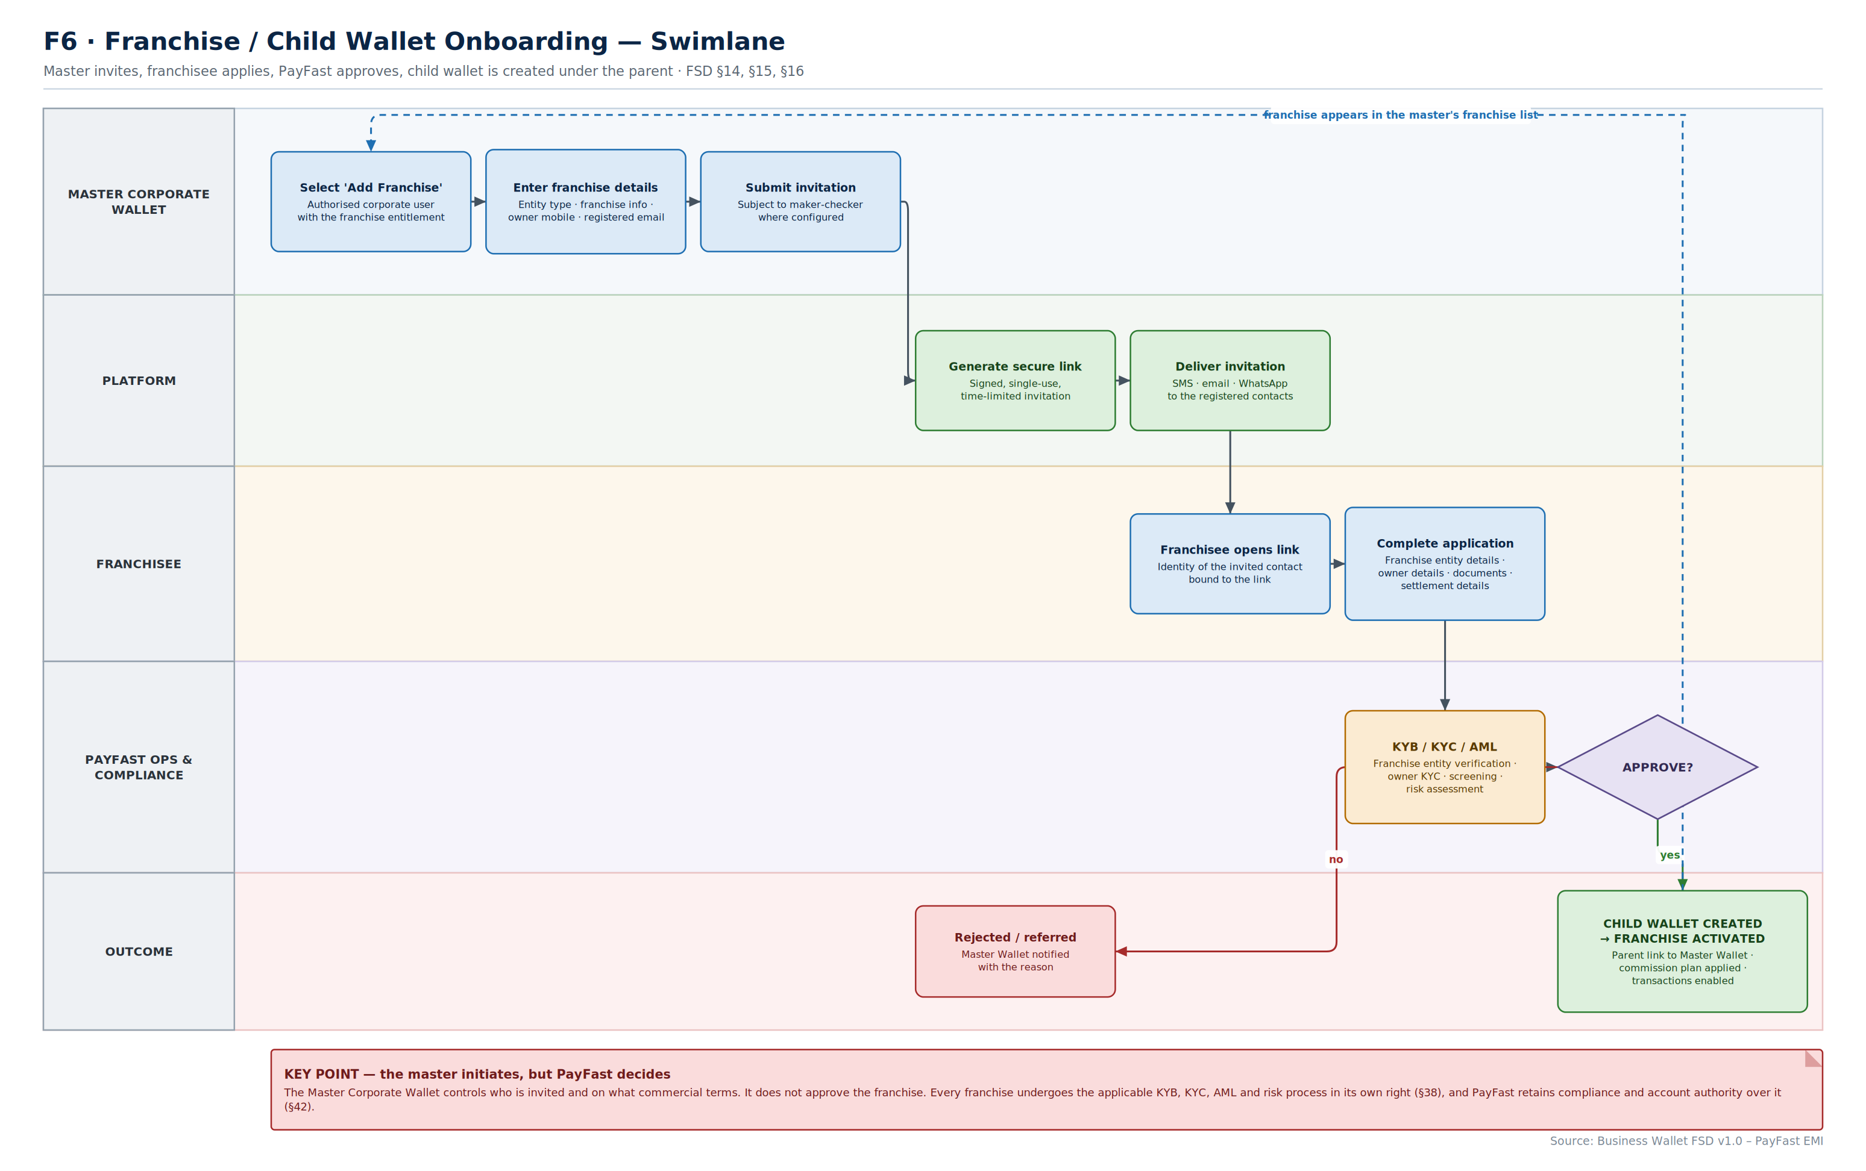
F6
Franchise Onboarding
The master invites and sets the commercial terms; PayFast still runs the full KYB, KYC and AML process.
Business Wallet · Solution Architecture & Flows
F6
Notes:
Purpose: FSD §15 and §16, with the governance boundary made explicit.
Key points:
• The red note at the bottom is the point of the page. The master initiates; PayFast decides. Compliance status is never inherited from the parent.
• The secure invitation link is signed, single-use and time-limited, and the identity of the invited contact is bound to it. This is the primary attack surface of the whole franchise model.
• The franchise invitation itself is subject to maker-checker where the corporate has configured it — inviting a franchise creates a commercial obligation.
• On approval the child wallet is created with its parent link and its commission plan already applied, so it can transact immediately.
Confirm: whether franchise commission plans are set at invitation, at approval, or separately — and who can change them afterwards.

Slide 22
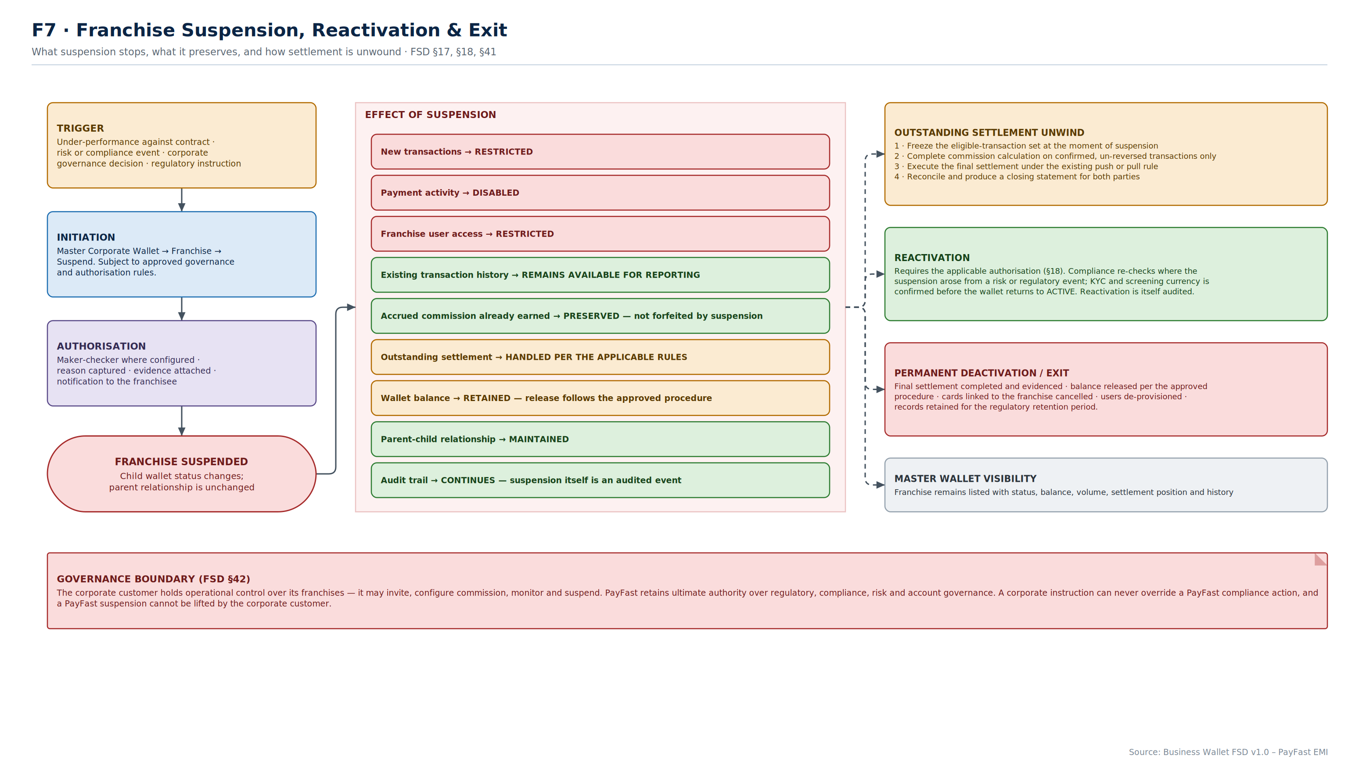
F7
Franchise Suspension & Exit
Suspension stops new value but preserves history, accrued commission and the parent relationship.
Business Wallet · Solution Architecture & Flows
F7
Notes:
Purpose: FSD §17 and §18. Suspension is easy to specify and hard to build correctly.
Key points:
• The centre column is a precise statement of what suspension does and does not do. Everything red stops; everything green continues. The amber items — outstanding settlement and wallet balance — are the ones that need explicit rules, because they involve someone else's money.
• The settlement unwind sequence matters: freeze the eligible set at the moment of suspension, calculate on confirmed transactions only, settle under the existing rule, then produce a closing statement for both parties. Suspending first and working out settlement later is how disputes start.
• Reactivation requires the applicable authorisation and, where the suspension arose from a risk event, a compliance re-check.
• The bottom banner restates the governance boundary: a PayFast suspension cannot be lifted by the corporate customer.
Confirm: the rule for releasing a suspended franchise's remaining wallet balance.

Slide 23
Onboarding — decisions to confirm
Seven points where the FSD leaves a choice open and the build cannot start without an answer.
COMPLIANCE
COMPLIANCE
OPERATIONS
PRODUCT
Which partners are mandatory KYC subjects?
What UBO threshold applies?
SLA for Ops and Compliance review?
KYC re-attempt limit before referral?
All declared partners, or only those above an ownership or control threshold? This determines how long a partnership takes to activate, and it is the single biggest driver of onboarding drop-off.
For limited companies, the ownership or control percentage at which a natural person becomes a beneficial owner requiring KYC — and how far up a corporate shareholding chain the trace must go.
The clock starts at submission. Without a target the queue has no service level, the applicant has no expectation, and escalation has no trigger.
How many failed biometric or document attempts before the case is referred to Compliance rather than retried. Too high is a fraud risk; too low is a support burden.
PRODUCT
GOVERNANCE
COMMERCIAL
OPERATIONS
Can low-risk cases be auto-approved?
Does suspending a master suspend its children?
When is a franchise commission plan set?
How is a suspended franchise's balance released?
A sole proprietor with clean screening and verified documents could activate without manual review. This is a significant cost and speed decision, and a compliance one.
Automatic cascade is safer but blunt — it stops franchises that did nothing wrong. Explicit action is more precise but relies on an operator remembering. F5 and F7 depend on this answer.
At invitation, at approval, or separately afterwards — and who may change it once the franchise is transacting. Rate changes must never affect historic commission (T7).
Suspension preserves the balance. The procedure for releasing it — who authorises, to which account, after what settlement — needs to exist before the first suspension, not after.

Slide 24
SECTION T
Transaction Flows
Money movement, commission, settlement and the exception paths that decide whether the numbers reconcile.
T1 Maker-checker payment
T2 Approval hierarchy
T3 Transfers & rails
T4 Bulk payment
T5 Bill, telco & QR
T6 Corporate cards
T7 Commission
T8 Push settlement
T9 Pull settlement
T10 Push vs pull
T11 Reconciliation
T12 End-to-end journey

Slide 25
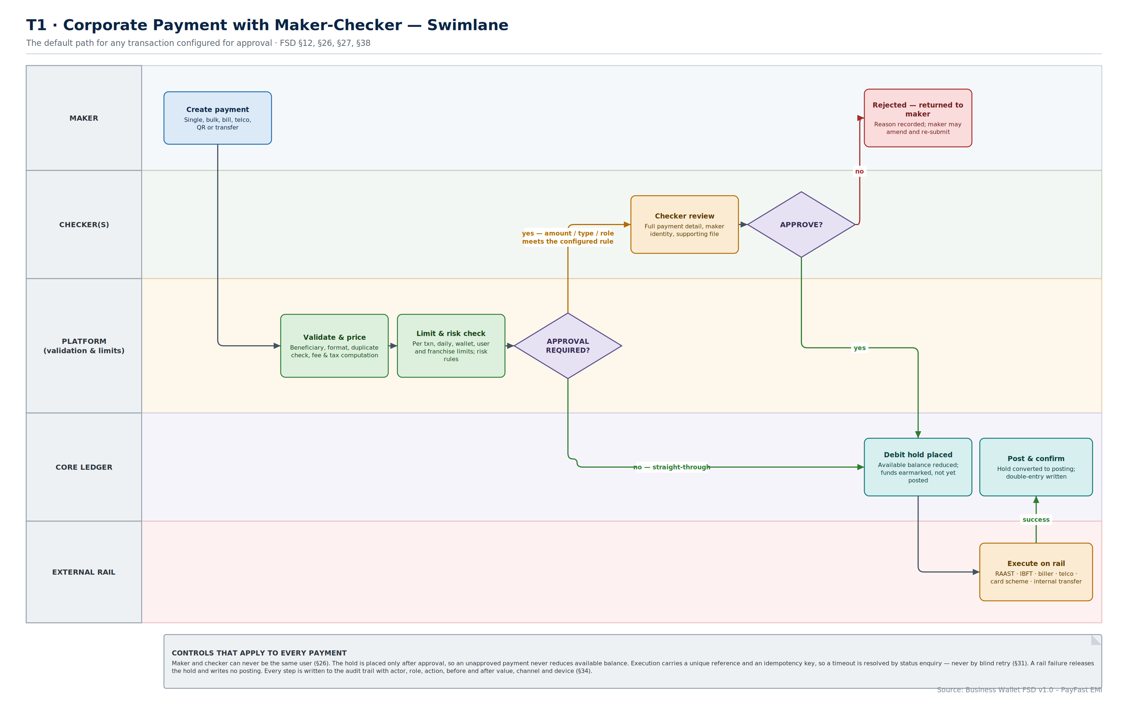
T1
Payment with Maker-Checker
Validate, price, limit-check, route for approval, hold, execute, post — with the hold placed only after approval.
Business Wallet · Solution Architecture & Flows
T1
Notes:
Purpose: the default transaction path. Every payment type in FSD §12 runs through this shape.
Key points:
• Order matters. Validation and limit checks happen before approval routing, so a checker never wastes time on a payment that would fail anyway.
• The debit hold is placed after approval, not before. An unapproved payment must never reduce available balance — otherwise a pending approval queue silently freezes the corporate's working capital.
• Straight-through processing is a first-class path, not an exception. Most corporate payments will be below the approval threshold.
• A rail failure releases the hold and writes no posting. A timeout triggers status enquiry, never a blind retry.
Confirm: the default straight-through threshold, and whether it is set per corporate or per product.

Slide 26
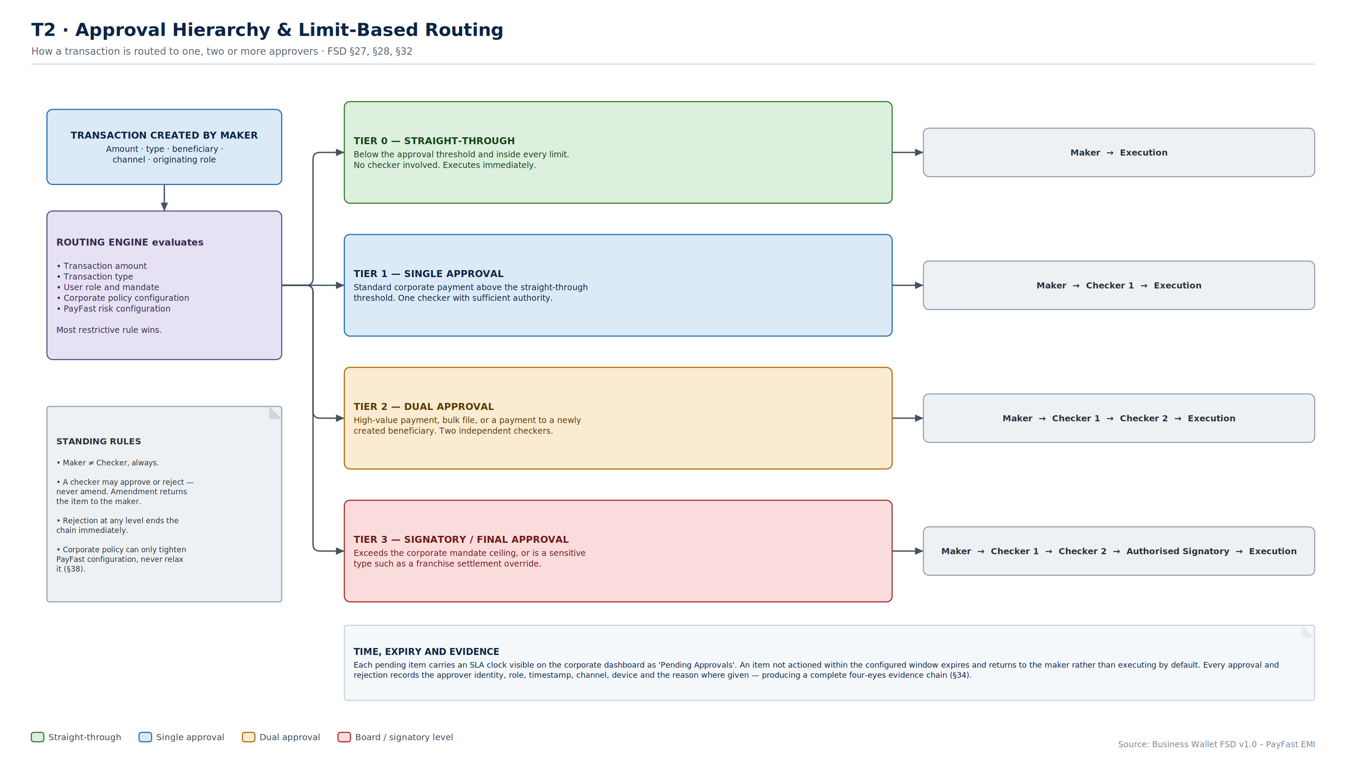
T2
Approval Hierarchy
Four routing tiers driven by amount, type, role, corporate policy and PayFast risk configuration — most restrictive wins.
Business Wallet · Solution Architecture & Flows
T2
Notes:
Purpose: FSD §27 and §28, made concrete. The FSD says approval levels are configurable; this says what the configuration actually looks like.
Key points:
• Four tiers is a starting proposal, not a constraint. The mechanism supports N levels; four covers the realistic corporate cases.
• 'Most restrictive rule wins' is the resolution rule when corporate policy and PayFast risk configuration disagree. Corporate policy can tighten, never relax.
• A checker approves or rejects but never amends. Amendment returns the item to the maker and restarts the chain. This preserves the integrity of what was approved.
• Expiry returns an item to the maker rather than executing by default. Silent execution on timeout would be a control failure.
Confirm: default thresholds per tier, and whether Tier 3 signatory approval is required for any specific transaction types regardless of amount.

Slide 27
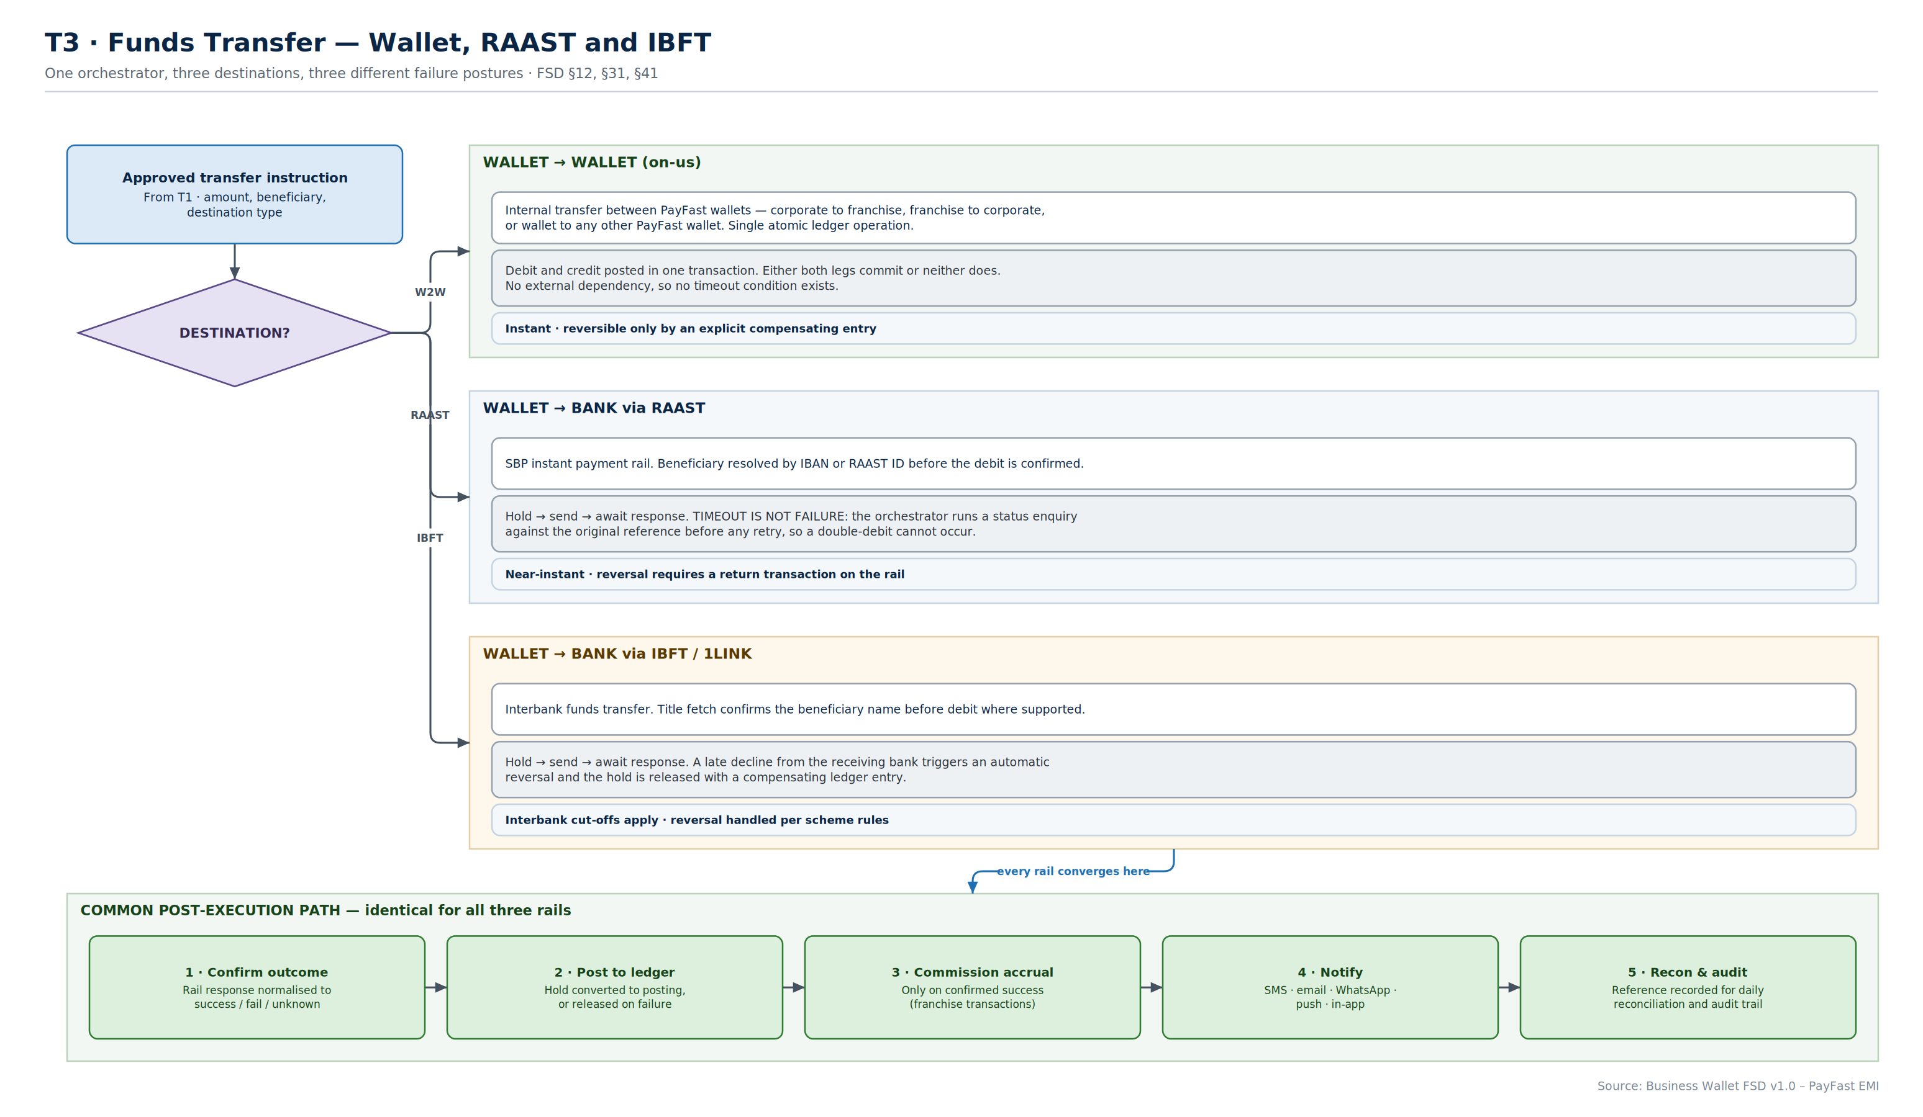
T3
Funds Transfer
One orchestrator, three destinations — and three genuinely different failure postures.
Business Wallet · Solution Architecture & Flows
T3
Notes:
Purpose: on-us, RAAST and IBFT look the same to the customer and behave very differently underneath.
Key points:
• On-us wallet-to-wallet is a single atomic ledger operation with no external dependency and therefore no timeout condition. It is the simple case and should not be over-engineered.
• RAAST and IBFT both need the hold-send-await pattern, but their failure handling differs: RAAST needs status enquiry on timeout; IBFT needs automatic reversal on a late decline from the receiving bank.
• The common post-execution path is identical for all three — confirm, post, accrue commission, notify, reconcile. Commission accrues only on confirmed success.
• Beneficiary resolution (IBAN or RAAST ID, title fetch on IBFT) happens before the debit is confirmed, so the customer sees who they are paying.
Confirm: whether title fetch is available on all IBFT destinations, and the agreed timeout values per rail.

Slide 28
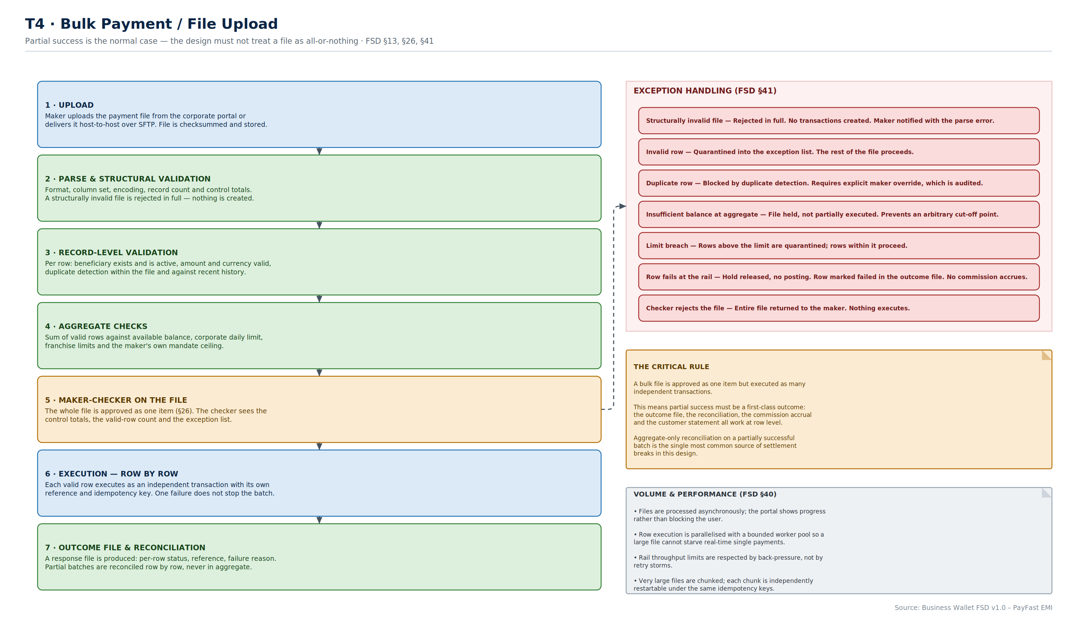
T4
Bulk Payment
Approved as one item, executed as many independent transactions — so partial success must be a first-class outcome.
Business Wallet · Solution Architecture & Flows
T4
Notes:
Purpose: bulk payments are where corporate platforms most often produce unreconcilable positions.
Key points:
• The critical rule, stated on the right: the file is approved once but executes row by row. That means the outcome file, reconciliation, commission accrual and the customer statement all have to work at row level. Aggregate-only reconciliation on a partially successful batch is the most common source of settlement breaks.
• Structural failure rejects the whole file; row failure quarantines one row. These are different behaviours and both are needed.
• Aggregate balance failure holds the file rather than executing part of it, because an arbitrary cut-off point is impossible to explain to a customer.
• Files process asynchronously with a bounded worker pool, so a large file cannot starve real-time payments.
Confirm: maximum file size and row count, and the agreed file format and outcome-file specification for host-to-host customers.

Slide 29
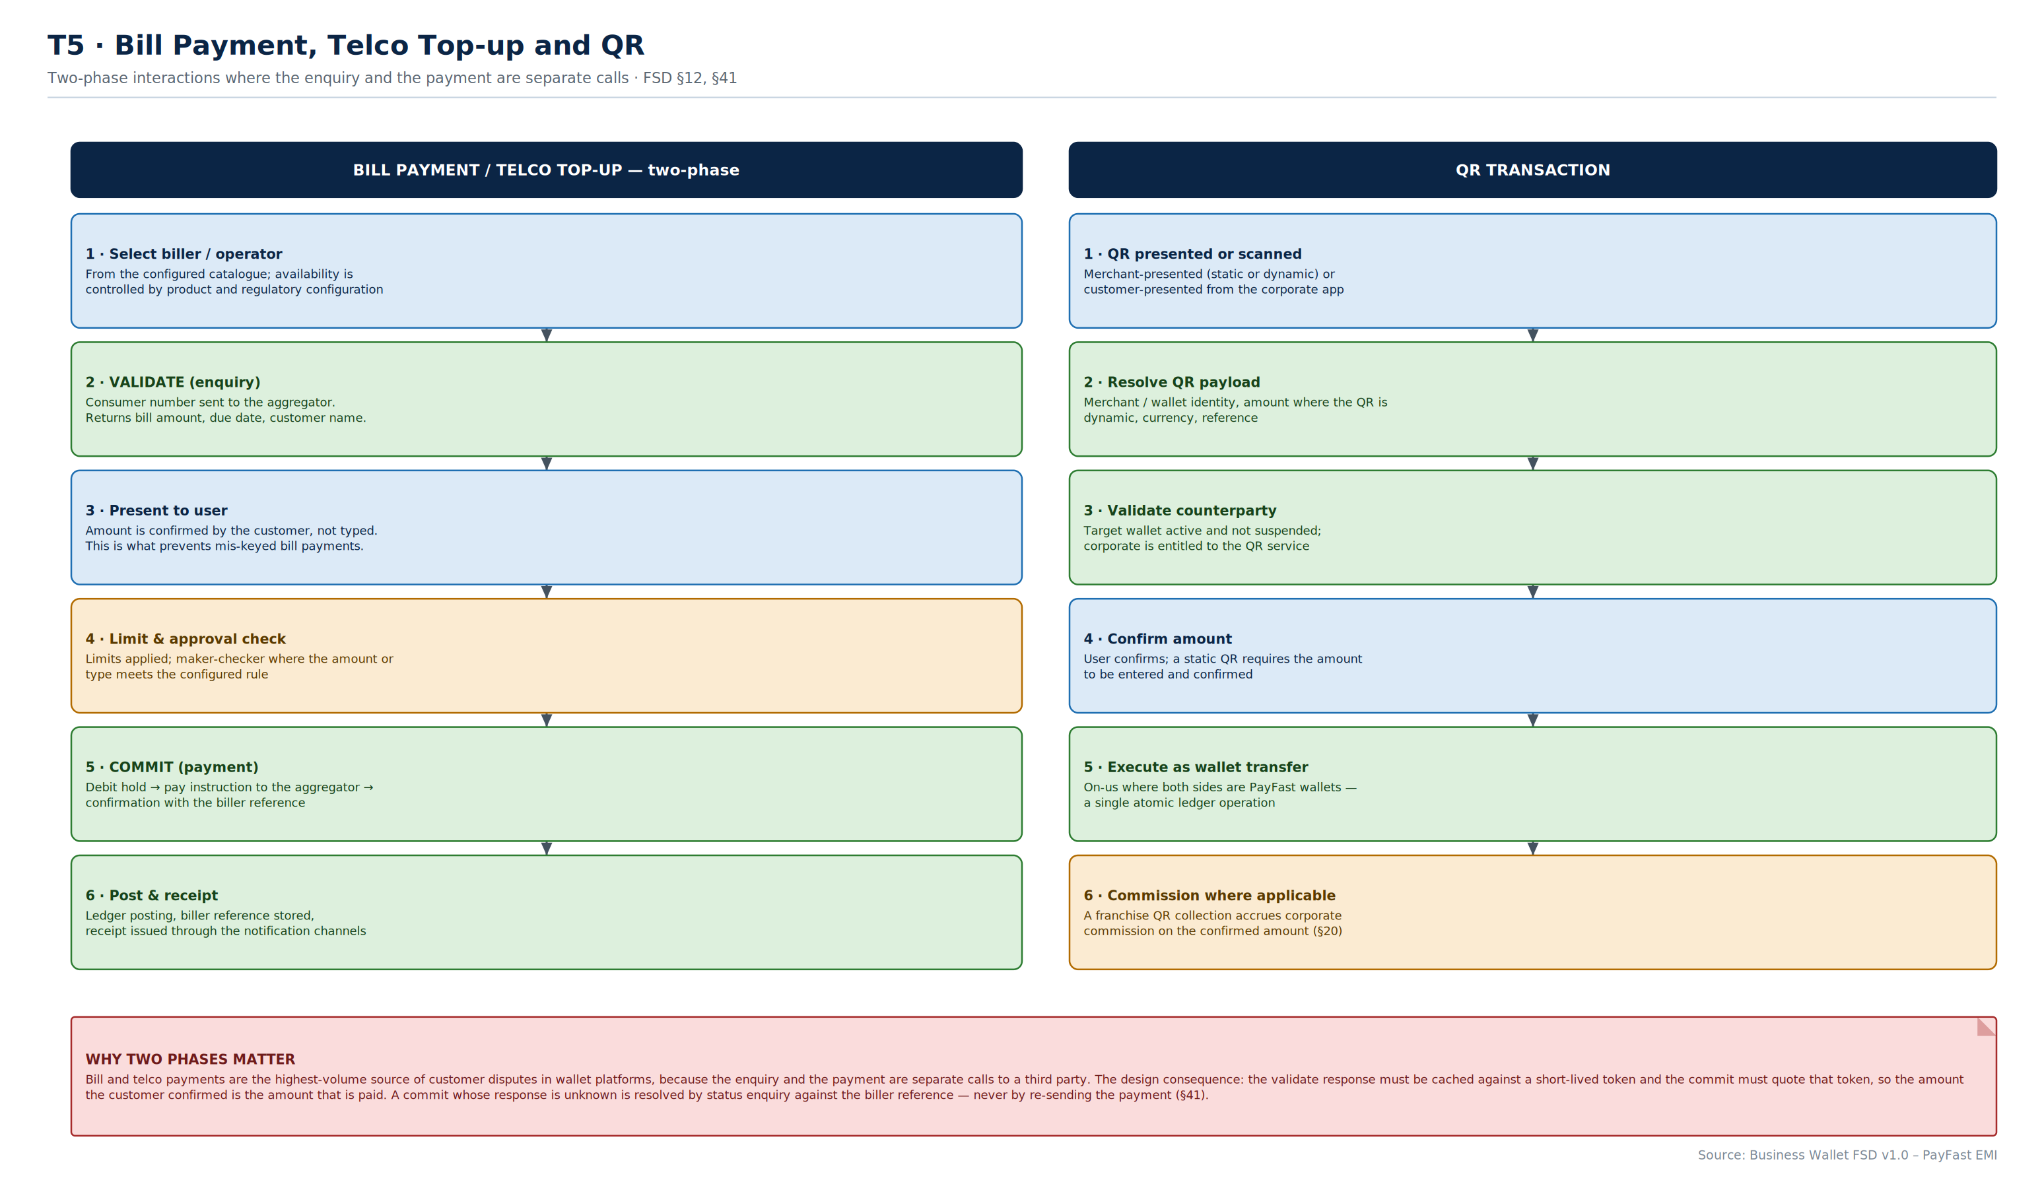
T5
Bill, Telco and QR
Two-phase interactions — validate then commit — where the customer confirms an amount rather than typing one.
Business Wallet · Solution Architecture & Flows
T5
Notes:
Purpose: bill and telco payments generate the highest dispute volume in wallet platforms, and the reason is architectural.
Key points:
• The enquiry and the payment are separate calls to a third party. The design consequence, in the red note: cache the validate response against a short-lived token, and have the commit quote that token. The amount the customer confirmed is then the amount that is paid.
• The customer confirms an amount returned by the biller rather than keying one. This single decision removes most mis-keyed bill payment disputes.
• An unknown commit response is resolved by status enquiry against the biller reference — never by re-sending the payment.
• On the QR side, a franchise QR collection accrues corporate commission on the confirmed amount, which links this page to T7.
Confirm: which aggregators support two-phase validate/commit, and the behaviour for those that do not.

Slide 30
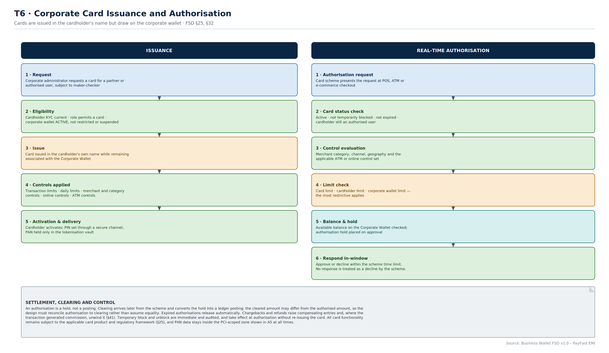
T6
Corporate Cards
Issued in the cardholder's name, drawing on the corporate wallet, with the most restrictive limit applying.
Business Wallet · Solution Architecture & Flows
T6
Notes:
Purpose: FSD §25, plus the settlement mechanics the FSD leaves open.
Key points:
• Cards are issued in the cardholder's own name while remaining associated with the Corporate Wallet. This matters for liability and for the cardholder's own KYC obligations.
• Three limit sets apply — card, cardholder and corporate wallet — and the most restrictive wins. Getting this precedence wrong is a common defect.
• The authorisation is a hold, not a posting. Clearing arrives later and may differ from the authorised amount, so the design must reconcile authorisation to clearing rather than assume equality.
• Chargebacks and refunds raise compensating entries and, where the transaction generated commission, unwind it.
• PAN data never leaves the PCI-scoped zone shown in A5.
Confirm: the card product and processor, and whether stand-in authorisation is permitted when the link to the platform is down.

Slide 31
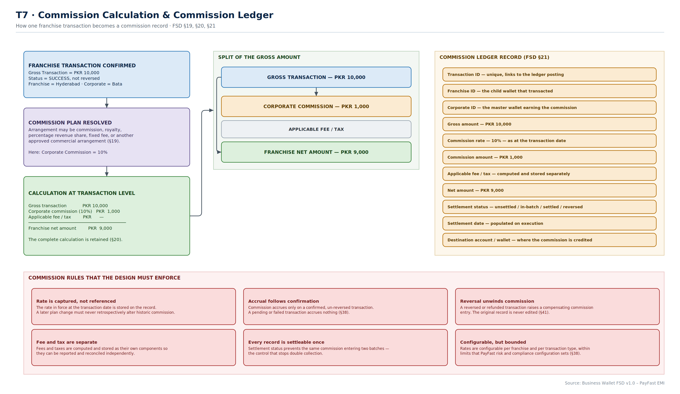
T7
Commission Calculation
PKR 10,000 gross, 10% corporate commission, PKR 9,000 franchise net — and eleven fields retained per transaction.
Business Wallet · Solution Architecture & Flows
T7
Notes:
Purpose: FSD §19–§21 worked through end to end using the FSD's own example.
Key points:
• Commission is calculated and recorded at transaction level, not at period level. This is what makes reversal, dispute and partial settlement tractable.
• The rate is captured on the record, not referenced from the plan. A plan change must never retrospectively alter historic commission — the single most important rule on this page.
• Accrual follows confirmation. A pending or failed transaction accrues nothing.
• Settlement status on each record is what prevents the same commission entering two batches. It is the control that stops double collection.
• Fee and tax are stored as separate components so they can be reported and reconciled independently.
Confirm: the tax treatment of commission, and whether withholding applies at settlement.

Slide 32
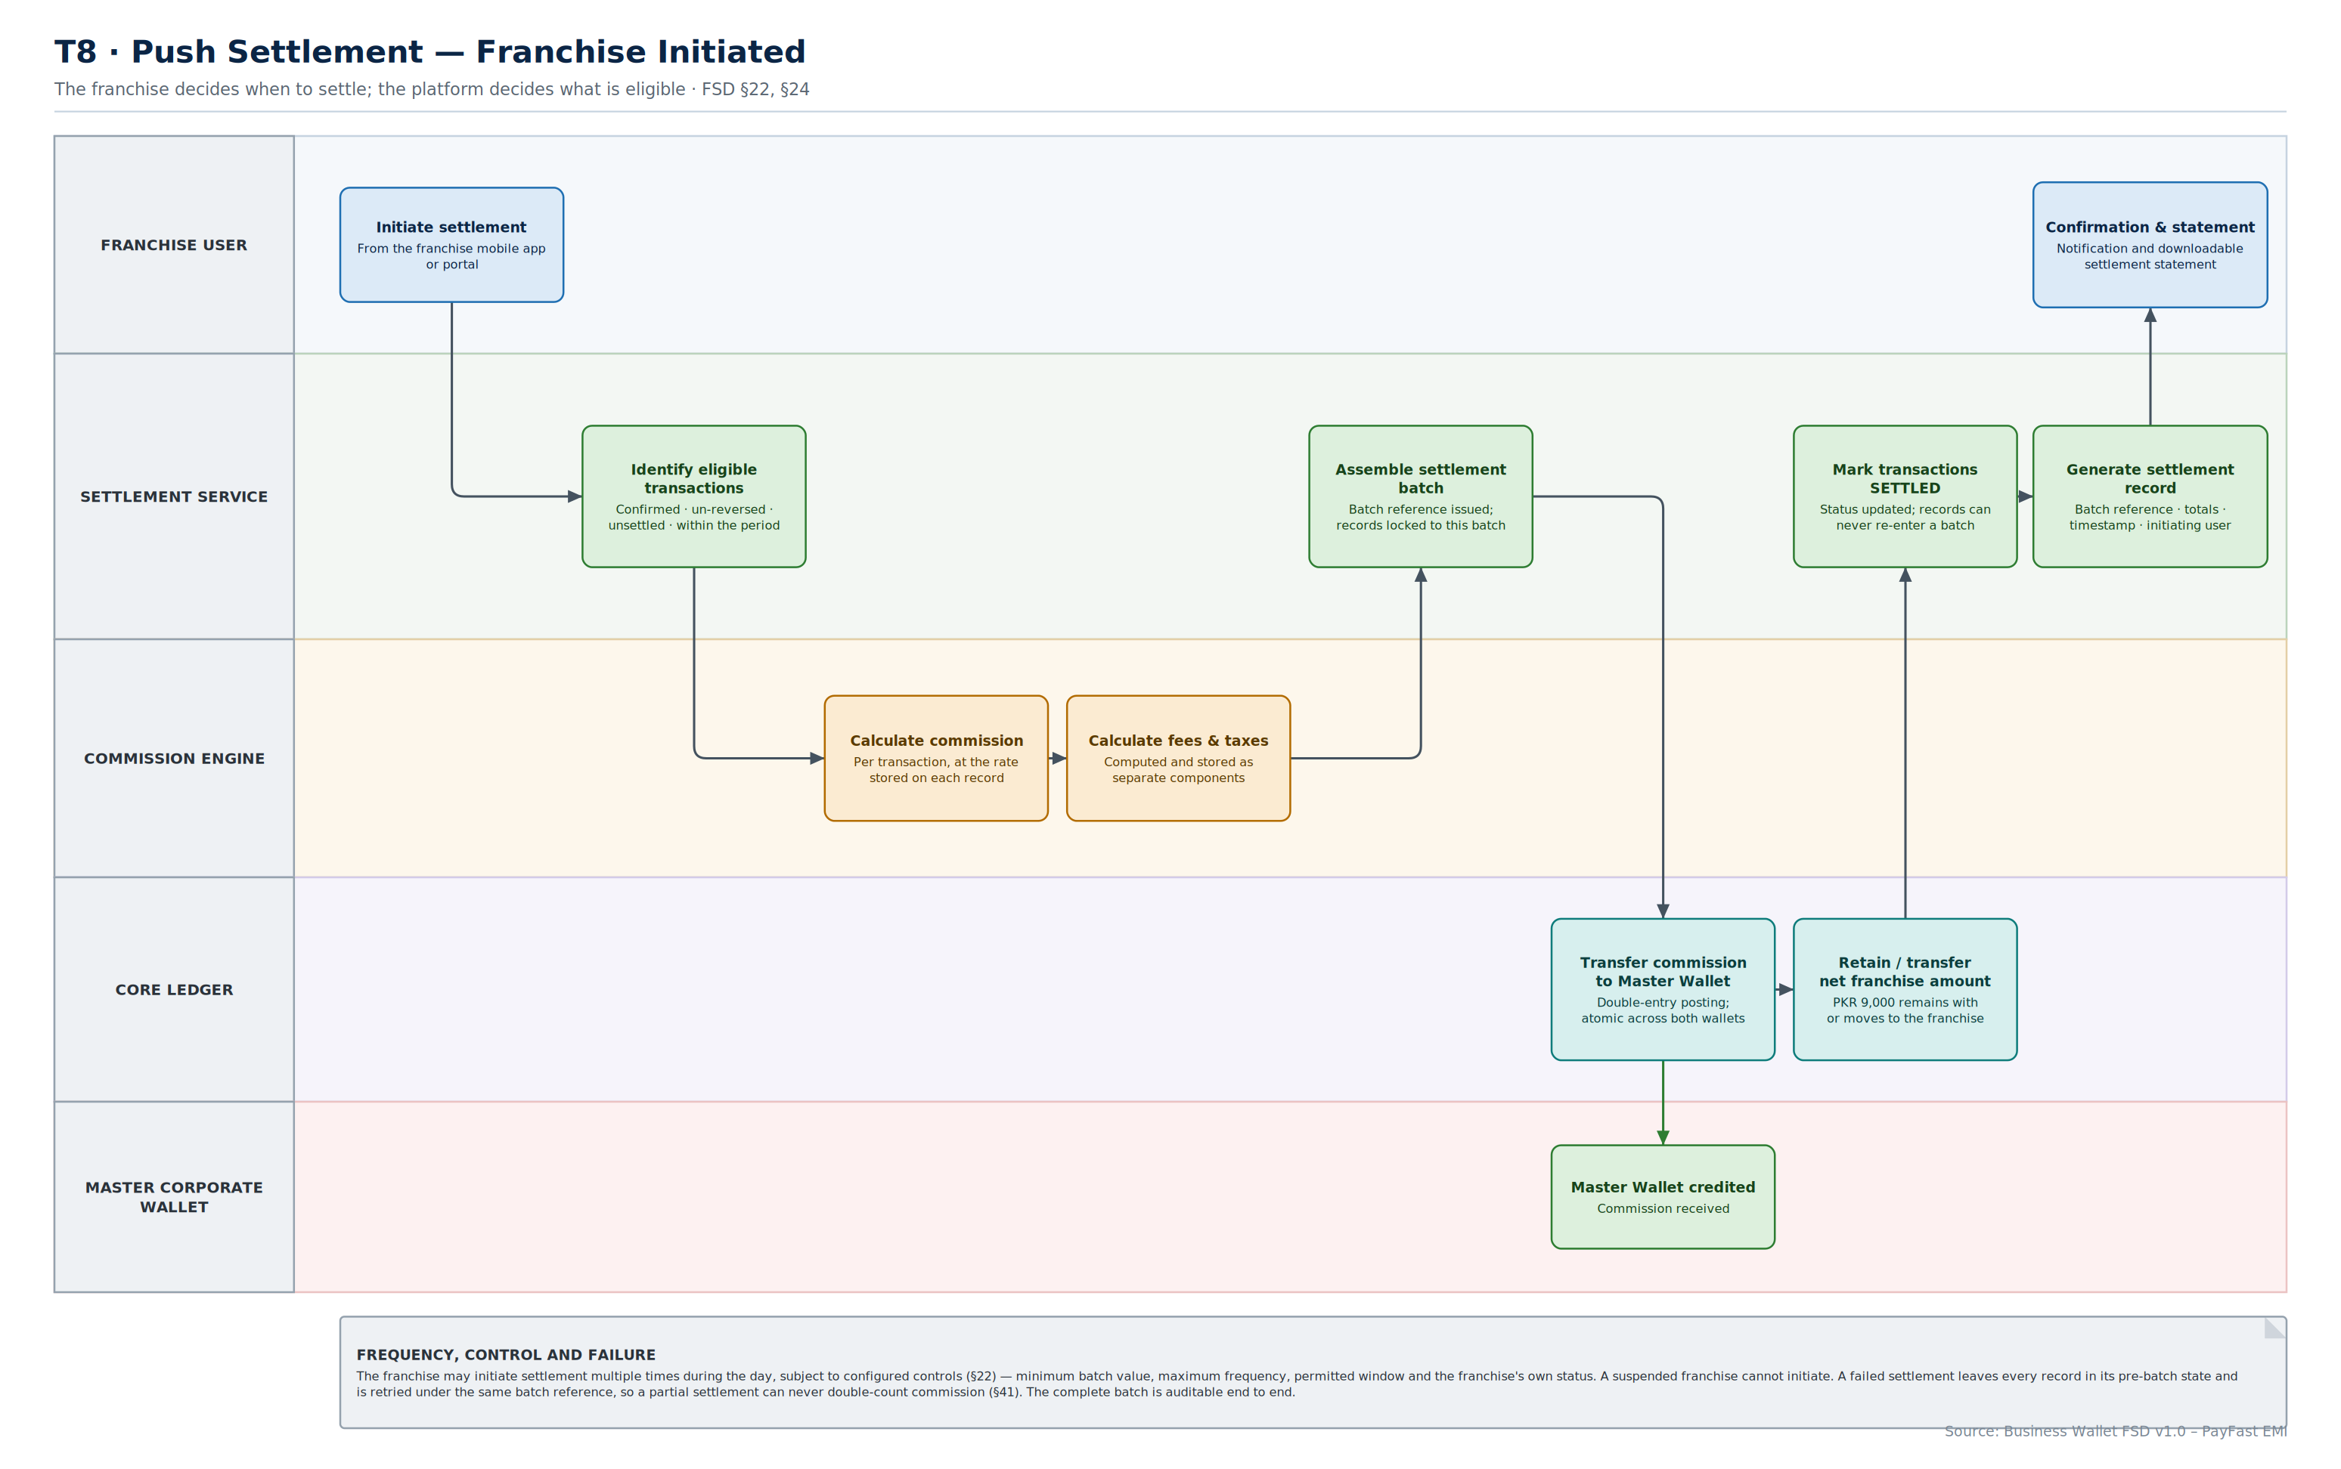
T8
Push Settlement
The franchise decides when to settle; the platform decides what is eligible.
Business Wallet · Solution Architecture & Flows
T8
Notes:
Purpose: FSD §22. The franchise-initiated model.
Key points:
• Eligibility is computed by the platform, not chosen by the franchise: confirmed, un-reversed, unsettled, within the period. The franchise controls timing only.
• Records are locked to a batch reference at assembly. This is what makes a failed settlement safe to retry — every record stays in its pre-batch state and the retry uses the same reference, so commission can never be double-counted.
• The franchise may settle multiple times a day, subject to configured controls — minimum batch value, maximum frequency, permitted window, and the franchise's own status. A suspended franchise cannot initiate.
• The commission transfer and the net retention are one atomic ledger operation across both wallets.
Confirm: the default control set — minimum batch value, maximum daily frequency, permitted settlement window.

Slide 33
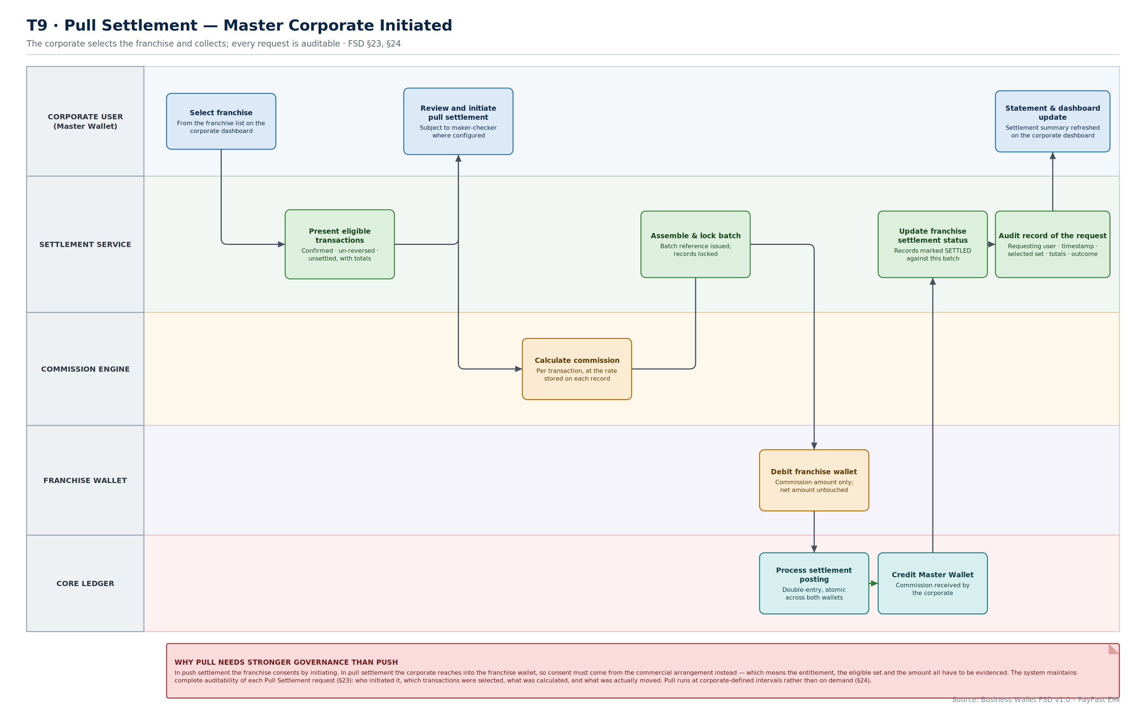
T9
Pull Settlement
The master selects the franchise and collects; every request is fully auditable.
Business Wallet · Solution Architecture & Flows
T9
Notes:
Purpose: FSD §23. The master-initiated model, and the one needing stronger governance.
Key points:
• In push settlement the franchise consents by initiating. In pull settlement the corporate reaches into the franchise wallet, so consent comes from the commercial arrangement instead — which means the entitlement, the eligible set and the amount all have to be evidenced.
• The audit record of the request is a deliberate step in the flow, not a side effect: who initiated, which transactions were selected, what was calculated, what moved.
• Only the commission amount is debited. The franchise net amount is never touched.
• Pull runs at corporate-defined intervals rather than on demand.
• Maker-checker applies to the pull request where the corporate has configured it.
Confirm: whether the franchise is notified before or after a pull settlement executes, and whether a franchise can dispute one.

Slide 34
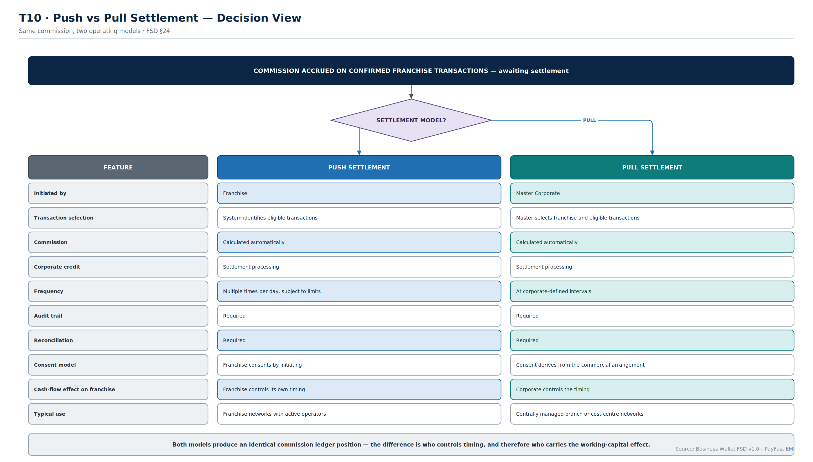
T10
Push vs Pull
Identical commission ledger position — the difference is who controls timing, and therefore who carries the working capital.
Business Wallet · Solution Architecture & Flows
T10
Notes:
Purpose: FSD §24, extended past the FSD table with the three rows that actually drive the commercial choice.
Key points:
• The first seven rows are the FSD's own comparison. The last three — consent model, cash-flow effect and typical use — are the ones the business needs in order to choose.
• Both models produce the same commission ledger position. Nothing about the accounting differs; only the timing and the initiating party.
• Push suits franchise networks with active independent operators. Pull suits centrally managed branch or cost-centre networks.
• A single corporate can use both across different franchises. The model is a per-franchise configuration, not a platform-wide setting.
Confirm: whether both models are in scope for launch, or whether one is phase two.

Slide 35
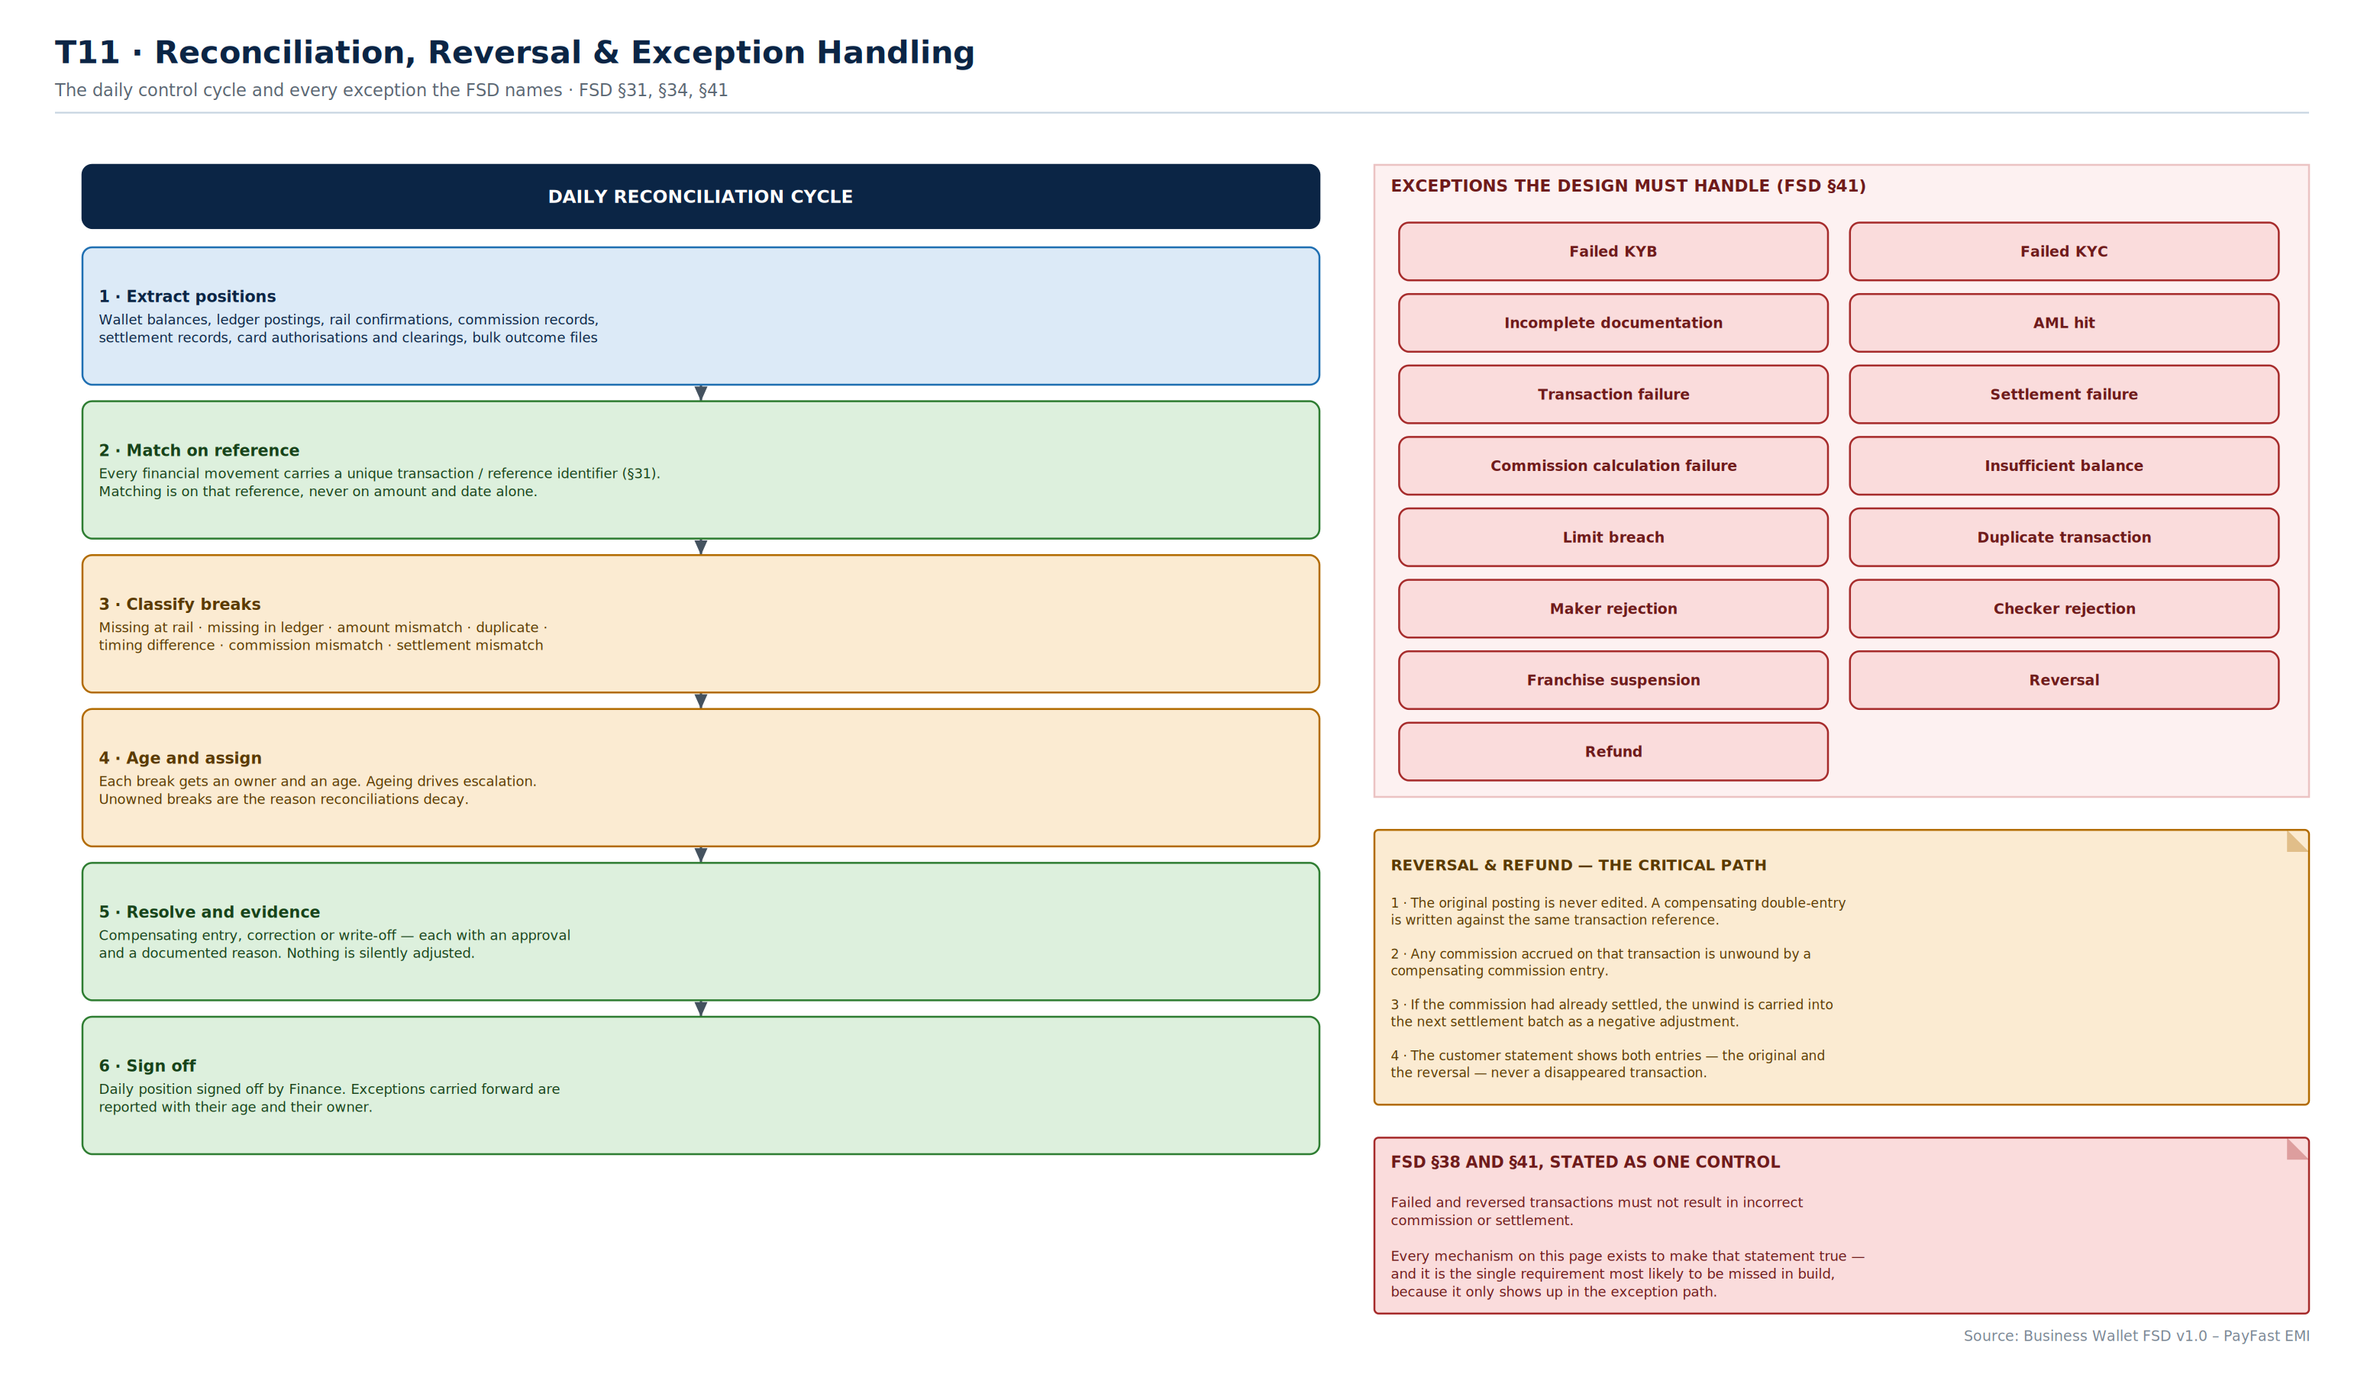
T11
Reconciliation & Exceptions
A six-step daily cycle, the fifteen exceptions FSD §41 names, and the reversal path that unwinds commission.
Business Wallet · Solution Architecture & Flows
T11
Notes:
Purpose: FSD §31, §34 and §41 in one operating picture.
Key points:
• Matching is on the unique transaction reference, never on amount and date. Heuristic matching produces false matches, which are worse than breaks.
• Ageing and ownership are what keep a reconciliation alive. Unowned breaks are why reconciliations decay into a permanently carried balance nobody can explain.
• The reversal path is the critical one: the original posting is never edited, a compensating entry is written, accrued commission is unwound, and if the commission had already settled the unwind carries into the next batch as a negative adjustment.
• The customer statement shows both entries — original and reversal — never a disappeared transaction.
• The bottom-right box restates FSD §38 as a single testable control, and it is the requirement most likely to be missed in build because it only appears in the exception path.
Confirm: daily reconciliation sign-off owner, and break ageing thresholds for escalation.

Slide 36
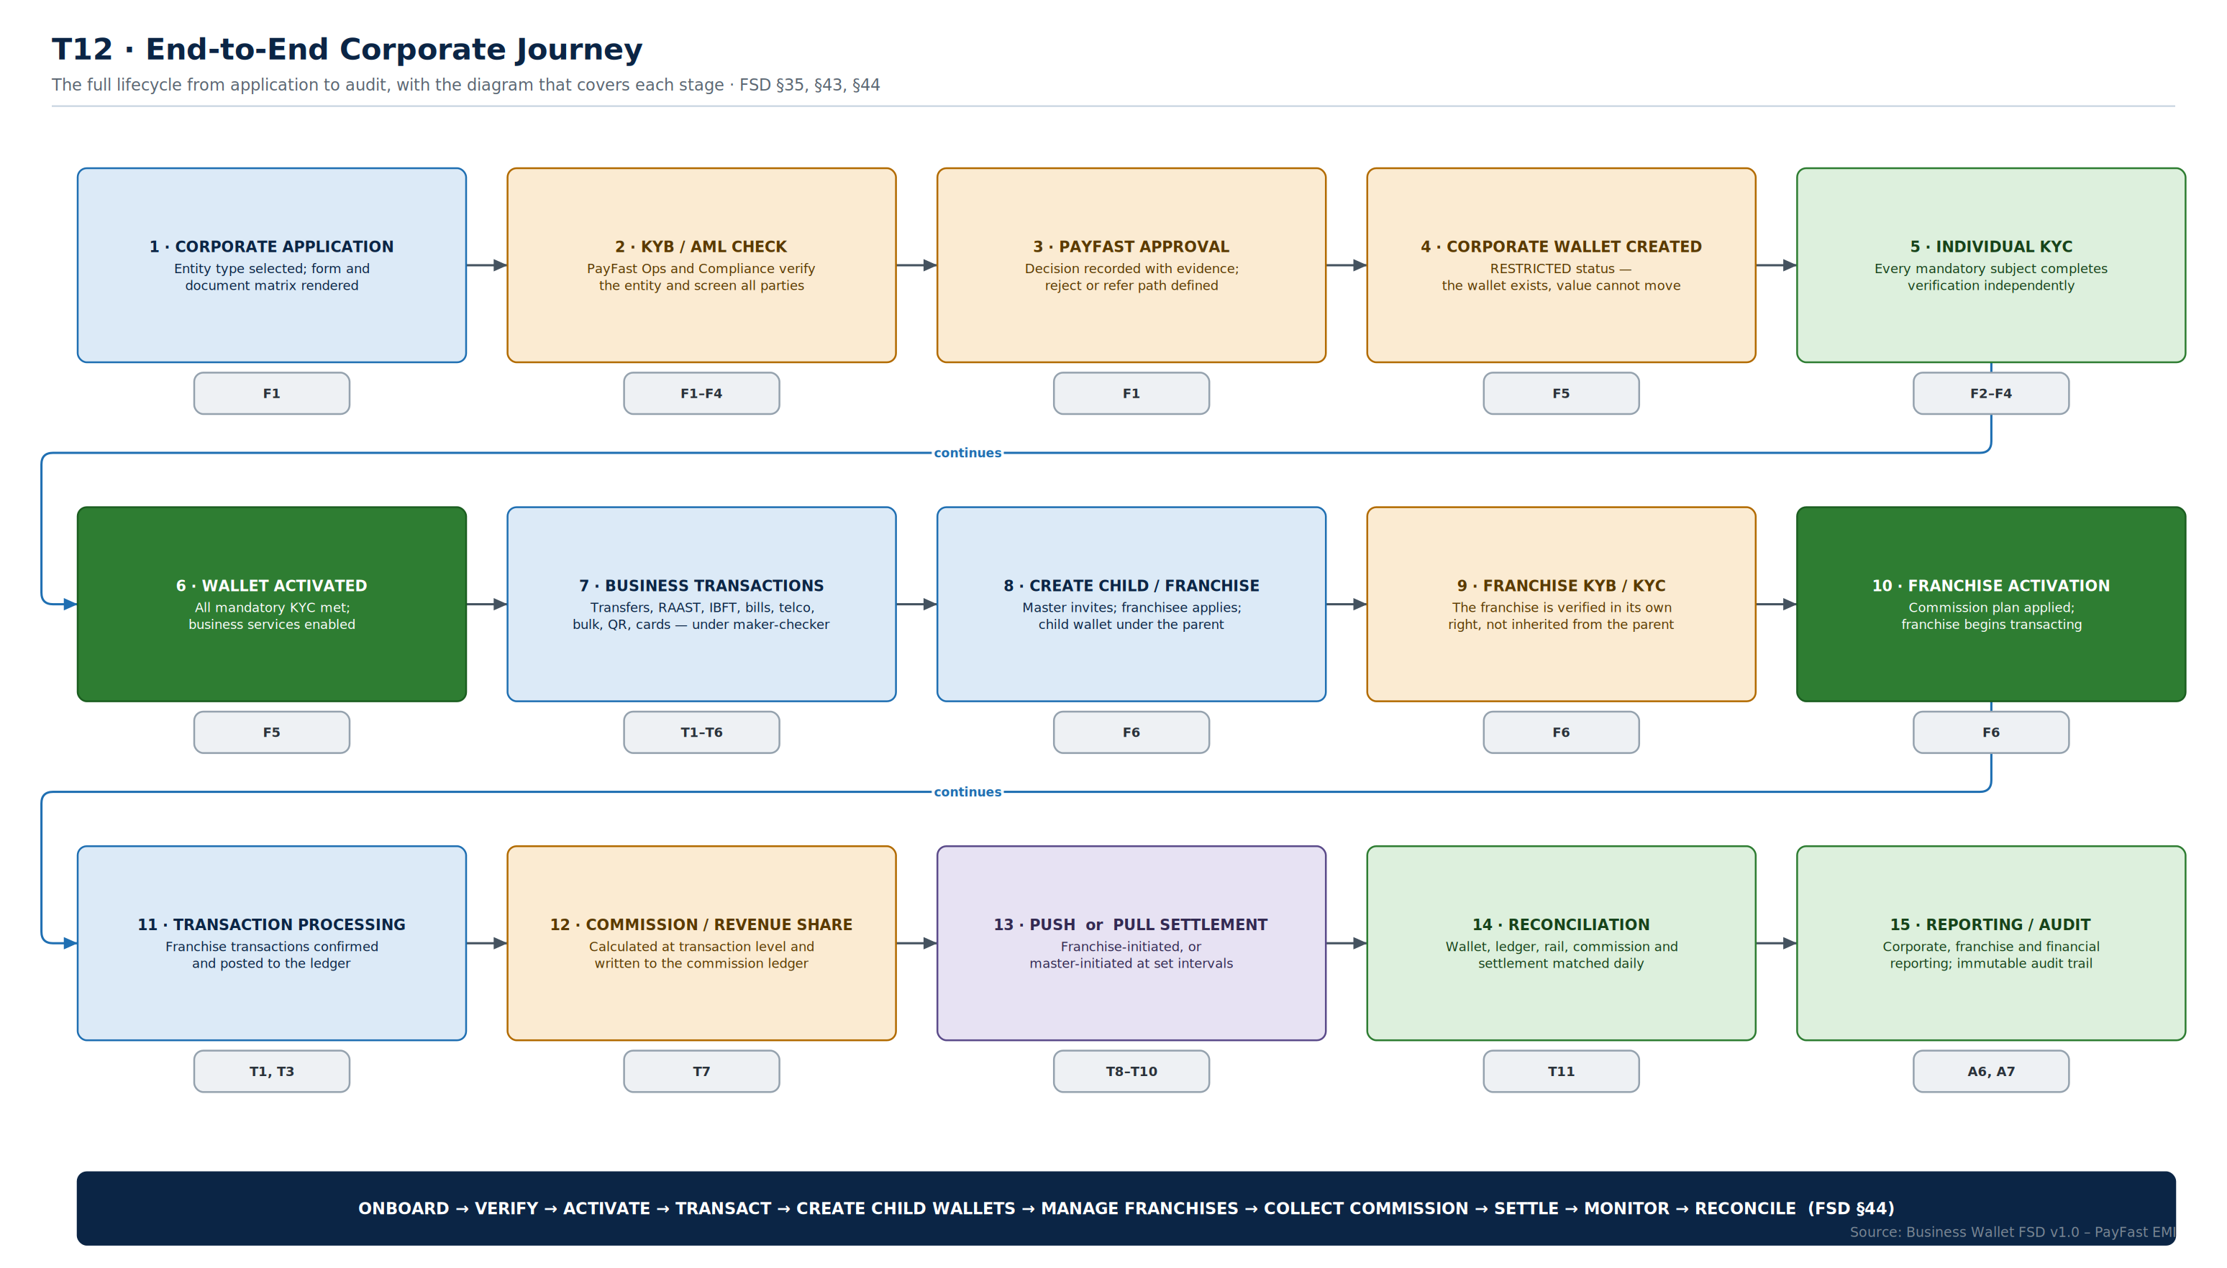
T12
End-to-End Journey
Fifteen stages from application to audit, each mapped to the diagram in this pack that details it.
Business Wallet · Solution Architecture & Flows
T12
Notes:
Purpose: FSD §35 and §44, used as the index for the whole pack.
Key points:
• The reference chip under each stage points to the detailed diagram. This is the page to return to when someone asks 'where does X happen'.
• The journey has two gates: wallet activation at stage 6, and franchise activation at stage 10. Nothing downstream of a gate is reachable until it is passed.
• Stages 11 to 15 are the recurring operating cycle. Stages 1 to 10 happen once per entity.
• The banner is the FSD's own value proposition sentence, which is a fair summary of what the platform does.
Use this slide to close the walkthrough and to frame the build sequencing discussion.

Slide 37
Transactions — decisions to confirm
Eight open points across payments, commission and settlement.
PRODUCT
PRODUCT
TECHNICAL
TECHNICAL
Straight-through threshold?
Default approval tier thresholds?
Timeout values per rail?
Bulk file format and limits?
The amount below which no checker is involved — set per corporate, or per product, or both. Sets the balance between control and usability for every corporate customer.
Where single approval becomes dual, and dual becomes signatory. Also whether any transaction type always requires signatory approval regardless of amount.
RAAST, IBFT and the card scheme each need an agreed timeout and an agreed status-enquiry interval. These come from the scheme rules, not from us.
Maximum file size and row count, the accepted format, and the outcome-file specification for host-to-host customers. Needed early — corporates build to it.
INTEGRATION
FINANCE
COMMERCIAL
OPERATIONS
Which aggregators support validate/commit?
Tax treatment of commission?
Push, pull, or both at launch?
Reconciliation sign-off and break ageing?
Two-phase bill payment depends on it. For aggregators that do not, the design needs a defined single-phase behaviour and a different dispute posture.
Whether withholding applies at settlement, and how fee and tax components are reported. T7 stores them separately precisely so this can be answered later — but not much later.
Both are specified. Delivering one at launch and one in phase two is a legitimate scope decision, and pull carries the heavier governance requirement.
Who signs off the daily position, and at what age a break escalates. Unowned breaks are why reconciliations decay into a permanently carried unexplained balance.

Slide 38
Requirement traceability — BW-001 to BW-018
Every numbered requirement in FSD §39, and the diagram in this pack that shows how it is delivered.
ID | REQUIREMENT | MODULE | COVERED BY
BW-001 | Corporate onboarding | M1 | F1, F2, F3, F4
BW-002 | Sole Proprietor onboarding | M1 | F1, F2
BW-003 | Partnership onboarding | M1 | F1, F3
BW-004 | Limited Company onboarding | M1 | F1, F4
BW-005 | KYB verification | M1 | F1–F4, A3
BW-006 | Individual KYC | M1 | F1–F4, A3
BW-007 | AML / sanctions screening | M1 | F1–F4, A4, A7
BW-008 | Corporate Wallet creation | M2 | F1, F5, A6
BW-009 | Restricted wallet status | M2 | F5, A7
BW-010 | Wallet activation | M2 | F1, F5
BW-011 | Child Wallet creation | M3 | F6, A8
BW-012 | Franchise onboarding | M3 | F6
BW-013 | Franchise KYB / KYC | M3 | F6, A7
BW-014 | Franchise activation | M3 | F6, F5
BW-015 | Franchise suspension | M3 | F7, F5
BW-016 | Wallet-to-wallet transfer | M4 | T1, T3
BW-017 | Bank transfer | M4 | T1, T3, A4
BW-018 | RAAST | M4 | T3, A4

Slide 39
Requirement traceability — BW-019 to BW-035
Continued. Every requirement maps to at least one diagram; none is left to implementation discretion.
ID | REQUIREMENT | MODULE | COVERED BY
BW-019 | IBFT | M4 | T3, A4
BW-020 | Bill payment | M4 | T5, A4
BW-021 | Telco payment | M4 | T5, A4
BW-022 | Bulk payment | M4 | T4
BW-023 | QR | M4 | T5
BW-024 | Commission calculation | M4 | T7, A6
BW-025 | Push settlement | M4 | T8, T10
BW-026 | Pull settlement | M4 | T9, T10
BW-027 | Corporate cards | M5 | T6, A8
BW-028 | Maker-Checker | M5 | T1, T2
BW-029 | Role-based access | M2 | A8, T2
BW-030 | Corporate reporting | M6 | A6, T11
BW-031 | Franchise reporting | M6 | A6, A8, T11
BW-032 | Reconciliation | M6 | T11, A6
BW-033 | Notifications | M6 | A2, A4
BW-034 | Audit trail | M6 | A6, A7, T11
BW-035 | Risk and transaction controls | M6 | A7, T1, T2

Slide 40
Design gaps identified in the FSD
Areas the FSD does not cover that this architecture has had to take a position on. Each is a risk if left unresolved.
GAP 1
GAP 2
GAP 3
Failure and idempotency semantics
Reversal effect on settled commission
Wallet state transitions after activation
The FSD lists exceptions (§41) but not the mechanics. This pack proposes idempotency keys, status enquiry before retry, and hold-release on rail failure. Without these, double debits are inevitable.
§38 says reversals must not produce incorrect commission, but not how. Proposed: compensating commission entry, carried into the next settlement batch as a negative adjustment (T11).
§9 defines the path to activation but not what happens after. F5 proposes reversion to restricted on KYC expiry or adverse screening, and a defined suspension and closure path.
GAP 4
GAP 5
GAP 6
Bulk partial-success handling
Card authorisation vs clearing
Non-functional targets are unquantified
§39 lists bulk payment as one requirement. T4 proposes row-level execution, quarantine, outcome files and row-level reconciliation. Aggregate-only handling would not survive first contact with production.
§25 covers issuance and controls but not settlement. T6 proposes authorisation as a hold, clearing as the posting, and explicit reconciliation between the two amounts.
§40 refers to 'approved' availability, DR and performance requirements without stating them. A5 assumes synchronous ledger replication; the actual RTO and RPO targets are still needed.

Slide 41
Recommended next steps
In sequence. Steps 1 and 2 unblock everything else.
1
Close the open decisions
2
Start the integration lead times
Fifteen points are flagged across the three 'decisions to confirm' slides. Most are product or compliance calls, not technical ones, and they gate the build backlog.
Fourteen external interfaces (A4). Sandbox access and test data for RAAST, IBFT, the card processor and the biller aggregator have the longest lead times on this programme.
3
Confirm the non-functional targets
4
Cut the backlog from A3
Availability, RTO, RPO and performance SLAs. A5 assumes synchronous ledger replication; that assumption needs to be either confirmed or costed differently.
The twenty-five components map to roughly five squads. Each card becomes an epic with an API contract and a test suite.
5
Build the exception paths first
6
Review the pack with Compliance and Risk
T11 is the requirement most likely to be missed, because it only appears when something fails. Building reversal, reconciliation and compensating entries early is far cheaper than retrofitting them.
A7 is written in their language deliberately. Getting control ownership agreed now avoids a redesign during regulatory review.
All 27 diagrams are supplied as an editable multi-page draw.io file for the build team to extend.
Notes:
Close on the sequencing point: the decisions and the integration lead times are the two things that cannot be parallelised away. Everything else on this list can run concurrently once those two are moving.

