Slide 1
AES (Advanced Encryption Standard)
INTRODUCTION:
The Advanced Encryption Standard (AES) is a symmetric-key block cipher published by the National Institute of Standards and Technology (NIST) in December 2001.
History:
It supersedes the Data Encryption Standard (DES), which was published in 1977. The algorithm described by AES is a symmetric-key algorithm, meaning the same key is used for both encrypting and decrypting the data. In the United States, AES was announced by the NIST as U.S. FIPS PUB 197 (FIPS 197) on November 26, 2001.

Slide 2
AES (Advanced Encryption Standard)
AES is a subset of the Rijndael block cipher developed by two Belgian cryptographers, Vincent Rijmen and Joan Daemen, who submitted a proposal to NIST during the AES selection process.
Rijndael is a family of ciphers with different key and block sizes.
For AES, NIST selected three members of the Rijndael family, each with a block size of 128 bits, but three different key lengths: 128, 192 and 256 bits.

Slide 3
AES (Advanced Encryption Standard)
Criteria:
The criteria defined by NIST for selecting AES fall into three areas:
1. Security -128 bit key
2. Cost computational efficiency , storage requirement
3.Implementation flexibility and simplicity (implementable on any platform)

Slide 4
AES (Advanced Encryption Standard)
AES has been adopted by the U.S. government and is now used worldwide.
The algorithm described by AES is a symmetric-key algorithm, meaning the same key is used for both encrypting and decrypting the data.

Slide 5
AES (Advanced Encryption Standard)
AES became effective as a federal government standard on May 26, 2002, after approval by the Secretary of Commerce.
AES is included in the ISO 18033-3 standard. AES is available in many different encryption packages, and is the first (and only) publicly accessible cipher approved by the National Security Agency NSA) for top secret information when used in an NSA approved cryptographic module.

Slide 6
AES (Advanced Encryption Standard)
AES is based on a design principle known as a substitution–permutation network, and is efficient in both software and hardware.
AES does not use a Feistel network. AES is a modified of Rijndael, with a fixed block size of 128 bits, and a key size of 128, 192, or 256 bits.

Slide 7
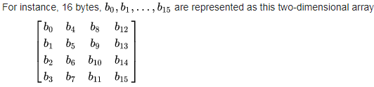
AES (Advanced Encryption Standard)
AES operates on a 4 × 4 column-major order array of bytes, termed the state. Most AES calculations are done in a particular finite field.

Slide 8
AES (Advanced Encryption Standard)
The key size used for an AES cipher specifies the number of transformation rounds that convert the input, called the plaintext, into the final output, called the ciphertext. The number of rounds are as follows:
10 rounds for 128-bit keys.
12 rounds for 192-bit keys.
14 rounds for 256-bit keys.

Slide 9
AES (Advanced Encryption Standard)
Each round consists of several processing steps, including one that depends on the encryption key itself.
A set of reverse rounds are applied to transform cipher-text back into the original plaintext using the same encryption key.

Slide 10
AES (Advanced Encryption Standard)
The more popular and widely adopted symmetric encryption algorithm likely to be encountered nowadays is the Advanced Encryption Standard (AES). It is found at least six time faster than triple DES.
A replacement for DES was needed as its key size was too small. With increasing computing power, it was considered vulnerable against exhaustive key search attack. Triple DES was designed to overcome this drawback but it was found slow.

Slide 11
AES (Advanced Encryption Standard)
The features of AES are as follows −
Symmetric key symmetric block cipher
128-bit data, 128/192/256-bit keys
Stronger and faster than Triple-DES
Provide full specification and design details
Software implementable in C and Java

Slide 12
AES (Advanced Encryption Standard)
Operation of AES:
AES is an iterative rather than Feistel cipher. It is based on ‘substitution–permutation network’. It comprises of a series of linked operations, some of which involve replacing inputs by specific outputs (substitutions) and others involve shuffling bits around (permutations).
Interestingly, AES performs all its computations on bytes rather than bits. Hence, AES treats the 128 bits of a plaintext block as 16 bytes. These 16 bytes are arranged in four columns and four rows for processing as a matrix.

Slide 13
AES (Advanced Encryption Standard)
Unlike DES, the number of rounds in AES is variable and depends on the length of the key.
AES uses 10 rounds for 128-bit keys, 12 rounds for 192-bit keys and 14 rounds for 256-bit keys.
Each of these rounds uses a different 128-bit round key, which is calculated from the original AES key.

Slide 14
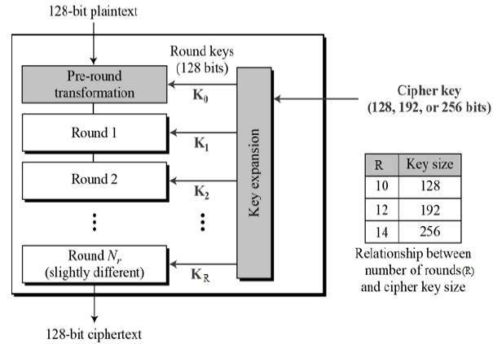
AES (Advanced Encryption Standard)

Slide 15
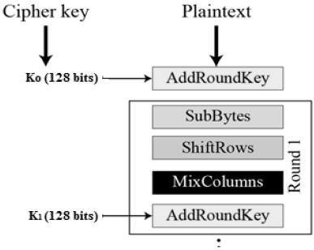
AES (Advanced Encryption Standard)
Encryption Process
Here, we restrict to description of a typical round of AES encryption. Each round comprise of four sub-processes. The first round process is depicted below:

Slide 16
AES (Advanced Encryption Standard)
Byte Substitution (SubBytes):
The 16 input bytes are substituted by looking up a fixed table (S-box) given in design. The result is in a matrix of four rows and four columns.
Shiftrows:
Each of the four rows of the matrix is shifted to the left. Any entries that ‘fall off’ are re-inserted on the right side of row. Shift is carried out as follows:

Slide 17
AES (Advanced Encryption Standard)
First row is not shifted.
Second row is shifted one (byte) position to the left.
Third row is shifted two positions to the left.
Fourth row is shifted three positions to the left.
The result is a new matrix consisting of the same 16 bytes but shifted with respect to each other.

Slide 18
AES (Advanced Encryption Standard)
Mix Columns:
Each column of four bytes is now transformed using a special mathematical function.
This function takes as input the four bytes of one column and outputs four completely new bytes, which replace the original column.
The result is another new matrix consisting of 16 new bytes.
It should be noted that this step is not performed in the last round.

Slide 19
AES (Advanced Encryption Standard)
Add round key:
The 16 bytes of the matrix are now considered as 128 bits and are XOR to the 128 bits of the round key.
If this is the last round then the output is the cipher-text. Otherwise, the resulting 128 bits are interpreted as 16 bytes and we begin another similar round.

Slide 20
AES (Advanced Encryption Standard)
Decryption Process:
The process of decryption of an AES cipher-text is similar to the encryption process in the reverse order. Each round consists of the four processes conducted in the reverse order:
Add round key
Mix columns
Shift rows
Byte substitution

Slide 21
AES (Advanced Encryption Standard)
Since sub-processes in each round are in reverse manner, unlike for a Feistel Cipher, the encryption and decryption algorithms needs to be separately implemented, although they are very closely related.
AES Analysis:
In present day cryptography, AES is widely adopted and supported in both hardware and software.

Slide 22
AES (Advanced Encryption Standard)
Till date, no practical cryptanalytic attacks against AES has been discovered.
Additionally, AES has built-in flexibility of key length, which allows a degree of ‘future-proofing’ against progress in the ability to perform exhaustive key searches.
However, just as for DES, the AES security is assured only if it is correctly implemented and good key management is employed.

Slide 23
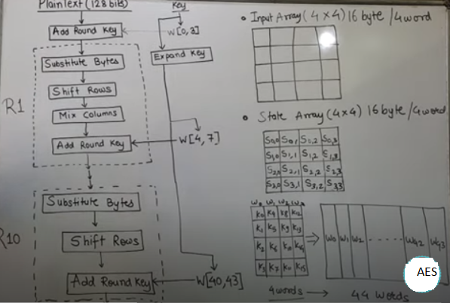
AES (Advanced Encryption Standard)

