Slide 1






Learning through Auxiliary Supervision: Practical Advancements and Applications in Natural Language Processing
Md Rizwan Parvez
University of California, Los Angles (UCLA)
Notes:
Hi Ev1, This is Rizwan from UCLA, and welcome to my presentation on the paper “Retrieval Augmented Code Generation and Summarization”. This is a joint work by me, and my colaborators from UCLA and Columbia University

Slide 2


Why auxiliary supervision is important?
Correct = True
Correct = 10
Fox, I don’t like it.
Language is ambiguous and hence needs background knowledge

Slide 3


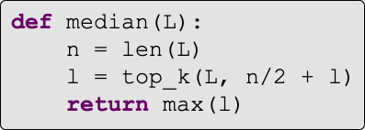
Why auxiliary supervision is important?
Find the median of an array
Concept
Summary
Challenging to generate w/o additional info
Diverse token seq
Code
Slide idea: Graham Neubig
Notes:
It has been a long cherished human dream to build a platform that can perform code automation like in code generation where we want to generate source code given a natural language description and in code summarization where a code is given and the task is to express in a short natural language summary. In this presentation I will be focused on code gen task for time limits.

Slide 4



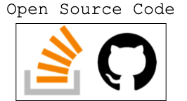

Why auxiliary supervision is important?
All available data
Labeled training data
Other labeled data
Reference: Barbara Plank
Notes:
ML needs

Slide 5
Challenges in processing auxiliary data?
Algorithm 2 is shown to perform better Berg-Kirkpatrick, ACL 2010. It can also be expected to converge faster -- anyway, the E-step changes the auxiliary function by changing the expected counts, so there's no point in finding a local maximum of the auxiliary
function in each iteration
Robin is alive and well. He is the same person that you read about in the book, Winnie the Pooh. As a boy, Chris lived in a pretty home called Cotchfield Farm. When Chris was three years old, his father wrote a poem about him. The poem was printed in a magazine for others to read. Mr. Robin then wrote a book
a local-optimality guarantee. Consequently, LOLS can improve upon the reference policy, unlike previous algorithms. This enables us to develop structured contextual bandits, a partial information structured prediction setting with many potential applications.
Methods for learning to search for structured prediction typically imitate a reference policy, with existing theoretical guarantees demonstrating low regret compared to that reference. This is unsatisfactory in many applications where the reference policy is suboptimal and the goal of learning is to
Can learning to search work even when the reference is poor? We provide a new learning to search algorithm, LOLS, which does well relative to the reference policy, but additionally guarantees low regret compared to deviations from the learned policy.
Bill Clinton, recently elected as the President of the USA, has been invited by the Russian President], [Vladimir Putin, to visit Russia. President Clinton said that he looks forward to strengthening ties between USA ^{and Russia}
Robin is alive and well. He is the same person that you read about in the book, Winnie the Pooh. As a boy, Chris lived in a pretty home called Cotchfield Farm. When Chris was three years old, his father wrote a poem about him. The poem was printed in a magazine for others to read. Mr. Robin then wrote a book
Heterogenous, unstructured, and noisy
Large amount of data
Wikipedia:
- 4.7 million English articles - 35 million in total
Tweets:
- 500 million per day
- 200 billion per year
Pronoun
Verb
Noun
And
Noun
Root They operate ships and banks .
No direct supervision

Slide 6
My Research Contributions
Frameworks w/ Auxiliary Supervision
[ACL 18; EMNLP 19, 21; NAACL 21; LREC 18; ICTD 16]
Design tractable, principled, models
Leveraging open-source resources
Enhance in multiple aspects
(acc, speed, interpretability)

Slide 7


Retrieval Augmented Code Generation and Summarization
EMNLP-Findings 2021
Notes:
Hi Ev1, This is Rizwan from UCLA, and welcome to my presentation on the paper “Retrieval Augmented Code Generation and Summarization”. This is a joint work by me, and my colaborators from UCLA and Columbia University

Slide 8
Motivation
Find the median of an array
Concept
Summary
Code
Slide idea: Graham Neubig
Notes:
It has been a long cherished human dream to build a platform that can perform code automation like in code generation where we want to generate source code given a natural language description and in code summarization where a code is given and the task is to express in a short natural language summary. In this presentation I will be focused on code gen task for time limits.

Slide 9





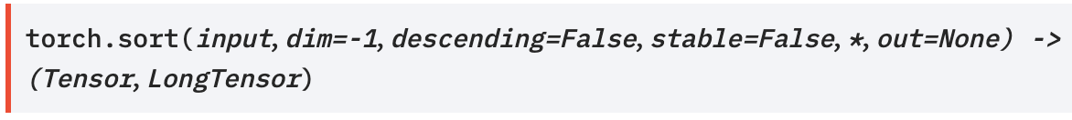
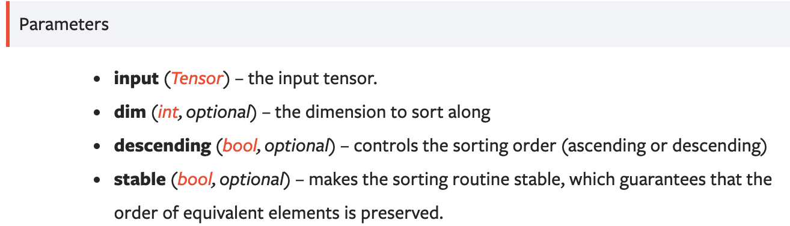
Motivation
Sort my_tensor in descending order
Concept
Python sorted in descending order
Search API guidelines
Browse thru. top few results
Adapt the results
my_tensor.sort(descending=True)
Slide idea: Graham Neubig
9
Notes:
To address this challenging problems like code gen, we first draw our motivation we developers write our code. Studies show that often we search API guidelines in opensource platforms or QA forums like github or stackoverfow and then we customize it in our context. And this is quite an effective way there are many studies on this too.

Slide 10

Retrieved -> target code
Retrieved code for sorted array
Find the median of an array
Notes:
Therefore, in this paper, we develop a Retrieval augmentED CODe gEneration and summaRization framework. We call it as REDcoder. The high level idea behid redocder is very strieghtforward. It has two modules or steps. The first one is a retriever. Given an input sequence it `retrieves relevant candidstaes from open-source repositories. And then it augments the input sequence with the top-k retrieved candidates and passes to a generative module such as PLBART. We call them as SCODE-R and SCODE-G respectively. Next we will discuss how can build our componenets SCODE-R and SCODE-G.

Slide 11
REDCODER
Summary and CODE Retriever (SCODE-R)
Summary and CODE Generator (SCODE-G)
PLBART, Ahmad et al., 2021
Fig: Retrieval augmentED CODe gEneration and summaRization framework (REDCODER)
Notes:
Therefore, in this paper, we develop a Retrieval augmentED CODe gEneration and summaRization framework. We call it as REDcoder. The high level idea behid redocder is very strieghtforward. It has two modules or steps. The first one is a retriever. Given an input sequence it `retrieves relevant candidstaes from open-source repositories. And then it augments the input sequence with the top-k retrieved candidates and passes to a generative module such as PLBART. We call them as SCODE-R and SCODE-G respectively. Next we will discuss how can build our componenets SCODE-R and SCODE-G.

Slide 12
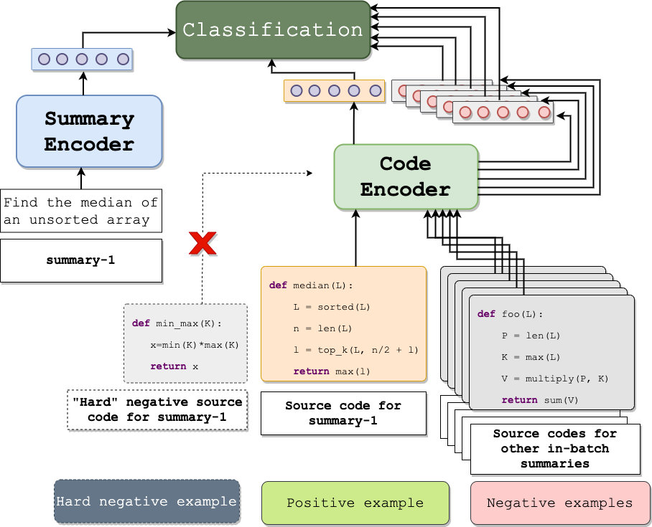
Sparse Vs Dense SCODE-R
Must be fast
Needs understanding of both natural and programming languages
Similarity
Input summary (i.e., query)
SCODE-R is based on
DPR (Karpukhin et al., 2020)
Candidate code (i.e., docs)
Notes:
Now to retrieve from a large pool, the retriever must be fast. A naïve solution wd be to use sparse retrievers like BM25.
However, Due to the complexity of our target tasks, we need to understand query, docs in both natural and p Ls which may be achievable by the naïve one. In this context we propose to use a dense retriever and In our paper we validate the claim that our dense SCODE-R does significantly better retrieval than sparse BM25.

Slide 13
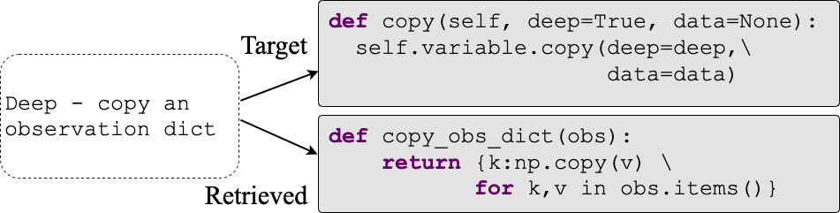

SCODE-R Training
As a binary classification problem
Using the same ＜summary, code＞ training set in our final gen/sum task
No hard-negatives
Example: A relevant yet not same retrieved code
Q₁
negative
Paired D₁
Weak Retriever
Hard Negative HD₂
Q₂
positive
Paired D₂
Q₃
Paired D₃
negative
Q₄
Paired D₄
Slide idea: facebookresearch
negative
Training minibatch
Notes:
We train our retrievr as a binary classification problem,
We use the same <summary, code> training set in our inten

Slide 14
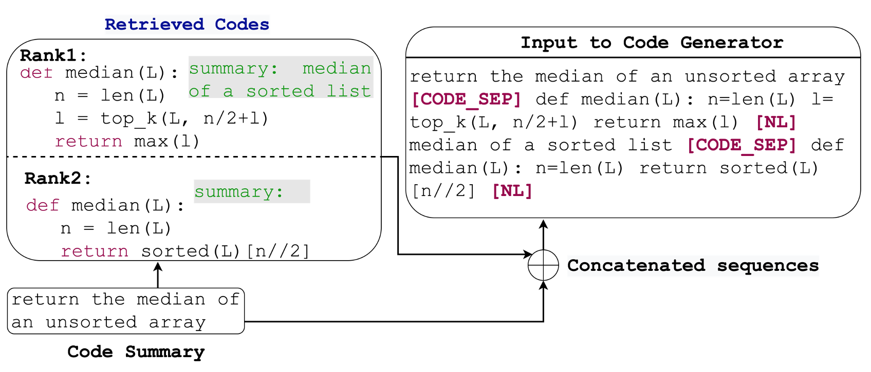
SCODE-G
SCODE-G in REDCODER uses retrieved candidate code only
Available paired summaries are used in (REDCODER-ext)
Notes:
As for the SSCODE-G, we consider a pretrained generative model PLBART but we only modify in the input leyer it which makes it generic to any other off-the-shelf generative models/architecture. We augment the top-k retrieved candidates with the input sequence with a special separator tokens. In addition to candidate code, whenever a candidate code has its paired summary, in a variation of framework, redcoder-ext, we also algument using another sep token.

Slide 15
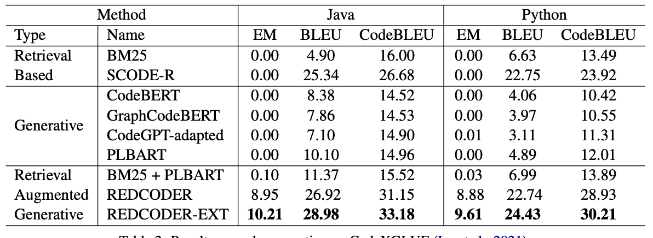
Evaluation Settings
Baselines
Benchmark
Retrieval DB
CodeXGlue: Lu et al. (2021)
CSNET: Husain et al. (2019)
Metrics
BLEU
CodeBLEU
EM
Monolingual:
Code
Bilingual:
(Code, Summary)
By default, target output is removed
Notes:
We evaluate on CODEXGLUE (JAVA and Pythn becj=mark). We report the performance on test set. We reteive candidates from the CSNET released monolingual and paired database.

Slide 16
Evaluation
Retrieval Augmented Generative
Retrieval based
+4%
BLEU scores
+18%
Generative
REDCODER
REDCODER-ext
Table: Code gen. performances

Slide 17
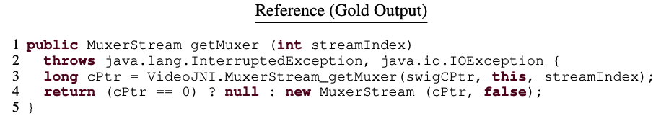
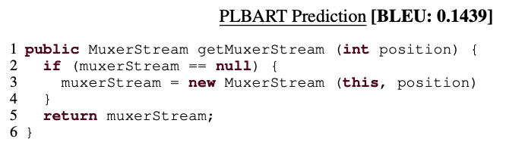
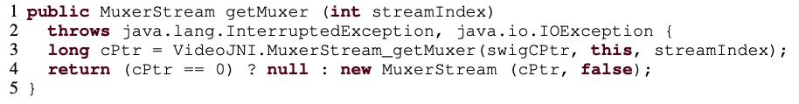
Qualitative Example
PLBART fails to predict the diverse identifiers (in red color) whereas REDCODER succeeds
Redcoder-ext Prediction
BLEU: 80.6

Slide 18


Questions?
https://github.com/rizwan09/REDCODER
Notes:
Short

Slide 19

Active research direction/contribution
Landscape of methods in my area of contribution
Deep learning/hidden representation e.g., seq2seq, pretrained models, text classification, bio-NLP
Efficient/interpretable inference e.g., Speedup, computation, memory, green AI
Programming language processing
e.g., Code generation, summarization, translation, search

Slide 20
Active teaching direction/contribution
Undergraduate and graduate in my area of contribution
Natural Language Processing
Machine Learning
Deep learning
Artificial Intelligence
Pattern Recognition
Special Topics in AI/NLP

Slide 21

Thank You!
Questions?
https://rizwan09.github.io/
Notes:
Short

