Slide 1

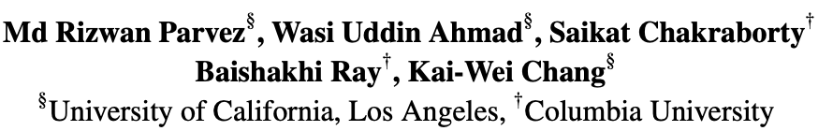

Retrieval Augmented Code Generation and Summarization
EMNLP-Findings 2021
Notes:
Hi Ev1, This is Rizwan from UCLA, and welcome to my presentation on the paper “Retrieval Augmented Code Generation and Summarization”. This is a joint work by me, and my colaborators from UCLA and Columbia University

Slide 2
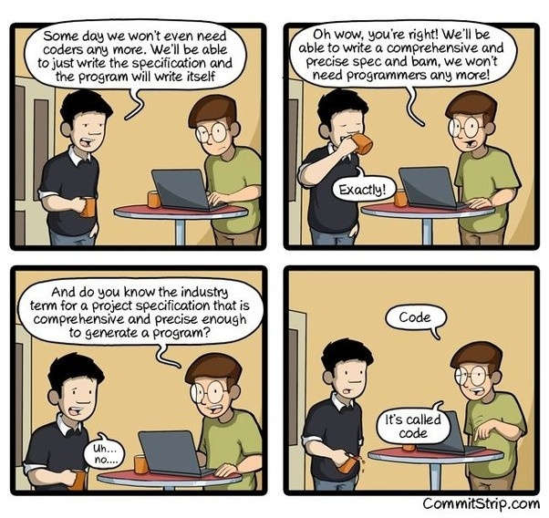

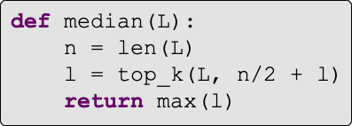
Motivation
Find the median of an array
Notes:
It has been a long cherished human dream to build a platform that can perform code automation like in code generation where we want to generate source code given a natural language description and in code summarization where a code is given and the task is to express in a short natural language summary. In this presentation I will be focused on code gen task for time limits.

Slide 3
Motivation
Diversity in identifiers
void function (Element arg0,
Formula arg1) {
arg0.addElement(
"string").setText(
arg1.getText());
}
Notes:
However, source code generation and summarization, however, are intrinsically complex and challenging. They involve generating diverse token sequences such as different variables, operators, keywords, classes, and method names.

Slide 4
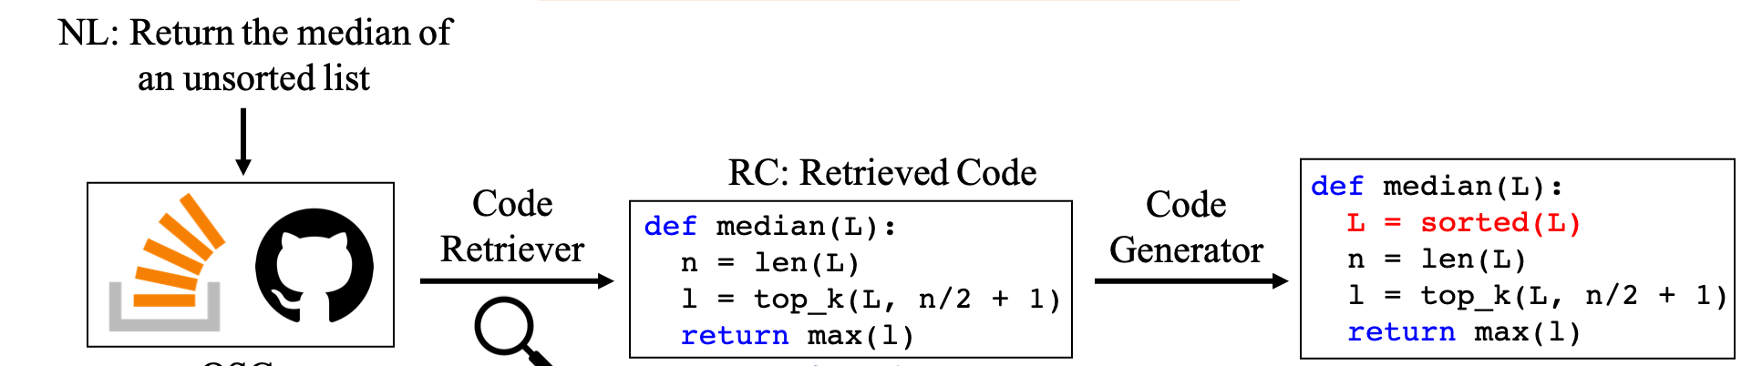

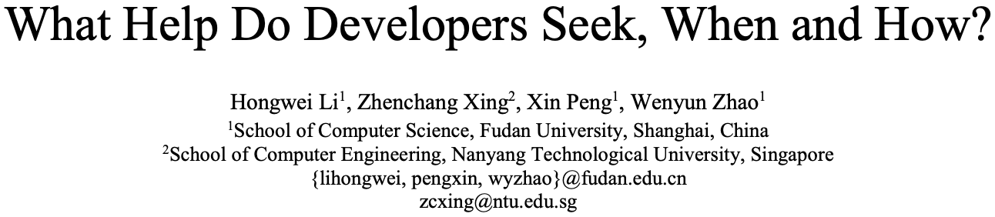
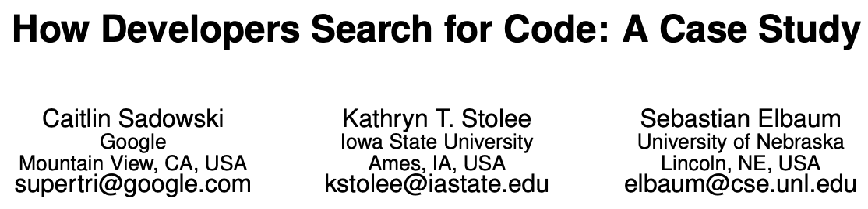
Motivation
Notes:
To address this challenging problems like code gen, we first draw our motivation from real developers. How do we write code. So often we search in opensource platforms or forums like github or stackoverfow and then we customize it in our context. And this is quite an effective way there are many studies on this too.

Slide 5
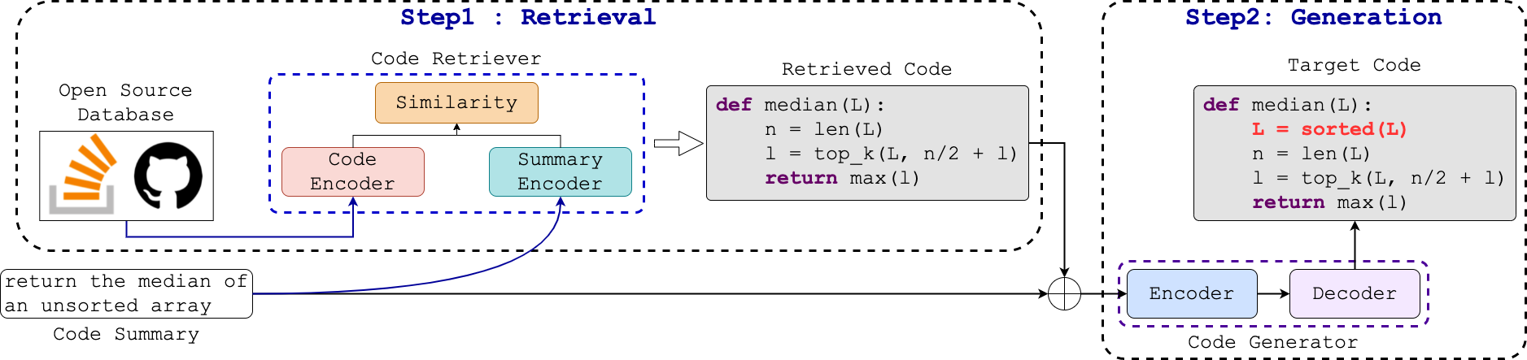
Our approach (REDCODER)
Summary and CODE Retriever (SCODE-R)
Summary and CODE Generator (SCODE-G)
PLBART, Ahmad et al., 2021
Fig: Retrieval augmentED CODe gEneration and summaRization framework (REDCODER)
Notes:
Therefore, in this paper, we develop a Retrieval augmentED CODe gEneration and summaRization framework. We call it as REDcoder. The high level idea behid redocder is very strieghtforward. It has two modules or steps. The first one is a retriever. Given an input sequence it first retrieves relevant candidstaes from open-source repositories. And then it augments the input sequence with the top-k retrieved candidates and passes to a generative module such as PLBART. We call them as SCODE-R and SCODE-G respectively. Next we will discuss how can build our componenets SCODE-R and SCODE-G.

Slide 6
Sparse Vs Dense SCODE-R?
Must be fast
Need Understanding both syntactically and semantically
Notes:
Now to retrieve from a large pool, the retriever must be fast. A naïve solution wd be to use sparse retrievers like BM25.
However, Due to the complexity of our target tasks, we need to understand query, docs in both natural and p Ls which may be achievable by the naïve one. In this context we propose to use a dense retriever and In our paper we validate the claim that our dense SCODE-R does significantly better retrieval than sparse BM25.

Slide 7
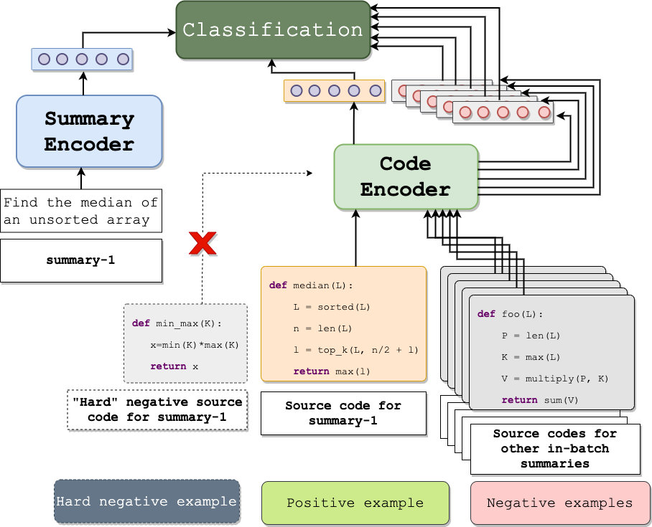
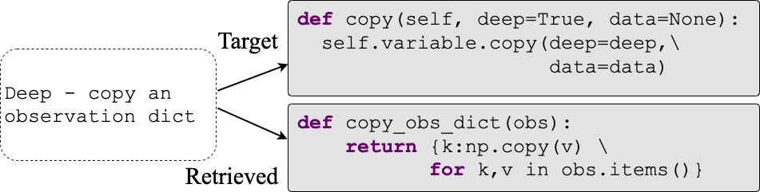
SCODE-R Training
SCODE-R is based on DPR (Karpukhin et al., 2020)
Example: A relevant yet not same retrieved code
SCODE-R Training
Notes:
We build our retrievr SCODE-R based on the dense retriever DPR, recently proposed in open-domain QA. It’s a bi-encoder model, one to encode the queries and the other to encode the documents. And then computes their dot product as a similarity measurement. We trained as SCODE-R as a binary classification problem using the code gen dataset. For each input sequence the correpsonding target code is traseted as + examples. And the – nagrtive exanples are the in-bacth negatives. + examples corresponifng to the other exmaples in the same batch is considered as -. Now, in the right hand side we present an example of a retrieed candidate for a “deep copy” function, although the candidate can

Slide 8
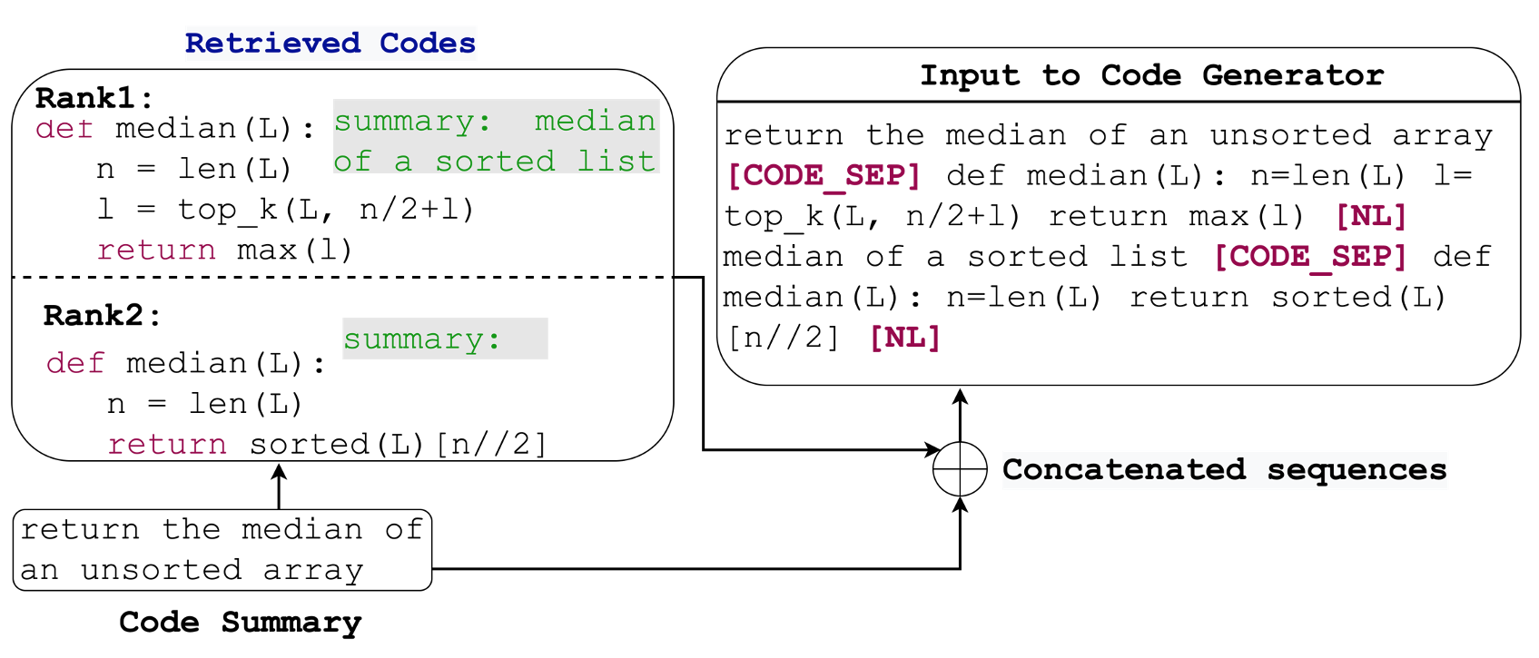
SCODE-G
Example SCODE-G input (REDCODER-EXT)
Never used
SCODE-G input (REDCODER)
Leveraged when available
SCODE-G input (REDCODER-EXT)
Notes:
As for the SSCODE-G, we consider a pretrained generative model PLBART but we only modify in the input leyer it which makes it generic to any other off-the-shelf generative models/architecture. We augment the top-k retrieved candidates with the input sequence with a special separator tokens. In addition we also conjecture that the paired data of the candidate can also benift the generation. (for example, if the candidate is a code, then it pair is it corresponding it’s a NL description).

Slide 9
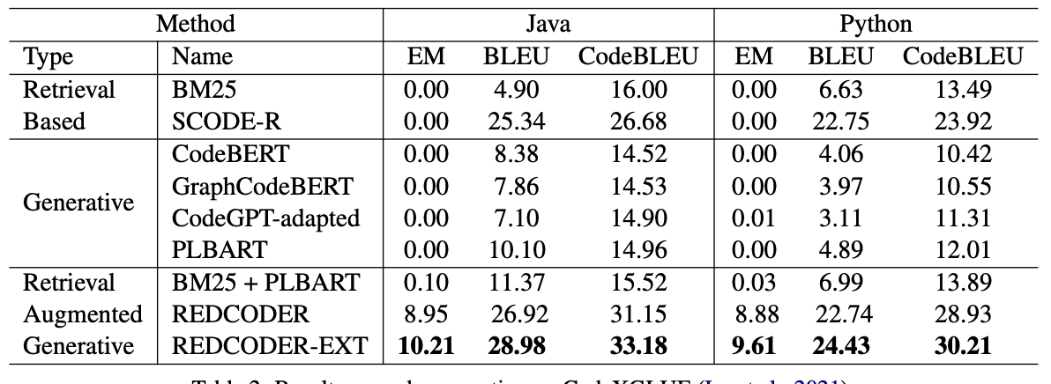
Evaluation settings
CodeXGlue: Lu et al. (2021)
CSNET: Husain et al. (2019)
}
Benchmark: Train/Valid/Test
Monolingual:
Codes
Bilingual:
(Code, Summary)
Finetune
Retrieval Database > 1M
By default, target output is removed
Evaluation
EM
BLEU
CodeBLEU
}
SCODE-R + SCODE-G (PLBART)
Baselines
Notes:
We evaluate on CODEXGLUE (JAVA and Pythn becj=mark). We report the performance on test set. We reteive candidates from the CSNET released monolingual and paired database.

Slide 10
Evaluation
Table: Code gen. performances

Slide 11
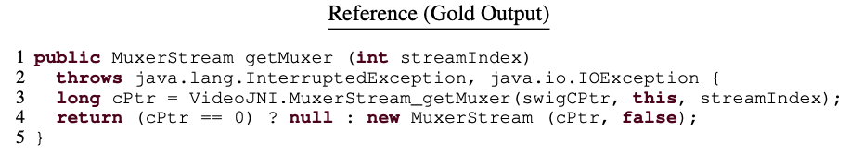
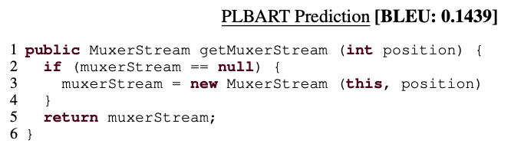
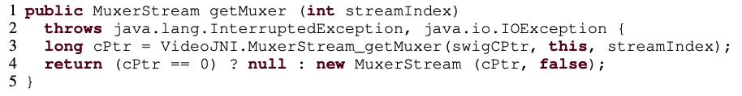
Qualitative examples
PLBART fails to predict the diverse identifiers (in red color) whereas REDCODER succeeds
Redcoder-ext Prediction
BLEU: 80.6

Slide 12


Thank You!
Questions?
https://github.com/rizwan09/REDCODER

