Slide 1

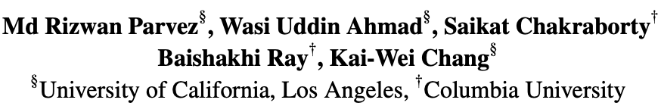

Retrieval Augmented Code Generation and Summarization
EMNLP-Findings 2021
Notes:
Hi Ev1, This is Rizwan from UCLA, and welcome to my presentation on the paper “Retrieval Augmented Code Generation and Summarization”. This is a joint work by me, and my colaborators from UCLA and Columbia University

Slide 2


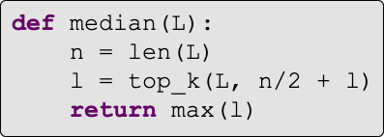
Motivation
Find the median of an array
Concept
Summary
Diverse identifiers
Code
Slide idea: Graham Neubig
Notes:
It has been a long cherished human dream to build a platform that can perform code automation like in code generation where we want to generate source code given a natural language description and in code summarization where a code is given and the task is to express in a short natural language summary. In this presentation I will be focused on code gen task for time limits.

Slide 3





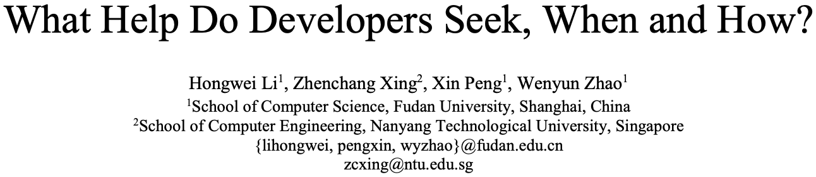
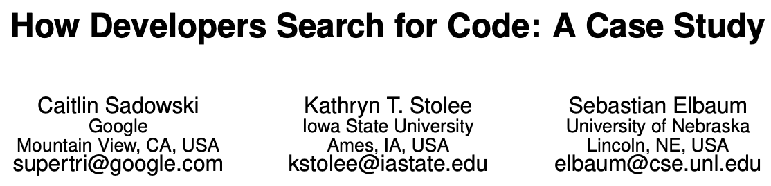
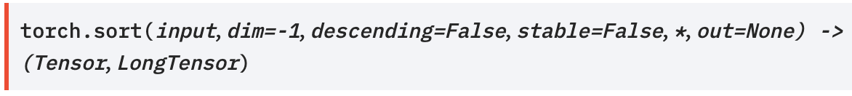
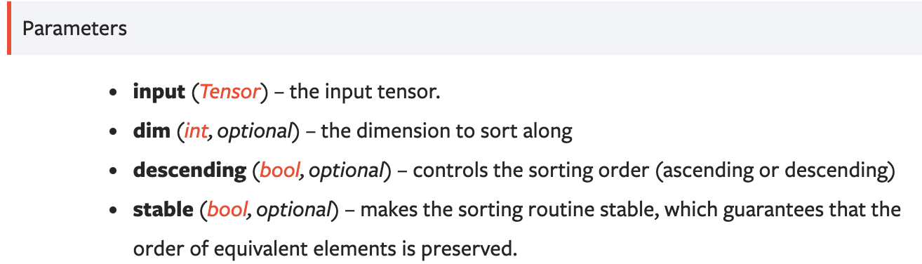
Motivation
Sort my_tensor in descending order
Concept
Python sorted in descending order
Search API guidelines
Browse thru. top few results
Adapt the results
my_tensor.sort(descending=True)
Slide idea: Graham Neubig
3
Notes:
To address this challenging problems like code gen, we first draw our motivation we developers write our code. Studies show that often we search API guidelines in opensource platforms or QA forums like github or stackoverfow and then we customize it in our context. And this is quite an effective way there are many studies on this too.

Slide 4
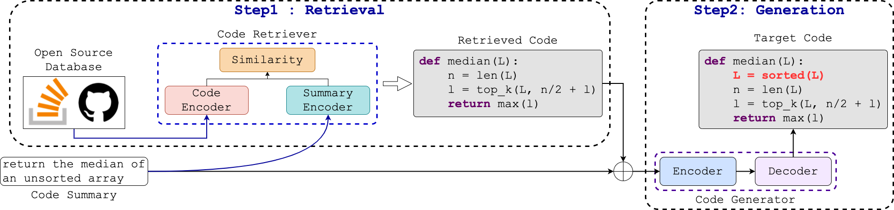
REDCODER
Summary and CODE Retriever (SCODE-R)
Summary and CODE Generator (SCODE-G)
PLBART, Ahmad et al., 2021
Fig: Retrieval augmentED CODe gEneration and summaRization framework (REDCODER)
Notes:
Therefore, in this paper, we develop a Retrieval augmentED CODe gEneration and summaRization framework. We call it as REDcoder. The high level idea behid redocder is very strieghtforward. It has two modules or steps. The first one is a retriever. Given an input sequence it `retrieves relevant candidstaes from open-source repositories. And then it augments the input sequence with the top-k retrieved candidates and passes to a generative module such as PLBART. We call them as SCODE-R and SCODE-G respectively. Next we will discuss how can build our componenets SCODE-R and SCODE-G.

Slide 5
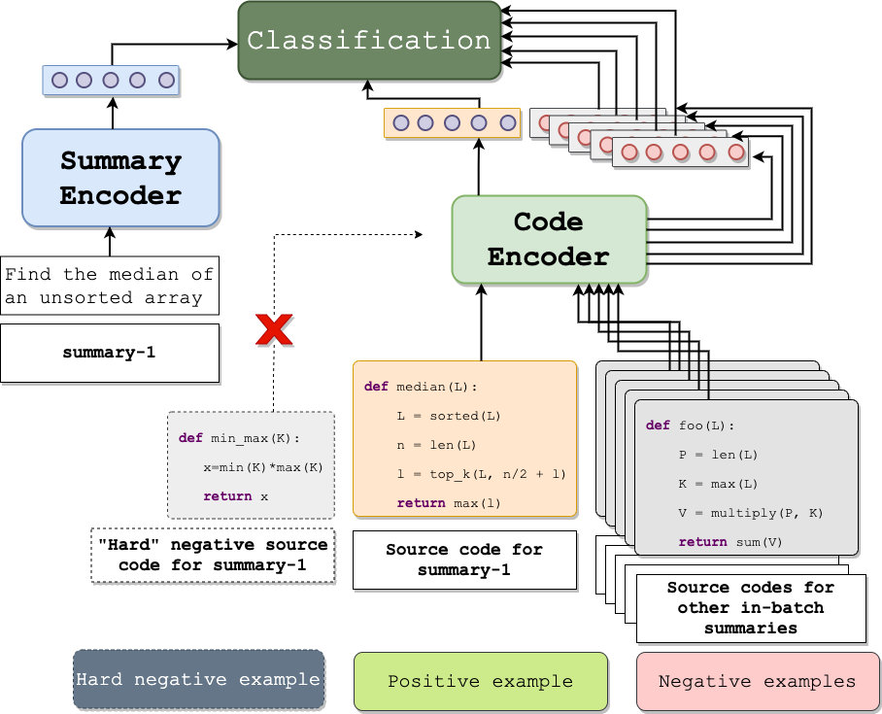
Sparse Vs Dense SCODE-R
Must be fast
Needs understanding of both natural and programming languages
Similarity
Input summary (i.e., query)
SCODE-R is based on
DPR (Karpukhin et al., 2020)
Candidate code (i.e., docs)
Notes:
Now to retrieve from a large pool, the retriever must be fast. A naïve solution wd be to use sparse retrievers like BM25.
However, Due to the complexity of our target tasks, we need to understand query, docs in both natural and p Ls which may be achievable by the naïve one. In this context we propose to use a dense retriever and In our paper we validate the claim that our dense SCODE-R does significantly better retrieval than sparse BM25.

Slide 6
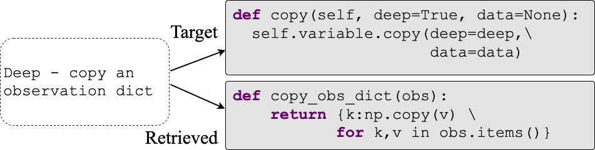

SCODE-R Training
As a binary classification problem
Using the same ＜summary, code＞ training set in our final gen/sum task
No hard-negatives
Example: A relevant yet not same retrieved code
Q₁
negative
Paired D₁
Weak Retriever
Hard Negative D₂
Q₂
positive
Paired D₂
Q₃
Paired D₃
negative
Q₄
Paired D₄
Slide idea: facebookresearch
negative
Training minibatch
Notes:
We train our retrievr as a binary classification problem,
We use the same <summary, code> training set in our inten

Slide 7
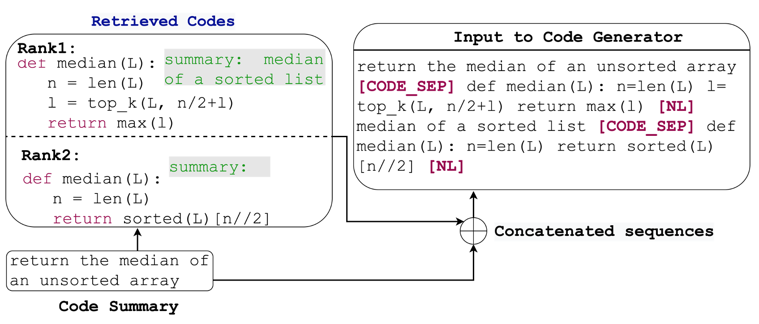
SCODE-G
SCODE-G in REDCODER uses retrieved candidate code only
Available paired summaries are used in (REDCODER-ext)
Notes:
As for the SSCODE-G, we consider a pretrained generative model PLBART but we only modify in the input leyer it which makes it generic to any other off-the-shelf generative models/architecture. We augment the top-k retrieved candidates with the input sequence with a special separator tokens. In addition to candidate code, whenever a candidate code has its paired summary, in a variation of framework, redcoder-ext, we also algument using another sep token.

Slide 8
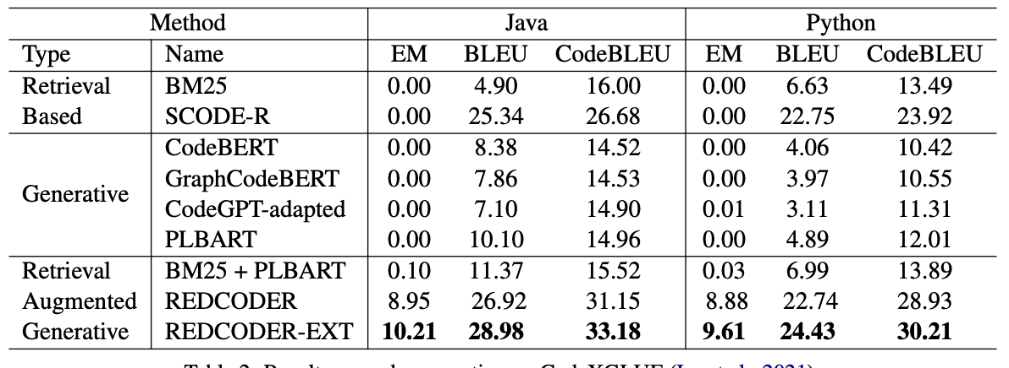
Evaluation Settings
Baselines
Benchmark
Retrieval DB
CodeXGlue: Lu et al. (2021)
CSNET: Husain et al. (2019)
Metrics
BLEU
CodeBLEU
EM
Monolingual:
Codes
Bilingual:
(Code, Summary)
By default, target output is removed
Notes:
We evaluate on CODEXGLUE (JAVA and Pythn becj=mark). We report the performance on test set. We reteive candidates from the CSNET released monolingual and paired database.

Slide 9
Evaluation
Retrieval Augmented Generative
Retrieval based
+4%
BLEU scores
+18%
Generative
REDCODER
REDCODER-ext
Table: Code gen. performances

Slide 10
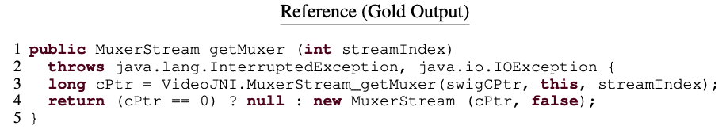
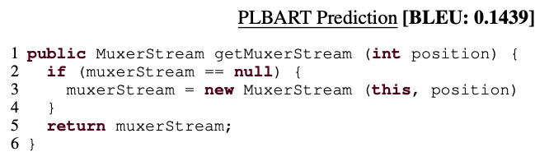
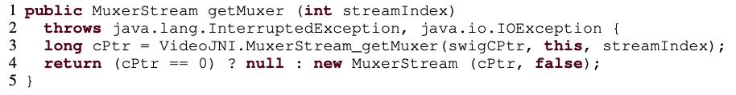
Qualitative Examples
PLBART fails to predict the diverse identifiers (in red color) whereas REDCODER succeeds
Redcoder-ext Prediction
BLEU: 80.6

Slide 11


Thank You!
Questions?
https://github.com/rizwan09/REDCODER
Notes:
Short

