Slide 1

Evaluating Source Values in Transfer Learning
Md Rizwan Parvez and Kai-Wei Chang
NAACL 2021
Notes:
Hi Everyone, I am Rizwan from UCLA and today I would like to introduce our work: . This is a joint work by me and my Professor Kai-Wei chang. This work is going to appear at NAACL this year.

Slide 2
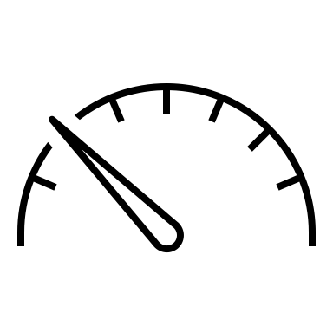

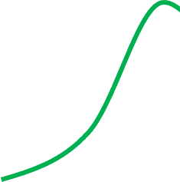
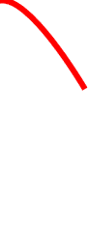
Motivation
Source A
Transfer Model
Transfer Performance
Source B
Source C
#Sources
Notes:
When training a transfer model over multiple source domains/languages, not every source is equally useful for the target domain/language. Some of them may even cause a performance drop. Therefore, to better transfer a model, it is essential to understand the values of the sources..
It is also essential for analyzing the source-target relationships.
In this paper, we develop SEAL- Shap, an efficient source valuation framework for quantifying the usefulness of the sources in transfer .

Slide 3

Motivation
Language Transfer
What languages are similar or relevant to English?
Is Arabic very different from Hindi?
Domain Transfer
Are the sentences in QNLI and QQP are both questionaries or they are different?
SEAL-Shap
Source Valuation
Data Synthesizer
Are the quality of the synthesized dataset good?
What datasets to use?
Notes:
When training a transfer model over multiple source domains/languages, not every source is equally useful for the target domain/language. Some of them may even cause a performance drop. Therefore, to better transfer a model, it is essential to understand the values of the sources..
It is also essential for analyzing different source-target aspects and relationships.
In this paper, we develop SEAL- Shap, an efficient source valuation framework that quantifies the usefulness of the sources in transfer learning .

Slide 4
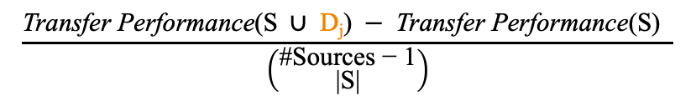
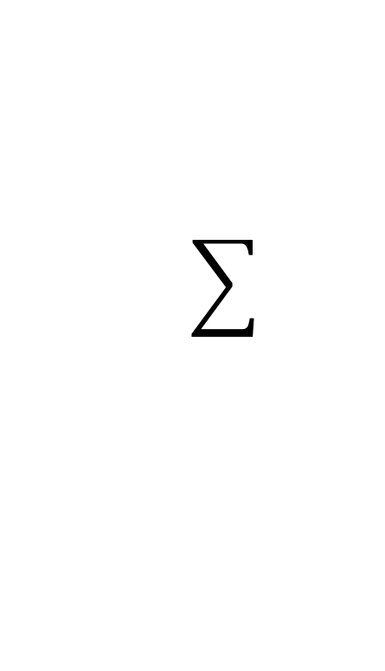
SEAL-SHAP
Data Shapley Value Vs
Single Source or Leave-one-out
marginal contribution
Value (source D_{j}) =
$$\frac{\text{Transfer} \text{Performance}\text{(}\text{S} ∪ \text{D}\text{j}\text{)} − \text{Transfer} \text{Performance}\text{(}\text{S}\text{) }}{\left({\text{\#}\text{Sources}\text{ − 1} \atop \text{|}\text{S}\text{|}}\right)}$$
Source subsets S not containing D_{j}
#subsets of size |S|

Slide 5




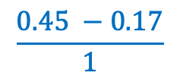
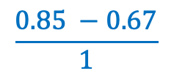

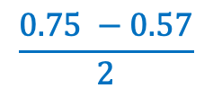

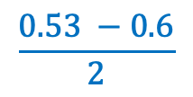
SEAL-SHAP
One subset of two elements
Two subsets of one elements
One empty subset
0.67
0.6
0.57
0.17
Value?
0.85
0.53
0.75
0.45
Sources
$$\frac{0.85 −0.67}{1}$$
$$\frac{0.53 −0.6}{2}$$
$$\frac{0.75 −0.57}{2}$$
$$\frac{0.45 −0.17}{1}$$
$$+$$
$$+$$
$$+$$
Notes:
çit's given by this formula let me just parse it for you
so the value of particular data point K right so here’s what we do to compute it
We look at all the possible subsets of our sources we extend this not contain its point K right so you see okay so how much does the performance change if I add K to that subset
so this this is basically the marginal change in performance by adding the source D_j
we do some normalization by dividing by the number of sets that have size just some some weighting scheme

Slide 6
SEAL-SHAP
Data Shapley Value
TMC-Shap (Monte Carlo Approximation)
Random sampling of subsets
Compute the marginal contributions
Repeat until converge
0.57
0.75
Ref: Amirata Ghorbani and James Zou; Data Shapley:Equitable valuation of data for machine learning; ICML, 2009

Slide 7
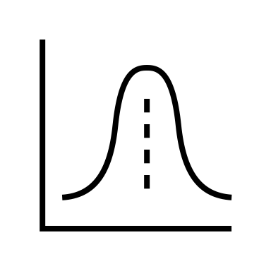

SEAL-SHAP
Data Shapley Value
TMC-Shap (Monte Carlo Approximation)
Efficient Estimation
Stratified sampling
Sample instances for each source in the sampled subset
0.57
0.37
0.75
0.55

Slide 8
SEAL-SHAP
Data Shapley Value
TMC-Shap (Monte Carlo Approximation)
Efficient Estimation
Stratified sampling
Truncation
Caching
0.17
0.39

Slide 9
Results
Generic to any transfer task and any model architectures.
Effective in selecting useful transfer sources
Efficient in run-time
Correct source value approximation
Source values match the intuitive source-target relationships
Source values match the data preprocessing impacts
Can be computed even when an evaluation target corpus

Slide 10


Efficient Run-time
Task | Transfer | Target | #Targets | #Samples | Caching | Run-time(h)
NLI [GLUE] | Domain | MNLI-mm | 1 |  |  | 300
 |  |  | 1 |  |  | 101
 |  |  | 1 | 20K |  | 18
 |  |  | 3 | 20K |  | 5
POS [UD-Treebank] | Language | Arabic | 1 |  |  | 210
 |  |  | 1 |  |  | 180
 |  |  | 1 | 3.3K |  | 25
 |  |  | 31 | 3.3K |  | 3.5
TMC-Shap
TMC-Shap

Slide 11
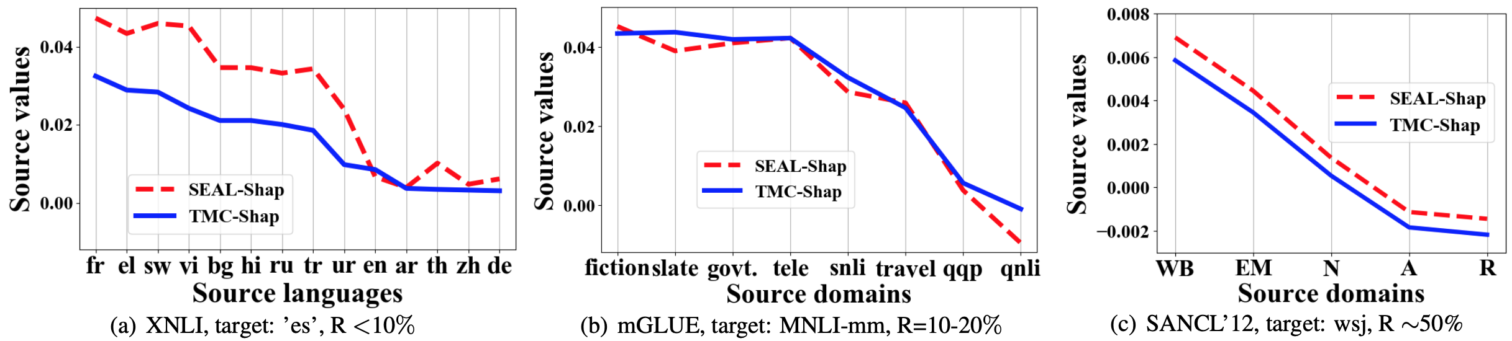
Correctness
Fig: Similar source values by SEAL-Shap and TMC-Shap
Notes:
Another benefits of SEAL-Shap vis that it’s values are interpretable. We anticipate that source languages in the same language family with smaller laguage distance are more useful. Here, for two diff target English (“en”) and Hindi (“hi”). In the x-axis, source languages are grouped into different language families and sorted based on the word order distance from English. As the figure illustrates, Germanic and Romance languages have higher Shapley value when the target is. The value gradually decreases for language of other families when the word order distance increase. As for Hindi, the trend is opposite in general.

Slide 12
Interpretability
Source Values
SEAL-Shap values corelates well with the language family and language distance
Different source value trend for two different language English and Hindi
Notes:
Another benefits of SEAL-Shap vis that it’s values are interpretable. We anticipate that source languages in the same language family with smaller laguage distance are more useful. Here, for two diff target English (“en”) and Hindi (“hi”). In the x-axis, source languages are grouped into different language families and sorted based on the word order distance from English. As the figure illustrates, Germanic and Romance languages have higher Shapley value when the target is. The value gradually decreases for language of other families when the word order distance increase. As for Hindi, the trend is opposite in general.

Slide 13
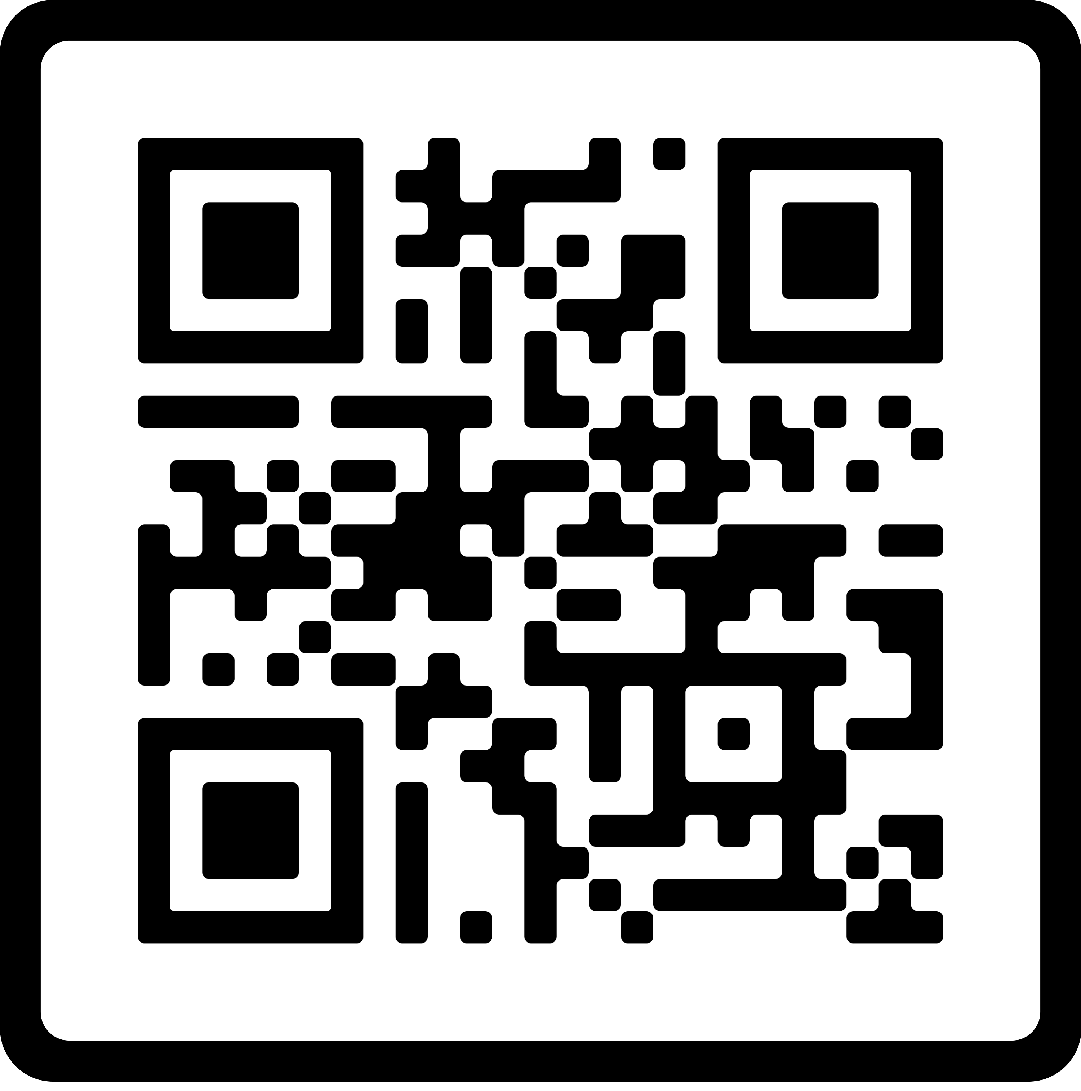
Thank You!
https://github.com/rizwan09/NLPDV

