Slide 1
Introduction to Programming with Python
Python Review. Modified slides from Marty Stepp and Moshe Goldstein

Slide 2

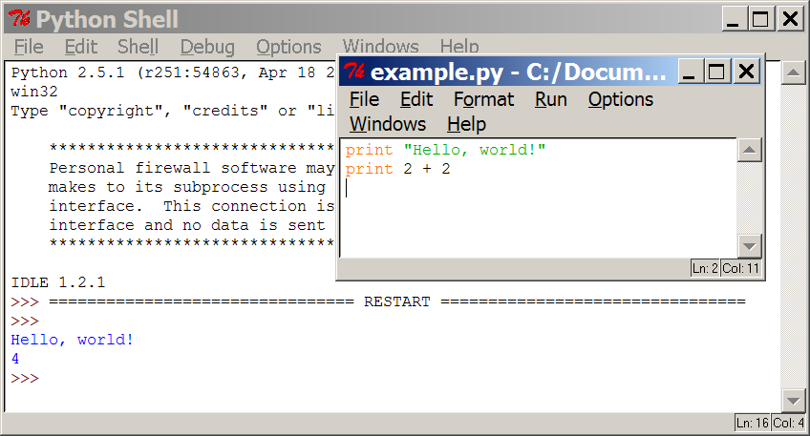
Programming basics
code or source code: The sequence of instructions in a program.
syntax: The set of legal structures and commands that can be used in a particular programming language.
output: The messages printed to the user by a program.
console: The text box onto which output is printed.
Some source code editors pop up the console as an external window,
and others contain their own console window.

Slide 3




Compiling and interpreting
Many languages require you to compile (translate) your program into a form that the machine understands.
compile execute
source code
Hello.java
byte code
Hello.class
output
Python is instead directly interpreted into machine instructions.
interpret
source code
Hello.py
output

Slide 4
The Python Interpreter
Python is an interpreted
language
The interpreter provides an interactive environment to play with the language
Results of expressions are printed on the screen
>>> 3 + 7
10
>>> 3 < 15
True
>>> 'print me'
'print me'
>>> print 'print me' print me
>>>

Slide 5
Expressions
expression: A data value or set of operations to compute a value.
Examples:
1 + 4 * 3
42
Arithmetic operators we will use:
+ - * /
%
**
addition, subtraction/negation, multiplication, division modulus, a.k.a. remainder
exponentiation
precedence: Order in which operations are computed.
* / % ** have a higher precedence than + -
1 + 3 * 4 is 13
Parentheses can be used to force a certain order of evaluation.
(1 + 3) * 4 is 16

Slide 6
Integer division
When we divide integers with / , the quotient is also an integer.
3 |  | 52
4 ) 14 | 27 | ) 1425
12 |  | 135
2 |  | 75
 |  | 54
 |  | 21
More examples:
35 / 5 is 7
84 / 10 is 8
156 / 100 is 1
The % operator computes the remainder from a division of integers.
3
4 ) 14
12
2
43
5 ) 218
20
18
15
3

Slide 7
Real numbers
Python can also manipulate real numbers.
Examples: 6.022 -15.9997 42.0 2.143e17
The operators + - * / % ** ( ) all work for real numbers.
The / produces an exact answer: 15.0 / 2.0 is 7.5
The same rules of precedence also apply to real numbers: Evaluate ( ) before * / % before + -
When integers and reals are mixed, the result is a real number.
Example: 1 / 2.0 is 0.5
The conversion occurs on a per-operator basis.
7 / 3 * | 1.2 | + | 3 / 2
2 * | 1.2 | + | 3 / 2
2.4 |  | + | 3 / 2
2.4 | 3.4 | + | 1

Slide 8
Math commands
Python has useful commands (or called functions) for performing calculations.
Constant | Description
e | 2.7182818...
pi | 3.1415926...
Command name | Description
abs(value) | absolute value
ceil(value) | rounds up
cos(value) | cosine, in radians
floor(value) | rounds down
log(value) | logarithm, base e
log10(value) | logarithm, base 10
max(value1, value2) | larger of two values
min(value1, value2) | smaller of two values
round(value) | nearest whole number
sin(value) | sine, in radians
sqrt(value) | square root
To use many of these commands, you must write the following at the top of your Python program:
from math import *
8

Slide 9
Numbers: Floating Point
int(x) converts x to an integer
float(x) converts x to a floating point
The interpreter shows
a lot of digits
>>> 1.23232
1.2323200000000001
>>> print 1.23232
1.23232
>>> 1.3E7
13000000.0
>>> int(2.0) 2
>>> float(2)
2.0

Slide 10
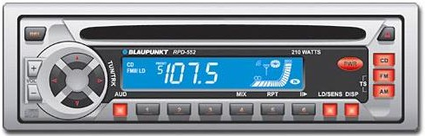
Variables
variable: A named piece of memory that can store a value.
Usage:
Compute an expression's result,
store that result into a variable,
and use that variable later in the program.
assignment statement: Stores a value into a variable.
Syntax:
name = value
Examples:
x = 5
gpa = 3.14
x
5
gpa
3.14
A variable that has been given a value can be used in expressions.
x + 4 is 9
Exercise: Evaluate the quadratic equation for a given a, b, and c.
10

Slide 11
Example
>>> x = 7
>>> x 7
>>> x+7
14
>>> x = 'hello'
>>> x
'hello'
>>>

Slide 12
print
print : Produces text output on the console.
Syntax:
print "Message" print Expression
Prints the given text message or expression value on the console, and
moves the cursor down to the next line.
print Item1, Item2, ..., ItemN
Prints several messages and/or expressions on the same line.
Examples:
print "Hello, world!" age = 45
print "You have", 65 - age, "years until retirement"
Output:
Hello, world!
You have 20 years until retirement
12

Slide 13
Example: print Statement
Elements separated by commas print with a space between them
A comma at the end of the statement (print ‘hello’,) will not print a newline character
>>> print 'hello' hello
>>> print 'hello', 'there'
hello there

Slide 14
input
input : Reads a number from user input.
You can assign (store) the result of input into a variable.
Example:
age = input("How old are you? ")
print "Your age is", age
print "You have", 65 - age, "years until retirement"
Output:
How old are you? 53
Your age is 53
You have 12 years until retirement
Exercise: Write a Python program that prompts the user for his/her amount of money, then reports how many Nintendo Wiis the person can afford, and how much more money he/she will need to afford an additional Wii.
14

Slide 15
Input: Example
print "What's your name?" name = raw_input("> ")
print "What year were you born?" birthyear = int(raw_input("> "))
print "Hi “, name, “!”, “You are “, 2016 – birthyear
% python input.py What's your name?
> Michael
What year were you born?
>1980
Hi Michael! You are 31

Slide 16
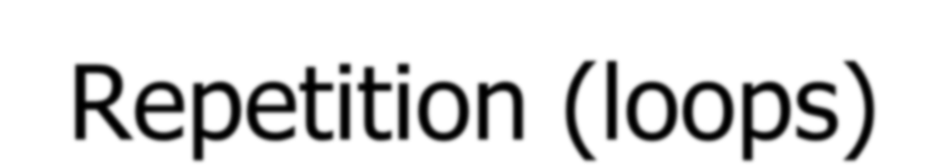
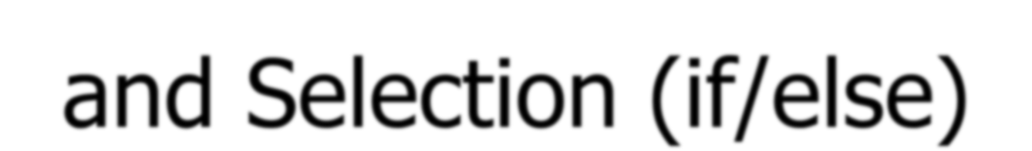
Repetition (loops) and Selection (if/else)

Slide 17
The for loop
for loop: Repeats a set of statements over a group of values.
Syntax:
for variableName in groupOfValues:
statements
We indent the statements to be repeated with tabs or spaces.
variableName gives a name to each value, so you can refer to it in the statements.
groupOfValues can be a range of integers, specified with the range function.
Example:
for x in range(1, 6):
print x, "squared is", x * x
Output:
1 squared | is | 1
2 squared | is | 4
3 squared | is | 9
4 squared | is | 16
5 squared | is | 25

Slide 18
range
The range function specifies a range of integers:
range(start, stop)
- the integers between start (inclusive) and stop (exclusive)
It can also accept a third value specifying the change between values.
range(start, stop, step) - the integers between start (inclusive)
and stop (exclusive) by step
Example:
for x in range(5, 0, -1): print x
print "Blastoff!"
Output:
5
4
3
2
1
Blastoff!
Exercise: How would we print the "99 Bottles of Beer" song?

Slide 19
Cumulative loops
Some loops incrementally compute a value that is initialized outside the loop. This is sometimes called a cumulative sum.
sum = 0
for i in range(1, 11):
sum = sum + (i * i)
print "sum of first 10 squares is", sum
Output:
sum of first 10 squares is 385
Exercise: Write a Python program that computes the factorial of an integer.

Slide 20
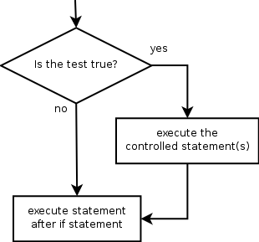
if
if statement: Executes a group of statements only if a certain condition is true. Otherwise, the statements are skipped.
Syntax:
if condition:
statements
Example:
gpa = 3.4
if gpa > 2.0:
print "Your application is accepted."

Slide 21
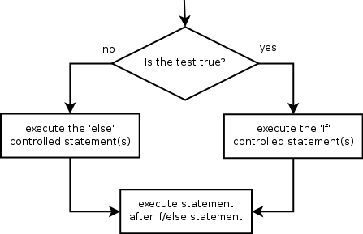
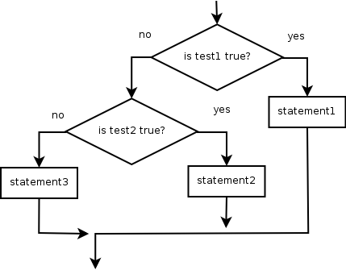
if/else
if/else statement: Executes one block of statements if a certain condition is True, and a second block of statements if it is False.
Syntax:
if condition:
statements
else:
statements
Example:
gpa = 1.4
if gpa > 2.0:
print "Welcome to Mars University!"
else:
print "Your application is denied."
Multiple conditions can be chained with elif ("else if"):
if condition:
statements elif condition: statements
else:
statements
2
1

Slide 22
Example of If Statements
import math
x = 30
if x <= 15 : y = x + 15
elif x <= 30 :
y = x + 30
else :
y = x print ‘y = ‘,
print math.sin(y)
>>> import ifstatement y = 0.999911860107
>>>
In interpreter
In file ifstatement.py

Slide 23
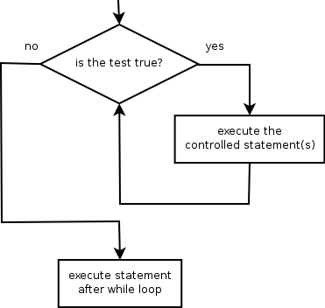
while
while loop: Executes a group of statements as long as a condition is True.
good for indefinite loops (repeat an unknown number of times)
Syntax:
while condition:
statements
Example:
number = 1
while number < 200: print number, number = number * 2
Output:
1 2 4 8 16 32 64 128
23

Slide 24
While Loops
>>> import whileloop 1
2
3
4
5
6
7
8
9
>>>
x = 1
while x < 10 : print x
x = x + 1
In whileloop.py
In interpreter

Slide 25
Logic
Many logical expressions use relational operators:
Operator | Meaning | Example | Result
== | equals | 1 + 1 == 2 | True
!= | does not equal | 3.2 != 2.5 | True
< | less than | 10 < 5 | False
> | greater than | 10 > 5 | True
<= | less than or equal to | 126 <= 100 | False
>= | greater than or equal to | 5.0 >= 5.0 | True
Logical expressions can be combined with logical operators:
Operator | Example | Result
and | 9 != 6 and 2 < 3 | True
or | 2 == 3 or -1 < 5 | True
not | not 7 > 0 | False
Exercise: Write code to display and count the factors of a number.
25

Slide 26
Loop Control Statements
break | Jumps out of the closest enclosing loop
continue | Jumps to the top of the closest enclosing loop
pass | Does nothing, empty statement placeholder

Slide 27
More Examples For Loops
Similar to perl for loops, iterating through a list of values
 |  | for x in [1,7,13,2]: print x | forloop2.py |  | for x in range(5) : print x
 | forloop1.py
%python forloop1.py 1 7 13 2
 |  |  |  | % python forloop2.py 0 1 2 3 4
range(N) generates a list of numbers [0,1, …, n-1]

Slide 28
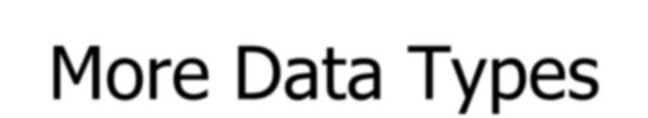
More Data Types

Slide 29
Everything is an object
Everything means everything, including functions and classes (more on this later!)
Data type is a property of the object and not of the variable
>>> x = 7
>>> x 7
>>> x = 'hello'
>>> x
'hello'
>>>

Slide 30
Numbers: Integers
Integer – the equivalent of a C long
Long Integer – an unbounded integer value.
>>> 132224
132224
>>> 132323 **
2
17509376329L
>>>

Slide 31
Numbers: Floating Point
int(x) converts x to an integer
float(x) converts x to a floating point
The interpreter shows
a lot of digits
>>> 1.23232
1.2323200000000001
>>> print 1.23232
1.23232
>>> 1.3E7
13000000.0
>>> int(2.0) 2
>>> float(2)
2.0

Slide 32
Numbers: Complex
Built into Python
Same operations are supported as integer and float
>>> x = 3 + 2j
>>> y = -1j
>>> x + y
(3+1j)
>>> x * y (2-3j)

Slide 33
String Literals
■ + is overloaded to do concatenation
>>> x = 'hello'
>>> x = x + ' there'
>>> x
'hello there'

Slide 34
String Literals
Can use single or double quotes, and three double quotes for a multi-line string
>>> 'I am a string' 'I am a string'
>>> "So am I!"
'So am I!'

Slide 35
Substrings and Methods
len(String) – returns the number of characters in the String
>>> s = '012345'
>>> s[3]
'3'
>>> s[1:4] '123'
>>> s[2:]
'2345'
>>> s[:4] '0123'
>>> s[-2]
'4'
str(Object) – returns a String representation of the Object
>>> len(x) 6
>>>
str(10.3)
'10.3'

Slide 36
String Formatting
Similar to C’s printf
<formatted string> % <elements to insert>
Can usually just use %s for everything, it will convert the object to its String representation.
>>> "One, %d, three" % 2 'One, 2, three'
>>> "%d, two, %s" % (1,3)
'1, two, 3'
>>> "%s two %s" % (1, 'three') '1 two three'
>>>

Slide 37
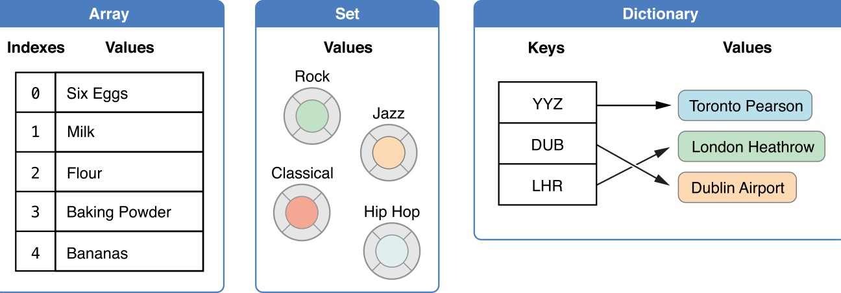
Types for Data Collection List, Set, and Dictionary
List
Ordered
Pairs of values
Unordered list

Slide 38
Lists
Ordered collection of data
Data can be of different types
Lists are mutable
Issues with shared references and mutability
Same subset operations as Strings
>>> x = [1,'hello', (3 + 2j)]
>>> x
[1, 'hello', (3+2j)]
>>> x[2] (3+2j)
>>> x[0:2]
[1, 'hello']

Slide 39
List Functions
list.append(x)
Add item at the end of the list.
list.insert(i,x)
Insert item at a given position.
Similar to a[i:i]=[x]
list.remove(x)
Removes first item from the list with value x
list.pop(i)
Remove item at position I and return it. If no index I is given then
remove the first item in the list.
list.index(x)
Return the index in the list of the first item with value x.
list.count(x)
Return the number of time x appears in the list
list.sort()
Sorts items in the list in ascending order
list.reverse()
Reverses items in the list

Slide 40
Lists: Modifying Content
x[i] = a reassigns the ith element to the value a
Since x and y point to the same list object, both are changed
The method append
also modifies the list
>>> x = [1,2,3]
>>> y = x
>>> x[1] = 15
>>> x [1, 15, 3]
>>> y
[1, 15, 3]
>>> x.append(12)
>>> y
[1, 15, 3, 12]

Slide 41
Lists: Modifying Contents
>>> x = [1,2,3]
>>> y = x
>>> z = x.append(12)
>>> z == None True
>>> y
[1, 2, 3, 12]
>>> x = x + [9,10]
>>> x
[1, 2, 3, 12, 9, 10]
>>> y
[1, 2, 3, 12]
>>>
The method append modifies the list and returns None
List addition (+) returns a new list

Slide 42
Using Lists as Stacks
You can use a list as a stack
>>> a = ["a", "b", "c“,”d”]
>>> a
['a', 'b', 'c', 'd']
>>> a.append("e")
>>> a
['a', 'b', 'c', 'd', 'e']
>>> a.pop() 'e'
>>> a.pop() 'd'
>>> a = ["a", "b", "c"]
>>>

Slide 43
Tuples
Tuples are immutable
versions of lists
One strange point is the format to make a tuple with one element:
‘,’ is needed to differentiate from the mathematical expression (2)
>>> x = (1,2,3)
>>> x[1:]
(2, 3)
>>> y = (2,)
>>> y (2,)
>>>

Slide 44
Sets
A set is another python data structure that is an unordered collection with no duplicates.
>>> setA=set(["a","b","c","d"])
>>> setB=set(["c","d","e","f"])
>>> "a" in setA True
>>> "a" in setB
False

Slide 45
Sets
>>> setA - setB
{'a', 'b'}
>>> setA | setB
{'a', 'c', 'b', 'e', 'd', 'f'}
>>> setA & setB
{'c', 'd'}
>>> setA ^ setB
{'a', 'b', 'e', 'f'}
>>>

Slide 46
Dictionaries
A set of key-value pairs
Dictionaries are mutable
>>> d= {‘one’ : 1, 'two' : 2, ‘three’ : 3}
>>> d[‘three’] 3

Slide 47
Dictionaries: Add/Modify
Entries can be changed by assigning to that entry
>>> d
{1: 'hello', 'two': 42, 'blah': [1, 2, 3]}
>>> d['two'] = 99
>>> d
{1: 'hello', 'two': 99, 'blah': [1, 2, 3]}
Assigning to a key that does not exist adds an entry
>>> d[7] = 'new entry'
>>> d
{1: 'hello', 7: 'new entry', 'two': 99, 'blah': [1, 2, 3]}

Slide 48
Dictionaries: Deleting Elements
The del method deletes an element from a dictionary
>>> d
{1: 'hello', 2: 'there', 10: 'world'}
>>> del(d[2])
>>> d
{1: 'hello', 10: 'world'}

Slide 49
Iterating over a dictionary
>>>address={'Wayne': 'Young 678', 'John': 'Oakwood 345',
'Mary': 'Kingston 564'}
>>>for k in address.keys():
print(k,":", address[k])
Wayne : Young 678 John : Oakwood 345 Mary : Kingston 564
>>>
>>> for k in sorted(address.keys()): print(k,":", address[k])
John : Oakwood 345 Mary : Kingston 564 Wayne : Young 678
>>>

Slide 50
Copying Dictionaries and Lists
The built-in list function will copy a list
The dictionary has a method called copy
>>> | l1 = [1] | >>> d = {1 : 10}
>>> | l2 = list(l1) | >>> d2 = d.copy()
>>> | l1[0] = 22 | >>> d[1] = 22
>>> | l1 | >>> d
[22] |  | {1: 22}
>>> | l2 | >>> d2
[1] |  | {1: 10}

Slide 51
Data Type Summary
Integers: 2323, 3234L Floating Point: 32.3, 3.1E2 Complex: 3 + 2j, 1j
Lists: l = [ 1,2,3]
Tuples: t = (1,2,3)
Dictionaries: d = {‘hello’ : ‘there’, 2 : 15}
Lists, Tuples, and Dictionaries can store any type (including other lists, tuples, and dictionaries!)
Only lists and dictionaries are mutable
All variables are references

Slide 52
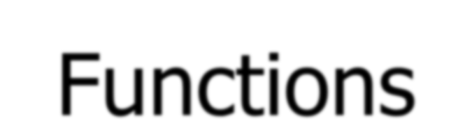
Functions

Slide 53
Function Basics
def max(x,y) : if x < y :
return x else :
return y
>>> import functionbasics
>>> max(3,5) 5
>>> max('hello', 'there')
'there'
>>> max(3, 'hello') 'hello'
functionbasics.py

Slide 54
Functions are objects
Can be assigned to a variable
Can be passed as a parameter
Can be returned from a function
Functions are treated like any other variable in Python, the def statement simply assigns a function to a variable

Slide 55
Function names are like any
variable
>>> x = 10
>>> x 10
>>> def x () :
... print 'hello'
>>> x
<function x at 0x619f0>
>>> x()
hello
>>> x = 'blah'
>>> x
'blah'
Functions are objects
The same reference rules hold for them as for other objects

Slide 56
Functions as Parameters
def foo(f, a) :
return f(a)
def bar(x) : return x * x
>>> from funcasparam import *
>>> foo(bar, 3)
9
funcasparam.py
Note that the function foo takes two parameters and applies the first as a function with the second as its parameter

Slide 57
Higher-Order Functions
map(func,seq) – for all i, applies func(seq[i]) and returns the
corresponding sequence of the calculated results.
>>> from highorder import *
>>> lst = range(10)
>>> lst
[0,1,2,3,4,5,6,7,8,9]
>>> map(double,lst) [0,2,4,6,8,10,12,14,16,18]
def double(x): return 2*x
highorder.py

Slide 58
Higher-Order Functions
filter(boolfunc,seq) – returns a sequence containing all those items in seq for which boolfunc is True.
>>> from highorder import *
>>> lst = range(10)
>>> lst
[0,1,2,3,4,5,6,7,8,9]
>>> filter(even,lst) [0,2,4,6,8]
def even(x):
return ((x%2 ==
0)
highorder.py

Slide 59
Higher-Order Functions
reduce(func,seq) – applies func to the items of seq, from left to right, two-at-time, to reduce the seq to a single value.
>>> from highorder import *
>>> lst = [‘h’,’e’,’l’,’l’,’o’]
>>> reduce(plus,lst)
‘hello’
def plus(x,y): return (x + y)
highorder.py

Slide 60
Functions Inside Functions
Since they are like any other object, you can have functions inside functions
def foo (x,y) : def bar (z) :
return z * 2 return bar(x) + y
>>> from funcinfunc import *
>>> foo(2,3)
7
funcinfunc.py

Slide 61
Functions Returning Functions
def foo (x) : def bar(y) :
return x + y return bar
# main
f = foo(3) print f print f(2)
% python funcreturnfunc.py
<function bar at 0x612b0> 5
funcreturnfunc.py

Slide 62
Parameters: Defaults
Parameters can be assigned default values
They are overridden if a parameter is given for them
The type of the default doesn’t limit the type of a parameter
>>> def foo(x = 3) :
... print x
...
>>> foo()
3
>>> foo(10)
10
>>> foo('hello')
hello

Slide 63
Parameters: Named
Call by name
Any positional arguments must come before named ones in a call
>>> def foo (a,b,c) :
... print a, b, c
...
>>> foo(c = 10, a = 2, b = 14) 2 14 10
>>> foo(3, c = 2, b = 19) 3 19 2

Slide 64
Anonymous Functions
A lambda expression returns a function object
The body can only be a simple expression, not complex statements
>>> f = lambda x,y : x + y
>>> f(2,3) 5
>>> lst = ['one', lambda x : x * x, 3]
>>> lst[1](4) 16

Slide 65
Modules
The highest level structure of Python
Each file with the py suffix is a module
Each module has its own namespace

Slide 66
Modules: Imports
import mymodule | Brings all elements of mymodule in, but must refer to as mymodule.<elem>
from mymodule import x | Imports x from mymodule right into this namespace
from mymodule import * | Imports all elements of mymodule into this namespace

Slide 67
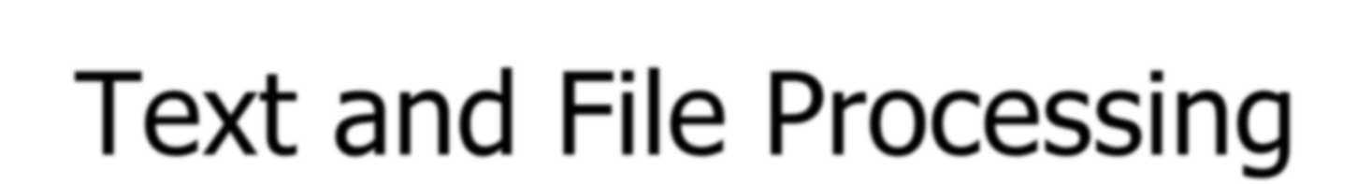
Text and File Processing

Slide 68
Strings
string: A sequence of text characters in a program.
Strings start and end with quotation mark " or apostrophe ' characters.
Examples:
"hello"
"This is a string"
"This, too, is a string. It can be very long!"
A string may not span across multiple lines or contain a " character.
"This is not
a legal String."
"This is not a "legal" String either."
A string can represent characters by preceding them with a backslash.
\t
\n
\"
\\
tab character
new line character quotation mark character backslash character
Example: "Hello\tthere\nHow are you?"

Slide 69
Indexes
Characters in a string are numbered with indexes starting at 0:
Example:
name = "P. Diddy"
index | 0 | 1 | 2 | 3 | 4 | 5 | 6 | 7
character | P | . |  | D | i | d | d | y
Accessing an individual character of a string:
variableName [ index ]
Example:
print name, "starts with", name[0]
Output:
P. Diddy starts with P

Slide 70
String properties
len(string)
number of characters in a string (including spaces)
lowercase version of a string
uppercase version of a string
str.lower(string)
str.upper(string)
Example:
name = "Martin Douglas Stepp" length = len(name)
big_name = str.upper(name)
print big_name, "has", length, "characters"
Output:
MARTIN DOUGLAS STEPP has 20 characters

Slide 71
raw_input
raw_input : Reads a string of text from user input.
Example:
name = raw_input("Howdy, pardner. What's yer name? ")
print name, "... what a silly name!"
Output:
Howdy, pardner. What's yer name? Paris Hilton
Paris Hilton ... what a silly name!

Slide 72
Text processing
text processing: Examining, editing, formatting text.
often uses loops that examine the characters of a string one by one
A for loop can examine each character in a string in sequence.
Example:
for c in "booyah":
print c
Output:
b
o o
y a h

Slide 73
Strings and numbers
ord(text) - converts a string into a number.
Example: ord("a") is 97, ord("b") is 98, ...
Characters map to numbers using standardized mappings such as
ASCII and Unicode.
chr(number) - converts a number into a string.
Example: chr(99) is "c"
Exercise: Write a program that performs a rotation cypher.
e.g. "Attack" when rotated by 1 becomes "buubdl"

Slide 74
File processing
Many programs handle data, which often comes from files.
Reading the entire contents of a file:
variableName = open("filename").read()
Example:
file_text = open("bankaccount.txt").read()

Slide 75
Line-by-line processing
Reading a file line-by-line:
for line in open("filename").readlines():
statements
Example:
count = 0
for line in open("bankaccount.txt").readlines(): count = count + 1
print "The file contains", count, "lines."
Exercise: Write a program to process a file of DNA text, such as:
ATGCAATTGCTCGATTAG
Count the percent of C+G present in the DNA.

Slide 76
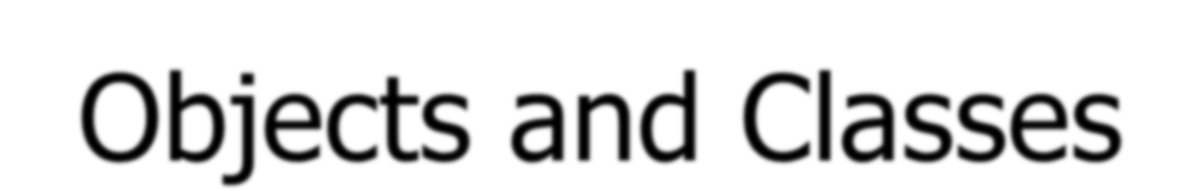
Objects and Classes

Slide 77
Defining a Class
Python program may own many objects
An object is an item with fields supported by a set of method functions.
An object can have several fields (or called attribute variables) describing
such an object
These fields can be accessed or modified by object methods
A class defines what objects look like and what functions can operate on these object.
Declaring a class:
class name:
statements
Example:
class UCSBstudent: age = 21 schoolname=‘UCSB’

Slide 78
Fields
name = value
Example:
class Point:
x = 0
y = 0
# main
p1 = Point() p1.x = 2
p1.y = -5
can be declared directly inside class (as shown here) or in constructors (more common)
Python does not really have encapsulation or private fields
relies on caller to "be nice" and not mess with objects' contents
point.py
1 2 3 | class Point: x = 0 y = 0

Slide 79
Using a Class
import class
client programs must import the classes they use
point_main.py
1 | from Point import *
2
3 | # main
4 | p1 = Point()
5 | p1.x = 7
6 | p1.y = -3
7
8 | p2 = Point()
9 | p2.x = 7
10 | p2.y = 1
 | # Python objects are dynamic (can add fields any time!)
 | p1.name = "Tyler Durden"

Slide 80
Object Methods
def name(self, parameter, ..., parameter): statements
self must be the first parameter to any object method
represents the "implicit parameter" (this in Java)
must access the object's fields through the self reference
class Point:
def move(self, dx, dy): self.x += dx self.y += dy

Slide 81
Exercise Answer
point.py
1 | from math import *
2
3 | class Point:
4 | x = 0
5 | y = 0
6
7 | def set_location(self, x, y):
8 | self.x = x
9 | self.y = y
10
11 | def distance_from_origin(self):
12 | return sqrt(self.x * self.x + self.y * self.y)
13
14 | def distance(self, other):
15 | dx = self.x - other.x
16 | dy = self.y - other.y
17 | return sqrt(dx * dx + dy * dy)

Slide 82
Calling Methods
A client can call the methods of an object in two ways:
(the value of self can be an implicit or explicit parameter)
1) object.method(parameters)
or 2)
Class.method(object, parameters)
Example:
p = Point(3, -4)
p.move(1, 5)
Point.move(p, 1, 5)

Slide 83
Constructors
def init (self, parameter, ..., parameter): statements
a constructor is a special method with the name init
Example:
class Point:
def init (self, x, y): self.x = x
self.y = y
...
How would we make it possible to construct a
Point() with no parameters to get (0, 0)?

Slide 84
toString and str
def str (self): return string
equivalent to Java's toString (converts object to a string)
invoked automatically when str or print is called
Exercise: Write a str method for Point objects that returns strings like "(3, -14)"
def str (self):
return "(" + str(self.x) + ", " + str(self.y) + ")"

Slide 85
Complete Point Class
point.py
1 from math import *
2
class Point:
def init (self, x, y):
self.x = x
self.y = y
7
8
9
10
11
12
13
14
15
16
17
18
19
20
21
def distance_from_origin(self):
return sqrt(self.x * self.x + self.y * self.y)
def distance(self, other): dx = self.x - other.x dy = self.y - other.y
return sqrt(dx * dx + dy * dy)
def move(self, dx, dy): self.x += dx self.y += dy
def str (self):
return "(" + str(self.x) + ", " + str(self.y) + ")"

Slide 86
Operator Overloading
operator overloading: You can define functions so that Python's built-in operators can be used with your class.
See also: http://docs.python.org/ref/customization.html
Operator | Class Method
- | neg (self, other)
+ | pos (self, other)
* | mul (self, other)
/ | truediv (self, other)
Operator | Class Method
== | eq (self, other)
!= | ne (self, other)
< | lt (self, other)
> | gt (self, other)
<= | le (self, other)
>= | ge (self, other)
Unary Operators
- | neg (self)
+ | pos (self)

Slide 87
Generating Exceptions
raise ExceptionType("message")
useful when the client uses your object improperly
types: ArithmeticError, AssertionError, IndexError,
NameError, SyntaxError, TypeError, ValueError
Example:
class BankAccount:
...
def deposit(self, amount):
if amount < 0:
raise ValueError("negative amount")
...

Slide 88
Inheritance
class name(superclass): statements
Example:
class Point3D(Point):
z = 0
...
# Point3D extends Point
Python also supports multiple inheritance
class name(superclass, ..., superclass): statements
(if > 1 superclass has the same field/method, conflicts are resolved in left-to-right order)

Slide 89
Calling Superclass Methods
methods:
constructors:
class.method(object, parameters) class. init (parameters)
class Point3D(Point): z = 0
def init (self, x, y, z): Point. init (self, x, y) self.z = z
def move(self, dx, dy, dz): Point.move(self, dx, dy) self.z += dz

