Slide 1
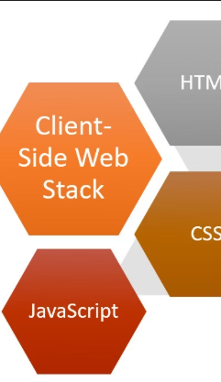
Introduction
Client-Side Development
DR Rizwana Naz Asif

Slide 2
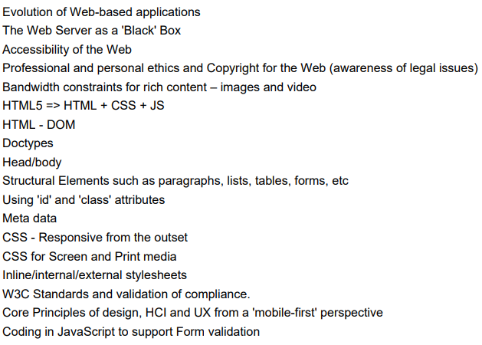
Module Content

Slide 3
Module Information
HTML5, CSS, Bootstrap, JS
Module Coordinator and Lectures –
Practical Sessions –
Assessments:
Assignment One – 20% of module mark. Group Assignment, will take the form of a written report. Will take place within November.
Assignment Two – 80% of module mark. Individual assignment, will take the form of a coding assessment. Will take place within December.

Slide 4
Assessments
Group-Based Website Evaluation Report
Assessment One:
Assignment will be undertaken in groups.
Each student will contribute to a unified report having each individually reviewed a separate website allocated to them.
Report will focus on analysing how well each website incorporates HCI and design principles.
A peer assessment will be given indicating the effort each group member gave to the assignment.
Students will then receive an individual mark based on peer assessment.

Slide 5
Assessments
Individual Website Development Project
Assessment Two:
Assignment will be undertaken individually.
Students will develop a website to collect contact details of potential employers who have requested their CV.
Students will use the knowledge of UX design and apply the principles to develop the HTML structure to take into account accessibility features as well as including coding for validation of user input.
The Web page will host both short and detailed student CVs information and display who has requested copies of their CVs.

Slide 6
Contact
Contact Us
Practical specific issues:
All other issues:
JSFiddle - https://jsfiddle.net/

Slide 7
Questions?
👉 We’re happy to help! Feel free to ask anything about the assessments or requirements.
📧 rizwana.asif@qa.com

