Slide 1

Overview of the World Wide Web
Dr Rizwana Naz Asif

Slide 2
What Isn’t The Web
Information About Web
The internet is not the web.
The internet consists of many applications, not just the web, other applications include:
Email.
SSH.
FTP.
Video game communication.
The applications may run on a specific protocol, such as SMTP.

Slide 3
What Is The Web?
World Wide Web
The World Wide Web (WWW), the web, is a large collection of documents and files that are accessible via the internet.
Web information is stored in documents called Web pages.
A Web site is a collection of Web pages written by one Web page author or a team of Web page authors.

Slide 4
What Is The Web?
Web Information
Computers reading the Web pages are called Web clients.
Web pages are files stored on computers called Web servers.
Web clients view the pages with a program called a Web browser.
The protocol that web browsers use to communicate with web servers is HTTP.

Slide 5
What Is The Web?
Web Address
TCP/IP operates across the internet and gives each client and server an IP address.
Communications on these IP addresses is split into ports to allow multiple applications to communicate, ports are 0 to 65535 (16-bit range).
HTTP communicates over TCP/IP, typically on port 80. HTTPS is a secured version of HTTP that typically communicates on port 443.

Slide 6
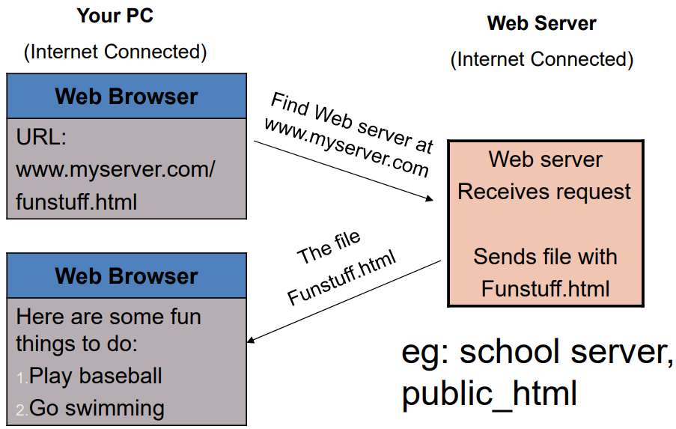
How Do Browsers Fetch Pages?

Slide 7
What’s In a Page?
HTML Structure
All Web pages contain instructions for display • The browser displays the page by reading these instructions.
The most common display instructions are called HTML tags, created by HTML (Hypertext Markup Language).
HTML ‘marks up’ content though tags, providing structure and semantics.

Slide 8
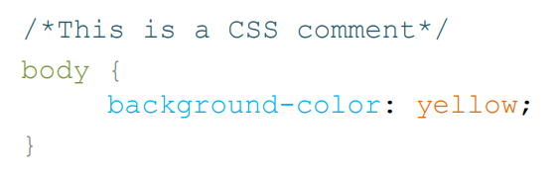
What’s In a Page?
CSS Structure
Web pages also typically contain:
Cascading Style Sheets (CSS) – Providing style information to determine how to present the marked up content.

Slide 9
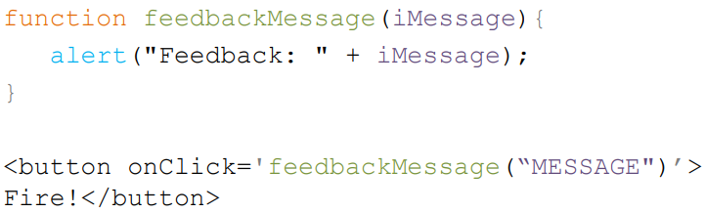
What’s In a Page?
JavaScript Structure
Web pages also typically contain:
JavaScript/ECMAScript – providing a way to enable programmatic functionality within a web page.

Slide 10

What’s In a Page?
CSS / JS
Web pages also typically contain:
Linked multimedia assets – such as Images/Videos.
CSS/JS may be incorporated through:
Independent files that are specified within the head of a HTML document.
In‐line specification throughout the HTML.

Slide 11
Who Makes Web Standards?
Web Standard Elements
The rule-making body of the Web is the W3C.
W3C stands for the World Wide Web Consortium.
W3C puts together specifications for Web standards.
http://www.w3.org/.
The most essential Web standards are HTML, CSS and XML.
HTML5, CSS3.
XHTML5.

Slide 12
Web Development Toolbox
Client / Server Side Toolkit
Client Side:
HTML, CSS.
XML.
JavaScript.
Server Side:
JavaScript, Java.
Perl, PHP.
Databases.

Slide 13
Web Development Toolbox
Tools / Resources
Online Tools/Resources:
StackOverlow – A great source of help and advice.
Codepen.io – Rapid development tool.
Jsfiddle.net – Rapid development tool.
W3schools.com – A great source of code examples and tutorials.

Slide 14
Static / Dynamic Web Authoring
Web Creation Authority
Historically web authoring focussed on static web pages, these typically loaded an entire page every time a widget was clicked/interacted with.
This approach is inefficient and jarring to the user.

Slide 15
Static / Dynamic Web Authoring
Static Webpages
Static Webpages
Content is fixed: Each page is pre-written and does not change unless edited manually.
Written in: HTML, CSS (no server-side scripting).
Faster to load: Because they don’t require server processing.
No user interaction or personalization.
Best for: Simple websites like portfolios, blogs, or informational pages.
✅ Example: An “About Us” page that always shows the same content to everyone

Slide 16
Static / Dynamic Web Authoring
Dynamic Webpages
🔹 Dynamic Webpages
Content changes based on user input or data: Generated in real-time from a server or database.
Written in: HTML with server-side scripts like PHP, Python, ASP.NET, or JavaScript frameworks.
Can interact with databases: For user login, shopping carts, etc.
Slower to load: Slightly, due to server processing.
Best for: E-commerce sites, social networks, dashboards, etc.
✅ Example: A user profile page that shows different data for each user.

Slide 17
Static/Dynamic Web Authoring
Dynamic HTML
Modern dynamic web authoring produces, rich and interactive web pages through Dynamic HTML.
Benefits of dynamic web pages include:
Increased responsiveness.
More efficient loading of data.
Better user experience.
Interactivity.
Rich multimedia experiences.

Slide 18
DHTML – Dynamic HTML
Group of Technologies
It is not a special version of HTML.
It is a group of technologies used to create, rich, interactive Web pages:
Cascading StyleSheets (CSS).
Web scripting/JavaScript.
DOM (Document Object Model).
HTML5

Slide 19
DHTML – Dynamic HTML
Advantages Of DHTML
Some advantages include:
Support by all browsers.
Open standards.
Change content on the fly.
Small size of the file initially served.
No plug-ins required.
Easy to learn, fast development, faster web experience.
More interaction through AJAX.

Slide 20
DHTML – Dynamic HTML
Disadvantages DHTML
However, DHTML has some disadvantages:
Feature level browser and operating system incompatibilities.
Support for handheld devices may require customisation.
Web developer requires more skill.

Slide 21
Web Page Editors
How to Edit Web Pages
To edit web pages/HTML/CSS/JS an editor is required, these may include:
Notepad++.
Visual Studio Community.
Visual Studio Code.
Brackets.
Sublime Text.
Vim.
Nano.

Slide 22
Basic Web Development Cycle
Let’s Start Work on HTML File
The Four-Step development cycle:
Save your HTML file.
Load the file into your web browser.
Review the file with your Web browser.
Revise your HTML file with a text editor.

Slide 23
Questions?
👉 We’re happy to help! Feel free to ask anything about the assessments or requirements.
📧 rizwana.asif@qa.com

