Slide 1

Hyper Text Markup Language
HTML5
Dr Rizwana Naz Asif

Slide 2
What is an HTML File?
Introduction
An HTML file is a text file containing small markup tags.
The markup tags tell the web browser how to display the page.
An HTML file must have an htm or html file extension.
An HTML file can be created using a simple text editor.

Slide 3
Text Editors
Web Authoring Tools
Creating a website requires:
A text editor – NotePad++, Atom, Sublime Text, Vi, etc.
There are other tools known as web authoring tools.
A web hosting service.
A browser
Notes:
The web authoring tools have WYSIWYG functionality.
What's that?
What you see is what you get.
More specifically, WYSIWYG means that when you're editing your text, you can see what your text will look like after it's uploaded to a website.
DreamWeaver and Visual Studio are more expensive, have lots of features, and are widely used in industry.

Slide 4
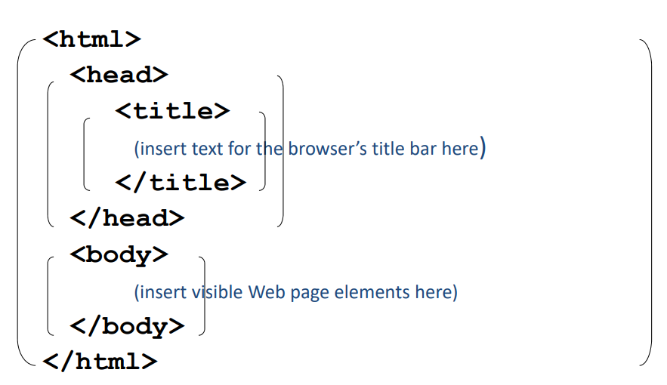
HTML Tag Template

Slide 5
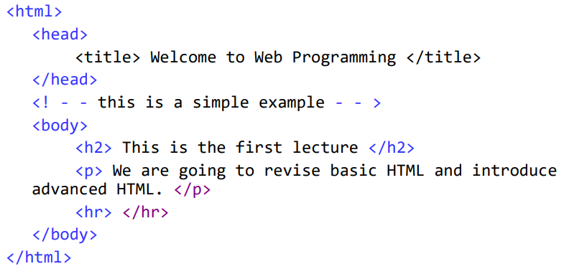
An HTML Example

Slide 6
Basic HTML
Basic Working Tags
HTML Basic Tags
Formatting
Entities
Links
Frames
Tables
Lists
Forms
Images
Background
Checkbox
Radio Button
Button

Slide 7
HTML Basics
Tag Information
HTML is composed of tags. HTML tags are always enclosed in angle brackets, <>, and are case-insensitive.
Tags typically occur in begin-end pairs, with an opening and closing tag.
<tag></tag>
Web pages begins with <html> and ends with </html>.

Slide 8
Head and Title Tags
Beginner's Tag
The HEAD tags contain all of the document’s header information.
<head></head>
It doesn’t appear at the top of the browser window, but contains things like the document title and so on.
The Title tag is placed within the HEAD structure. Between the TITLE tags, you should have the title of your document. This will appear at the top of the browser’s title bar.
<title></title>

Slide 9
Body Tag
Main Tag
The BODY tags come after the HEAD tags. Between the BODY tags you find all of the stuff that gets displayed in the browser window. All of the text, the graphics, and links, and so on.
<body></body>
Placing a background image can be done by typing in the following:
<body background=“myImage.jpg” text=“white”>

Slide 10
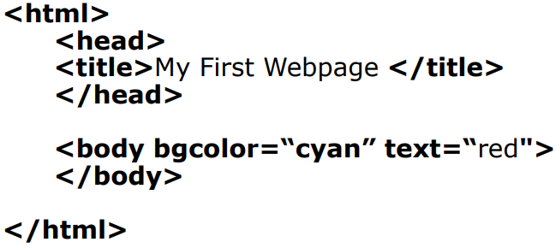
Webpage
Creation of Webpage
So, putting everything we’ve covered this far into one file we have:

Slide 11
Headings and Paragraphs
Starting Tag
There are six levels of headings, from heading 1 <h1> through to heading 6 <h6>.
The beginning of a paragraph is marked by <p>, and the end by </p>.
<p> This is a paragraph. </p>
<p> This is a paragraph . </p>
<p> This is
a
paragraph. </p>

Slide 12
Text Formatting
Setting Up Tag
If you want to end a line after a certain word, but don’t want to start a new paragraph, you can use the <br /> tag.
Text on a web page can be set to bold, italic, and underline:
<b></b> - is for bold.
<i></i> - is for italics.
<u></u> - is for underline.

Slide 13
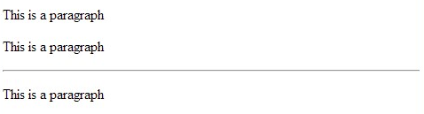
Font Tag
Font Style
The FONT and COLOR tags can be used to change the fonts and colours of your web page.
<font face = “Arial” color = “blue”> Your Text </font>
The Horizontal Rule <hr /> is useful when you want to separate two sections with a line.

Slide 14
Hyperlinks
Links Working
In order to create a hyperlink, you’ll need to know two things.
The URL – the location of the file to which you want to link to.
How links works.
Links work by using the HREF (Hypertext REFerence) tag and the URL you want to link to.
<a href=http://www.google.com/> Google</a>
Note: a signifies the anchor.

Slide 15
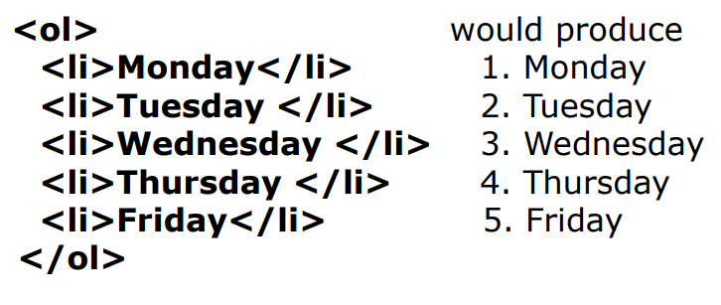
Lists
Items on List
There are two types of lists in HTML – Ordered lists, and unordered lists.
<ol> and </ol> for ordered lists (numbered).
<ul> and </ul> for unordered lists (bullets).
<li> and </li> for items on the list.

Slide 16
Images
Display Images
Images are placed in web documents using the IMG tag.
In order to make the IMG tag work, you need to use an SRC attribute.
SRC stands for source, where SRC is the URL of the graphic you want to have displayed.
<img src=“image.jpg” width=“400” height=“300”>

Slide 17
Tables
Table Creation
The Table tag consists of the <table> and </table> tags.
<caption></caption> - used to create the title of a table.
<tr></tr> - used to create a table row.
<th></th> - used to create a header cell.
<td></td> - used to create a table cell.
Border – specify the border size.
Bordercolor – specify the colour of the border.
Align – specify the alignment of the whole table.
Cellspacing – specify the amount of empty space between the outer edges of each table cell.
Cellpadding – specify the amount of empty space between the border of the table cell and the content of the cell.

Slide 18
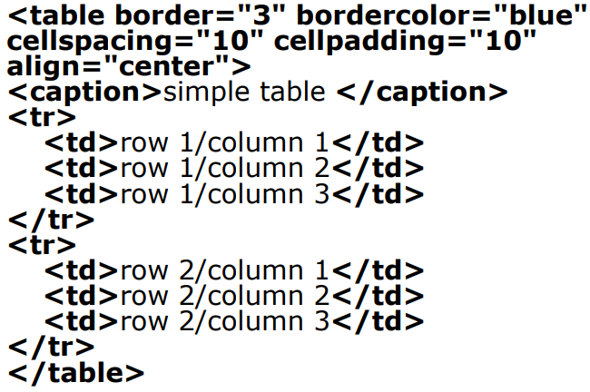
Table

Slide 19
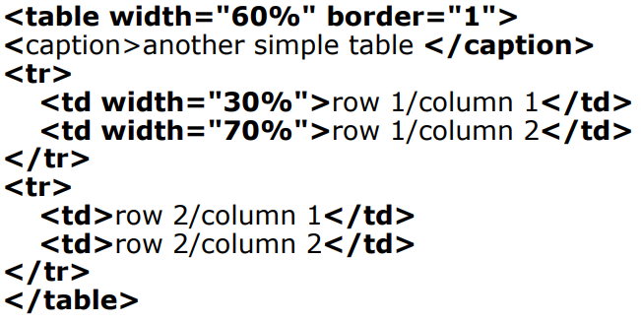
Tables
Organising Layout
Tables can be used to organise the layout of your webpage.

Slide 20
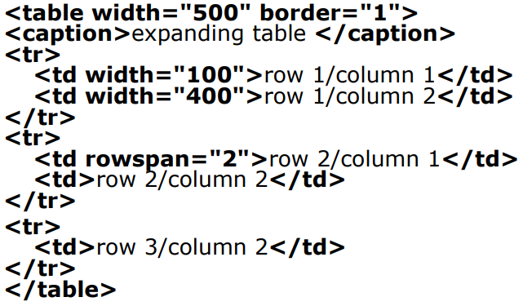
Tables
Expanding Table
Rows can be expanded.

Slide 21
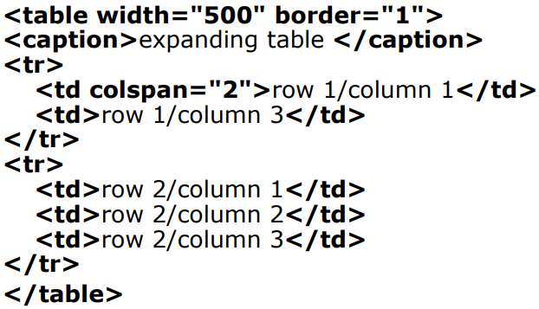
Tables
Expanding Table
Columns can also be expanded.

Slide 22
Forms
Creating Form
A form can contain input elements like text fields, checkboxes, radio-buttons, submit buttons etc.
Forms are placed in web documents using the form tag.
<form name=“InputTypes”>
The input tag is used to place input elements on the web page.
<input type=“text” name=“FirstName” size=“20”>

Slide 23
Questions?
👉 We’re happy to help! Feel free to ask anything about the assessments or requirements.
📧 rizwana.asif@qa.com

