Slide 1
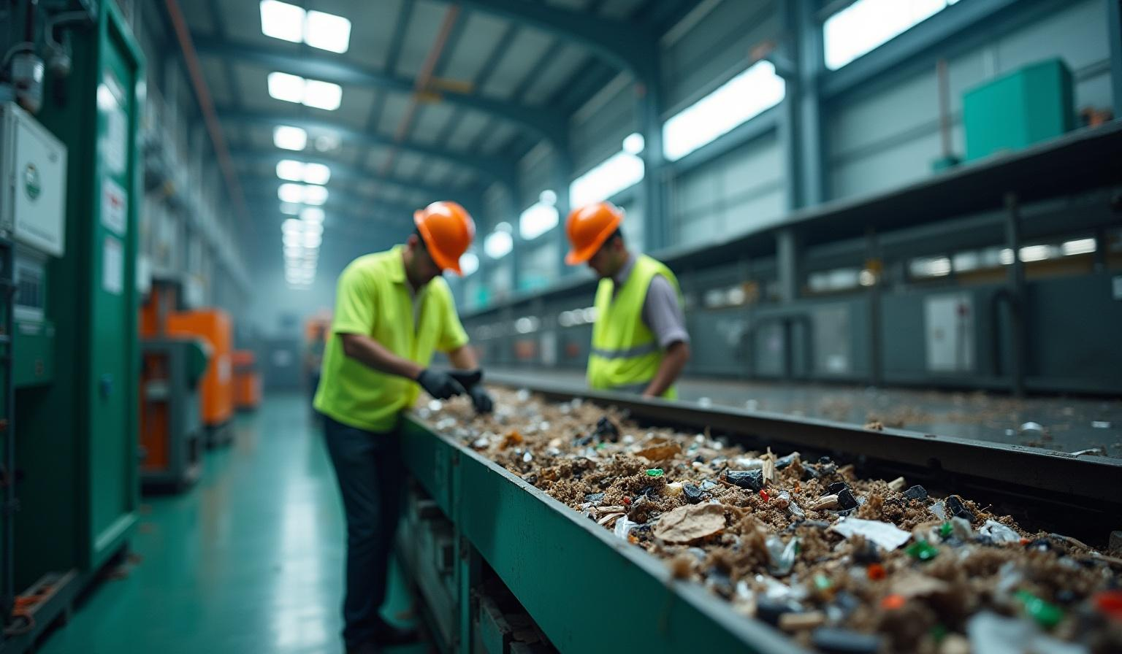
Cleantech in Waste Management

Slide 2
Introduction
This presentation explores the intersection of cleantech and waste management, focusing on how transfer learning can optimize waste processes, reduce environmental impact, and promote sustainability.

Slide 3

01
Overview

Slide 4

Introduction to Cleantech
Cleantech refers to innovative technologies aimed at improving environmental performance. It encompasses solutions that enhance energy efficiency, reduce emissions, and promote sustainable practices, particularly in waste management.

Slide 5
Importance of Waste Management
Effective waste management is critical for sustainability, impacting environmental health and resource conservation. By utilizing advanced technologies, businesses can minimize waste, reduce landfill use, and promote recycling and resource recovery.

Slide 6
Role of Transfer Learning
Transfer learning is a machine learning technique where a model developed for one task is reused for a different but related task. In waste management, it enhances predictive modeling, allowing for more accurate assessments and improved decision-making while reducing the time and resources needed for model training.

Slide 7
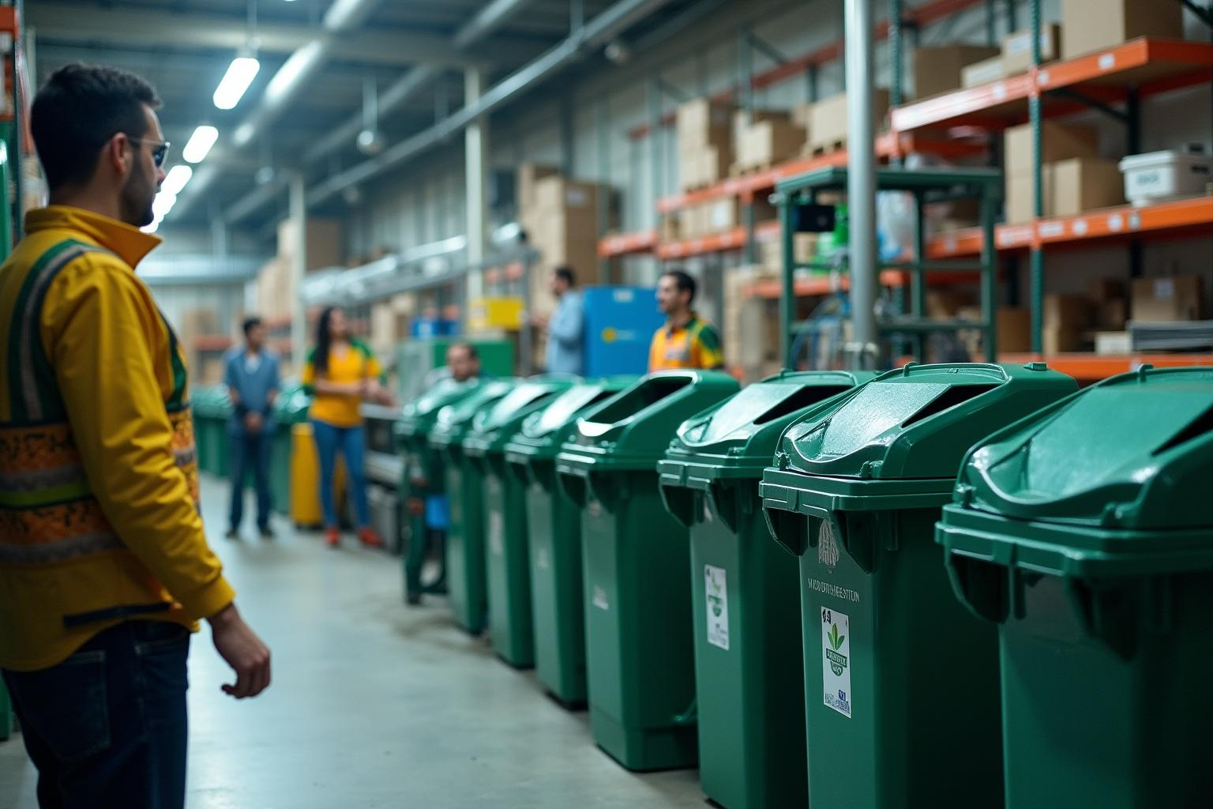
02
Applications

Slide 8
Transfer Learning Techniques
Various transfer learning techniques can be applied in waste management, such as domain adaptation and fine-tuning pre-trained models. These methods reduce the need for large datasets specific to waste types, enabling more efficient use of available data.

Slide 9
Case Studies in Waste Management
Numerous case studies demonstrate the effectiveness of transfer learning in waste management. For instance, models trained on urban waste sorting have been adapted for agricultural waste management, yielding significant accuracy improvements in waste classification.

Slide 10

Future Trends and Innovations
The future of transfer learning in waste management looks promising with advancements in artificial intelligence and machine learning. Innovations may include real-time waste monitoring systems and enhanced recycling processes that leverage AI-driven predictions.

Slide 11
Conclusions
In conclusion, transfer learning holds significant potential to revolutionize waste management practices. By improving accuracy and efficiency, it can contribute to more sustainable waste solutions, fostering environmental health and resource conservation.

Slide 12
Thank you!
Do you have any questions?
+00 000 000 000

