Slide 1
MACHINE LEARNING RESEARCH / NOV 2026
EMPLOYEE
ATTRITION
Prediction using a 10,000-record HR benchmark
THE UNIVERSITY OF LAHORE | DEPARTMENT OF COMPUTER SCIENCE
Abdul Rehman + Muhammad Rizwan
9 features + 1 target / 3 supervised algorithms / 2,000 final test cases
Notes:
[Sources]
- User-supplied Employee_Attrition_Results.xlsx (validation, final test), November 2026.
- User-supplied confusion matrix and ROC chart screenshots.
- Dataset source: https://github.com/RuchitaGarde/Human-Resources-Analytics
- Original IBM-based project article supplied by the user.
[/Sources]

Slide 2
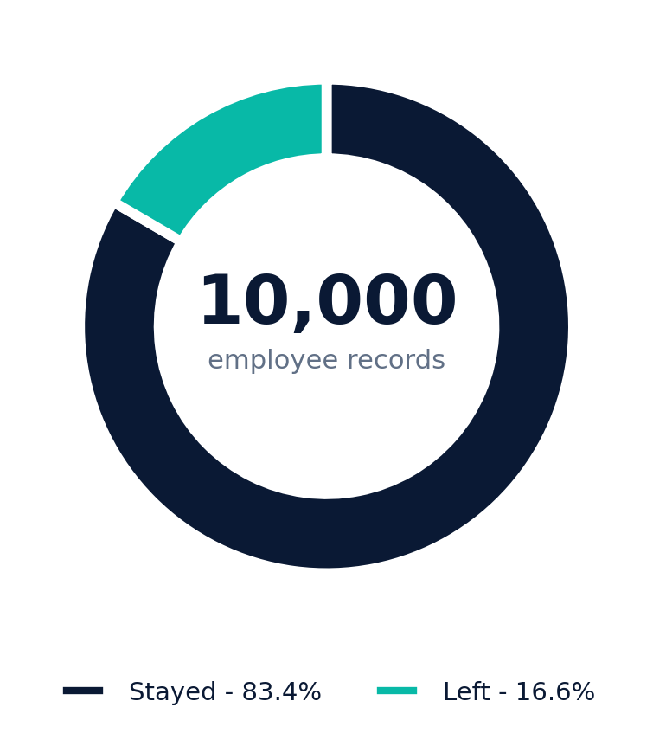
THE UNIVERSITY OF LAHORE / ML RESEARCH
DATA & METHOD
DATASET AND PROTOCOL
10,000 employees. Three classifiers.
Stratified splits protect the final evaluation and preserve the class distribution.
MODEL INPUTS
1,660
9 numeric/categorical inputs
Left (Yes)
Satisfaction, evaluation, workload, tenure, accident,
promotion, department and salary band.
8,340
Stayed (No)
6,400
1,600
2,000
TRAIN
VALIDATION
TEST
Educational / simulated public benchmark, not verified real HR records.
EMPLOYEE ATTRITION | ML RESEARCH
02
Notes:
[Sources]
- User-supplied Employee_Attrition_Results.xlsx (validation, final test), November 2026.
- User-supplied confusion matrix and ROC chart screenshots.
- Dataset source: https://github.com/RuchitaGarde/Human-Resources-Analytics
- Original IBM-based project article supplied by the user.
[/Sources]
Rows sampled without duplicate predictors. Stratified train/validation/test.

Slide 3
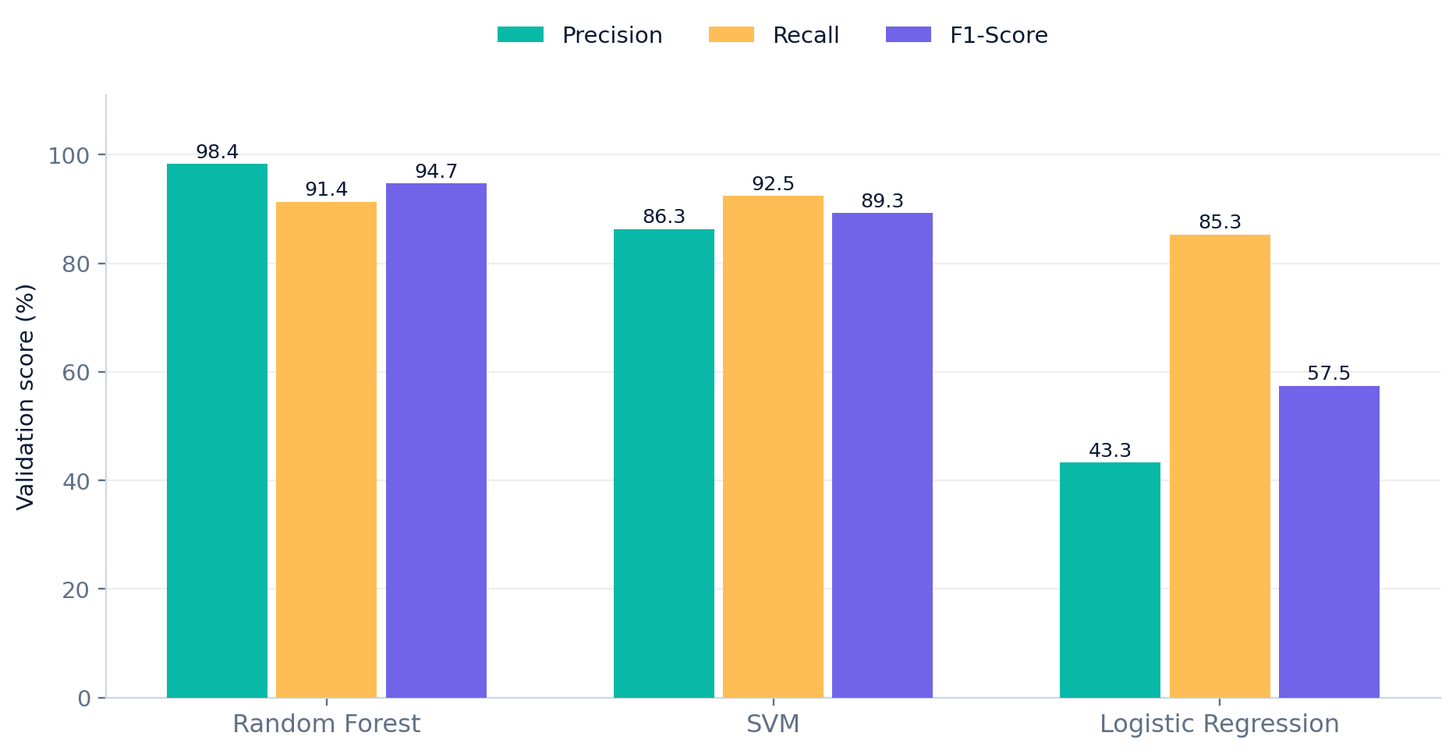
THE UNIVERSITY OF LAHORE / ML RESEARCH
VALIDATION
MODEL COMPARISON
Random Forest wins on F1-score
Choose using validation F1; do not use final test cases for model selection.
BEST VALIDATION F1
94.74%
Random Forest
SVM F1 89.29%
Logistic F1 57.47%
RF precision 98.38% / recall 91.35%
EMPLOYEE ATTRITION | ML RESEARCH
03
Notes:
[Sources]
- User-supplied Employee_Attrition_Results.xlsx (validation, final test), November 2026.
- User-supplied confusion matrix and ROC chart screenshots.
- Dataset source: https://github.com/RuchitaGarde/Human-Resources-Analytics
- Original IBM-based project article supplied by the user.
[/Sources]

Slide 4
THE UNIVERSITY OF LAHORE / ML RESEARCH
FINAL TEST
HELD-OUT PERFORMANCE
98.25% accuracy across 2,000 rows
Selected Random Forest refitted on all 8,000 development records.
98.25%
99.01%
90.36%
94.49%
Accuracy
Precision
Recall
F1-score
1,965 correct
Leaving class
300 of 332 leavers
Balanced detection
0.9802
32 actual leavers were missed
ROC-AUC
EMPLOYEE ATTRITION | ML RESEARCH
04
Notes:
[Sources]
- User-supplied Employee_Attrition_Results.xlsx (validation, final test), November 2026.
- User-supplied confusion matrix and ROC chart screenshots.
- Dataset source: https://github.com/RuchitaGarde/Human-Resources-Analytics
- Original IBM-based project article supplied by the user.
[/Sources]

Slide 5
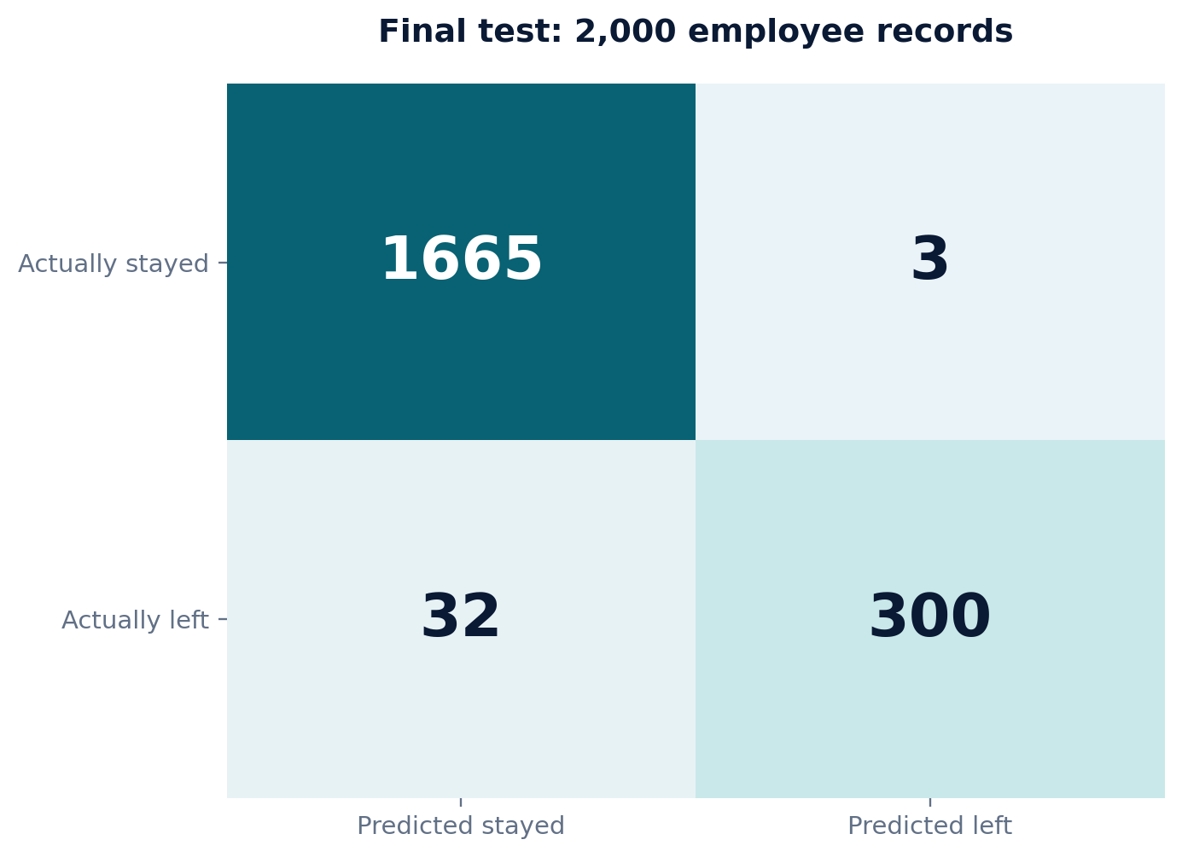
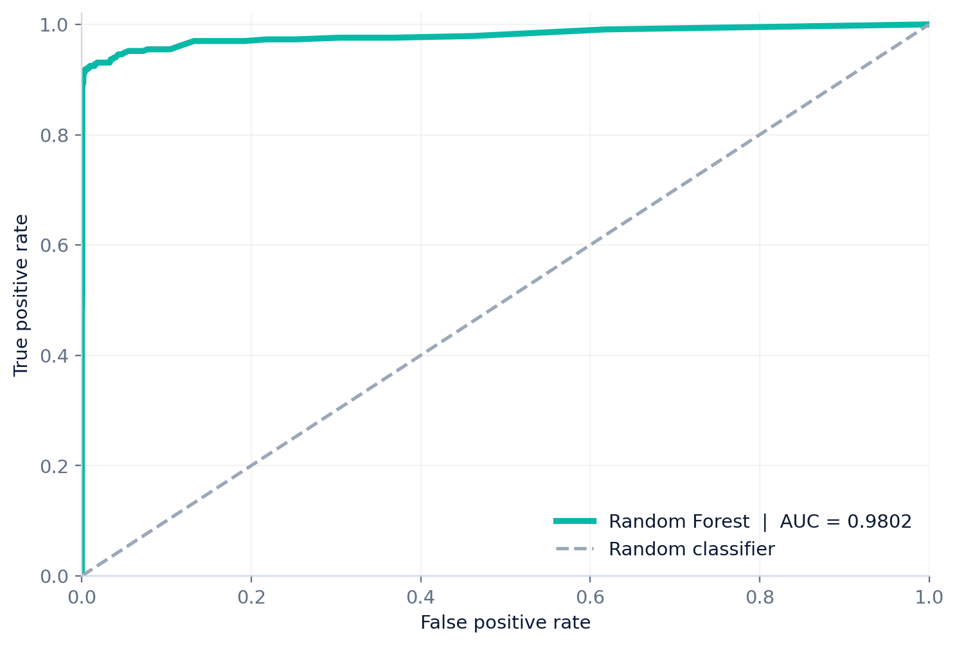
THE UNIVERSITY OF LAHORE / ML RESEARCH
MODEL DIAGNOSTICS
EVIDENCE
Confusion matrix + ROC curve
Inspect who was missed and how class scores are separated.
CLASSIFICATION OUTCOMES
RECEIVER OPERATING CHARACTERISTIC
1,665 TN | 300 TP | 3 FP | 32 FN
AUC = 0.9802
32 false negatives are the most important remaining errors.
EMPLOYEE ATTRITION | ML RESEARCH
05
Notes:
[Sources]
- User-supplied Employee_Attrition_Results.xlsx (validation, final test), November 2026.
- User-supplied confusion matrix and ROC chart screenshots.
- Dataset source: https://github.com/RuchitaGarde/Human-Resources-Analytics
- Original IBM-based project article supplied by the user.
[/Sources]

Slide 6
RESEARCH CONCLUSION
RANDOM FOREST
98.25% Accuracy / 94.49% F1 / 0.9802 AUC
01
Educational benchmark
Records are simulated / not authenticated employee histories.
02
External validation needed
Performance on a different real organization is unknown.
03
Keep humans in the loop
Do not automate employment decisions from predicted risk.
Abdul Rehman + Muhammad Rizwan | University of Lahore
Notes:
[Sources]
- User-supplied Employee_Attrition_Results.xlsx (validation, final test), November 2026.
- User-supplied confusion matrix and ROC chart screenshots.
- Dataset source: https://github.com/RuchitaGarde/Human-Resources-Analytics
- Original IBM-based project article supplied by the user.
[/Sources]

