Slide 1
Prerequisites
1- Understanding of Digital Electronics
2- Basic Understanding of HDL programming ( Verilog/VHDL)

Slide 2
Tools
Tools we need :
Vivado https://www.youtube.com/watch?v=eXuHADE2Buw&ab_channel=RizwanTariq
Version: 2019.1 : its freely available. installation instructions are in this video

Slide 3
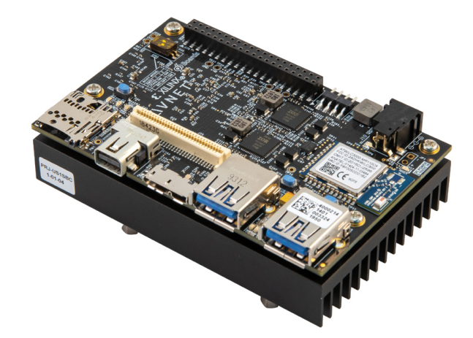
FPGA Board
Ultra96 V2
https://www.avnet.com/wps/portal/us/products/new-product-introductions/npi/aes-ultra96-v2/

Slide 4
Objectives
Or Gate example
Understand the Simulation workflow on Vivado
Create or_gate project
Quick Simulation method
Test bench method
Third party simulators I.e. modelsim and cadence etc.
Understand the Implementation workflow on Vivado
Synthesis: Synthesis is the process of transforming an RTL-specified design into a gate-level representatio
Synthesize with out constraints.
Adding Constraints
How to read constraints from FPGA board User guide
Adding constraints using GUI
Adding constraints using XDC file
Implementation
Vivado implementation includes all steps necessary to place and route the netlist onto the FPGA device resources, while meeting the logical, physical, and timing constraints of a design.
Generate Bitstream
Connect FPGA board to PC/Laptop
if the FPGA board is not detected by Vivado, check device manager if the drivers are installed. If not, please install drivers.
Program the FPGA

Slide 5
Objectives
Use ILA: Second Method
Monitoring of internal signals i.e. states of state machine
ILA + VIO = very powerful debugging of FPGA designs

Slide 6
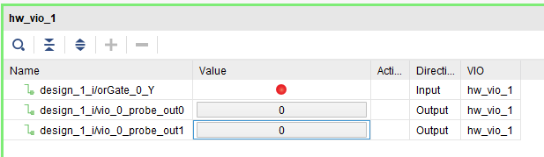
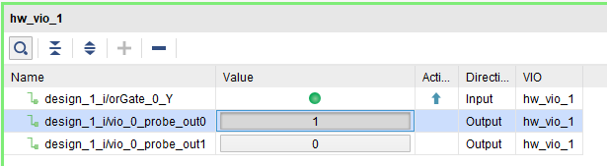
Objectives
Use Vivado Block Design
Use Virtual I/O to interact with the design
Virtual Input/Output (VIO) core is a customizable core that can both monitor and drive internal FPGA signals in real time.
VIO requires clock
In Ultra96, I have to get clock from Zynq Processing System
This requires a bit understanding of HW/SW codesign.
I have explained HW/SW co-design concepts in these two vides in detail
https://www.youtube.com/watch?v=xb7QBuBZuvI&ab_channel=RizwanTariq
https://www.youtube.com/watch?v=bs3bzgAZqqw&t=1s&ab_channel=RizwanTariq

Slide 7
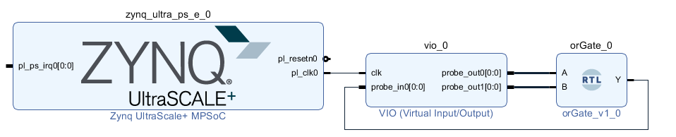
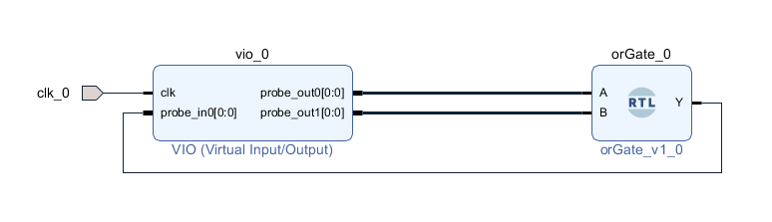
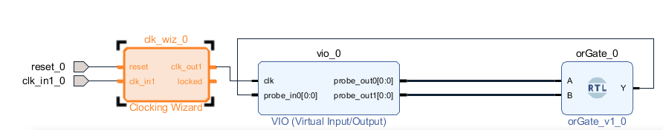
Vivado Block Design
My Block Design: Zynq PS provides Clock
Alternative Approach: Provide External Clock directly
Alternative Approach: Provide External Clock via Clocking Wizard

Slide 8
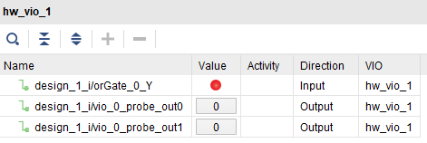
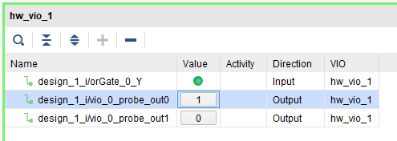
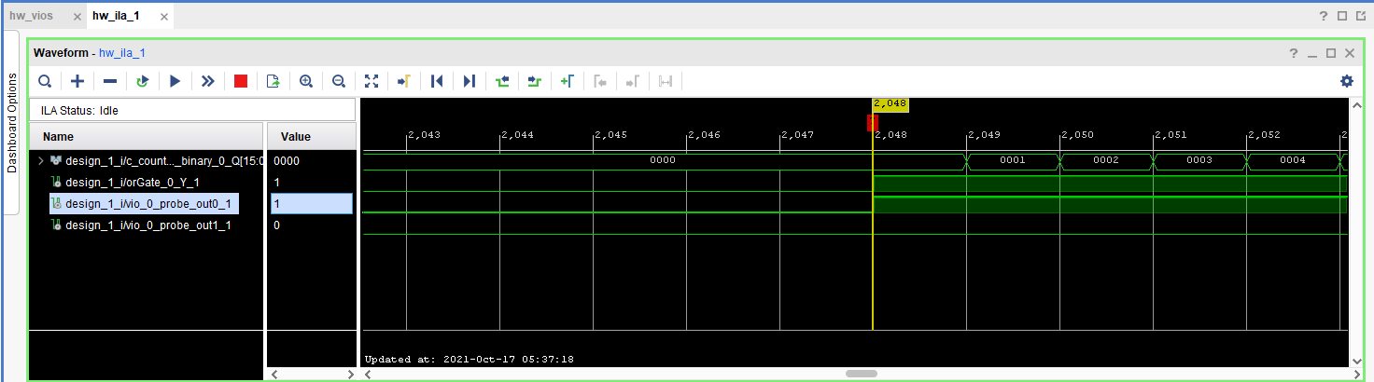
Objectives
Use ILA
Integrated Logic Analyzer (ILA) IP core is a logic analyzer core that can be used to monitor the internal signals of a design
Save the data for post processing
Different Trigger combinations
ILA + VIO = very powerful debugging of FPGA designs
Example:
Data Capture from a sensor. If the sensor is a Radar. Then we can capture the radar data on a Trigger, save that data in a excel file, and can use that for post processing (e.g. FFT) ( MATLAB, OCTAVE, Python etc. )

Slide 9
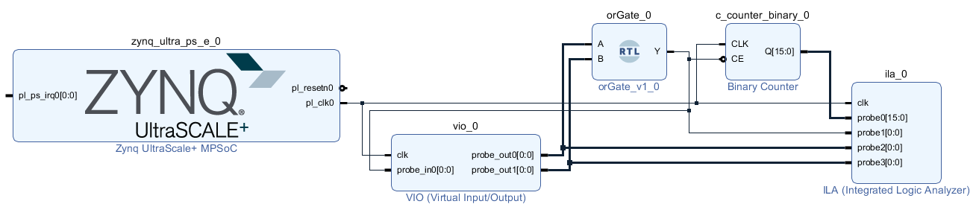
Vivado Block Design
My Block Design: Zynq PS provides Clock

Slide 10
Microblaze Simulation

Slide 11
Microblaze
Soft-Core processor is delivered in the form of Synthesizable HDL
MicroBlaze is Softcore by Xilinx
Customizable
32 bit or 64 bit implementations
Instruction and Data-side Cache
Optional Floating Point Unit (FPU)
ECC
And many more features. Etc.
Cadence Tensilica Cores
Synthesizable HDL (Verilog)
ASIC Design Flow
FPGA Design Flow

Slide 12
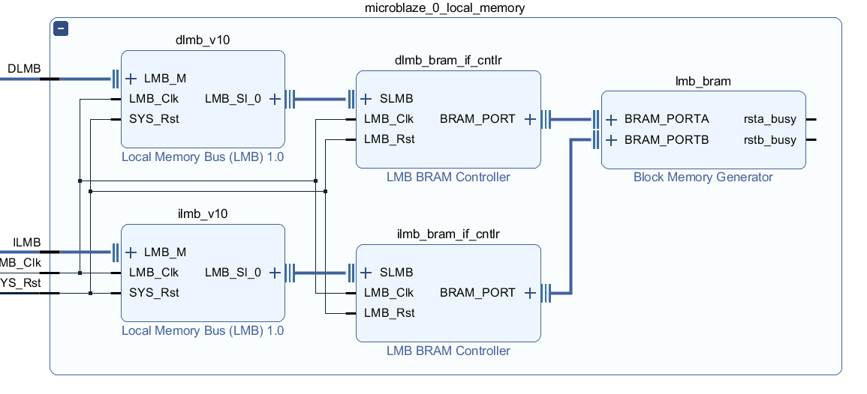
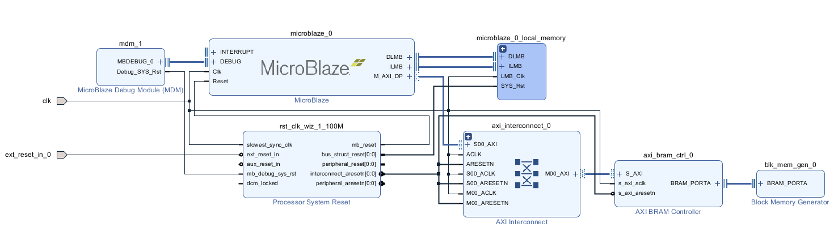
Microblaze Design Simulation
Microblaze
LMB
Local Memory
AXI Bus
Block Ram

Slide 13
Microblaze Simulation
Simulation workflow for Microblaze
Create block design project
Add relevant IP cores
Create Test bench
Add Constraints (if any)
Complete the design implementation.
Explore the Hardware Design to SDK
Create and build the Microblaze Application
Associate the ELF file to the Microblaze design
Simulate the Design

Slide 14
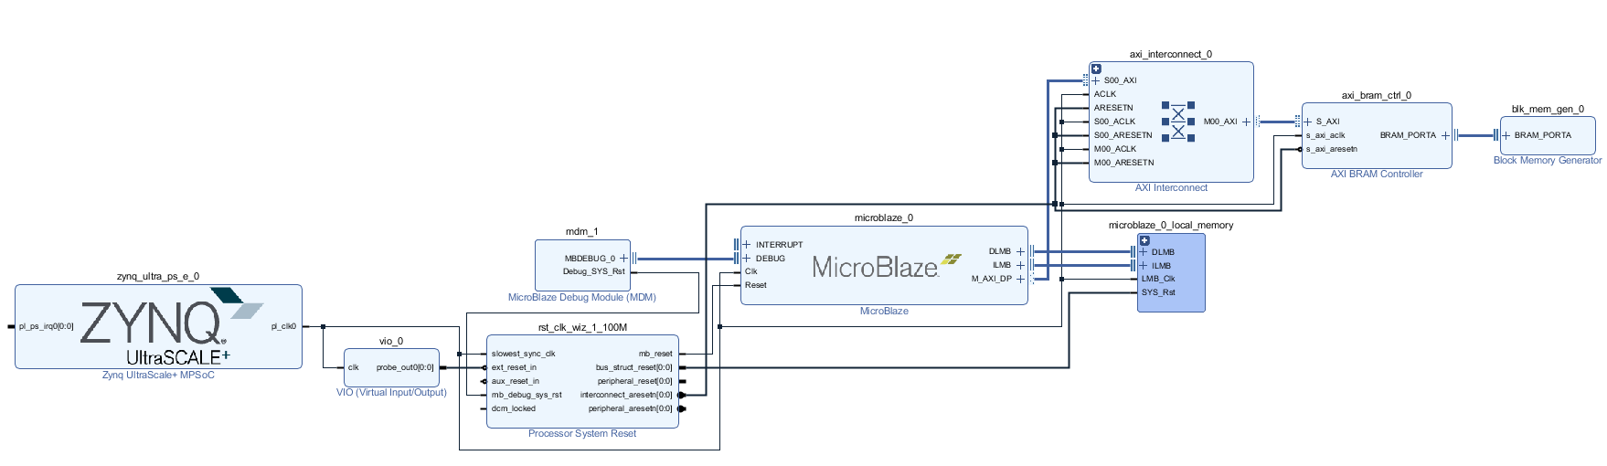
Microblaze Design Implementation
Using VIO to provide reset
Using Zynq PS to provide Clock 100 MHz

