Slide 1
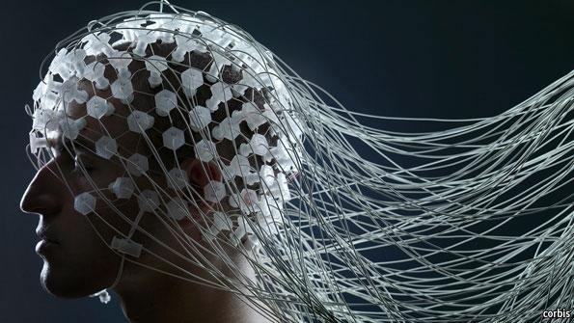
Real-time Cognitive Load Detection AND Classification
Advancements in Brain Computer Interfaces
Name Of Presenter: Md Shafiullah Quraishi
Roll Of Presenter: 20CS8085
Under Supervision of: Prof. Tandra Pal
May, 2024
Department of Computer Science and Engineering
Notes:
NOTE:
To change the image on this slide, select the picture and delete it. Then click the Pictures icon in the placeholder to insert your own image.

Slide 2
Objective of the work
BCI Development: Innovate a user-friendly Brain Computer Interface (BCI) system to detect and classify cognitive load, enhancing human-device interaction capabilities significantly.
EEG Insight Utilization: Utilize Electro Encephalography (EEG) data to explore into cognitive load dynamics, facilitating a deeper understanding of mental effort during tasks.
Efficient Workload Assessment: Design and implement an effective system for assessing mental workload by analyzing intricate brain activity patterns, ensuring accurate workload evaluation.
Feature-Driven Classifier Enhancement: Identify and leverage crucial EEG features to enhance classifier performance, elevating the precision and reliability of cognitive load detection algorithms.
Real-time Load Prediction: Develop machine learning models capable of swiftly determining an individual's cognitive state, whether at rest or engaged in a task.

Slide 3
Contribution of the work: Flowchart/Block Diagram
1
EEG brain signal
2
Signal processing
3
Feature extraction
4
5
Getting two dataset of EEG from opensource
filtration using butterworth filter
time domain and frequency domain feature extraction from EEG data
Feature Ranking
using three different ranking algorithms chi-square test, ReliefF and MRMR Algorithm
Classification
using different ML algorithm Like LDA, SVM, KNN and NN to classify weather brain state is in task or rest

Slide 4
Contribution of the work: Methodology
EEG data from 29 subjects recorded during mental arithmetic (MA) versus resting state tasks using a BrainAmp EEG amplifier with 32 active electrodes. Preprocessed and down sampled to 200 Hz.
EEG data segmented into before mental task (BMT) and during mental task (DMT) periods, with entropy metrics calculated including Shannon, wavelet, and maximum likelihood entropy for alpha, beta, theta and delta frequency bands. Utilized a sliding window approach with a 3-second window and 2-second overlap for feature extraction, labelling based on cognitive load states (0 for BMT, 1 for DMT) for classification.
Aggregated feature matrices for all subjects across 12 time domain and 13 frequency domain feature, totaling 2 matrices experimental session and 6 matrices across three sessions.
Utilizing advanced machine learning classifiers such as Support Vector Machines (SVM), K-Nearest Neighbors (KNN), Linear Discriminant Analysis (LDA), and Neural Networks (NN) specifically designed to model cognitive load patterns, we aim to predict the mental state of subjects with elevated accuracy.

Slide 5
Outcome of the work: Performance analysis
The table beside presents the performance of various classifiers across different feature metrics on 2 different Datasets.
The table provides a comprehensive illustration of classifier properties, including accuracy, precision, recall, and F1-score, derived from rigorous performance evaluations. It offers a comparative analysis of machine learning classifiers such as SVM, KNN, LDA, and NN, highlighting their efficiency in modeling cognitive load patterns and predicting mental states with varying degrees of accuracy and precision .
 | Classifier | Accuracy | Precision | Recall | F1-Score
Dataset I | LDA | 0.75 | 0.74 | 0.60 | 0.67
 | SVM | 0.61 | 0.79 | 0.25 | 0.50
 | KNN | 0.65 | 0.64 | 0.30 | 0.41
 | NN | 0.65 | 0.66 | 0.89 | 0.75
Dataset II | LDA | 0.84 | 0.83 | 0.84 | 0.33
 | SVM | 0.82 | 0.83 | 0.96 | 0.89
 | KNN | 0.79 | 0.79 | 0.53 | 0.85
 | NN | 0.94 | 0.96 | 0.96 | 0.88
Performance of different classifier on time domain feature matrix for 2 dataset .

Slide 6
Outcome of the work: Comparative discussion.
In comparing different classifiers, each showed strengths and weaknesses. Linear Discriminant Analysis (LDA) stood out for its high accuracy and precision, while Support Vector Machine (SVM) was best for complex data. K-Nearest Neighbors (KNN) and Neural Network (NN) were simpler and faster, but had their own drawbacks. Overall, LDA performed the best, especially in telling apart task and rest mental states accurately. So, for understanding cognitive load, LDA is the top choice because of its accuracy and precision in classifying and predicting mental states.

Slide 7
Publication/Conference
To be communicated to IEEE Calcutta Conference (CALCON), 2024

Slide 8
Conclusion:
Optimal Classifier Selection: Through comparative analysis, Linear Discriminant Analysis (LDA) emerges as the preferred model due to its superior accuracy and precision in distinguishing task and rest mental states. LDA's performance surpasses other classifiers like Support Vector Machine (SVM), K-Nearest Neighbors (KNN), and Neural Network (NN), highlighting its efficacy in cognitive load assessment.
Add Advancement in Cognitive Load Understanding: This research significantly advances the understanding of cognitive processes by accurately assessing cognitive load states in real time. The development of robust models using EEG data contributes to personalized interventions, enhancing various applications in education, healthcare, and human-computer interaction .Future
Future scope: Future research should consider adding more signals like fNIRS or heart rate to make predictions better. Also, we need to find better ways to pick out important features from data. This will help us understand cognitive load better. We need to keep improving how we study cognitive load so it can help in education, healthcare, and computers. By always looking for new ways to study, we can understand how our brains work better and make better tools to help us.

Slide 9
Thank You

