Slide 1


Slide 2

MEDICAL SURGICAL NURSING
I

Slide 3

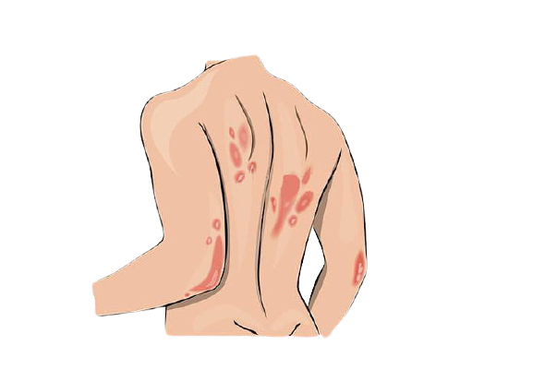
Systemic Lupus Erythematosus

Slide 4
Definition
An inflammatory disease caused when the immune system attacks its own tissues. Lupus (SLE) can affect the joints, skin, kidneys, blood cells, brain, heart and lungs.

Slide 5
Types
Systematic lupus erythematosus
Discoid lupus erythematosus
Drug-induced lupus

Slide 6
Sign
& Symptoms
Butterfly-shaped rashes
Red patches on your skin
Ulcers in mouth
Hair loss
Blood in urine
Inflammation in the lining of your heart or lungs

Slide 7
Causes
Genetics
Certain medications
Viruses
Physical or emotional stress
Trauma

Slide 8
Complications
Kidney failure
Joint deformities
Skin scarring

Slide 9
Diagnostic
Evaluation
Complete Blood Cell (CBC) (decreased)
ANA test
Platelet count test (decreased)
Skin biopsy
Kidney biopsy

Slide 10
Medical
Management
Nonsteroidal anti-inflammatory drugs (NSAIDs)
Antimalarial drugs
Corticosteroids

Slide 11
Nursing
Management
Provide psychology support and general support
Physical effects can lead to isolation, self-esteem and body image disturbances
Protection from direct sunlight
Provide healthful diet for patient
Maintain joint function and increase muscle strength

Slide 12
Thank you
Questions ?
Saima Akhtar
GNM 2nd year

