Slide 1

Energy Demand Forecasting
By Group 1:
Rishabh Kumar Dhirhe
Naresh R
Nikhil Vyas
PEDDINTI SRI SAHITHI
Yuvaraj R Lamani
Ravi Langatad
Rutuja Anil Pawar
MENTORS:
B Harish
Kartik

Slide 2
Table of Contents
Business Objective
Dataset Description
EDA & Data Preprocessing
Model Building
Model Comparison Table
Deployment Page
Challenges & Solutions
Conclusion

Slide 3
Business Objective
Forecast hourly energy demand in the PJM Interconnection region using historical MW data.
Understand usage patterns (hourly, seasonal, holiday).
Generate accurate 30-day forecasts.
Support operational planning and energy distribution.

Slide 4

Dataset Description
Datetime: Timestamp of each hourly observation.
PJMW_MW: Megawatts (MW) of energy demand.

Slide 5

EDA & Data Preprocessing
Set datetime index and resample as needed.
Identify trends, seasonality using STL decomposition.
Add holiday features using US Federal Calendar.

Slide 6
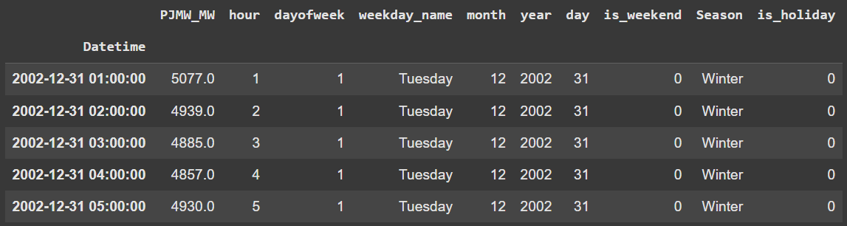
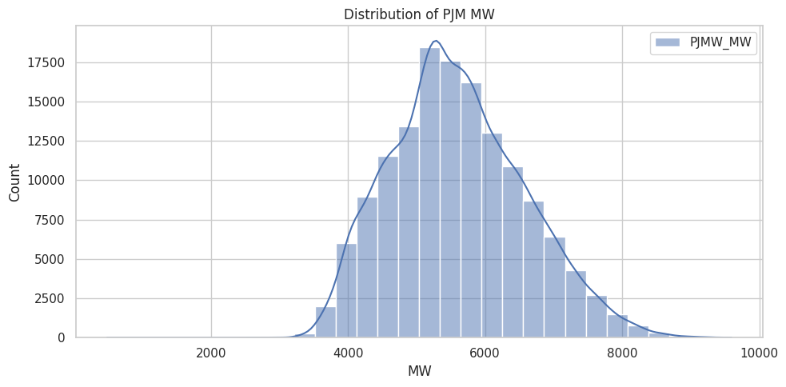
EDA & Data Preprocessing
Our Target Column was Normally Distributed so no need for any transformation.
Engineered new features like hour of the day, da of the week, weekday, month, year, is weekend, season and lastly is holiday to explore the dataset better and gauge the understanding of energy consumption thoroughly.

Slide 7
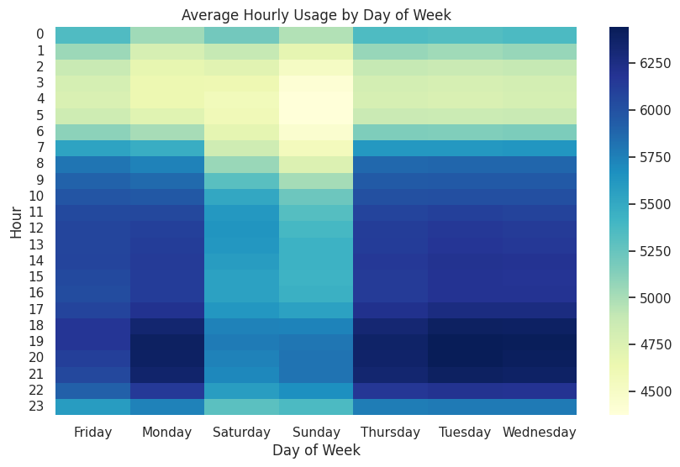
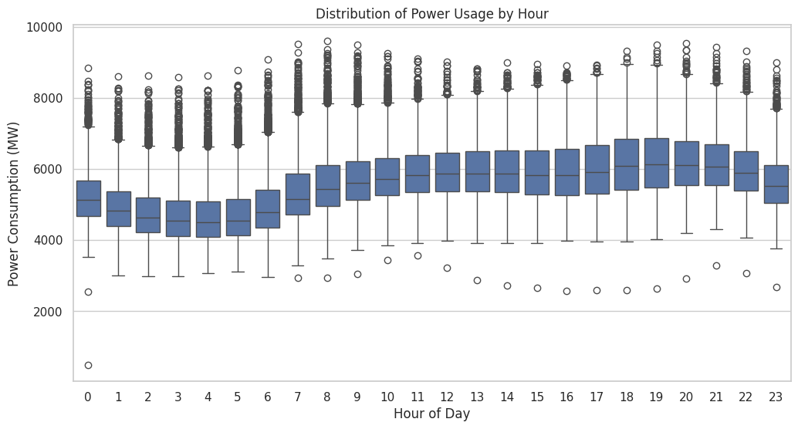
EDA & Data Preprocessing
From the above heatmap it is clear the most consumption of energy is done on Mondays, Tuesdays, Wednesdays and Thursdays around 18-21 hour of the day
The least is on Saturdays and Sundays around 2-6 hour
From above whisker plot it is clear that most energy consumption is done around 18th to 20th hour.
The least is around 3rd to 6th hour od the day

Slide 8
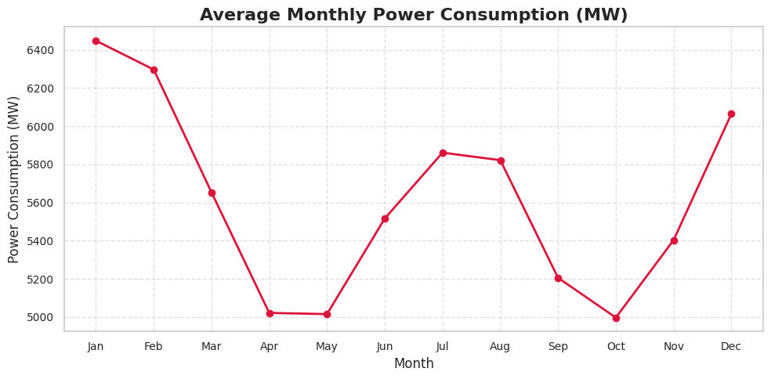
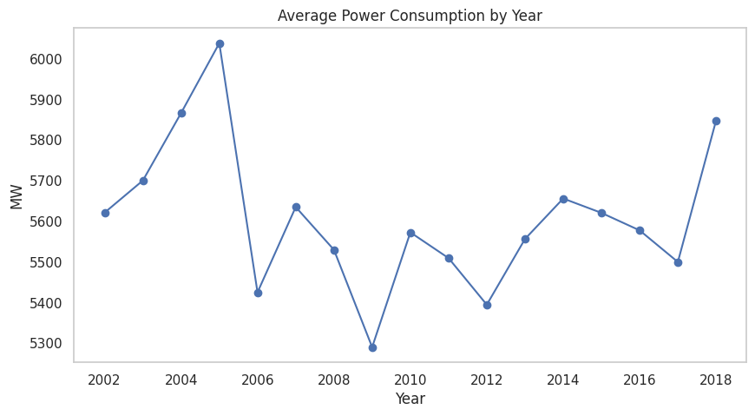
EDA & Data Preprocessing
Based on above plot Jan, Feb and Dec has the highest average consumption rate since those are the holidays seasons.
Apr, May and Oct are towards the lower end of the line chart graph
Average yearly consumption peaked in 2005 and steady decline until 2018.
The least usage was in the year 2009 and since then it kept on increasing.

Slide 9
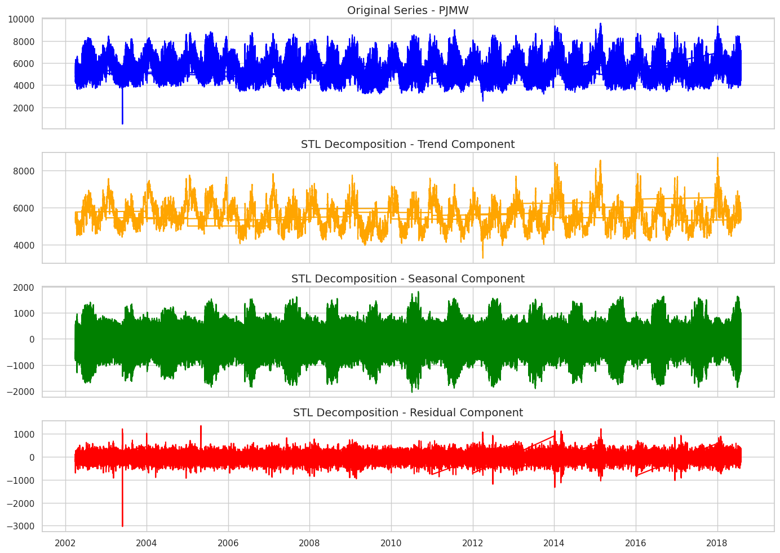
EDA & Data Preprocessing
Trend is upwards, indicating gradual increase in demand over the years.
Clear repetitive pattern indicating strong seasonality.
Residual Component shows random noise.
Mostly fluctuates around zero with occasional spikes showing unexpected events like blackouts or storms

Slide 10
MODEL BUILDING

Slide 11
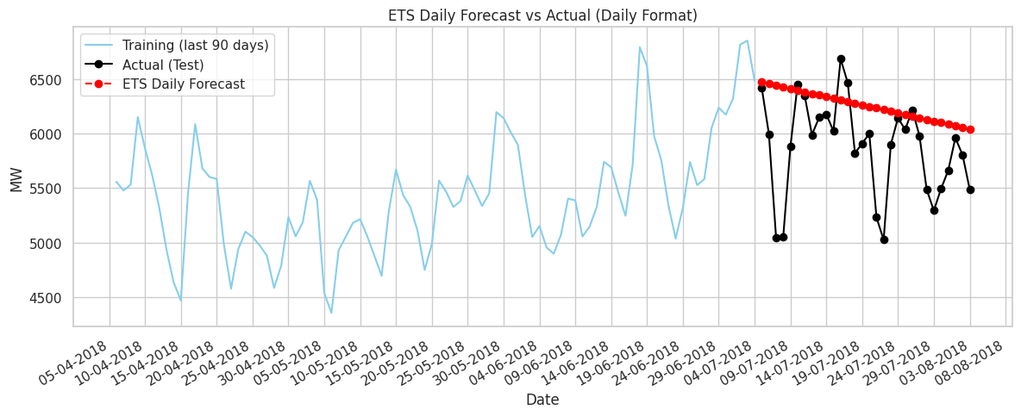
ETS Model
ETS with added trend.
RMSE: 571.26

Slide 12
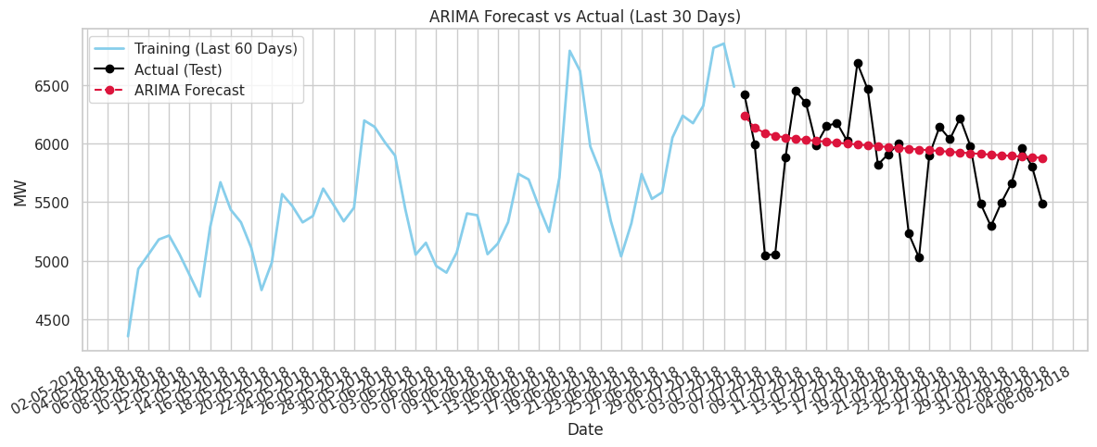
ARIMA Model
Used ADF test for stationarity.
ACF and PACF plots guided p, d, q.
RMSE: 436.13

Slide 13
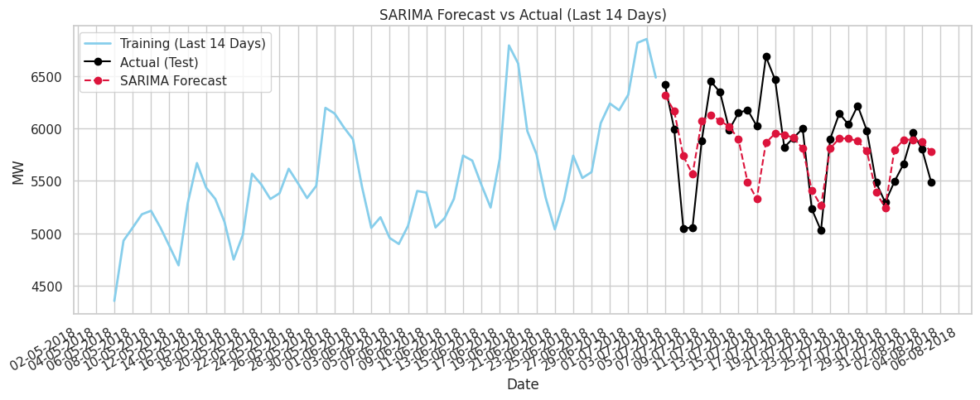
SARIMAX Model
Included seasonal and holiday components.
Best performance among classical models.
RMSE: 344.61

Slide 14
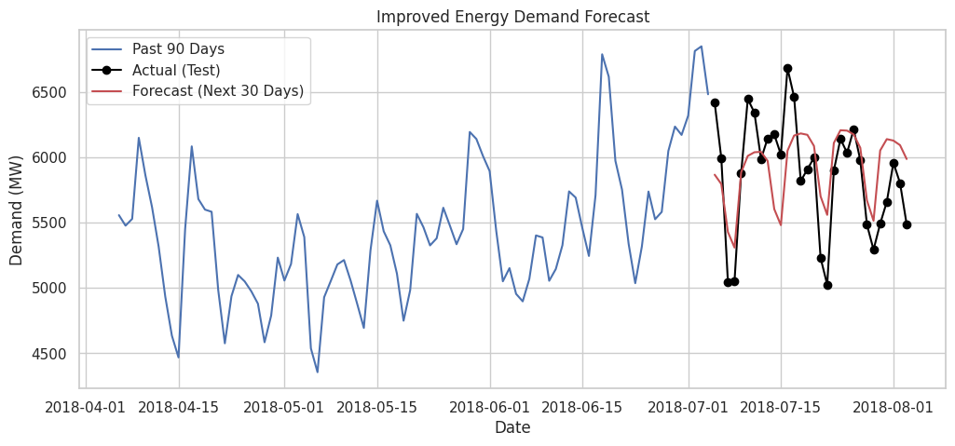
Prophet Model
Captures seasonality and holidays.
Simple yet powerful for time series.
RMSE: 354.95

Slide 15
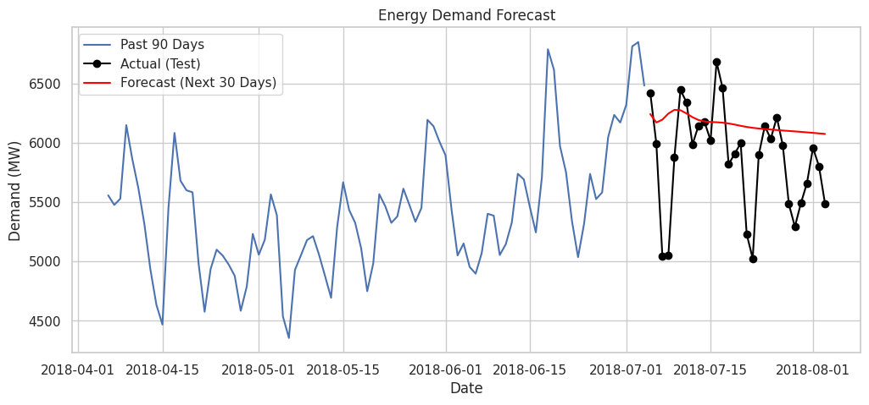
LSTM Model 1 (Basic)
Scaled data with MinMaxScaler.
Built sequential model using Keras.
RMSE: 508.90

Slide 16
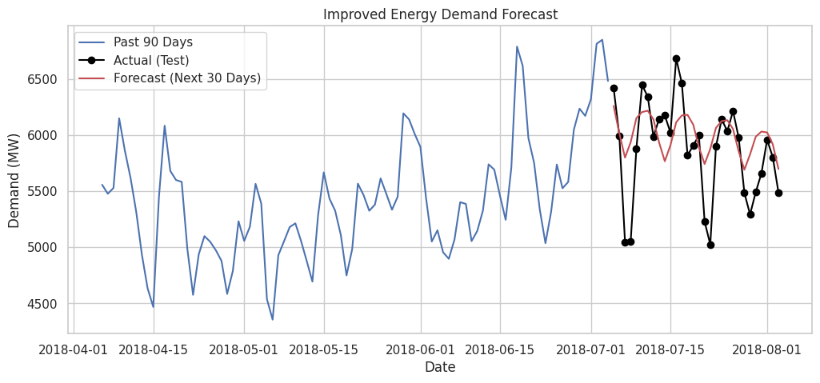
LSTM Model 2 (Better)
Built deeper sequential model using Keras.
RMSE: 374.20

Slide 17
Model Comparison Table
Model Used | RMSE Score
Exponential Smoothing Model | 571.26
ARIMA Model | 436.13
SARIMAX Model | 344.61
Prophet Model | 354.95
LSTM Model 1 (Basic) | 508.90
LSTM Model 2 (Better) | 374.20

Slide 18
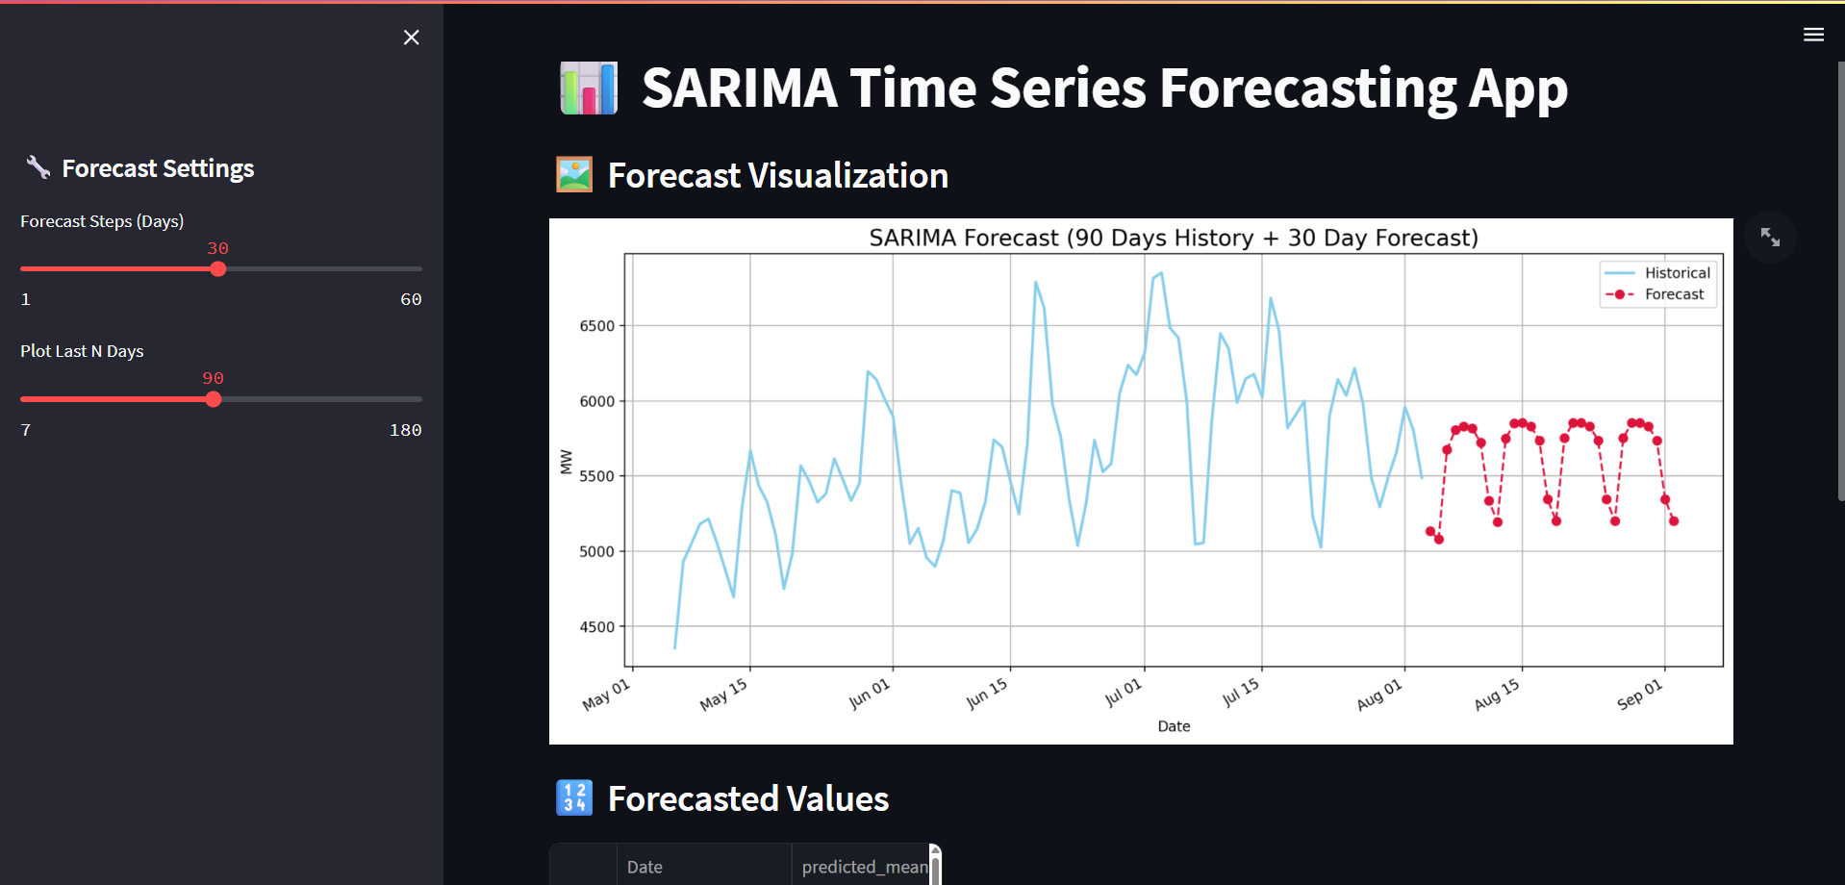
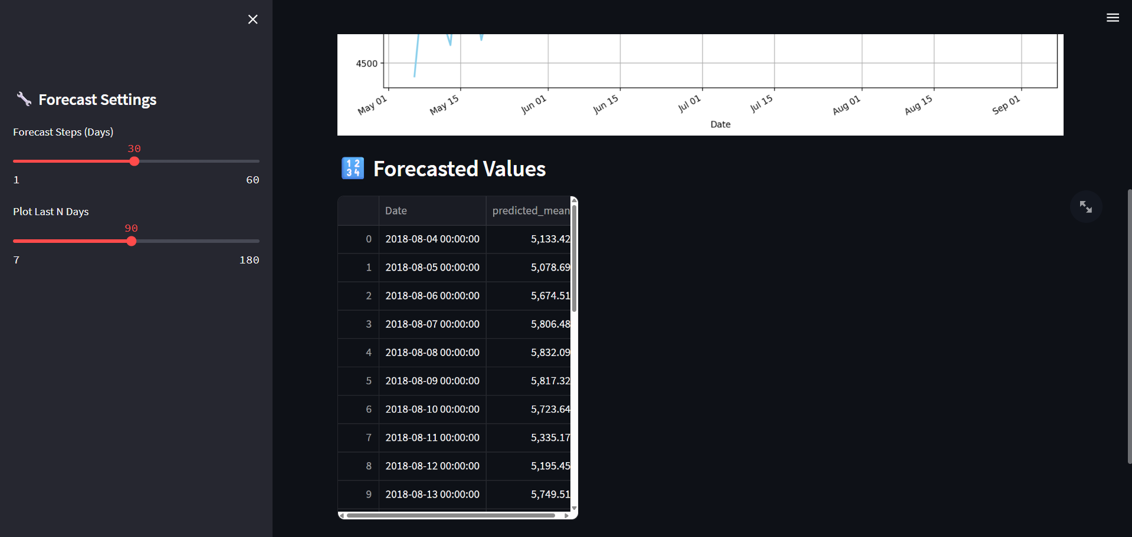
Deployment Page
Deployed SARIMAX Model using Streamlit.
We can adjust the number of days ranging from 0 to 60.
Deployed it locally due to enormous size of model
We can see the actual forecasted values on the table.

Slide 19
Challenges & Solutions
Data Volume and Granularity: Solved by resampling the data on daily basis.
Non-Stationary: Solved by differencing the data.
Model Selection: Solved by choosing the best model on the basis of RMSE Score.
Challenges with LSTM Models: Tuning, Overfitting and Training Time.
Feature Engineering: Solved by crafting many time features.
Increasing Forecast Errors: As we increase the number of days, the forecasting error keeps on increasing.

Slide 20
Conclusion
This project focused on forecasting hourly energy demand in the PJM Interconnection region using historical megawatt data. By analyzing trends, seasonality, and holiday effects through STL decomposition, we built and compared models including ETS, ARIMA, SARIMAX, and LSTM. SARIMAX emerged as the best performer, accurately capturing seasonal and external factors.
The 30-day forecasts generated support operational planning and energy distribution by helping manage peak loads and improve grid reliability. This highlights the value of combining classical time series models with domain-specific insights for accurate and actionable forecasting.

Slide 21


Thank You

