Slide 1
Proofquote
[TEAM NO.] · END-TERM GROUP ASSESSMENT · AI TOOLS FOR BUSINESS · JGBS MBA 2026
DRAFT Q-1042 · SHARMA TRADERS
400 kg MS angle 50x50x6 at ₹62 per kg
GST 12% on MS angle (Sharma special)
No list, no rate.
List says: GST 18%. HSN 7216.
Checks a distributor's draft quote against this week's price list before it reaches the dealer.
NOT ON THE LIST
Member 1 · Member 2 · Member 3 · Member 4 · Member 5 · Member 6
Notes:
Proofquote checks a sales quote against the price list before it goes out. The whole idea fits on this card: the dealer wanted 12%, the list says 18%, and the 12% does not leave the building.

Slide 2
9:40 pm, and the dealer wants 12%
01 · PROBLEM AND TARGET USER
WHO
Ravi does inside sales at Goyal Distributors, a steel and hardware distributor in Ambala. He builds every dealer quote from a weekly price list and sends it on WhatsApp.
Sharma Traders · 9:40 pm
12% lagao, 18 nahi chalega.
WHAT HAPPENS
Sharma Traders wants 400 kg of MS angle and 20 L of primer, and adds: “12% lagao, 18 nahi chalega.” The list says GST 18%. To keep the order, the draft says 12%.
PRICE LIST · WEEK OF 21 OCT
MS angle 50x50x6: ₹62 per kg. GST 18%. HSN 7216.
WHAT IT COSTS
The quote becomes the invoice. Charge 12% on an 18% item and the distributor owes the difference to the tax department, with interest. Ask a chatbot to tidy the draft and the 12% comes back looking official.
RAVI'S DRAFT
GST 12% on MS angle (Sharma special)
Ravi, Goyal Distributors and Sharma Traders are composites built from public sources. We did not interview distributors.
Notes:
Our user is inside sales at a mid-size distributor, not 'SMEs'. The moment we design for is this one: a regular dealer asks for a lower slab in the same chat where the quote is going. The price list says one thing, the draft says another, and the draft becomes the invoice. Be clear that Ravi is a composite: we built him from public sources, we did not interview distributors.

Slide 3
A wrong rate gets into a quote two ways
01 · PROBLEM
THE DEALER ASKS FOR IT
THE MODEL MIS-COPIES IT
“Put 12%”
2 of 25
Gemini invoices charged 18% GST when the prompt said 12%.
Dealers bargain on the GST slab as well as the price. Orders arrive as WhatsApp messages that someone retypes into a GST invoice by hand.
3 of 25
Claude invoices swapped the HSN code they had been given.
TarkApp, “GST invoice from WhatsApp order”, B2B wholesale use case.
Kryotta, 28 Aug 2026: one printing business wrote 50 GST invoices with AI. A vendor blog and a small sample; we read it as a signal, not a market size.
Either way it carries forward: a quotation's details flow into the invoice (Tally Solutions). So the check has to happen before Send, against the list, whoever typed the number.
Notes:
Two sources of the same error. Human pressure, which nobody measures, and model error, which Kryotta measured on a small sample: Gemini used 18 when told 12 in 2 of 25 invoices, Claude changed the HSN in 3 of 25. We don't care which one it was. The fix is the same: check the number against the list before it leaves. Say plainly that Kryotta is a vendor blog.

Slide 4
Business model canvas
02 · BUSINESS MODEL
PROBLEM
KEY METRIC
Quotes are retyped from a price list and a WhatsApp chat. Dealers push for lower slabs; chat assistants copy or invent rates. The wrong rate carries into the invoice.
Off-list lines caught per 100 quotes, and false alarms per 100 true lines.
KEY PARTNERS
KEY ACTIVITIES
VALUE PROPOSITION
RELATIONSHIP
CUSTOMER SEGMENT
Tally and Marg implementation partners (distribution). CAs who see the bad invoices (evidence). An LLM API, for splitting drafts only.
Keep the check strict. Grow the golden set. Parse PDF and Tally price lists.
Every rate on the quote is on this week's list, printed next to it. Off-list lines are caught before Send, not after the accountant finds them.
Self-serve. The sales lead approves every line; the tool never fills in a rate.
Inside-sales staff at steel, hardware and building-material distributors who quote dealers on WhatsApp. Payer: the owner or sales head. Not “SMEs”.
KEY RESOURCES
CHANNELS
The citation rule, the golden set, the n8n send flow.
Distributor and trade associations, Tally partners, CAs.
COST STRUCTURE
REVENUE (HYPOTHESIS)
LLM tokens (small: splitting only), n8n hosting, our time on the parser and the test set.
₹499 per sales seat per month. Untested: would a distributor pay this to avoid one reissued invoice a month?
Sources: Kryotta (Aug 2026), Tally Solutions, TarkApp; full links in endterm/bmc.md. Price, channels and partners are hypotheses; nothing has been sold.
Notes:
Read it left to right through the value proposition. The segment is narrow on purpose: serving everyone serves no one. Revenue is a hypothesis with the test we'd run to check it. Cost follows from the other blocks; the model is a small line because it only splits drafts.

Slide 5
Four steps, in order, once
03 · AGENTIC ARCHITECTURE
A model may help read the draft. Every decision about a rate is made by code it can't talk its way around.
Price list
01
02
03
04
Extractor
Citation checker
Pack writer
Critic
n8n
Splits the draft into one line per rate or term. Numbers unchanged.
Finds the list line for each item. Every ₹, %, HSN and number must be on it.
Lays out each quote line next to its list line.
Holds Send while any line is off the list. Never fills a rate.
Email to the sales lead + WhatsApp draft
Draft quote
Model: optional
Model: never
Model: never
Model: never
WHY NOT ONE PROMPT
WHERE IT SITS ON NG'S SPECTRUM
PATTERNS FROM CLASS
A prompt that's asked for 12% writes 12%. Splitting a messy draft is a language job; whether a rate is on the list is a lookup, so it lives in code.
L2: a fixed multi-step plan with a tool doing the check. We stopped short of L3 on purpose: no agent gets to decide whether to check.
Tool use (the list lookup). Reflection against an external signal (the critic reads the checker, not itself). Human in the loop (Ravi removes or fixes).
Notes:
Agentic is a spectrum, not a switch. We put the model where language is the problem, splitting a messy draft, and kept it away from the decision. If you ask which agent is the clever one: none of them. The value is the process wrapped around the model. Guard worth mentioning: if the model returns a line containing a number that isn't in the draft, we throw that line away before the check.

Slide 6
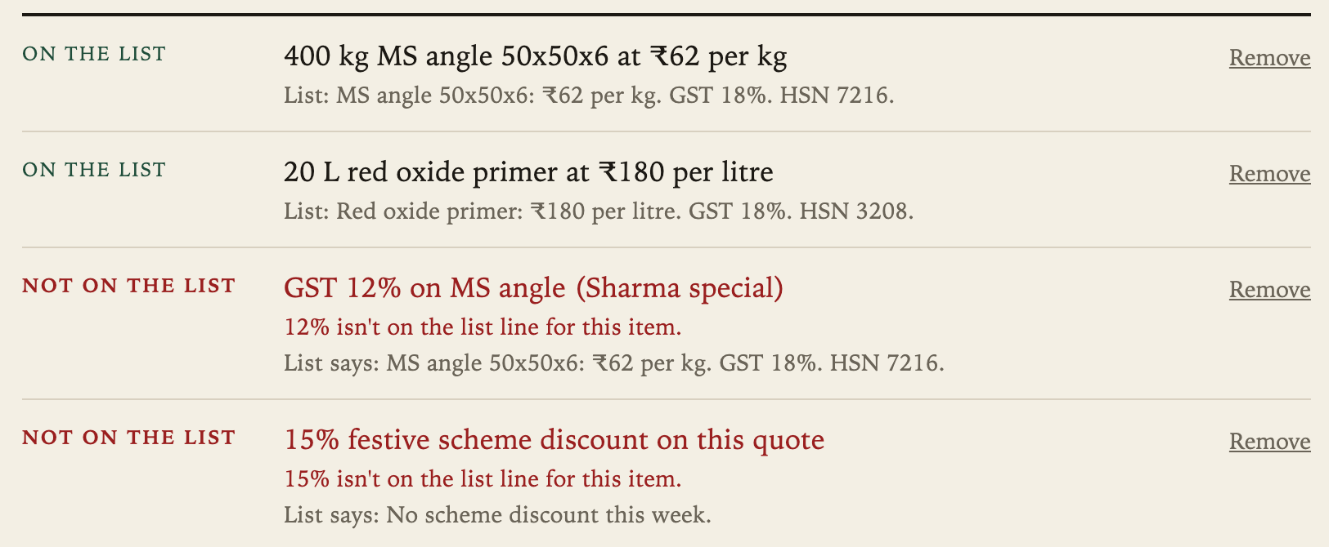
The check is code, not a prompt
03 · AGENTIC ARCHITECTURE
A DRAFT LINE PASSES ONLY IF
One price-list line is about the same item: it shares a word like “angle” or “primer”.
Every ₹ amount, GST %, HSN code and other number in the draft line is on that list line. Quantities like “400 kg” don't count.
That list line appears word for word in the pasted list, at least 20 characters.
Otherwise the line is marked Not on the list, with the closest list line beside it. Nothing is filled in.
The sample quote in the app: three lines pass. The 12% and the 15% scheme don't, and each shows what the list actually says.
src/lib/cite.ts → supports()
Notes:
This is the product. Read the three conditions. Then point at the screenshot: 12% isn't on the MS angle line, which says 18; the festive scheme isn't on the list, which says no scheme this week. If someone asks why 20 characters: it stops a two-word fragment like 'GST 18' from counting as a citation.

Slide 7
From desk research to one flow
04 · DESIGN THINKING TO MVP
01
02
03
04
05
Empathise
Insight
How might we
Ideas
MVP scope
We read how a small firm actually uses AI for GST invoices (Kryotta), how wholesalers turn WhatsApp orders into invoices (TarkApp), and how quotes carry into invoices (Tally).
Ravi needs to quote fast without breaking the list, because the quote becomes the invoice and the pressure to bend the slab arrives in the same chat.
How might we let Ravi send a fast quote where every rate is provably on this week's list?
AI quote writer: rejected, it is the problem.
HSN-to-GST lookup: rejected, misses prices and schemes.
Draft-against-list checker: chosen.
One persona, one flow, three screens: paste, check, send. No login, no database, no payments. The riskiest assumption first: can a rule stop off-list lines with no false passes?
This was desk research, not interviews. The persona is a composite. Talking to real sales staff is the next test (slide 10).
Notes:
Double diamond, honestly applied. We had no access to distributors this term, so empathy came from public sources, and we label it that way. GenAI was a research partner, not a respondent. The HMW is narrow on purpose. Three ideas, two rejected, and why. The MVP tests our riskiest assumption first: can a plain rule stop the bad lines without stopping the good ones.

Slide 8
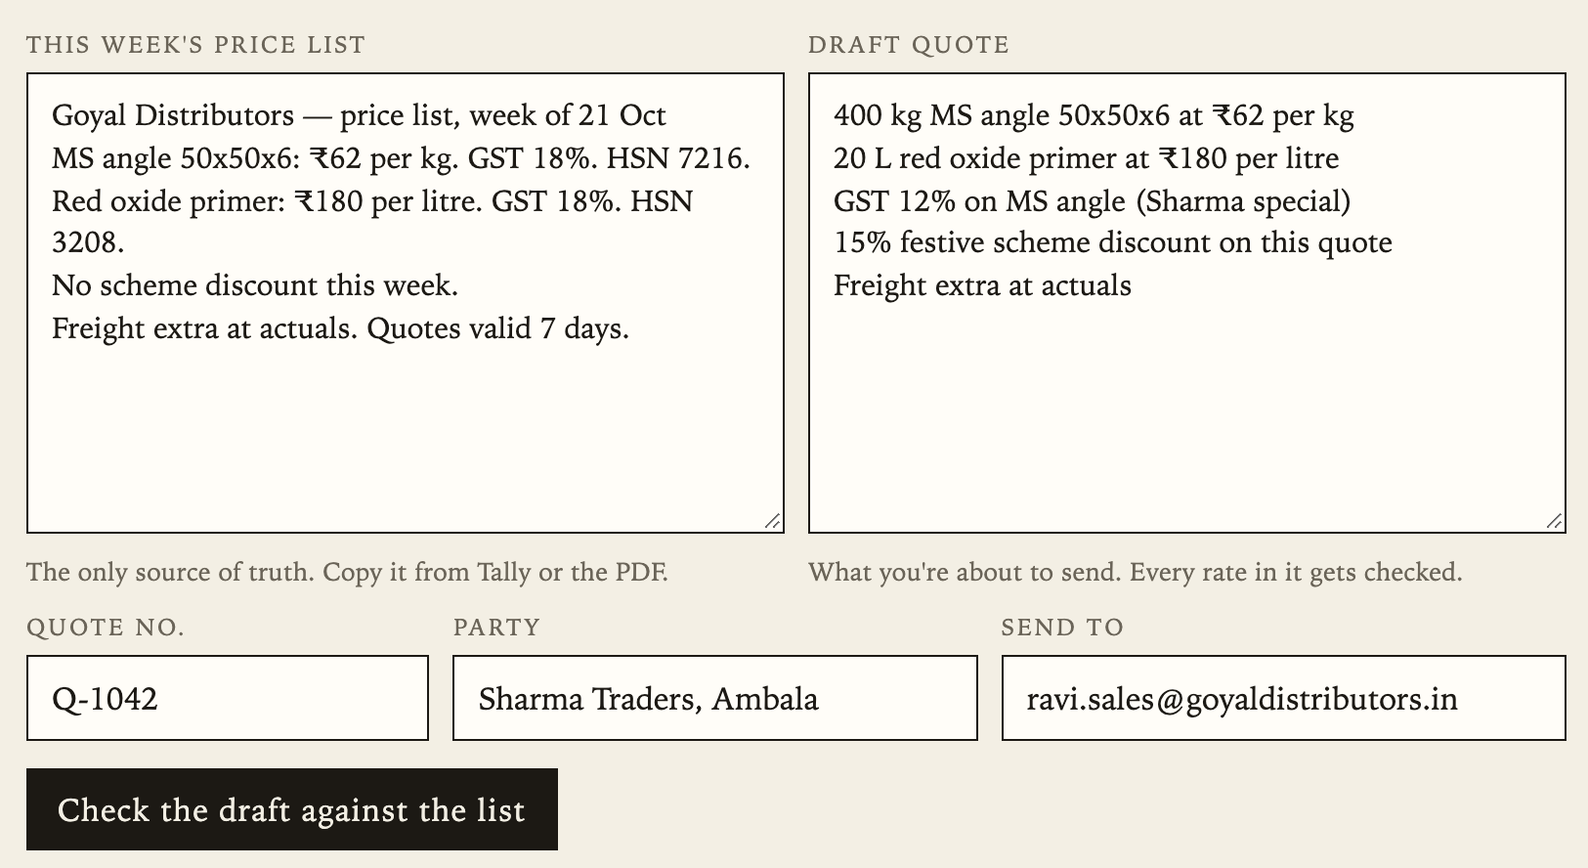
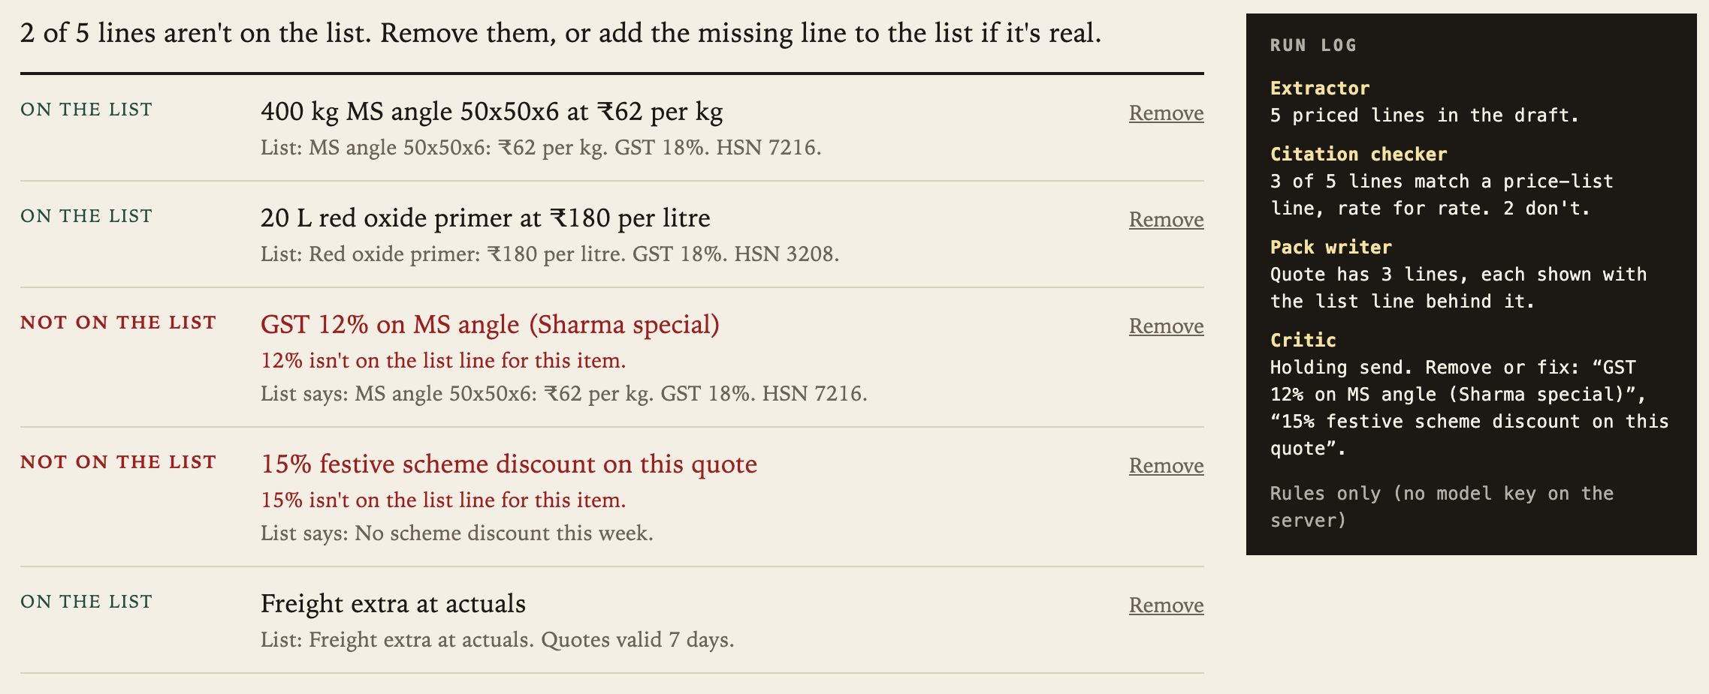
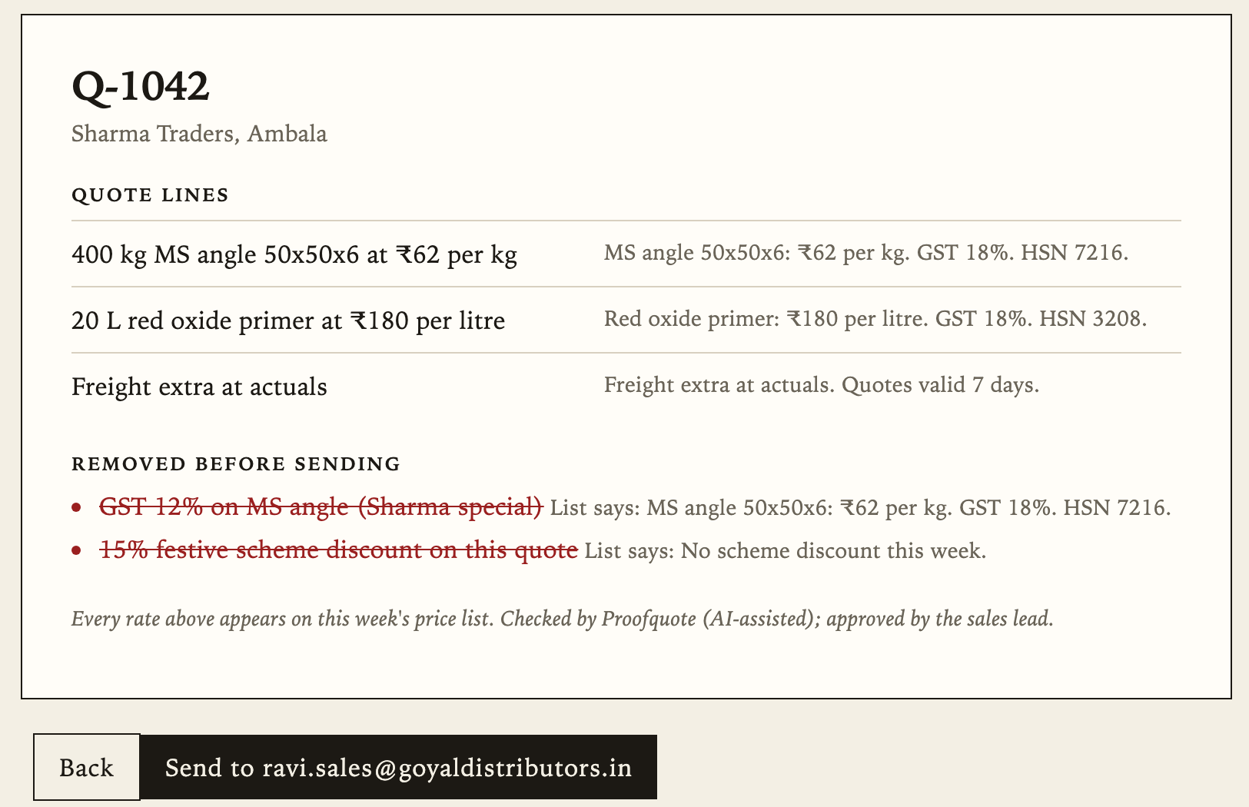
The MVP: paste, check, send
04 · MVP
1 · PASTE
2 · CHECK
3 · SEND
The price list and the draft go in separately. The list is the only source of truth.
Each line shows the list line behind it, or why it isn't on the list. The run log shows the four steps.
Off until every line is on the list. Removed lines stay visible, struck through.
Live: localhost:5173/#/app · Without a model key it runs on rules only. With one, the model splits messy drafts and every line it returns is checked the same way.
Notes:
Do the live demo here if the room allows: Check a sample quote, press Check, show the two red lines, remove them, review, send, open the email. If the network or laptop fails, these three screenshots are the same flow.

Slide 9
The test we ran: 16 lines, no wrong calls
04 · TEST METRIC, ACTUALLY RUN
Proofquote said
THE 9 LINES IT HAD TO STOP
Passed
Stopped
GST 12% on MS angle (Sharma special)
15% festive scheme discount
MS angle HSN 73089000
MS angle at ₹58 per kg · angle 58 per kg · MS angle 58
Red oxide primer at ₹62 per litre (MS angle's rate)
Quote valid till 5 Nov
Freight free to Ambala
7
0
On the list
correct passes
false alarms
0
9
Not on the list
What this shows: the rule does what we claim, on 16 lines we wrote. What it doesn't: how it does on real drafts and messy PDF lists, or whether sales staff will use it. That's the next test.
false passes: the one that matters
correct stops
Precision 1.00 · Recall 1.00 · npm run eval, 2 Nov 2026
Notes:
An MVP without a success metric is just a demo, so here is the one number we actually produced. Precision matters more than recall for us: a false pass sends a wrong rate to a dealer; a false alarm costs Ravi a minute. Then be straight about the limit: we wrote the test lines. The first version of this rule had a hole: a bare 'MS angle 58' without a rupee sign passed. The golden set caught it, and the fix is in.

Slide 10
The test we haven't run yet
04 · TEST CARD
NOT RUN YET
We believe
someone who has rebuilt a quote from WhatsApp will finish a checked quote faster than by hand, and agree the flagged lines were wrong.
We will
give 6–10 classmates who didn't build it a printed price list and a messy draft with two off-list lines. No help after the first sentence.
We'll measure
finished (sent with nothing off the list), time to send against their own estimate, and agreement with each flag.
We're right if (set before testing)
≥ 60%
< ½
≥ 80%
finish
of their own time estimate, median
agree with every flag
Notes:
This is the test card format from session 16, with thresholds set before testing. We have not run it. If we run it before the presentation, the real numbers go here, pass or fail. If not, this slide says not run, and we don't invent a result.

Slide 11
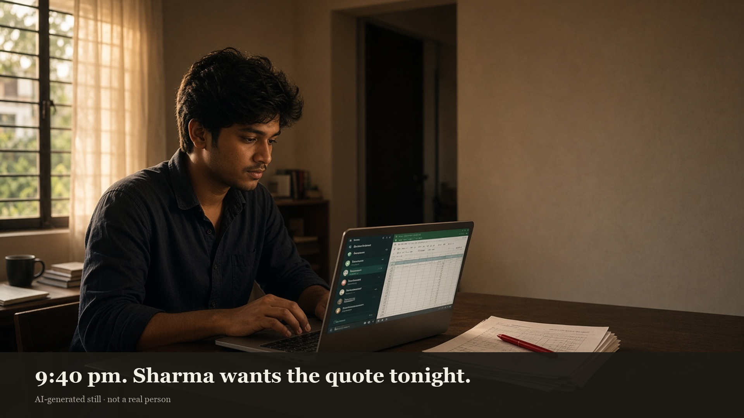
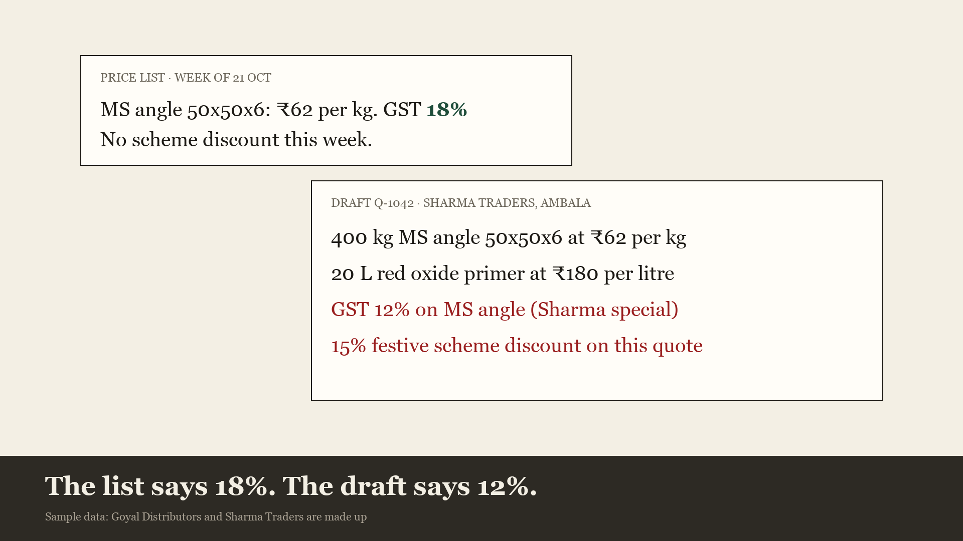
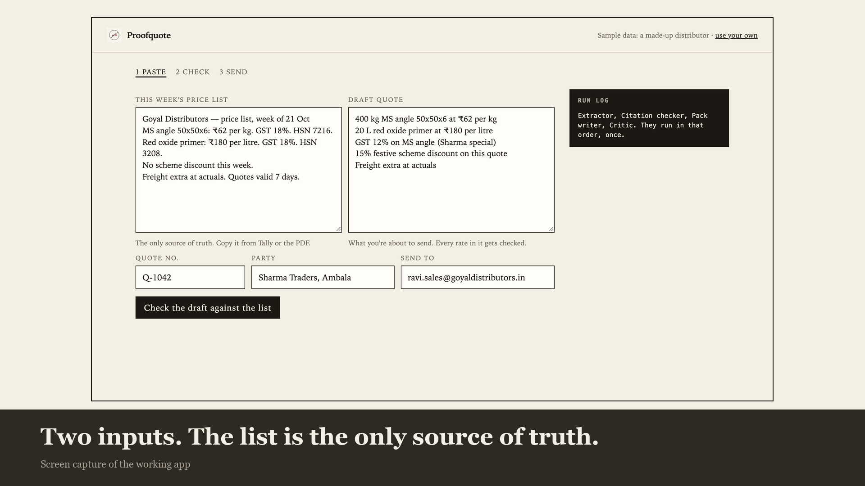
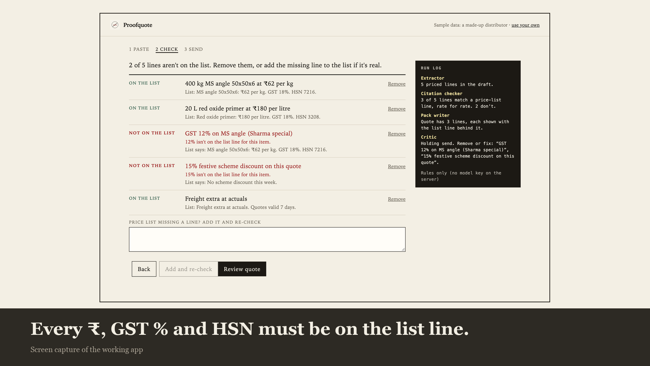
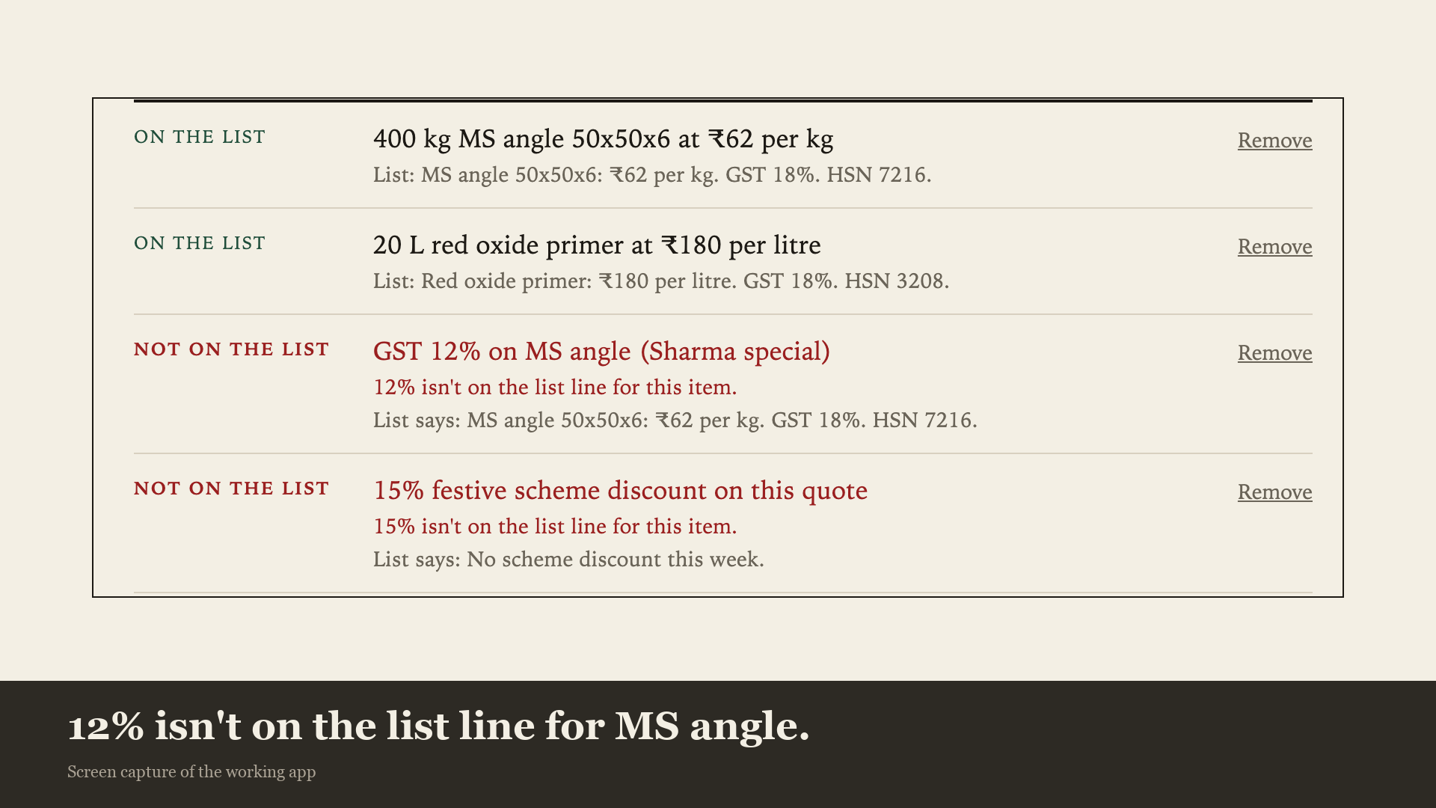
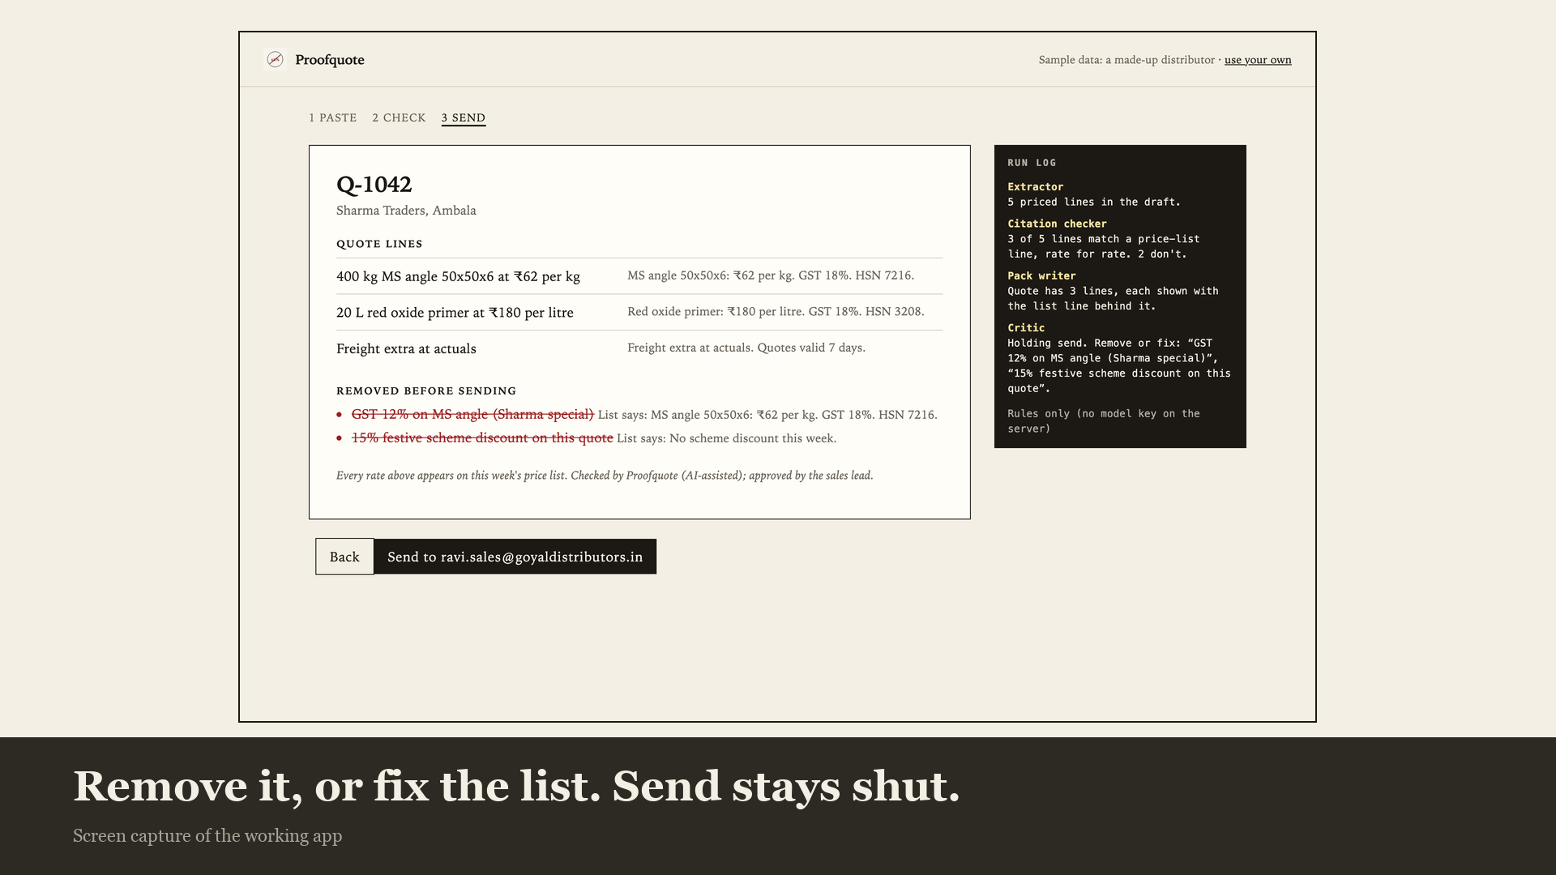
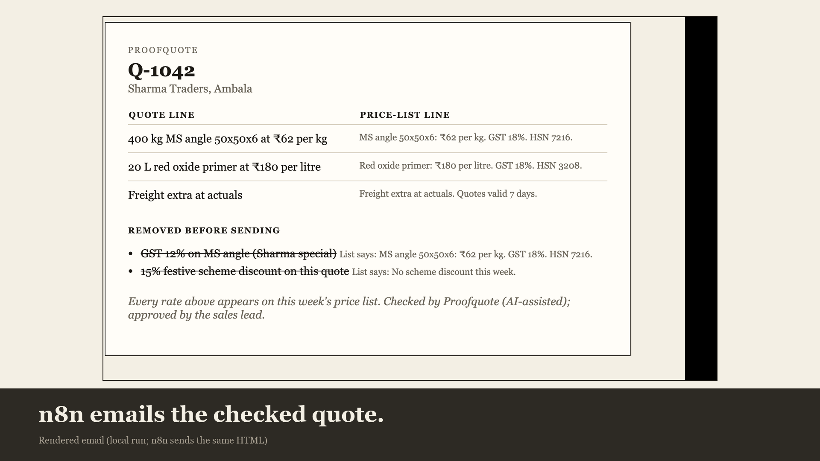
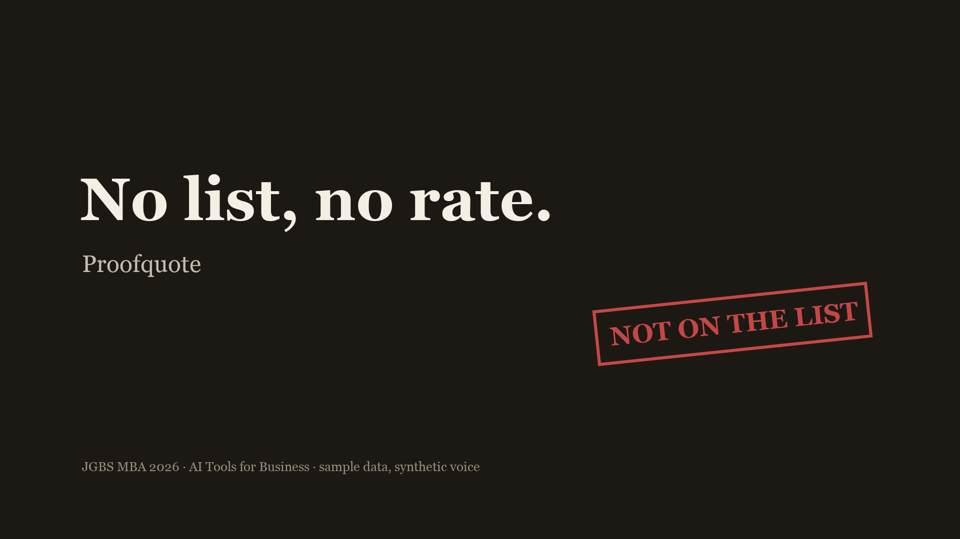
Two minutes, one quote
05 · LAUNCH VIDEO
0:00
0:18
0:37
0:46
1:11
1:27
1:40
1:52
FALLBACK CUT, READY
SESSION 17'S FOUR CHECKS
endterm/Proofquote-launch-2min.mp4, 2:00. Real app footage, a synthetic Indian-English voice, one AI still, labelled on screen.
Accuracy: every number is from the app. Rights: our own footage and still. Disclosure: AI labels on screen. Brand truth: no shot shows the product doing anything it doesn't do.
Notes:
Storyboard first, then generate, per session 19. The film follows one quote from the dealer's message to the email. Every product shot is a real screen capture; we never let a generator draw the app or the numbers. Swap in the group's own cut here if it's ready; the prompt and shot list are in endterm/video-prompt.md.

Slide 12
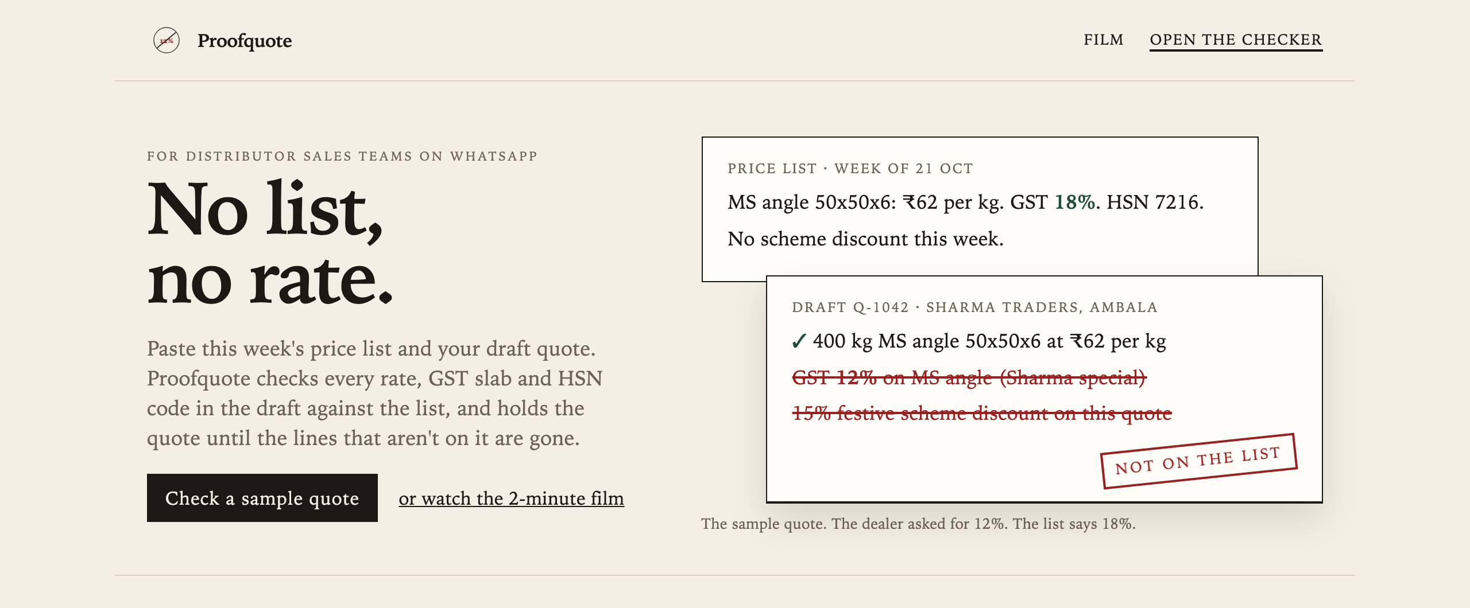

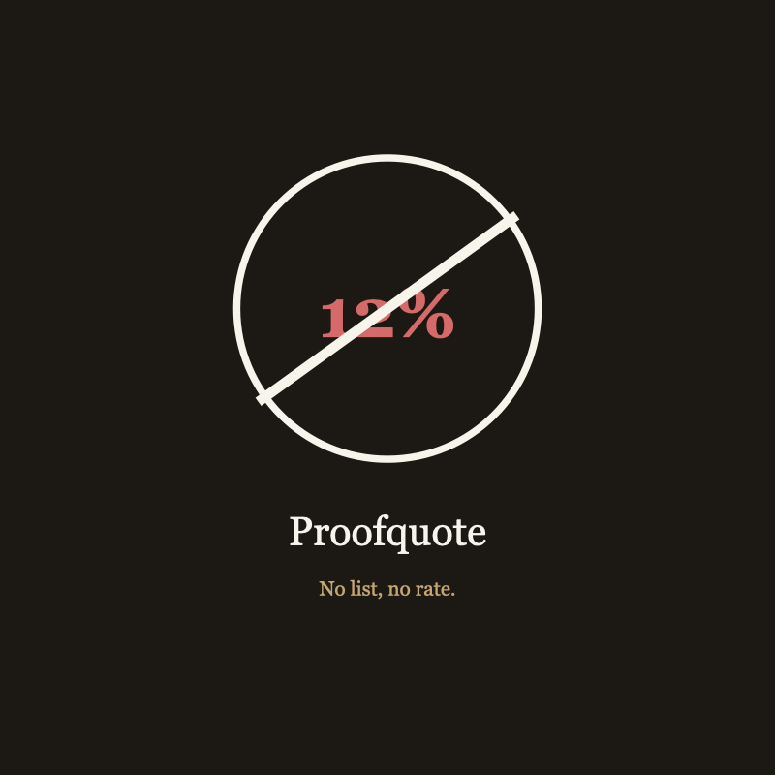
Other tools write the quote. Proofquote checks it.
05 · MULTIMEDIA AND COMPETITIVE DIFFERENTIATION
 | Chat assistant or AI quote writer | Proofquote
Starts from | Your prompt | This week's price list
Dealer asks for 12% | Writes 12% | Flags 12%, shows the list's 18%
Wrong HSN or price | Can swap it (Kryotta: 3 of 25 HSNs) | Stops it unless it's on the list line
What you send | A quote | A quote with the list line beside every rate
Who decides | The model | The sales lead
Logo: the 12% struck through. 1:1 banner for WhatsApp status and LinkedIn. Landing hero: the product's moment, not a stock photo.
Session 18, visual whitespace: AI quote and invoice tools sell speed with glossy dashboards. We use paper, ink and one red stamp, because the product is a check, not a generator.
Notes:
The competitive line is the whole positioning: everyone else generates; we verify. The table is fair to chat assistants: they're great at writing, which is exactly why they'll write the 12%. The brand follows from that: a red stamp that says not on the list.

Slide 13
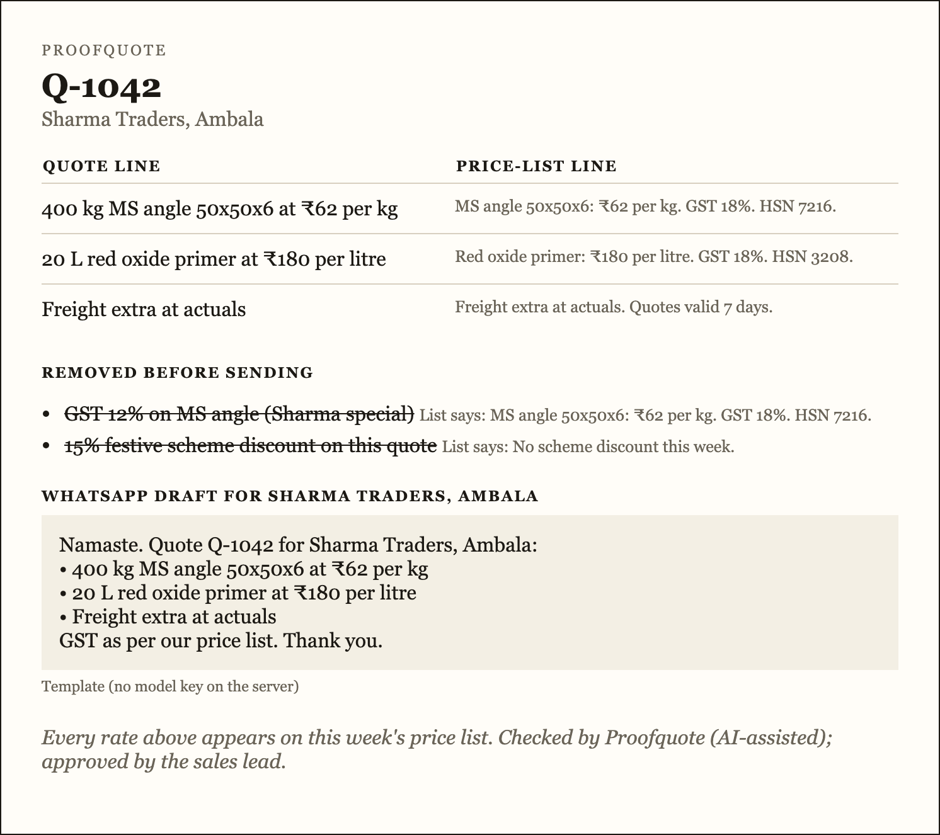
n8n sends exactly what was checked
06 · AUTOMATION
Webhook
Build request
Gemini
Check message
Gmail
Respond
Send button
Checked lines only
Drafts the WhatsApp message
Rejects any number not on the quote
To the sales lead
Back to the app
THE REPETITIVE STEP
After a quote is fixed, someone retypes it into WhatsApp for the dealer, and that's where the old 12% creeps back. Gemini drafts the message from the checked lines only; the next node rejects it if it adds any number.
TRIGGER
The app's Send button calls the webhook. No schedule.
CONSIDERED, NOT CHOSEN
WhatsApp Business API straight to the dealer (needs Meta approval, and we want a human to forward). A daily digest (too late for today's quote).
Run shown: the same logic on the dev server, no webhook set, so nothing was emailed. Gmail execution screenshot: pending.
Notes:
Why this step: it's the last manual retype, and it's where errors come back. Gemini is useful here, writing a polite message, and still not trusted: the next node checks every number. Be precise about the run: the screenshot is our local execution of the same logic. Import n8n/proofquote-send.json, add the Gemini and Gmail credentials, and replace this with the n8n execution view.

Slide 14
Where it can go wrong
07 · RISKS AND ETHICS
Risk | What happens | What we do about it
False alarm | A true line is flagged because the list is formatted differently (a PDF table, a code in another column). | Strict on purpose: a stopped true line costs a minute, a passed false one costs a reissued invoice. Ravi can add the line and re-check.
False pass | A wrong rate passes because the number appears on the item's list line for another reason. | Same item and every number must match. Tested on 16 lines we wrote; not yet on real drafts.
Model invents a line | The extractor adds a rate the draft never had. | Lines with numbers not in the draft are discarded before the check.
Stale list | Ravi pastes last week's list. | Not handled yet. The sales lead is accountable; date-stamping the list is next.
GSTIN errors | A shortened GSTIN blocks the buyer's input credit (Kryotta: 4 of 25). | Not checked. Roadmap.
Over-trust | “Proofquote passed it” replaces judgment on terms the list doesn't cover. | It never fills a rate, and a person approves every send.
Notes:
Lead with the weaknesses before someone else finds them. The biggest real one is false alarms on messy price lists. We chose strictness, and we can say why in money terms. Two risks we don't handle yet, stale lists and GSTINs, are named, not hidden.

Slide 15
Who's accountable, and what we label
07 · GOVERNANCE AND FAIR USE
ACCOUNTABILITY
DATA (DPDP ACT, 2023)
The sales lead who presses Send owns the quote. Proofquote never fills in a rate; its job is to make sure that person sees every off-list line first. Every emailed quote says: “Checked by Proofquote (AI-assisted); approved by the sales lead.”
Sample data is made up and nothing is stored. With a key, the list and draft go to OpenAI or Google for one step; testers are told first, give written consent, and test data is deleted within 24 hours. Quotes go to the sales lead, never straight to the dealer.
KEYS AND CODE (SESSION 14)
SYNTHETIC MEDIA (SESSIONS 17, 20)
API keys live in .env and n8n credentials: never in the repo, the deck or the zip, and never VITE_-prefixed, so they don't reach the browser. The decision logic is readable code, not a hidden prompt.
The AI still and any AI footage are labelled on screen. Fictional people only: no avatar, no cloned voice. The persona is labelled as a composite. Mindful of the IT Rules on synthetic-media labels.
Notes:
Governance is invisible until it fails. Four things we can point at: a named accountable human, a disclosure footer on every quote, keys that never leave the server, and labels on anything synthetic.

Slide 16
Who built what, and what we'd do next
08 · TEAM AND WHAT'S NEXT
Member | Owned
Member 1 | —
Member 2 | —
Member 3 | —
Member 4 | —
Member 5 | —
Member 6 | —
NEXT, IN ORDER
Run the classmate test on slide 10 and publish the numbers, whatever they are.
Do a real Gmail run in n8n and replace the local-run screenshot.
Put the app on a public URL.
Parse PDF and Tally price lists: the biggest source of false alarms.
Check GSTINs (Kryotta: 4 of 25 shortened).
Date-stamp the list so a stale one gets caught.
App: localhost:5173/#/app · Film: endterm/Proofquote-launch-2min.mp4 · n8n: n8n/proofquote-send.json · Every artifact: endterm/proof-of-artifacts.md
Notes:
Each member names what they owned in one sentence. Then the next steps, in the order we'd do them: the user test first, because it's the assumption we haven't tested.

Slide 17
No list, no rate.
NOT ON THE LIST
Proofquote checks the quote before the dealer sees it.
Questions
Notes:
Close on the line. Then take questions; the likely ones and our answers are in HANDOVER.md.

